Slide 1
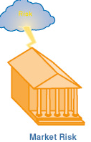
Market Risk
the potential loss of value in assets and liabilities due to changes in market variables
the risk that arises from movements in stock prices, interest rates, exchange rates, and commodity prices
the risk arising from changes in the markets to which an organization has exposure.

Slide 2
Market Risk
Risk management is the process of identifying and measuring risk and ensuring that the risks being taken are consistent with the desired risks.
The process of managing market risk relies heavily on the use of models.
A model is a simplified representation of a real-world phenomenon.
Financial models attempt to capture the important elements that determine prices and sensitivities in financial markets.
In doing so, they provide critical information necessary to manage investment risk.

Slide 3
Market Risk
Investment risk models help a portfolio manager understand how much the value of the portfolio is likely to change given a change in a certain risk factor.
They also provide insight into the gains and losses the portfolio might reasonably be expected to experience and the frequency with which large losses might occur.

Slide 4
Do stockholders care about volatile cash flows?
If volatility in cash flows is not caused by systematic risk, then stockholders can eliminate the risk of volatile cash flows by diversifying their portfolios.
Stockholders might be able to reduce impact of volatile cash flows by using risk management techniques in their own portfolios.

Slide 5
Risk vs Return for Companies
If shareholders care only about systematic risk, should the same be true of company managers?
In practice companies are concerned about total risk
Earnings stability and company survival are important managerial objectives
The regulators of financial institutions are most interested in total risk
Bankruptcy costs arguments show that that managers can be acting in the best interests of shareholders when they consider total risk
  Lost sales (There is a reluctance to buy from a bankrupt company)
  Key employees leave
  Legal and accounting costs

Slide 6
What are some actions that companies can take to minimize or reduce risk exposures?
Transfer risk to an insurance company by paying periodic premiums.
Transfer functions which produce risk to third parties.
Share risk with third party by using derivatives contracts to reduce input and financial risks.
Take actions to reduce the probability of occurrence of adverse events.
Take actions to reduce the magnitude of the loss associated with adverse events.
Avoid the activities that give rise to risk.

Slide 7
Forward Contracts
2 parties to contract, each with a basic position:
  One party is “long” (buy). Obligates party to buy the underlying asset at some fixed price at a specified date in the future.
  One party is “short” (sell). Obligates party to sell the underlying asset at some fixed price at a specified date in the future.
Terms
  Forward price
  Delivery date (expiration date)
Forward contracts are common for currencies.

Slide 8
Using Forward Rates to Reduce Foreign Exchange Risk
Example: A U.S. retailer is going to import electronic games from Japan.
  Purchase price: ¥1 million; current exchange rate is 150 yen per dollar.
Retailer takes long position in a forward contract to buy one million yen at 150 yen per dollar.
This locks in the dollar cost of the purchase.

Slide 9
Futures Contract
Similar to forwards, except:
  Daily marking-to-market
  Many more assets- agriculture, livestock, metals, indexes, currencies, interest rates, energy
  Standardized contracts that trade on exchanges
  How can commodity futures markets be used to reduce input price risk?
  The purchase of a commodity futures contract will allow a firm to make a future purchase of the input at today’s price, even if the market price on the item has risen substantially in the interim.
  Eg: Kellogg produces cereal—major component and cost factor is sugar
    Forecasted income and sales volume are set by fixed selling prices
    Cost change impacts forecasts
    To fix sugar costs, Kellogg would like to purchase all sugar today as forecast is based on this price, but cannot
    Kellogg can sign futures contract to purchase sugar in future at price negotiated today

Slide 10
Market RISK
Market Risk is the risk of losses owing to movements in the level or volatility of market prices.
Two forms:
Absolute risk (measured in dollar terms)
Relative risk (measured relative to a benchmark)

Slide 11
Directional and Non-Directional RISK
Directional risks involve exposures to the direction of movements in major financial market variables.
Beta for exposure to general stock market movements
Duration for exposure to the level of interest rates
Delta for exposure of options to the price of the underlying asset
Non-directional risks involve other remaining exposures, such as nonlinear exposures, exposures to hedged positions or to volatilities.
Basis risk when dealing with differences in prices or in interest rates
Convexity when dealing with second-order effects for interest rates
Gamma when dealing with second-order effects for options
Volatility when dealing with volatility effects

Slide 12
DELTA
Delta of a portfolio is the partial derivative of a portfolio with respect to the price of the underlying asset
Suppose that a $0.1 increase in the price of gold leads to the portfolio decreasing in value by $100
The delta (∆P/ ∆S) of the portfolio is -100/0.1 = −1000
The portfolio could be hedged against short-term changes in the price of gold by buying 1000 ounces of gold.
This is known as making the portfolio delta neutral

Slide 13
Linear vs Nonlinear Products
When the price of a product is linearly dependent on the price of an underlying asset a “hedge and forget’’ strategy can be used
Non-linear products require the hedge to be rebalanced to preserve delta neutrality

Slide 14
Delta of the option
Option
price
Slope = Δ
B
A
Stock price

Slide 15
Example of Hedging a Nonlinear Product
A bank has sold for $300,000 a European call option on 100,000 shares of a non-dividend paying stock
S₀ = 49, K = 50, r = 5%, σ = 20%, T = 20 weeks
The Black-Scholes-Merton value of the option is $240,000
How does the bank hedge its risk?

Slide 16
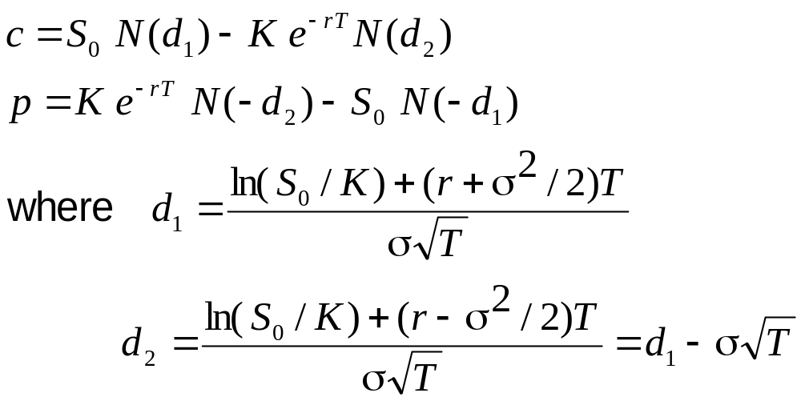
The Black-Scholes-Merton Formulas for Options

Slide 17
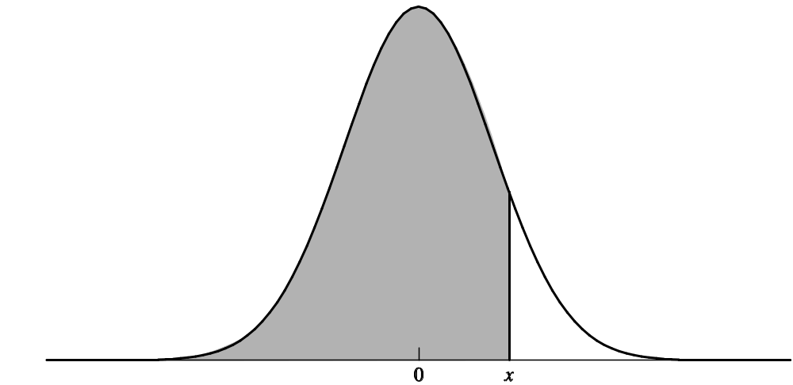
The N(x) Function
N(x) is the probability that a normally distributed variable with a mean of zero and a standard deviation of 1 is less than x

Slide 18
Delta hedging
Initially the delta of the option is 0.522
The delta of the position is -52,200
This means that 52,200 shares must purchased to create a delta neutral position
But, if a week later delta falls to 0.458, 6,400 shares must be sold to maintain delta neutrality

Slide 19
Where the Costs Come From
Delta hedging a short option position tends to involve selling after a price decline and buying after a price increase
This is a “sell low, buy high” strategy.
The total costs incurred are close to the theoretical price of the option

Slide 20
Gamma
Gamma (Γ) is the rate of change of delta (Δ) with respect to the price of the underlying asset
Gamma is greatest for options that are close to the money

Slide 21
Gamma Measures the Delta Hedging Errors Caused By Curvature
Call
price
C''
C'
C
Stock price
S
S'

Slide 22
Example
A portfolio is delta neutral and has a gamma of -3000
The delta and gamma of a particular traded call option are 0.62 and 1.50, respectively
The portfolio can be made gamma neutral by including a long position of 3000/1.5 = 2000 call option
The gamma of the portfolio is -3000 + 1.5 x 2000 = 0
Delta of the portfolio will change from zero to 2000 x 0.62 =1,240
A quantity, 1240 of the underlying asset to be sold to keep it delta neutral

Slide 23
VEGA
Vega (ν) is the rate of change of the value of a portfolio with respect to volatility
Like gamma, vega tends to be greatest for options that are close to the money
In practice, a traders must keep gamma and vega within limits set by risk management

Slide 24
theta
Theta (Θ) of a portfolio is the rate of change of the value with respect to the passage of time
The theta of a call or put is usually negative. This means that, if time passes with the price of the underlying asset and its volatility remaining the same, the value of the option declines

Slide 25
rho
Rho is the rate of change of a portfolio with respect to the level of interest rates.

Slide 26
Managing Delta, Gamma, & Vega
Δ can be changed by taking a position in the underlying
To adjust Γ & ν it is necessary to take a position in an option or other derivative

Slide 27
Hedging in Practice
Traders usually ensure that their portfolios are delta-neutral at least once a day
Whenever the opportunity arises, they improve gamma and vega
As portfolio becomes larger hedging becomes less expensive

Slide 28
Scenario Analysis
A scenario analysis involves testing the effect on the value of a portfolio of different assumptions concerning asset prices and their volatilities

Slide 29
Example
Profit/Loss under different scenarios
 | Exchange Rate
Volatility | 0.94 | 0.96 | 0.98 | 1.00 | 1.02 | 1.04 | 1.06
8% | +102 | +55 | +25 | +6 | -10 | -34 | -80
10% | +80 | +40 | +17 | +2 | -14 | -38 | -85
12% | +60 | +25 | +9 | -2 | -18 | -42 | -90

Slide 30
Value at Risk and Expected Shortfall

Slide 31
VaR
Statistical Risk Measure of potential losses
Summarizes the worst loss over a target horizon that will not be exceeded with a given level of confidence.

Slide 32
The Question Being Asked in VaR
“What loss level is such that we are X% confident it will not be exceeded in N business days?”

Slide 33
VaR vs. Expected Shortfall
VaR is the loss level that will not be exceeded with a specified probability
Expected Shortfall (or C-VaR) is the expected loss given that the loss is greater than the VaR level
Although expected shortfall is theoretically more appealing, it is VaR that is used by regulators in setting bank capital requirements
Regulators have indicated that they plan to move from using VaR to using ES for determining market risk capital
Two portfolios with the same VaR can have very different expected shortfalls

Slide 34
VaR and Regulatory Capital
Regulators base the capital they require banks to keep on VaR
The market-risk capital has traditionally been calculated from a 10-day VaR estimated where the confidence level is 99%
Credit risk and operational risk capital are based on a one-year 99.9% VaR

Slide 35
VaR AND Expected Shortfall
VaR captures an important aspect of risk in a single number
It is easy to understand
It asks the simple question: “How bad can things get?”
ES answers the question: “If things do get bad, just how bad will they be”

Slide 36
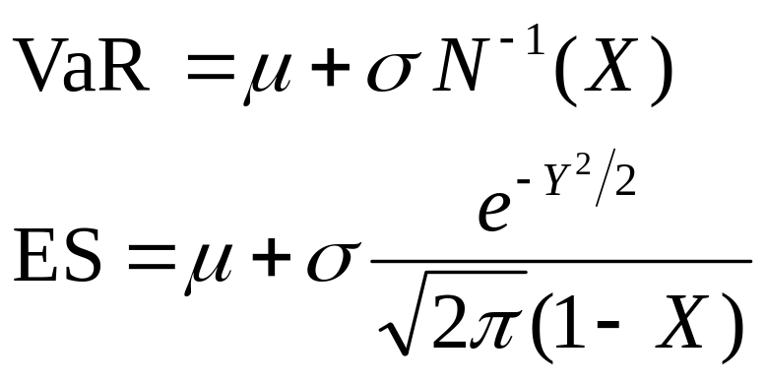
Normal Distribution Assumption
When losses are normally distributed with mean μ and standard deviation σ

Slide 37
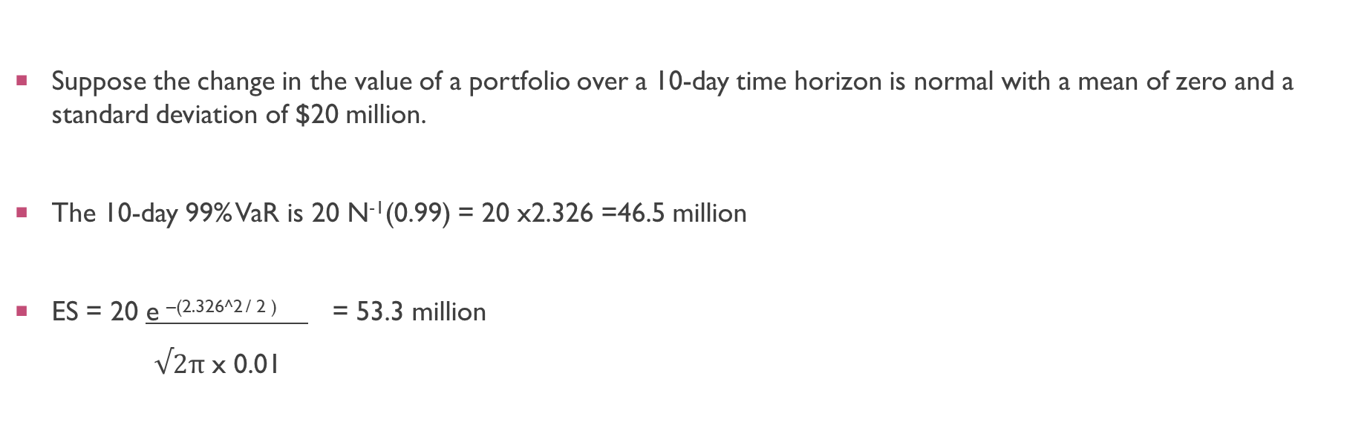
EXAMPLE
Suppose the change in the value of a portfolio over a 10-day time horizon is normal with a mean of zero and a standard deviation of $20 million.
The 10-day 99% VaR is 20 N⁻¹(0.99) = 20 x2.326 =46.5 million
ES = 20 e ^{–(2.326^2 / 2 )} = 53.3 million
$√2π$ x 0.01

Slide 38
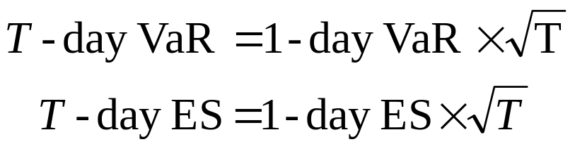
Changing the Time Horizon
If losses in successive days are independent, normally distributed, and have a mean of zero

Slide 39
Choice of VaR Parameters
Time horizon should depend on how quickly portfolio can be unwound. Regulators are planning to move toward a system where ES is used, and the time horizon depends on liquidity.
Confidence level depends on objectives. Regulators use 99% for market risk and 99.9% for credit/operational risk.
A bank wanting to maintain a AA credit rating might use confidence levels as high as 99.97% for internal calculations.

Slide 40
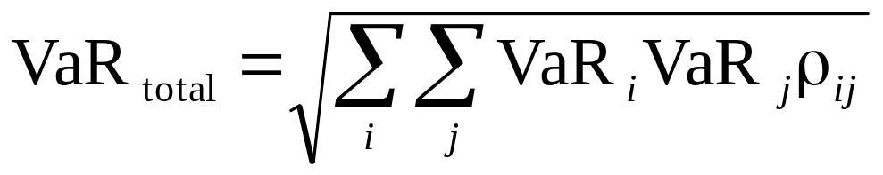
Aggregating VaR
  An approximate approach that seems to works well is
  where VaR_{i} is the VaR for the ith segment, VaR_{total} is the total VaR, and ρ_{ij} is the coefficient of correlation between losses from the ith and jth segments
  The same is true when VaR is replaced by ES

Slide 41
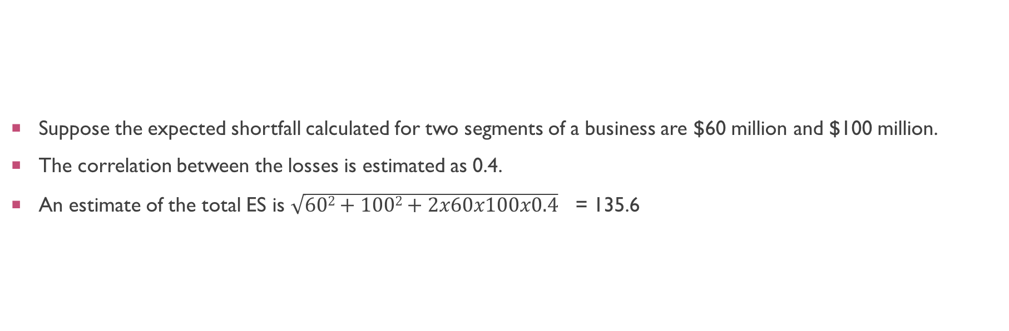
EXAMPLE
Suppose the expected shortfall calculated for two segments of a business are $60 million and $100 million.
The correlation between the losses is estimated as 0.4.
An estimate of the total ES is $\sqrt{602+1002+2x60x100x0.4}$ = 135.6

Slide 42
Back-testing
Back-testing a VaR calculation methodology involves looking at how often exceptions (loss > VaR) occur

Slide 43
Question -1
The change in the value of a portfolio in three months is normally distributed with a mean of $500,000 and a standard deviation of $3 million.
Calculate the VaR and ES for a confidence level of 99.5% and a time horizon of three months.

Slide 44
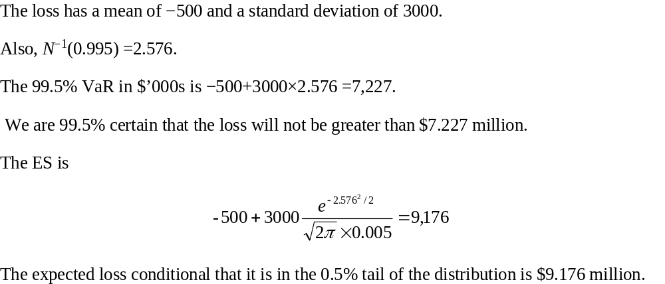
ANSWER

Slide 45
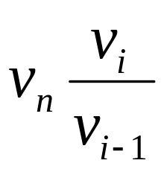
Historical Simulation
Collect data on the daily movements in all market variables
The first simulation trial assumes that the percentage changes in all market variables are as on the first day
The second simulation trial assumes that the percentage changes in all market variables are as on the second day
and so on
Suppose we use n days of historical data with today being day n
Let v_{i} be the value of a variable on day i
There are n-1 simulation trials
The ith trial assumes that the value of the market variable tomorrow (i.e., on day n+1) is

Slide 46
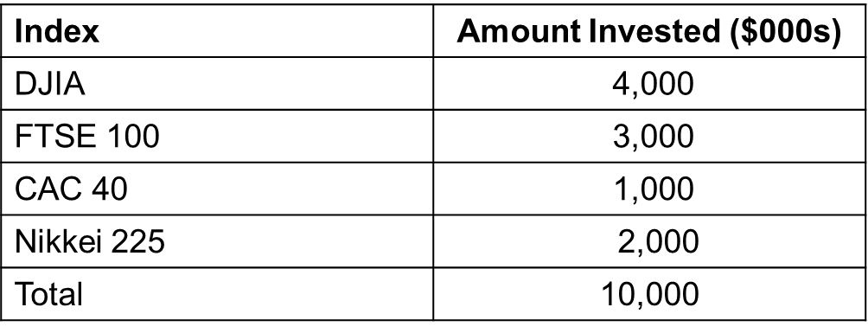
EXAMPLE : PORTFOLIO on sept 25, 2008

Slide 47
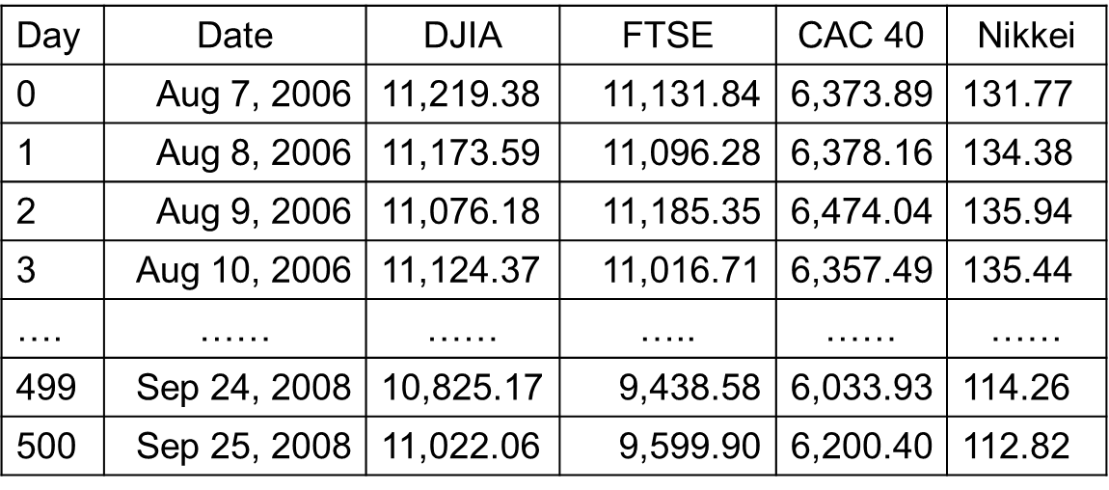
U.S. Dollar Equivalent of Stock Indices

Slide 48
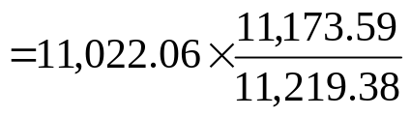
Scenarios
Scenario Number | DJIA | FTSE | CAC | Nikkei | Portfolio Value | Loss
1 | 10,977.08 | 9,569.23 | 6,204.55 | 115.05 | 10,014.334 | -14.334
2 | 10,925.97 | 9,676.96 | 6,293.60 | 114.13 | 10,027.481 | -27,481
3 | 11,070.01 | 9,455.16 | 6,088.77 | 112.40 | 9,946.736 | 53,264
…. | …… | ….. | ….. | ….. | ….. | …..
499 | 10,831.43 | 9,383.49 | 6,051.94 | 113.85 | 9,857.465 | 142.535
500 | 11,222.53 | 9,763.97 | 6,371.45 | 111.40 | 10,126.439 | -126.439

Slide 49
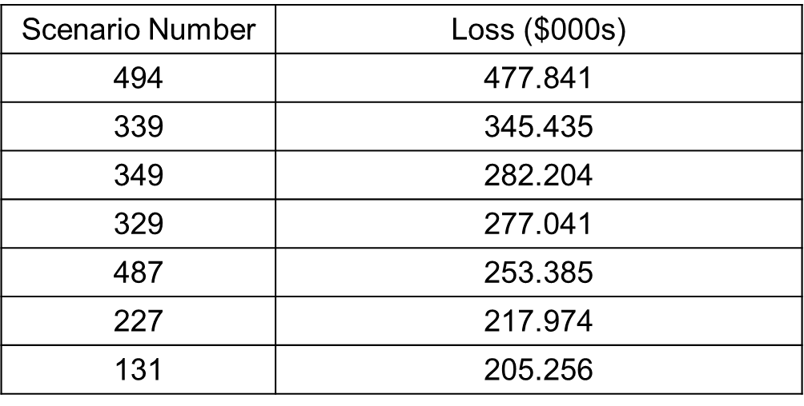
Losses
One-day 99% VaR=$253,385
One-day 99% ES is the average of the five worst losses or or $327,181

Slide 50
Stressed VaR and Stressed ES
Instead of basing calculations on the movements in market variables over the last n days, we can base calculations on movements during a period in the past that would have been particularly bad for the current portfolio
This produces measures known as “stressed VaR” and “stressed ES”

