Slide 1
The Model-Building Approach
The main alternative to historical simulation is to make assumptions about the probability distributions of the returns on the market variables
This is known as the model building approach (or sometimes the variance-covariance approach)

Slide 2
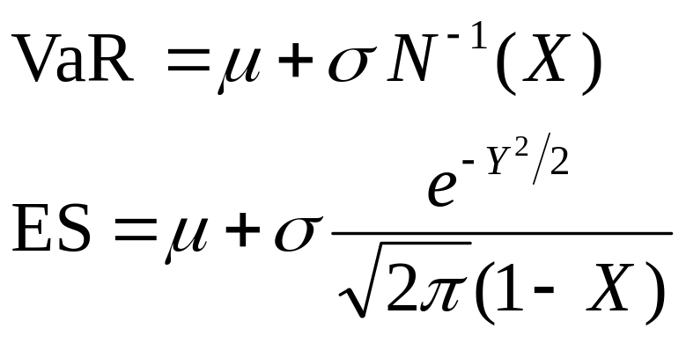
Normal Distribution Assumption
When losses are normally distributed with mean μ and standard deviation σ

Slide 3
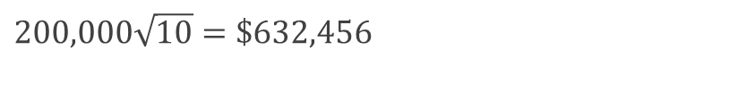
Example
We have a position worth $10 million in Microsoft shares
The volatility of Microsoft is 2% per day (about 32% per year)
We use N=10 and X=99
The standard deviation of the change in the portfolio in 1 day is $200,000
The standard deviation of the change in 10 days is
$$200,000\sqrt{10}=\$632,456$$

Slide 4

Example (Contd…)
We assume that the expected change in the value of the portfolio is zero (This is OK for short time periods)
We assume that the change in the value of the portfolio is normally distributed
Since N(–2.326)=0.01, the VaR is
$$2.326×632,456=\$1,471,312$$

Slide 5
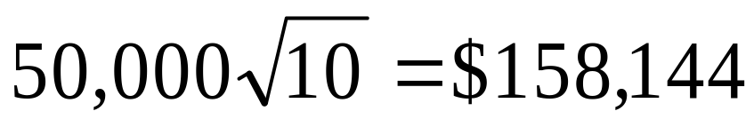

Example (Contd…)
Consider a position of $5 million in AT&T
The daily volatility of AT&T is 1% (approx 16% per year)
The SD per 10 days is
The VaR is
$$158,144×2.326=\$367,828$$

Slide 6
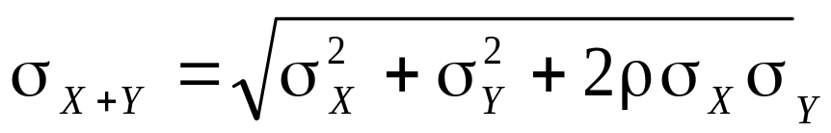
Portfolio
Now consider a portfolio consisting of both Microsoft and AT&T
Suppose that the correlation between the returns is 0.3
A standard result in statistics states that
In this case σ_{X} = 200,000 and σ_{Y} = 50,000 and ρ = 0.3. The standard deviation of the change in the portfolio value in one day is therefore 220,227

Slide 7
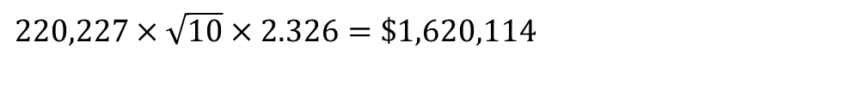
Var for portfolio
The 10-day 99% VaR for the portfolio is
The benefits of diversification are
(1,471,312+367,828)–1,620,114=$219,026
$$\text{220,2}27×\sqrt{\text{10}}×2.326=\$1,620,114$$

Slide 8
ES Results (10-day 99%)
Microsoft shares: $1,686,056
AT&T shares: $421,514
Portfolio: $1,856,578

Slide 9
Linear model
We assume
The daily change in the value of a portfolio is linearly related to the daily returns from market variables
The returns from the market variables are normally distributed

Slide 10
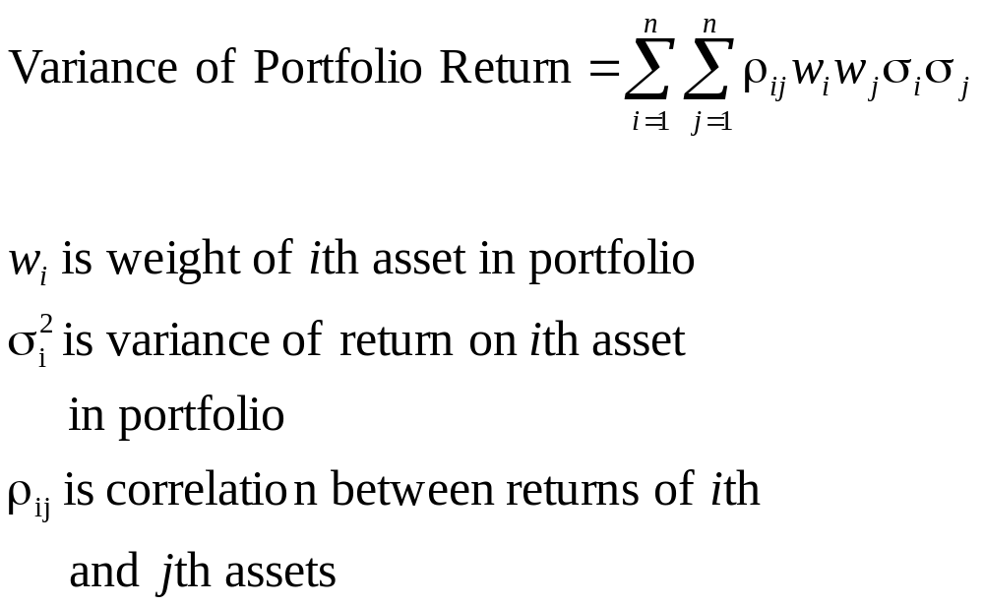
Markowitz Result for Variance of Return on Portfolio

Slide 11
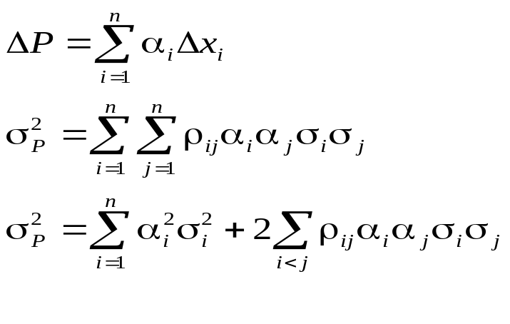
Corresponding Result for Variance of Portfolio Value
σ_{i} is the daily volatility of the ith asset (i.e., SD of daily returns)
σ_{P} is the SD of the change in the portfolio value per day
α_{i} =w_{i} P is amount invested in ith asset

Slide 12
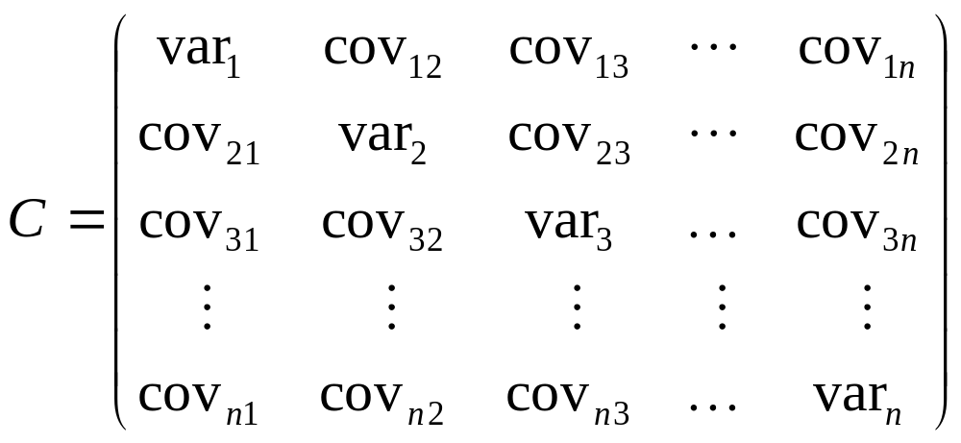
Covariance Matrix

Slide 13
Covariance Matrix

Slide 14
When Linear Model Can be Used
Portfolio of stocks
Portfolio of bonds
Forward contract on foreign currency
Interest-rate swap

Slide 15
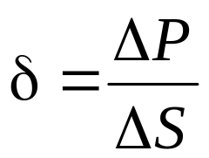
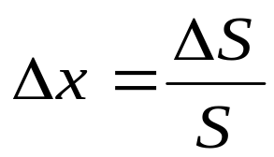
The Linear Model and Options
Consider a portfolio of options dependent on a single stock price, S. Define
and

Slide 16
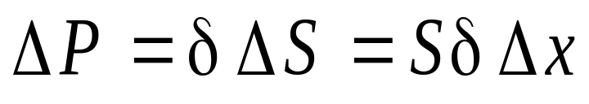
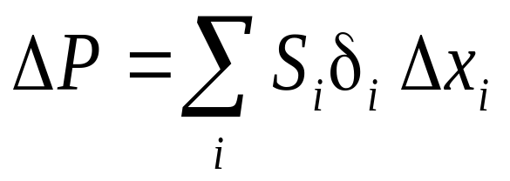
The Linear Model and Options (CONTD…)
As an approximation
Similarly when there are many underlying market variables
where δ_{i} is the delta of the portfolio with respect to the ith asset

Slide 17
Example
Consider an investment in options on Microsoft and AT&T.
Suppose the stock prices are 120 and 30 respectively and the deltas of the portfolio with respect to the two stock prices are 1,000 and 20,000 respectively
As an approximation
where Δx₁ and Δx₂ are the percentage changes in the two stock prices

Slide 18
Model building Approach
Results can be produced quickly
Linear model
Used for investment portfolios where there are no derivatives

Slide 19
Comparison of Approaches
Model building approach assumes normal distributions for market variables. It tends to give poor results for low delta portfolios
Historical simulation lets historical data determine distributions, but is computationally slower

Slide 20
QUESTION 1
Consider a position consisting of a $300,000 investment in gold and a $500,000 investment in silver.
Suppose that the daily volatilities of these two assets are 1.8% and 1.2% respectively, and that the coefficient of correlation between their returns is 0.6.
What is the 10-day 97.5% VaR for the portfolio?
By how much does diversification reduce the VaR?

Slide 21
QUESTION 2
Consider a portfolio of options on a single asset.
Suppose that the delta of the portfolio is 12, the value of the asset is $10, and the daily volatility of the asset is 2%.
Estimate the one-day 95% VaR for the portfolio from the delta.

Slide 22
Scenario Analysis and Stress Testing
Key Questions
  How do we generate the scenarios?
  How do we evaluate the scenarios?
  What do we do with the results?

Slide 23
Generating the scenarios
Stress individual variables
Choose particularly days when there were big market movements and stress all variables by the amount they moved on those days
Form a stress testing committee of senior management and ask it to generate the scenarios

Slide 24
Reverse Stress Testing
Use an algorithm to search for scenarios where large losses occur
Can be a useful input to the stress testing committee.

Slide 25
What are the Incentives of a Financial Institution?
If the stress testing committee comes up with extreme scenarios more regulatory capital is likely to be required
The stress testing committee may therefore have an incentive to “water down” the scenarios they consider

Slide 26
What to do with the Results?
Should managers place more reliance on stress testing results or VaR results
One idea is to ask the stress testing committee to assign probabilities to scenarios (e.g. 0.05% or 0.2% or 0.5%)
The stress scenarios can then be integrated with the historical simulation scenarios to produce a composite VaR

Slide 27
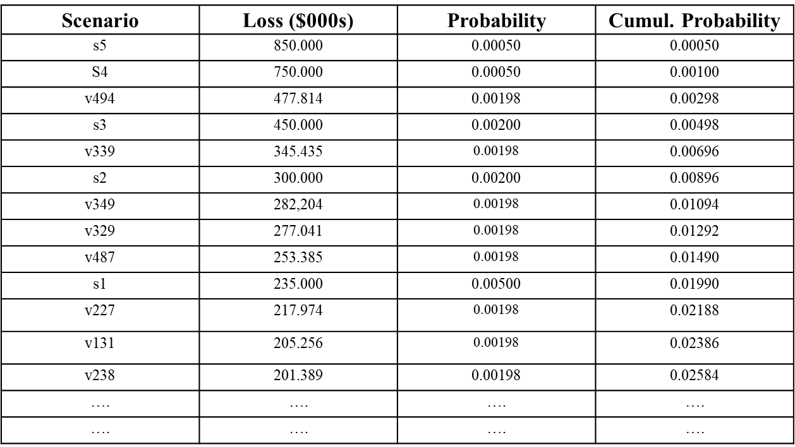
Example

Slide 28
Subjective vs Objective Probabilities
Objective probabilities are calculated from data
Subjective probabilities is based on an individual’s judgment
Objective probabilities are inevitably backward looking
The procedure just described is a way of combining subjective and objective probabilities

Slide 29
Correlations and Copulas
It is important for the risk manager to estimate correlations between the changes in market variables as well as their volatilities when assessing risk exposure
Suppose the company has exposure to two different market variables.
If changes in the two variables have high positive correlation, the company’s total exposure is high
If they have zero correlation, the exposure is less but still large
If they have high negative correlation, the exposure is quite low

Slide 30
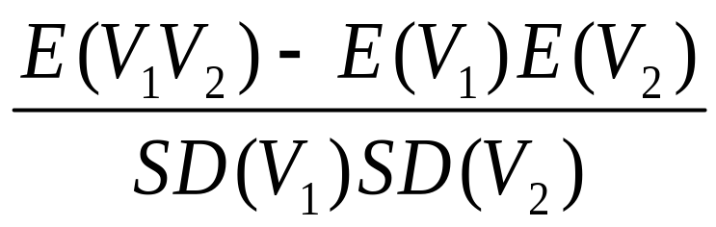
Correlation and Covariance
The coefficient of correlation between two variables V₁ and V₂ is defined as
The covariance is
E(V₁V₂)−E(V₁ )E(V₂)

Slide 31
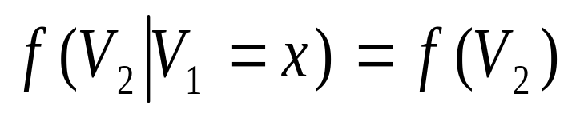
Independence
V₁ and V₂ are independent if the knowledge of one does not affect the probability distribution for the other
where f(.) denotes the probability density function

Slide 32
Independence is Not the Same as Zero Correlation
Suppose V₁ = –1, 0, or +1 (equally likely)
If V₁ = -1 or V₁ = +1 then V₂ = 1
If V₁ = 0 then V₂ = 0
V₂ is clearly dependent on V₁ (and vice versa) but the coefficient of correlation is zero

Slide 33
Types of Dependence
E(Y)
E(Y)
X
X
(a)
(b)
E(Y)
X
(c)

Slide 34
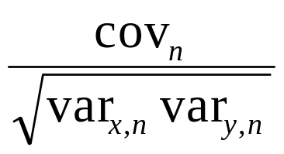
Monitoring Correlation Between Two Variables X and Y
Define x_{i}=(X_{i}−X_{i-1})/X_{i-1} and y_{i}=(Y_{i}−Y_{i-1})/Y_{i-1}
Also
var_{x,n}: daily variance of X calculated on day n-1
var_{y,n}: daily variance of Y calculated on day n-1
cov_{n}: covariance calculated on day n-1
The correlation is

Slide 35
Covariance
The covariance on day n is
E(x_{n}y_{n})−E(x_{n})E(y_{n})
It is usually approximated as E(x_{n}y_{n})

Slide 36
Multivariate normal distributions
Useful tools for specifying the correlation structure between variables, even when the distributions of the variables are not normal

Slide 37
Factor Models
When there are N variables, V_{i} (i = 1, 2,..N), in a multivariate normal distribution there are N(N−1)/2 correlations
We can reduce the number of correlation parameters that have to be estimated with a factor model

Slide 38
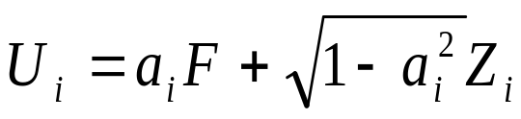
One-Factor Model continued
If U_{i} have standard normal distributions, we can set
where the common factor F and the idiosyncratic component Z_{i} have independent standard normal distributions
Correlation between U_{i} and U_{j} is a_{i} a_{j}

Slide 39
Gaussian Copula Models:
Creating a correlation structure for variables that are not normally distributed
Suppose we wish to define a correlation structure between two variable V₁ and V₂ that do not have normal distributions
We transform the variable V₁ to a new variable U₁ that has a standard normal distribution on a “percentile-to-percentile” basis.
We transform the variable V₂ to a new variable U₂ that has a standard normal distribution on a “percentile-to-percentile” basis.
U₁ and U₂ are assumed to have a bivariate normal distribution

Slide 40
The Correlation Structure Between the V’s is Defined by that Between the U’s
-0.2
0
0.2
0.4
0.6
0.8
1
1.2
-0.2
0
0.2
0.4
V
0.6
0.8
1
1.2
V
V
V
2
1
2
1
One
-
to
-
one
One
-
to
-
one
mappings
mappings
-6
-4
-2
0
2
2
4
4
6
-6
-4
-2
0
6
-6
-6
-4
-4
-2
-2
0
0
2
2
4
4
6
U
6
U
2
U
2
U
1
1
Correlation
Correlation
Assumption
Assumption

Slide 41
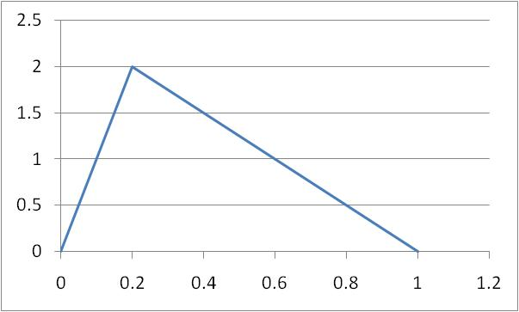
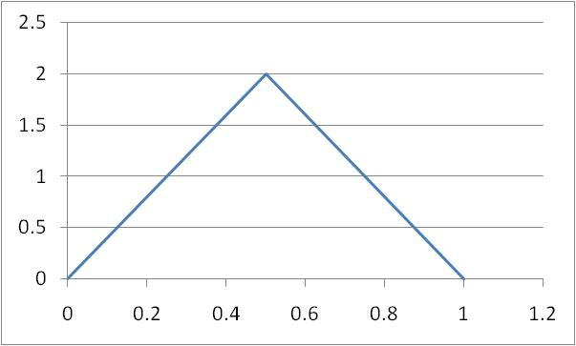
Example
V₁
V₂

Slide 42
V₁ Mapping to U₁
V₁ | Percentile | U₁
0.2 | 20 | -0.84
0.4 | 55 | 0.13
0.6 | 80 | 0.84
0.8 | 95 | 1.64

Slide 43
V₂ Mapping to U₂
V₂ | Percentile | U₂
0.2 | 8 | −1.41
0.4 | 32 | −0.47
0.6 | 68 | 0.47
0.8 | 92 | 1.41

Slide 44
Example of Calculation of Joint Cumulative Distribution
Probability that V₁ and V₂ are both less than 0.2 is the probability that U₁ < −0.84 and U₂ < −1.41
When copula correlation is 0.5 this is
M( −0.84, −1.41, 0.5) = 0.043
where M is the cumulative distribution function for the bivariate normal distribution

Slide 45
Other Copulas
Instead of a bivariate normal distribution for U₁ and U₂ we can assume any other joint distribution
One possibility is the bivariate Student t distribution

Slide 46
Multivariate Gaussian Copula
We can similarly define a correlation structure between V₁, V₂,…V_{n}
We transform each variable V_{i} to a new variable U_{i} that has a standard normal distribution on a “percentile-to-percentile” basis.
The U’s are assumed to have a multivariate normal distribution

Slide 47
Factor Copula Model
In a factor copula model the correlation structure between the U’s is generated by assuming one or more factors.

Slide 48
Credit Default Correlation
The credit default correlation between two companies is a measure of their tendency to default at about the same time
Default correlation is important in risk management when analyzing the benefits of credit risk diversification
It is also important in the valuation of some credit derivatives

Slide 49
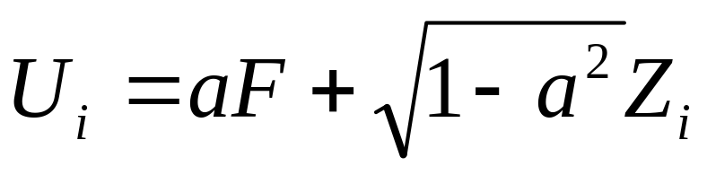
Model for Loan Portfolio
We map the time to default for company i, T_{i}, to a new variable U_{i} and assume
Where F and the Z_{i} have independent standard normal distributions
The copula correlation is ρ=a²

Slide 50
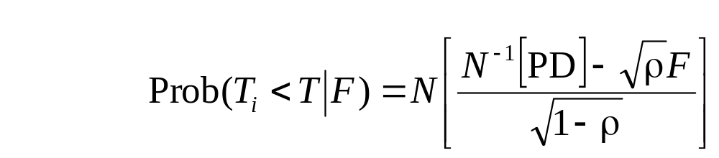
Analysis
To analyze the model we
  Calculate the probability that, conditional on the value of F, U_{i} is less than some value U
  This is the same as the probability that T_{i} is less that T where T and U are the same percentiles of their distributions
  This leads to
  where PD is the probability of default in time T

Slide 51
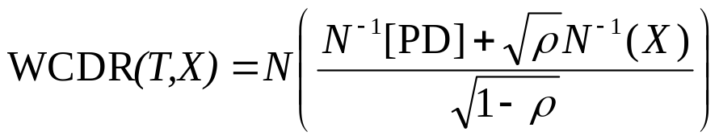
The Model continued
Low values of F give high default probabilities
The value of F is that has an X% chance of being exceeded is −N⁻¹(X)
The “worst case default rate” that will not be exceeded with probability X during time T is therefore

Slide 52
example
Suppose that a bank has a large number of loans to retail customers. The one-year probability of default for each loan is 2% and the copula correlation parameter,ρ, in Vasicek’s model is estimated as 0.1. In this case,
WCDR (1,0.999)= 0.128
99.9% worst case one-year default rate is 12.8%

Slide 53
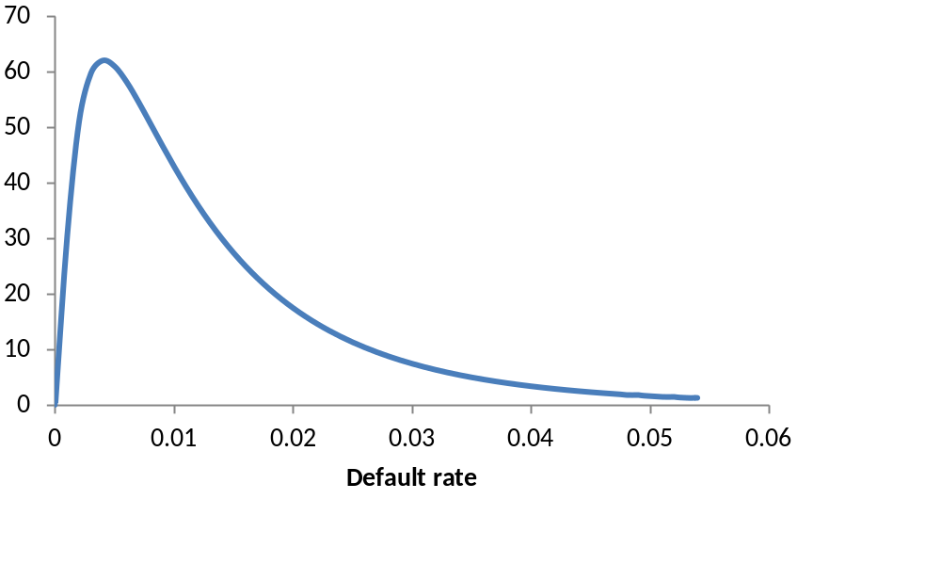
Probability Distribution for Default Rate

