Slide 1
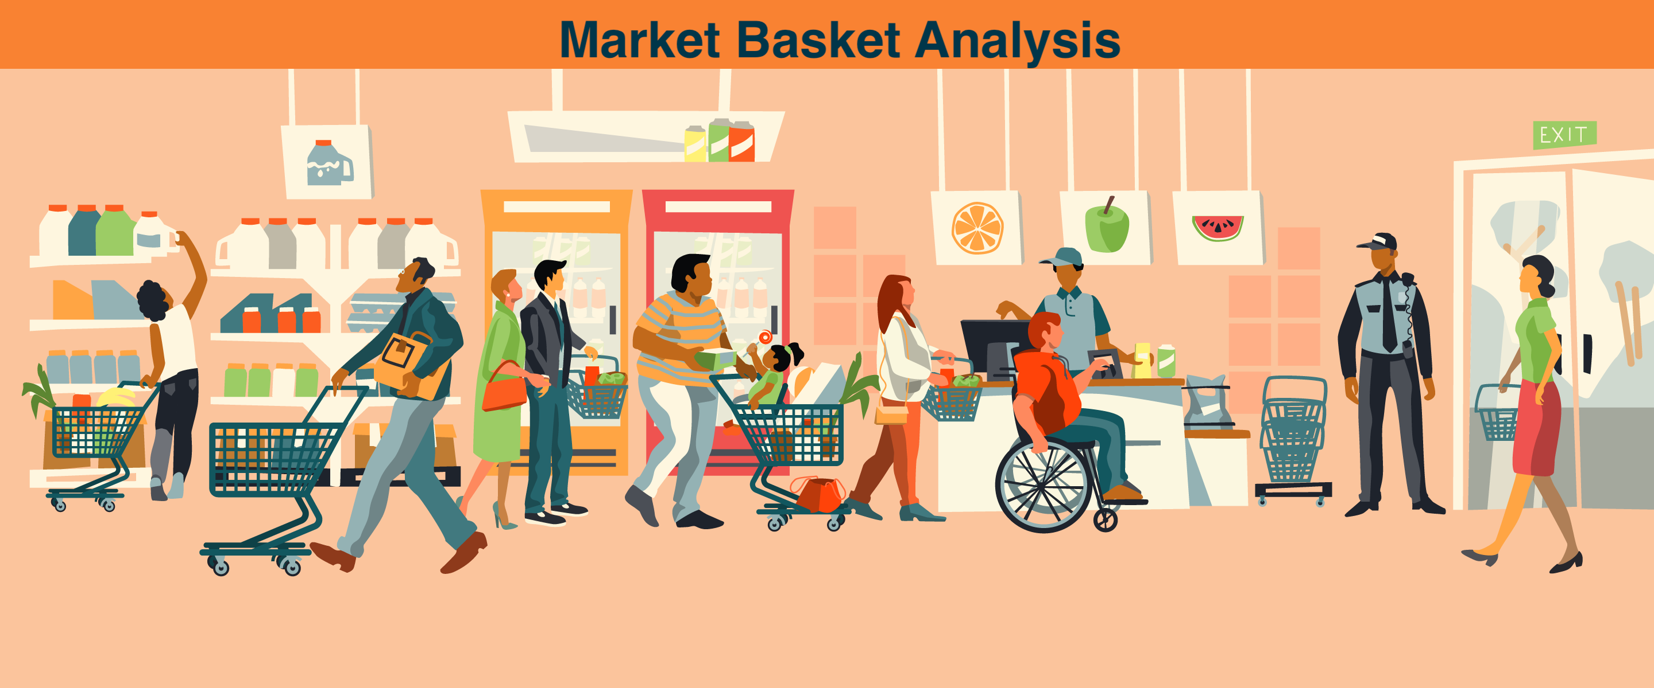

Slide 2
Introduction
Market Basket Analysis is a techniques used by large retailers to uncover associations between items.
It works by looking for combinations of items that occur together frequently in transactions.
To put it another way, it allows retailers to identify relationships between the items that people buy.

Slide 3
Market Basket Analysis is modeled on Association rule mining, OR, the IF {}, THEN {} construct.
For example, IF a customer buys bread, THEN he is likely to buy butter as well.
Association rules are usually represented as: {Bread} -> {Butter}

Slide 4
For Example look at the Transaction Table Below. Can you Identify any association between Items?
Look For items that have been bought together most of the time.
Transaction No. | Item 1 | Item 2 | Item 3 | Item 4 | ………
100 | Beer | Diaper | Chocolate | Cheese
101 | Milk | Chocolate | Shampoo
102 | Beer | Wine | Vodka
103 | Beer | Cheese | Diaper | Chocolate
104 | Ice Cream | Diaper | Beer
105 | Diaper | Beer | Milk | Chocolate
106 | Diaper | Cheese | Milk
107 | Diaper | Beer | Choclate
………..

Slide 5
From Previous Slide we observe:
Shoppers Who buy Diaper are very likely to buy Beer
{Diaper} -> {Beer} or Vice-Versa
2. Shoppers Who Buy Beer and Diaper are also likely to buy Chocolate
If Buy Diaper
Then
Buy Beer

Slide 6
It turns out that in a large retail transaction many such rules can be found -- the challenge is to find those that are meaningful or interesting and that also lead to actionable business decisions.
An example is "eighty percent of people who buy beer and pretzels also buy chocolate." {Beer, Pretzel} -> {Chocolate}
This combination is not obvious, and it can lead to a change in display layout, for example, moving the chocolate display closer to where beer is on sale.
On the other hand, a rule like "eighty percent of people who buy paint also buy paint brushes" is not very useful. {Paint} -> {Paint Brush}

Slide 7
Given that it's obvious and doesn't lead you to change the arrangement of these items in your store -- they're probably already displayed near each other
Similarly, "eighty percent of people who buy toothpaste and tissues also buy tomatoes” {Toothpaste, Tissues} -> {Tomatoes}
Although not obvious, however the above association is probably not useful since it may not lead to any actionable business decision.
Secondly, since transaction datasets are large determining such association is not very easy. Therefore, to identify rules that are useful or interesting, few measures have been suggested.

Slide 8
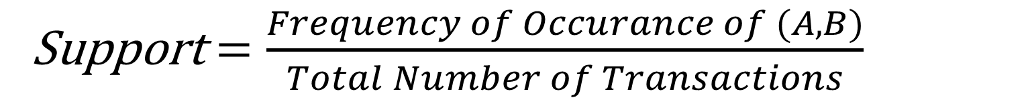
Measures
To identify rules that are useful or interesting, three measures are introduced: Support, Confidence, Lift and Coverage.
Support: First, determine which rules have strong support, that is, rules that are based on many examples in the database. Support is the percentage of records that obey the rule, that is, baskets that contain both A and B.
Support$=\frac{Frequency of Occurance of (A,B)}{Total Number of Transactions}$

Slide 9
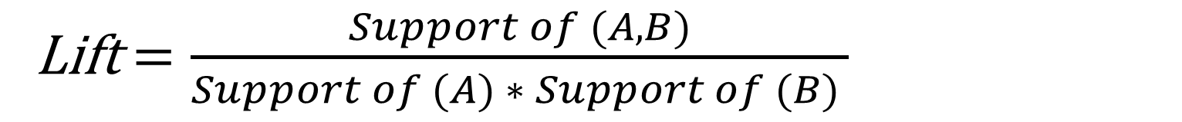
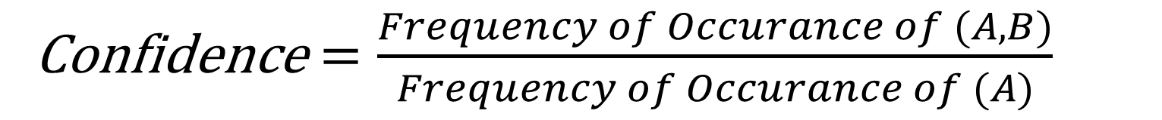
Confidence: Next, determine which rules have high confidence, that is, instances that obey the rule (contain both A and B) as a percentage of all instances of A. For example, assume you have 10 instances of A, 8 of which also have B; the other 2 do not have B. Confidence is 8 out of 10, or 80 percent.
Lift: Lift compares the chances of having B, given A, to the chances of having B in any random basket. Of the three, lift is the most useful because it improves predictability.
Confidence$=\frac{Frequency of Occurance of (A,B)}{Frequency of Occurance of (A)}$
Lift$=\frac{Support of (A,B)}{Support of (A) ∗ Support of (B) }$

Slide 10
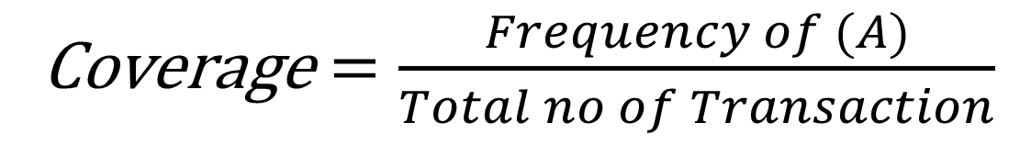
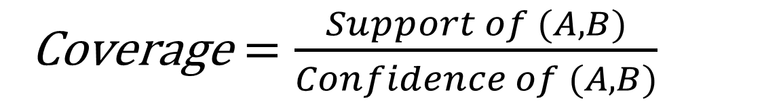
Coverage: is cover or LHS-support, and is the support of the left-hand-side of the rule X => Y, i.e., supp(X). It represents a measure of how often the rule can be applied.
This can be further simplified as using the support and confidence formula
This suggest that coverage is nothing but Support (A).
Coverage$=\frac{Support of (A,B)}{Confidence of (A,B)}$
Coverage$=\frac{Frequency of (A)}{Total no of Transaction}$

Slide 11
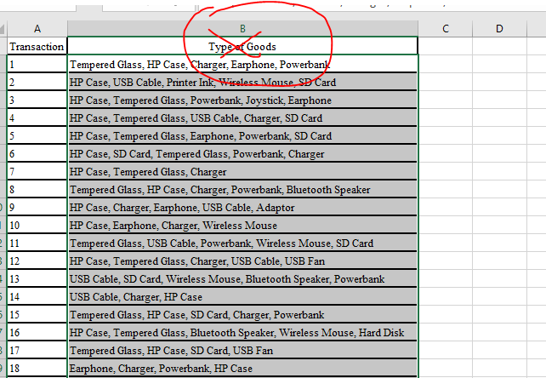
Steps for Market Basket Analysis in R
Open the data file “market basket analysis.xlsx” shared with you.
Don’t Copy the header or the first line from excel i.e. “Type of Goods”. Copy from Second line onwards.

Slide 12
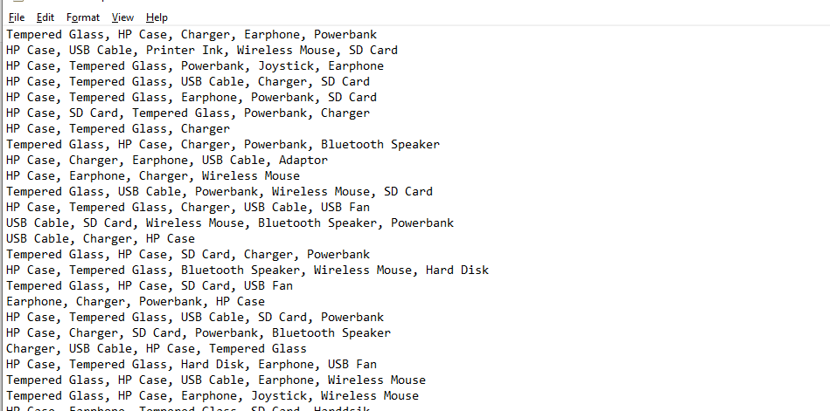
3. Copy the second column and paste it into a New Notepad file. As shown below

Slide 13
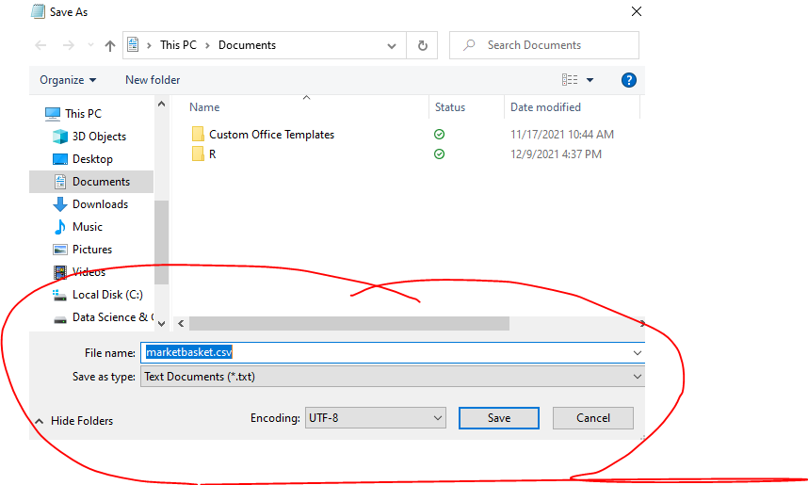
4. Save the Notepad file save as .csv file. For e.g. “marketbasket.csv” . This file will now be used to do analysis in R. So remember wherever you have saved it.

Slide 14
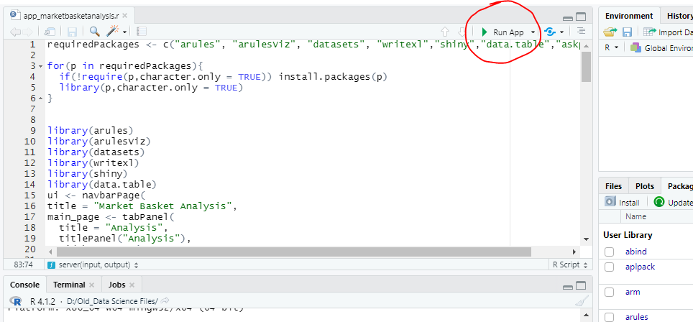
5. Open the R file named “app_marketbasketanalysis.R” already shared with you. It should open up in R-Studio. And Click on Run App as shown below.

Slide 15
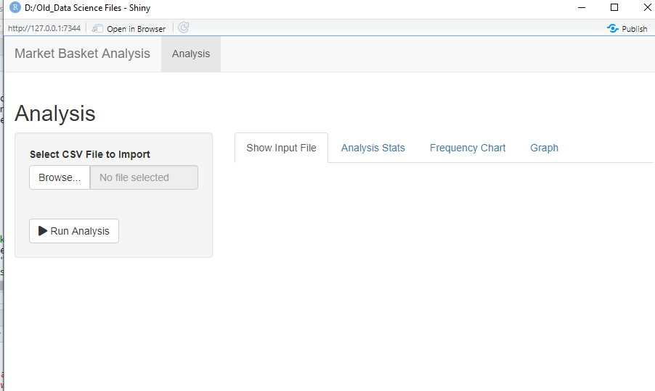
6. Run app button should open a window as shown below. Using the browse button choose the file made in step 3. File “marketbasket.csv.

Slide 16
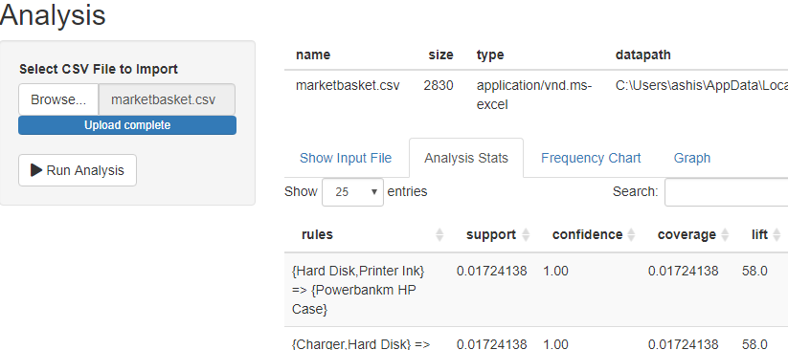
7. Click on Run Analysis Button to get output, which will as shown below. The different tabs will show you different results. Clicking on each Tab i.e. Analysis Stat, Frequency Chart and Graph will show you different Output

Slide 17
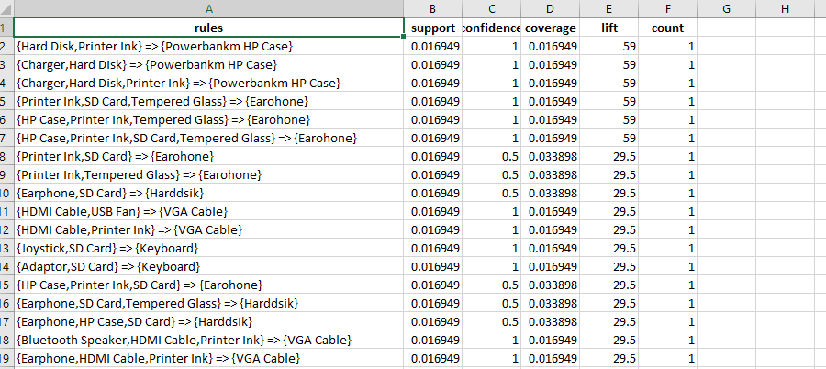
An Output file with name “mba12.xlsx” is also available in the directory where you have saved the file “app_marketbasketanalysis.R”

