Slide 1
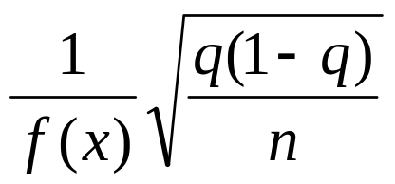
Accuracy of var
Suppose that x is the qth percentile of the loss distribution when it is estimated from n observations.
The standard error of x is
where f(x) is an estimate of the probability density of the loss at the qth percentile calculated by assuming a probability distribution for the loss

Slide 2
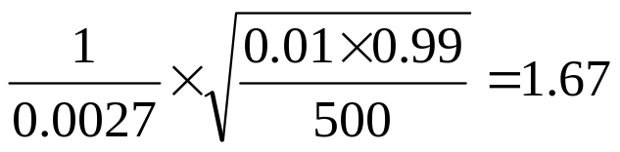
Example
We estimate the 99th percentile of a loss distribution from 500 observations as $25 million
We estimate f(x) by approximating the actual empirical distribution with a normal distribution mean zero and standard deviation $10 million
The 99th percentile of the approximating distribution is NORMINV(0.99,0,10) = 23.26 and the value of f(x) is NORMDIST(23.26,0,10,FALSE)=0.0027
The estimate of the standard error is therefore
95% confidence interval is from 25 – 1.96 x 1.67 to 25 + 1.96 x 1.67, ie, from $ 21.7 million to $ 28.3 million

Slide 3
Weighting of observations
Let weights assigned to observations decline exponentially as we go back in time
  Weight given to scenario i is λ^{n-i} (1- λ)
  1- λ^{n}
Rank observations from worst to best
Starting at worst observation sum weights until the required percentile is reached

Slide 4
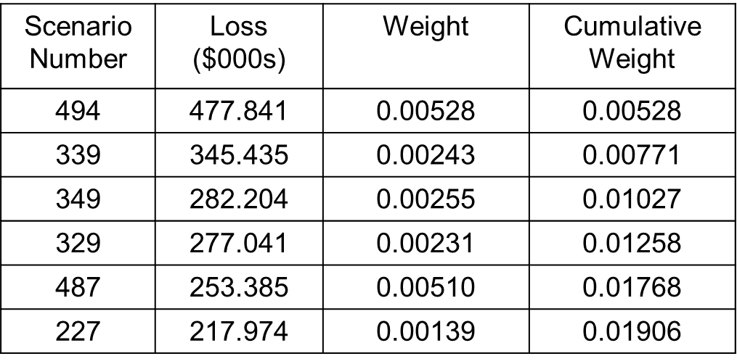
Application to 4-Index Portfolio
λ=0.995
One-day 99% VaR=$282,204
One day 99% ES is
[0.00528×477,841+0.00243×345,435+(0.01−0.00528 − 0.00243)×282,204]/0.01 = $400,914

Slide 5
Volatility
In risk management, the daily volatility of a market variable is defined as the standard deviation of the percentage daily change in the market variable.
The daily variance rate is the square of the daily volatility
Volatility tends to be higher on trading days than on nontrading days
Most market variables have distributions for percentage daily changes with much heavier tails than normal distribution

Slide 6
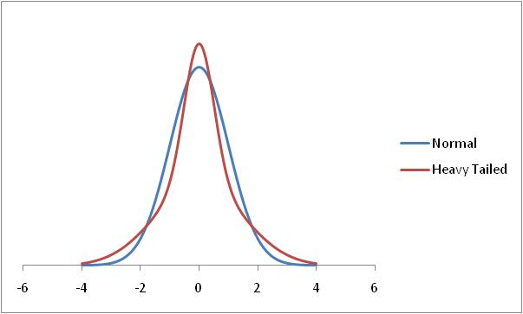
Normal and Heavy-Tailed Distribution

Slide 7
Heavy TAILS
Daily exchange rate changes are not normally distributed
  The distribution has heavier tails than the normal distribution
  It is more peaked than the normal distribution
This means that small changes and large changes are more likely than the normal distribution would suggest
Many market variables have this property, known as excess kurtosis

Slide 8
Alternatives to Normal Distributions: The Power Law
Prob(v > x) = Kx^{-α}
This seems to fit the behavior of the returns on many market variables better than the normal distribution

Slide 9
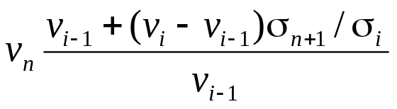
Volatility Updating
Use a volatility updating scheme to monitor volatilities of all market variables
If the current volatility for a market variable is β times the volatility on Day i, multiply the percentage change observed on day i by β
Value of market variable under ith scenario becomes

Slide 10
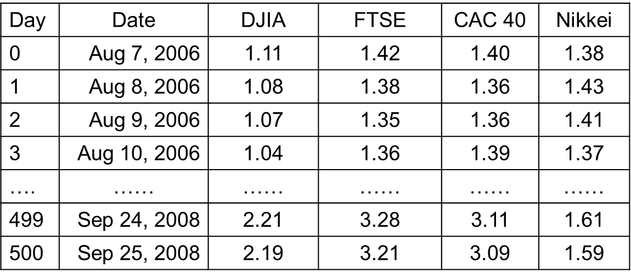
Volatilities (% per Day) Estimated for Next Day in 4-Index Example

Slide 11
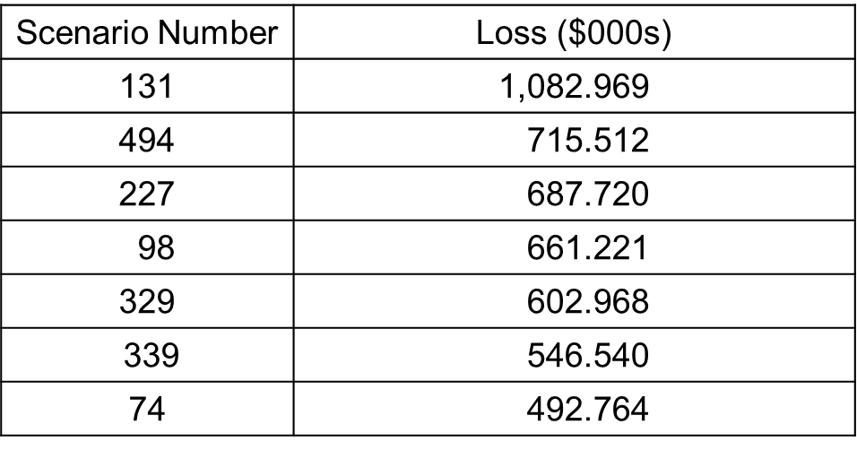
Volatility Adjusted Losses
One-day 99% VaR = $602,968
One-day 99% ES = (1,082,969+715,512+687,720+661,221+602.968)/5 = $750,078

Slide 12
A Simpler Approach
Monitor variance of simulated losses on the portfolio using EWMA
If current standard deviation of losses is β_{P} times the standard deviation of simulated losses on Day i, multiply ith loss given by the standard approach by β_{P}
This approach gives VaR and ES as $627,916 and $747, 619 respectively

Slide 13
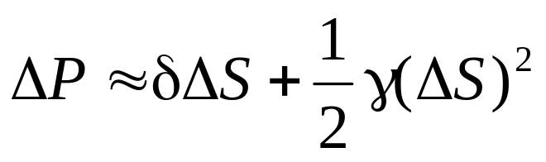
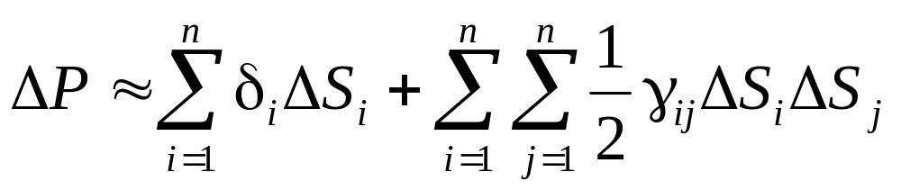
Computational Issues
To avoid revaluing a complete portfolio many times a delta/gamma approximation is sometimes used
When a derivative depend on only one underlying variable, S
With many variables

Slide 14
Extreme Value Theory
Extreme value theory can be used to investigate the properties of the right tail of the empirical distribution of a variable x. (If we interested in the left tail, we consider the variable –x.)
We first choose a level u somewhat in the right tail of the distribution
We then use Gnedenko’s result which shows that for a wide class of distributions as u increases the probability distribution that v lies between u and u+y conditional that it is greater than u tends to a generalized Pareto distribution

Slide 15
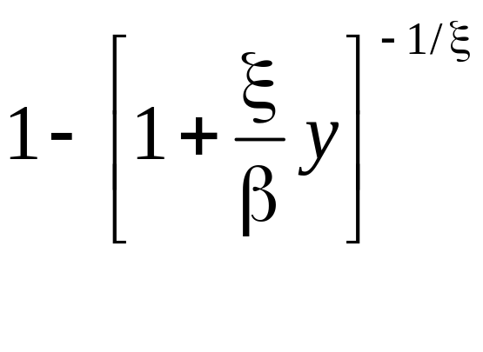
Generalized Pareto Distribution
This has two parameters ξ (the shape parameter) and β (the scale parameter)
The cumulative distribution is

Slide 16
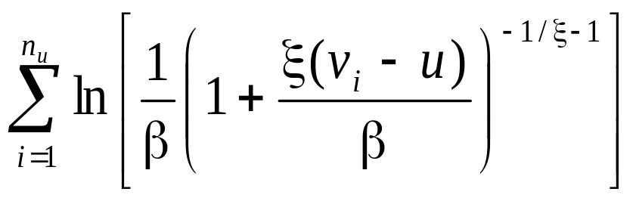
Maximum Likelihood Estimator
The observations on v are sorted in descending order. Suppose that there are n_{u} observations greater than u
We choose ξ and β to maximize

Slide 17
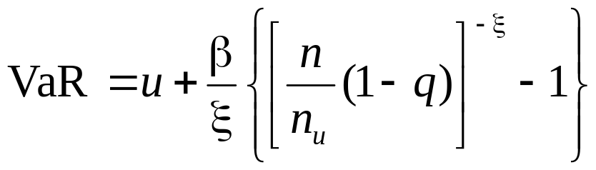
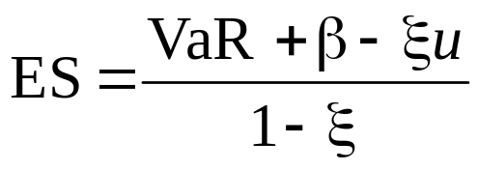
Estimating VaR and ES Using Extreme Value Theory
An estimate of VaR with a confidence level of q

Slide 18
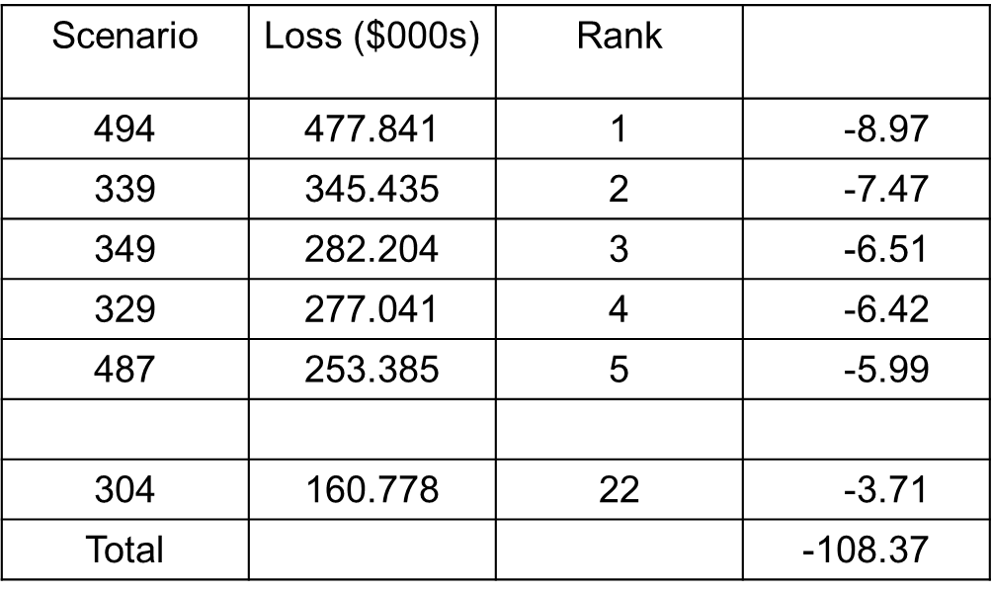
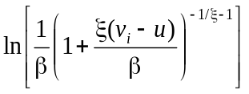
Using Maximum Likelihood for 4-Index Example, u=160

Slide 19
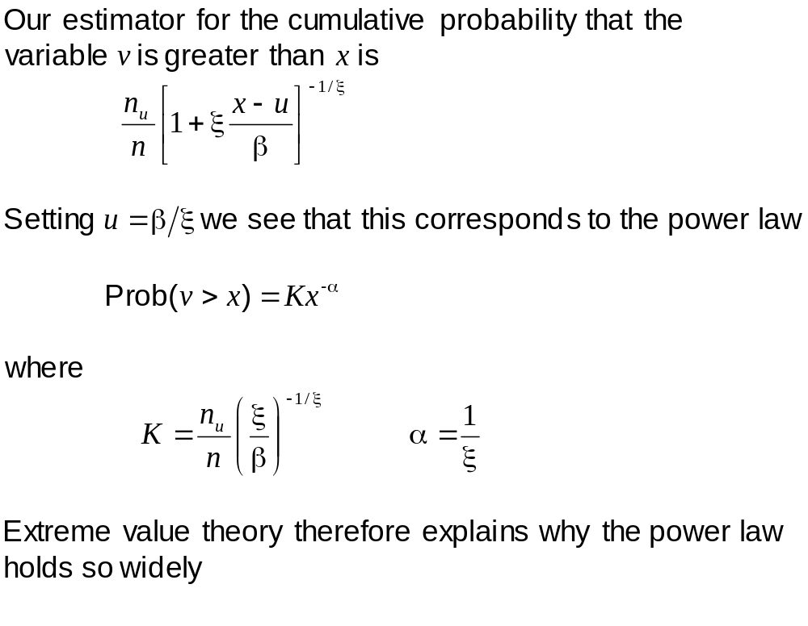
Tail Probabilities

Slide 20
EXAMPLE (CONTD…)
VaR with a 99% confidence level is 227.8
VaR with a 99.9% confidence level is 474.0
VaR with a 99.97% confidence level is 742.5

