Slide 1
Managing Uncertainty in a Supply Chain: Safety Inventory
Dr. Anurag Tiwari
Assistant Professor
Indian Institute of Management Rohtak

Slide 2
Role of Inventory in the Supply Chain
Improve Matching of Supply and Demand
Improved Forecasting
Reduce Material Flow Time
Reduce Waiting Time
Reduce Buffer Inventory
Economies of Scale
Supply / Demand Variability
Seasonal Variability
Cycle Inventory
Safety Inventory
Seasonal Inventory

Slide 3
The Role of Safety Inventory in a Supply Chain
Forecasts are rarely completely accurate
If average demand is 1000 units per week, then half the time actual demand will be greater than 1000, and half the time actual demand will be less than 1000; what happens when actual demand is greater than 1000?
If you kept only enough inventory in stock to satisfy average demand, half the time you would run out
Safety inventory: Inventory carried for the purpose of satisfying demand that exceeds the amount forecasted in a given period

Slide 4
Role of Safety Inventory
Average inventory is therefore cycle inventory plus safety inventory
There is a fundamental tradeoff:
  Raising the level of safety inventory provides higher levels of product availability and customer service
  Raising the level of safety inventory also raises the level of average inventory and therefore increases holding costs
    Very important in high-tech or other industries where obsolescence is a significant risk (where the value of inventory, such as PCs, can drop in value)
    Compaq and Dell in PCs

Slide 5
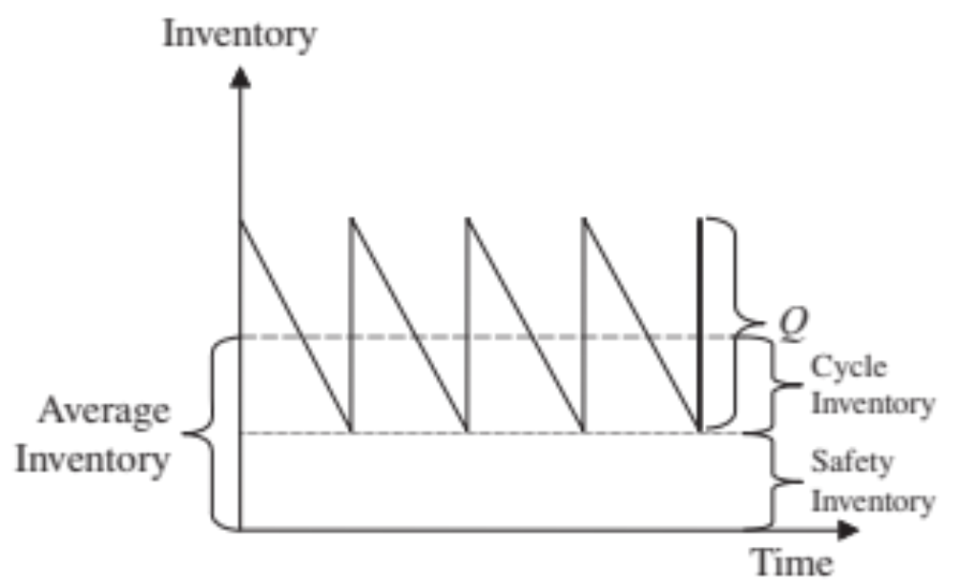
The Role of Safety Inventory
What is the appropriate level of product availability?
How much safety inventory is needed for the desired level of product availability?
What actions can be taken to reduce safety inventory without hurting product availability?

Slide 6
Determining the Appropriate
Level of Safety Inventory
Measuring demand uncertainty
Measuring product availability
Replenishment policies
Evaluating cycle service level and fill rate
Evaluating safety level given desired cycle service level or fill rate
Impact of required product availability and uncertainty on safety inventory

Slide 7
Determining the Appropriate
Level of Demand Uncertainty
Appropriate level of safety inventory determined by:
  supply or demand uncertainty
  desired level of product availability
Higher levels of uncertainty require higher levels of safety inventory given a particular desired level of product availability
Higher levels of desired product availability require higher levels of safety inventory given a particular level of uncertainty

Slide 8
Measuring Demand Uncertainty
Demand has a systematic component and a random component
The estimate of the random component is the measure of demand uncertainty
Random component is usually estimated by the standard deviation of demand
Notation:
  D = Average demand per period
  s_{D} = standard deviation of demand per period
  L = lead time = time between when an order is placed and when it is received
Uncertainty of demand during lead time is what is important

Slide 9
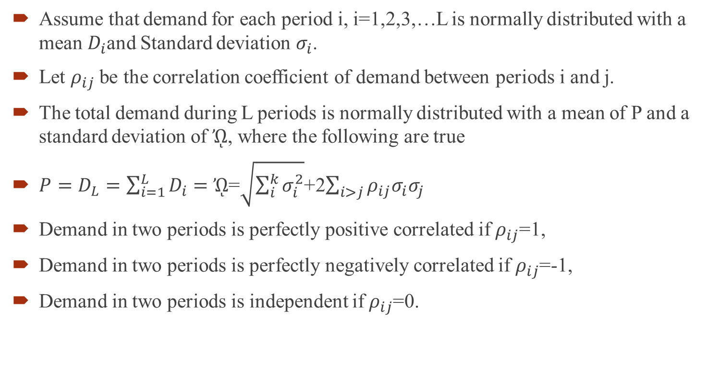
Measuring Demand Uncertainty
Assume that demand for each period i, i=1,2,3,…L is normally distributed with a mean $D_{i}$and Standard deviation $σ_{i}$.
Let $ρ_{ij}$ be the correlation coefficient of demand between periods i and j.
The total demand during L periods is normally distributed with a mean of P and a standard deviation of $ᾨ$, where the following are true
$P=D_{L}=\sum_{i=1}^{L}{D_{i}}=$ $ᾨ$=$\sqrt{\sum_{i}^{k}{σ_{i}^{2}}}$+2$\sum_{i>j}{ρ_{ij}σ_{i}σ_{j}}$
Demand in two periods is perfectly positive correlated if $ρ_{ij}$=1,
Demand in two periods is perfectly negatively correlated if $ρ_{ij}$=-1,
Demand in two periods is independent if $ρ_{ij}$=0.

Slide 10
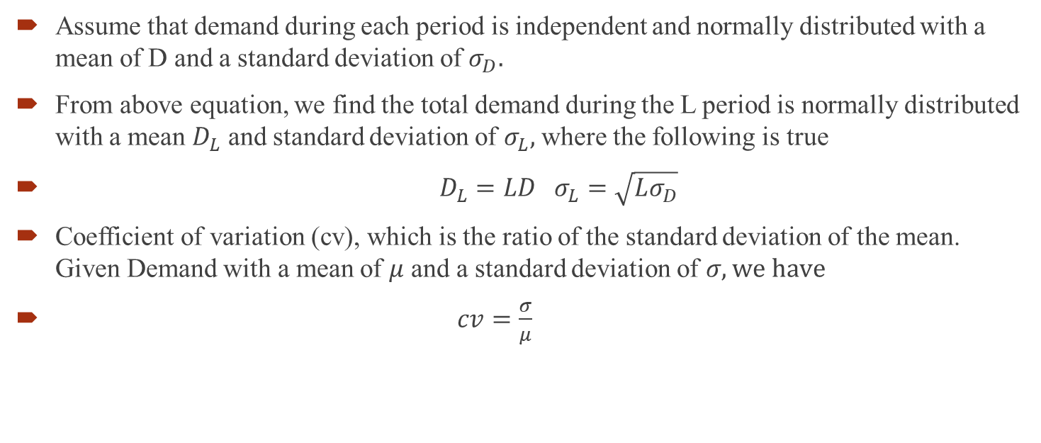
Measuring Demand Uncertainty
Assume that demand during each period is independent and normally distributed with a mean of D and a standard deviation of $σ_{D}.$
From above equation, we find the total demand during the L period is normally distributed with a mean $D_{L}$ and standard deviation of $σ_{L},$ where the following is true
$D_{L}=LD σ_{L}=\sqrt{Lσ_{D}}$
Coefficient of variation (cv), which is the ratio of the standard deviation of the mean. Given Demand with a mean of $μ$ and a standard deviation of $σ, we have$
$cv=\frac{σ}{μ}$

Slide 11
Measuring Product Availability
Product availability: a firm’s ability to fill a customer’s order out of available inventory
Stockout: a customer order arrives when product is not available
Product fill rate (fr): fraction of demand that is satisfied from product in inventory
Order fill rate: fraction of orders that are filled from available inventory
Cycle service level: fraction of replenishment cycles that end with all customer demand met

Slide 12
Replenishment Policies
Replenishment policy: decisions regarding when to reorder and how much to reorder
Continuous review: inventory is continuously monitored and an order of size Q is placed when the inventory level reaches the reorder point ROP
Periodic review: inventory is checked at regular (periodic) intervals and an order is placed to raise the inventory to a specified threshold (the “order-up-to” level)

Slide 13
Continuous Review Policy: Safety Inventory and Cycle Service Level
Evaluating Safety Inventory Given a Replenishment Policy
Expected demand during lead time = D x L
Safety inventory, ss = ROP – D x L

Slide 14
Example
Assume that weekly demand for phones at B&M office supplies is normally distributed, with a mean of 2500 and standard deviation of 500. The manufacturer takes two weeks to fill an order placed by the B&M manager. The store manager currently orders 10000 phones when the inventory on hand drops to 6000. Evaluate the safety inventory and the average inventory carried by B&M. Also the average time a phone spends at B&M.

Slide 15
Example 11.1: Estimating Safety Inventory (Continuous Review Policy)
D = 2,500/week; σ_{D =} 500
L = 2 weeks; Q = 10,000; ROP = 6,000
D_{L} = DL = (2500)(2) = 5000
ss = ROP - R_{L} = 6000 - 5000 = 1000
Cycle inventory = Q/2 = 10000/2 = 5000
Average Inventory = cycle inventory + ss = 5000 + 1000 = 6000
Average Flow Time = Avg inventory / throughput = 6000/2500 = 2.4 weeks

Slide 16
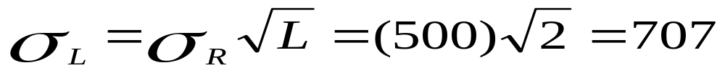
Example 11.2: Estimating Cycle Service Level (Continuous Review Policy)
D = 2,500/week; σ_{D =} 500
L = 2 weeks; Q = 10,000; ROP = 6,000
Cycle service level, CSL = F(D_{L} + ss, D_{L}, σ_{L}) =
= NORMDIST (D_{L} + ss, D_{L}, σ_{L}) = NORMDIST(6000,5000,707,1)
= 0.92 (This value can also be determined from a Normal probability distribution table)

Slide 17
Determining the Appropriate Level of Safety Inventory
Evaluating Cycle Service Level Given a Replenishment Policy
CSL = Prob(ddlt of L weeks ≤ ROP)
Z = (ROP – ddlt)/s_{L}
CSL = NORMSDIST(Z)

Slide 18
Example
Weekly demand for phones at B&M office supplies is normally distributed, with a mean of 2500 and standard deviation of 500. The manufacturer takes two weeks to fill an order placed by the B&M manager. Assume the demand in independent from one week to the next. Evaluate the CSL resulting from a policy of ordering 10000 phones when there are 6000 phones in inventory.

Slide 19
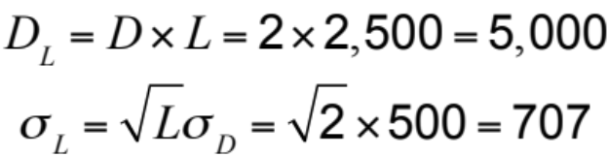
Determining the Appropriate Level of Safety Inventory
Q = 10,000, ROP = 6,000, L = 2 weeks
D = 2,500/week, s_{D} = 500
Z = (ROP – ddlt)/s_{L}
CSL = NORMSDIST(Z)
= NORMSDIST(1000/707) = 0.92

Slide 20
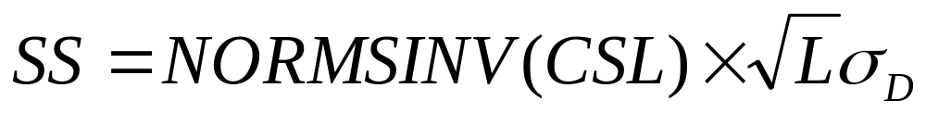
Determining the Appropriate Level of Safety Inventory
Evaluating Required Safety Inventory Given a Desired Cycle Service Level CSL
    Mean demand during lead time = D_{L}
    Standard deviation of demand during lead time = σ_{L}
        Z = (ROP – ddlt)/ σ_{L}
        CSL = NORMSDIST(Z)
        CSL = NORMSDIST((ROP – ddlt)/ σ_{L} )
        NORMSINV(CSL) = (ROP – ddlt)/ σ_{L}
        SS = NORMSINV(CSL) * σ_{L}

Slide 21
Example
Weekly demand for phones at B&M office supplies is normally distributed, with a mean of 2500 and standard deviation of 500. The manufacturer takes two weeks to fill an order placed by the B&M manager. Assume the demand in independent from one week to the next. Evaluate the safety inventory that the B&M should carry to achieve a CSL of 90%.

Slide 22
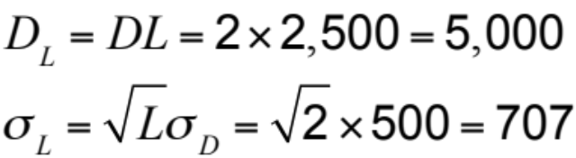
Determining the Appropriate Level of Safety Inventory
D = 2,500/week, s_{D} = 500, CSL = 0.9, L = 2 weeks

Slide 23
Factors Affecting Fill Rate
Safety inventory: Fill rate increases if safety inventory is increased. This also increases the cycle service level.
Lot size: Fill rate increases on increasing the lot size even though cycle service level does not change.

Slide 24
Periodic Review Policy
  Lot size determined by prespecified order-up-to level (OUL)
D: Average demand per period
s_{D}: Standard deviation of demand per period
L: Average lead time for replenishment
T: Review interval
CSL: Desired cycle service level

Slide 25
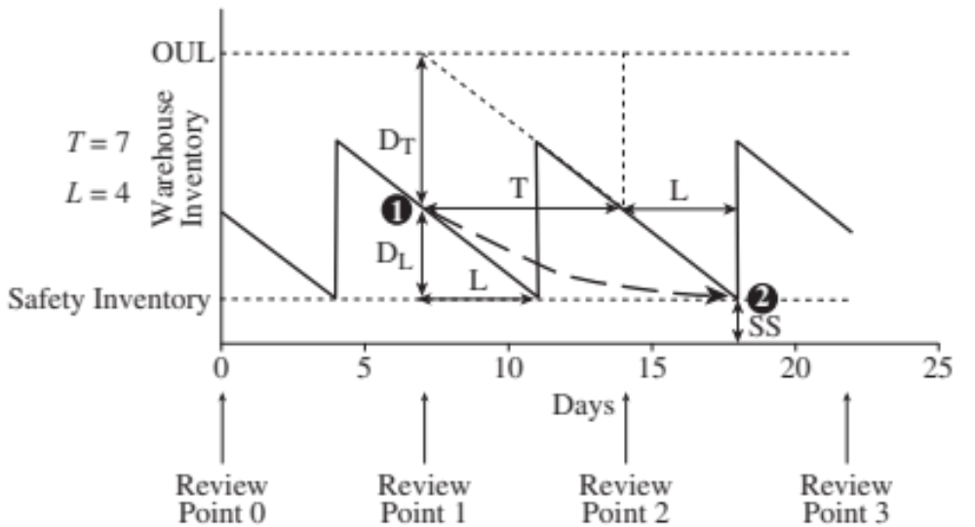
Periodic Review Policy

Slide 26
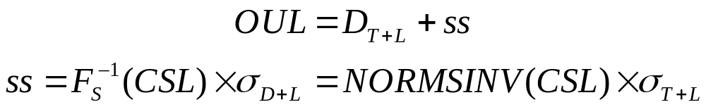
Periodic Review Policy
Probability (demand during L + T ≤ OUL) = CSL

Slide 27
Example
Weekly demand for phones at B&M office supplies is normally distributed, with a mean of 2500 and standard deviation of 500. The manufacturer takes two weeks to fill an order placed by the B&M manager. Assume the demand in independent from one week to the next. The manager has decided to review inventory every four weeks. Assuming a periodic review replenishment policy, evaluate the safety inventory that the B&M should carry to provide a CSL of 90%. Evaluate the OUL for such a policy.

Slide 28
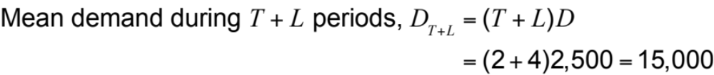
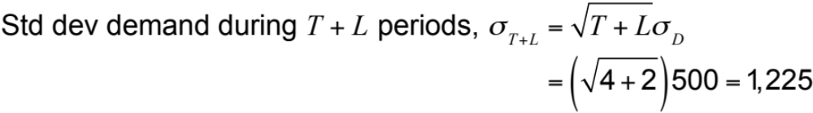
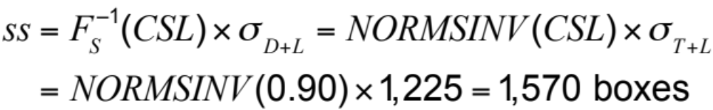
Evaluation Safety Inventory for a Periodic Review Policy
D = 2,500, s_{D} = 500, L = 2 weeks, T = 4 weeks

Slide 29
Key Points
Periodic review replenishment policies require more safety inventory than continuous review policies for the same lead time and level of product availability.

Slide 30
Impact of Required Product Availability and Uncertainty on Safety Inventory
Desired product availability (cycle service level or fill rate) increases, required safety inventory increases
Demand uncertainty (s_{L}) increases, required safety inventory increases
Managerial levers to reduce safety inventory without reducing product availability
  reduce supplier lead time, L (better relationships with suppliers)
  reduce uncertainty in demand, s_{L} (better forecasts, better information collection and use)

Slide 31
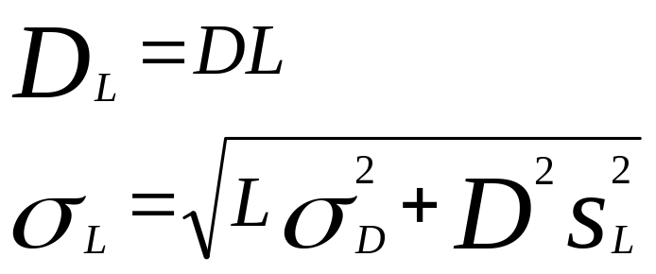
Impact of Supply Uncertainty
D: Average demand per period
σ_{D:} Standard deviation of demand per period
L: Average lead time
s_{L}: Standard deviation of lead time

Slide 32
Example
Daily demand of PCs at Dell in normally distributed, with a mean of 2500 and a standard deviation of 500. A key component in PC assembly is the hard drive. The hard drive suppliers takes an average of L=7 days to replenish inventory at Dell. Dell is targeting a CLS of 90% (Providing a fill rate close to 100 percent) for its hard drive inventory. Evaluate the safety inventory of hard drives that Dell must carry if the standard deviation of lead time is seven days. Dell is working with supplier to reduce the standard deviation to zero. Evaluate the reduction in safety inventory that Dell can expect as a result of this initiative.

Slide 33
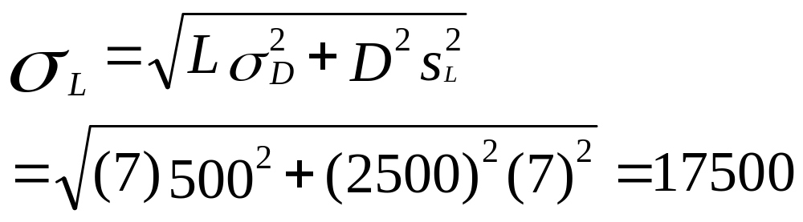
Impact of Supply Uncertainty
D = 2,500/day; σ_{D =} 500
L = 7 days; Q = 10,000; CSL = 0.90; s_{L} = 7 days
D_{L} = DL = (2500)(7) = 17500
ss = F⁻¹_{s}(CSL)s_{L} = NORMSINV(0.90) x 17550
= 22,491

Slide 34
Impact of Supply Uncertainty
Safety inventory when s_{L} = 0 is 1,695
Safety inventory when s_{L} = 1 is 3,625
Safety inventory when s_{L} = 2 is 6,628
Safety inventory when s_{L} = 3 is 9,760
Safety inventory when s_{L} = 4 is 12,927
Safety inventory when s_{L} = 5 is 16,109
Safety inventory when s_{L} = 6 is 19,298

Slide 35
Impact of Aggregation on Safety Inventory
Models of aggregation
Information centralization
Specialization
Product substitution
Component commonality
Postponement

Slide 36
Impact of Aggregation
If number of independent stocking locations decreases by n, the expected level of safety inventory will be reduced by square root of n (square root law)
Many e-commerce retailers attempt to take advantage of aggregation (Amazon) compared to bricks and mortar retailers (Borders)
Aggregation has two major disadvantages:
  Increase in response time to customer order
  Increase in transportation cost to customer
  Some e-commerce firms (such as Amazon) have reduced aggregation to mitigate these disadvantages

Slide 37
Information Centralization
Virtual aggregation
Information system that allows access to current inventory records in all warehouses from each warehouse
Most orders are filled from closest warehouse
In case of a stockout, another warehouse can fill the order
Better responsiveness, lower transportation cost, higher product availability, but reduced safety inventory
Examples: McMaster-Carr, Gap, Wal-Mart

Slide 38
Specialization
Stock all items in each location or stock different items at different locations?
  Different products may have different demands in different locations (e.g., snow shovels)
  There can be benefits from aggregation
Benefits of aggregation can be affected by:
  coefficient of variation of demand (higher cv yields greater reduction in safety inventory from centralization)
  value of item (high value items provide more benefits from centralization)
  Table 11.5

Slide 39
Product Substitution
Substitution: use of one product to satisfy the demand for another product
Manufacturer-driven one-way substitution
Customer-driven two-way substitution

Slide 40
Component Commonality
Using common components in a variety of different products
Can be an effective approach to exploit aggregation and reduce component inventories

Slide 41
Postponement
The ability of a supply chain to delay product differentiation or customization until closer to the time the product is sold
Goal is to have common components in the supply chain for most of the push phase and move product differentiation as close to the pull phase as possible
Examples: Dell, Benetton

Slide 42
Impact of Replenishment
Policies on Safety Inventory
Continuous review policies
Periodic review policies

Slide 43
Estimating and Managing
Safety Inventory in Practice
Account for the fact that supply chain demand is lumpy
Adjust inventory policies if demand is seasonal
Use simulation to test inventory policies
Start with a pilot
Monitor service levels
Focus on reducing safety inventories

Slide 44
Case: Managing Inventories at ALKO Inc.
John Williams started AlKO in 1943 in his garage workshop at Cleveland.
In February 1948 he obtained a patent for one of his designs for lighting fixtures.
The company become successful and in 1957 it grown to $3 Million company.
In 1963, John took the company public.
The company’s profitability, began to worsen

Slide 45
Gary Fisher was appointed in 2009 to reorganize and restructure the company.
He identified that company has historically ignored its distribution system.
Gary set up a task force to review the company’s current distribution system and come up with recommendations.

Slide 46
Current Distribution System
Total 100 products in product line
All production occurred at three facilities located in the Cleveland area
The US market was divided in 5 region and a DC was operated in each of them.
Customers placed orders with DCs.
When the inventory at the DC diminished, DC placed order to plants (periodic review policy)

Slide 47
Inbound cost = $0.09/unit
Outbound cost = $0.10/unit
Lead time = 5 days
Holding cost = $0.15/unit-day
CSL = 95%

Slide 48
Part | No. |  | Region 1 | Region 2 | Region 3 | Region 4 | Region 5
1 | 10 | Mean | 35.48 | 22.31 | 17.66 | 11.81 | 3.36
1 |  | Std. dev | 6.98 | 6.48 | 5.26 | 3.48 | 4.49
3 | 20 | Mean | 2.48 | 4.15 | 6.15 | 6.16 | 7.49
3 |  | Std. dev | 3.16 | 6.20 | 6.39 | 6.76 | 3.56
7 | 70 | Mean | 0.48 | 0.73 | 0.80 | 1.94 | 2.54
7 |  | Std. dev | 1.98 | 1.42 | 2.39 | 3.76 | 3.98

Slide 49
Alternative Distribution System
The task force recommended that ALKO build a national distribution centre (NDC) outside Chicago and close its five DC
They expected to recover $50000 from each closed warehouse
Inbound cost = $0.05/unit
Outbound Cost = $0.24/unit
They can also consider building NDC while keeping regional DCs open.

Slide 50
Questions
What is the annual inventory and distribution cost of the current distribution system?
What are the savings that would result from following the task force recommendation and setting up an NDC? Evaluate the savings as the correlation coefficient of demand in any pair of regions varies from 0 to 0.5 to 1.0. Do you recommend setting up NDC?
Suggest other options that Gary Fisher should consider. Evaluate each option and recommend a distribution system for ALKO that would be most profitable. How dependent is your recommendation on the correlation coefficient of demand across different regions?

Slide 51
Summary of Learning Objectives
Describe different measures of product availability
Understand the role of safety inventory in a supply chain
Identify factors that influence the required level of safety inventory

Slide 52
Thank You

