Slide 1
Leading, Managing, Acquiring and Developing Project Teams
Indian Institute of Management Rohtak

Slide 2
Acquiring a team
4 R
P-O fit
P-J fit

Slide 4
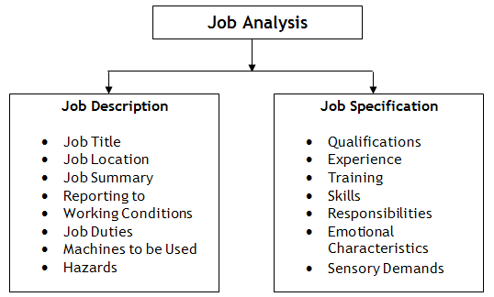
For What and Who?

Slide 5
Question?
Prepare a Job Description of a Project Manager (IT)?
A Project Manager (IT)
  Responsible for overseeing and managing technology projects,
  Ensuring they are completed on time,
  Within budget, and
  Meet the defined scope and quality standards.

Slide 6
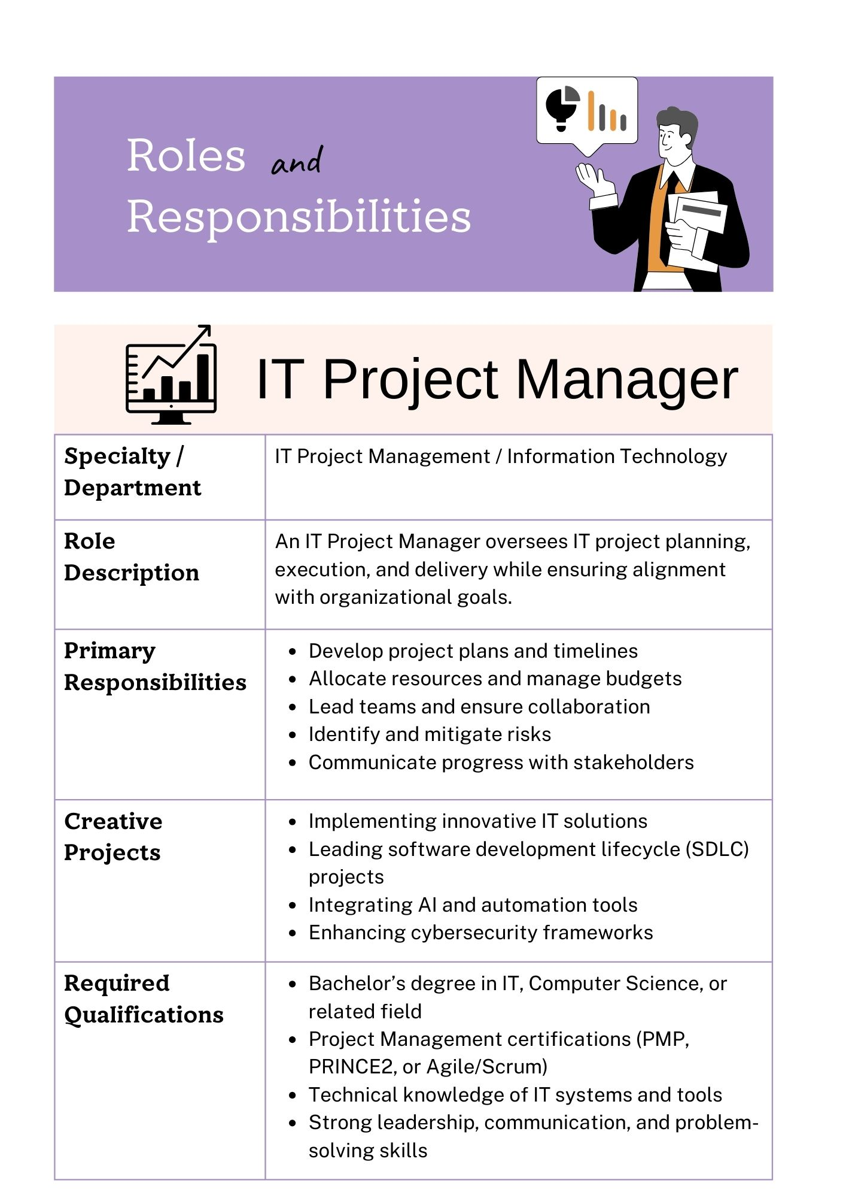
Job Analysis: Project Manager (IT)

Slide 8
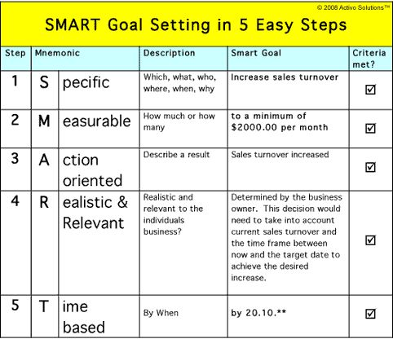

Slide 9
Assignment
You are Mr. Mehta Project Manager (Construction). You have two project assistant working under you. Now prepare a SMART goal setting for the project assistant.

Slide 10
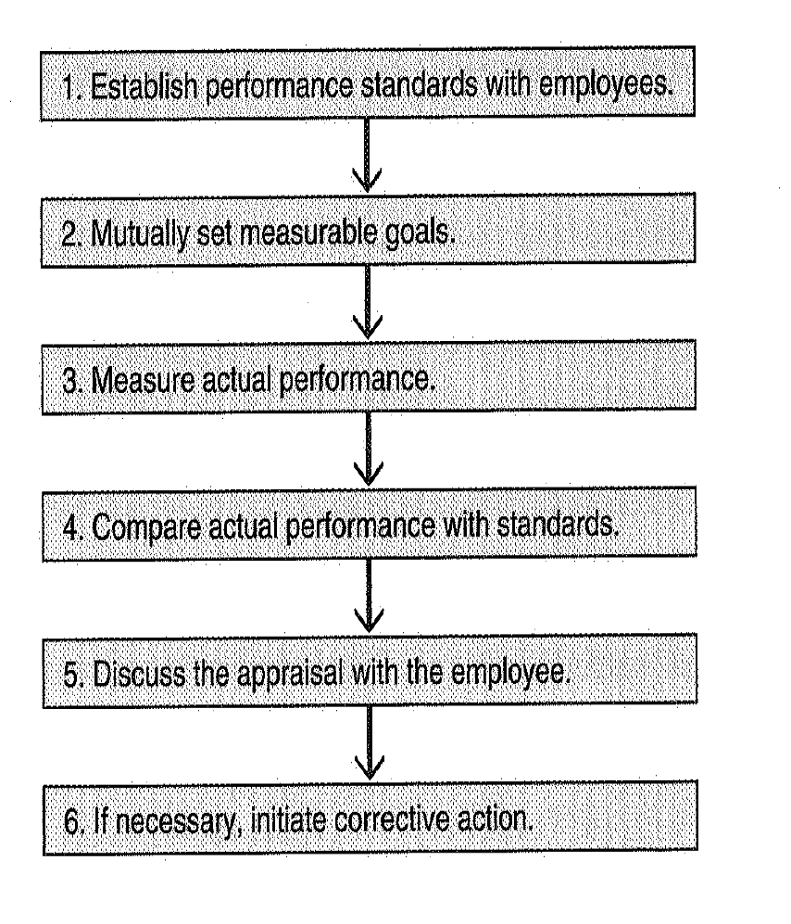
Managing Performance of Members

Slide 12
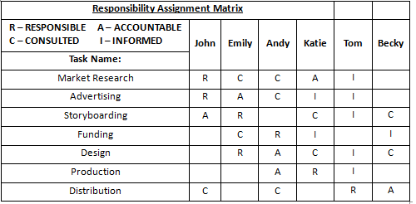
A Responsibility Assignment Matrix

Slide 16
Providing Feedback
Praise publicly, scold privately”
Positive reinforcement can go a long way!
Address negative behaviour by using a direct, appropriate approach

Slide 17
Summary
Project roles and responsibilities should be clear to the entire team
Acquiring, developing, and managing staff are management responsibilities
Documentation of plan and process is important aspect of PM

Slide 20
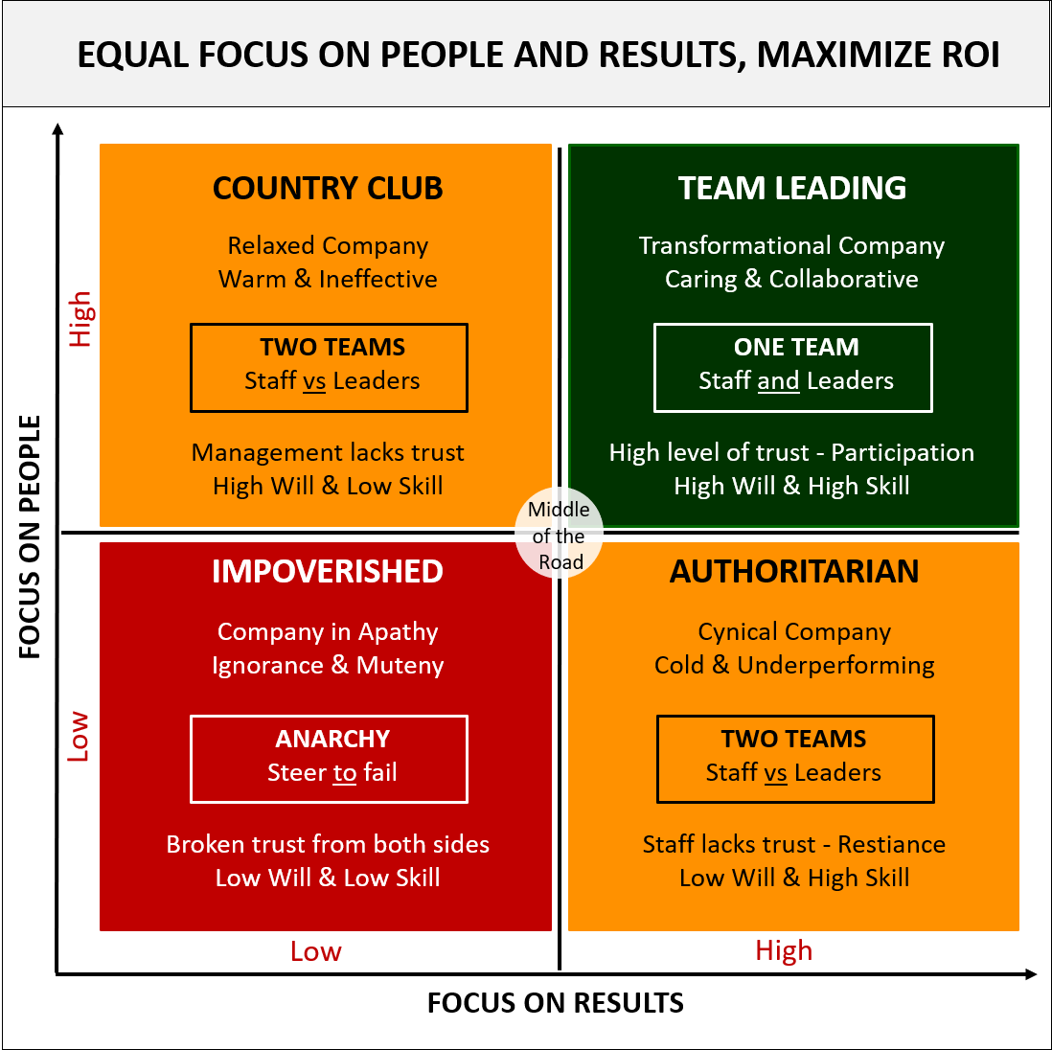
Leadership

