Slide 1
Managing Multi-Category Brand

Slide 2
“You need to change the orientation of a company so that people think of brands as assets. Then you must manage your portfolio of brand assets.”
- David Aaker

Slide 3
Questions You May Hear on Managing Multiple Brands
Why do we have two brands serving the same purpose in our portfolio?
How should we use our budget to drive brand growth?
We need to consolidate brands. What is your recommendation?
How well do our customers understand what we have to oﬀer?
What is the rationale for how you have allocated your
marketing budget?

Slide 4
Brand Portfolio Strategy
The eﬀective creation, deployment and management of brand assets in support of simultaneous top and bottom line growth

Slide 5
















What is a Brand Portfolio Strategy?
The eﬀective creation, deployment & management of brand assets in support of simultaneous top and bottom line growth
Maximum Portfolio Value
Key Beneﬁts
Access to new markets and Consumers
Marketing Investment Eﬃciency
Strengthened Customer Relationships
Uncovered Latent Brand Potential

Slide 6
Relevance of a Brand Portfolio Strategy
Brands tie a company to its customers – the brand strategy must inform and be informed by the business strategy
Brand strategy is business strategy…
Business Strategy
Professional Experience & Research
Execution
Brand & Brand PorIolio Strategy
Customer Experience
Company
Feedback, perceptions, satisfaction, etc.

Slide 7
Why is Brand Portfolio Strategy So Challenging?
Generally, no single group is reviewing or has the authority to manage the entire portfolio, resulting in many challenges for senior executives…
Overlapping brands in a portfolio oﬀering similar products/services targeted to the same customer
Ineﬃcient allocation of brand/building resources including having to support multiple brands across multiple countries
Mergers & acquisitions resulting in bloated brand portfolio
No clear brand/driven growth platforms to fuel future growth
Internal constructs, politics, and new product development drive portfolio strategy vs. customer/insights and strategic growth drivers
Lack of portfolio management system

Slide 8
Brand Architecture vs. Brand Portfolio Strategy
Brand Architecture
Addresses how a company can best structure and communicate
Its portfolio of brands
Brand Portfolio Matrix
Addresses how a company can use its brand(s) to achieve top
and bottom line growth

Slide 9
Brand Architecture Strategy
Brand Architecture, describes how a family of brands relate to one another
There are essentially 3 architectural naming models to which businesses subscribe: / Masterbrand, Endorsed Brand & Individual Brand.
Many brand architectures are complex, requiring diligence in streamlining and attempting to maintain consistency
Brand architecture is a critical component of brand portfolio strategy

Slide 10
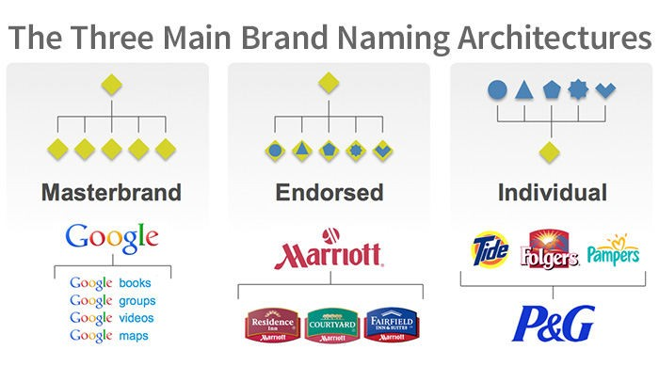
Brand Architecture Strategy

Slide 11
Brand Portfolio Strategy
Brand portfolio strategy addresses key strategic business issues and decisions rather than the linkages of brands within
It is the intersection of brand and business strategy
By strategically building, leveraging, and protecting the company’s brands, the brand portfolio strategy optimizes the value of the entire portfolio
It is not static but is grounded in market dynamics and can change dramatically over time

Slide 12
Brand Architecture vs. Brand Portfolio Strategy
Brand architecture provides a more tactical focus while brand portfolio strategy provides a more strategic focus
BRAND ARCHITECTURE BRAND PORTFOLIO STRATEGY
Sample Question:
What should this brand be called? Should it be linked to the master brand or not?
Sample Question:
Is this not only the right brand, but the right category in which to grow revenues by 15%?
Primary Objective:
Achieve clarity and synergy among brand(s) in the portfolio
Primary Objective:
Maximize portfolio value by strategically growing, leveraging, and protecting brands in a portfolio
VS.
Scope of Activities:
- Customer research to understand existing equities of brands
- Brand, business, and customer ﬁlters to identify optimal solution
- Naming and visual identity system
Scope of Activites:
- Comprehensive fact base (customer and brand data – qual/quant)
- Portfolio mapping
- Business case development
.

Slide 13
An Approach to Brand Portfolio Strategy
Take a long-term, holistic approach to managing your portfolio of brands Stage 1 Stage 2 Stage 3 Renovation & Identification of Optimization Rationalization Growth Opportunities Focus and clarify portfolio • Expand brand and business • Maintain brand relevance to ensure efficient allocation frame of reference _{• Manage portfolio roles to} ^{of resources} • Leverage brand(s) into new combat market pressures, Determine scope, roles and markets or customer e.g., consumer bifurcation relationships of brands in segments • Build branded differentiators ^{the portfolio (brand} • Make strategic brand or energizers to maintain ^{architecture)} acquisitions brand-built margins Ongoing Management System Determine appropriate organizational structure to manage brands as a portfolio Develop metrics system to track brand and business performance across the portfolio Other operationalization issues, e.g., channel, sales force, pricing?

Slide 14
Leading brand Portfolio practices for driving growth
Optimize the brand portfolio
  The goal is to drive growth and generate marketing eﬃciencies
  Decisions often require tough calls and must be guided by detailed analysis of customer targets, brand performance and impact on business results
Organize for success
  Most companies fail to optimally manage their brand portfolios
  Senior executives must institute the organizational structures, processes, and metrics that foster long/term brand building

Slide 15
Key Learnings
A brand portfolio strategy should logically ﬂow from, and lend support to, the broader business strategy
As a rule, a portfolio of fewer, bigger and better brands is preferred over a broader portfolio of regional and niche brands
A brand portfolio strategy must provide clarity on the scope, role and inter-relationship for all brands within the portfolio
Brand portfolio strategy should dictate the level and mix of investment and communication priorities across the portfolio
It is imperative to have an organizational structure that is empowered to manage the brands and is aligned with the right talent and processes
A measurement system needs to be establish to gauge and guide success of the brand portfolio

