Slide 1

Managing Financial Aspects during Organizational Change

Slide 2
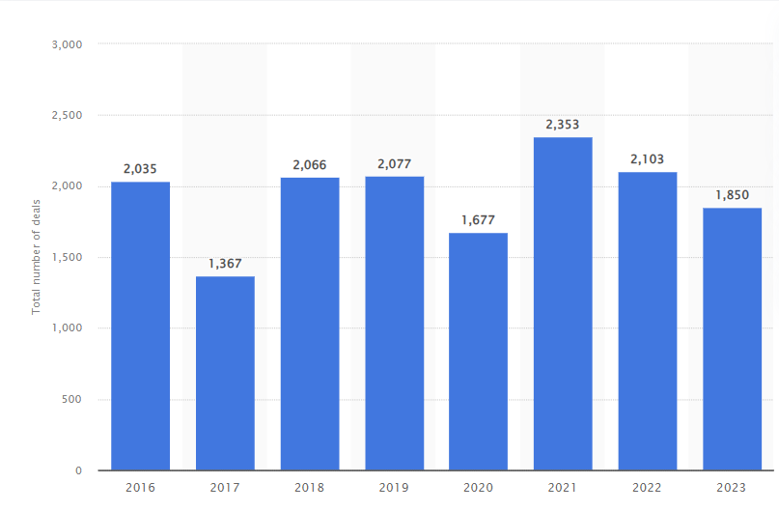
Total number of mergers & acquisitions deals in India
Source: https://www.statista.com

Slide 3

Examples
Merger between Tata Group and Air India:
Tata Group acquired Air India for a value of $2.4 billion or Indian Rupees 18000 crore, wherein INR 2700 crore was paid upfront, and INR 15,300 of debt was taken up by Tata Sons.
Adani Group acquired Ambuja Cements and ACC :
In February 2023, Adani Group acquired controlling stakes in both Ambuja Cements and ACC from Holcim for a combined value of $10.5 billion. The Group has become the second-largest cement player in the country. Holcim closed the deal with Adani Group by selling its entire stake in Ambuja Cements at ₹385 per share and in ACC at ₹2,300 per share. The cash proceeds aggregated to $6.4 billion for Holcim.

Slide 4

Examples
Reliance Retail Ventures acquired majority stake in Ed-a-Mamma:
Reliance Retail Ventures Ltd (RRVL) finalised a joint venture agreement to acquire a 51 per cent stake in Ed-a-Mamma, a kid and maternity-wear brand founded by actor Alia Bhatt, September 2023. This strategic partnership aims to expand the brand into new categories, including personal care, baby furniture, children's storybooks, and an animated series.
PVR and Inox Leisure Merge, rebranded as PVR INOX Pictures:
PVR Pictures, the leading multiplex operator, underwent a significant transformation, merging with Inox Leisure and adopting the new identity, PVR INOX Pictures in May 2023. The merger, following the closure of certain cinema screens, positions the combined entity with 361 cinemas and 1,689 screens across 115 cities in India and Sri Lanka.

Slide 5
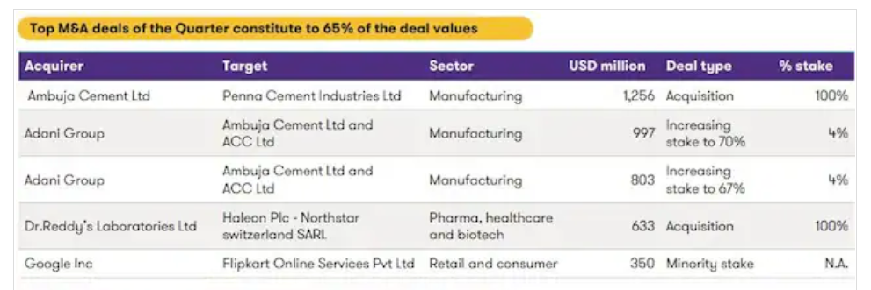
M&As in India soar to new heights
Source: Grant Thornton

Slide 6
The Basic Forms of Acquisitions
There are three basic legal procedures that one firm can use to acquire another firm:
  Merger or Consolidation
  Acquisition of Stock
  Acquisition of Assets

Slide 7

Merger versus Consolidation
Merger
  One firm is acquired by another
  Acquiring firm retains name and acquired firm ceases to exist
  Advantage – legally simple
  Disadvantage – must be approved by stockholders of both firms
Consolidation
  Entirely new firm is created from combination of existing firms

Slide 8
Acquisitions
A firm can be acquired by another firm or individual(s) purchasing voting shares of the firm’s stock
Tender offer – public offer to buy shares
Stock acquisition
  No stockholder vote required
  Can deal directly with stockholders, even if management is unfriendly
  May be delayed if some target shareholders hold out for more money – complete absorption requires a merger
Classifications
  Horizontal – both firms are in the same industry
  Vertical – firms are in different stages of the production process
  Conglomerate – firms are unrelated

Slide 9
Varieties of Takeovers
Merger
Acquisition
Acquisition of Stock
Takeovers
Proxy Contest
Acquisition of Assets
Going Private
(LBO)

Slide 10

Synergy
Most acquisitions fail to create value for the acquirer.
The main reason why they do not lie in failures to integrate two companies after a merger.
  Intellectual capital often walks out the door when acquisitions are not handled carefully.
  Traditionally, acquisitions deliver value when they allow for scale economies or market power, better products and services in the market, or learning from the new firms.
Notes:
More specifically, about 55% do not create value (The Wall Street Journal, 12/5/2000).

Slide 11

Motives for Mergers
Economies of Scale
  Larger firms can reduce per-unit cost by using excess capacity or spreading fixed costs across more units
  Economies of scale can reduce costs through increased operational or administrative efficiencies.

Slide 12

Motives for Mergers
Economies of Vertical Integration
“Vertical” integration can be either up or down, that is, suppliers or distributors
  Control over suppliers can reduce costs
  Over-integration can increase costs
  Best when two business activities are inextricably linked
Notes:
.

Slide 13
Motives for Mergers
Complementary Resources
Merging may result in firms filling missing pieces in each other’s supply chains
Small firms can benefit from existing organization of large firms
Surplus Funds
If firm is mature, has few positive NPV projects available, acquisition may be best use of funds
Notes:
Paying out high dividends is often (but not always) a better use of surplus funds than acquisition.

Slide 14
Some Dubious Reasons for Mergers
Diversification
  Investors should not pay premium for diversification; they can diversify themselves
  Diversification easier and cheaper for stockholders than corporations

Slide 15
Some Dubious Reasons for Mergers
Increasing Earnings per Share: Bootstrap Game
Acquiring firm has high P/E ratio
Selling firm has low P/E ratio (due to low number of shares)
After merger, acquiring firm has short-term EPS rise
Long term, acquirer will have slower than normal EPS growth due to share dilution.
Notes:
In this case, the acquiring firm has a high P/E ratio because of high-growth potential. The acquiring firm has short-term increase in EPS. But in the long-run, acquirer will suffer from a slower EPS growth rate.

Slide 16
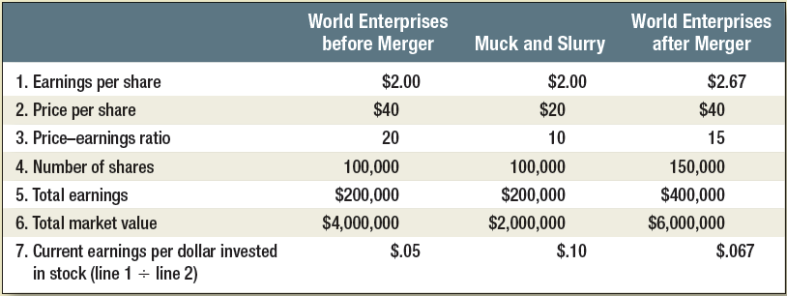
Market Value and Earnings Per Share, World Enterprises
Notes:
The selling firm has a low P/E ratio due to slower growth. After the merger, the acquiring firm has a short-term increase in EPS. This is called the bootstrap game.

Slide 17
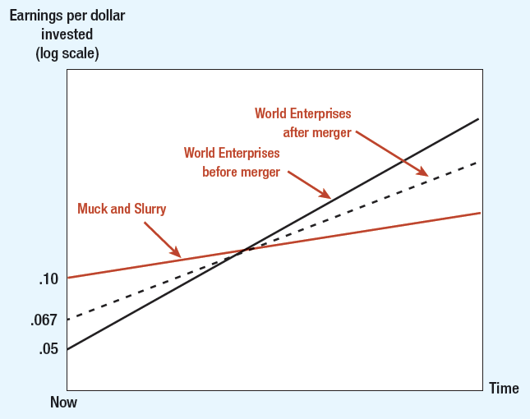
Effects of Merger on Earnings Growth
Notes:
In the long run, the acquirer will have slower growth due to dilution. This graph shows why the acquirer will have a slower growth rate in the future. The acquirer has given up a future growth rate for an increase in current earnings.

Slide 18
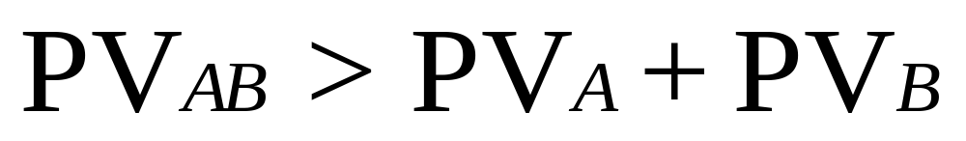
Estimating Merger Gains and Costs
Questions
  Is there overall economic gain to merger?
  Do terms of merger make company and shareholders better off?
Notes:
The value of the combined firms should be greater than the sum of the values of the two separate firms.

Slide 19
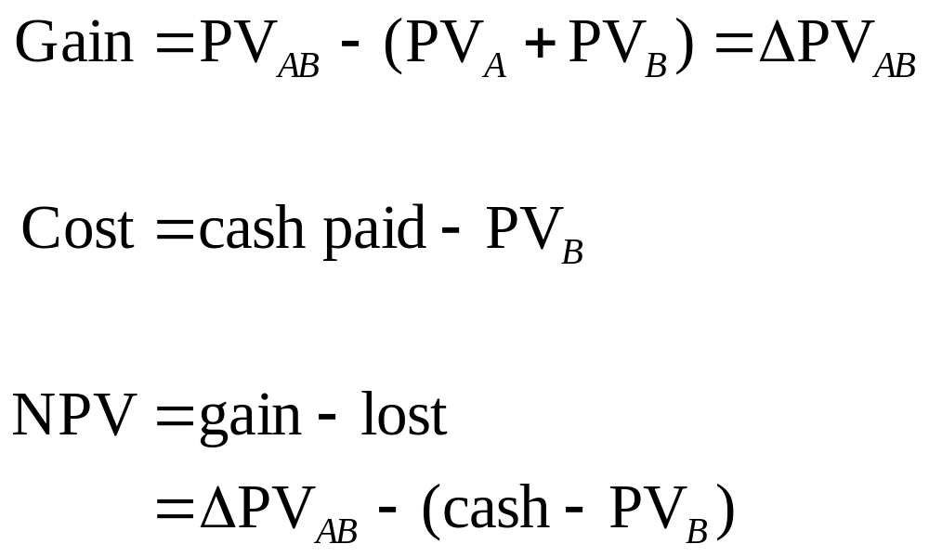
Estimating Merger Gains and Costs
Notes:
Economic gain is equal to the present value of new cash flows from synergies discounted at the cost of capital of the combined firm.
Gain = PV_{AB} – (PV_{A} + PV_{B})
Cost = cash paid – PV_{B}
NPV = gain – cost
NPV = (PV_{AB} – cash paid) – PV_{A}

Slide 20
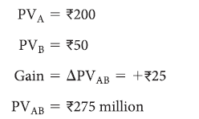

Estimating Merger Gains and Costs
Example
  Two firms merge, creating Rs. 25 million in synergies. If Firm A buys Firm B for Rs. 65 million, cost is Rs. 15 million
Notes:
A numerical example illustrating the calculation of gain and cost of merger is shown.
PV_{A} = Rs.200; PV_{B} = Rs.50
Gain = +Rs.25; PV_{AB} = Rs.275
Cost = 65 – 50 = Rs.15 million

Slide 21

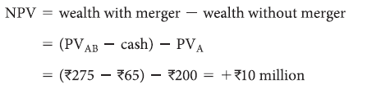
Estimating Merger Gains and Costs
Example
  NPV to Firm A will be difference between gain and cost
Notes:
NPV = gain – cost;
NPV_{A} = 25 – 15 = +Rs.10;
NPV = (PV_{AB} – cash paid) – PV_{A}
NPV = (275 – 65) – 200 = +Rs.10 million

Slide 22
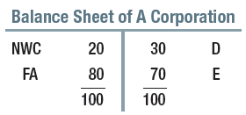
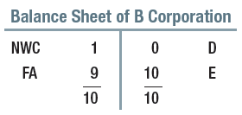
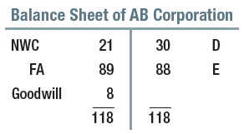
Accounting for Merger of A Corporation and B Corporation
Assume A Corporation pays Rs. 18 million for B Corporation
Notes:
This is the purchase method of accounting for mergers. Here, “goodwill” account is created to account for the price paid for merger. The value of equity has also increased to 88. Goodwill is Rs.8 million.

Slide 23
Proxy Fights, Takeovers, Market for Corporate Control
Tools Used to Acquire Companies
Proxy Contest
Tender Offer
Acquisition
Merger
Leveraged Buy-Out
Management Buy-Out
Notes:
Proxy contest: Attempt to gain control of a firm by soliciting a sufficient number of stockholder votes to replace the existing management.
Acquisition: Occurs when one corporation buys the stock or assets of another corporation
Leveraged buyout: Where an acquiring company’s capital structure is substantially higher debt than equity.
Management buyout: Occurs when managers of a firm form a new corporation and, with funds provided by a lender, acquire the firm.
Merger: When two or more corporations combine to form one corporation.
Tender offer: A publicly announced offer by the buyer to acquire shares of a single class of stock at a specified price.

Slide 24
Summary of Takeover Defenses
Takeover Defenses
  White Knight
    Friendly potential acquirer sought by target company threatened by unwelcome acquirer
  Shark Repellent
    Amendments to company charter made to forestall takeover attempts
  Poison Pill
    Action taken by target firm to prevent acquisition, e.g., right for existing shareholders to buy additional shares at attractive price, should bidder acquire large holding

Slide 25
Leveraged Buyouts
LBOs versus Acquisitions
Large fraction of purchase price is debt financed
LBO goes private, no longer traded on open market

Slide 26
Leveraged Buyouts
Three Characteristics of LBOs
High debt
Incentives
Private ownership

Slide 27
Fusion and Fission in Corporate Finance
Spin-off
Debut independent company created by detaching part of parent company's assets and operations
Carve-outs
Spin-off with shares in new company not given to existing shareholders, but sold in public offering
Privatization
Sale of government-owned company to private investors
Notes:
The main difference between spin-offs and carve-outs is that the shares in the new company are given to existing shareholders in spin-offs and sold to public through a public offering in the case of carve-outs. Privatization is the sale of a government-owned company to private investors.

Slide 28
Fusion and Fission in Corporate Finance
Motives for privatization
Increased efficiency
Shared ownership
Revenue for government

Slide 29
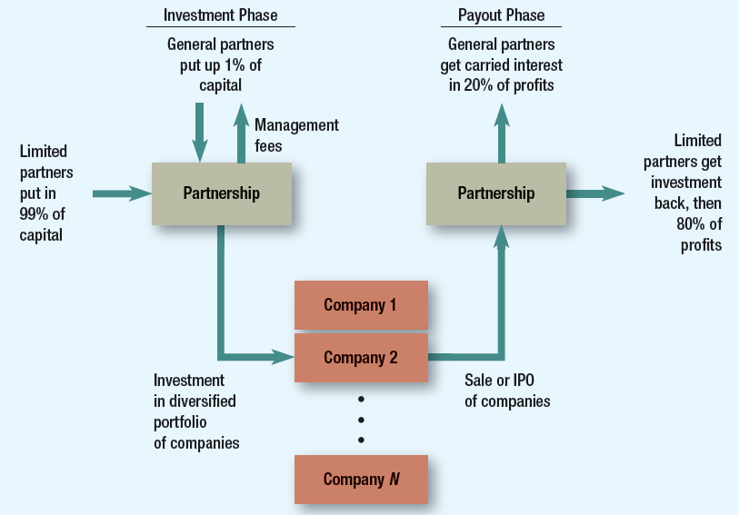
Private Equity Partnership
Notes:
This diagram shows the organization of a typical private-equity partnership. The limited partners who have invested almost all the money get first chance at the proceeds from the sale or IPOs of the portfolio companies. Once their investment is returned, they get 80% of any profits. The general partners who organize and manage the partnership get the remaining 20%.

