Slide 1
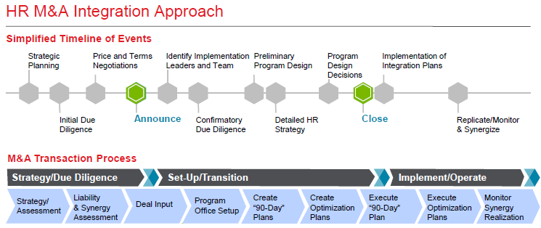

Slide 2
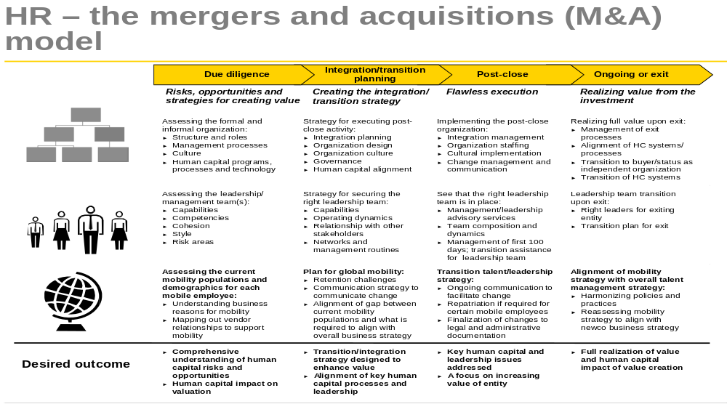

Slide 3
M&A Phases
Pre-combination
Step 1: Pre-Deal
Step 2: Due Diligence
Step 3: Integration Planning
Step 4: Implementation
Step 5: Post-Deal
HR is on the M/A Deal Team
Each step is a new level of commitment towards the deal and requires more information and analyses
  Pre-Deal: Identify the strategy driving the M/A, locate and select targets, determine potential business opportunity, define critical success factors, and notify target of intent
  HR’s role: educate team on HR implications, conduct high-level analysis of people, org, & culture fit based on available information, identify people-related issues, plan for due diligence
  Due Diligence: collect and analyze information from the target, assess leadership team, summarize findings, issues, and risks, and make go/no go decision
  HR’s role: collect and analyze HR related information, identify issues, risks, costs, savings
  Integration Planning: set deal terms, use information previously collected to create plans to combine companies with minimal business interruptions, close the deal
  HR’s role: secure key talent from target, collect more information where necessary, create integration team for HR, create HR integration plans (e.g., culture, organization, people, HR processes, HR systems and policies)
Notes:
Notes:
Steps 1, 2 and 3 are intertwined and can happen simultaneously. Degree of intertwining depends on the nature of the deal (size, speed). The steps are not linear
Different people are often involved in the pre-deal and due diligence phases so it is better to keep them separate.

Slide 4
M&A Phases
Combination
Step 1: Pre-Deal
Step 2: Due Diligence
Step 3: Integration Planning
Step 4: Implementation
Step 5: Post-Deal
HR has it’s own implementation team(s)
Acquiring and the target company “combine”
HR’s role
  Announce deal and start ongoing communication to both companies
  Execute HR Integration Plans & adapt as necessary
  Provide ongoing change management for both companies (e.g., management ability to deal with people issues, training, motivation, systems integration, job security/career concerns, realistic merger preview, Ethics & Compliance standards)
  Monitor people-related integration activities
  Encourage capture of synergies (e.g., use incentives) and areas of desired lack of synergy

Slide 5
M&A Phases
Post-Combination
Step 1: Pre-Deal
Step 2: Due Diligence
Step 3: Integration Planning
Step 4: Implementation
Step 5: Post-Deal
HR is a member of the Deal Evaluation Team
Deal Team evaluates the successful capture of synergies and achievement of original strategy
HR’s role
  Capture lessons learned from the management of the project
  Evaluate organization, people, processes, systems (e.g., 24th month audit)
  Suggest process improvements
  Align with Business Strategy of the Future
  Learn from this deal to be ready for the next deal
  Ongoing involvement in integration of culture

Slide 6
Sample Tools
Defining the End State
high
Absorption
Acquired company conforms to acquirer
Transformation
Both companies find new ways to operate
Degree of Change in Acquired Company
Best of Both
Additive from both sides
Preservation
Acquired company remains independent
Reverse Merger
Unusual case of acquired firm leadership
low
low
high
Degree of Change in Acquiring Company
*Mitchell Marks, Joining Forces
Notes:
Use in pre-combination to get both sides on the same page. Go function by function – the entire deal doesn’t need to (and usually doesn’t) end up in the same place. This is particularly important for the buyer to understand what they really want before the deal. Once decisions are made, can better identify people and organizational risks, issues, costs, savings, etc.

Slide 7
Sample Tools
What to Look for in Due Diligence
What to get
  Census info
  Benefits plans (e.g., Defined contribution, Defined benefit, Health & Wellness benefits, Disability)
  Compensation plans (including exec plans, stock, severance)
  Employment agreements
  Union Contracts
  Org Structure (e.g., org design, headcount, mgmt layers, centralized/decentralized, staff/line ratios)
  HR Compliance risks
  Pending employment lawsuits
  Turnover
  Open requisitions
  HR technology systems
  HR contracts/vendor obligations
  HR Policies
  Leadership/Mgmt practices
  Values
What to look for
  Assets
  Liabilities and expenses
  Potential cost savings
  Potential synergies
  Substantiation of financial records
  Organization fit
  Cultural norms and values
  Technology
  HR capabilities
  HR fit
  Depth of management talent
  Talent Retention
  Motives and mindset of management team
  Labor relations issues
  Integration risk
  Fit with business case and integration strategy
Examples of how to get it in a friendly deal:
  Employee attitude surveys
  Performance reviews
  Succession plans
  HR metrics & systems (e.g., HRIS, Diversity, Staffing)
  Company communications
  Policy manuals and employee handbooks
  Organization Charts
Examples of how to get it in an unfriendly deal:
  Published reports and news stories
  Exes or employees who have left
  Customers and suppliers
  Researchers, recruiters, retirees and other 3rd parties
*Based on the work of Mitchell Marks, Joining Forces

Slide 8
Sample Tools
HR Due Diligence Update
A PowerPoint Template Including:
  What do we know?
  What do we assume?
  What are the implications to the strategy?
  What are the implications to structure?
  What is a potential organization design?

Slide 9
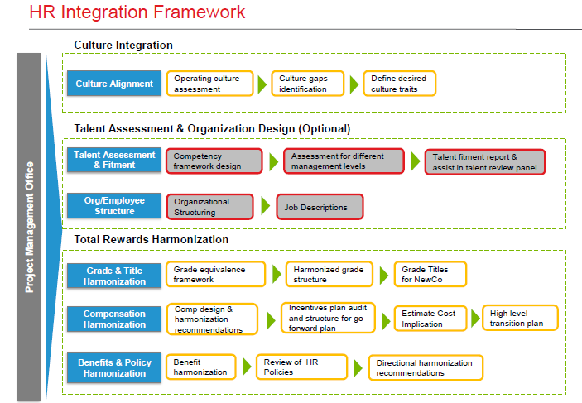

Slide 10
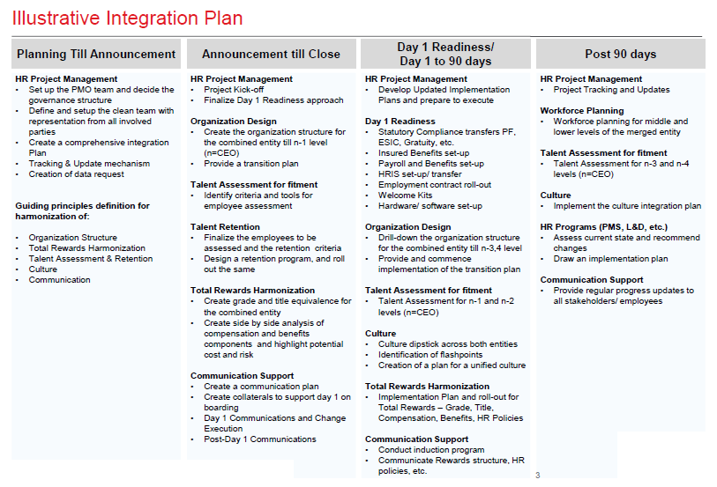

Slide 11
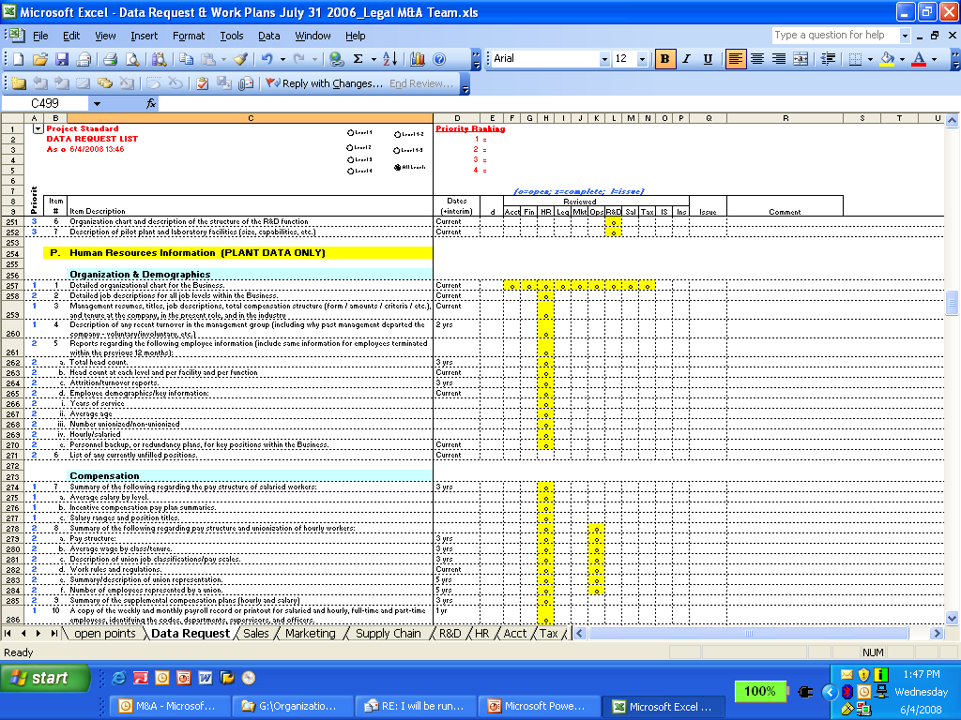
Sample Tools
HR Due Diligence Information Request
Notes:
The key is coordination of resources
TO DO: identify “required vs. nice-to-have”, work with the M&A team on their process, identify who is responsible in HR, column for “when you need it”, add columns for “requested”, “received” and “reviewed by”, add tabs for “salaried” and “hourly”

Slide 12
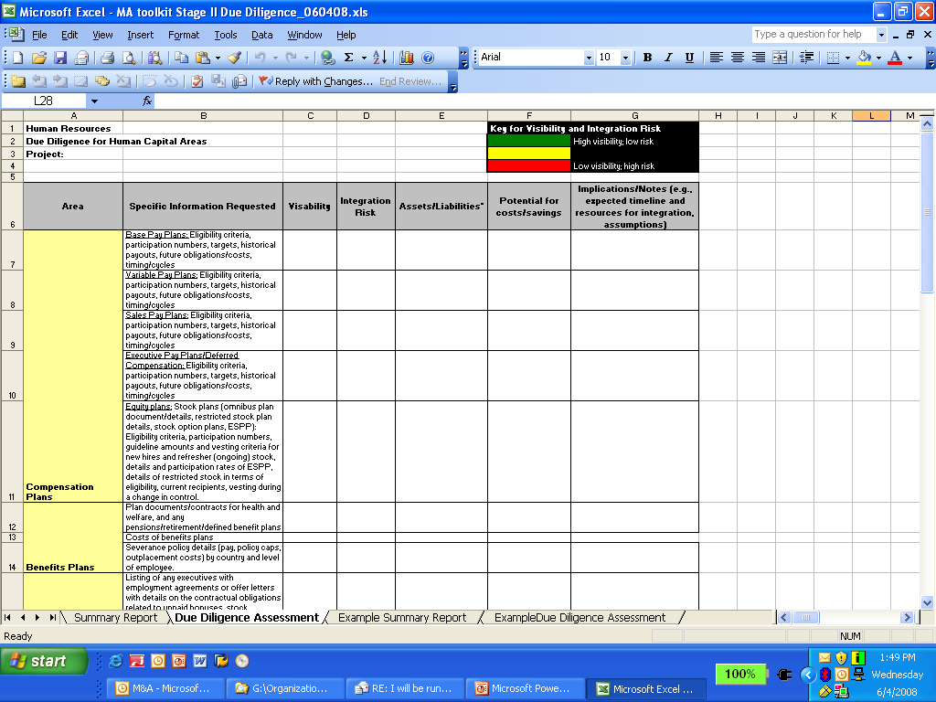
Sample Tools
HR Due Diligence Assessment
Notes:
NOTE: would need to clarify what we’re looking for in the Assets/Liabilities column and identify that it is a joint accountability with the cost accountant for HR

Slide 13
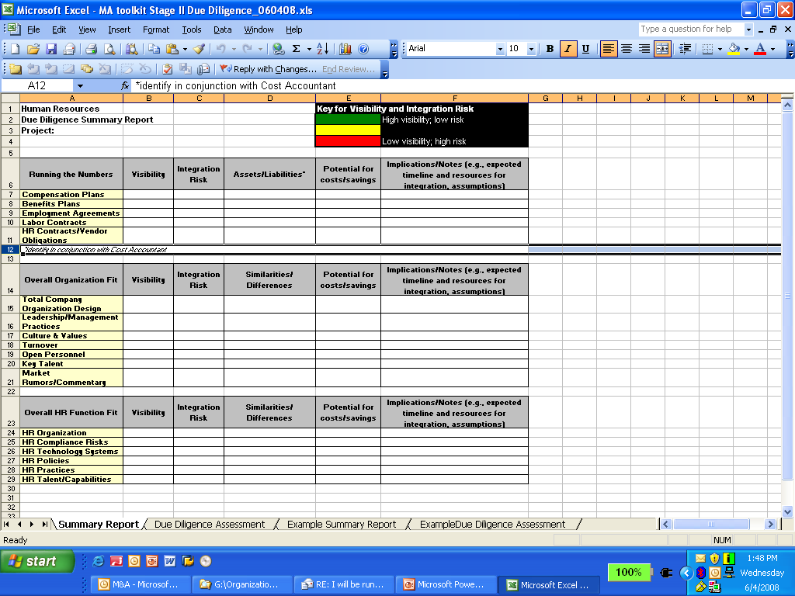
Sample Tools
HR Due Diligence Summary Report

Slide 14
