Slide 1
Change Leadership
Advanced Leadership and Change Management
Sunday, May 4, 2025
Faculty: Prof. Anupama Sharma, IIM-V

Slide 2
Formal approaches/models to organizational change

Slide 3
Kotter Model

Slide 4
1. Not Establishing a Sense of Urgency
Why Transformation Efforts Fail (John P. Kotter, HBR)
Examining market and competitive realities
Identifying and discussing crises, or major opportunities
Notes:
50 % of companies fail in phase 1
Insufficient time spent in this phase
Not enough leaders, too many managers
If there is insufficient urgency, the transformation process cannot success
How do we evaluate when the urgency is high enough
When 75 percent of management is convinced that business as usual is totally unacceptable.

Slide 5
2. Not Creating a Powerful Guiding Coalition
Assembling a group with enough power to lead
Encouraging the group to work as a team
Notes:
Establishment of a powerful guiding team
senior management
people with expertise
reputations
strong networking capabilities
operates outside normal hierarchy
Size:
3 to 5 people during first year
emphasis on the use of retreats
Why this phase fails
underestimate the importance of a coalition
Key line managers not in charge
Overwhelmed by opposition

Slide 6
3. Lacking a Vision
Creating a vision to direct the change effort
Developing strategies for achieving vision
5-minute vision
Notes:
Purpose of Vision
Provide direction
Reason for failure in this stage
After vision is created, an operational plan for achieving vision is required
Creation of a Transformation Vision
Easy to communicate and appeals to employees, and target group
Clarifies direction that the organization will take
Should include new growth possibilities
Needs to be a clear compelling statement, rule of thumb, if it doesn’t initiate interest in 5 minutes or less, work isn’t finished

Slide 7
4. Undercommunicating the Vision
Relentless communication of new vision and strategies
Teaching new behaviors by the example of the guiding coalition
Notes:
Promotion of the vision with in the organization is crucial.
Although speeches, newsletters and endorsements are important, the emphasis in definitely on people “walking the talk” -actions speak louder than words.
Management need to:
tie vision into every day operations
ensure that management related training, courses also tie into new initiative.
Success at this stage is indicated by the increasingly larger numbers of people what become involved in the initiative

Slide 8
5.Not Removing Obstacles to New Vision
Getting rid of obstacles to change
Changing systems or structures that undermine vision
Encouraging risk taking, nontraditional ideas, activities and actions
Notes:
This phase focuses on the elimination or removal of obstacles
Obstacles:
people who refuse to change
organizational structure
Emphasis is on rewarding and recognizing behavior which supports the new vision

Slide 9
6. Not Planning and Creating Short-Term Wins
Planning for performance improvements
Creating improvements
Recognizing and Rewarding
Notes:
Planning process needs to include identifying short term wins
Purpose: keeps the urgency levels up
Reduce people becoming discouraged (1-2 years)
Strategy in this phase
find clear performance improvements
establish and achieve goals and objectives
reward people
Caution: short term wins, don’t declare victory too soon.

Slide 10
7. Declaring Victory Too Soon
Using credibility to change systems, structures and policies that stand in way
Hiring, promoting, developing employees to implement change
Reinvigorating with new projects, themes and change agents
Notes:
Strategy:
Don’t declare victory, but do reward
Use opportunity to tactile even bigger issues, systems or obstinacies
Attention should be paid to hiring, development and promotion of staff

Slide 11
8. Not Anchoring Changes into Organization’s Culture
Articulating connections between new behaviors and success
Developing means to ensure leadership development and succession
Notes:
Action:
Need to continually promote and inform staff of the new changes
Choice of new staff, senior management is critical
Tying requirements for promotion into the vision

Slide 12
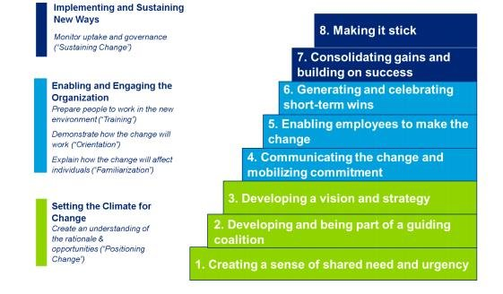
Leading Change by John P Kotter (8 Step Model)

Slide 13
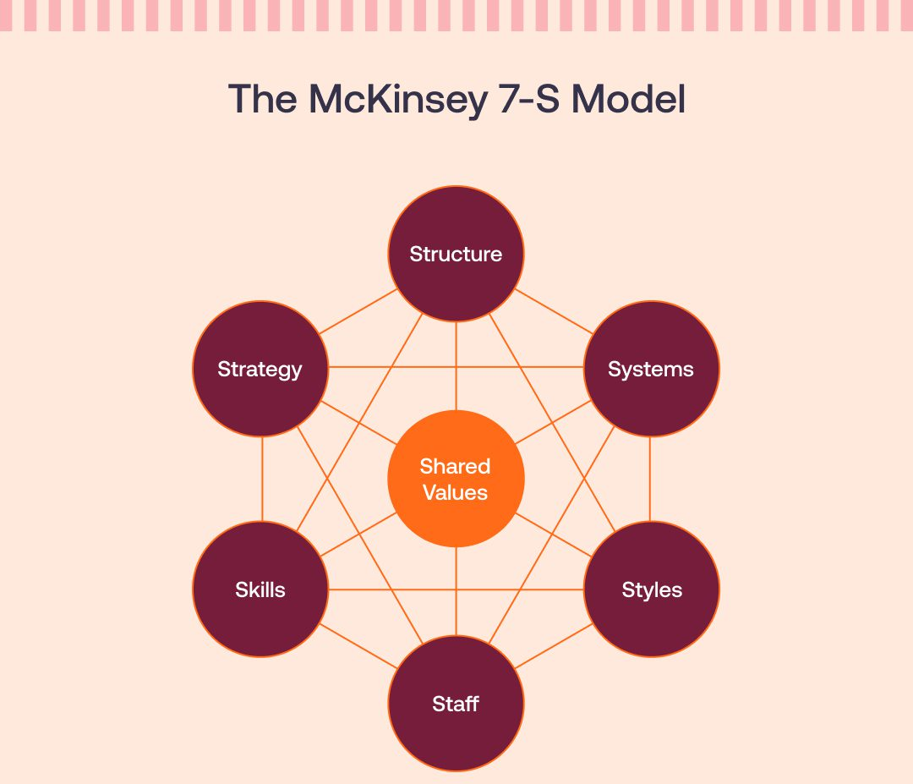
The McKinsey 7-S model
The McKinsey 7-S model is perfect for when you know there is something wrong within the organization, but you’re not sure how to address the issue. Once you have identified what changes need to be made, the seven elements serve as a guide to keep your company in balance.

Slide 14
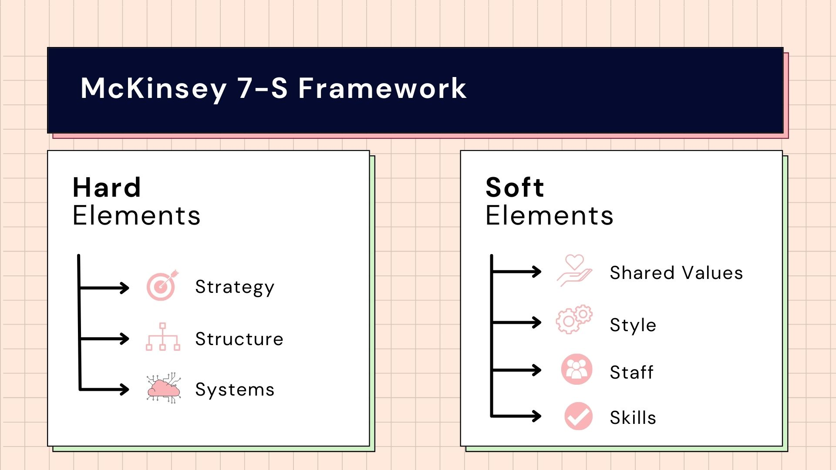
The McKinsey 7-S model

Slide 15
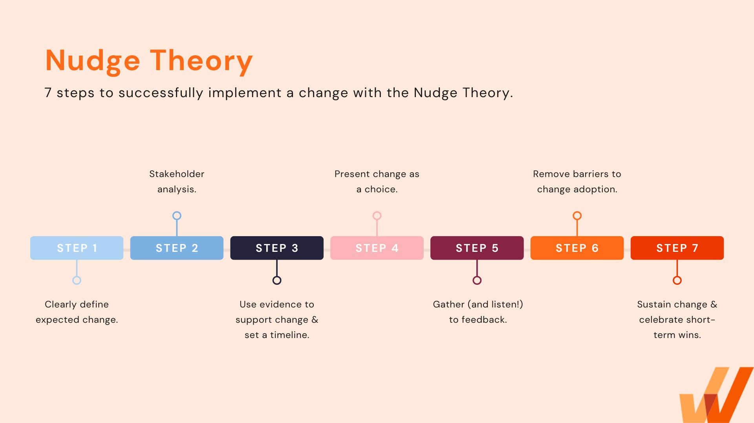
Nudge Theory

Slide 16
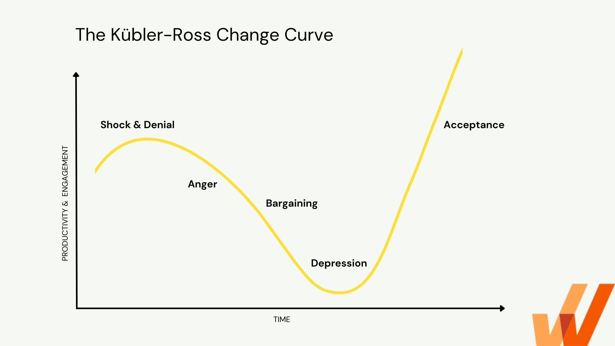
Kübler-Ross Change Curve

Slide 17
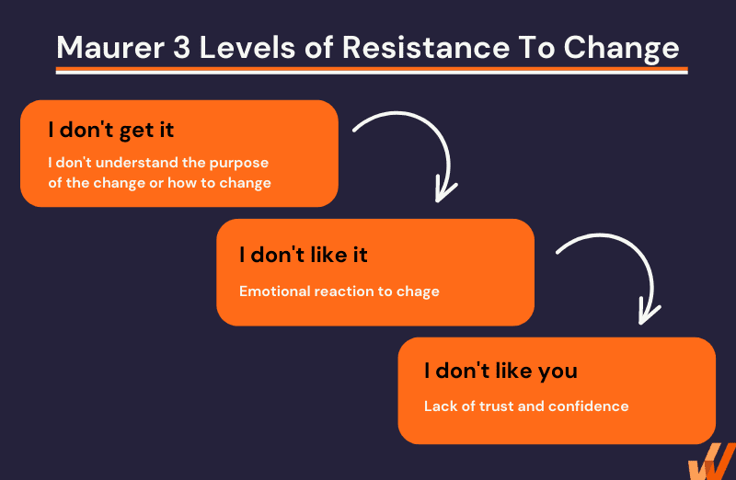
Maurer 3 Levels of Resistance and Change Model

Slide 18
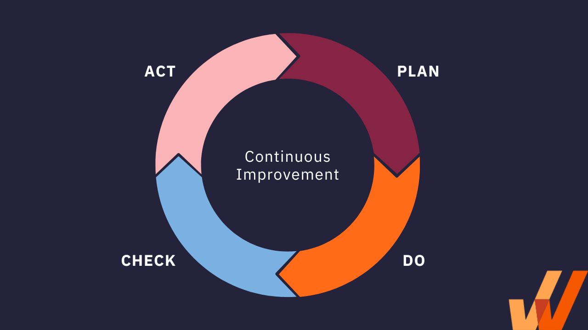
Deming Cycle (PDCA)

Slide 19
Action Research Approach
Meaningful change combines action orientation (changing attitudes/behavior) and research orientation (testing theory).
Action orientation.
  Diagnose, conduct interventions to achieve change.
Research orientation.
  Data-driven, problem-oriented approach.
  Use data to diagnose problems, evaluate change success.
Open systems view.
  Organization has many interdependent parts.
  Need to be aware of intended and unintended consequences of interventions
Highly participative process.
  Change requires employee knowledge and commitment.
  Employees are co-researchers and participants.
Notes:
Meaningful change combines action orientation (changing attitudes/behavior) and research orientation (testing theory).
Action orientation:
Diagnose current problems.
Apply interventions that resolve those problems.
Research orientation:
Research study approach.
Data-driven, problem-oriented process.
Collect data to diagnose problems.
Data helps to systematically evaluate how well the intervention works.
Action research adopts an open systems view.
Organizations have many interdependent parts.
Change agents need to anticipate intended and unintended consequences of interventions.
Action research is a highly participative process.
Change requires employee knowledge and commitment.
Employees are co-researchers and participants.

Slide 20
Action Research Process
Form client-consultant relationship.
Diagnose need for change.
Introduce intervention.
Evaluate and stabilize change.
Disengage consultant’s services.
Notes:
1. Form client-consultant relationship.
Assumes change agent originates outside the system.
Client readiness — client’s motivation, open to meaningful change, possess abilities to complete change process.
2. Diagnose need for change.
Organizational diagnosis — gathering and analyzing data about an ongoing system (e.g., interviews and surveys).
Includes employee involvement — agree on change methods, schedule, expected standards of successful change.
3. Introduce intervention.
Applies one or more actions (e.g., managing conflict, team building, changing corporate culture)
Incremental change vs. rapid change — small steps or massive overhaul.
4. Evaluate and stabilize change.
Evaluating intervention effectiveness against the standards established in the diagnostic stage.
Problems — outcomes aren’t apparent for a long time or might be difficult to separate effects from other factors.
Refreeze conditions to stabilize change.
5. Disengage consultant’s services.

Slide 21
Action Research Process
Establish
Client-
Consultant
Relations
Diagnose
Need for
Change
Introduce
Change
Evaluate/
Stabilize
change
Disengage
Consultant’s
Services

Slide 22
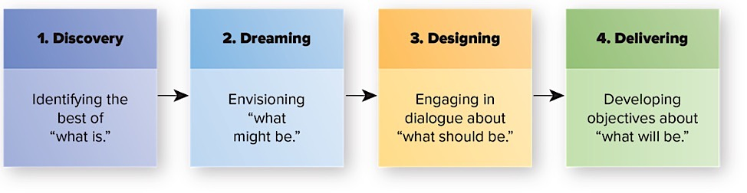
Four-D Model of Appreciative Inquiry
The Four-D Model of Appreciative Inquiry.
Notes:
1. Discovery.
Discovering positive elements of the observed event/organization (e.g., documenting positive customer experience).
2. Dreaming.
Envisioning what might be possible in an ideal organization.
Participants feel safer revealing their hopes and aspirations then discussing their own organization or predicament.
3. Designing.
Dialogue in which participants listen with receptivity to each other’s models and assumptions — create a common image of what should be.
4. Delivering.
Participants establish specific objectives and direction for their own organization based on their “should be” model.
Appreciative inquiry effectiveness — Several successful change stories from this approach, but not always successful.
Participants need to avoid problem-oriented mindset (blame game).
Not yet clear what conditions are best for appreciative inquiry (i.e. contingencies not yet known).

Slide 23
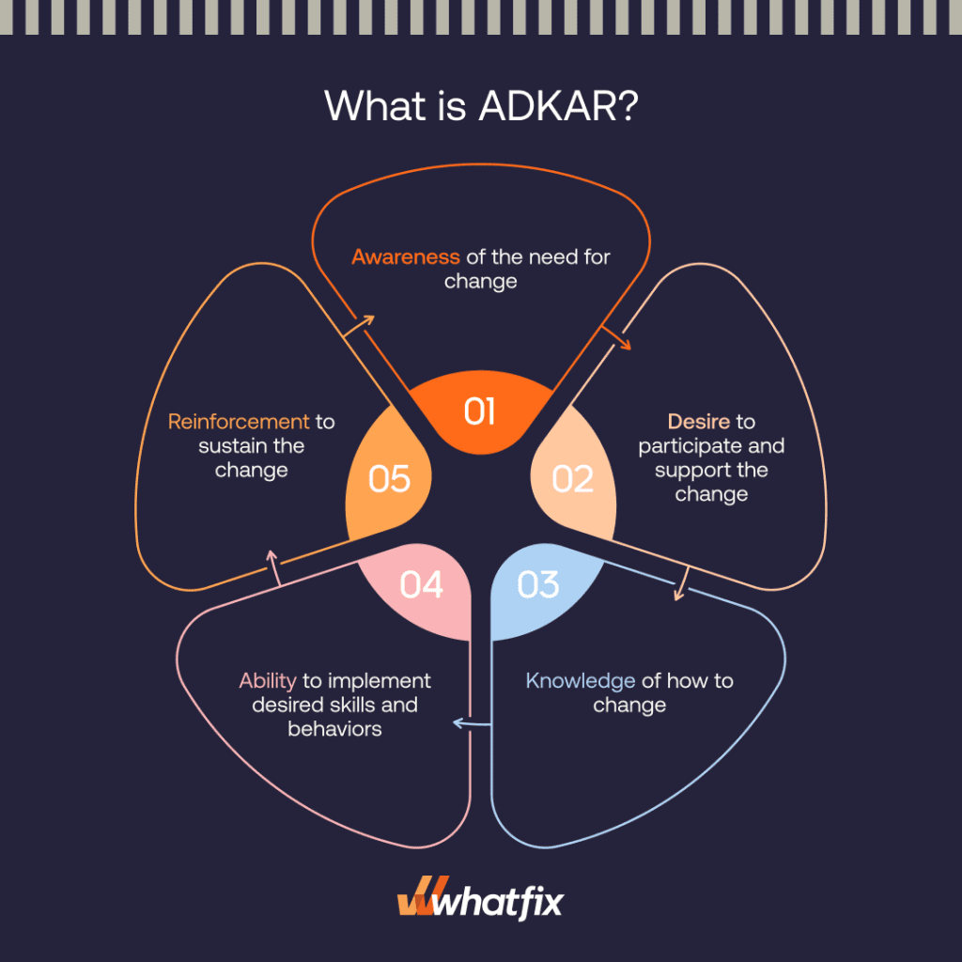
ADKAR Model
ADKAR stands for Awareness, Desire, Knowledge, Ability, and Reinforce-ment.

Slide 24
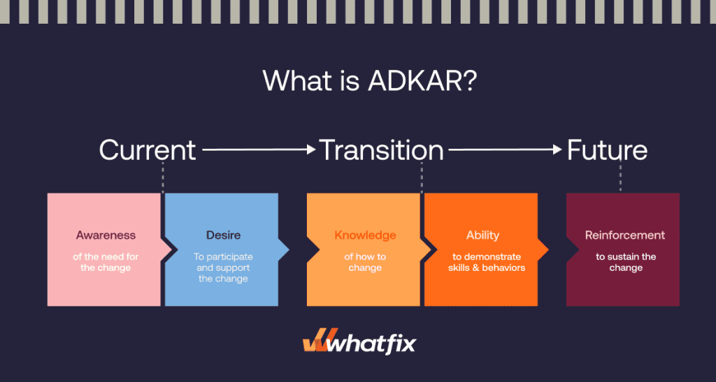
ADKAR Model

Slide 25
Organizations Are about People
“Take away my people, but leave my factories, and soon grass will grow on the factory floors. Take away my factories, but leave my people, and soon we will have a new and better factory.”
Andrew Carnegie (1835-1919)

Slide 26
Thank You

