Slide 1
Change Leadership
Advanced Leadership and Change Management
Sunday, June 23, 2024
Faculty: Prof. Anupama Sharma, IIM-V

Slide 2
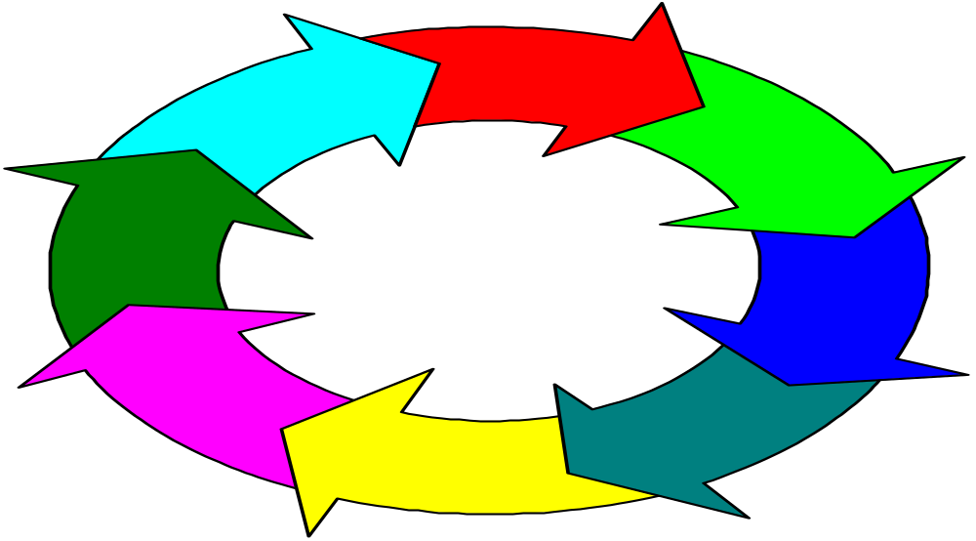
Change Process
Resistance to Change
Notes:
Lesson 1
Change process is a series of phases
Each phase takes time
Important that each phase occur
Lesson 2
Mistakes in any single phase can negatively impact on gains made in earlier phases

Slide 3

External Forces for Change
Computer technology
  law of telecosm
  effect on knowledge, competition, employment relations
Globalization and local competition
  effect on restructuring, outsourcing
  mergers
Demography
  diversity
  emerging expectations
© Corel Corp. With permission.

Slide 4
Internal Forces For Change
Turnover of leaders
Need for profits
_______________
_________________
________________

Slide 5
Driving and Restraining Forces
Driving forces:
  Push organizations toward change.
  External forces or leader’s vision.
Restraining forces:
  Resistance to change.
  Employee behaviors that block the change process.
  Try to maintain status quo.
Notes:
Organizations operate as open systems that need to keep pace with ongoing changes in their external environment.
Force Field Model — Highly respected model of change developed by social psychologist Kurt Lewin.
Driving forces:
Push organizations toward change.
Includes external forces (e.g., new competitors, technologies).
Leader’s vision inspires employees to strive for higher standards.
Restraining forces:
Resistance to change – block the change process.
Try to maintain the status quo.

Slide 6
Force Field Analysis
Driving forces
Resisting forces
High performance goals
Group norms for output
New equipment
Familiarity with
present equipment
Competition
Complacency
Employees with
new skills
Need to learn new skills
Desire for increased
influence and rewards
Fear of reduced
influence and rewards
Current level
of group
performance
Desired level
of group
performance
Source: Adapted from Zand, D.E. Force field analysis. In N. Nicholson (ed.), Blackwell Encyclopedic
Dictionary of Organizational Behavior. Oxford, England: Blackwell, 1995, 181.

Slide 7
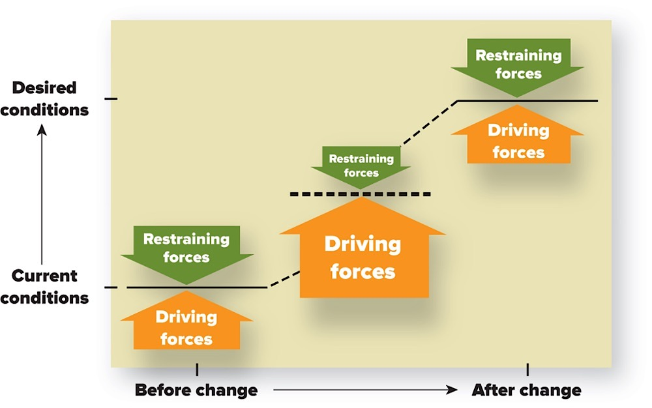
Force Field Analysis Model
Lewin’s Force Field Analysis Model.
Notes:
Effective change occurs by unfreezing the current situation, moving to a desired condition, and then refreezing the system so it remains in the desired state.
Unfreezing:
Producing disequilibrium between the driving and restraining forces.
Stability:
When driving and restraining forces are roughly in equilibrium (i.e. approximately equal strength in opposite directions).
Refreezing:
Introducing systems and conditions that reinforce and maintain the desired behaviors.
Support and reinforce the new role patterns and prevent the organization from slipping back into the old ways.

Slide 8
Sources of Resistance to Change
Individual Resistance
* Perception
* Personality
* Habit
* Threats to power
and influence
* Fear of the unknown
* Economic reasons
Organizational Resistance
* Organization design
* Organizational culture
* Resource limitations
* Fixed investments
* Interorganizational
agreements
Resistance to Change

Slide 9
Resistance to Change
Direct Costs
Saving Face
Fear of the Unknown
Breaking Routines
Incongruent Systems
Incongruent Team Dynamics
Forces for
Change

Slide 10
Understanding Resistance to Change
Many forms of resistance.
  Complaints, absenteeism, passive noncompliance.
  Subtle resistance more common than overt.
View resistance as task conflict.
  Signals that employee lack readiness for change or that change strategy should be revised.
View resistance as a form of voice.
  Redirect resistance into constructive conversations.
  Encourages better decisions through involvement.
  Voice and involvement increase commitment to change.
Notes:
Many forms of resistance – complaints, overt work stoppages, passive noncompliance.
Subtle resistance is much more common than overt resistance — more difficult to address because not as obvious.
Change agents tend to view resistance as relationship conflict — i.e., they focus on the people as the problem.
Effective change agents view resistance as task conflict and a form of voice.
Resistance as task conflict:
Resistance signals that (a) employees are sufficiently ready for change or (b) the change strategy should be revised.
Lack urgency to change, lack acceptance of the specific change initiative.
Lack confidence to change, believe change will make them worse off.
Resistance as a form of voice:
Redirect resistance into constructive conversations.
May improve procedural justice and serve as a motivational force.
Encourages better decisions through employee involvement — may increase employee motivation and commitment to the change.

Slide 11
Why People Resist Change 1
1. Negative valence of change.
  Negative more than positive outcomes.
2. Fear of the unknown.
  People assume worst.
  Perceive lack of control.
3. Not-invented-here-syndrome.
  Staff oppose change in their area introduced by others.
  To protect self-esteem.
Notes:
1. Negative valence of change:
Cost-benefit analysis has a negative valence — employees imperfectly apply the rational choice decision model (same as expectancy theory model).
Resistance when more negative than positive outcomes expected.
Employees consider organizational outcomes, not just personal outcomes.
2. Fear of the unknown — uncertainty has two negative effects on change perceptions:
People assume the worst (i.e., assume negative rather than positive valence of outcomes).
People perceive lack of control — also has negative valence.
3. Not-invented-here-syndrome:
Staff oppose the change to prove their ideas were better.
Most common among employees who are usually responsible for that expertise or initiative.
Successful change initiated by others threatens employee self-esteem.

Slide 12
Why People Resist Change 2
Breaking routines.
  Changing routines/habits is uncomfortable and requires time/effort to learn new behaviors.
Incongruent team dynamics.
  Team norms conflict with desired change.
Incongruent organizational systems.
  Systems/structures reinforce status quo.
  Pull employees back to old ways.
Notes:
4. Breaking routines:
People are creatures of habit — they resist changes to routines and habits.
Requires time/effort to learn new routines and role patterns.
5. Incongruent team dynamics:
Existing team norms contrary to the desired change.
6. Incongruent organizational systems:
Old systems/structures reinforce status quo — revert to past attitudes and behavior.
Include rewards, information systems, patterns of authority, career paths, selection criteria.

Slide 13
Employee Readiness for Change
Perceived Personal Risk from Change
Low
High
High
High readiness
for change
Moderate to
indeterminant
readiness for change
Level of Dissatisfaction
with the Current
Situation
Moderate to
indeterminant
readiness for change
Low readiness
for change
Low
Source: Adapted from Zeira, Y., and Avedisian, J. Organizational planned change: Assessing the
chances for success. Organizational Dynamics, Spring 1989, 37.

Slide 14
A Systems Model of Change
People
Culture
Task
Technology
Design
Strategy

Slide 15
Unfreezing, Changing, Refreezing
Force field model: unfreeze the current situation, move to a desired condition, refreeze the system so it remains in this desired state.
Three strategies for unfreezing:
  Increase driving forces.
  Weaken/remove restraining forces.
  Increase driving forces AND reduce restraining forces (preferred strategy).
Notes:
Force Field Model — effective change occurs by unfreezing the current situation, moving to a desired condition, and then refreezing the system so it remains in this desired state.
Unfreezing — driving forces are stronger than restraining forces (disequilibrium).
a) Increase driving forces (e.g. describe external forces, management issues threats).
Strategy rarely works alone because employees respond with increase in restraining forces.
b) Weaken/remove restraining forces.
Strategy rarely works alone — facilitates but doesn’t motivate change.
c) Increase driving forces AND reduce/remove restraining forces (preferred strategy).

Slide 16
Creating an Urgency for Change
Inform employees about driving forces.
Customer-driven change:
  Reveals problems and consequences of inaction.
  Human element energizes.
Create urgency without external drivers.
  Requires persuasive influence.
  Positive vision rather than threats.
Notes:
Inform employees about driving forces — competitors, changing consumer trends, changing government regulations — most difficult to change when organization is doing well.
Customer-driven change:
Reveals problems and consequences of inaction — dissatisfied customers describe why company’s products are inferior.
Human element energizes employees to change behaviors.
Create urgency for change without external drivers.
Requires persuasive influence — employees visualize future competitive threats and environmental shifts.
Use positive vision of future (makes current situation less appealing) rather than threats.

Slide 17
Reducing the Restraining Forces 1
1. Communication.
  Highest priority, first strategy.
  Generates urgency to change.
  Reduces uncertainty.
  Problems: takes time, costly.
2. Learning.
  Provides new knowledge/skills.
  Strengthens self-efficacy, more commitment to change.
  Problems: potentially time consuming and costly.
Notes:
1. Communication.
Highest priority and first strategy for change.
Generates an urgency to change.
Reduces uncertainty (fear of unknown).
Problems — time-consuming and potentially costly.
2. Learning.
Provides new knowledge/skills to perform well in new situation.
Strengthens change self-efficacy, more confident means more commitment to change.
Problems — time-consuming and potentially costly.

Slide 18
Reducing the Restraining Forces 2
3. Involvement: employees involved in the process.
  More personal responsibility/ownership.
  Minimizes not-invented-here syndrome.
  Reduces fear of unknown.
  Better decisions about the change initiative.
  Problems: time-consuming, potential conflict.
4. Stress management: help staff cope with change.
  Removes some negative valence of change.
  Less fear of unknown.
  Less wasted energy.
  Problems: time-consuming, costly, doesn’t help everyone.
Notes:
3. Employee involvement.
Employees participate in change process – often essential.
More personal responsibility/ownership — increases commitment to change.
Minimizes not-invented-here syndrome — participants in the change idea.
Reduces fear of unknown.
Better decisions about the change initiative.
Problems – time-consuming, potential conflict.
4. Stress Management.
When communication, learning, and involvement are not enough to minimize stress — to help employees cope with change.
Removes some negative valence of change.
Less fear of unknown.
Less wasted energy, so more motivation to support the change process.
Problems — time-consuming, expensive, doesn’t help everyone.

Slide 19
Reducing the Restraining Forces 3
5. Negotiation.
  Influence by negotiation reduces direct costs.
  For those who clearly lose (negative valence from change).
  Problems: expensive, gains compliance not commitment.
6. Coercion.
  When other strategies fail.
  Assertive influence.
  Dismissals remove outdated mental models, routines.
  Problems: reduces trust, may create subtle resistance, organizational politics.
Notes:
5. Negotiation.
Applies negotiation as the main influence tactic to gain employee compliance with change.
May be necessary for those who clearly lose out from the change people (negative valence outcomes) and won’t otherwise support change.
Problems – expensive; gains compliance, not commitment.
6. Coercion.
Necessary when all other strategies fail.
Assertive influence tactics — persistently reminders, frequent monitoring.
Executive dismissals — remove outdated mental models and routines.
Problems – reduces trust, may create subtle resistance, more politics to protect their own job security.

Slide 20
Refreezing the Desired Conditions
Systems and structures hold (refreeze) changes.
Examples:
  Alter rewards to reinforce new behaviors.
  Change career paths.
  Revise information systems.
Notes:
Systems and structures hold (refreeze) the desired changes — otherwise tend to revert to past behaviors.
Refreezing realigns systems, structures, team dynamics to support the desired change.
Alter rewards to reinforce new behaviors.
Change career paths.
Revise information systems — feedback mechanisms relate to desired objectives – “what gets measured, gets done.”

Slide 21
Transformational Leadership and Change
Transformational leaders are change agents.
  Champion vision of desired future.
  Communicate the vision meaningfully.
  Act consistently with the vision.
  Encourage employee experimentation.
Strategic vision and change.
  Provides a sense of direction.
  Identifies critical success factors to evaluate change.
  Links employee values to the change.
  Minimizes employee fear of the unknown.
  Clarifies role perceptions.
Notes:
Transformational leaders are change agents.
Champion vision of desired future.
Communicate the vision meaningfully.
Act consistently with the vision.
Encourage employee experimentation.
Strategic vision and change:
Provides a sense of direction.
Identifies critical success factors to evaluate change.
Emotional foundation for change — links employee values to the change.
Minimizes employee fear of the unknown — provides an image of the future.
Clarifies role perceptions — better understanding of what employees need to learn.

Slide 22
Coalitions, Social Networks and Viral Change
Guiding coalition.
  Strong commitment to change.
  Diagonal representation.
  Informal influence leaders.
Social networks and viral change.
  Word-of-mouth, viral marketing.
  Network members have mutual trust and referent power.
  Network members learn new behaviors through observation.
Notes:
Change agents need a guiding coalition.
Group with strong commitment to the change.
Ideally a diagonal swath across the firm — representing various functions and levels.
Informal influence leaders – respected (referent power).
Social networks and viral change.
People connected to each other through interdependence.
Viral change through principles of word-of-mouth and viral marketing.
Potential for change informally through social networks.
Network members have trust and referent power — more persuasive than communication through formal channels.
Members learn from each other, particularly from influence leaders — behavior observation.

Slide 23
Formal approaches/models to organizational change

Slide 24
Pilot Projects and Diffusion of Change
Rely on pilot projects and diffuse through MARS model.
Motivation.
  Pilot project successful, rewarded.
  Minimize resistance to change.
Ability.
  Employees learn pilot behavior.
Role perceptions.
  Translate pilot to other situations.
Situational factors.
  Provide resources to apply pilot elsewhere.
Notes:
Successful change initiatives usually begin as pilot projects — pilot projects offer greater flexibility, less risk.
Effective diffusion of pilot project applies the MARS model.
Motivation.
Employees see success of pilot project.
Reward people in the pilot project for changing their previous work practices.
Apply practices that minimize resistance to change.
Ability.
Give employees the opportunity to interact with and learn from those in the pilot project.
Disperse employees in the original pilot to other work units as role models and knowledge sources.
Clear role perceptions.
Help employees understand how the practices in a pilot project apply to them (even in completely different areas).
Supportive situational factors.
Provide resources and time necessary to adopt the practices demonstrated in the pilot project.

Slide 25
Action Research Approach
Meaningful change combines action orientation (changing attitudes/behavior) and research orientation (testing theory).
Action orientation.
  Diagnose, conduct interventions to achieve change.
Research orientation.
  Data-driven, problem-oriented approach.
  Use data to diagnose problems, evaluate change success.
Open systems view.
  Organization has many interdependent parts.
  Need to be aware of intended and unintended consequences of interventions
Highly participative process.
  Change requires employee knowledge and commitment.
  Employees are co-researchers and participants.
Notes:
Meaningful change combines action orientation (changing attitudes/behavior) and research orientation (testing theory).
Action orientation:
Diagnose current problems.
Apply interventions that resolve those problems.
Research orientation:
Research study approach.
Data-driven, problem-oriented process.
Collect data to diagnose problems.
Data helps to systematically evaluate how well the intervention works.
Action research adopts an open systems view.
Organizations have many interdependent parts.
Change agents need to anticipate intended and unintended consequences of interventions.
Action research is a highly participative process.
Change requires employee knowledge and commitment.
Employees are co-researchers and participants.

Slide 26
Action Research Process
Form client-consultant relationship.
Diagnose need for change.
Introduce intervention.
Evaluate and stabilize change.
Disengage consultant’s services.
Notes:
1. Form client-consultant relationship.
Assumes change agent originates outside the system.
Client readiness — client’s motivation, open to meaningful change, possess abilities to complete change process.
2. Diagnose need for change.
Organizational diagnosis — gathering and analyzing data about an ongoing system (e.g., interviews and surveys).
Includes employee involvement — agree on change methods, schedule, expected standards of successful change.
3. Introduce intervention.
Applies one or more actions (e.g., managing conflict, team building, changing corporate culture)
Incremental change vs. rapid change — small steps or massive overhaul.
4. Evaluate and stabilize change.
Evaluating intervention effectiveness against the standards established in the diagnostic stage.
Problems — outcomes aren’t apparent for a long time or might be difficult to separate effects from other factors.
Refreeze conditions to stabilize change.
5. Disengage consultant’s services.

Slide 27
Action Research Process
Establish
Client-
Consultant
Relations
Diagnose
Need for
Change
Introduce
Change
Evaluate/
Stabilize
change
Disengage
Consultant’s
Services

Slide 28
Appreciative Inquiry Approach
Frames change around positive and possible future, not problems.
Appreciative Inquiry Principles:
Positive principle: Focus on positive, not problems.
Constructionist principle: Conversations shape reality.
Simultaneity principle: Inquiry and change are simultaneous.
Poetic principle: We choose how situations are perceived (glass half full).
Anticipatory principle: People are motivated by desirable visions.
Notes:
Frames change around positive and possible future, rather than traditional problem/focus.
Build on strengths rather than focus on problems.
Improves dialogue, minimizes tension and negativity among organizational members.
Framing a positive reality has constructive value for future development.
Appreciative Inquiry Principles:
Positive principle — focus on positive events and potential.
Constructionist principle — conversations don’t describe reality, they shape reality.
Simultaneity principle — inquiry and change are simultaneous, not sequential.
Poetic principle — organizations are open books so we can choose how to perceive, frame, and describe them.
Anticipatory principle — people are motivated by desirable visions of the future (i.e. use inspiring and engaging images.)

Slide 29
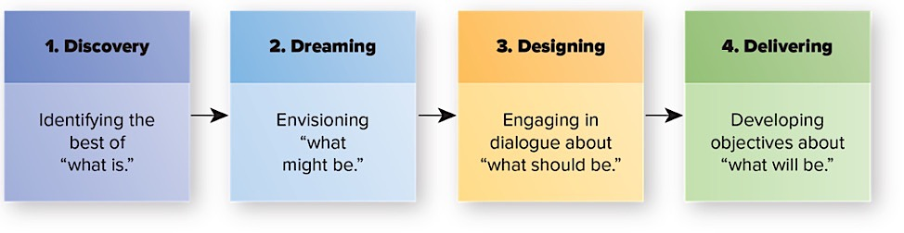
Four-D Model of Appreciative Inquiry
The Four-D Model of Appreciative Inquiry.
Notes:
1. Discovery.
Discovering positive elements of the observed event/organization (e.g., documenting positive customer experience).
2. Dreaming.
Envisioning what might be possible in an ideal organization.
Participants feel safer revealing their hopes and aspirations then discussing their own organization or predicament.
3. Designing.
Dialogue in which participants listen with receptivity to each other’s models and assumptions — create a common image of what should be.
4. Delivering.
Participants establish specific objectives and direction for their own organization based on their “should be” model.
Appreciative inquiry effectiveness — Several successful change stories from this approach, but not always successful.
Participants need to avoid problem-oriented mindset (blame game).
Not yet clear what conditions are best for appreciative inquiry (i.e. contingencies not yet known).

Slide 30
Large Group Interventions
Highly participative events involving employees and other stakeholders.
  Involve the “whole system”.
  Future oriented, usually to create a shared vision.
Limitations of large group interventions:
  Limited opportunity to contribute.
  Risk that a few people will dominate.
  Focus on common ground may hide differences.
  Generates high expectations about ideal future.
Notes:
Highly participative events involving employees and other stakeholders — participants typically discuss their experiences, expectations, and ideas in numerous small groups within the large gathering.
Adopts a “whole systems” view of change.
Views organizations as open systems with interdependent parts.
Highly participative events — need to involve many employees and stakeholders.
Some processes occur over 2-3 days.
Adopts a future-oriented positive focus.
Event’s purpose is usually to create a shared vision — “meaning making” (shared mental model of the future).
Limitations of large group interventions:
Participation limitations due to (a) many people involved and (b) some people tend to dominate.
Focus on common ground may hide differences that interfere with future progress.
Generates high expectations about ideal future.

Slide 31
Parallel Learning Structure Approach
Highly participative social structures.
Members representative across the formal hierarchy.
Applies the action research model of change.
Sufficiently free from firm’s constraints.
Develop change solutions; then applied back into the larger organization.
Notes:
Highly participative social structures .
Members representative across the formal hierarchy.
Applies the action research model to produce meaningful change.
Sufficiently free from firm’s constraints — social structures developed alongside the formal hierarchy.
Develop solutions for organizational change which are then applied back into the larger organization.

Slide 32
Organizations Are about People
“Take away my people, but leave my factories, and soon grass will grow on the factory floors. Take away my factories, but leave my people, and soon we will have a new and better factory.”
Andrew Carnegie (1835-1919)

Slide 33
Kotter Model

Slide 34
1. Not Establishing a Sense of Urgency
Why Transformation Efforts Fail (John P. Kotter, HBR)
Examining market and competitive realities
Identifying and discussing crises, or major opportunities
Notes:
50 % of companies fail in phase 1
Insufficient time spent in this phase
Not enough leaders, too many managers
If there is insufficient urgency, the transformation process cannot success
How do we evaluate when the urgency is high enough
When 75 percent of management is convinced that business as usual is totally unacceptable.

Slide 35
2. Not Creating a Powerful Guiding Coalition
Assembling a group with enough power to lead
Encouraging the group to work as a team
Notes:
Establishment of a powerful guiding team
senior management
people with expertise
reputations
strong networking capabilities
operates outside normal hierarchy
Size:
3 to 5 people during first year
emphasis on the use of retreats
Why this phase fails
underestimate the importance of a coalition
Key line managers not in charge
Overwhelmed by opposition

Slide 36
3. Lacking a Vision
Creating a vision to direct the change effort
Developing strategies for achieving vision
5-minute vision
Notes:
Purpose of Vision
Provide direction
Reason for failure in this stage
After vision is created, an operational plan for achieving vision is required
Creation of a Transformation Vision
Easy to communicate and appeals to employees, and target group
Clarifies direction that the organization will take
Should include new growth possibilities
Needs to be a clear compelling statement, rule of thumb, if it doesn’t initiate interest in 5 minutes or less, work isn’t finished

Slide 37
4. Undercommunicating the Vision
Relentless communication of new vision and strategies
Teaching new behaviors by the example of the guiding coalition
Notes:
Promotion of the vision with in the organization is crucial.
Although speeches, newsletters and endorsements are important, the emphasis in definitely on people “walking the talk” -actions speak louder than words.
Management need to:
tie vision into every day operations
ensure that management related training, courses also tie into new initiative.
Success at this stage is indicated by the increasingly larger numbers of people what become involved in the initiative

Slide 38
5.Not Removing Obstacles to New Vision
Getting rid of obstacles to change
Changing systems or structures that undermine vision
Encouraging risk taking, nontraditional ideas, activities and actions
Notes:
This phase focuses on the elimination or removal of obstacles
Obstacles:
people who refuse to change
organizational structure
Emphasis is on rewarding and recognizing behavior which supports the new vision

Slide 39
6. Not Planning and Creating Short-Term Wins
Planning for performance improvements
Creating improvements
Recognizing and Rewarding
Notes:
Planning process needs to include identifying short term wins
Purpose: keeps the urgency levels up
Reduce people becoming discouraged (1-2 years)
Strategy in this phase
find clear performance improvements
establish and achieve goals and objectives
reward people
Caution: short term wins, don’t declare victory too soon.

Slide 40
7. Declaring Victory Too Soon
Using credibility to change systems, structures and policies that stand in way
Hiring, promoting, developing employees to implement change
Reinvigorating with new projects, themes and change agents
Notes:
Strategy:
Don’t declare victory, but do reward
Use opportunity to tactile even bigger issues, systems or obstinacies
Attention should be paid to hiring, development and promotion of staff

Slide 41
8. Not Anchoring Changes into Organization’s Culture
Articulating connections between new behaviors and success
Developing means to ensure leadership development and succession
Notes:
Action:
Need to continually promote and inform staff of the new changes
Choice of new staff, senior management is critical
Tying requirements for promotion into the vision

Slide 42
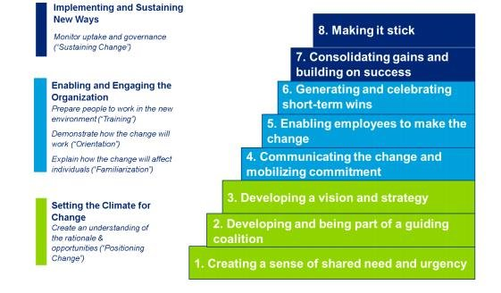
Leading Change by John P Kotter (8 Step Model)

Slide 43
Thank You

