Slide 1
Change Leadership
Advanced Leadership and Change Management
Sunday, June 16, 2024
Faculty: Prof. Anupama Sharma, IIM-V

Slide 2
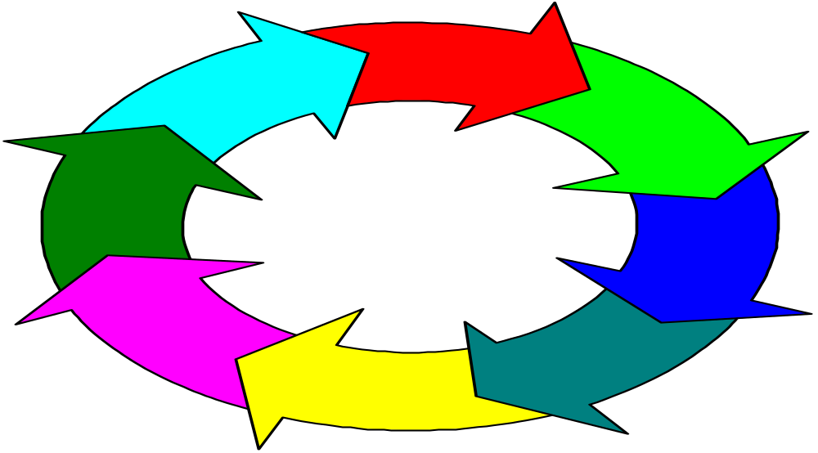
Change Process
Resistance to Change
Notes:
Lesson 1
Change process is a series of phases
Each phase takes time
Important that each phase occur
Lesson 2
Mistakes in any single phase can negatively impact on gains made in earlier phases

Slide 3
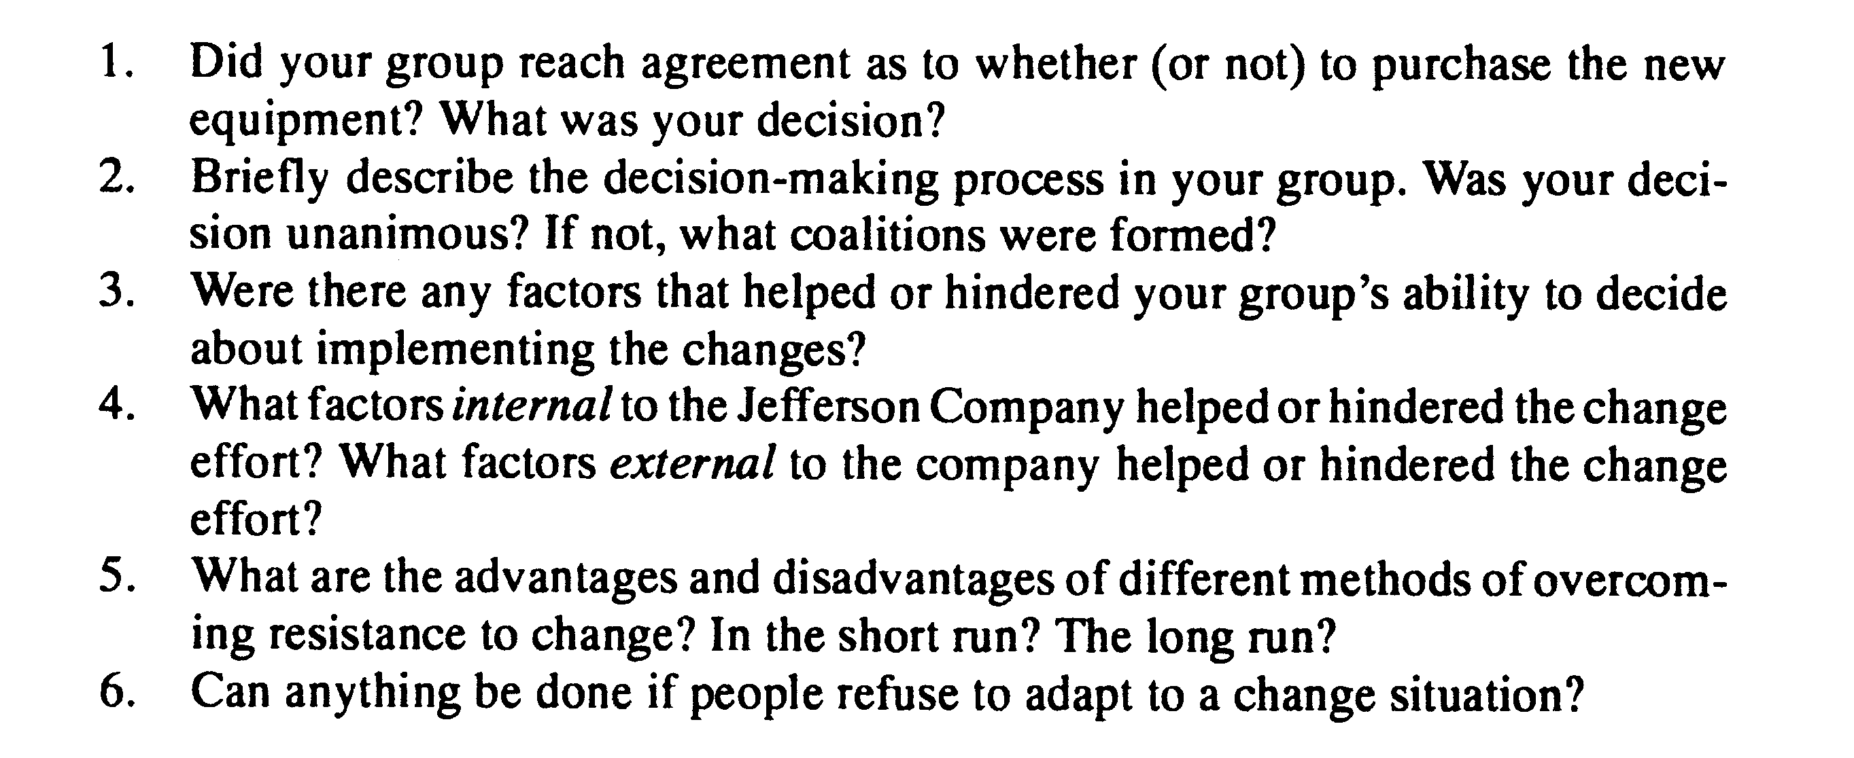
Jefferson Exercise

Slide 4
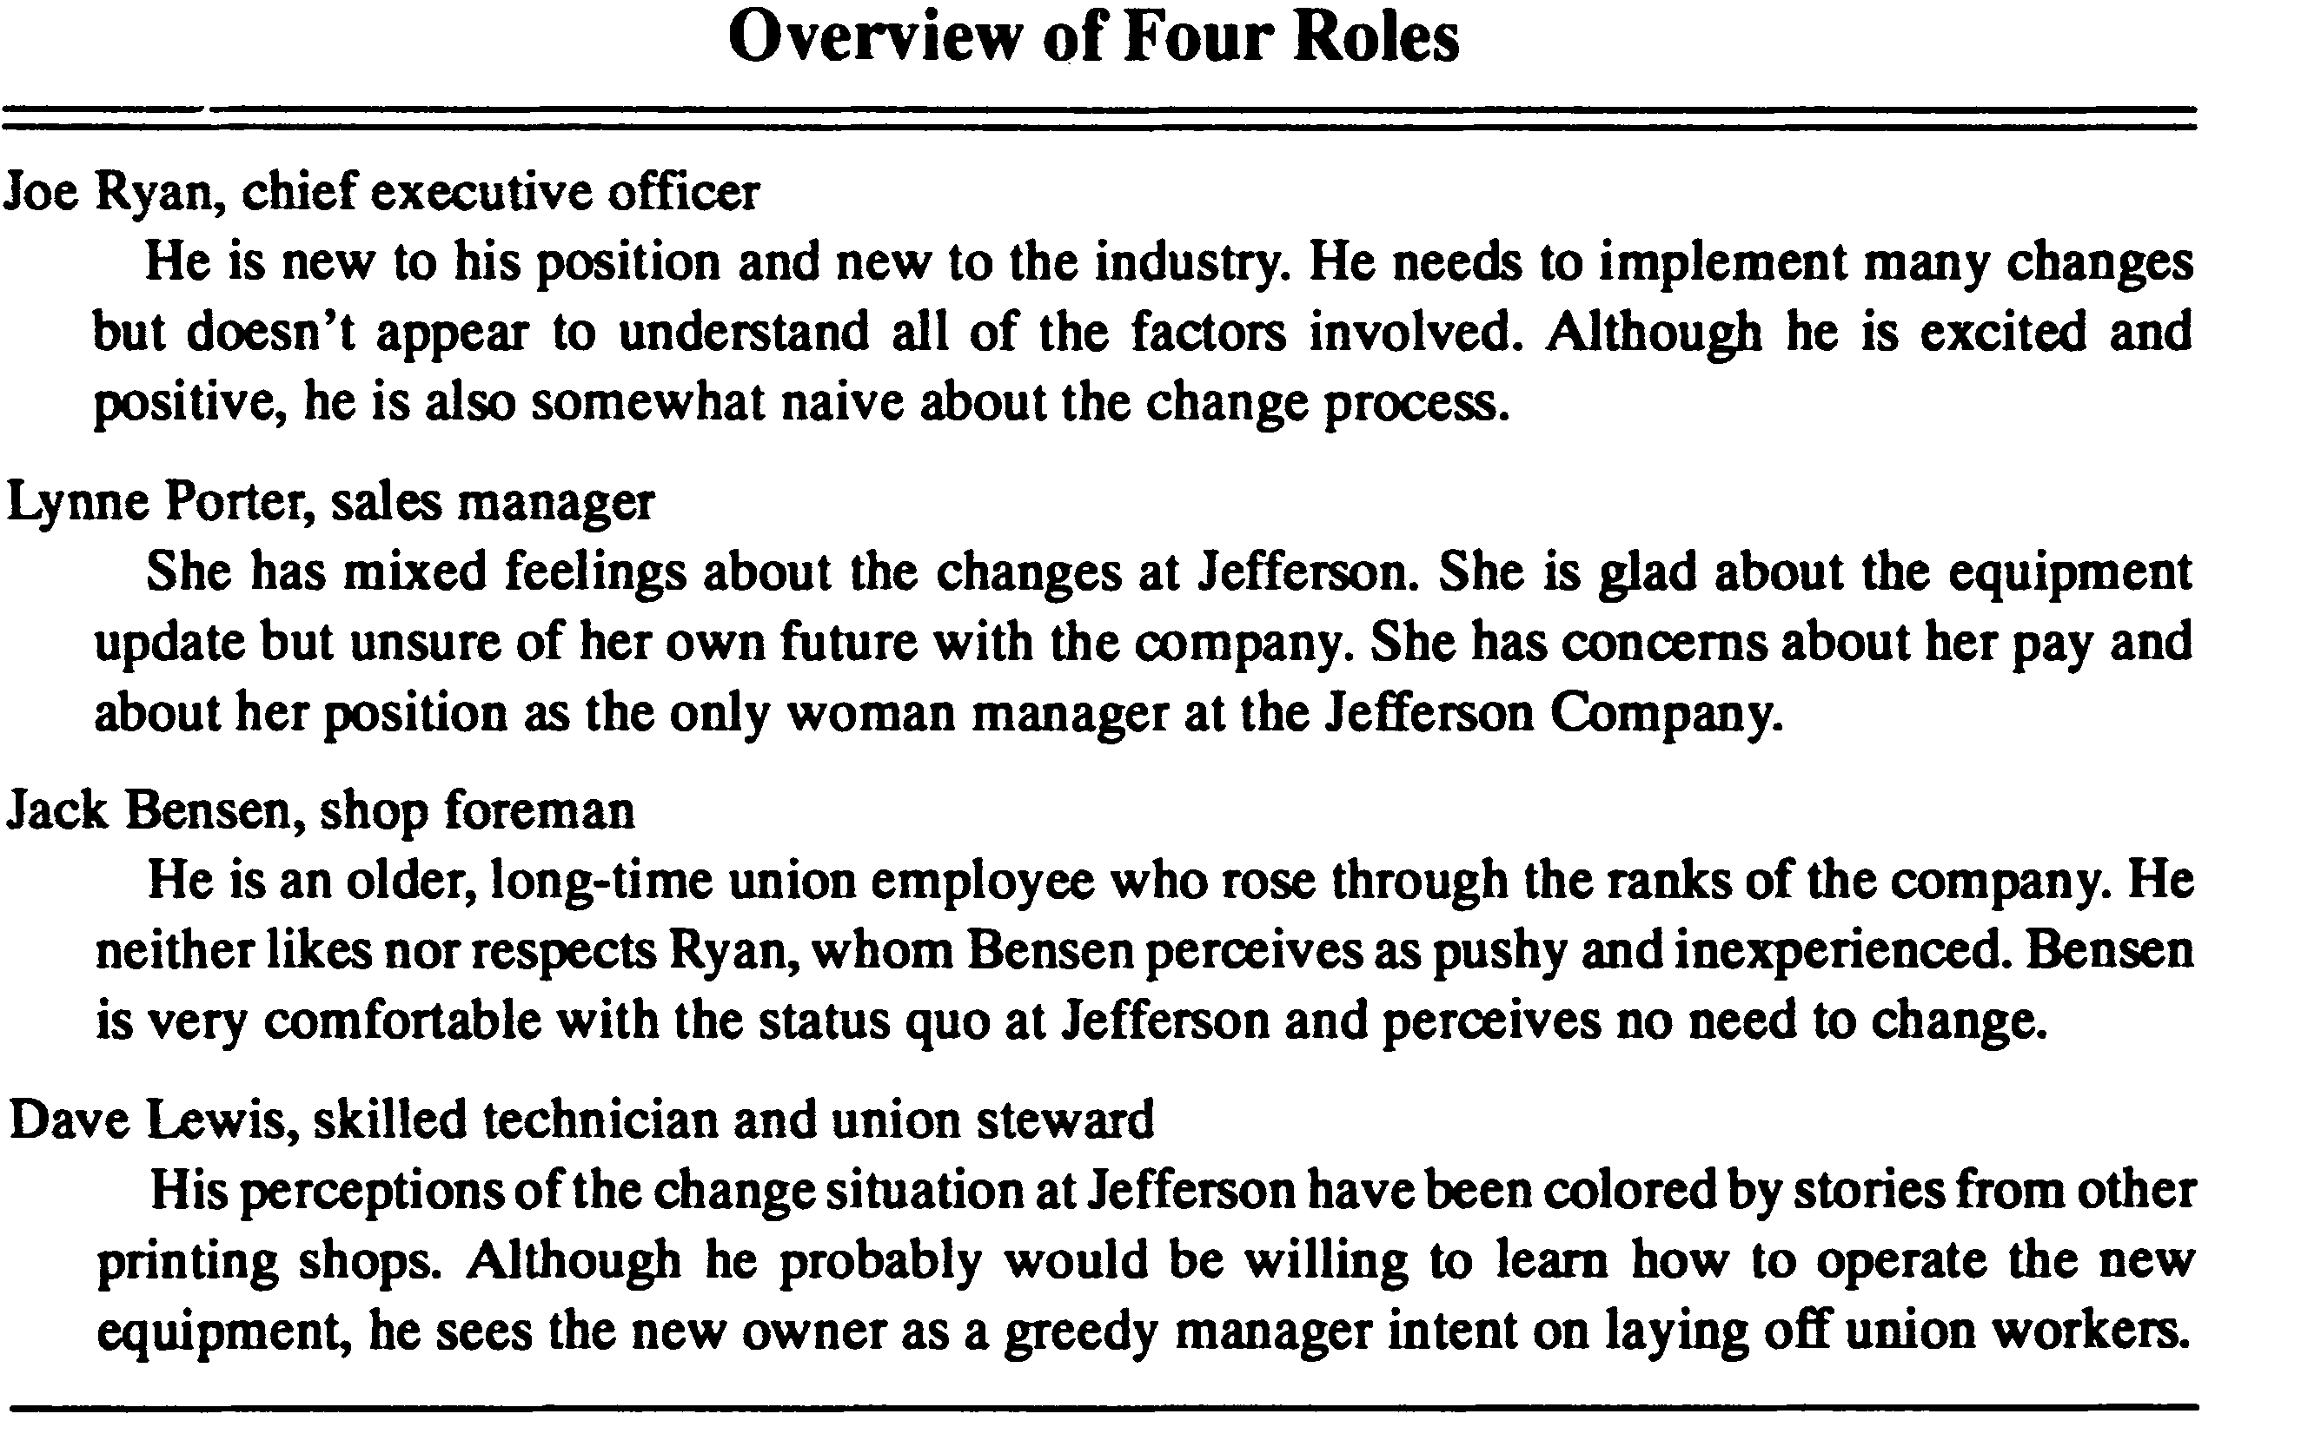

Slide 5
Joe Ryan - CEO
Lynne Porter – Sales Manager
Jack Bensen – Shop Supervisor
Dave Lewis – Technician, Union Leader

Slide 6
Sources of Change
Internal
External

Slide 7
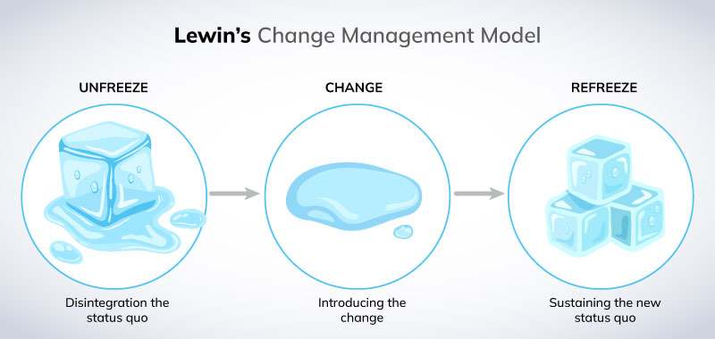
Kurt Lewin Change Model
Unfreeze → Change → Refreeze

Slide 8
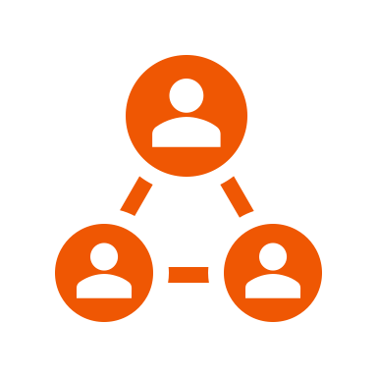
Strategies to Overcome Resistance to Change
Resistance
Mitigation
Strategies
When you introduce a change to employees and leadership in an organization, there is bound to be some pushback from those who are resistant to the idea of a change.
These seven strategies will help you resolve the resistance to keep your change project moving forward.
Tool

Slide 9
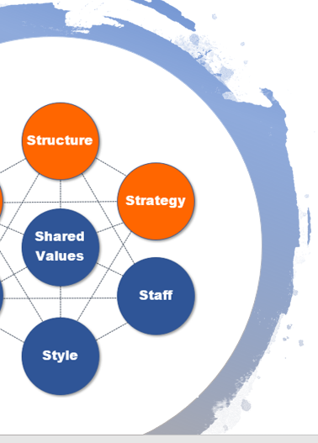

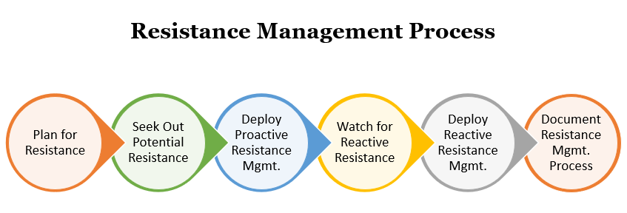
Overcoming resistance to change is part of your entire resistance management process in a change management project:
Plan for resistance
Seek out potential resistance
Deploy proactive resistance management
Watch for reactive resistance
Deploy reactive resistance management
Document the resistance management process
Why Do People Resist Change?
Don’t understand it
Fear of change
No incentive
Distrust
Cling to habits
Bad experience
Peer pressure
Lack of knowledge
Stress in life

Slide 10


Managing resistance to change in an organization effectively involves understanding that there will be all types of resistance that you’ll run into. Some may seem logical, some more personal, but all of it is important and needs to be resolved.
Because there are so many different types of resistance to change, you need to be ready with several strategies for managing resistance to change in an organization.
Some strategies may work better for certain types of resistance than others.
Lewin Force Field Analysis
You need to mitigate restraining (resisting) forces and create more driving (positive) forces for a change project to be successful.

Slide 11

1. Seek Out & Listen to Feedback
You want to invite feedback to help you uncover resistance that may not be expressed vocally in a meeting. Not all people are outspoken, and they may keep their resistance quiet.
But quiet resistance can be just as damaging to a project as more vocal resistance.
Give people a chance to voice their input and feel heard. Just being heard is sometimes all a person wants.
Listen to feedback carefully so you can properly address concerns.
Find Resistance
Invite Feedback
Observe Behavior
Ask Co-workers
Ask Managers
Survey Employees
Look for Non-Participants

Slide 12

2. Communicate & Address Concerns
Proactive communications help resolve resistance that comes from being in the dark about aspects of the change project.
When people don’t know what’s going on, they often assume the worst and resistance can solidify as a result.
You want to communicate proactively with the entire team, with departments that may be more resistant, and one-on-one to address specific concerns individuals have.
Communication
Entire organization
Resisting Departments
One-on-one with individuals that are resistant

Slide 13

3. Invite Participation
You can resolve certain types of resistance by inviting people to participate in the change process.
Sometimes all it takes is making someone feel like part of the team and that their opinion matters to resolve their resistance.
Invite resisting individuals to be in the Change Champions Network, to attend a committee meeting, or celebrate a milestone achievement.
Ideas for Participation
Champions Network
Milestone Celebration
Committee Meeting
Beta Testing New Process
Help Surveying Others

Slide 14

4. Use Your Support Networks
Two support networks that change mangers have are:
Leadership Network
Change Champions Network
Leverage these networks to help you reach people who may be more receptive to someone they know and trust.
It’s often easier for people to accept information when it’s coming from someone they work with every day, so managers and co-workers are often an excellent resource for resolving resistance to change.
Support Networks
Leadership Network
Change Champions Network

Slide 15

5. Deploy Hard Facts & Data
Some people need to be convinced that a change is good by hard facts and data.
Put together information that backs up exactly how the change will benefit the organization. How the change will benefit their department, and… most importantly…
How the change will benefit them personally as well.
You want to give them the “WIIFM.” (What’s in it for me.)
Data & Facts For:
Benefits to Organization
Benefits to Department
Benefits to Them

Slide 16

6. Provide Support to Remove Fears
Fear of being thrown into a new situation without support and expected to perform their job just as efficiently is a key reason for resistance.
Mitigate this by providing a thorough employee training plan that gives people the opportunity to gain the knowledge and abilities they need for the change.
Provide support for employees during and after the change program so they know you have their back.
Types of Support
Training
Help Desk
Q&A Sessions
Webinars
1on1 Sessions

Slide 17
7. Negotiate Acceptance If Other Methods Fail
If you have a stakeholder that can put a serious barrier up for your change project if they continue resisting, you may have to resort to negotiation if all else fails.
This would be a stakeholder that can have significant impact, like reducing your budget or stopping the project altogether.
Negotiation could include offering an incentive of some kind or adjusting the project in a way that they accept.

Slide 18
Decoding Resistance to Change (Jeffrey D. Ford and Laurie W. Ford, HBR)
Resistance is a resource
Boost awareness
Return to purpose
Change the change
Build participation and engagement
Complete the past

Slide 19
Thank You

