Slide 1
Models and Frameworks of Change
Understanding the Psychology of Change
Advanced Leadership and Change Management Program
Sunday, April 27, 2025
Faculty: Prof. Anupama Sharma, IIM-V

Slide 2
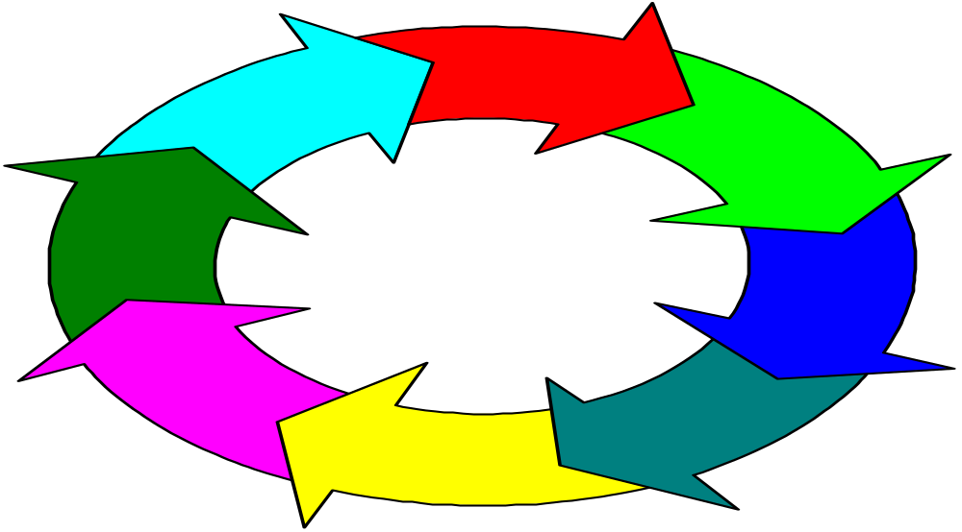
Change Process
Resistance to Change
Notes:
Lesson 1
Change process is a series of phases
Each phase takes time
Important that each phase occur
Lesson 2
Mistakes in any single phase can negatively impact on gains made in earlier phases

Slide 3

External Forces for Change
Computer technology
  law of telecosm
  effect on knowledge, competition, employment relations
Globalization and local competition
  effect on restructuring, outsourcing
  mergers
Demography
  diversity
  emerging expectations
© Corel Corp. With permission.

Slide 4
Internal Forces For Change
Turnover of leaders
Need for profits
_______________
_________________
________________

Slide 5
Driving and Restraining Forces
Driving forces:
  Push organizations toward change.
  External forces or leader’s vision.
Restraining forces:
  Resistance to change.
  Employee behaviors that block the change process.
  Try to maintain status quo.
Notes:
Organizations operate as open systems that need to keep pace with ongoing changes in their external environment.
Force Field Model — Highly respected model of change developed by social psychologist Kurt Lewin.
Driving forces:
Push organizations toward change.
Includes external forces (e.g., new competitors, technologies).
Leader’s vision inspires employees to strive for higher standards.
Restraining forces:
Resistance to change – block the change process.
Try to maintain the status quo.

Slide 6
Force Field Analysis
Driving forces
Resisting forces
High performance goals
Group norms for output
New equipment
Familiarity with
present equipment
Competition
Complacency
Employees with
new skills
Need to learn new skills
Desire for increased
influence and rewards
Fear of reduced
influence and rewards
Current level
of group
performance
Desired level
of group
performance
Source: Adapted from Zand, D.E. Force field analysis. In N. Nicholson (ed.), Blackwell Encyclopedic
Dictionary of Organizational Behavior. Oxford, England: Blackwell, 1995, 181.

Slide 7
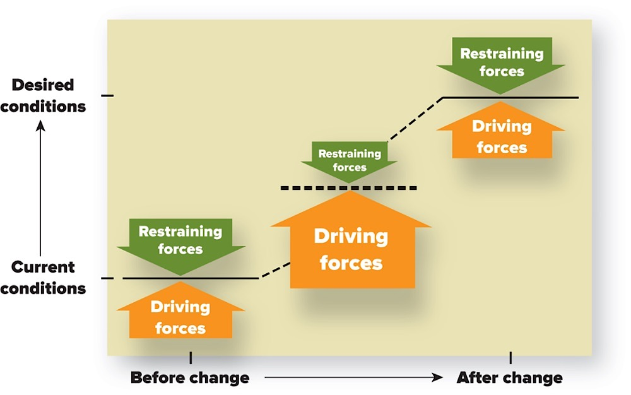
Force Field Analysis Model
Lewin’s Force Field Analysis Model.
Notes:
Effective change occurs by unfreezing the current situation, moving to a desired condition, and then refreezing the system so it remains in the desired state.
Unfreezing:
Producing disequilibrium between the driving and restraining forces.
Stability:
When driving and restraining forces are roughly in equilibrium (i.e. approximately equal strength in opposite directions).
Refreezing:
Introducing systems and conditions that reinforce and maintain the desired behaviors.
Support and reinforce the new role patterns and prevent the organization from slipping back into the old ways.

Slide 8
Sources of Resistance to Change
Individual Resistance
* Perception
* Personality
* Habit
* Threats to power
and influence
* Fear of the unknown
* Economic reasons
Organizational Resistance
* Organization design
* Organizational culture
* Resource limitations
* Fixed investments
* Interorganizational
agreements
Resistance to Change

Slide 9
Resistance to Change
Direct Costs
Saving Face
Fear of the Unknown
Breaking Routines
Incongruent Systems
Incongruent Team Dynamics
Forces for
Change

Slide 10
Understanding Resistance to Change
Many forms of resistance.
  Complaints, absenteeism, passive noncompliance.
  Subtle resistance more common than overt.
View resistance as task conflict.
  Signals that employee lack readiness for change or that change strategy should be revised.
View resistance as a form of voice.
  Redirect resistance into constructive conversations.
  Encourages better decisions through involvement.
  Voice and involvement increase commitment to change.
Notes:
Many forms of resistance – complaints, overt work stoppages, passive noncompliance.
Subtle resistance is much more common than overt resistance — more difficult to address because not as obvious.
Change agents tend to view resistance as relationship conflict — i.e., they focus on the people as the problem.
Effective change agents view resistance as task conflict and a form of voice.
Resistance as task conflict:
Resistance signals that (a) employees are sufficiently ready for change or (b) the change strategy should be revised.
Lack urgency to change, lack acceptance of the specific change initiative.
Lack confidence to change, believe change will make them worse off.
Resistance as a form of voice:
Redirect resistance into constructive conversations.
May improve procedural justice and serve as a motivational force.
Encourages better decisions through employee involvement — may increase employee motivation and commitment to the change.

Slide 11
A Systems Model of Change
People
Culture
Task
Technology
Design
Strategy

Slide 12
Unfreezing, Changing, Refreezing
Force field model: unfreeze the current situation, move to a desired condition, refreeze the system so it remains in this desired state.
Three strategies for unfreezing:
  Increase driving forces.
  Weaken/remove restraining forces.
  Increase driving forces AND reduce restraining forces (preferred strategy).
Notes:
Force Field Model — effective change occurs by unfreezing the current situation, moving to a desired condition, and then refreezing the system so it remains in this desired state.
Unfreezing — driving forces are stronger than restraining forces (disequilibrium).
a) Increase driving forces (e.g. describe external forces, management issues threats).
Strategy rarely works alone because employees respond with increase in restraining forces.
b) Weaken/remove restraining forces.
Strategy rarely works alone — facilitates but doesn’t motivate change.
c) Increase driving forces AND reduce/remove restraining forces (preferred strategy).

Slide 13
Reducing the Restraining Forces 1
1. Communication.
  Highest priority, first strategy.
  Generates urgency to change.
  Reduces uncertainty.
  Problems: takes time, costly.
2. Learning.
  Provides new knowledge/skills.
  Strengthens self-efficacy, more commitment to change.
  Problems: potentially time consuming and costly.
Notes:
1. Communication.
Highest priority and first strategy for change.
Generates an urgency to change.
Reduces uncertainty (fear of unknown).
Problems — time-consuming and potentially costly.
2. Learning.
Provides new knowledge/skills to perform well in new situation.
Strengthens change self-efficacy, more confident means more commitment to change.
Problems — time-consuming and potentially costly.

Slide 14
Reducing the Restraining Forces 2
3. Involvement: employees involved in the process.
  More personal responsibility/ownership.
  Minimizes not-invented-here syndrome.
  Reduces fear of unknown.
  Better decisions about the change initiative.
  Problems: time-consuming, potential conflict.
4. Stress management: help staff cope with change.
  Removes some negative valence of change.
  Less fear of unknown.
  Less wasted energy.
  Problems: time-consuming, costly, doesn’t help everyone.
Notes:
3. Employee involvement.
Employees participate in change process – often essential.
More personal responsibility/ownership — increases commitment to change.
Minimizes not-invented-here syndrome — participants in the change idea.
Reduces fear of unknown.
Better decisions about the change initiative.
Problems – time-consuming, potential conflict.
4. Stress Management.
When communication, learning, and involvement are not enough to minimize stress — to help employees cope with change.
Removes some negative valence of change.
Less fear of unknown.
Less wasted energy, so more motivation to support the change process.
Problems — time-consuming, expensive, doesn’t help everyone.

Slide 15
Reducing the Restraining Forces 3
5. Negotiation.
  Influence by negotiation reduces direct costs.
  For those who clearly lose (negative valence from change).
  Problems: expensive, gains compliance not commitment.
6. Coercion.
  When other strategies fail.
  Assertive influence.
  Dismissals remove outdated mental models, routines.
  Problems: reduces trust, may create subtle resistance, organizational politics.
Notes:
5. Negotiation.
Applies negotiation as the main influence tactic to gain employee compliance with change.
May be necessary for those who clearly lose out from the change people (negative valence outcomes) and won’t otherwise support change.
Problems – expensive; gains compliance, not commitment.
6. Coercion.
Necessary when all other strategies fail.
Assertive influence tactics — persistently reminders, frequent monitoring.
Executive dismissals — remove outdated mental models and routines.
Problems – reduces trust, may create subtle resistance, more politics to protect their own job security.

Slide 16
Refreezing the Desired Conditions
Systems and structures hold (refreeze) changes.
Examples:
  Alter rewards to reinforce new behaviors.
  Change career paths.
  Revise information systems.
Notes:
Systems and structures hold (refreeze) the desired changes — otherwise tend to revert to past behaviors.
Refreezing realigns systems, structures, team dynamics to support the desired change.
Alter rewards to reinforce new behaviors.
Change career paths.
Revise information systems — feedback mechanisms relate to desired objectives – “what gets measured, gets done.”

Slide 17
Transformational Leadership and Change
Transformational leaders are change agents.
  Champion vision of desired future.
  Communicate the vision meaningfully.
  Act consistently with the vision.
  Encourage employee experimentation.
Strategic vision and change.
  Provides a sense of direction.
  Identifies critical success factors to evaluate change.
  Links employee values to the change.
  Minimizes employee fear of the unknown.
  Clarifies role perceptions.
Notes:
Transformational leaders are change agents.
Champion vision of desired future.
Communicate the vision meaningfully.
Act consistently with the vision.
Encourage employee experimentation.
Strategic vision and change:
Provides a sense of direction.
Identifies critical success factors to evaluate change.
Emotional foundation for change — links employee values to the change.
Minimizes employee fear of the unknown — provides an image of the future.
Clarifies role perceptions — better understanding of what employees need to learn.

Slide 18
Why People Resist Change 1
1. Negative valence of change.
  Negative more than positive outcomes.
2. Fear of the unknown.
  People assume worst.
  Perceive lack of control.
3. Not-invented-here-syndrome.
  Staff oppose change in their area introduced by others.
  To protect self-esteem.
Notes:
1. Negative valence of change:
Cost-benefit analysis has a negative valence — employees imperfectly apply the rational choice decision model (same as expectancy theory model).
Resistance when more negative than positive outcomes expected.
Employees consider organizational outcomes, not just personal outcomes.
2. Fear of the unknown — uncertainty has two negative effects on change perceptions:
People assume the worst (i.e., assume negative rather than positive valence of outcomes).
People perceive lack of control — also has negative valence.
3. Not-invented-here-syndrome:
Staff oppose the change to prove their ideas were better.
Most common among employees who are usually responsible for that expertise or initiative.
Successful change initiated by others threatens employee self-esteem.

Slide 19
Why People Resist Change 2
Breaking routines.
  Changing routines/habits is uncomfortable and requires time/effort to learn new behaviors.
Incongruent team dynamics.
  Team norms conflict with desired change.
Incongruent organizational systems.
  Systems/structures reinforce status quo.
  Pull employees back to old ways.
Notes:
4. Breaking routines:
People are creatures of habit — they resist changes to routines and habits.
Requires time/effort to learn new routines and role patterns.
5. Incongruent team dynamics:
Existing team norms contrary to the desired change.
6. Incongruent organizational systems:
Old systems/structures reinforce status quo — revert to past attitudes and behavior.
Include rewards, information systems, patterns of authority, career paths, selection criteria.

Slide 20
Decoding Resistance to Change (Jeffrey D. Ford and Laurie W. Ford, HBR)
Resistance is a resource
Boost awareness
Return to purpose
Change the change
Build participation and engagement
Complete the past

Slide 21
Thank You

