Slide 1
Data Data , everywhere ,
Not a single drop of wisdom

Slide 2
https://hbr.org/1979/03/chief-executives-define-their-own-data-needs

Slide 3
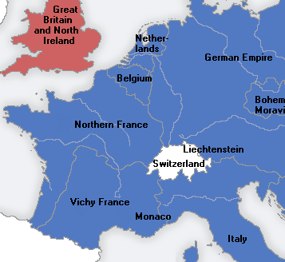
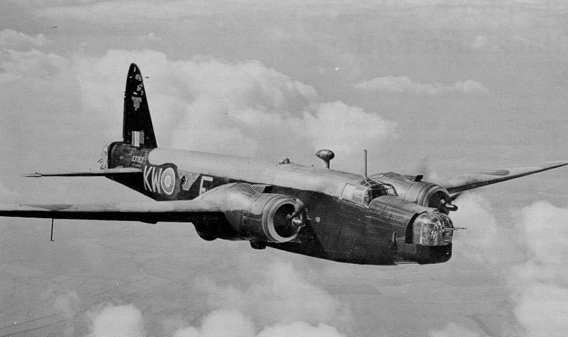
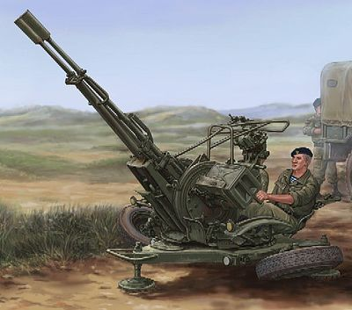

Slide 4
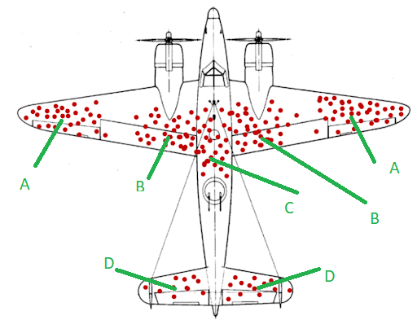
https://www.menti.com/pjv69siz6e
menti.com 1606 6124

Slide 5
Survivorship bias

Slide 6
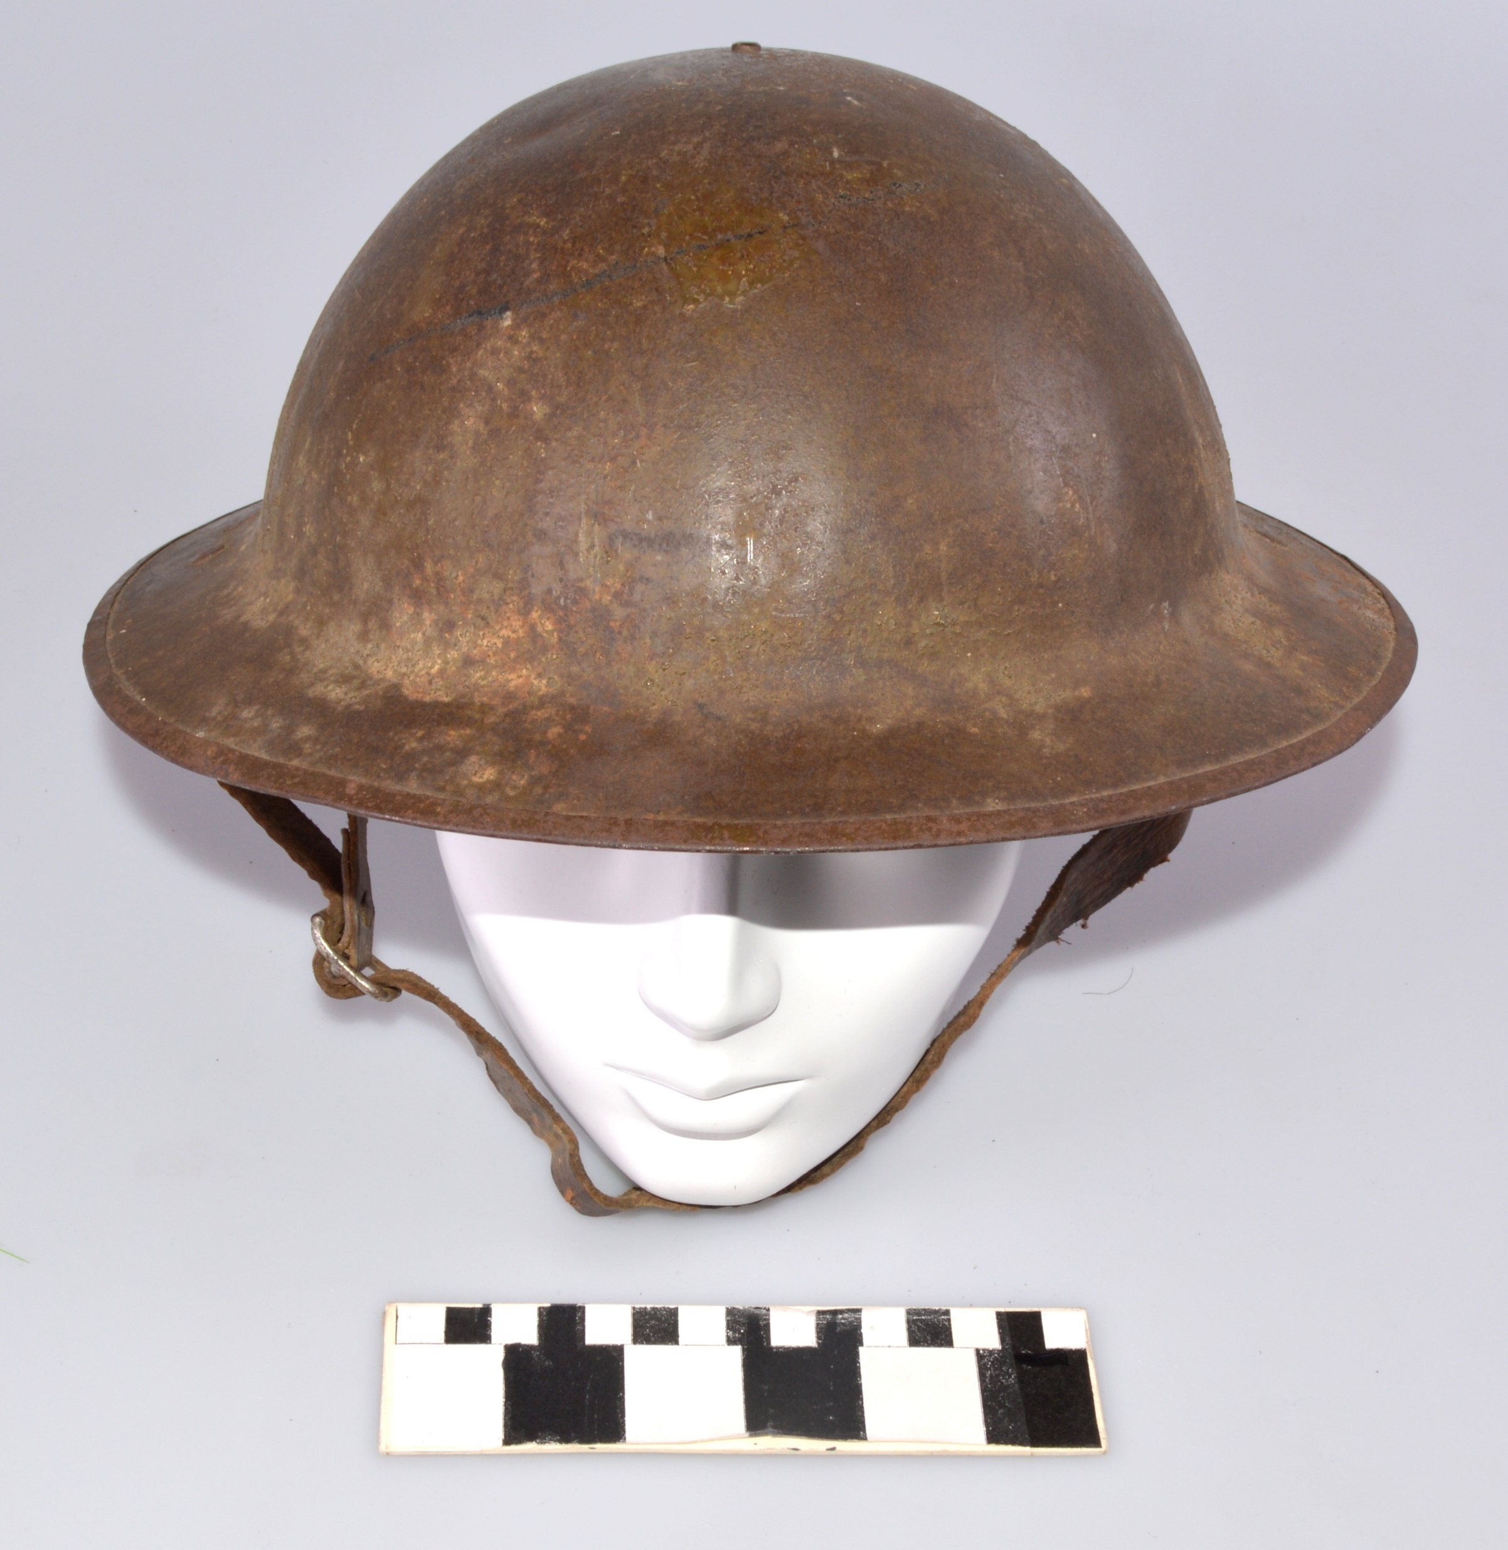
Brodie helmet

Slide 7
They don't build it like they used to

Slide 8
More Applications …

Slide 9
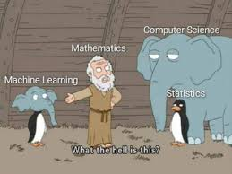
What is Machine Learning ?

Slide 11
Machine learning - computers discovering how they can perform tasks without being explicitly programmed to do so

Slide 12
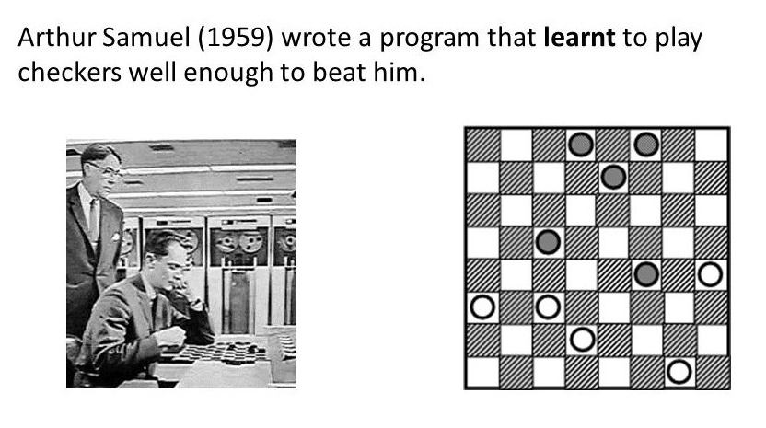

Slide 13
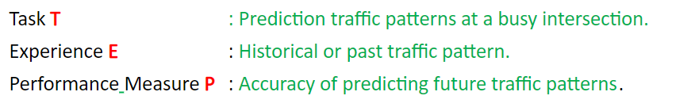
"A computer program is said to learn from experience E with respect to some class of tasks T and performance measure P if its performance at tasks in T, as measured by P, improves with experience E."

Slide 14
Types of Machine Learning - Supervised , Unsupervised , Semi-Supervised

Slide 15
Supervised
Human interaction/interference
Labelled data
Y = f(x)

Slide 16
Example of Supervised Learning
Linear Regression
Logistic regression based Classification
Naive Bayesian based Classification
Decision trees
SVM
kNN

Slide 17
Unsupervised
algorithm is not provided with any pre-assigned labels or scores for the training data.
No Y

Slide 18
Examples of Unsupervised Learning
K means Clustering
hierarchical clustering
Apriori ( Association Rules )

Slide 19
Semi supervised
100 records
90 records – unlabelled
10 records – labelled
100 unlabelled records – unsupervised ML problem

Slide 20
Uses the unlabeled data to gain more understanding
When only small training set is available.
To take advantage of the test set which also contains a lot of valuable information .
Quite frequently used in text and image data.

Slide 21
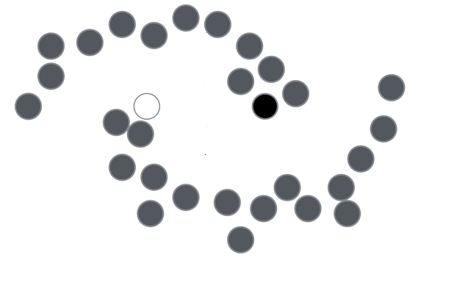
Only 1 black and 1 white is labelled , grey are unlabelled data and needs to be predicted.

Slide 22
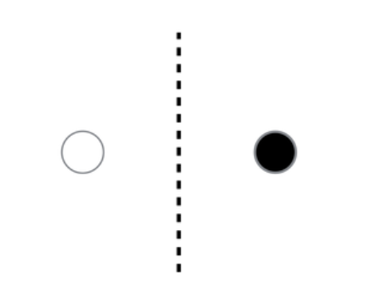

Slide 23
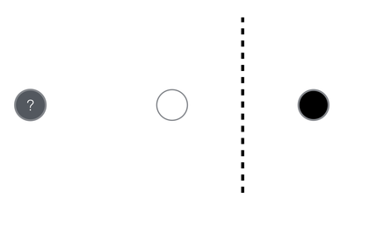

Slide 24
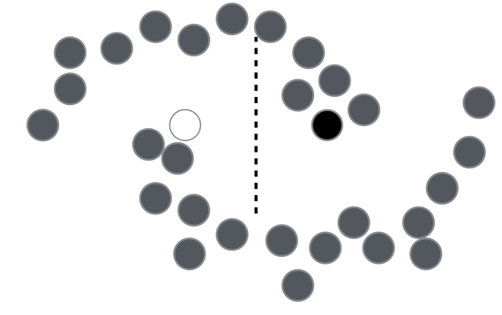

Slide 25
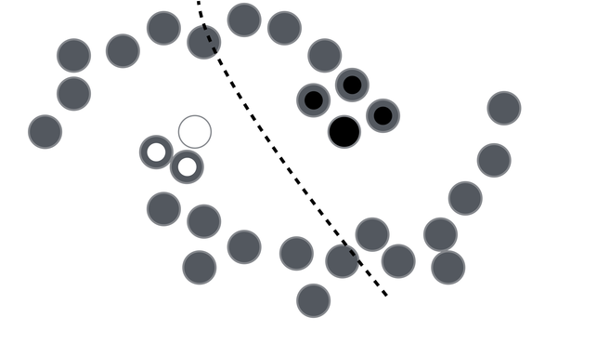
Some homogeneity , smoothness assumption - points close to each other belong to the same class

Slide 26
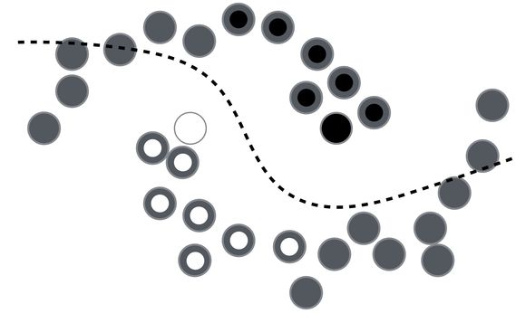

Slide 27
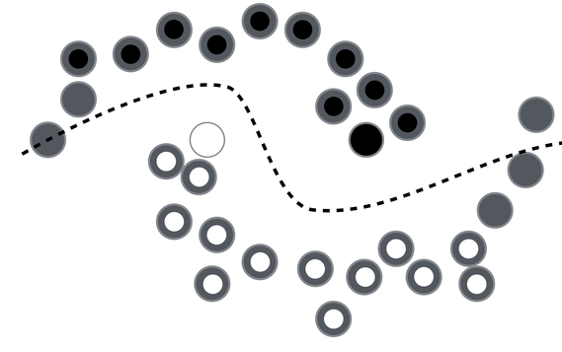

Slide 28
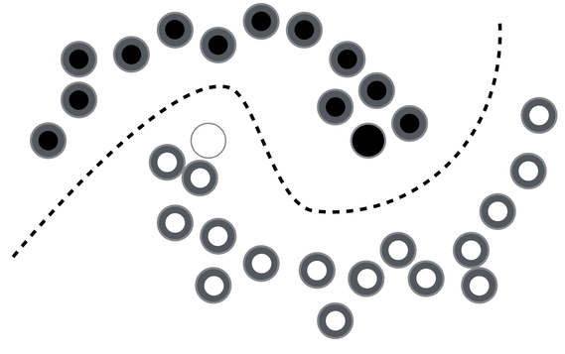

Slide 29
Vapnik Principle

Slide 30
Vapnik Principle
In order to solve a problem don’t pick an intermediate problem of a higher order of complexity.

Slide 31
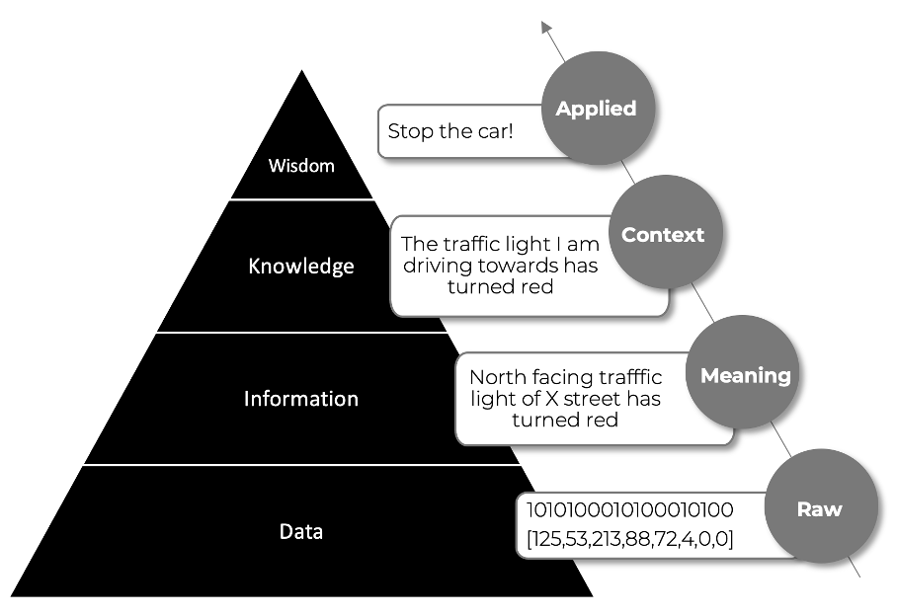
DIKW Pyramid
@ https://grapeup.com/blog/associative-knowledge-graphs

