Slide 1

Analytical Techniques for Business Intelligence
Pramod C. Mane
11 February 2023

Slide 2
Outline (Theoretical Analysis)
Machine Learning: Brief Overview
              Introduction
              Techniques
                Supervised
                Unsupervised
                Deep Learning
Software Tool: Orange
Market Basket Analysis

Slide 3
Machine Learning: Brief Overview

Slide 4
Some Common Terms
Artificial Intelligence – Any method that tries to replicate the results of some aspects of human cognition.
Machine Learning - Programs that perform better with experience.
Artificial Neural Network (ANN) – A machine learning algorithm
Deep Learning – A type of ANN
Big Data – Using data to find unobvious patterns

Slide 5
What is Machine Learning?
Simple Definition: Using Data to answer questions
Study of computer algorithms:
                that improves automatically
                through experiences
(Tom Mitchell in his book Machine Learning)
Formally, A computer program is said to learn from experience E with respect to some class of tasks T and performance measure P if its performance at task T, as measured by P, improves with experience E.

Slide 6
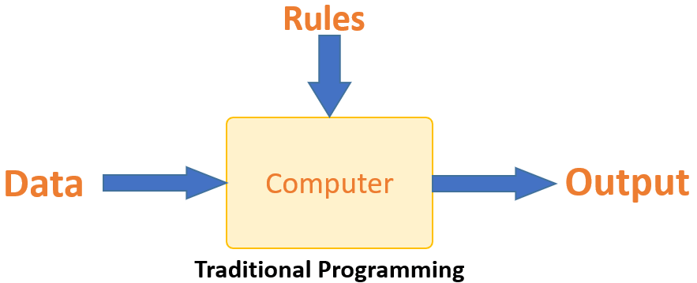
Traditional Programming Vs. Machine Learning
Image Source: https://www.guru99.com/

Slide 7
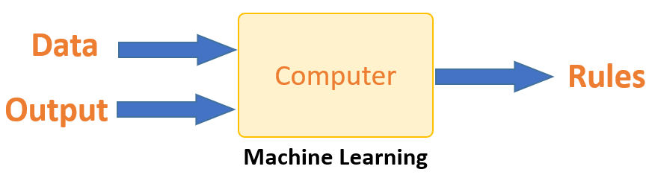
Traditional Programming Vs. Machine Learning
Image Source: https://www.guru99.com/

Slide 8
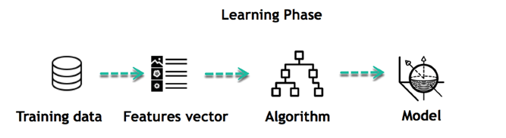
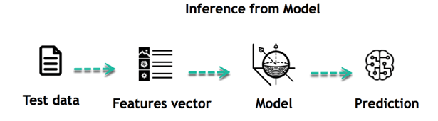
How does Machine Learning?
The core objective of machine learning is the learning and inference.
Image Source: https://www.guru99.com/

Slide 9
Machine Learning Lifecycle
The life of Machine Learning programs is straightforward and can be summarized in the following points:
Define a question
Collect data
Visualize data
Train algorithm
Test the Algorithm
Collect feedback
Refine the algorithm
Loop 4-7 until the results are satisfying
Use the model to make a prediction

Slide 10
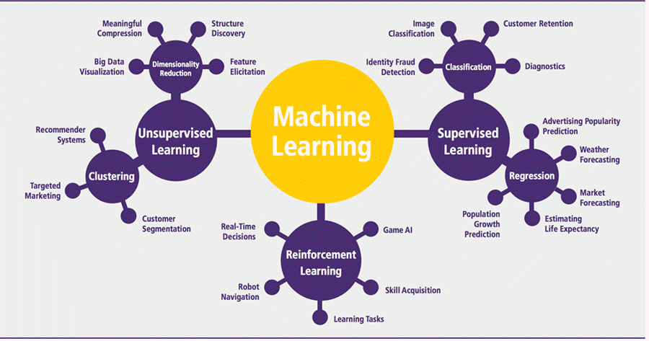
Machine Learning Algorithms and Where they are Used?
Image Source: https://www.guru99.com/

Slide 11
What is Supervised Machine Learning?
In Supervised learning, you train the machine using data which is well “labeled.”
It means some data is already tagged with the correct answer.
It can be compared to learning which takes place in the presence of a supervisor or a teacher.

Slide 12
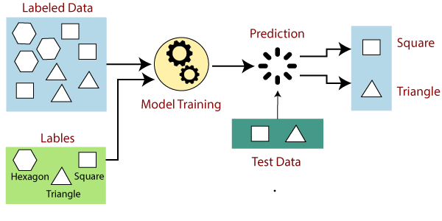
What is Supervised Machine Learning?
Image Source: https://www.javatpoint.com/

Slide 13
Example Supervised Machine Learning
Example: House prices
One practical example of supervised learning problems is predicting house prices.
How is this achieved?
First, we need data about the houses: square footage, number of rooms, features, whether a house has a garden or not, and so on.
We then need to know the prices of these houses, i.e. the corresponding labels.
By leveraging data coming from thousands of houses, their features and prices, we can now train a supervised machine learning model to predict a new house’s price based on the examples observed by the model.

Slide 14
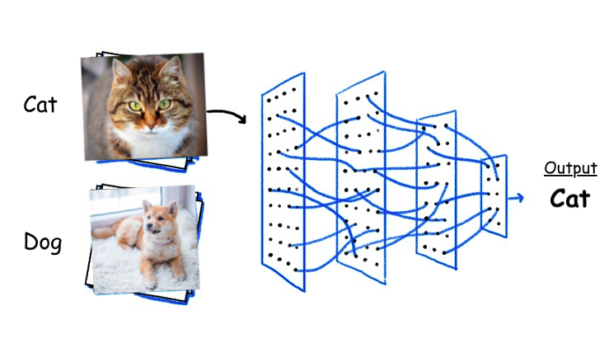
Examples Supervised Machine Learning
Example: Is it a cat or a dog?
Image Source: https://datasolutions.techdata.com/introduction-to-deep-learning/

Slide 15
Example Supervised Machine Learning
Example: How’s the weather today?
To make correct predictions for the weather, we need to take into account various parameters, including historical temperature data, precipitation, wind, humidity, and so on.
Example: Who are the unhappy customers?

Slide 16
How supervised learning works
Supervised learning can be separated into two types of problems when data mining—
- Classification
- Regression

Slide 17
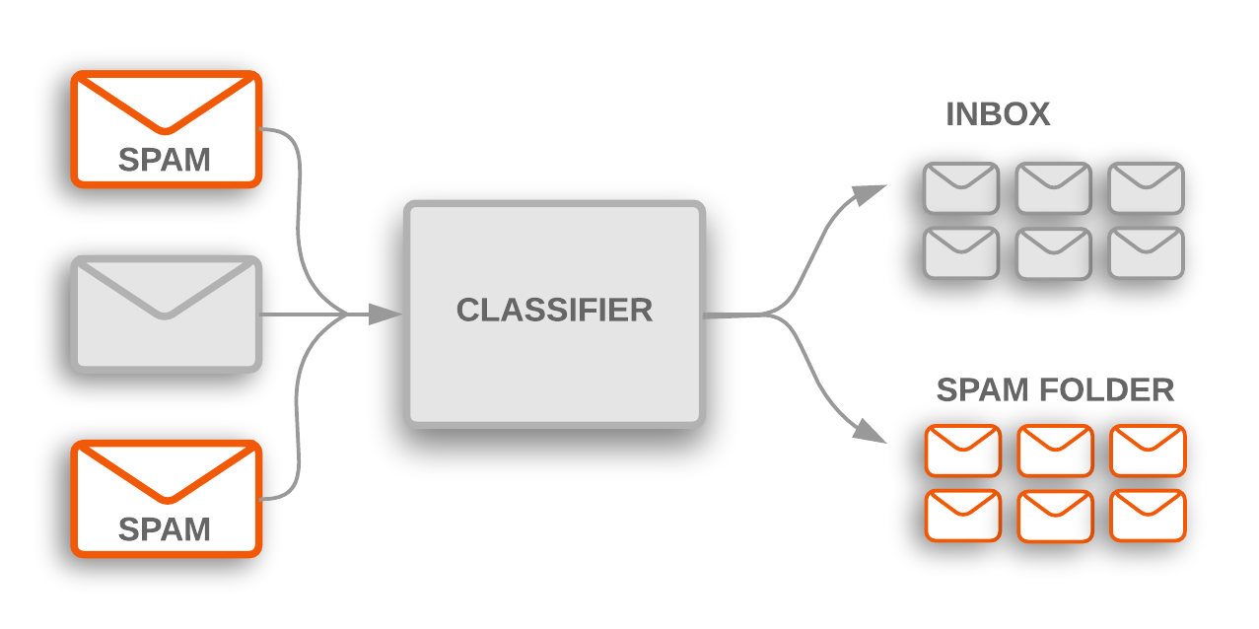
How supervised learning works
- Classification
Image Source: https://developers.google.com/

Slide 18
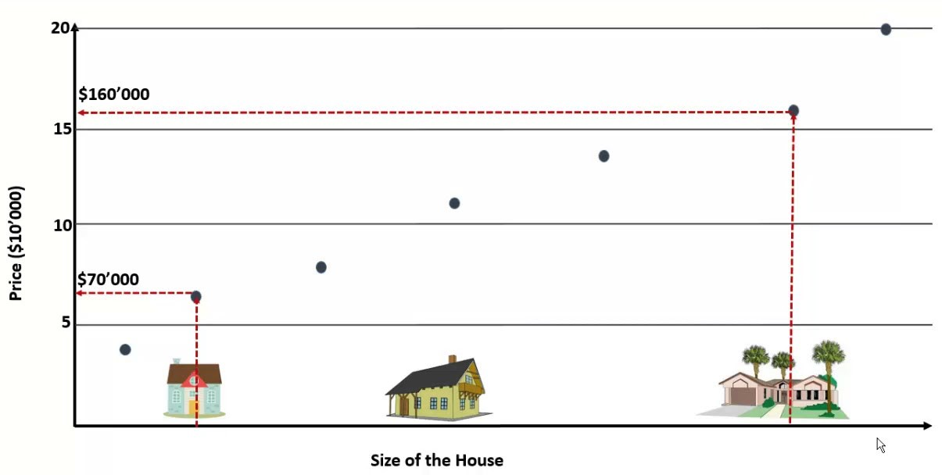
How supervised learning works
- Regression
Image Source: https://i.ytimg.com

Slide 19
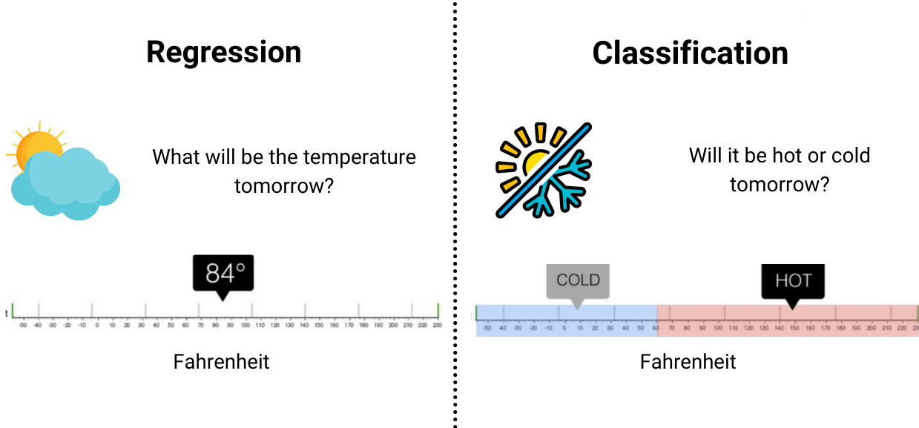
How supervised learning works
- Classification Vs Regression
Image Source: https://www.enjoyalgorithms.com/

Slide 20
Supervised learning algorithms
Classification
    Linear classifiers,
    Support vector machines (SVM),
    Naive Bayes,
    Decision trees,
    k-Nearest neighbor, and
    Random forest
Regression
    Linear regression,
    Logistical regression, and
    polynomial regression

Slide 21
Unsupervised Learning

Slide 22
What is Unsupervised Machine Learning?
Unsupervised learning is a machine learning technique, where you do not need to supervise the model.
Instead, you need to allow the model to work on its own to discover information.
It mainly deals with the unlabelled data.

Slide 23
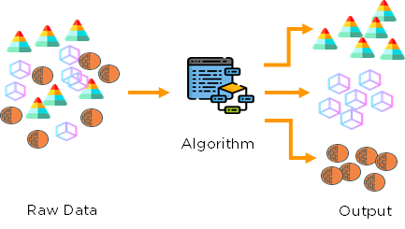
How Unsupervised Machine Works?
Image Source: https://medium.com/

Slide 24
Examples: Unsupervised Machine Learning
Finding customer segments
Clustering is commonly used for determining customer segments in marketing data.
Being able to determine different segments of customers helps marketing teams approach these customer segments in unique ways.
(Think of features like gender, location, age, education, income bracket, and so on.)

Slide 25
Examples: Unsupervised Machine Learning
Recommendation Engines
Using past purchase behavior data, unsupervised learning can help to discover data trends that can be used to develop more effective cross-selling strategies.
This is used to make relevant add-on recommendations to customers during the checkout process for online retailers.

Slide 26
Examples: Unsupervised Machine Learning
News Sections
Google News uses unsupervised learning to categorize articles on the same story from various online news outlets.
For example, the results of a presidential election could be categorized under their label for “US” news.
Anomaly detection
Computer vision
Medical imaging

Slide 27
Common unsupervised learning approaches
Unsupervised learning models are utilized for three main tasks—
Clustering,
Association, and
Dimensionality reduction.

Slide 28
Common unsupervised learning approaches
Clustering :
Clustering is a data mining technique which groups unlabeled data based on their similarities or differences.
Clustering algorithms are used to process raw, unclassified data objects into groups represented by structures or patterns in the information.
Clustering algorithms can be categorized into a few types, specifically
                exclusive,
                overlapping,
                hierarchical, and
                probabilistic.

Slide 29
Common unsupervised learning approaches
Clustering :
Clustering is a data mining technique which groups unlabeled data based on their similarities or differences.
Clustering algorithms are used to process raw, unclassified data objects into groups represented by structures or patterns in the information.
Clustering algorithms can be categorized into a few types, specifically
                exclusive,
                overlapping,
                hierarchical, and
                probabilistic.

Slide 30
Common unsupervised learning approaches
Clustering :
Clustering is a data mining technique which groups unlabeled data based on their similarities or differences.
Clustering algorithms are used to process raw, unclassified data objects into groups represented by structures or patterns in the information.
Clustering algorithms can be categorized into a few types, specifically-
                exclusive (partitioning),
                agglomerative,
                overlapping, and
                probabilistic.

Slide 31
Common unsupervised learning approaches
Clustering :
Exclusive (partitioning)
  In this clustering method, Data are grouped in such a way that one data can belong to one cluster only.
  Example: K-means

Slide 32
Common unsupervised learning approaches
Clustering :
Agglomerative
    In this clustering technique, every data is a cluster. The iterative unions between the two nearest clusters reduce the number of clusters.
    Example: Hierarchical clustering

Slide 33
Common unsupervised learning approaches
Clustering :
Overlapping
    In this technique, fuzzy sets is used to cluster data. Each point may belong to two or more clusters with separate degrees of membership.
    Here, data will be associated with an appropriate membership value.
    Example: Fuzzy C-Means

Slide 34
Common unsupervised learning approaches
Clustering :
Probabilistic
    This technique uses probability distribution to create the clusters
    Example: Following keywords
    “man’s shoe.”
    “women’s shoe.”
    “women’s glove.”
    “man’s glove.”
    can be clustered into two categories “shoe” and “glove” or “man” and “women.”

Slide 35
Common unsupervised learning approaches
Association Rules
An association rule is a rule-based method for finding relationships between variables in a given dataset.
These methods are frequently used for market basket analysis, allowing companies to better understand relationships between different products.
Understanding consumption habits of customers enables businesses to develop better cross-selling strategies and recommendation engines.
While there are a few different algorithms used to generate association rules, such as Apriori, Eclat, and FP-Growth, the Apriori algorithm is most widely used.

Slide 36
Common unsupervised learning approaches
Dimensionality reduction
Dimensionality reduction is a technique used when the number of features, or dimensions, in a given dataset is too high.
It reduces the number of data inputs to a manageable size while also preserving the integrity of the dataset as much as possible.
A few different dimensionality reduction methods that can be used, such as: principal component analysis, singular value decomposition, and autoencoders.

Slide 37
Clustering: K-Means and Hierarchical Algorithms
K-means
The k-means algorithm is an algorithm to cluster n objects based on attributes into k partitions, such that, k<n.

Slide 38
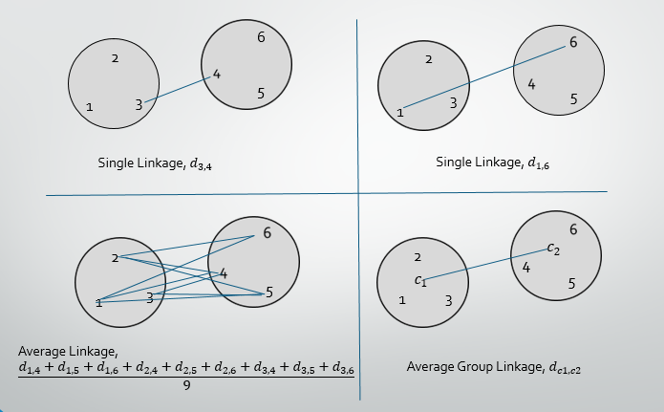
Measuring Similarity Between Clusters

Slide 39
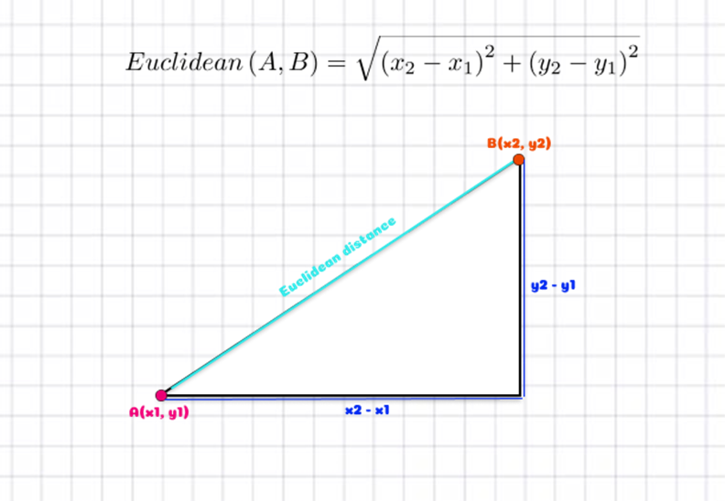
Distance Metrics for Machine Learning
Euclidean Distance represents the shortest distance between two data points.

Slide 40
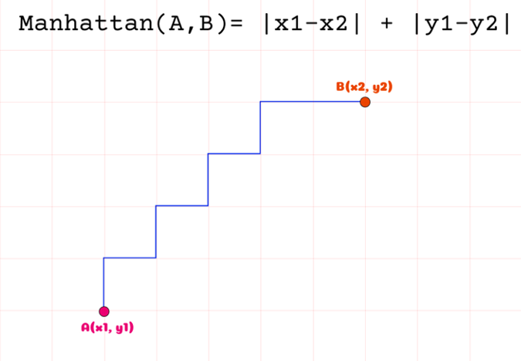
Distance Metrics for Machine Learning
Manhattan Distance is the sum of absolute differences between points across all the dimensions.

Slide 41
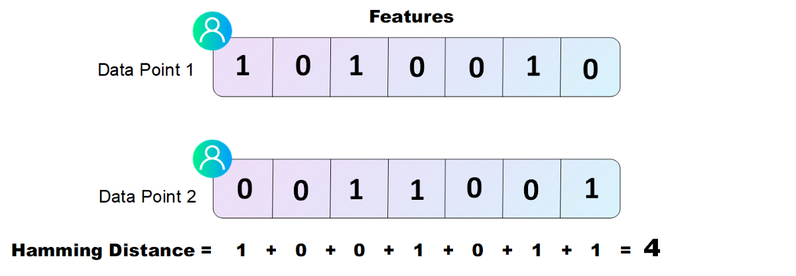
Distance Metrics for Machine Learning
Hamming Distance measures the similarity between two strings of the same length. The Hamming Distance between two strings of the same length is the number of positions at which the corresponding characters are different.

Slide 42
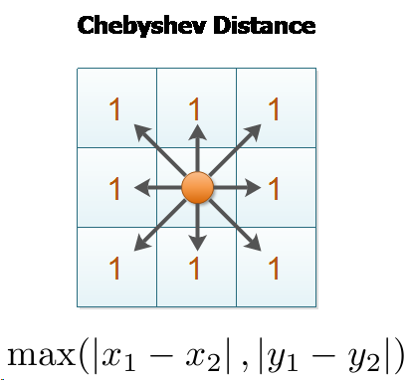
Distance Metrics for Machine Learning
Chebyshev distance is defined as the greatest of difference between two vectors along any coordinate dimension.

Slide 43
Example: k-means Clustering
Cluster the following ten points [with (x, y) representing locations] into three cluster.
P1 | (2, 8)
P2 | (2, 7)
P3 | (4, 1)
P4 | (8, 2)
P5 | (3, 7)
P6 | (1, 9)
P7 | (5, 8)
P8 | (6, 6)
P9 | (6, 9)
P10 | (4, 7)

Slide 44
Example: k-means Clustering
Iteration 1
 |  | (2, 7) | (1, 9) | (6, 9)
 | Point | Dist Mean 1 | Dist Mean 2 | Dist Mean 3 | Cluster
P1 | (2, 8)
P2 | (2, 7)
P3 | (4, 1)
P4 | (8, 2)
P5 | (3, 7)
P6 | (1, 9)
P7 | (5, 8)
P8 | (6, 6)
P9 | (6, 9)
P10 | (4, 7)

Slide 45

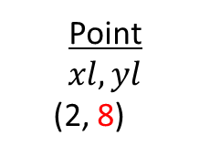
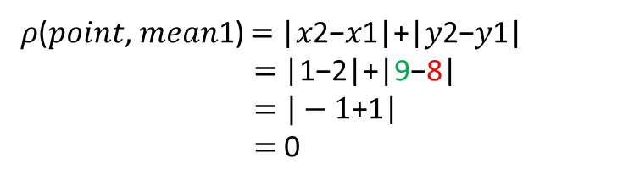

Example: k-means Clustering
Point
$$xl, yl$$
(2, 8)
mean1
𝑥2, 𝑦2
(2, 7)
Point
𝑥𝑙, 𝑦𝑙
(2, 8)
mean1
𝑥2, 𝑦2
(1, 9)
$$ρ\left(a, b\right)=\left|x2−x1\right|+|y2−y1|$$
$$ρ\left(point, mean1\right)=\left|x2−x1\right|+\left|y2−y1\right|$$
$=\left|2−2\right|+\left|7−8\right|$
$=|0−1$| $=−1$
𝜌(𝑎, 𝑏)=|𝑥2−𝑥1|+|𝑦2−𝑦1|
𝜌(𝑝𝑜𝑖𝑛𝑡, 𝑚𝑒𝑎𝑛1) $=$|𝑥2−𝑥1|+|𝑦2−𝑦1|
$=$|1−2|+|9−8|
$=|−1$+1|
$=$0

Slide 46
Example Continued
Cluster 1
(2, 8)
(2, 7)
(4, 1)
(3, 7)
(4, 7)
-------
15/5 30/5
(3, 6)
Cluster 2
(1, 9)
Iteration 1
 |  | (2, 7) | (1, 9) | (6, 9)
 | Point | Dist Mean 1 | Dist Mean 2 | Dist Mean 3 | Cluster
P1 | (2, 8) | 1 | 2 | 5 | 1
P2 | (2, 7) | 0 | 3 | 6 | 1
P3 | (4, 1) | 8 | 11 | 10 | 1
P4 | (8, 2) | 11 | 14 | 9 | 3
P5 | (3, 7) | 1 | 4 | 5 | 1
P6 | (1, 9) | 3 | 0 | 5 | 2
P7 | (5, 8) | 4 | 5 | 2 | 3
P8 | (6, 6) | 5 | 8 | 3 | 3
P9 | (6, 9) | 6 | 5 | 0 | 3
P10 | (4, 7) | 2 | 5 | 4 | 1
Cluster 3
(8, 2)
(5, 8)
(6, 6)
(6, 9)
-----------
(6.25, 6.25)

Slide 47
Example Continued
Cluster 1
(2, 7)
(4, 1)
(3, 7)
(4, 7)
-------
(3.25, 5.5)
Cluster 2
(1, 9)
(2, 8)
------
(1.5, 8.5)
Iteration 2
 |  | (3, 6) | (1, 9) | (6.25, 6.25)
 | Point | Dist Mean 1 | Dist Mean 2 | Dist Mean 3 | Cluster
P1 | (2, 8) | 3 | 2 | 6 | 2
P2 | (2, 7) | 2 | 3 | 5 | 1
P3 | (4, 1) | 6 | 11 | 7.5 | 1
P4 | (8, 2) | 9 | 14 | 6 | 3
P5 | (3, 7) | 1 | 4 | 4 | 1
P6 | (1, 9) | 5 | 0 | 8 | 2
P7 | (5, 8) | 4 | 5 | 3 | 3
P8 | (6, 6) | 3 | 8 | 0.5 | 3
P9 | (6, 9) | 6 | 5 | 3 | 3
P10 | (4, 7) | 2 | 5 | 3 | 1
Cluster 3
(8, 2)
(5, 8)
(6, 6)
(6, 9)
-----------
(6.25, 6.25)

Slide 48
Example Continued
Cluster 1
(4, 1)
(3, 7)
(4, 7)
-------
(3.66, 5)
Cluster 2
(1, 9)
(2, 8)
(2, 7)
------
(1.66, 8)
Iteration 3
 |  | (3.25, 5.5) | (1.5, 8.5) | (6.25, 6.25)
 | Point | Dist Mean 1 | Dist Mean 2 | Dist Mean 3 | Cluster
P1 | (2, 8) | 3.75 | 1 | 6 | 2
P2 | (2, 7) | 2.75 | 2 | 5 | 2
P3 | (4, 1) | 5.25 | 10 | 7.5 | 1
P4 | (8, 2) | 8.25 | 13 | 6 | 3
P5 | (3, 7) | 1.75 | 3 | 4 | 1
P6 | (1, 9) | 5.75 | 1 | 8 | 2
P7 | (5, 8) | 4.25 | 4 | 3 | 3
P8 | (6, 6) | 3.25 | 7 | 0.5 | 3
P9 | (6, 9) | 6.25 | 5 | 3 | 3
P10 | (4, 7) | 2.25 | 4 | 3 | 1
Cluster 3
(8, 2)
(5, 8)
(6, 6)
(6, 9)
-----------
(6.25, 6.25)

Slide 49
Example Continued
Cluster 1
(4, 1)
(3, 7)
(4, 7)
Cluster 2
(1, 9)
(2, 8)
(2, 7)
Iteration 4
 |  | (3.66, 5) | (1.66, 8) | (6.25, 6.25)
 | Point | Dist Mean 1 | Dist Mean 2 | Dist Mean 3 | Cluster
P1 | (2, 8) | 3.75 | 1 | 6 | 2
P2 | (2, 7) | 2.75 | 2 | 5 | 2
P3 | (4, 1) | 5.25 | 10 | 7.5 | 1
P4 | (8, 2) | 8.25 | 13 | 6 | 3
P5 | (3, 7) | 1.75 | 3 | 4 | 1
P6 | (1, 9) | 5.75 | 1 | 8 | 2
P7 | (5, 8) | 4.25 | 4 | 3 | 3
P8 | (6, 6) | 3.25 | 7 | 0.5 | 3
P9 | (6, 9) | 6.25 | 5 | 3 | 3
P10 | (4, 7) | 2.25 | 4 | 3 | 1
Cluster 3
(8, 2)
(5, 8)
(6, 6)
(6, 9)

Slide 50
Example: Question
Cluster the following ten points [with (x, y) representing locations] into three cluster.
Point | X, Y
P1 | (2, 10)
P2 | (2, 5)
P3 | (8, 4)
P4 | (5, 8)
P5 | (7, 5)
P6 | (6, 4)
P7 | (1, 2)
P8 | (4, 9)
Initial cluster centres are: P1(2, 10), P4(5, 8), P(1, 2). Let distance measure is Manhattan distance

Slide 51
Hierarchical Clustering
Hierarchical clustering is used to group the unlabeled datasets into a cluster and also known as hierarchical cluster analysis or HCA.
In this algorithm, we develop the hierarchy of clusters in the form of a tree, and this tree-shaped structure is known as the dendrogram.
The hierarchical clustering technique has two approaches:
  Agglomerative: Agglomerative is a bottom-up approach, in which the algorithm starts with taking all data points as single clusters and merging them until one cluster is left.
  Divisive: Divisive algorithm is the reverse of the agglomerative algorithm as it is a top-down approach.

Slide 52
Why hierarchical clustering?
In the k-means clustering that there are some challenges with this algorithm,
  which are a predetermined number of clusters, and
  it always tries to create the clusters of the same size.
To solve these two challenges, we can opt for the hierarchical clustering algorithm because, in this algorithm, we don't need to have knowledge about the predefined number of clusters.

Slide 53
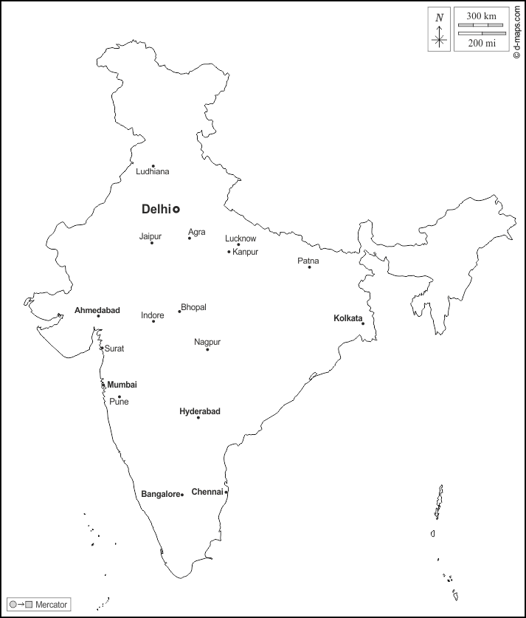
Example: Hierarchical Clustering
 | AH | BA | CH | DL | HY | KL | MU
AH | 0 | 1497 | 1850 | 945 | 1179 | 2073 | 525
BA | 1497 | 0 | 346 | 1741 | 569 | 1553 | 813
CH | 1850 | 346 | 0 | 2208 | 626 | 1678 | 1025
DL | 945 | 1741 | 2208 | 0 | 1559 | 1304 | 1163
HY | 1179 | 569 | 626 | 1559 | 0 | 1483 | 708
KL | 2073 | 1553 | 1678 | 1304 | 1483 | 0 | 1947
MU | 525 | 813 | 1025 | 1163 | 708 | 1947 | 0

Slide 54

 | AH | BA | CH | DL | HY | KL | MU
AH | 0 | 1497 | 1850 | 945 | 1179 | 2073 | 525
BA | 1497 | 0 | 346 | 1741 | 569 | 1553 | 813
CH | 1850 | 346 | 0 | 2208 | 626 | 1678 | 1025
DL | 945 | 1741 | 2208 | 0 | 1559 | 1304 | 1163
HY | 1179 | 569 | 626 | 1559 | 0 | 1483 | 708
KL | 2073 | 1553 | 1678 | 1304 | 1483 | 0 | 1947
MU | 525 | 813 | 1025 | 1163 | 708 | 1947 | 0
346 is the shortest distance between Chennai & Bangalore
So we club them and name as BACH
 | AH | BACH | DL | HY | KL | MU
AH | 0 | 1497 | 945 | 1179 | 2073 | 525
BACH | 1497 | 0 | 1741 | 569 | 1553 | 813
DL | 945 | 1741 | 0 | 1559 | 1304 | 1163
HY | 1179 | 569 | 1559 | 0 | 1483 | 708
KL | 2073 | 1553 | 1304 | 1483 | 0 | 1947
MU | 525 | 813 | 1163 | 708 | 1947 | 0
 | AH | BACH | DL | HY | KL | MU
AH | 0 | 1497 | 945 | 1179 | 2073 | 525
BACH | 1497 | 0 | 1741 | 569 | 1553
DL | 945 | 1741 | 0 | 1559 | 1304 | 1163
HY | 1179 | 569 | 1559 | 0 | 1483 | 708
KL | 2073 | 1553 | 1304 | 1483 | 0 | 1947
MU | 525 |  | 1163 | 708 | 1947 | 0
 | AH | BACH | DL | HY | KL | MU
AH | 0 | 1497 | 945 | 1179 | 2073 | 525
BACH | 1497 | 0
DL | 945 |  | 0 | 1559 | 1304 | 1163
HY | 1179 |  | 1559 | 0 | 1483 | 708
KL | 2073 |  | 1304 | 1483 | 0 | 1947
MU | 525 |  | 1163 | 708 | 1947 | 0
 | AH | BACH | DL | HY | KL | MU
AH | 0 | 1497 | 945 | 1179 | 2073 | 525
BACH | 1497 | 0 | 1741
DL | 945 | 1741 | 0 | 1559 | 1304 | 1163
HY | 1179 |  | 1559 | 0 | 1483 | 708
KL | 2073 |  | 1304 | 1483 | 0 | 1947
MU | 525 |  | 1163 | 708 | 1947 | 0
 | AH | BACH | DL | HY | KL | MU
AH | 0 | 1497 | 945 | 1179 | 2073 | 525
BACH | 1497 | 0 | 1741 | 569
DL | 945 | 1741 | 0 | 1559 | 1304 | 1163
HY | 1179 | 569 | 1559 | 0 | 1483 | 708
KL | 2073 |  | 1304 | 1483 | 0 | 1947
MU | 525 |  | 1163 | 708 | 1947 | 0
 | AH | BACH | DL | HY | KL | MU
AH | 0 |  | 945 | 1179 | 2073 | 525
BACH |  | 0
DL | 945 |  | 0 | 1559 | 1304 | 1163
HY | 1179 |  | 1559 | 0 | 1483 | 708
KL | 2073 |  | 1304 | 1483 | 0 | 1947
MU | 525 |  | 1163 | 708 | 1947 | 0

Slide 55
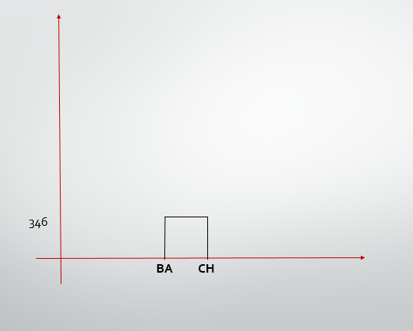
Example: Hierarchical Clustering

Slide 56
 | AH | BACH | DL | HY | KL | MU
AH | 0 | 1497 | 945 | 1179 | 2073 | 525
BACH | 1497 | 0 | 1741 | 569 | 1553 | 813
DL | 945 | 1741 | 0 | 1559 | 1304 | 1163
HY | 1179 | 569 | 1559 | 0 | 1483 | 708
KL | 2073 | 1553 | 1304 | 1483 | 0 | 1947
MU | 525 | 813 | 1163 | 708 | 1947 | 0
 | AH | BACH | DL | HY | KL | MU
AH | 0 | 1497 | 945 | 1179 | 2073 | 525
BACH | 1497 | 0 | 1741 | 569 | 1553 | 813
DL | 945 | 1741 | 0 | 1559 | 1304 | 1163
HY | 1179 | 569 | 1559 | 0 | 1483 | 708
KL | 2073 | 1553 | 1304 | 1483 | 0 | 1947
MU | 525 | 813 | 1163 | 708 | 1947 | 0
 | AH | BACH | DL | HY | KL | MU
AH | 0 | 1497 | 945 | 1179 | 2073 | 525
BACH | 1497 | 0 | 1741 | 569 | 1553 | 813
DL | 945 | 1741 | 0 | 1559 | 1304 | 1163
HY | 1179 | 569 | 1559 | 0 | 1483 | 708
KL | 2073 | 1553 | 1304 | 1483 | 0 | 1947
MU | 525 | 813 | 1163 | 708 | 1947 | 0
 | AH | BACH | DL | HY | KL | MU
AH | 0 | 1497 | 945 | 1179 | 2073 | 525
BACH | 1497 | 0 | 1741 | 569 | 1553 | 813
DL | 945 | 1741 | 0 | 1559 | 1304 | 1163
HY | 1179 | 569 | 1559 | 0 | 1483 | 708
KL | 2073 | 1553 | 1304 | 1483 | 0 | 1947
MU | 525 | 813 | 1163 | 708 | 1947 | 0
 | AH | BACH | DL | HY | KL | MU
AH | 0 | 1497 | 945 | 1179 | 2073 | 525
BACH | 1497 | 0 | 1741 | 569 | 1553 | 813
DL | 945 | 1741 | 0 | 1559 | 1304 | 1163
HY | 1179 | 569 | 1559 | 0 | 1483 | 708
KL | 2073 | 1553 | 1304 | 1483 | 0 | 1947
MU | 525 | 813 | 1163 | 708 | 1947 | 0
The distance between Mumbai & Ahmedabad is the minimum.
Therefore we form cluster of Mumbai and Ahmedabad
 | AHMU | BACH | DL | HY | KL
AHMU | 0 | 813
BACH | 813 | 0 | 1741 | 569 | 1553
DL |  | 1741 | 0 | 1559 | 1304
HY |  | 569 | 1559 | 0 | 1483
KL |  | 1553 | 1304 | 1483 | 0
 | AHMU | BACH | DL | HY | KL
AHMU | 0 | 813 | 945 | 708 | 1947
BACH | 813 | 0 | 1741 | 569 | 1553
DL | 945 | 1741 | 0 | 1559 | 1304
HY | 708 | 569 | 1559 | 0 | 1483
KL | 1947 | 1553 | 1304 | 1483 | 0
 | AHMU | BACH | DL | HY | KL
AHMU | 0
BACH |  | 0 | 1741 | 569 | 1553
DL |  | 1741 | 0 | 1559 | 1304
HY |  | 569 | 1559 | 0 | 1483
KL |  | 1553 | 1304 | 1483 | 0
 | AHMU | BACH | DL | HY | KL
AHMU | 0 | 813 | 945 | 708
BACH | 813 | 0 | 1741 | 569 | 1553
DL | 945 | 1741 | 0 | 1559 | 1304
HY | 708 | 569 | 1559 | 0 | 1483
KL |  | 1553 | 1304 | 1483 | 0
 | AHMU | BACH | DL | HY | KL
AHMU | 0 | 813 | 945
BACH | 813 | 0 | 1741 | 569 | 1553
DL | 945 | 1741 | 0 | 1559 | 1304
HY |  | 569 | 1559 | 0 | 1483
KL |  | 1553 | 1304 | 1483 | 0

Slide 57
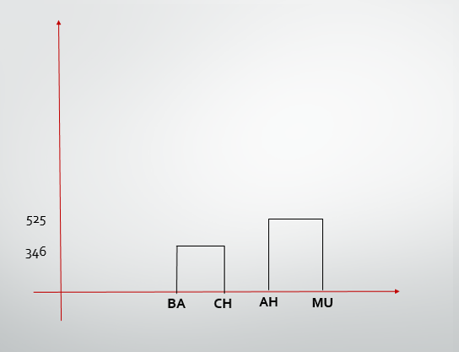
Example: Hierarchical Clustering

Slide 58
 | AHMU | BACH | DL | HY | KL
AHMU | 0 | 813 | 945 | 708 | 1947
BACH | 813 | 0 | 1741 | 569 | 1553
DL | 945 | 1741 | 0 | 1559 | 1304
HY | 708 | 569 | 1559 | 0 | 1483
KL | 1947 | 1553 | 1304 | 1483 | 0
 | AHMU | BACH | DL | HY | KL
AHMU | 0 | 813 | 945 | 708 | 1947
BACH | 813 | 0 | 1741 | 569 | 1553
DL | 945 | 1741 | 0 | 1559 | 1304
HY | 708 | 569 | 1559 | 0 | 1483
KL | 1947 | 1553 | 1304 | 1483 | 0
 | AHMU | BACH | DL | HY | KL
AHMU | 0 | 813 | 945 | 708 | 1947
BACH | 813 | 0 | 1741 | 569 | 1553
DL | 945 | 1741 | 0 | 1559 | 1304
HY | 708 | 569 | 1559 | 0 | 1483
KL | 1947 | 1553 | 1304 | 1483 | 0
 | AHMU | BACH | DL | HY | KL
AHMU | 0 | 813 | 945 | 708 | 1947
BACH | 813 | 0 | 1741 | 569 | 1553
DL | 945 | 1741 | 0 | 1559 | 1304
HY | 708 | 569 | 1559 | 0 | 1483
KL | 1947 | 1553 | 1304 | 1483 | 0
The distance 569 is the closest. Therefore we form
cluster of BACH and HY as BACHY
 | AHMU | BACHY | DL | KL
AHMU | 0 |  | 945 | 1947
BACHY |  | 0
DL | 945 |  | 0 | 1304
KL | 1947 |  | 1304 | 0
 | AHMU | BACHY | DL | KL
AHMU | 0 | 708 | 945 | 1947
BACHY | 708 | 0 | 1559
DL | 945 | 1559 | 0 | 1304
KL | 1947 |  | 1304 | 0
 | AHMU | BACHY | DL | KL
AHMU | 0 | 708 | 945 | 1947
BACHY | 708 | 0
DL | 945 |  | 0 | 1304
KL | 1947 |  | 1304 | 0
 | AHMU | BACHY | DL | KL
AHMU | 0 | 708 | 945 | 1947
BACHY | 708 | 0 | 1559 | 1483
DL | 945 | 1559 | 0 | 1304
KL | 1947 | 1483 | 1304 | 0

Slide 59
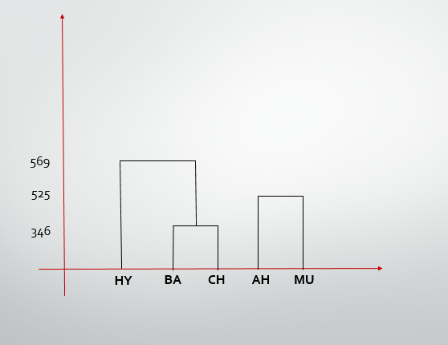
Example: Hierarchical Clustering

Slide 60
Example: Hierarchical Clustering
 | AHMU | BACHY | DL | KL
AHMU | 0 | 708 | 945 | 1947
BACHY | 708 | 0 | 1559 | 1483
DL | 945 | 1559 | 0 | 1304
KL | 1947 | 1483 | 1304 | 0
 | AHMU | BACHY | DL | KL
AHMU | 0 | 708 | 945 | 1947
BACHY | 708 | 0 | 1559 | 1483
DL | 945 | 1559 | 0 | 1304
KL | 1947 | 1483 | 1304 | 0
 | AHMU | BACHY | DL | KL
AHMU | 0 | 708 | 945 | 1947
BACHY | 708 | 0 | 1559 | 1483
DL | 945 | 1559 | 0 | 1304
KL | 1947 | 1483 | 1304 | 0
The distance 708 is closest between AHMU and BACHY
is the minimum
 | AHMUBACHY | BACH | HY
AHMUBACHY | 0
DL |  | 0 | 1304
KL |  | 1304 | 0
 | AHMUBACHY | BACH | HY
AHMUBACHY | 0 | 945
DL | 945 | 0 | 1304
KL |  | 1304 | 0
 | AHMUBACHY | DL | KL
AHMUBACHY | 0 | 945 | 1483
DL | 945 | 0 | 1304
KL | 1483 | 1304 | 0

Slide 61
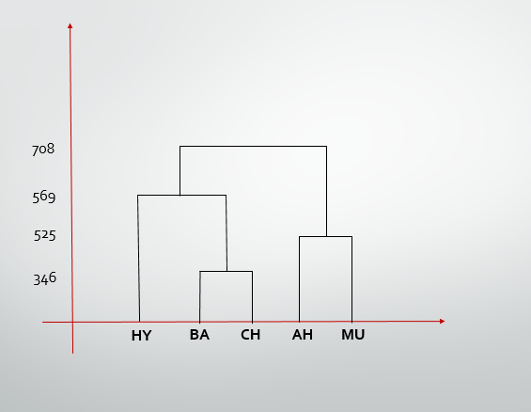
Example: Hierarchical Clustering

Slide 62
Example: Hierarchical Clustering
 | AHMUBACHY | BACH | HY
AHMUBACHY | 0 | 945 | 1483
DL | 945 | 0 | 1304
KL | 1483 | 1304 | 0
 | AHMUBACHY | BACH | KL
AHMUBACHY | 0 | 945 | 1483
DL | 945 | 0 | 1304
KL | 1483 | 1304 | 0
The distance between AHMUBACHY & DL is the minimum.
Therefore we form cluster of ABCDHM
 | ABCDHM | KL
ABCDHM | 0
KL |  | 0
 | ABCDHM | KL
ABCDHM | 0 | 1304
KL | 1304 | 0

Slide 63
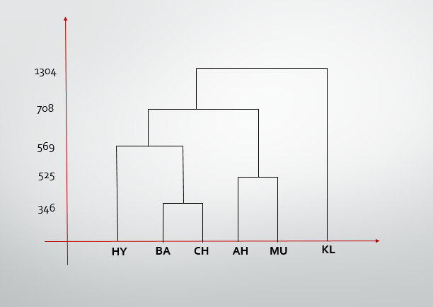
Example: Hierarchical Clustering

Slide 64
Exercise: Hierarchical Clustering
 | A | B | C | D | E | F
A | 0 | 662 | 877 | 255 | 412 | 996
B | 662 | 0 | 295 | 468 | 268 | 400
C | 877 | 295 | 0 | 754 | 564 | 138
D | 255 | 468 | 754 | 0 | 219 | 869
E | 412 | 268 | 626 | 219 | 0 | 669
F | 996 | 400 | 1678 | 869 | 669 | 0

Slide 65
Association: Market Basket Analysis

Slide 66
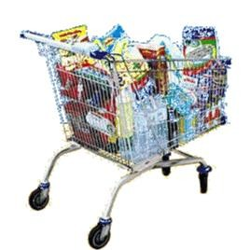
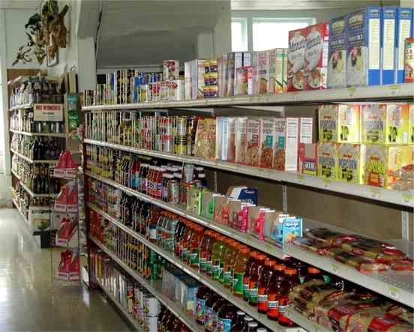

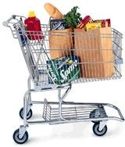

WHAT IS ASSOCIATION RULE MINING?
Association rule mining searches for relationships between items in a dataset:
  aims at discovering associations between items in a
transactional database.
Store
{a,b,c,d…}
find combinations of items that occur typically together
{x,y,z}
{ , , ,…}
Rule form: “Body → Head [support, confidence]”.
buys(x, “bread”) → buys(x, “milk”) [0.6%, 65%]
major(x, “CS”) ^ takes(x, “DB”) → grade(x, “A”) [1%, 75%]

Slide 67

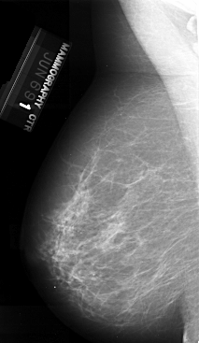
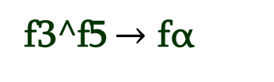
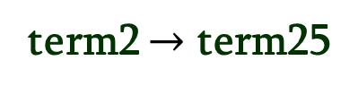
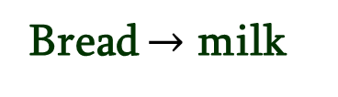
Transaction Frequent itemset
Transactional Databases
Rule
(Bread, milk)
Bread $→$ milk
{bread, milk, Pop,…}
Automatic diagnostic
{term₁, term₂,…,term_{n}}
(term₂, term₂₅)
term2 $→$ term25
(f3, f5, fα)
f3^f5 $→$ fα
{f1, f2,…,fn}

Slide 68






Association Rule Mining
Given a set of transactions, find rules that will predict the occurrence of an item based on the occurrences of other items in the transaction
Market-Basket transactions
Example of Association Rules
{Diaper} → {Beer},
{Milk, Bread} → {Eggs,Coke},
{Beer, Bread} → {Milk},
Implication means co- occurrence, not causality!

Slide 69

DEFINITION: FREQUENT ITEMSET
Itemset
  A collection of one or more items
    Example: {Milk, Bread, Diaper}
  k-itemset
    An itemset that contains k items
Support count ()
  Frequency of occurrence of an itemset
  E.g. ({Milk, Bread,Diaper}) = 2
Support
  Fraction of transactions that contain an itemset
  E.g. s({Milk, Bread, Diaper}) = 2/5
Frequent Itemset
  An itemset whose support is greater than or equal to a minsup threshold

Slide 70
The model: data
I = {i₁, i₂, …, i_{m}}: a set of items.
Transaction t : t a set of items, and t ⊆ I.
Transaction Database T: a set of transactions T = {t₁, t₂, …, t_{n}}.

Slide 71
Transaction data: supermarket data
Market basket transactions:
  t1: {bread, cheese, milk}
  t2: {apple, eggs, salt, yogurt}
  … …
  tn: {biscuit, eggs, milk}
Concepts:
  An item: an item/article in a basket
  I: the set of all items sold in the store
  A transaction: items purchased in a basket; it may have TID (transaction ID)
  A transactional dataset: A set of transactions

Slide 72
Example: Transaction data
Consider the following four sets of items (itemsets) bought together:
{bread, diapers, milk}
{beer, diapers, butter}
{bread, beer, diapers, butter}
{beer, butter}

Slide 73
Example: Transaction data
Transaction id | Items
t1 | {1, 2, 4, 5}
t2 | {2, 3, 5}
t3 | {1, 2, 4, 5}
t4 | {1, 2, 3, 5}
t5 | {1, 2, 3, 4, 5}
t6 | {2, 3, 4}

Slide 74
The model: rules
A transaction t contains X, a set of items (itemset) in I, if X ⊆ t.
An association rule is an implication of the form:
X → Y, where X, Y ⊂ I, and X ∩Y = ∅
An itemset is a set of items.
  E.g., X = {milk, bread, cereal} is an itemset.
A k-itemset is an itemset with k items.
  E.g., {milk, bread, cereal} is a 3-itemset

Slide 75
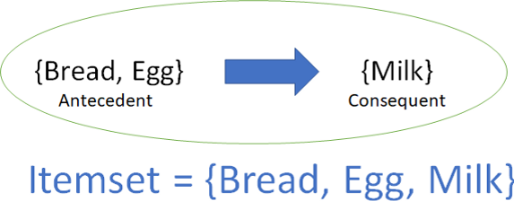
What an association rule exactly looks like?
A `rule’ is something like this:
If a basket contains Bread and Egg, then it also contains Milk.
It consists of an antecedent and a consequent, both of which are a list of items.
For a given rule, itemset is the list of all the items in the antecedent and the consequent.
An association rule is a pattern that states when X occurs, Y occurs with certain probability.

Slide 76
Rule strength measures
  N is the number of transactions in the transaction database,
  sup(X ∪ Y) is the number of transactions containing X and Y,
  sup(X) is the number of transactions containing X
  sup(Y) is the number of transactions containing Y.

Slide 77
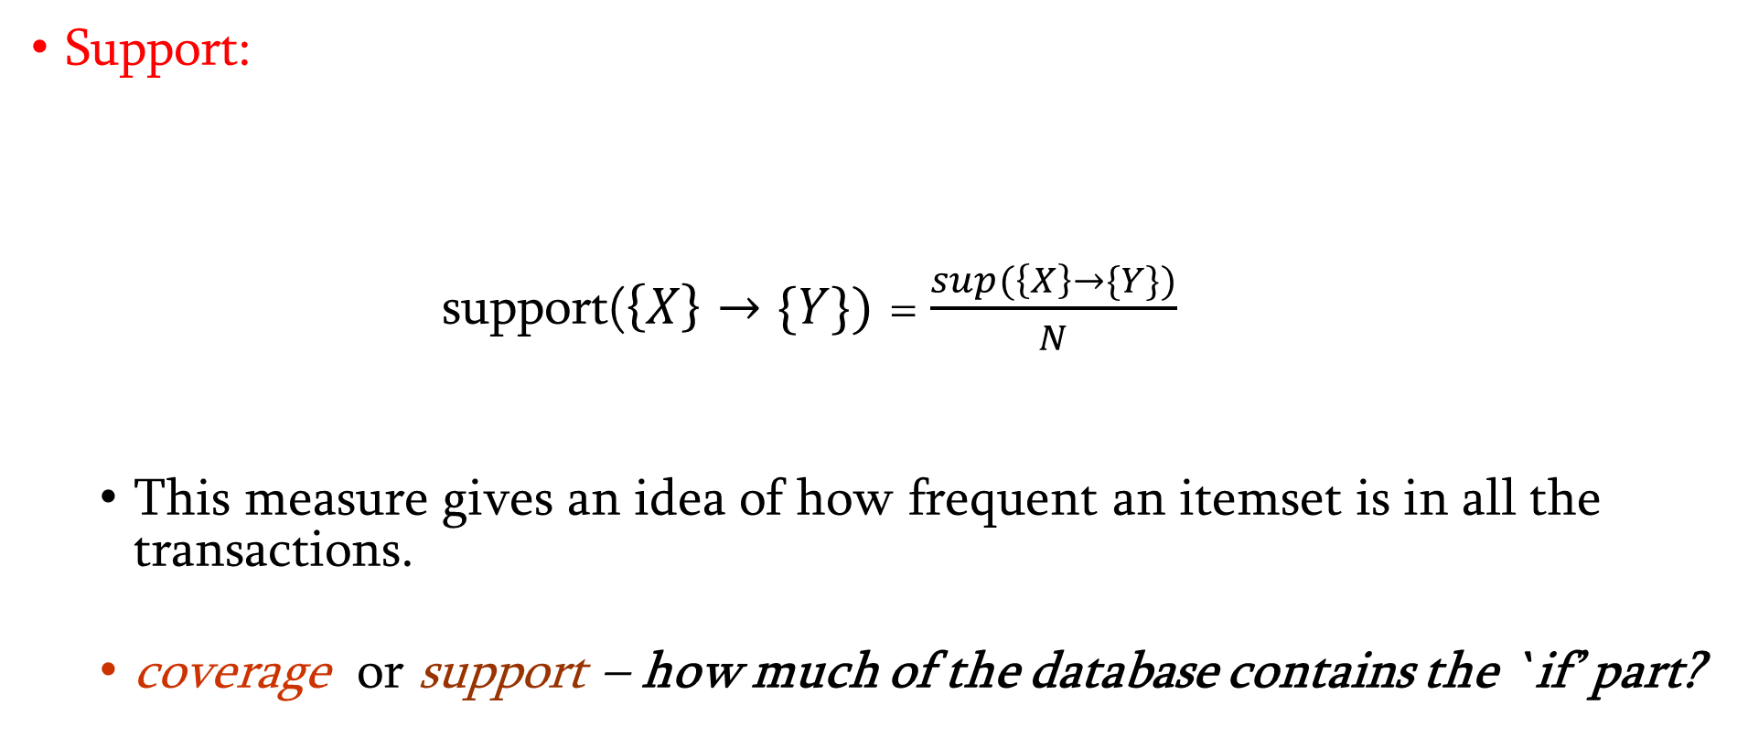
Rule strength measures
Support:
  support($\left\{X\right\}→\{Y\})$ = $\frac{sup(\left\{X\right\}→\{Y\})}{N}$
  This measure gives an idea of how frequent an itemset is in all the transactions.
  coverage or support – how much of the database contains the `if’ part?

Slide 78
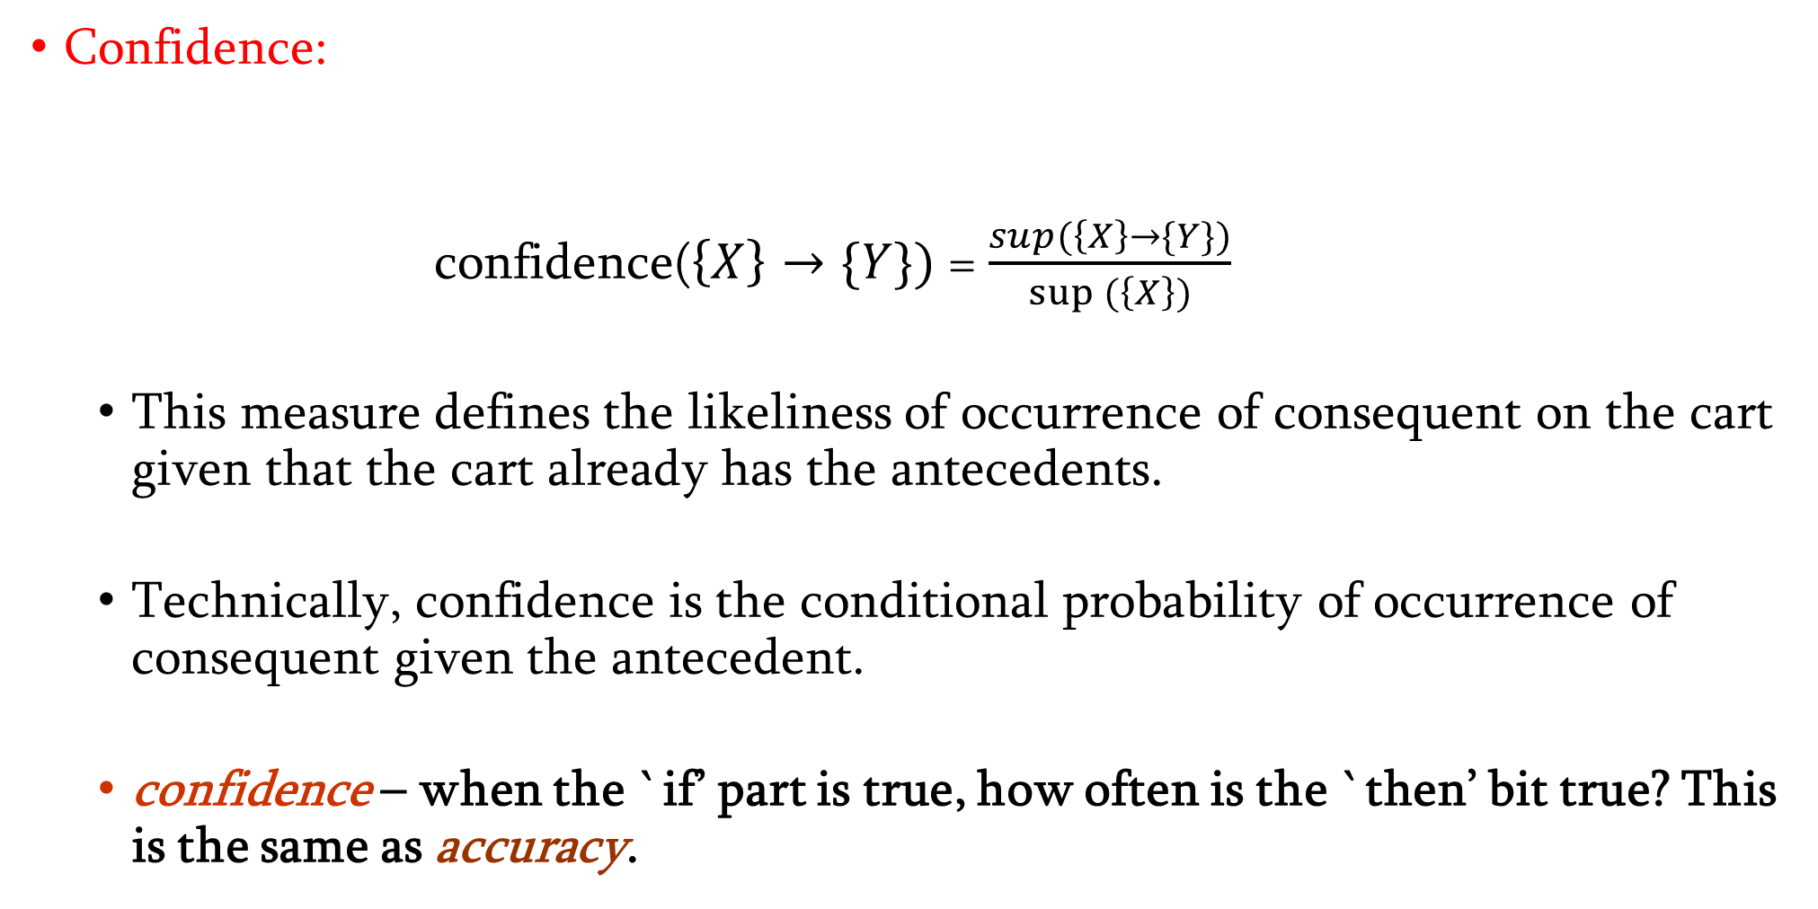
Rule strength measures
Confidence:
  confidence($\left\{X\right\}→\{Y\})$ = $\frac{sup(\left\{X\right\}→\{Y\})}{sup(\left\{X\right\})}$
  This measure defines the likeliness of occurrence of consequent on the cart given that the cart already has the antecedents.
  Technically, confidence is the conditional probability of occurrence of consequent given the antecedent.
  confidence – when the `if’ part is true, how often is the `then’ bit true? This is the same as accuracy.

Slide 79
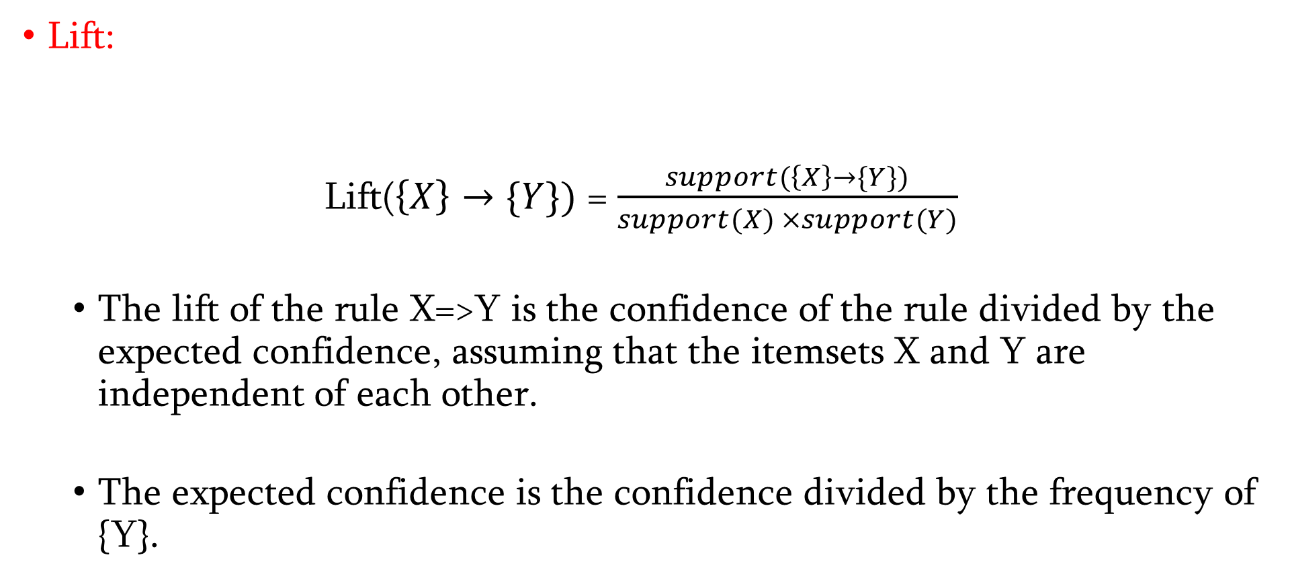
Rule strength measures
Lift:
    Lift($\left\{X\right\}→\{Y\})$ = $\frac{support(\left\{X\right\}→\{Y\})}{support(X) ×support(Y)}$
  The lift of the rule X=>Y is the confidence of the rule divided by the expected confidence, assuming that the itemsets X and Y are independent of each other.
  The expected confidence is the confidence divided by the frequency of {Y}.

Slide 80
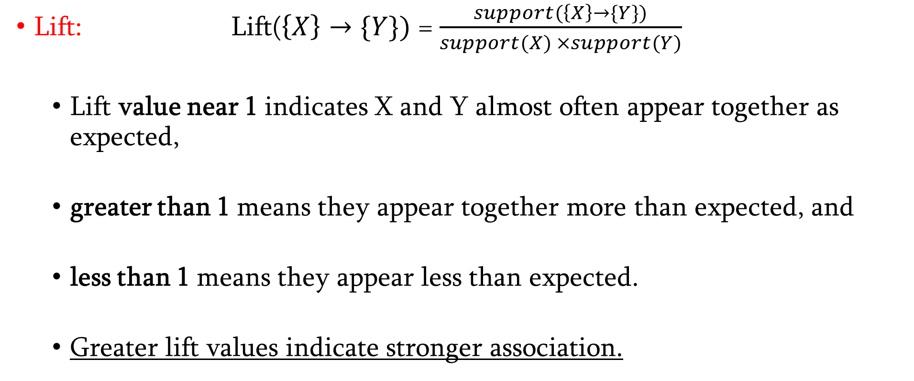
Rule strength measures
Lift: Lift($\left\{X\right\}→\{Y\})$ = $\frac{support(\left\{X\right\}→\{Y\})}{support(X) ×support(Y)}$
  Lift value near 1 indicates X and Y almost often appear together as expected,
  greater than 1 means they appear together more than expected, and
  less than 1 means they appear less than expected.
  Greater lift values indicate stronger association.

Slide 81
What Is An Itemset?
A set of items together is called an itemset. If any itemset has k- items it is called a k-itemset.
An itemset consists of two or more items. An itemset that occurs frequently is called a frequent itemset.
Thus frequent itemset mining is a data mining technique to identify the items that often occur together.
For Example, Bread and butter, Laptop and Antivirus software, etc.

Slide 82
What Is a Frequent Itemset?
A set of items is called frequent if it satisfies a minimum threshold value for support and confidence. Support shows transactions with items purchased together in a single transaction. Confidence shows transactions where the items are purchased one after the other.
For frequent itemset mining method, we consider only those transactions which meet minimum threshold support and confidence requirements. Insights from these mining algorithms offer a lot of benefits, cost-cutting and improved competitive advantage.
There is a tradeoff time taken to mine data and the volume of data for frequent mining. The frequent mining algorithm is an efficient algorithm to mine the hidden patterns of itemsets within a short time and less memory consumption.

Slide 83
Example
1 | Milk | Egg | Bread | Butter
2 | Milk | Butter | Egg | Ketchup
3 | Bread | Butter | Ketchup
4 | Milk | Bread | Butter
5 | Bread | Butter | Cookies
6 | Milk | Bread | Butter | Cookies
7 | Milk | Cookies
8 | Milk | Bread | Butter
9 | Bread | Butter | Egg | Cookies
10 | Milk | Butter | Bread
11 | Milk | Bread | Butter
12 | Milk | Bread | Cookies | Ketchup

Slide 84
Rule strength measures
Support ( Milk)?
Support (Egg) ?
Support (Milk -> Bread) ?
Confidence( Milk-> Bread) ?
Lift(Milk-> Bread) ?

Slide 85
Example
 | Item | Frequency
 | Milk | 9
 | Egg | 3
 | Bread | 10
 | Butter | 10
 | Cookies | 5
 | Ketchup | 3

Slide 86
Apriori Algorithm in Data Mining
1: Find all large 1-itemsets
2: For (k = 2 ; while L_{k-1} is non-empty; k++)
3 {C_{k} = apriori-gen(L_{k-1})
4 For each c in C_{k}, initialise c.count to zero
5 For all records r in the DB
{C_{r} = subset(C_{k}, r); For each c in C_{r} , c.count++ }
7 Set L_{k} := all c in C_{k} whose count >= minsup
8 } /* end -- return all of the L_{k} sets.

Slide 87
Apriori Algorithm in Data Mining
There are two-step process is followed, including join and prune actions which are as follows −
Join Step: This step generates (K+1) itemset from K-itemsets by joining each item with itself.
Prune Step: This step scans the count of each item in the database. If the candidate item does not meet minimum support, then it is regarded as infrequent and thus it is removed. This step is performed to reduce the size of the candidate itemsets.

Slide 88
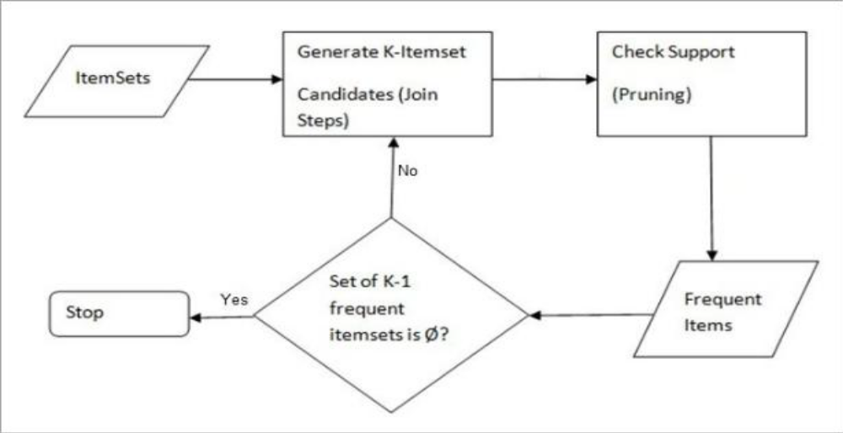
Apriori Algorithm in Data Mining

Slide 89
Apriori Algorithm in Data Mining
The Apriori Algorithm: Pseudo Code
C: Candidate item set of size k
L: Frequent itemset of size k

Slide 90
Apriori Algorithm: Find Association Rules
Here are dozen sales transactions
Find which products sell together often (that is, affinities between products)
The minimum support level will be set at 33% and the confidence level will be set at 50%.

Slide 91
Apriori Algorithm Example
1 | Milk | Egg | Bread | Butter
2 | Milk | Butter | Egg | Ketchup
3 | Bread | Butter | Ketchup
4 | Milk | Bread | Butter
5 | Bread | Butter | Cookies
6 | Milk | Bread | Butter | Cookies
7 | Milk | Cookies
8 | Milk | Bread | Butter
9 | Bread | Butter | Egg | Cookies
10 | Milk | Butter | Bread
11 | Milk | Bread | Butter
12 | Milk | Bread | Cookies | Ketchup

Slide 92
Apriori Algorithm: Iteration 1
 | 1-Item Sets | Frequency
 | Milk | 9
 | Egg | 3
 | Bread | 10
 | Butter | 10
 | Cookies | 5
 | Ketchup | 3
 | Frequent 1-Item Sets | Frequency
 | Milk | 9
 | Bread | 10
 | Butter | 10
 | Cookies | 5

Slide 93
Apriori Algorithm: Iteration 2
Milk
Bread
Butter
Cookies
 | 2-Item Sets | Frequency
 | Milk, Bread | 7
 | Milk, Butter | 7
 | Milk, Cookies | 3
 | Bread, Butter | 9
 | Bread, Cookies | 4
 | Butter, Cookies | 3
 | Frequent 2-Item Sets | Frequency
 | Milk, Bread | 7
 | Milk, Butter | 7
 | Bread, Butter | 9
 | Bread, Cookies | 4

Slide 94
Apriori Algorithm: Iteration 3
Milk
Bread
Butter
Cookies
 | 3-Item Sets | Frequency
 | Milk, Bread, Butter | 6
 | Milk, Bread, Cookies | 2
 | Milk, Butter, Cookies | 1
 | Bread, Butter, Cookies | 3
 | Frequent 3-Item Sets | Frequency
 | Milk, Bread, Butter | 6

Slide 95
Apriori Algorithm: Iteration 3
Milk
Bread
Butter
 | 4-Item Sets | Frequency
 | ???? | ????
 | Frequent 3-Item Sets | Frequency
 | Milk, Bread, Butter | 6

Slide 96
Apriori Algorithm: Association Rule Formation
Frequent 3-Item Set I = { Milk, Bread, Butter}
Non-empty Subset are = { (Milk), (Bread), (Butter),
(Milk, Bread) (Milk, Butter), (Bread, Butter),
(Milk, Bread, Butter)
}

Slide 97
Apriori Algorithm: Association Rule Formation
How to form Association Rule …
For every non-empty set S of I, the association rule is:
S -> (S-I)
If support (I)/ support(S) >= minimum_confidance

Slide 98
Apriori Algorithm: Association Rule Formation
Non-empty Subset are = {(Milk), (Bread), (Butter), (Milk, Bread) (Milk, Butter), (Bread, Butter), (Milk, Bread, Butter)}
Min_support =30% and Min_Confidence = 60%
Rule 1: {Milk} -> {Bread, Butter}
  support(Milk, Bread, Butter) = 6/12
  support(Milk) = 9/ 12
  Confidence = support(Milk, Bread, Butter)/ support(Milk)
      = 6/12 * 12/9 = 6/9
      = 66.67% >= 60%
      √ {Milk} -> {Bread, Butter}

Slide 99
Apriori Algorithm: Association Rule Formation
Rule 2: {Bread} -> {Milk, Butter}
  support(Milk, Bread, Butter) = 6/12
  support(Bread) = 10/ 12
  Confidence = support(Milk, Bread, Butter)/ support(Bread)
      = 6/12 * 12/10 = 6/10
      = 66.00% >= 60%
      √ {Bread} -> {Milk, Butter}
Rule 3: {Butter} -> {Milk, Butter, Bread}
  support(Milk, Bread, Butter) = 6/12
  support(Butter) = 10/ 12
  Confidence = support(Milk, Bread, Butter)/ support(Butter)
      = 6/12 * 12/10 = 6/10
      = 66.00% >= 60%
      √ {Butte} -> {Milk, Bread}

Slide 100
Apriori Algorithm: Association Rule Formation
Rule 4: {Milk, Bread} -> {Butter}
  support(Milk, Bread, Butter) = 6/12
  support(Milk, Bread) = 7/ 12
  Confidence = support(Milk, Bread, Butter)/ support(Milk, Bread)
      = 6/12 * 12/7 = 6/7
      = 85.7% >= 60%
      √ {Milk, Bread} -> {Butter}
Rule 5: {Milk, Butter} -> {Bread}
  support(Milk, Bread, Butter) = 6/12
  support(Milk, Butter) = 7/ 12
  Confidence = support(Milk, Bread, Butter)/ support(Milk, Butter)
      = 6/12 * 12/7 = 6/7
      = 85.7% >= 60%
      √ {Milk, Butter} -> {Bread}

Slide 101
Apriori Algorithm: Association Rule Formation
Rule 6: {Butter, Bread} -> {Milk}
  support(Milk, Bread, Butter) = 6/12
  support(Butter, Bread) = 7/ 12
  Confidence = support(Milk, Bread, Butter)/ support(Butter, Bread)
      = 6/12 * 12/9 = 6/9
      = 85.7% >= 66.66%
      √ {Butter, Bread} -> {Milk}

Slide 102
Thanks

