Slide 1
Capital Budgeting:
Principles, Tools & Techniques, Cash Flow Estimation
Executive Certificate Program in
Financial Data Analytics & Corporate Finance
Module – 1: Corporate finance fundamentals
Prof. M Shameem Jawed, IIM Visakhapatnam

Slide 2
For Firm’s growth and survival in the competitive market space, it needs…
Constant Flow of Ideas, for:
  Developing New Product/Services
  Improving the quality of existing Product/Service
  Reducing the cost of production/operations
  Reach to new markets/geographies, etc.
Thus, good companies should always be looking new project proposals, screen them and choose the ones which are value maximizing!

Slide 3
Capital Budgeting?
Process of identifying projects that add value to the firm (shareholders).
At mid/senior management levels, Capital Budgeting is perhaps one of the most important and crucial decisions which managers make. Why?

Slide 4
Ans (Why?)
Cap. Budgeting:
  Defines the strategic direction of the firm(Product/Geographical diversification)
  Long term implications (reducing financial flexibility)
  Poor decisions can have serious value eroding consequences in future
    (Overinvestment/ underinvestment) leading to excess capacity or inferior quality w.r.t. competition resulting in reduced profitability or shrinking market share.

Slide 5
Six most used Capital Budgeting Methods…
Net Present Value (NPV)
Internal Rate of Return (IRR)
Modified Internal Rate of Return (MIRR)
Payback Method
Discounted Payback Method
Profitability Index (PI)

Slide 6
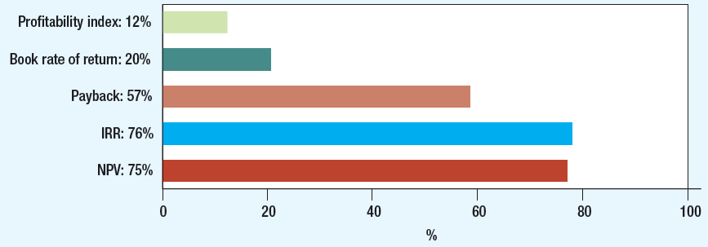
CFO Decision Tools (Globally)

Slide 7
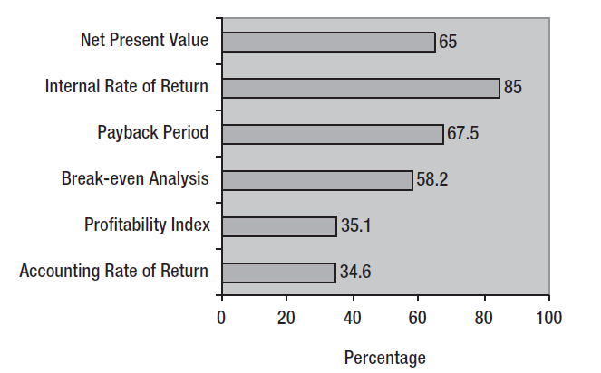
CFO Decision Tools (India)

Slide 8
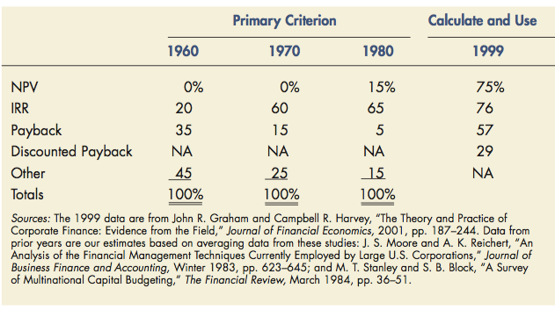
Capital Budgeting Methods Used in Practice: A Temporal View

Slide 9
Project S & L
Project/Year | t=0 | t=1 | t=2 | t=3 | t=4
Project-S | -1,000 | 500 | 400 | 300 | 100
Project-L | -1,000 | 100 | 300 | 400 | 600
Cost of Capital = (Project ) |  | 10%

Slide 10

Net Present Value (NPV) Method
Let’s calculate the NPV of Project S & L…

Slide 11
NPV In MS-Excel
= NPV(rate, value1, value2, …., value(n)) – value0
  E.g.,
  = NPV (0.1, B2 : B12) – B1
  = NPV (10%, B2 : B12) – B1

Slide 12

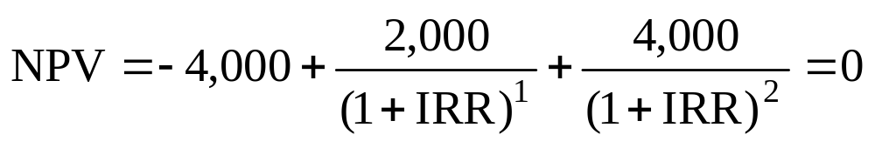
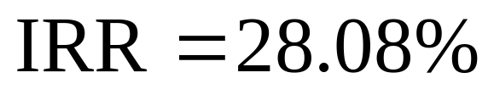
Internal Rate of Return
Example
  Tool A costs 4,000. Investment will generate Rs. 2,000 and Rs. 4,000 in cash flows for two years. What is IRR?

Slide 13
IRR In MS-Excel
= IRR(value0, value2, …..., value(n), Guess)
  E.g.,
  = IRR (B1 : B12, 0.1)
  = IRR (B1 : B12, 10%)

Slide 14
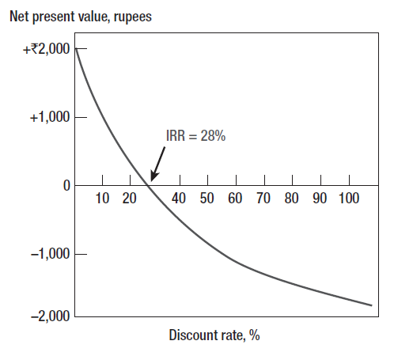
Internal Rate of Return

Slide 15
Internal Rate of Return
Pitfall 1: Lending or Borrowing?
  IRR?
  NPV ?
Project/Year | t=0 | t=1
A | -1,000 | 1500
B | +1,000 | -1500
Cost of Capital of the (Projects) = 10%

Slide 16
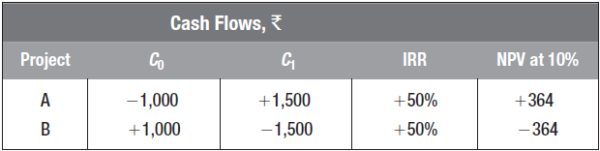
Internal Rate of Return
Pitfall 1: Lending or Borrowing?
  NPV of project increases as discount rate increases for some cash flows

Slide 17
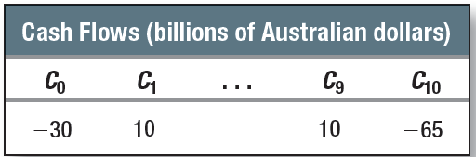
Internal Rate of Return
Pitfall 2: Multiple Rates of Return
  Certain cash flows generate NPV = 0 at two different discount rates
    Following cash flow generates NPV = $A253 million at IRR% of 3.5% and 19.54%

Slide 18
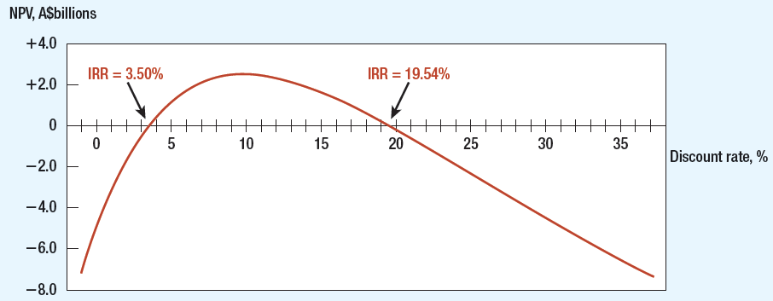
Multiple Rates of Return

Slide 19
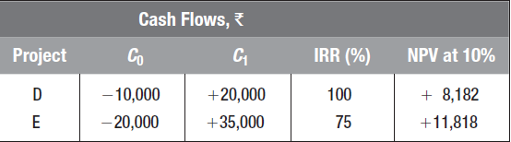
Internal Rate of Return
Pitfall 3: Mutually Exclusive Projects
  IRR sometimes ignores magnitude of project

Slide 20
Project/Year | t=0 | t=1 | t=2 | t=3 | t=4
Project-S | -1,000 | 500 | 400 | 300 | 100
Project-L | -1,000 | 100 | 300 | 400 | 600
Cost of Capital = (Project ) |  | 7.0%

Slide 21
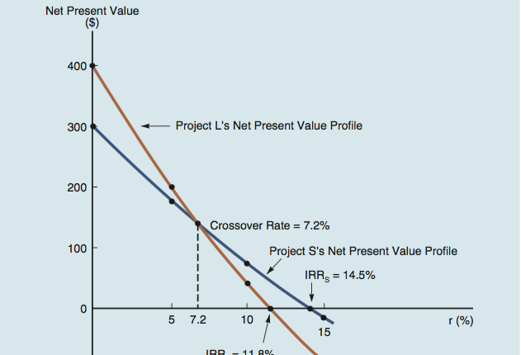

Slide 22
Internal Rate of Return
Pitfall 4: More than One Opportunity Cost of Capital
  Term Structure Assumption
    Assume discount rates stable during term of project
  Implies all funds reinvested at IRR
    False assumption

Slide 23
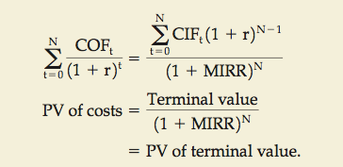
MIRR

Slide 24
MIRR in MS-Excel
  =MIRR(cash flows, financing rate, reinvestment rate)
  Where:
    Cash Flows – Individual cash flows from each period in the series
    Financing Rate – Cost of borrowing or interest expense in the event of negative cash flows
    Reinvestment Rate – Compounding rate of return at which positive cash flow is reinvested

Slide 25
Payback
Payback Period
  Number of years before cumulative cash flow equals initial outlay
Payback Rule
  Only accept projects that pay back within desired time frame
  Ignores later year cash flows and present value of future cash flows

Slide 26
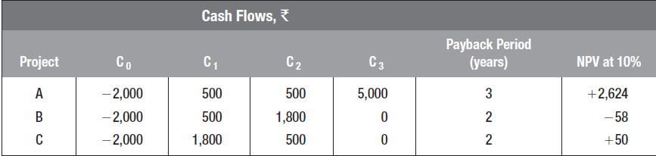
Payback
Example
  Find disadvantage of only taking projects with payback period of two years or less

Slide 27
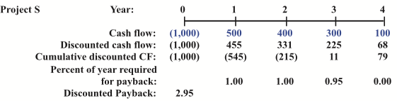
Discounted Payback
Number of years required to recover the investment from discounted net cash flows.

Slide 28
Let’s now talk a little about the X-factor!
Can you point out one basic underlying assumption in all the methods discussed so far which may not be true in real life?
  Timing of cash flows – both in and out!
  Cash don’t wait till the end of the year to come and go!
  =XNPV(rate, values, dates) ,
  =XIRR (values, date, guess[rate])

Slide 29
Choosing Capital Investments When Resources are Limited
Capital Rationing
  Limit set on amount of funds available for investment
    Soft Rationing
      Imposed by management
    Hard Rationing
      Imposed by unavailability of funds in capital market

Slide 30
Choosing Capital Investments When Resources are Limited
Profitability Index (PI)
  Tool for selecting between project combinations and alternatives
  Set of limited resources and projects can yield various combinations
  Highest weighted average PI indicates optimal project

Slide 31
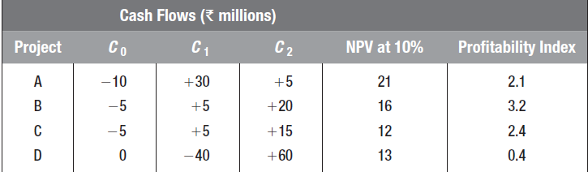
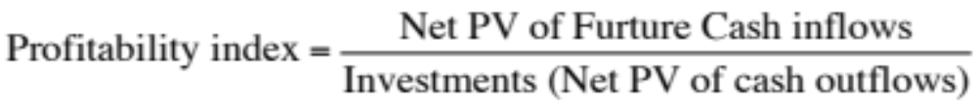
Choosing Capital Investments When Resources are Limited

Slide 32
Choosing Capital Investments When Resources are Limited
Example
  Select best projects for Rs. 300,000
Project | NPV | Investment | PI
A | 230,000 | 200,000 | 1.15
B | 141,250 | 125,000 | 1.13
C | 194,250 | 175,000 | 1.11
D | 162,000 | 150,000 | 1.08

Slide 33
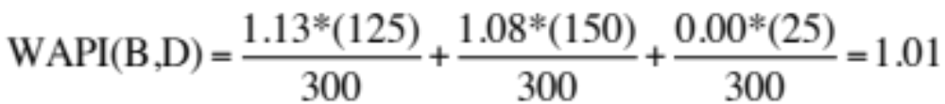
Choosing Capital Investments When Resources are Limited
Example
Project | NPV | Investment | PI
A | 230,000 | 200,000 | 1.15
B | 141,250 | 125,000 | 1.13
C | 194,250 | 175,000 | 1.11
D | 162,000 | 150,000 | 1.08
Select Projects with highest Weighted average PI.

Slide 34
Choosing Capital Investments When Resources are Limited
Example (Continued)
Select projects with highest weighted average PI
  WAPI (BD) = 1.01
  WAPI (A) = 0.77
  WAPI (BC) = 1.12
Project | NPV | Investment | PI
A | 230,000 | 200,000 | 1.15
B | 141,250 | 125,000 | 1.13
C | 194,250 | 175,000 | 1.11
D | 162,000 | 150,000 | 1.08

Slide 35
Let’s turn to the case – 1
Take 5 minutes and read the Case...
Which are the top four projects to be recommended?
15-23

Slide 36
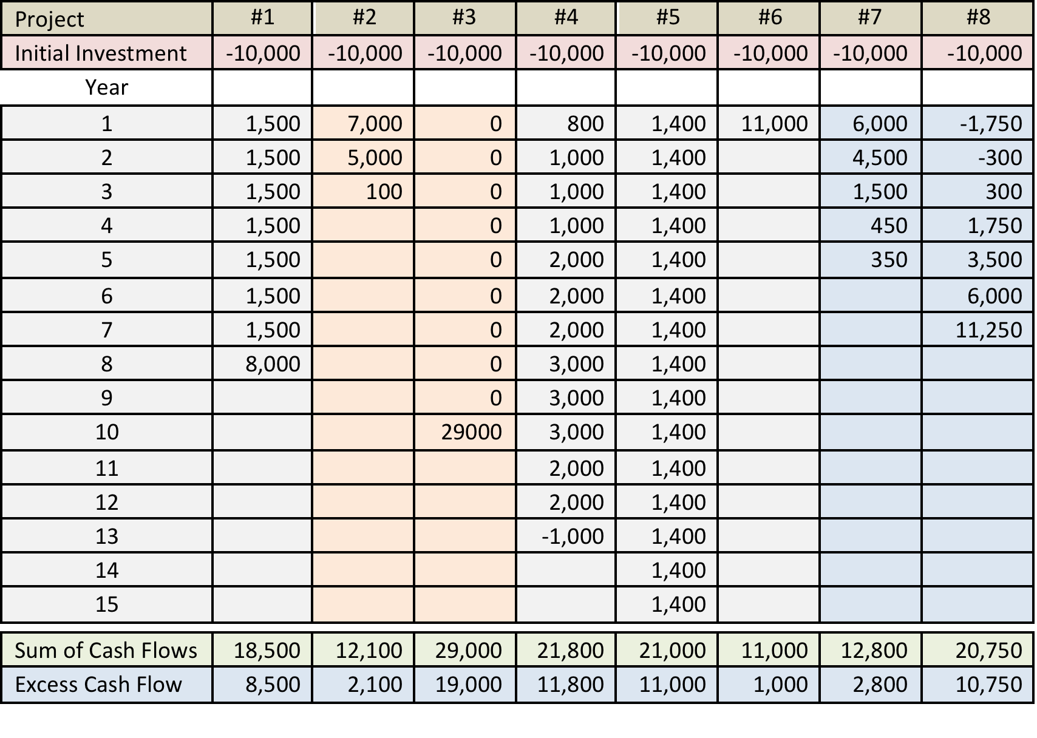

Slide 37
For projects with unequal life…
Repeated Chain Method
Equivalent Annuity Method

Slide 38
Do we get the cash flows (on a platter) for real life projects?
  No, someone needs to estimate them…
  Can we do it ourselves?

Slide 39
Regency Integrated Chips
Take 5 mins and read the problem.
What is it all about?
The managerial dilemma?

Slide 40
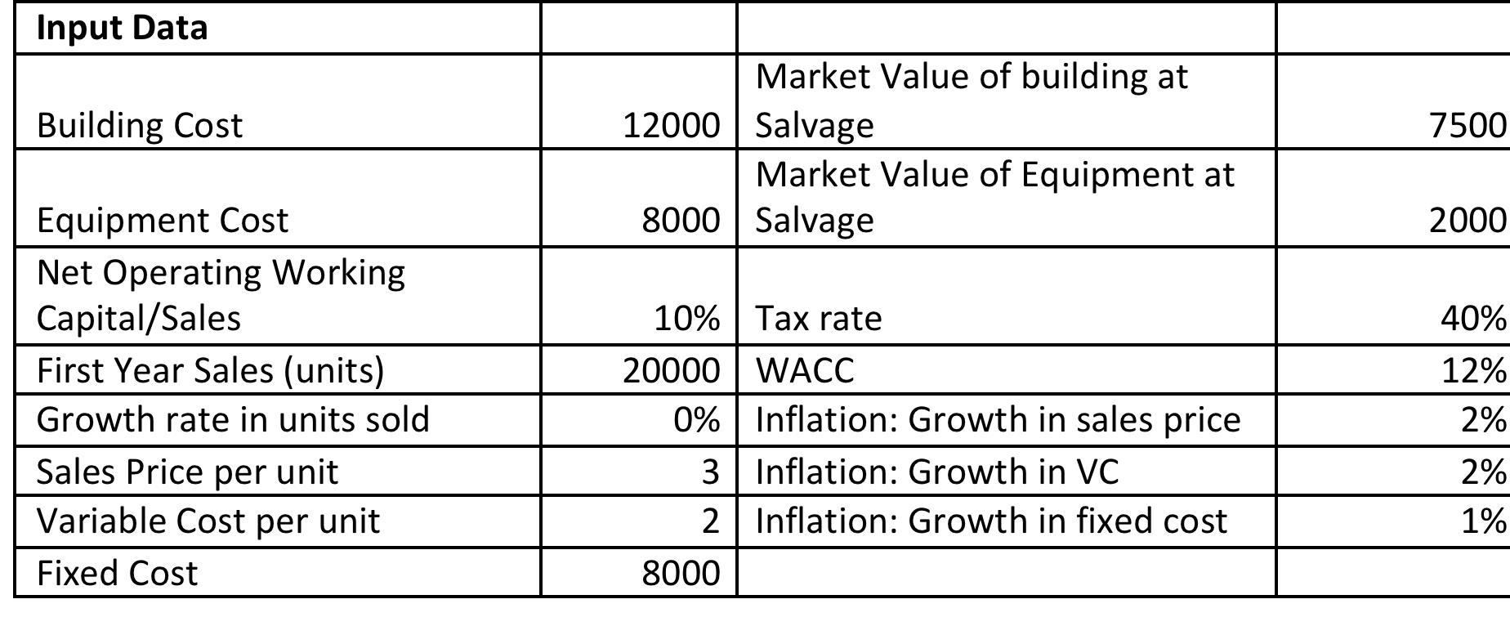
A snapshot of the Problem…

Slide 41
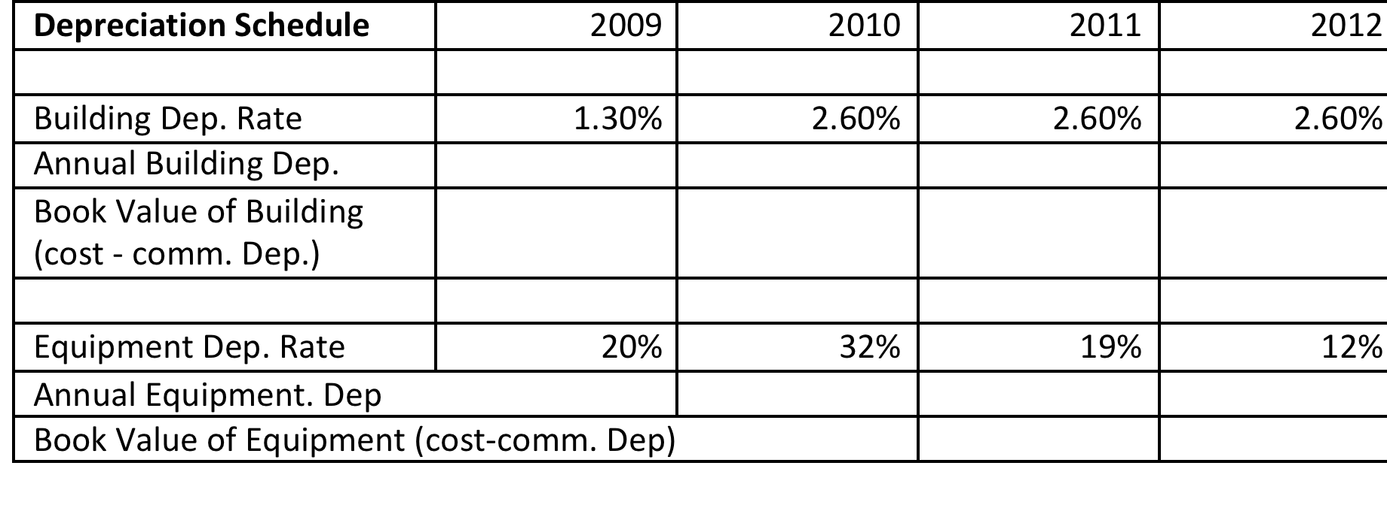
Lets start by computing the depreciation schedule

Slide 42
Net Salvage Value?
Net Salvage Value @ end of project
 | Building | Equipment
Market Value when Salvaged (2010)
Book value when salvaged
Expected Gain/Loss
Taxes liability or credit
Net Cash flow from Salvage

Slide 43
Free Cash Flow =
Investment Outlay
+ Net Operating cash Flow (NOPAT)
+ Net change in Operating Working Capital
+ Salvage cash Flow (if any)
Projected Net Cash Flows in our case for the year 2009-2012?

Slide 44
 |  | 2008 | 2009 | 2010 | 2011 | 2012
Investment Outlay - Long Term investments
 | Bulding | 12000
 | Equipment | 8000
Operating Cash Flow of the Project
 | Units Sold
 | Sales Price
 | Sales Revenue
 | Variable Cost
 | Fixed Operating cost
 | Dep. (Building)
 | Dep. (Equipment)
 | Operating Income before taxes (EBIT)
 | Tax on operating Income (40%)
 | NOPAT
 | Add back the Dep.
 | Operating Cash Flow
Cash Flow due to net operating working capital change
 | Net Operating working capital (based on sales)
 | Cash flow due to investments in NOWC
Salvage cash Flow- long term assets
 | Net Salvage cash Flow (Building)
 | Net Salvage cash Flow (Equipement)
Project Net cash Flow

Slide 45


