Slide 1
Capital Budgeting:
Principles, Tools & Techniques, Cash Flow Estimation
Executive Certificate Program in
Financial Data Analytics & Corporate Finance
Module – 1: Corporate finance fundamentals
Prof. M Shameem Jawed, IIM Visakhapatnam

Slide 2
Do we get the cash flows (on a platter) for real life projects?
  No, someone needs to estimate them…
  Can we do it ourselves?

Slide 3
Estimation of cash flow for capital budgeting excercise
Regency Integrated Chips
What is the case all about? , what’s the managerial dilemma?

Slide 4
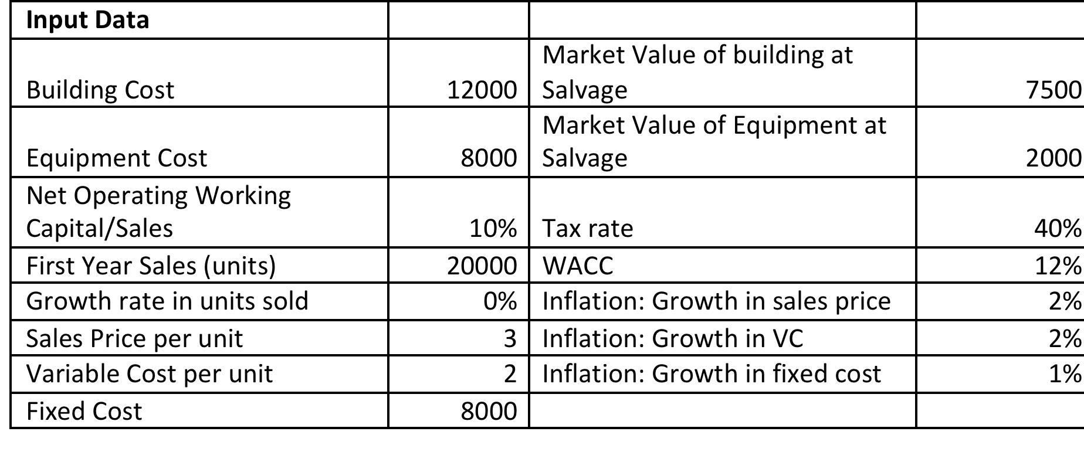
A snapshot of the Problem…

Slide 5
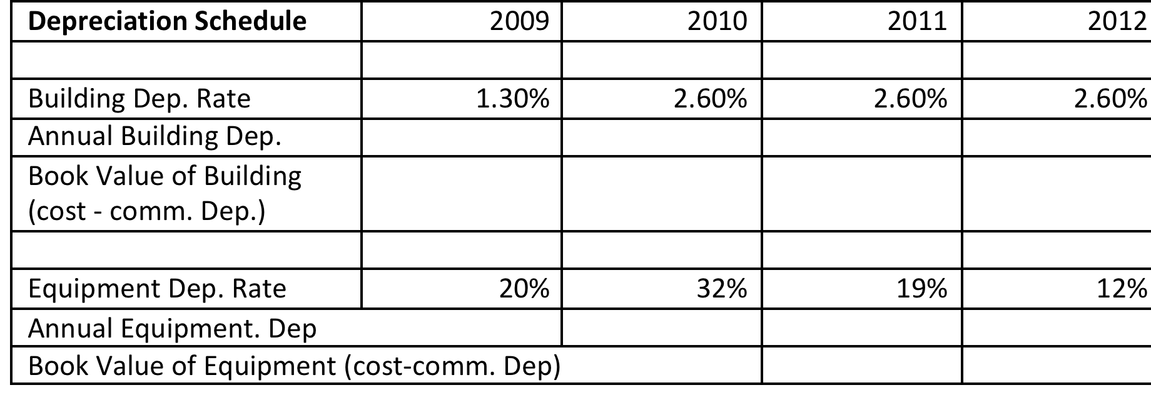
Lets start by computing the depreciation schedule

Slide 6
Net Salvage Value?
Net Salvage Value @ end of project
 | Building | Equipment
Market Value when Salvaged (2010)
Book value when salvaged
Expected Gain/Loss
Taxes liability or credit
Net Cash flow from Salvage

Slide 7
Free Cash Flow =
Investment Outlay
+ Net Operating cash Flow (NOPAT)
+ Net change in Operating Working Capital
+ Salvage cash Flow (if any)
Projected Net Cash Flows in our case for the year 2009-2012?

Slide 8
 |  | 2008 | 2009 | 2010 | 2011 | 2012
Investment Outlay - Long Term investments
 | Bulding | 12000
 | Equipment | 8000
Operating Cash Flow of the Project
 | Units Sold
 | Sales Price
 | Sales Revenue
 | Variable Cost
 | Fixed Operating cost
 | Dep. (Building)
 | Dep. (Equipment)
 | Operating Income before taxes (EBIT)
 | Tax on operating Income (40%)
 | NOPAT
 | Add back the Dep.
 | Operating Cash Flow
Cash Flow due to net operating working capital change
 | Net Operating working capital (based on sales)
 | Cash flow due to investments in NOWC
Salvage cash Flow- long term assets
 | Net Salvage cash Flow (Building)
 | Net Salvage cash Flow (Equipement)
Project Net cash Flow

Slide 9
How to measure Project Risk?
Commonly used techniques of analyzing Standalone Project’s risk:
    Sensitivity Analysis
    Scenario Analysis
    Monte Carlo Simulation

Slide 10
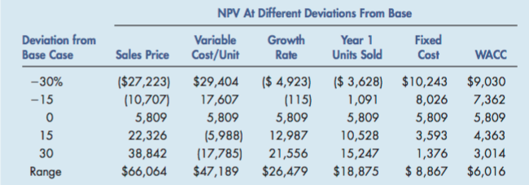
Sensitivity Analysis

Slide 11
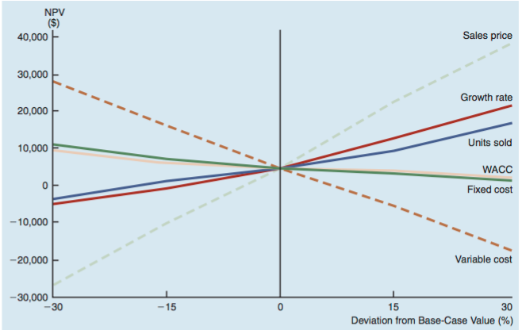

Slide 12
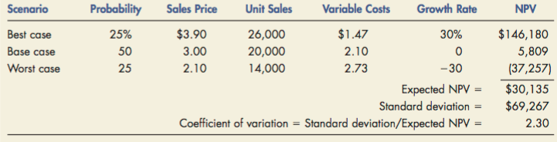
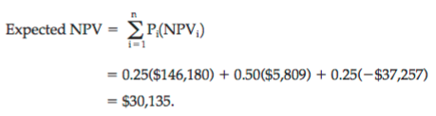
    Scenario Analysis

Slide 13
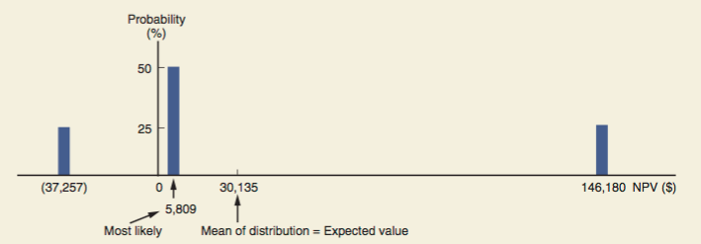
Scenario Analysis

Slide 14
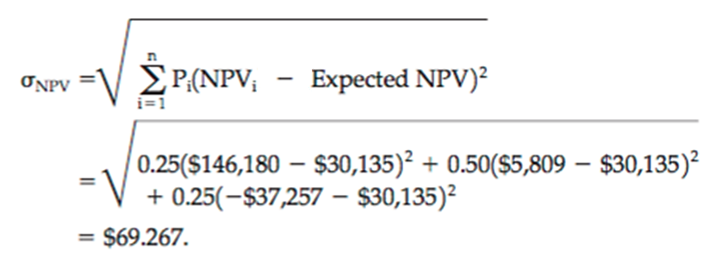

Project’s Coefficient of Variation
Calculate the SD of the different estimates of NPVs
Divide the SD with mean NPV to get the Project’s CV/CoV.

Slide 15
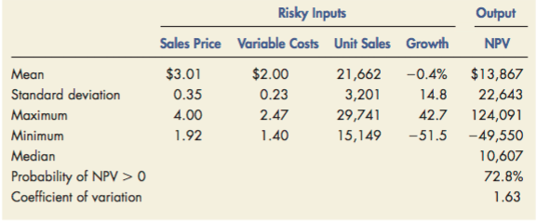
Monte-Carlo Simulation

Slide 16
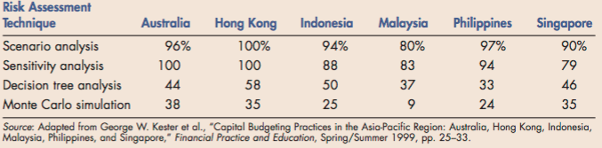

Slide 17


