Slide 1
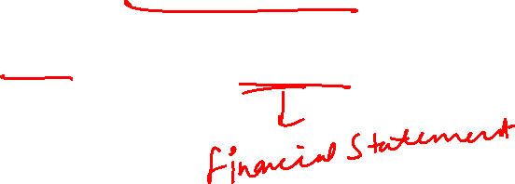
Financial Statement Analysis - Quantitative
Dr. Monika Dhochak

Slide 2
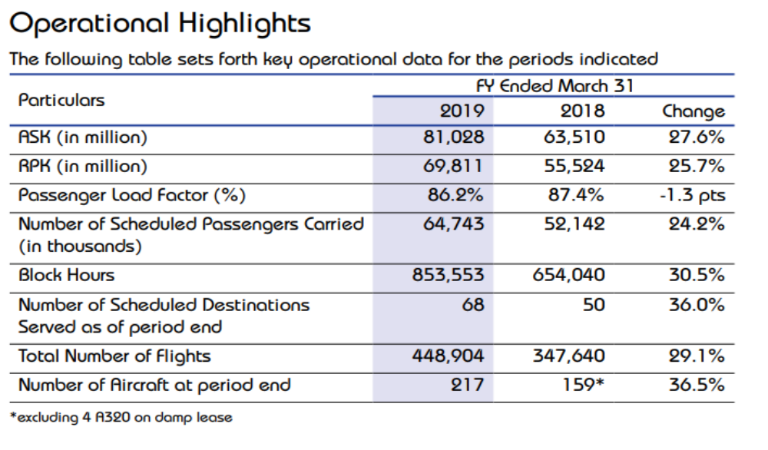
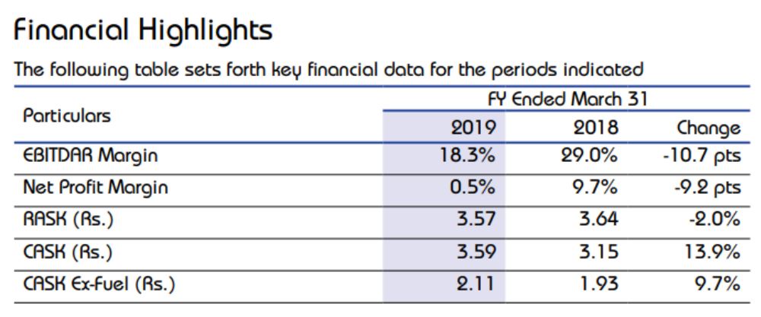

Indigo
ASK – available Seat kms
RPK = revenue passenger kms
RASK= revenue per available seat km
CASK=Unit cost per available seat km

Slide 3
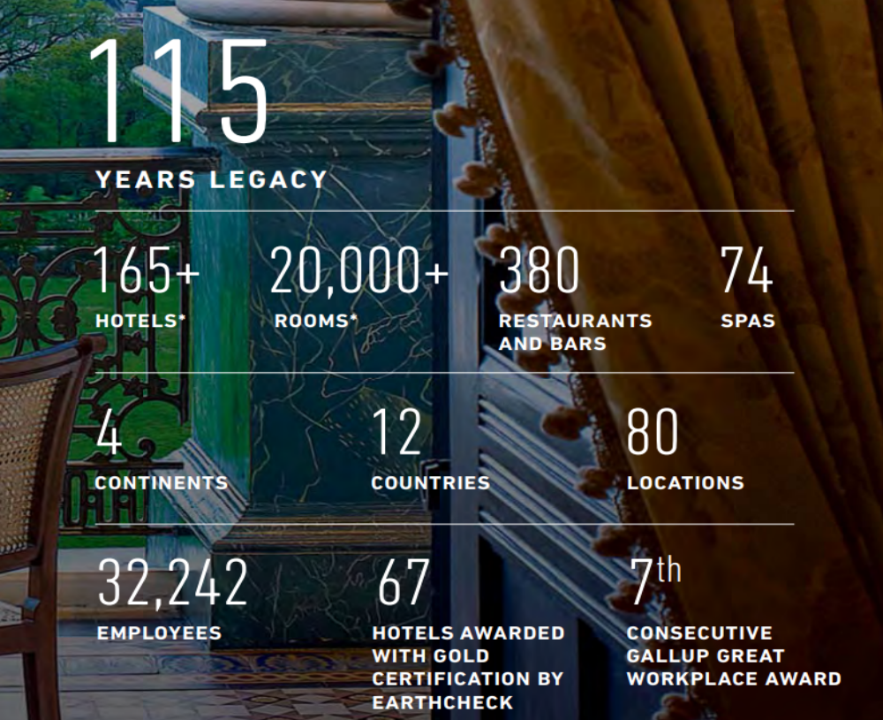
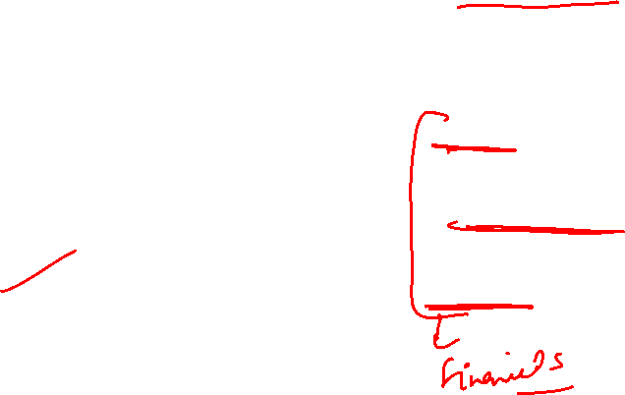
Indian Hotels Co. Ltd.
2017-18
30% consumer loyalty revenue
64% average occupancy
Rs. 5530 revenue per available room
Rs. 8634 average room rate
30.56 Lakhs guests welcomed during the year

Slide 4
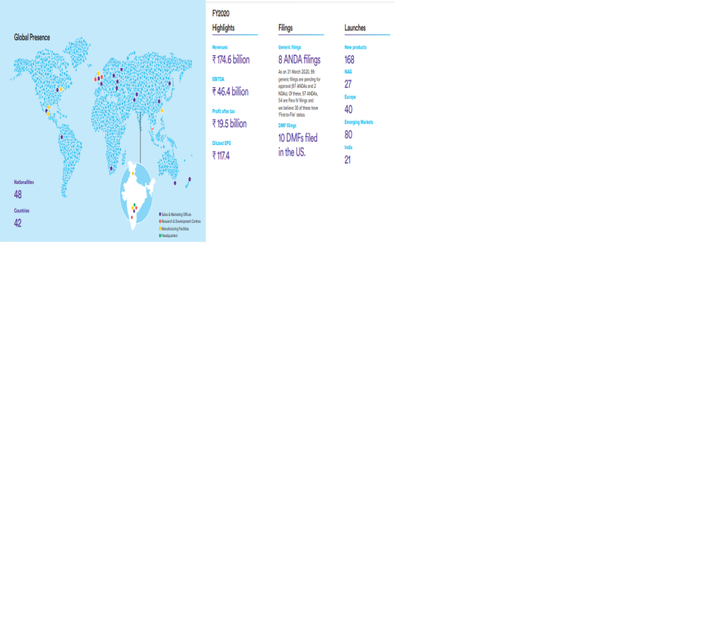
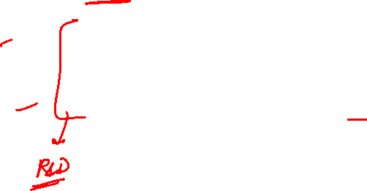
Dr. Reddy’s

Slide 5
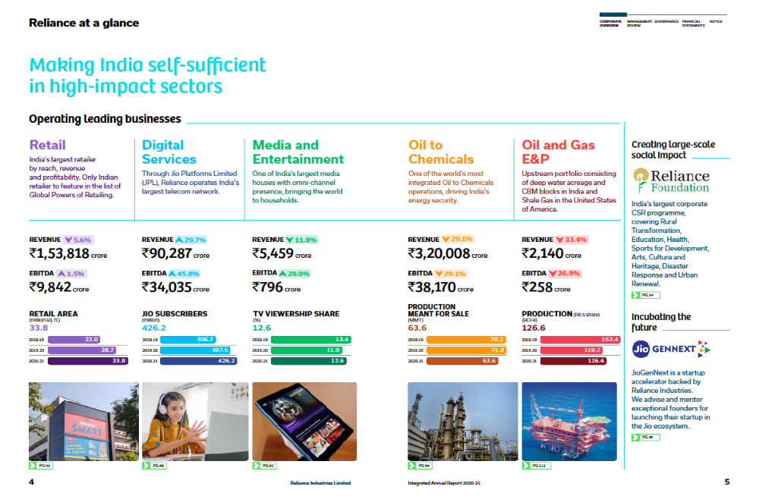
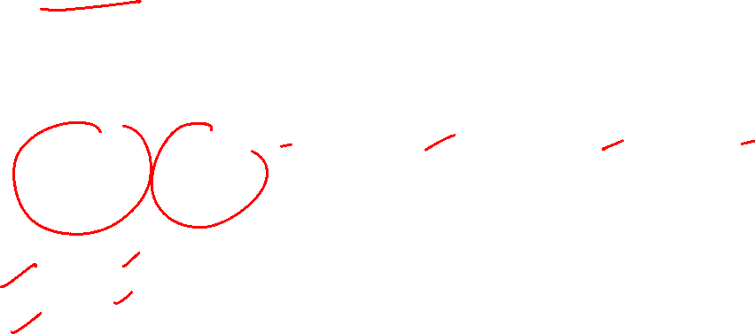

Slide 6
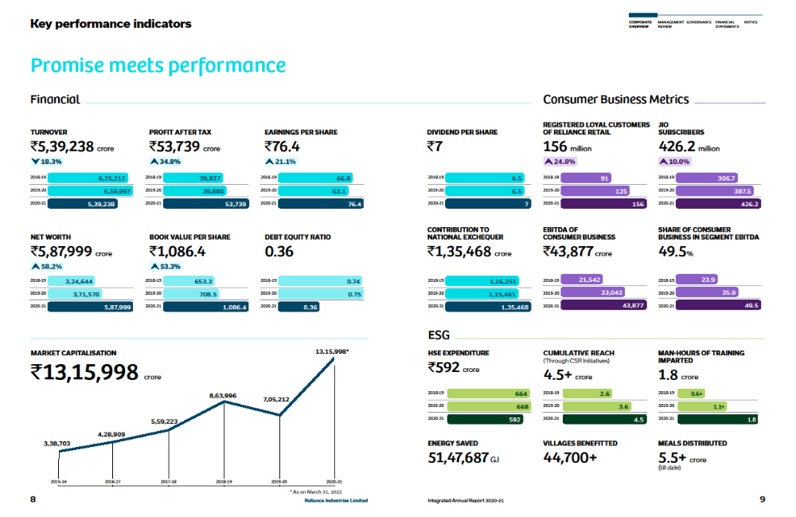

Slide 7

Framework for Financial Analysis
The purpose of financial analysis is to evaluate financial performance (Income Statement), financial position (Balance Sheet)and liquidity/solvency position of a company.
Such an evaluation (Benchmarking) is done in 3 ways:
  Compare the data/results of the same company over a period of time – trend analysis
  Compare the data with that of other companies/competitor
  Compare the data with industry average

Slide 8
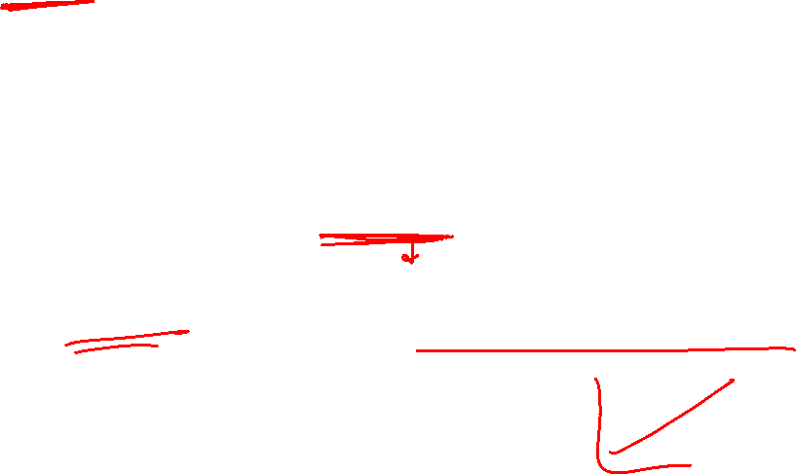
GVK – The House of Debt
The GVK group built India’s first six-lane expressway, airports in Bengaluru, Mumbai and Bali.
In the boom years after 2008, Indian companies borrowed heavily.
Unfortunately, there growth expectations were over-optimistic.

Slide 9
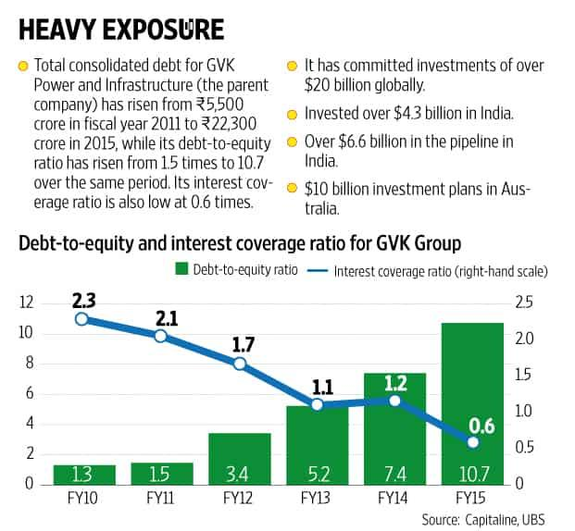
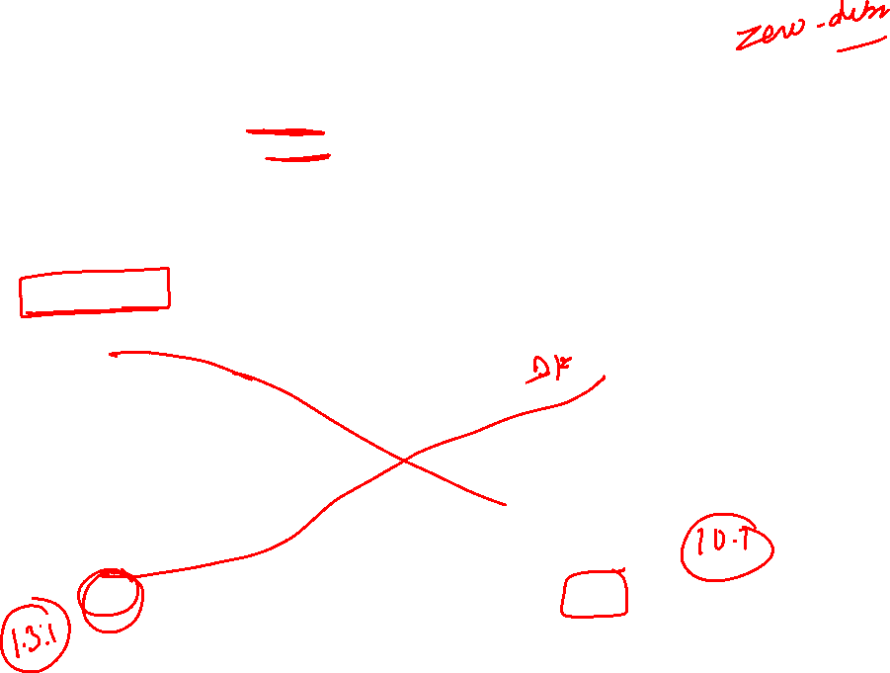
Raghuram Rajan, RBI governor said
“Debt is very much like a dynamite. It is an instrument which is very useful in right places and explosive in others”

Slide 10
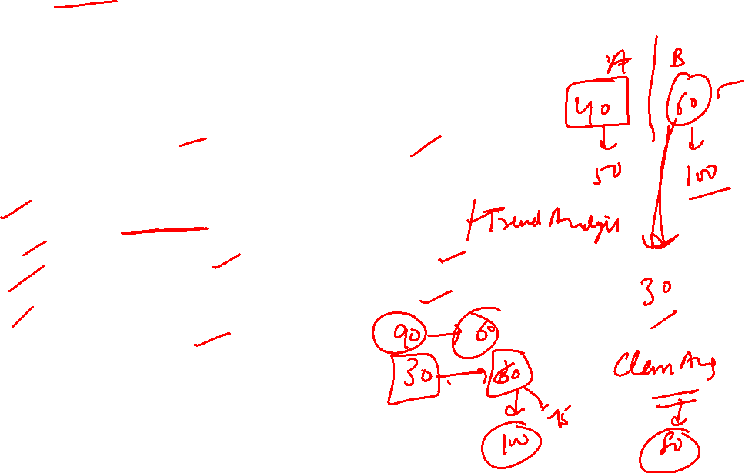
Analyzing financial statements involves:
Characteristics
Comparison
Bases
Tools of
Analysis
Liquidity
Profitability
Turnover
Solvency
Intracompany
Industry averages
Intercompany
Horizontal
Vertical
Ratio

Slide 11

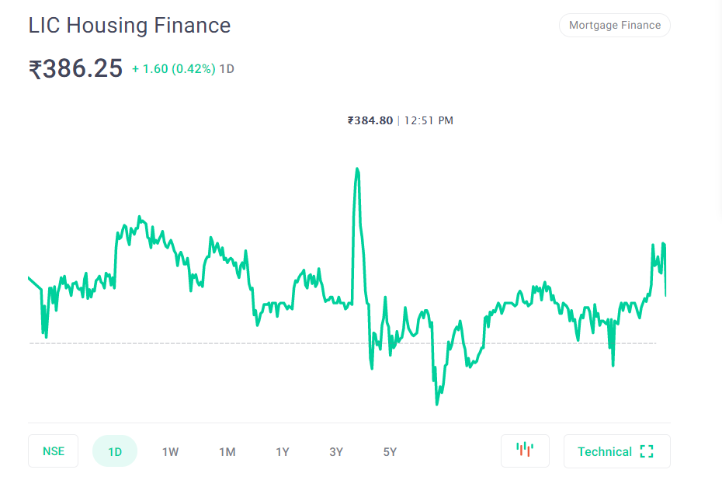
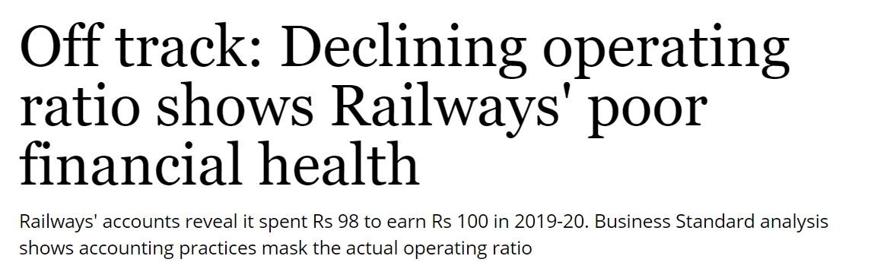
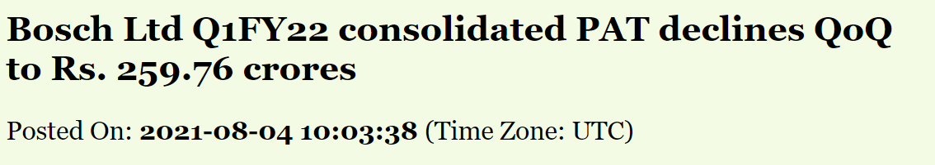
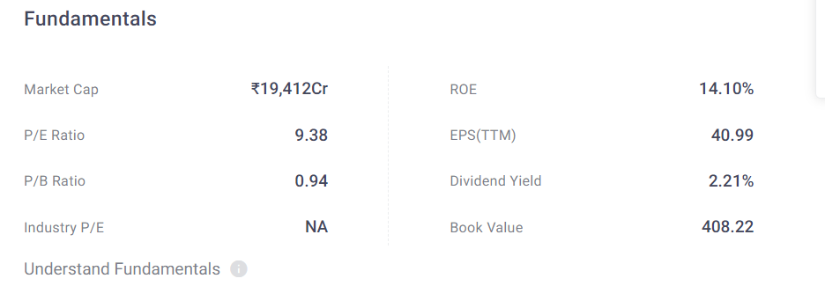
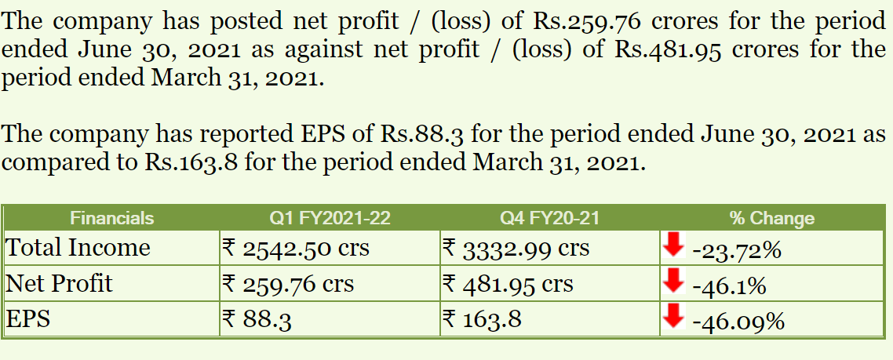
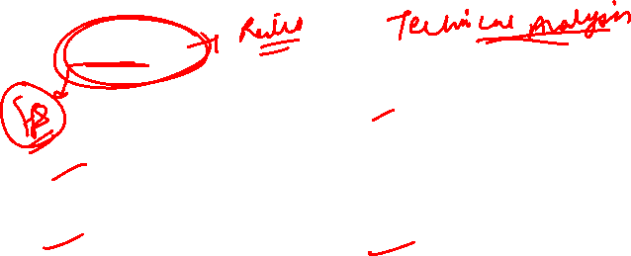

Slide 12

Horizontal Analysis
Horizontal analysis, also called trend analysis, is a technique for evaluating a series of financial statement data over a period of time.
  Purpose is to determine the increase or decrease.
  Commonly applied to the
    balance sheet,
    income statement, and
    statement of retained earnings.

Slide 13
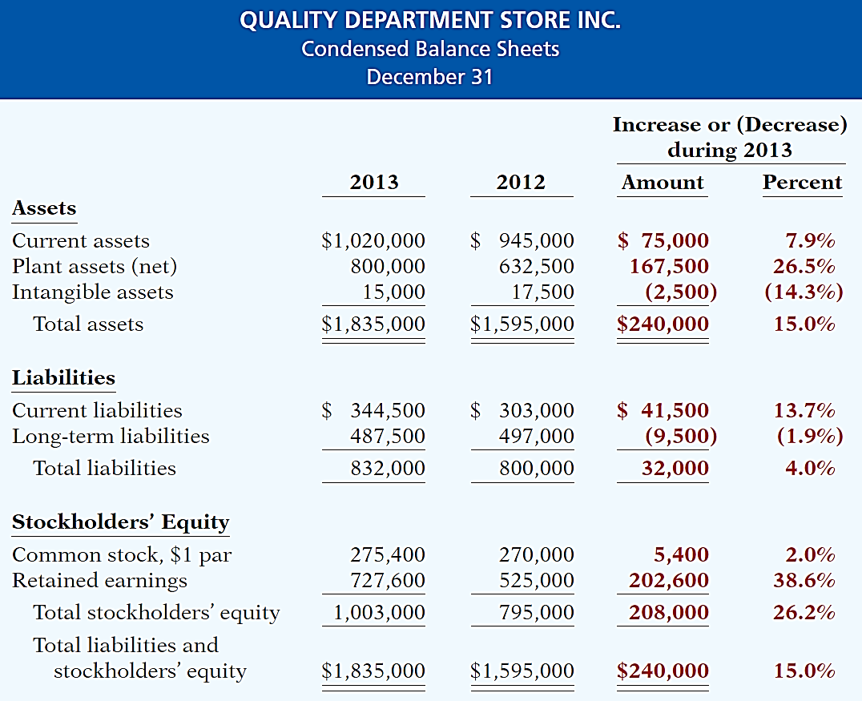
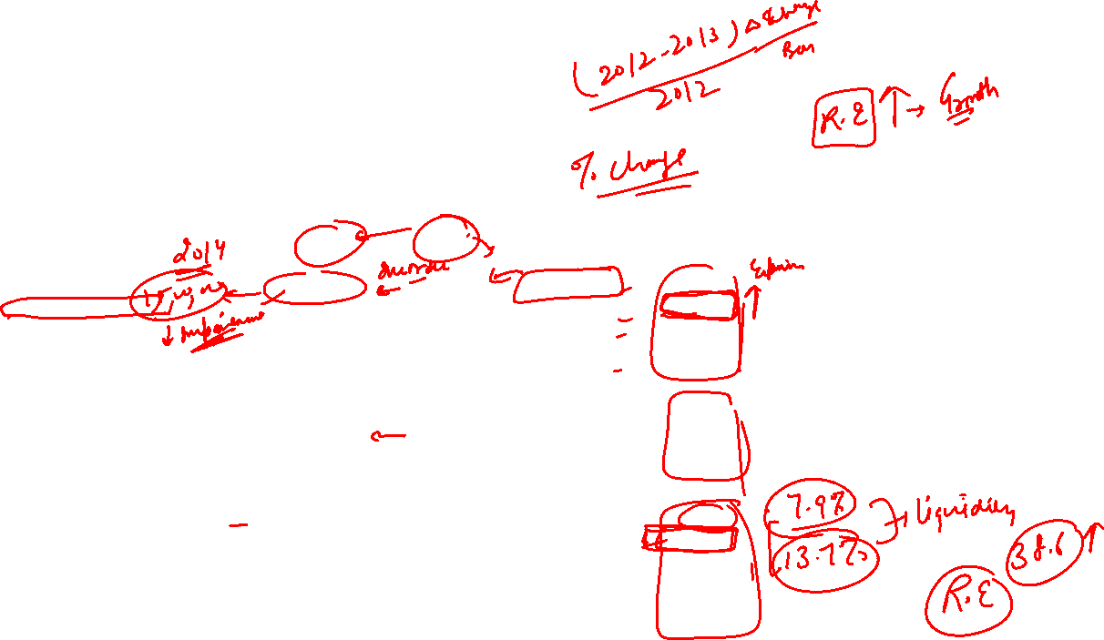
Horizontal Analysis
Changes suggest that the company expanded its asset base during 2013 and financed this expansion primarily by retaining income rather than assuming additional long-term debt.

Slide 14
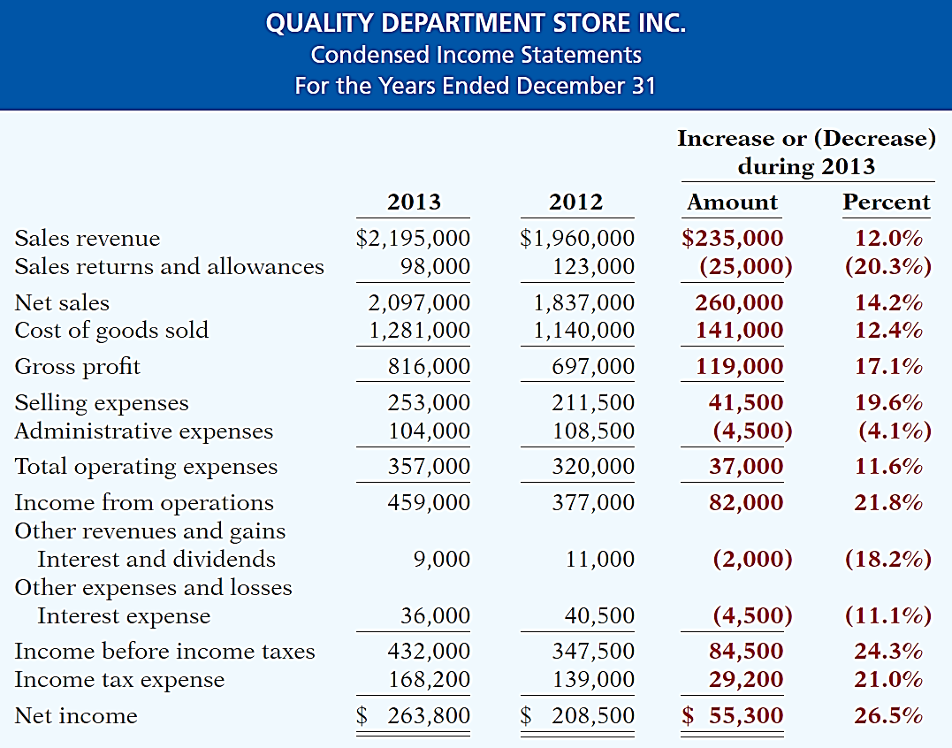
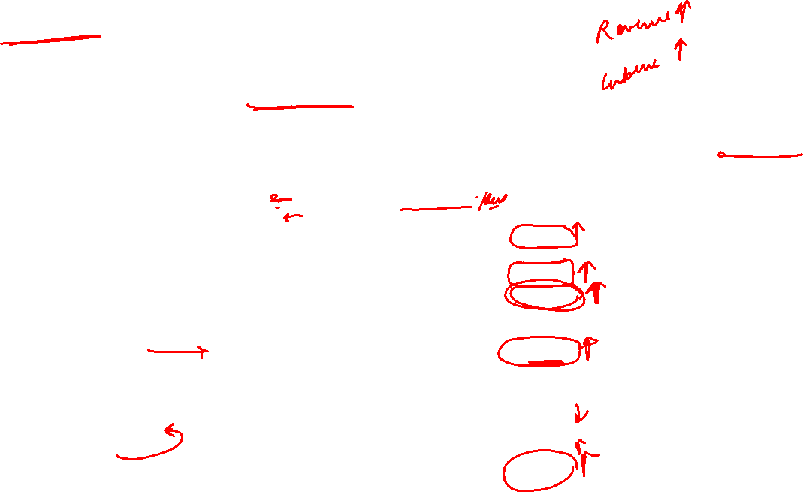
Horizontal Analysis
Overall, gross profit and net income were up substantially.
Gross profit increased
17.1%, and net income, 26.5%.
Quality’s profit trend appears favorable.

Slide 15
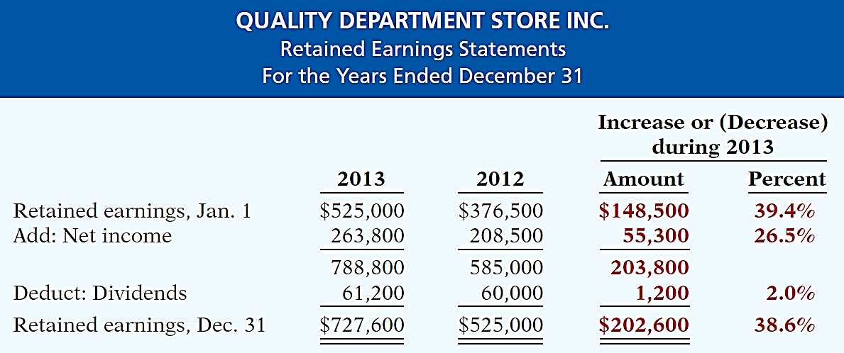
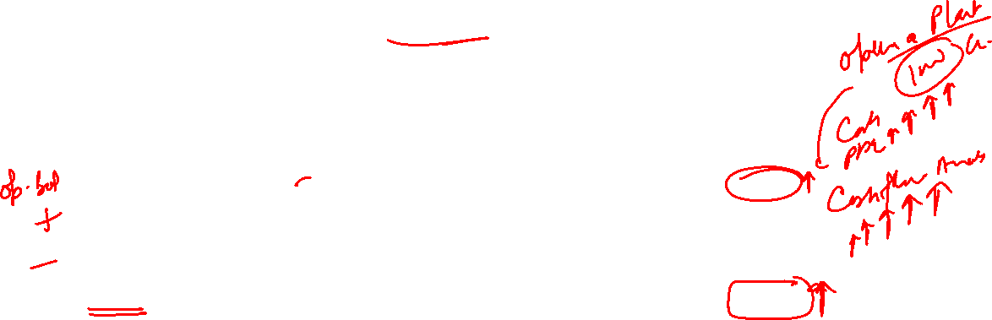
Horizontal Analysis
The ending retained earnings increased 38.6%. As indicated earlier, the company retained a significant portion of net income to finance additional plant facilities.

Slide 16
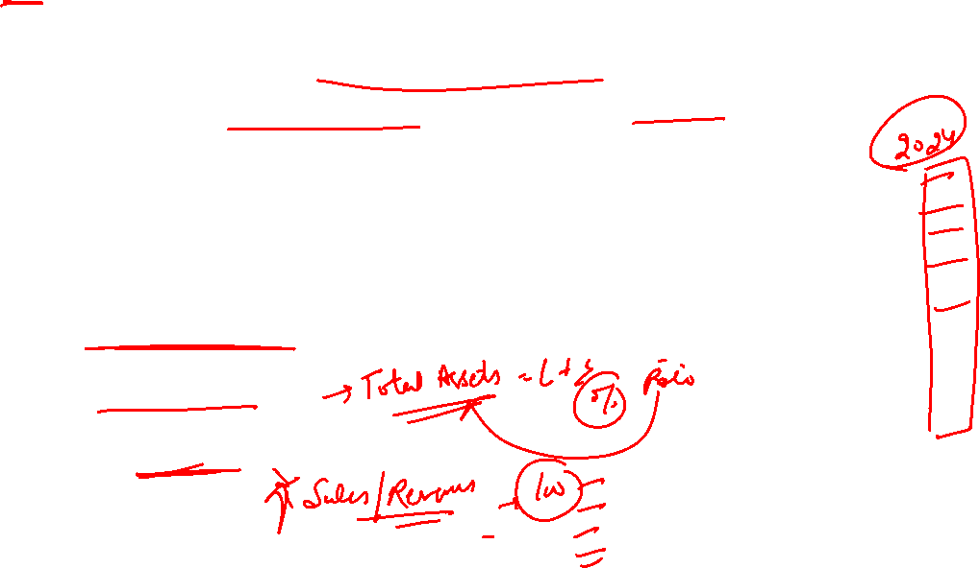
Vertical Analysis
Vertical analysis, also called common-size analysis, is a technique that expresses each financial statement item as a percent of a base amount.
  On an income statement, we might say that selling expenses are 16% of net sales.
  Vertical analysis is commonly applied to the
    balance sheet and
    income statement.

Slide 17
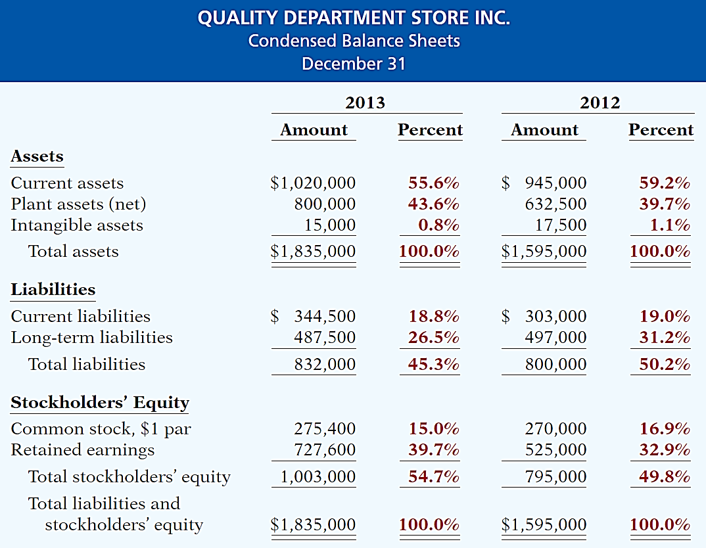
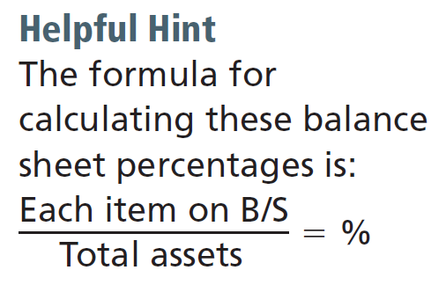
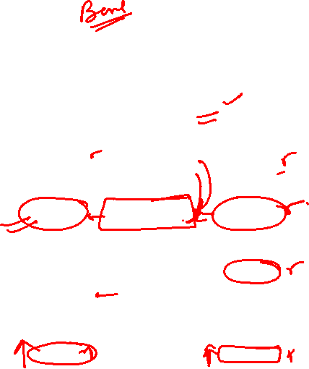
Vertical Analysis
Quality is choosing to finance its growth through retention of earnings rather than through issuing additional debt.

Slide 18
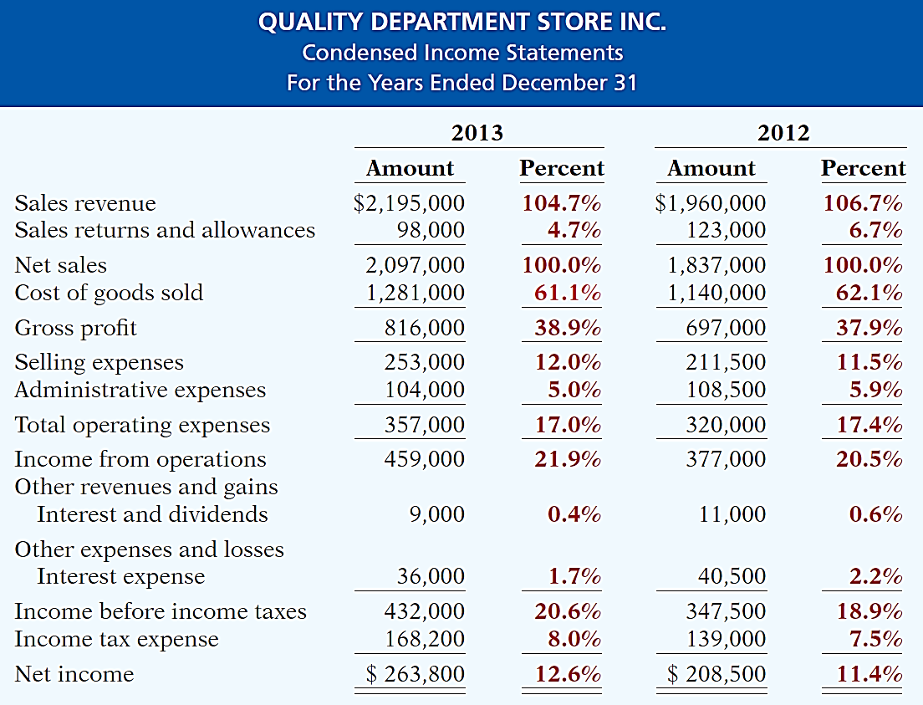
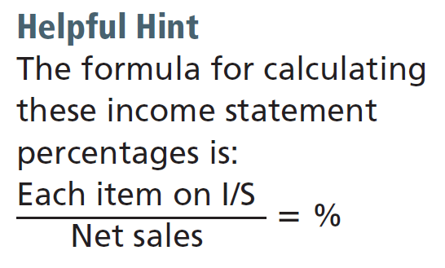
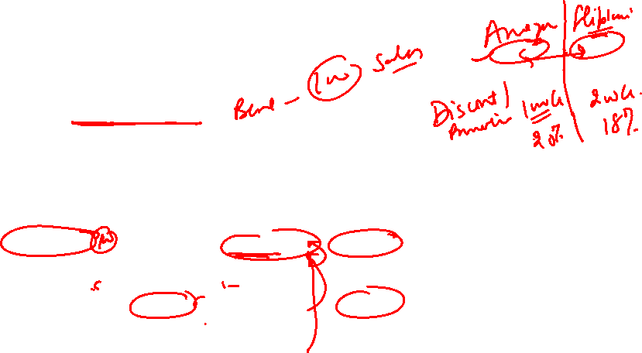
Vertical Analysis
Quality appears
to be a profitable enterprise that is becoming even more successful.

Slide 19
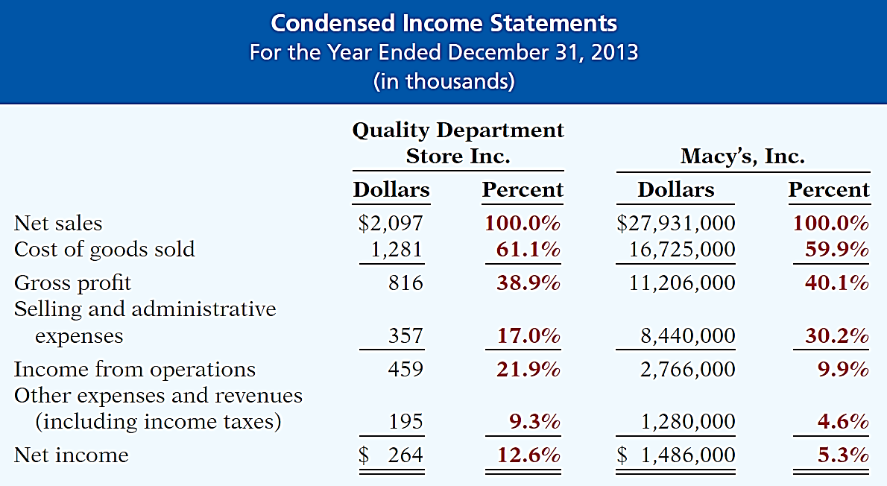
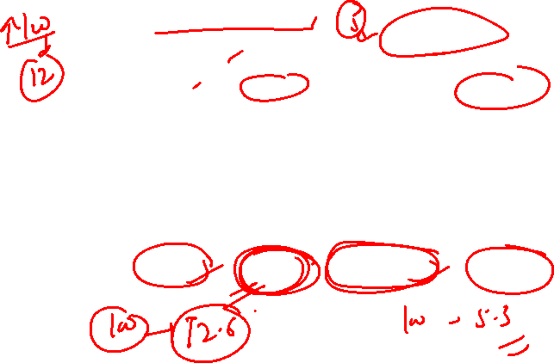
Vertical Analysis
Enables a comparison of companies of different sizes.

Slide 20
FSA – Ratio analysis
Notes:
Videos
Fancy numbers – doesn’t make much sense. (Price to book value
Sometimes you just focus on these numbers and your company position
That bullet was like a external forces/ market forces
https://www.youtube.com/watch?v=s5WVd1qaavg&ab_channel=MacfarlaneTV

Slide 21
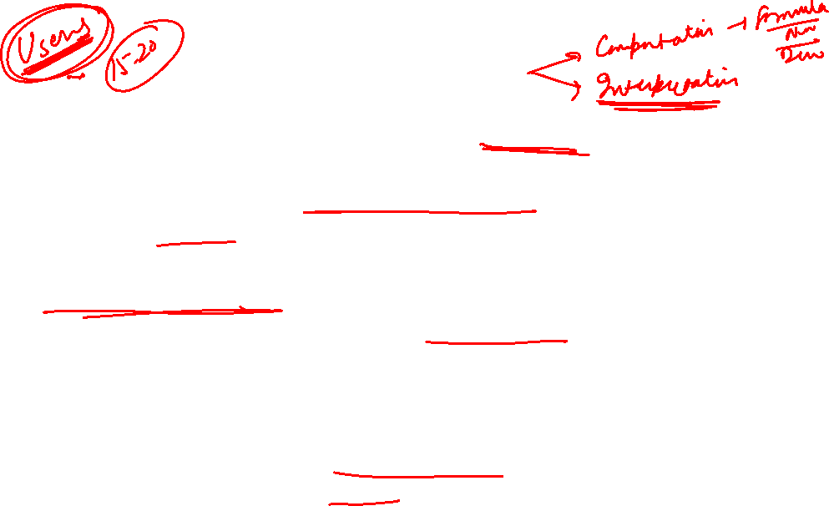
Ratio Analysis
A ratio is defined as a relationship between two numbers.
Ratio analysis of financial statement is another tool that helps identify changes in a company’s financial situation.
A single ratio is not sufficient to adequately judge the financial situation of the company. Several ratios must be analyzed together and compared with prior-year ratios, or even with other companies in the same industry. This comparative aspect of ratio analysis is extremely important in financial analysis.
It is important to note that ratios are parameters and not precise or absolute measurements. Thus, ratios must be interpreted cautiously to avoid erroneous conclusions.

Slide 22

Importance of Ratio Analysis
Enables the bankers or lenders to arrive at the following factors:
  Liquidity position
  Profitability
  Solvency
  Financial stability
  Quality of the management
  Safety and security of the loans and advances to be provided or already provided

Slide 23



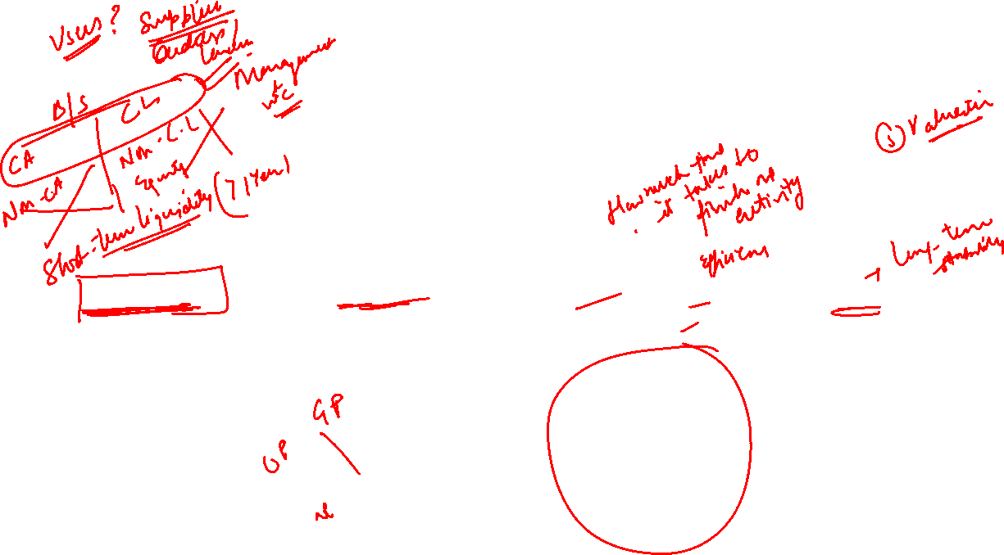
Financial Ratios
Liquidity Ratios
Profitability Ratios
Turnover/Activity
Ratios
Solvency Ratios

Slide 24
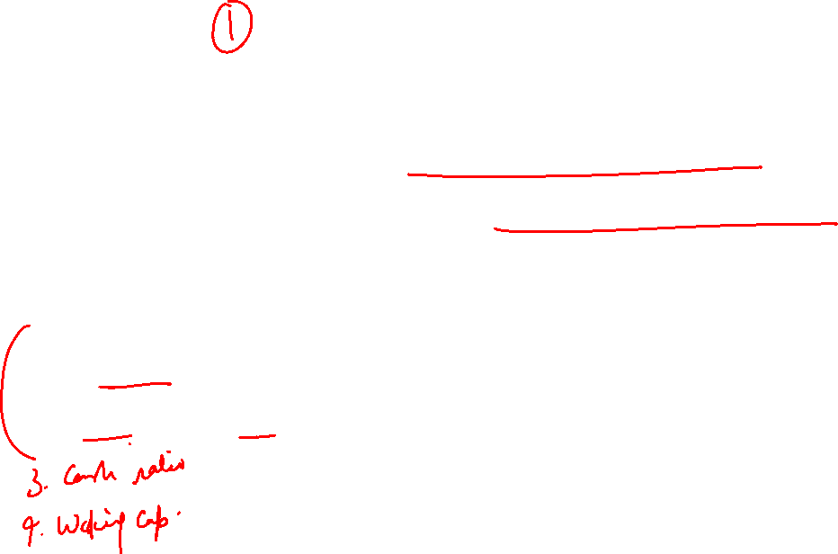
Liquidity Ratios
Liquidity ratio analysis measure how liquid the company’s assets are (how easily can the assets be converted into cash) as compared to its current liabilities. The common liquidity ratio are:
Current ratio analysis
Acid test (or quick asset) ratio analysis

Slide 25
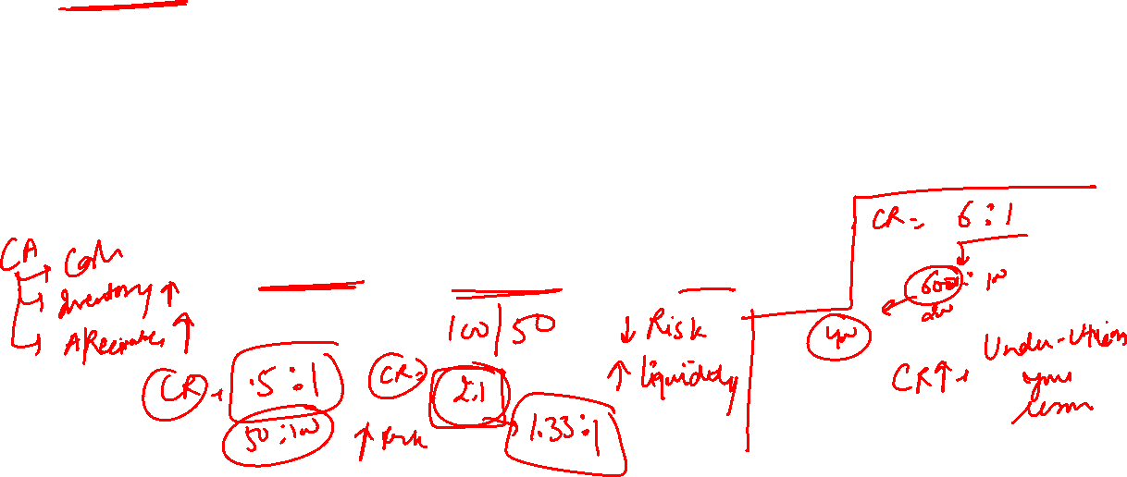
Current Ratio Analysis
Current ratio is the most frequently used ratio to measure company’s liquidity as it is quick, intuitive and easy measure to understand the relationship between the current assets and current liabilities.
It basically answers this question “How many rupees in current assets does the company have to cover each rupee of current liabilities”
Current Ratio = Current Assets / Current Liabilities

Slide 26
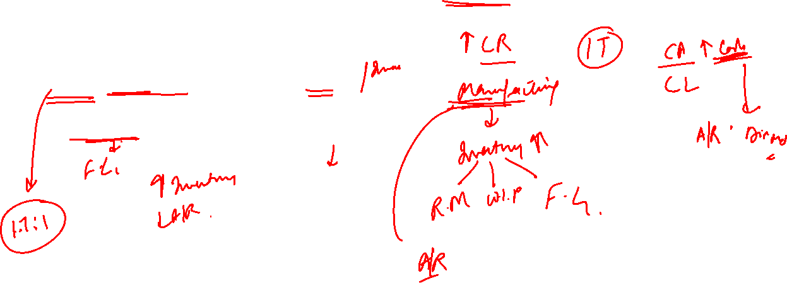
INTERPRETATION OF CURRENT RATIO
Manufacturing companies - High CR
Retail Sector (Walmart, BigBazar) – Lower CR

Slide 27
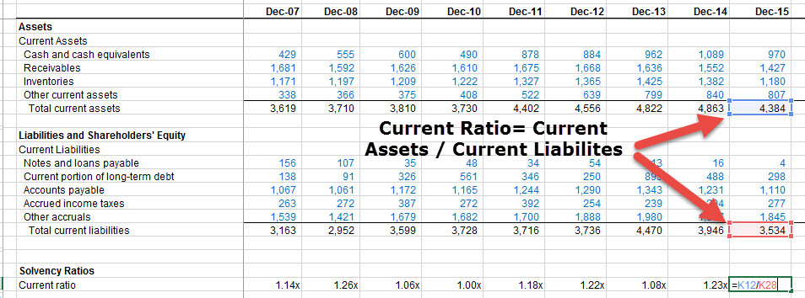
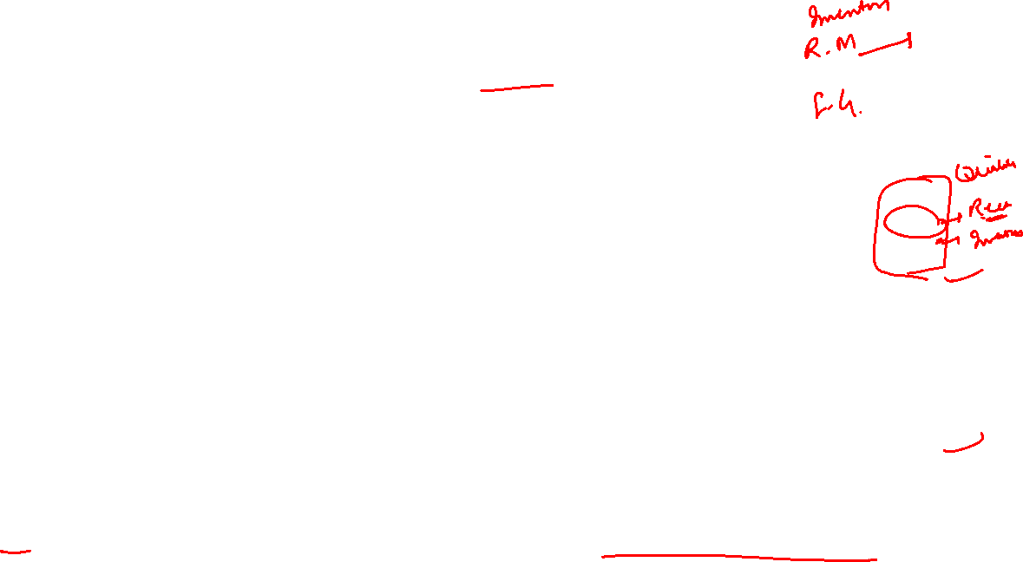
CURRENT RATIO ANALYSIS – COLGATE PALMOLIVE

Slide 28
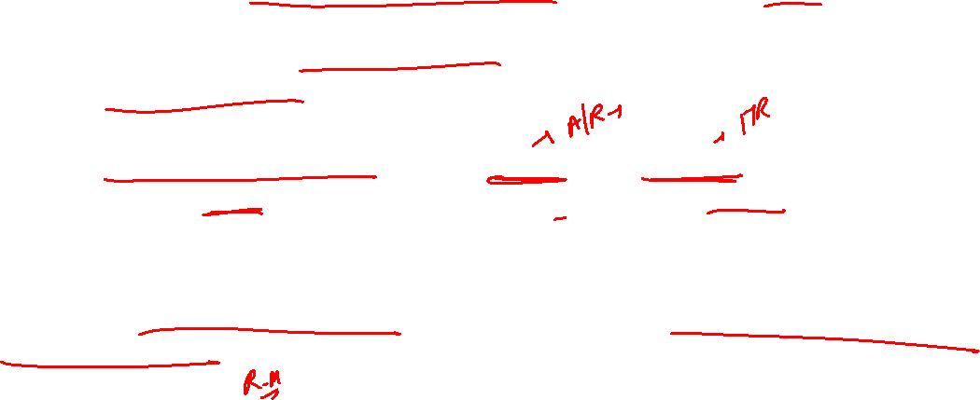
Colgate has maintained a healthy current ratio of greater than 1 in the past 10 years.
Current ratio of Colgate for 2015 was at 1.24x. This implies that current assets of Colgate are more than current liabilities of Colgate.
However, we still need to investigate on the quality and liquidity of Current Assets. We note that around 45% of current assets in 2015 consists of Inventories and Other Current Assets. This may affect the liquidity position of Colgate.
When investigating Colgate’s inventory, we note that majority of the Inventory consists of Finished Goods (which is better in liquidity than raw materials supplies and work-in-progress).

Slide 29
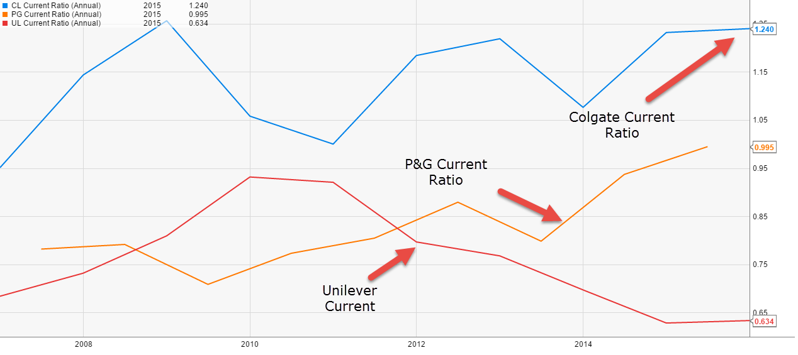
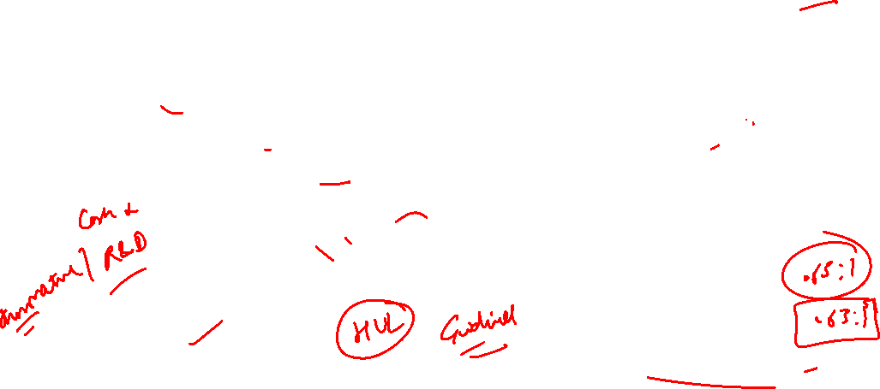
Comparison of Current Ratio of Colgate’s vs P&G vs Unilever

Slide 30
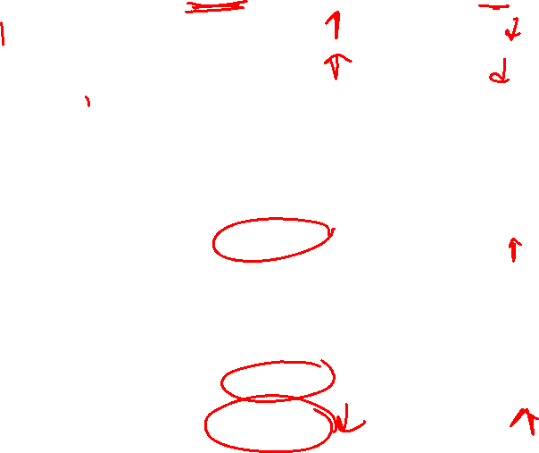
Competitive Comparison Data
Ticker | Company | Market Cap (M) | Current Ratio
UL | Unilever PLC | $ 155,510.39 | 0.81
XAMS:UNA | Unilever NV | $ 150,542.24 | 0.81
XPAR:OR | L'Oreal SA | $ 147,791.56 | 1.24
EL | The Estee Lauder Companies Inc | $ 66,356.58 | 1.69
CL | Colgate-Palmolive Co | $ 61,450.42 | 1.13
BOM:500696 | Hindustan Unilever Ltd | $ 56,179.60 | 1.37
LSE:RB. | Reckitt Benckiser Group PLC | $ 52,845.19 | 0.59
KMB | Kimberly-Clark Corp | $ 48,168.75 | 0.81
XTER:HEN3 | Henkel AG & Co KGaA | $ 42,512.42 | 1.02
TSE:4452 | Kao Corp | $ 35,398.23 | 1.86
Notes:
Typically, short-term creditors will prefer a high current ratio because it reduces their overall risk. However, investors may prefer a lower current ratio since they are more concerned about growing the business using assets of the company. Acceptable current ratios may vary from one sector to another, but generally accepted benchmark is to have current assets at least as twice as current liabilities (i.e. Current Ration of 2 to 1).

Slide 31
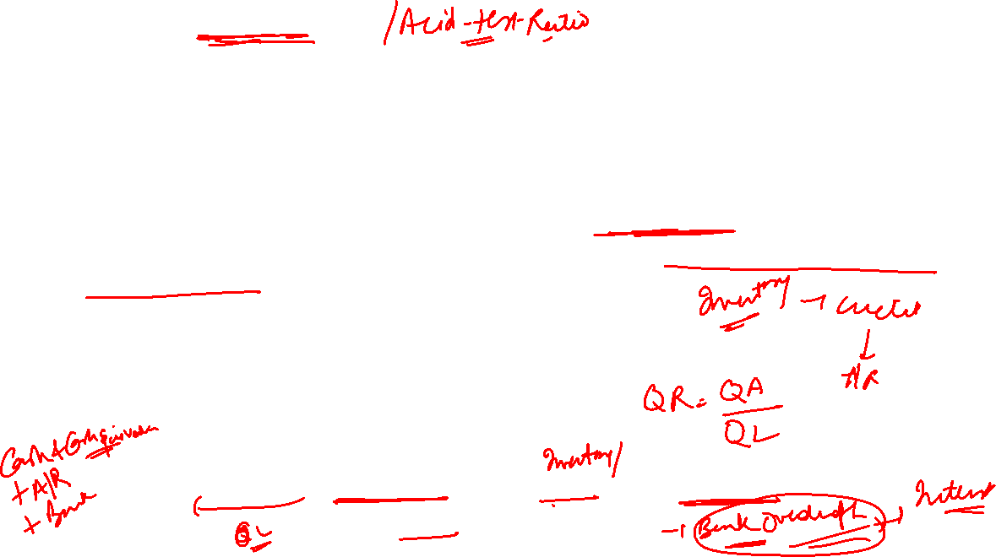
WHAT IS QUICK RATIO?
Sometimes current assets may contain huge amounts of inventory, prepaid expenses etc. This may skew the current ratio interpretations as these are not very liquid.
To address this issue, if we consider the only most liquid assets like Cash and Cash equivalents and Receivables, then it should provide us with a better picture on the coverage of short term obligations.
This ratio is know as Quick Ratio or the Acid Test.
The rule of thumb for a healthy acid test index is 1.0.
Quick Ratio = Current Assets – Stock - Prepaid Expenses/
Current Liabilities – B.O

Slide 32
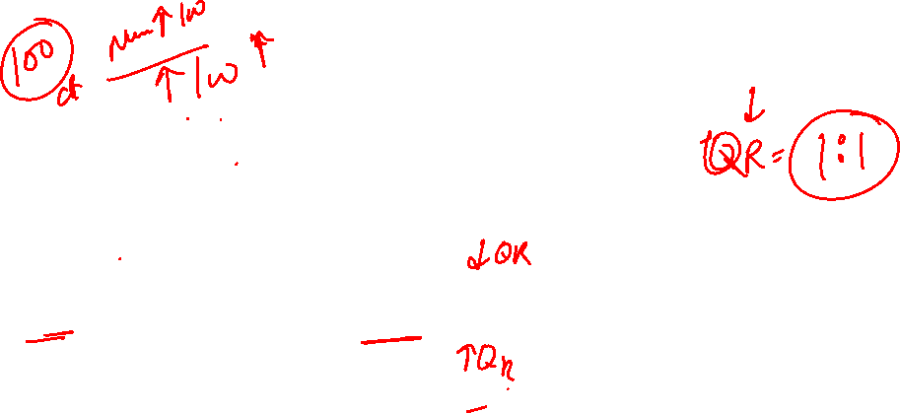
Interpretation of Q.R.
Low quick ratios in businesses that sell on cash basis (for example, restaurants, supermarkets etc). In these businesses there are no receivables, however, there maybe a huge pile of inventory.
Construction Companies – A/R takes much time to convert into cash

Slide 33
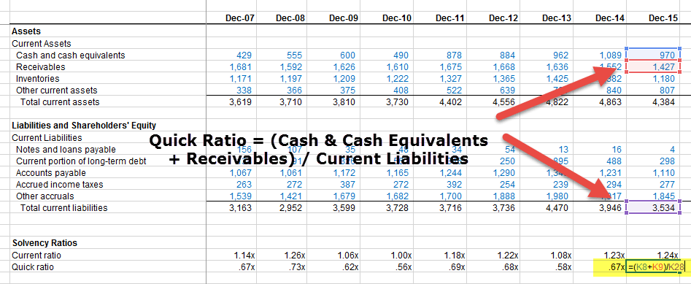
QUICK RATIO ANALYSIS – COLGATE PALMOLIVE

Slide 34
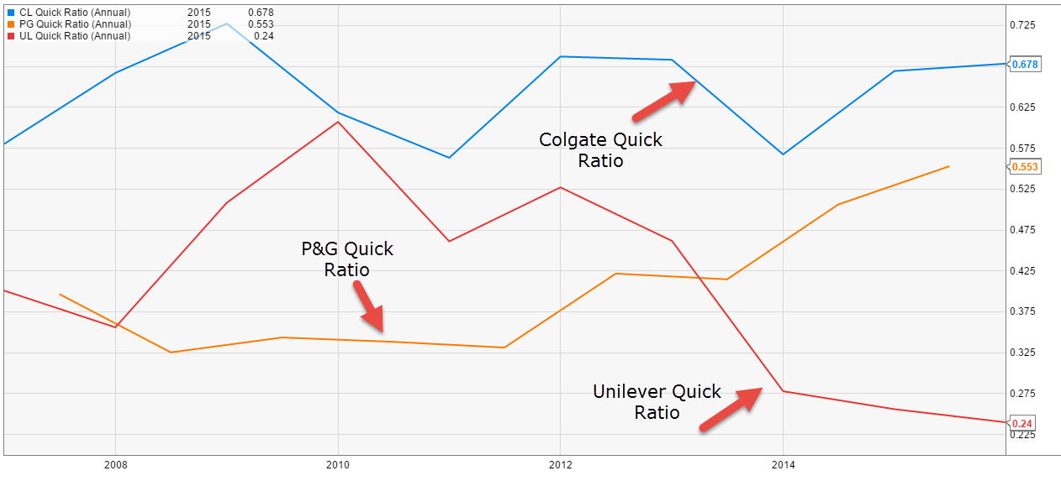

Comparison of Quick Ratio of Colgate’s vs P&G vs Unilever

Slide 35

Liquidity Ratios
3. Cash Ratio = Cash + Cash Equivalents
Current liabilities – B.O
4. Working Capital = Current Assets – Current Liabilities
Working Capital (Current Ratio) = Current Assets
Current Liabilities

Slide 36

Profitability Ratios
Net Sales
Return on Funds invested

Slide 37

Income Statement Format

Slide 38

GROSS PROFIT MARGIN?
Gross profit ratio (GP ratio) is a profitability ratio that shows the relationship between gross profit and total net sales revenue.
Gross Profit Margin Formula = (Sales – Costs of Goods Sold)/Net Sales
= Gross Profit / Net Sales

Slide 39

Gross Margin can vary drastically between industries. For example, digital products sold online will have extremely high Gross Margin as compared to a company that sells Laptop.
Gross margin is extremely useful when we look at the historical trends in the margins.
If the Gross Margins has increased historically, then it could be either because of price increase or control of direct costs.
However, if the Gross margins show a declining trend, then it may be because of increased competitiveness and therefore resulting in decreased sales price.

Slide 40



Slide 41

Operating Profit Margin
(Operating ability)
Operating profit or Earnings Before Interest and Taxes (EBIT) margin measures the rate of profit on sales after operating expenses. Operating income can be thought of as the “bottom line” from operations.
Operating Profit Margin = operating profit/ Net Sales
or
EBIT Margin = EBIT/Net Sales

Slide 42

Net Profit Margin
(Operating & Financial ability)
Net Profit Margin Formula = Net Income / Net Sales
Net Profit Margin Ratio indicates the proportion of sales revenue that translates into net profit. For example, a net profit margin of 35% means that every Rs.100 sale contributes Rs. 35 towards the net profits of the business.
Measuring the trend of NP margin over several periods in comparison to industry benchmarks is crucial for identifying performance gaps that could be overcome to improve the profitability of business in the future.

Slide 43


PROFITABILITY MARGIN ANALYSIS
Below is the Top 20 companies in the Technology sector with Market Capitalization of more than $25 billion.

Slide 44

Facebook and Adobe has the highest gross Margin in this peer group. This is primarily due the fact that they don’t sell tangible products (no raw material as they are into software/internet where direct costs are less).
Though Apple has a Gross Margin which is way low in comparison to Facebook. This is because they have a higher direct cost (including the manufacturing, raw material and direct labor costs).
However, Apple does really well at the Operating level (~27.8%) and Profit Margin Levels (21.2%)

