Slide 1


Legal and Ethical Issues related to Digital Platforms
Dr. Neeraj Singh
Marketing & Strategy Area
IIM Rohtak
neeraj.singh@iimrohtak.ac.in

Slide 2
Recap

Slide 3
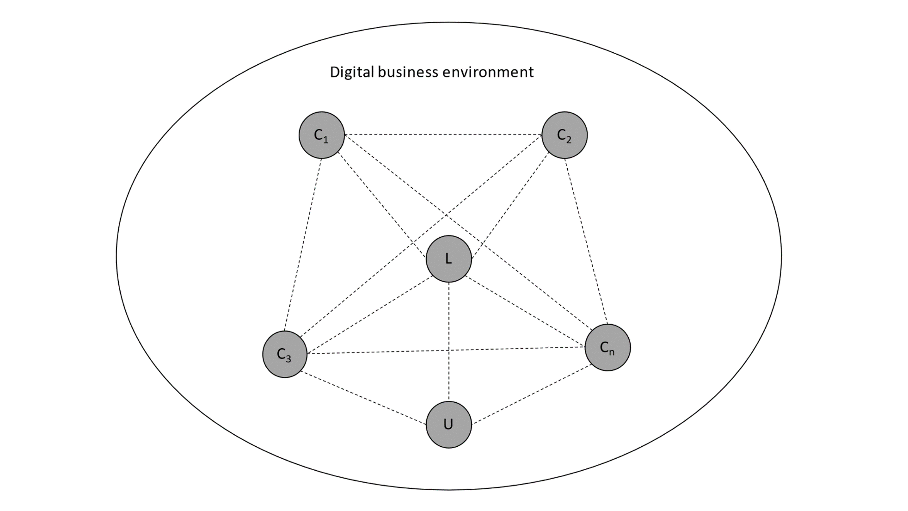
The conceptual schematics of digital platforms
The digital platforms are sociotechnical systems consisting of technical elements, organizational standards, processes, lead firms and a dynamic network of complementors.^{1,2,3}
Complementors on the food delivery platforms (for instance) include: ^{2,3}
  Physical restaurants
  Hyper-local logistic partners
  Technology developers
  Social media modules
  Banks and payment partners (including mobile wallets)
  Real estate entities (For Dark kitchens and cloud kitchens)
Dynamic interactions
Source: Authors’ conceptualization based on literature review.
C₁, C₂, C₃…C_{n} are complementors
L is the lead firm
U is the end users of the platform
De Reuver, M., Sørensen, C., & Basole, R. C. (2018). The digital platform: a research agenda. Journal of information technology, 33(2), 124-135.
Cenamor, J. (2021). Complementor competitive advantage: A framework for strategic decisions. Journal of Business Research, 122, 335-343.
Cusumano, M., Yoffie, D., & Gawer, A. (2020). The future of platforms. MIT Sloan Management Review, 46-54.

Slide 4





Platforms and other Digital markets
Point solutions
Aggregation
Platform Integration
Self-organisation
(local-entrepreneurs)
Discuss

Slide 5
Value proposition of platform
DMTE as a cycle
Discovery
Matching
Transaction
Evaluation
4. The platform provide mechanism for evaluation and feedback of product and services offered
1. Reduce search cost for one entity, transaction may not occur on platform.
2. Reduce search cost for both interested entities, transaction may not occur on platform
3. The transactions are subsumed in the platform
Srinivasan, R. (2021). Platform Business Models. Springer.
Kanoria, Y., & Saban, D. (2021). Facilitating the search for partners on matching platforms. Management Science, 67(10), 5990-6029.
Hänninen, M. (2020). Review of studies on digital transaction platforms in marketing journals. The International Review of Retail, Distribution and Consumer Research, 30(2), 164-192.
Bonina, C., Koskinen, K., Eaton, B., & Gawer, A. (2021). Digital platforms for development: Foundations and research agenda. Information Systems Journal, 31(6), 869-902.
.

Slide 6
Ethical issues & Regulatory frameworks
Consumer/ Citizen Data
Should digital platforms store consumer/citizen data? Discuss

Slide 7
General Data Protection Regulation→ ‘GDPR’
Many small and big businesses have been accused of not taking care of customer data and exposing it to third-party companies.
There are not one or two occasions where aggressive marketers targeted users with spam campaigns, and customers cried for change.
The European Parliament heard their calls and introduced GDPR.
GDPR is globally relevant. It forms the gold standard for best practices regarding consumer data sharing.
Along the same lines India is in process of developing ‘Digital Personal Data Protection Bill, 2022’

Slide 8
General Data Protection Regulation→ ‘GDPR’
GDPR is the acronym that stands for “General Data Protection Regulation,” and it is a law that concerns all European citizens.
It has implications for Indian firms. Digital markets go beyond national boundary.
The initial idea was approved in April 2016, but GDPR took effect on the 25th of May 2018.
An important thing to note about the latest data protection act is that it concerns all types of collecting data – regardless of it being data on paper or digital records.

Slide 9
General Data Protection Regulation→ ‘GDPR’
It is a general law that doesn’t target a single area or type of business.
It is a blanket regulation,
Since its launch, every single bookstore, hospital, ecommerce business, government institution, etc., should comply with the processing data rules for European Union citizens.

Slide 10
Why is the GDPR Important?
GDPR is highly important in digital commerce, as online stores process data daily. Lots of data.
As we mentioned earlier, the GDPR law was passed because of multiple customer complaints heavily targeted with spammy campaigns to which they have never subscribed.
Among the most critical things after the introduction of GDPR is that customer data can no longer be sold and mishandled.
If there were a way to escape massive financial charges in the past, authorities would now sanction data breaches regardless of whether they are intentional.

Slide 11
GDPR for Customers
The law gives customers extra data security and control of their personal information.
Nowadays, users can decide if they want their IP addresses (location) to be tracked and which companies to share data with.
When the European Parliament passed the GDPR law,
  It gave customers the option to provide or deny access to their private data
  The right to be erased from a database if they have changed their minds
  Most importantly, the right to have control of their data at all times.
And it’s not valid just for online companies, and the GDPR applies to all types of data, whether digital storage or paper.

Slide 12
GDPR for Ecommerce
Ecommerce businesses weren’t that happy with the introduction, as they needed to change their existing means of data processing.
For example, each company nowadays should have a dedicated data protection officer.
All company executives who have access to private information will now have to follow strict GDPR requirements.
It’s also important to know that every e-commerce store selling goods and services with European citizens has to be GDPR-compliant, regardless of their location (it has an extraterritorial effect).

Slide 13
Scam Filtering- Benefits of GDPR
If you’re a legitimate e-commerce business, you know how bad it is to compete with scammers.
They know all the tricks of black-hat marketing and often target customers with exceptional offers that don’t exist and offers that you have no chance of matching.
Scammers put a dark stain on the whole e-commerce industry and its reputation.
Although GDPR hasn’t put an end to cruel practices, as some people will always find loopholes in regulations, it has significantly raised customer awareness and made shoppers more conscious.

Slide 14
Targeted Marketing- Benefits for platforms
Instead of paying for ads that will reach everyone who enters your website, you will only reach out to those willing to share their data.
And if users are proactive, they probably have some initial interest that you could use.
That’s especially valid for email/Whatsapp/SMS marketing.
GDPR law could save you thousands in terms of marketing costs (provided that you follow the rules).

Slide 15
Benefitting from GDPR
That’s odd at first sight, but you can promote your ecommerce store by stating how strong your data protection policies are and how customers’ personal data is safe with you.
A report shared in TechRepublic states that 47% of respondents fear their data can be hacked, so promising a safe user experience will be welcomed with open arms.

Slide 16
GDPR- The specifics
Change the cookie policy from opt-out to opt-in: one of the biggest things to consider is the cookies’ policy.
  Beforehand, users were provided content by default, and they had to opt-out of receiving emails and other information from businesses. After the GDPR law enforcement, companies have to include a double opt-in to ensure customers know what they are doing.
Ensure 3rd party services are also GDPR-compliant:
  According to Art.6(1B) of the GDPR law, every single service provider of yours should also be compliant.
Assign people with access:
  Another essential thing is to check which employees from your company will have the right to store and collect data. Typically, people who are not in direct contact with customers (like janitors and office managers) should not have access to the database.

Slide 17
GDPR- The specifics
Have a dedicated data protection officer (DPO):
  If you process large amounts of data (although there is not a clear explanation of how much is “large”), you should hire a DPO who will:
    Implement the GDPR policies.
    Oversee how the company complies with them.
    Train employees on how to process personal data.
    Answer questions from data subjects in case of a request.

Slide 18
GDPR- Guidelines for Digital Businesses
Minimize Data Collection
  To ensure your store will stay compliant with the new regulations, it will be best to minimize data collected from customers.
    Your customer service, marketing, and sales teams will most probably be the ones that will need more personal information from customers.
    You have to provide them with all the data they need to work with, but make sure that people who churn or are unsuccessful leads are erased from your database to avoid issues in the future.
Restrict Access to Databases
  To avoid data theft, you should restrict the access of anyone who won’t operate with personal data.
  This includes creating a company access hierarchy and protecting information with hard-to-guess passwords and reliable antivirus software.
Provide a Proper GDPR Education to Company Executives
  Most companies of large size deliver dedicated training to their employees, but even if you are a small business, ensure you provide all the necessary information before they start processing customer data.

Slide 19
GDPR- Guidelines for Digital Businesses
Hold Your Employees Accountable
  Many companies force employees to sign non-disclosure agreements (NDAs) to ensure there won’t be data leaks. If you’re a business owner, ensure you have secured a clause that will hold employees accountable in case of a data breach, whether caused intentionally or due to negligence.
Check all Service Providers
  One crucial task is to check all service providers – including payment processors and cloud services. The GDPR law clearly states that all data controllers (you) should ensure any third-party data processors are also compliant.
React Quickly in Case of a Breach
  If a data breach happens, you should notify supervisory authorities within 72h after the incident has happened and you have identified it.
  Another vital thing to do is let all affected customers know immediately.
  Reporting to customers and authorities should be thorough, including the date and time of the incident, what type of data has been stolen, why it happened, etc.
How to Create a Compliant Privacy Policy
  Creating a compliance policy is not a challenging task to do, and all you need to remember is that you should follow honest and transparent business practices.

Slide 20
GDPR for eCommerce Checklist
1. Use Clear and Plain Language When Asking for Consent
  When asking for consent, ensure you use simple language and avoid using words that can be misinterpreted.
2. Do Not “Help” Users with Shortcuts
  By “assisting” users, I mean ticking the checkboxes for them, assuming things, and navigating them. Any of these things can be considered an “opt-out” policy, which is banned. According to the GDPR rules, consent should be “freely given, specific, informed and unambiguous.”
3. Clear Data Privacy Policy
  Ensure your privacy policy and terms & conditions are visible. Do not hide anything with small print, as in case of a data breach, this could be an aggravating factor that could lead to a more significant penalty.
4. Collect Only Necessary Information
  According to the GDPR law, you should only be collecting data required to run your operations. Any unneeded fields you should skip. For example, if you don’t sell alcoholic beverages or any products that are forbidden for non-adults, you should not ask for the date of birth.

Slide 21
Non-Compliance Consequences
Non-compliance with the GDPR could potentially lead to severe penalties. Of course, this is a delicate matter, and no one can decide how much money the organization will pay in case of data breaches.
Many things are taken under consideration, like:
Magnitude and nature of the data breach: how much information was leaked, number of people affected, what type of data has been stolen, how much damage it caused to users, and how much time it took to resolve the issue?
Cooperation with authorities: did someone notify the supervisory authority as soon as possible, and did the organization fully cooperate with authorities to resolve the issue as quickly as possible?
Previous records of GDPR infringements: did the company have previous records of mishandling personal data, and how long ago did it happen for the last time?
Precautionary measures: did the company ensure it had protected customers’ data before the breach?
Potential benefits from the infringement: did the company or any company executive benefitted from the data infringement?
In the worst-case scenario, companies can be fined up to €20 million or 4% of the global annual revenue (whichever is higher).

Slide 22
Anti-Piracy legal frameworks

Slide 23
‘SOPA’ → Stop Online Piracy Act
It aims to crack down on copyright infringement by restricting access to sites that host or facilitate the trading of pirated content.
SOPA's main targets are "rogue" overseas sites like the torrent hub and the Pirate Bay, which are a trove for illegal downloads.
Go to the Pirate Bay, type in any current hit movie or TV shows like "Glee," and you'll see links to download full seasons and recent episodes for free.

Slide 24
‘SOPA’ → Stop Online Piracy Act
Content creators have battled against piracy for years, but it's hard for U.S. companies to take action against foreign sites.
The Pirate Bay's servers are physically located in Sweden.
So SOPA's goal is to cut off pirate sites' oxygen by requiring U.S. search engines, advertising networks and other providers to withhold their services.
“That means sites like Google wouldn't show flagged sites in their search results, and payment processors like eBay's (EBAY, Fortune 500) PayPal couldn't transmit funds to them.”

Slide 25
‘SOPA’ → Stop Online Piracy Act
Let's say a YouTube user uploads a copyrighted song.
  Under the SOPA, that song's copyright holders could send a "takedown notice" to YouTube. YouTube is protected against liability as long as it removes the content within a reasonable timeframe.
SOPA has replace DMCA- ‘Digital Millennium Copyright Act ‘
  When it gets a DMCA warning, YouTube has to notify the user who uploaded the content. That user has the right to file a counter-motion demonstrating that the content doesn't infringe on any copyrights. If the two sides keep disagreeing, the issue can go to court.
  DMCA is useless against the overseas website.

Slide 26
‘SOPA’ → Stop Online Piracy Act
SOPA tackles the issue by moving up the chain.
If you can't force overseas sites to take down copyrighted work, you can at least stop U.S. companies from providing their services to those sites.
You can also make it harder for U.S. Internet users to find and access the sites.

Slide 27
PROTECT IP Act- ‘PIPA’
The PROTECT IP Act is designed to curb copyright infringement and counterfeiting.
The full name of the bill is the Preventing Real Online Threats to Economic Creativity and Theft of Intellectual Property Act.
  PIPA provides a mechanism for preventing online copyright infringement by allowing the Department of Justice (DoJ) or copyright holder to block access to domains with alleged infringed content, including social networking websites and domain name services.

Slide 28
SOPA/PIPA
SOPA and PIPA originally included two methods of protection.
SOPA involves the United States Department of Justice filing for court orders to force ISPs to block the domain names of sites committing infringement. An ISP, like Comcast, might block customers from accessing a particular website reported for infringement of intellectual property, though the IP address would still be available through another ISP.
The PIPA allows the owner of the intellectual property to get a court order to prevent advertisers, search engines, and payment providers from doing business with an offending entity. The link would then disappear from search results and money would stop flowing to the company. The penalised site has five days to appeal.

Slide 29
Differences Between SOPA and PIPA
SOPA and PIPA have slightly different focuses.
SOPA applies to "foreign infringing sites" that "commit or facilitate" infringement on copyrighted media.
PIPA is aimed at sites with "no significant use other than" committing acts of infringement.
Between PIPA and SOPA, the SOPA is the more aggressive of the two.

Slide 30
The First Sale Doctrine
Manufacturers can create material differences and quality controls
Manufacturers often look to trademark law to stop unauthorised online sales of their products.
However, online resellers are typically immune from liability for selling genuine trademarked products.
This is due to what is known as the First Sale Doctrine.

Slide 31
The First Sale Doctrine
Many manufacturers contract with authorised sellers to help control the distribution of their products.
They can hold the authorized distributors accountable through, among other things, potential breach of contract claims.
However, manufacturers do not have such recourse against unauthorized sellers who obtain their products and resell them online.
Further, many of the unauthorized sellers benefit from the aforementioned First Sale Doctrine.

Slide 32
The First Sale Doctrine
The First Sale Doctrine generally provides that someone who purchases a trademarked product acquires the right to resell that same product.
Stated differently, someone who buys a product usually can resell that product online, without incurring any liability.
Fortunately, for manufacturers, there are exceptions to the First Sale Doctrine.
These exceptions are significant, as they can serve as the basis for manufacturers being able to stop widespread unauthorised sales.

Slide 33
The First Sale Doctrine- Material difference exception
The Material Difference exception can give brands a legal claim for trademark infringement against gray market sellers who rely upon the First Sale Doctrine for their defense.
Resellers are not immune from trademark liability when they offer “trademarked goods materially different than those sold by the trademark holder.”
Thus, based on this “material difference” exception, manufacturers can work to distinguish their genuine products from the diverted goods sold outside the authorised distribution channels.

Slide 34
The First Sale Doctrine- Material difference exception
Material difference is defined as “one that consumers consider relevant to a decision about whether to purchase a product.”
Moreover, courts have established that only a single material difference is necessary to give rise to trademark infringement. Further, a material difference does not have to be “physical” to give rise to a trademark infringement claim.

Slide 35
The First Sale Doctrine- Material difference exception
One example of a material difference is a difference in warranty, guarantee or return policy.
For example, many manufacturers use language indicating that warranties only apply to purchases through authorized channels.
Thus, a non-genuine product not subject to the same warranty as a genuine product constitutes a material difference.
Material differences can also include an absence (on a reseller’s part) of certain offerings of customer service and repairs; certain promotions, discounts or other programs; or certain post-sale services

Slide 36
The First Sale Doctrine-Quality Control Exception
A manufacturer’s product is not considered truly “genuine” unless it is manufactured and distributed under quality controls established by the manufacturer.
Thus, courts have held that trademark holders have the right to control the quality of their distribution.
In other words, unauthorized resellers who do not follow a manufacturer’s quality controls can be liable for trademark infringement.

Slide 37
There are a number of potential quality controls that a manufacturer can implement.
For example, this list includes certain policies or practices for:
  vetting potential retailers;
  checking on/monitoring authorized sellers to ensure compliance;
  retailers removing (from the internet) or returning damaged/defective products;
  prohibiting anonymous online sales;
  product recalls;
  reporting customer complaints; and
  storage conditions.

Slide 38
Key take away
Manufacturers can potentially overcome the First Sale Doctrine by establishing potential material differences and certain quality controls (and enforcing them).
In other words, manufacturers can (and should) position themselves to have strong legal claims (i.e., trademark infringement).
This is critical to effectively stopping product diversion and limiting the effects of unauthorized online sales.

Slide 39
Doctrine of Fair Use
Fair use is an affirmative defense that can be raised in response to claims by a copyright owner that a person is infringing a copyright.
Fair use permits a party to use a copyrighted work without the copyright owner’s permission for purposes such as criticism, comment, news reporting, teaching, scholarship, or research.
These purposes only illustrate what might be considered as fair use and are not examples of what will always be considered as fair use.

Slide 40
Doctrine of Fair Use
Copyright laws establish four factors that must be considered in deciding whether a use constitutes fair use:
  The purpose and character of the use, including whether such use is of a commercial nature or is for non-profit educational purposes;
  The nature of the copyrighted work;
  The amount and substantiality of the portion used in relation to the copyrighted work as a whole; and
  The effect of the use upon the potential market for or value of the copyrighted work.

Slide 41
Factor 1: The Purpose and Character of the Use
The first factor mostly focuses on whether the use is commercial or non-commercial and whether the use is transformative.
If a use is commercial it is less likely to be fair use and if it is non-commercial it is more likely to be fair use.
Transformative uses are those that add something new, with a further purpose or different character, and do not substitute for the original use of the work.
If the use is transformative it is more likely to be fair use and if it is not transformative it is less likely to be fair use.

Slide 42
Factor 2: The Nature of the Copyrighted Work
The second factor considers the nature of the underlying work, specifically whether it is more creative or more factual.
Use of a more creative or imaginative underlying work is less likely to support a claim of fair use, while use of a factual work would be more likely to support a fair use claim.
This factor also looks at the publication status of the copyrighted work.
When the copyrighted work is unpublished the use is less likely to be a fair use.

Slide 43
Factor 3: The Amount Used
The third factor considers the amount of the copyrighted work that was used compared to the copyrighted work as a whole.
Where the amount used is very small in relation to the copyrighted work, this factor will favor a finding of fair use, but where the amount used is not insignificant, this factor will favor the copyright owner.
This factor also considers the qualitative amount of the copyrighted work used.
If the portion used was the “heart” of the work, this factor will likely weigh against a finding of fair use even if that portion was otherwise a very small amount.

Slide 44
Factor 4: The Effect of the Use on the Market
The fourth factor not only considers whether the defendant’s activities may harm the current market but also whether the use may cause any harm to potential markets that could be exploited by the copyright owner if the use were to become widespread.
If the use harms the copyright owner’s current or potential market, it will weigh against fair use.
Along with the first factor, this factor is one of the most important in the fair use analysis.

Slide 45
Online Reviews

Slide 46
Myths about online review importance
Reviews are only written by angry people
  85% of reviews are positive
Reviews are out of my control
  Reviews are “user-generated” content but you can control your business listings, menus and services, contact information, website links and conversation-changing review responses
Most reviews are fake, unreliable or unreasonable and they won’t effect my business
  Growing thought process that there are increased numbers of online reviews that are fake or paid for by companies – doesn’t mean real people have stopped posting, sharing, reading reviews.
  In fact, 80% of online purchases are influenced by online reviews

Slide 47
Myths about online review importance
Nothing good ever comes from bad reviews
  Negative reviews can be harsh, cruel and anger fueled, but read carefully and learn how to mine the good stuff from the negativity
  Negative reviews can help you identify and resolve customer issues, compare your performance to competitors and establish or increase your credibility

Slide 48
Managing Online Reviews
  Research
  Respond
    Negative AND Positive
  Don’t give in to pressure from negative reviews
    Don’t be held hostage by online “assassins” looking for free services
  Encourage
    Customers who have positive experiences are more likely to post comments or reviews when asked

Slide 49
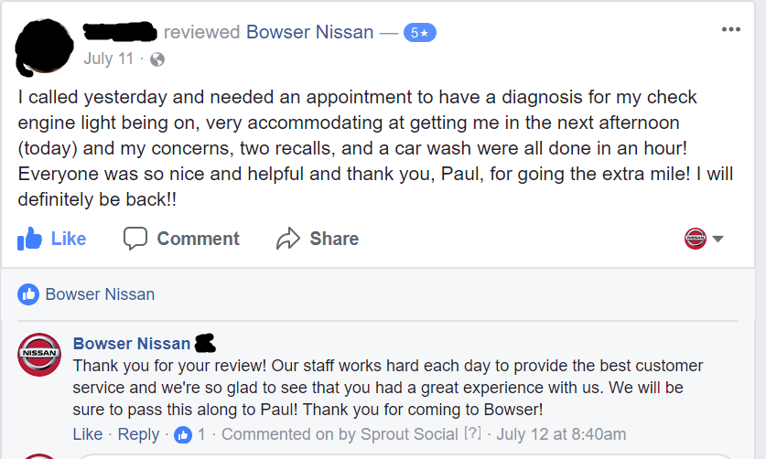
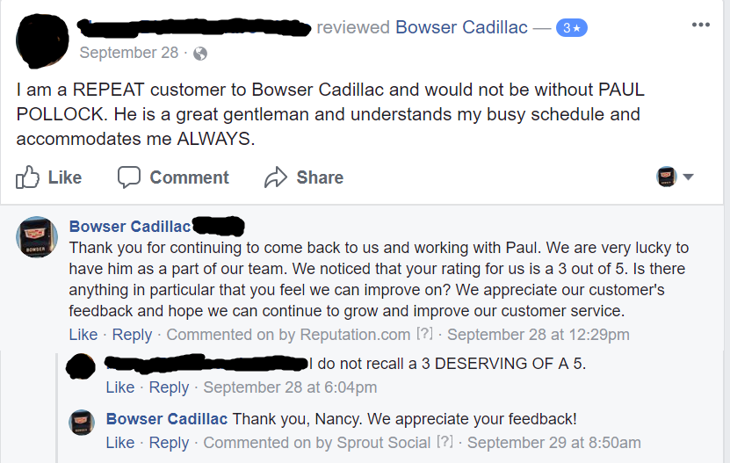
Positive Review Responses
Thank the customer for taking the time to review
Make it more personal – highlight what sets you apart from others, and be sure to acknowledge staff if mentioned

Slide 50
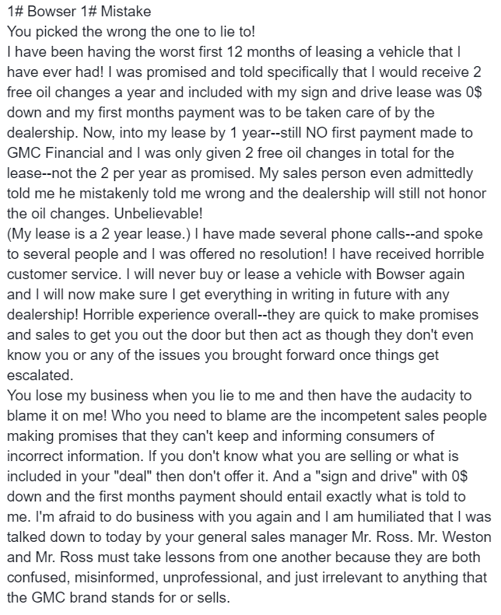
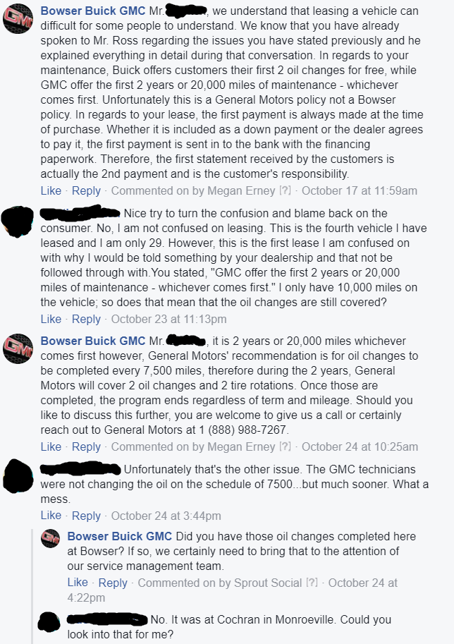
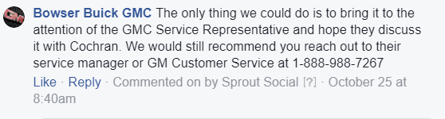
Negative Review Responses
Changing the Conversation

Slide 51
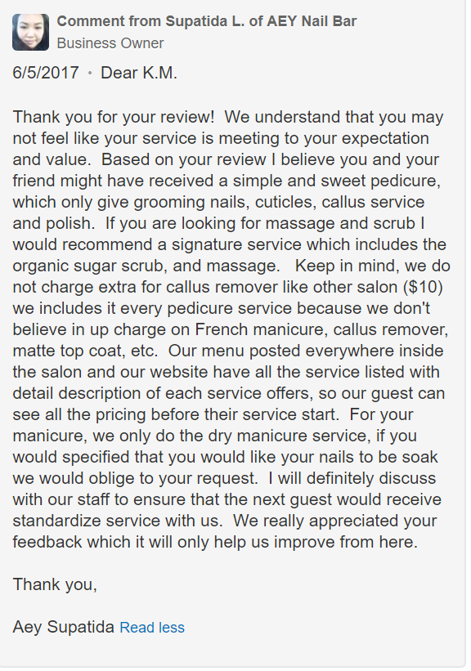
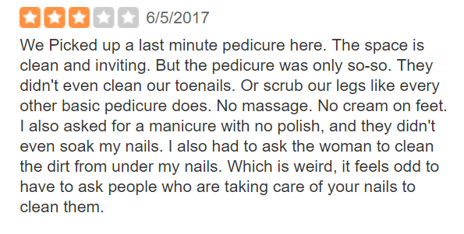
Review Responses – Online “Assassins”

Slide 52
The curious case of
fake reviews

Slide 53
Fake Reviews- Impact of Business
It's a crime story fit for the digital era.
It was recently reported that a number of restaurants in New York had been targeted by internet scammers threatening to leave unfavourable "one-star" reviews unless they received gift certificates.
The same threats were made to eateries in Chicago and San Francisco and it appears that a vegan restaurant received as many as eight one-star reviews in the space of a week before being approached for money.

Slide 54
Fake Reviews- Impact of Business
It's surprising this sort of thing hasn't emerged before. An over-reliance on the "wisdom of the crowd", whereby many people measure things by the approval of the rest of the community, leaves us vulnerable to this kind of fraud.
It's all about numbers.
Products and companies are measured online by the number of stars they get on a five-star scale, influencers are measured by numbers of followers, posts are measured by the numbers of likes or retweets.

Slide 55
Fake Reviews- Impact of Business
But why are these systems considered to be of value, and why do we consult them almost blindly?
In an age of information overload, feedback and reputation systems enable fast decision-making, providing us with the sense (or illusion) that we are in control as the decision taken is perceived to be informed.

Slide 56
Fake Reviews- Impact of Business
Another idea at play here is the "attention economy paradigm". Under this way of thinking, human attention is a scarce commodity and - as with all resources that are limited on this planet - it is of high value.
Businesses compete for a high as possible place on the first page of Google's search results in order to capture this attention. And user feedback is one of the many parameters that influence the search engine's secret ranking algorithms.
The notable success and acceptance of such reputation systems is grounded in the idea of the wisdom of the crowd comes in. If a sufficiently large sample of the population is asked to estimate something, the average of these estimations is expected to be very close to the actual value.

Slide 57
Fake Reviews
There are several reasons and motivations for fake reviews. Business competitors may try to flood a business target with negative reviews in order to harm their competitor.
Others may attempt, by creating fake profiles or "bribing" customers with free or discounted products, to engineer positive reviews and misrepresent the quality of their products.
But extortion via threats of negative review is particularly insidious.
A surge of negative reviews on a business's Google profile not only affects its search engine ranking, but significantly influences the potential customers' purchase decisions.

Slide 58
Fake Reviews→ What can be Done?
The abuse of online feedback and reputation systems has grown to epidemic proportion.
Countering it will require the coordination of everyone involved.
Google and other feedback and reputation service providers need to invest more resources into the prevention, detection and removal of fake reviews.
Machine learning technologies have made impressive leaps in recent years and could help in weeding out fake content.

Slide 59
Fake Reviews→ What can be Done?
Businesses also need to embrace the system for reporting problem reviews and use it responsibly.
They should not report negative feedback if it is genuine, as this affects the relationship with the feedback platform, which will understandably be more distrustful to the business.
And consumers should be more alert and educated about this rather than following these rankings religiously.
It's also instructive to check whether the reviewer produces a lot of negative reviews across many and seemingly unconnected products in a short time.

Slide 60
Counterfeits
To counterfeit means to imitate something authentic, with the intent to steal, destroy, or replace the original, for use in illegal transactions, or otherwise to deceive individuals into believing that the fake is of equal or greater value than the real thing.
Counterfeit products are fakes or unauthorized replicas of the real product.

Slide 61


Slide 62
Context
Counterfeit products constitute more than 3% of world trade.
Manufacturing and selling of counterfeits have become easier than ever with the wide and easy reach of technology.
The fakes manufactured in today’s era matches original products in terms of quality and performance.
In addition to that, internet has smoothened the sale of such fake replicas around the globe.

Slide 63
Context
Alibaba Group, which owns a multitude of e-commerce platforms, faced serious problem of counterfeit selling across its various websites.
The various challenges were degrading global image, rising number of fake products and numerous lawsuits filed against the company.

Slide 64
Discuss
Why selling fakes is easy over the internet?
Comment on the role of e-commerce marketplaces such as Alibaba in “accidental promotion” of counterfeiting.

Slide 65
Why selling fakes is easy over the internet?
According to a report by Organisation for Economic Co-operation and Development and the Intellectual property Office of the European Union published in the year 2019, 3.3% of the total global trade constitutes counterfeits (OECD & EUIPO, 2019).
Technology and internet had changed the way markets operate and has certainly brought sellers and consumers together.
Technology is the reason counterfeiters are able to produce products which are similar in quality and appearance to the original brands. Counterfeiters are able to copy the minute details due to technological advancement, and it becomes impossible to judge the authenticity with a simple effortless glance.
The use of technology, i.e. internet, in supplying such products have further aggravated the problem due to wider reach and easy accessibility.

Slide 66
Why selling fakes is easy over the internet?
Although technology is the reason counterfeiting thrived, it is also the medium to control it.
Methods like radio frequency identification and quick response codes (QR codes) are used by brands to prevent counterfeiting.
Alibaba, too, used the means of technology to detect and remove fake product listings from its websites.

Slide 67
Why selling fakes is easy over the internet?
With technology, there is a temporal and physical separation of consumers and buyers and selling fakes have become easier than ever.
Third party selling over e-commerce platforms have further aggravated the problem.
Third party selling is a system prevailing one-commerce platforms which function as “marketplace” constituting numerous sellers, known as “third-party sellers” who list their products on the platform for consumers to buy.
Simply put, the platform itself is not the seller but just a facilitator where products are listed. In such a scenario, it becomes really difficult for the e-commerce platform to look into the quality or authenticity of the products listed.
The mere images and descriptions used by the sellers may not suffice the information to judge the authenticity of the product. On the one hand, the consumers might get deceived by the information and make the purchase, known as deceptive counterfeiting.
On the other hand, the consumer might buy the product knowing it is fake. This is because the consumer was unable to buy the original version and seeks the intangible benefits associated with originals. This phenomenon is called non-deceptive counterfeiting and is more prominent in fashion goods.

Slide 68
Accidental promotion of Counterfeits on Alibaba
Counterfeiting over the e-commerce marketplaces, whether deceptive or non-deceptive (Grossman & Shapiro, 1988), harms the credibility of the platform.
This is because consumer buys the product from the platform and loses the trust after receiving a product which is not up to the expectations.
Even if the consumer knowingly purchases a fake product and sees no harm, the brand suffers significant loses in terms of lost revenue and depleting exclusivity.
The products are listed on the e-commerce platform, and hence, in either case, the platform is seeking consumers to buy it.
Therefore, accidentally it promotes counterfeits.
There is a dire need to rigorously monitor the platform to wipe out such listings to protect the intellectual property stakeholders.

Slide 69
Thank You

