Slide 1
Lean Supply Chain

Slide 2
Supply Chain
&
Channel Design and Distribution

Slide 3
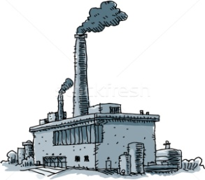
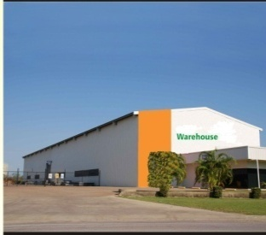
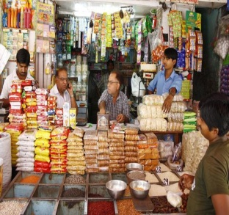
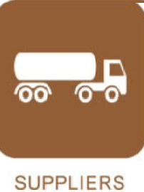
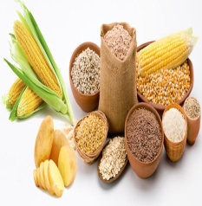
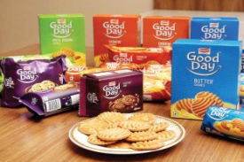

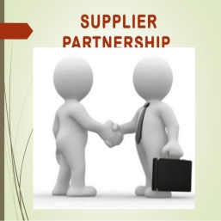


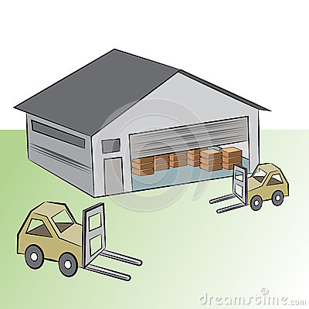
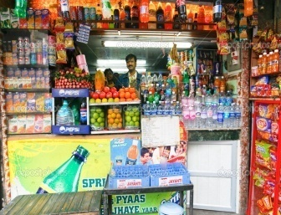

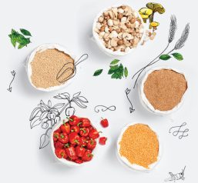
Supply Chain ( For Biscuit Cake and Rusk )
Its is not the companies which competing amongst themselves but the Supply Chain of the Companies
Its not the Organisations which are competing with each other but all functions encompassing
HR, Planning, Manufacturing, Sales, Marketing , Purchase , Quality & RD.
In Supply Chain we look for Increasing Efficiency , Productivity & Reducing Complexity
Retailers
Consumers
RM-PM
AW’s
Depots
SKU’s
Factories
Suppliers

Slide 4
Organisational Supply Chain to Support the Supply Chain
HR
IT
Finance
Administration
Replenishment
Manufacturing
Sales
Marketing
Purchase
Quality
Standards
R & D
Organisational Supply Chain
Business Supply Chain
88 Lacs Retailers ( 68 for BCRD )
1.3 Bn Consumers
600 (RM-PM)
3500 AW’s
50 Depots
250 SKU’s
100 Factories
400 Suppliers
In Supply Chain there is always a scope for Increasing Efficiency , Productivity & Reducing Complexity

Slide 5
Demand Planning

Slide 6
Short Term Demand Planning - The Big Picture
Demand
Planning
Inputs for Demand Planning
7th of month
Incorporate Product Lifecycle Changes
Newness / Intervention
Gather Data
During QOP Cycle
Brand Inputs for QOP
@ Q – 2M
Clean History & Develop
Baseline Forecast
Intervention history,
Short Supplies, Outliers, Month end Closing Stock
SPS
9th
Measure and Monitor Demand Plan Effectiveness
Correct Sales History
Generate Statistical Forecast
10th
Final Demand Plan @ SKU/AW
SMC - Final QOP @ Q – 1M
Develop Baseline Forecast
10th
Reports
20th
Alerts
2
Incorporate Brand
Rolling Demand Plan
& Sales Plan
Trade Activity Calendar
Consensus Plan from M-1
BI
Commercial Inputs
21th
Final Demand Plan @ SKU / Sales District
Rolling Demand Plan
Current & Future NSV
28th
1b
1a
25th
Consensus demand plan
3
Sales Plan
Supply Constrained plan - Sales Alignment Meeting
Newness/Intervention
Newness/Intervention Meeting
Consensus Demand – Workflow
28th
4
Run FSD for next month
Supply
Planning
No Capacity
Run Optimizer – FSD Plan
Feasibility Check for Capacity
5
Revise short
Term demand
Production Planning & Scheduling
6
7
Master Data for New SKUs
RM/PM Planning
Distribution Planning
Notes:
6

Slide 7
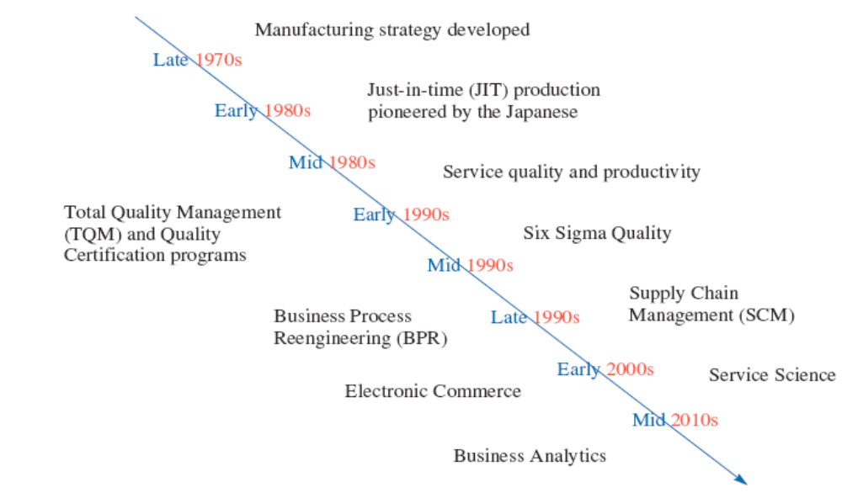
Time Line Depicting When Major OSCM Concepts Became Popular
Exhibit 1.5

Slide 8
Supply Chain Network Structure
&
Supplier Tiring
&
Customer Tiring

Slide 9
Conventional model of Supplier & Customer tiring
Initial Supplier
End Customer
Company
Tier 2 Supplier
Tier 2 Customer
Tier 3 Customer
Tier 3 Supplier
1
1
1
1
Tier 1 Supplier
Tier 1 Customer
1
1
2
2
2
2
3
3
3
3
n
n
n
n

Slide 10
Digital Economy talks about this Conventional model of Supplier & Customer tiring as B2C or C2C or B2B
Initial Supplier
End Customer
Company
B2C
B2C
B2C
B2C
Tier 2 Supplier
Tier 2 Customer
Tier 3 Customer
Tier 3 Supplier
1
1
1
1
Tier 1 Supplier
Tier 1 Customer
1
1
2
2
2
2
3
3
3
3
n
n
n
n
C2C
C2C
C2C

Slide 11
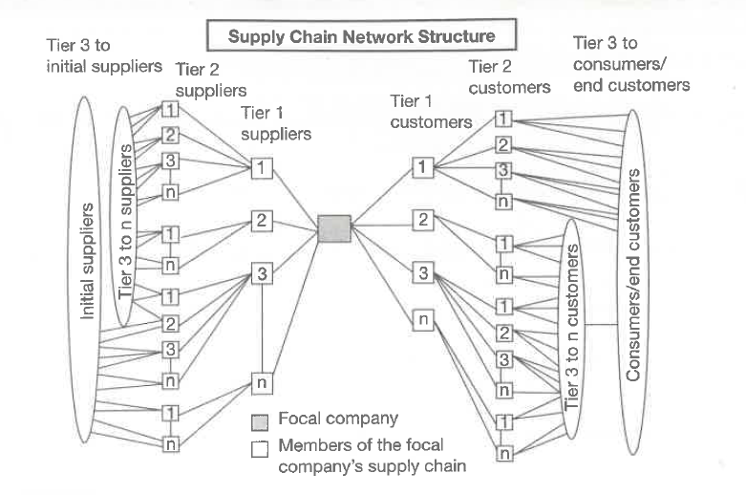

Slide 12

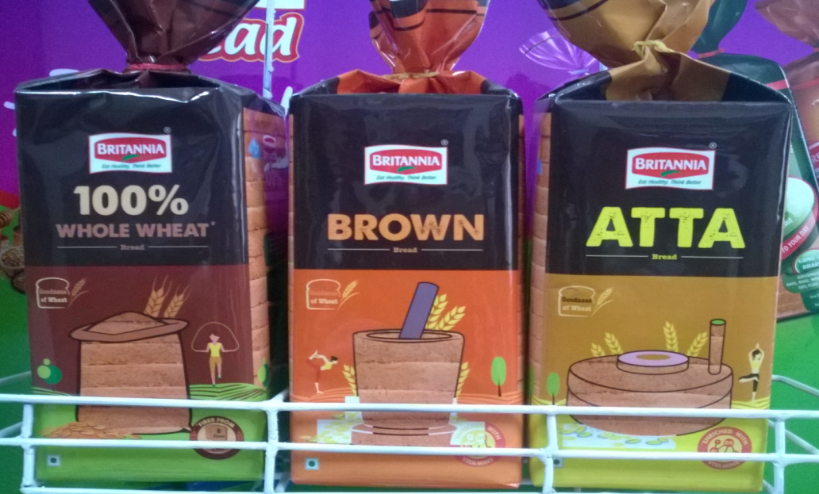
Chawla Plastics
Supplier tiring in Bread Polybag Industry

Slide 13
Supplier tiring in Bread Polybag Industry
Reliance
IOCL
BPCL
IOCL
Tier 3 Supplier
Tier 2 Supplier
Tier 1 Supplier
Customer
Granule Suppliers
Reliance
IOCL
HMEL
Cylinder makers
Affeletus
Shreeraj Roto
Reliable Gravier
BBIL
Chemicals
IOL
Easter
Import
Bread Polybag Supplier
(Chawla Plastics)
Ink Suppliers
Huber
DIC
Flint
Solvent

Slide 14
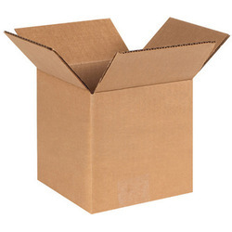
Supplier tiring in CBB ( Corrugated Box ) Industry

Slide 15
Supplier tiring in CBB ( Corrugated Box ) Industry
Tier 4 Supplier
Tier 3 Supplier
Tier 2 Supplier
Tier 1 Supplier
Customer
Paper Mills
V1
V2
V3
V4
V5
BIL
Domestic Waste
Imported Waste
Scrap vendor
Paper
V1
V2
V3
V4
V5
Stereo/ Plate Makers
V1
V2
V3
CBB Vendor
( Dhavan Box )
Glue Vendor
V1
V2
V3

Slide 16
B2B, B2C & C2C

Slide 17
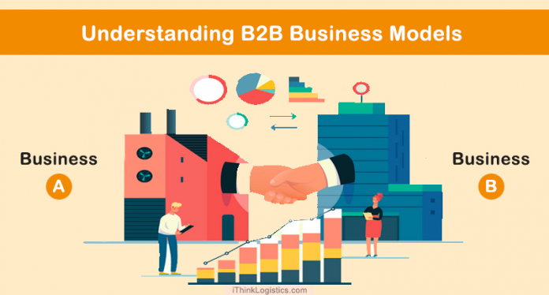
What is B2B
Business-to-business refers to business that is conducted between companies
Example : (1)Britannia Selling Bread to Reliance, Big Bazar, Spencers MORE Outlet etc
Example (2) Government contracts TATA Motors selling its cars through CSD
Example (3) OEM eg Bosh sellings auto parts to TATA Motors
Reliance Retail
BIL
Big Bazar Retail
MORE Stores

Slide 18
What is B2C
Company Selling product directly to end customer
Example : (1)Britannia Selling Bread directly through GT outlets
Example (2) TATA Motors selling its cars through its showroom
BIL
Reliance Retail
Big Bazar Retail
MORE Stores

Slide 19
What is C2C
Company Selling product directly to end customer
Example : (1)Handicraft gets sold by Exporter from India to an Importer who further sells to the end customer.
C2C
Handicraft maker ( In Moradabad )
Exporter in India
Importer overseas
customer

Slide 20
Power Shift in Supply Chain from manufacturing to manufacturing to Retailer/ Customer

Slide 21
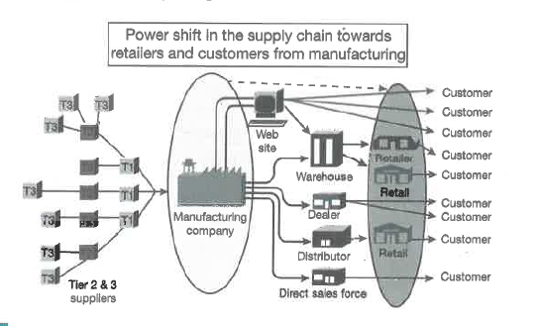

Slide 22
Cycle View of Supply Chain

Slide 23
5 Cycle View of Supply Chain
Customer
Customer Order Cycle
Retailer
Replenishment Cycle
Distributor
Manufacturing Cycle
Manufacturer
Procurement Cycle
Supplier

Slide 24
5 Cycle View of Supply Chain
Customer Order Cycle
Customer places an order
Customers Order is registered.
Replenishment Cycle
AW/ Depot places an order.
Order is Registered
Manufacturing Cycle
PO raised on supplier
NB (2) Supplies must be linked to Manufacturing schedule.
Procurement Cycle
Customer order is fulfilled
Customer receives the order.
Order is serviced.
AW/ Depot received the order
Order comes from AW/ Depot
Production is planned and scheduled.
Production is done.
Goods are Despatched.
Goods are received by AW/ Depot.
Supplier supplies the material.
NB (1) : PO & Production schedule must be factored

Slide 25
Lean Supply Chain

Slide 26
About Lean Supply Chain :
Lean Supply Chain refers to removing as much WASTE as possible in the Supply Chain.
Waste is defined as anything that does not add value from the customer’s perspective.
Lean production: integrated activities designed to achieve High-Volume production using Minimal Inventories.
  (1)Involves the timing of production resources i.e., parts arrive at the next workstation “Just In Time” ( JIT )

Slide 27
7 Wastages

Slide 28
7 Wastages
Taiichi Ohno, the former Chief Engineer of Toyota in Japan, was influential in the development of what is now widely known as ‘Lean thinking’.
He suggested seven common ‘Wastes’ or “Non-Value-Adding Activities.

Slide 29
Toyota Production System
( Benchmark of Lean Manufacturing )
Elimination of Waste
Respect for People
Waste from overproduction
Waste of waiting time
Transportation waste
Inventory waste
Processing waste
Waste of motion
Waste from product defects
Lifetime employment for permanent positions
Maintain level payrolls even when business conditions deteriorate
Company unions
Bonuses
View workers as assets

Slide 30
1)Waste of Over Production :It may happen due to :
--Manaufacturing not abiding by the Production plan issued by the Production planner to meets its LPF optimization target.
--Manufacturing expects Casual labour unavailability , this produces more when possible ( Labour Management )
2)Waste of Unnecessary Inventory : May be due to :
-Wrong PR being issued by Planning Department
-Vendors supplies excess more than required and factory unloads & Purchase gets the PR amended and edits PO.
--Discontinuation of SKU due to Re- Grammage ( DHANUSH )
--Drop in Demand
3)Waste of Defects & Poor Quality amy be due to :
--Product Stabalisation Phase. Machine & Product calibration is being arrived at.
--Labour and supervisor are unskilled for the job.
--PCT ( Pre- Commercial Trials ).
-- Due to RM issue.
4) Waste of Waiting :
--Due to Space shortage “ Inventory of Wheel” has to eb maintained.
--Commodity Space Utilisation Matrix
--Lumpy Flow : Due to Poor RM the machine stops regularly leading to recalibration of machine and drop in Efficiency of LPF
:7)The waste of inappropriate processing.
6)The waste Motion
(i) Departments should be close by.
(2) Human movement must be minimal
5)The waste of unnecessary transportation. May be due to :
--Bringing RM-PM from external warehouse & Cold room several times in a day.
7 Wastages

Slide 31
Kaizen
The kaizen philosophy for attacking waste is based upon these ideas:
  Waste is the enemy, and to eliminate waste it is necessary to get the hands dirty
  Improvement should be done gradually and continuously; the goal is not big improvements done intermittently.
  Everyone should be involved.
  Kaizen is built on a cheap strategy, and it does not require spending great sums on technology or consultants
  It can be applied everywhere
  It is supported by a visual system
  It focuses attention where value is created
  It is process oriented
  It stresses that the main effort for improvement should come from new thinking and a new work style
  The essence of organizational learning is to learn while doing

Slide 32
Lean SCM is based on the Logic of PULL System.

Slide 33
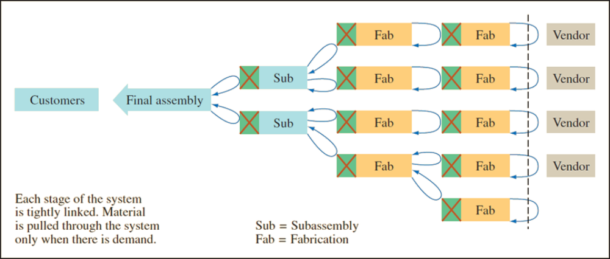
Lean Production – Pull System

Slide 34
Lean Logic
Lean is based on the logic that nothing will be produced until it is needed
A sale pulls a replacement from the last position in the system
This triggers an order to the factory production line
Each upstream station then pulls from the next station further upstream

Slide 35
Lean Supply Chain
( RM to Customer )

Slide 36
Lean-Focused Supply Chain Components
Lean suppliers :
  Able to respond to changes
  Lower prices
  Higher quality
Lean procurement:
  Key is automation (e-procurement)
  Suppliers must see into the customers’ operations and customers must see into their suppliers’ operation
Lean warehousing:
  Eliminate non-value-added steps and waste in storage process

Slide 37
Lean-Focused Supply Chain Components Continued
Lean logistics
  Optimized mode selection and pooling orders
  Combined multi-stop truckloads
  Optimized routing
  Cross docking
  Import/export transportation processes
  Backhaul minimization
Lean customers
  Understand their business needs
  Value speed and flexibility
  Establish effective partnerships with suppliers

Slide 38
5 Principles of Lean Supply Chain :

Slide 39
5 Principles of Lean Supply Chain :
  Identify customer values.
  Focus on processes that create value.
  Eliminate waste to create “flow”.
  Produce only according to customer demand.
  Strive for perfection.

Slide 40
4 Building Blocks of Lean SCM

Slide 41
Building Blocks of Lean SCM
Product Design
Process Design
Personnel/organizational elements
Manufacturing Planning and Control( MPC )

Slide 42
Building Blocks No 1 :
Product Design
Four elements of product design important for lean systems:
  Standard parts.
  Modular design.
  Highly capable systems with quality built in.
  Concurrent engineering

Slide 43
Building Blocks No 2 :
Process Design
Eight aspects of process design that are important for lean systems:
  Small lot sizes
  Setup time reduction
  Manufacturing cells
  Quality improvement
  Production flexibility
  A balanced system
  Little inventory storage
  Fail-safe methods

Slide 44
Building Blocks No 3 : Personnel/Organizational
Five personnel/organizational elements that are important for lean systems:
  Workers as assets
  Cross-trained workers
  Continuous improvement
  Cost accounting
  Leadership/project management

Slide 45
Building Blocks No 4 :
MPC ( Manufacturing, Planning & Controlling )
Seven elements of manufacturing planning and control (MPC) are particularly important for lean system:
  Level loading
  Pull systems
  Visual systems
  Limited work-in-process (WIP)
  Close vendor relationships
  Reduced transaction processing
  Preventive maintenance and housekeeping

Slide 46
Transition
&
Obstacles

Slide 47
Transitioning to Lean Systems
Make sure top management is committed and that they know what will be required
Decide which parts will need the most effort to convert
Obtain support and cooperation of workers
Begin by trying to reduce setup times while maintaining the current system
Gradually convert operations, begin at the end and work backwards
Convert suppliers to JIT
Prepare for obstacles

Slide 48
Obstacles to Conversion
Management may not be fully committed or willing to devote the necessary resources to conversion
Workers/management may not be cooperative
It can be difficult to change the organizational culture to one consistent with the lean philosophy
Suppliers may resist

Slide 49
Lean Tools
5W2H & Six Sigma

Slide 50
Lean Tools: 5W2H & Six Sigma
5W2H
  A method of asking questions about a process that includes what, why, where, when, who, how, and how much
Lean and Six Sigma
  Lean and Six Sigma can be viewed as two complementary approaches to process improvement
    Lean focuses on eliminating non-value-added activity to maximize process velocity
    Six Sigma seeks to eliminate process variation
    Together the two approaches can achieve process flow and quality

Slide 51
Value Stream Mapping Before and After Kaizan

Slide 52
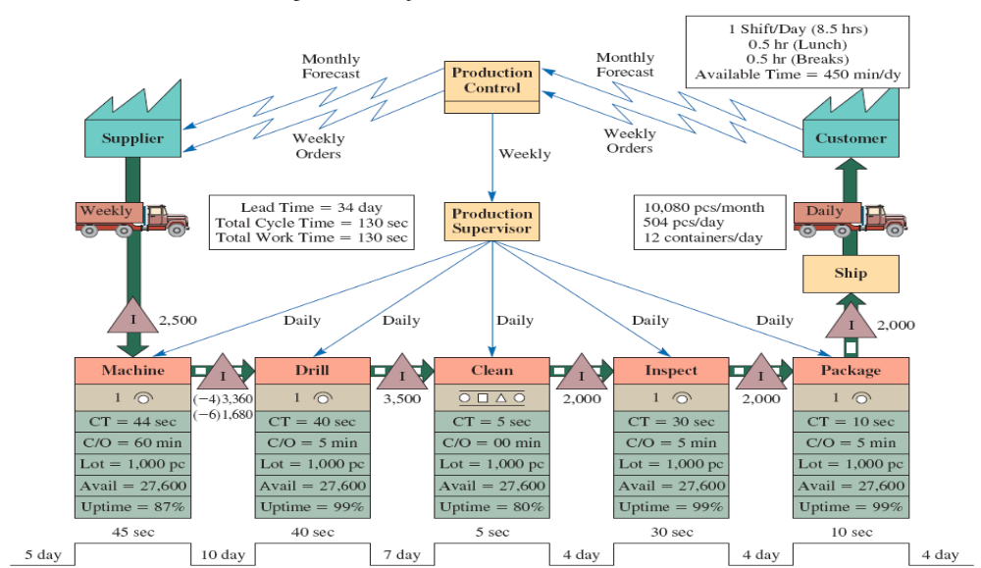
Manufacturing Process Map ( Original )
Lead Time = 34 days.
Total Cycle time =130 seconds

Slide 53
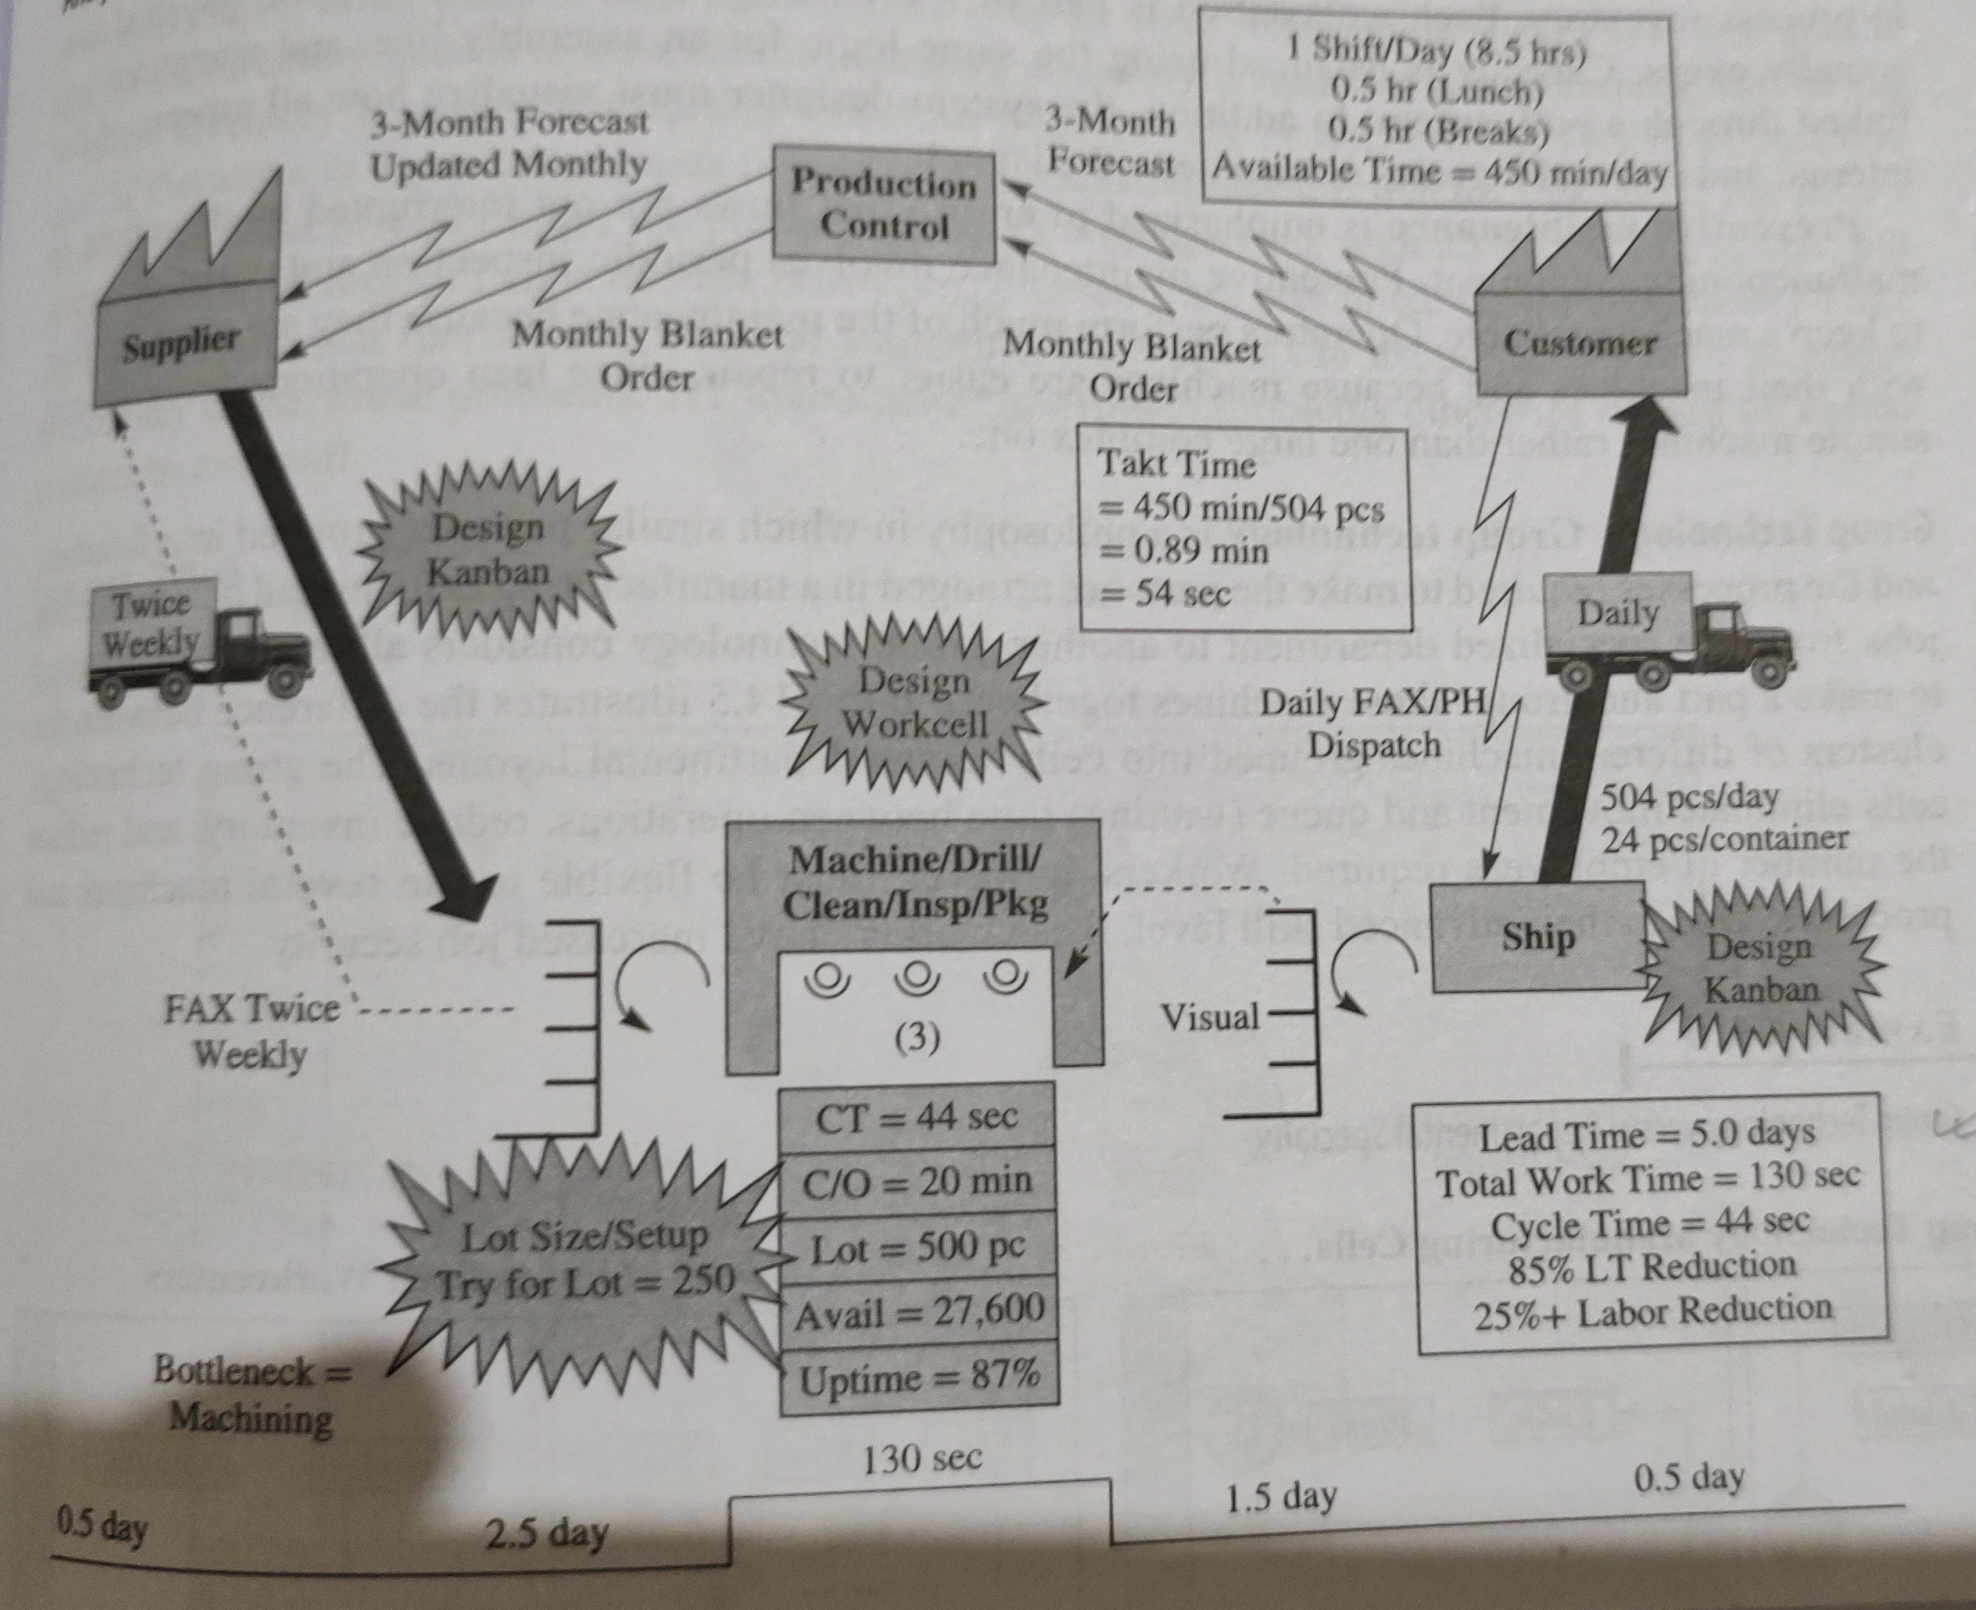
Manufacturing Process Map ( after Kaizan )
All 5 Depts merged
Lead Time = 5 days.
Total Cycle time =44 seconds

Slide 54
Customer Order Decoupling Point

Slide 55
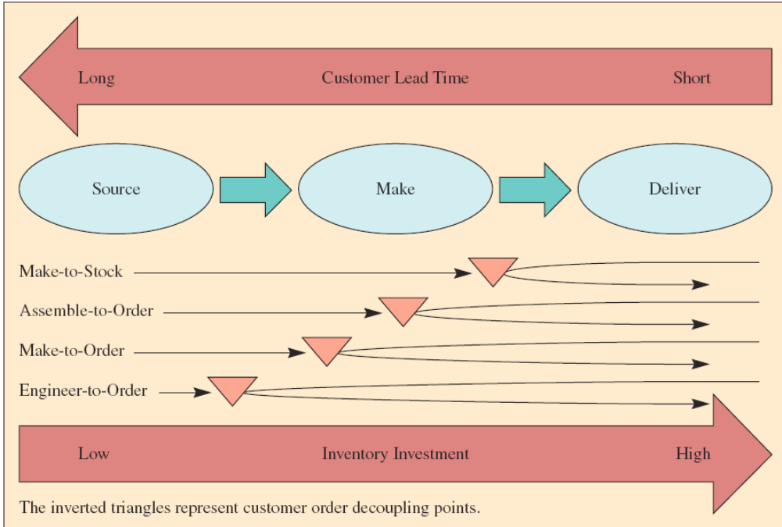
What Are Production Processes?
Production processes are used to make any manufactured item
High level view can be divided into three steps
  Step 1 – Source the parts needed
  Step 2 – Make the product
  Step 3 – Deliver the product

Slide 56
Types of Firms
Make-to-Stock
Assemble-to-Order
Make-to-Order
Engineer-to-Order
Serve customers from finished goods inventory
Combine a number of preassembled modules to meet a customer’s specifications
Make the customer’s product from raw materials, parts, and components
Work with the customer to design and then make the product

Slide 57
Make-to-Stock
Examples of products include the following:
  Televisions
  Clothing
  Packaged food products
Essential issue in satisfying customers is to balance the level of inventory against the level of customer service
  Easy with unlimited inventory, but inventory costs money
  Trade-off between the costs of inventory and level of customer service must be made
Use lean manufacturing to achieve higher service levels for a given inventory investment

Slide 58
Assemble-to-Order
A primary task is to define a customer’s order in terms of alternative components because these are carried in inventory
  An example is the way Dell Computer makes their desktop computers
One capability required is a design that enables as much flexibility as possible in combining components
There are significant advantages from moving the customer order decoupling point from finished goods to components

Slide 59
Make-to-Order/Engineer-to-Order
Boeing’s process for making commercial aircraft is an example
Customer order decoupling point could be in either raw materials at the manufacturing site or the supplier inventory
Depending on how similar the products are, it might not even be possible to preorder parts

Slide 60
Product Process Matrix

Slide 61
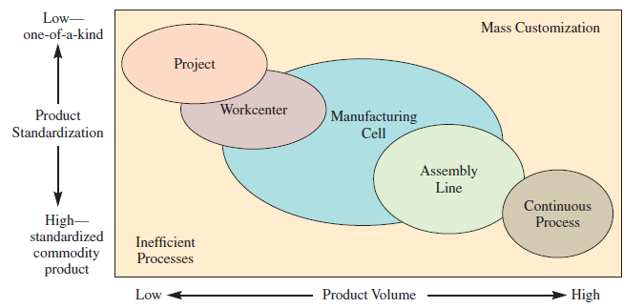
Product–Process Matrix: Framework Describing Layout Strategies

Slide 62
How Production Processes Are Organized
Project
The product remains in a fixed location
Manufacturing equipment is moved to the product
Workcenter (job shop)
Similar equipment or functions are grouped together
Manufacturing cell
A dedicated area where products that are similar in processing requirements are produced
Assembly line
Work processes are arranged according to the progressive steps by which the product is made
Continuous process
Assembly line only the flow is continuous such as with liquids
Notes:
11

Slide 63
5 S

Slide 64
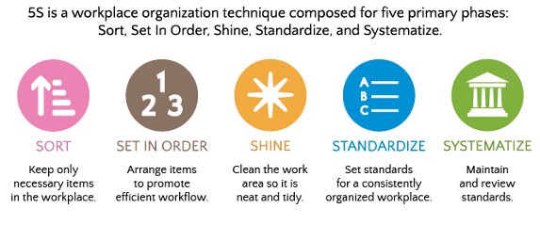
5S stands for the 5 steps of this methodology: Sort, Set in Order, Shine, Standardize, Sustain.
5S is designed to decrease waste while optimizing productivity through maintaining an orderly workplace and using visual cues to attain more consistent operational results. 5S refers to five steps – sort, set in order, shine, standardize and sustain (also known as the 5 pillars of a visual workplace).

