Slide 1
Lean Supply Chain

Slide 2

6 Blind Men Touching Different parts of an Elephant and expressing what is their assessment of Elephant as an animal. But this gives only a partial view of the Elephant.
It’s a Huge Fan
It’s a branch of a Tree.
It’s a Rope
It’s a Wall
It’s a snake Or a rope
It’s a Pillar

Slide 3
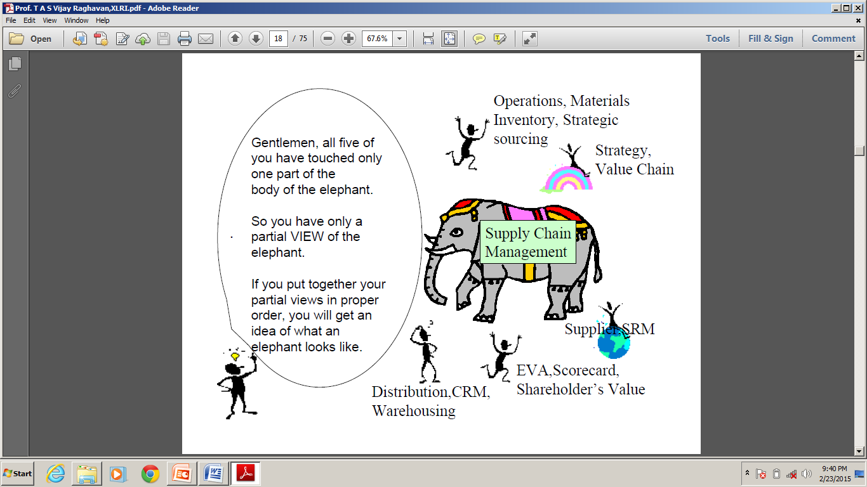
But when you put all the partial views together you get the full picture of an ELEPHANT.
Similarly when you put all the verticals of business together you get the full view of the Supply Chain

Slide 4
Digitalisation and Automation of Supply Chain
5 Facets of Digital Supply Chain
Internet of Things (IOT)
Cloud Computing
Automation
Data Analytics
Block chain
Digital Economy
GIG Economy
Data Analytics
Robotics
Predictive Analytics
Artificial Intelligence ( AI )

Slide 5
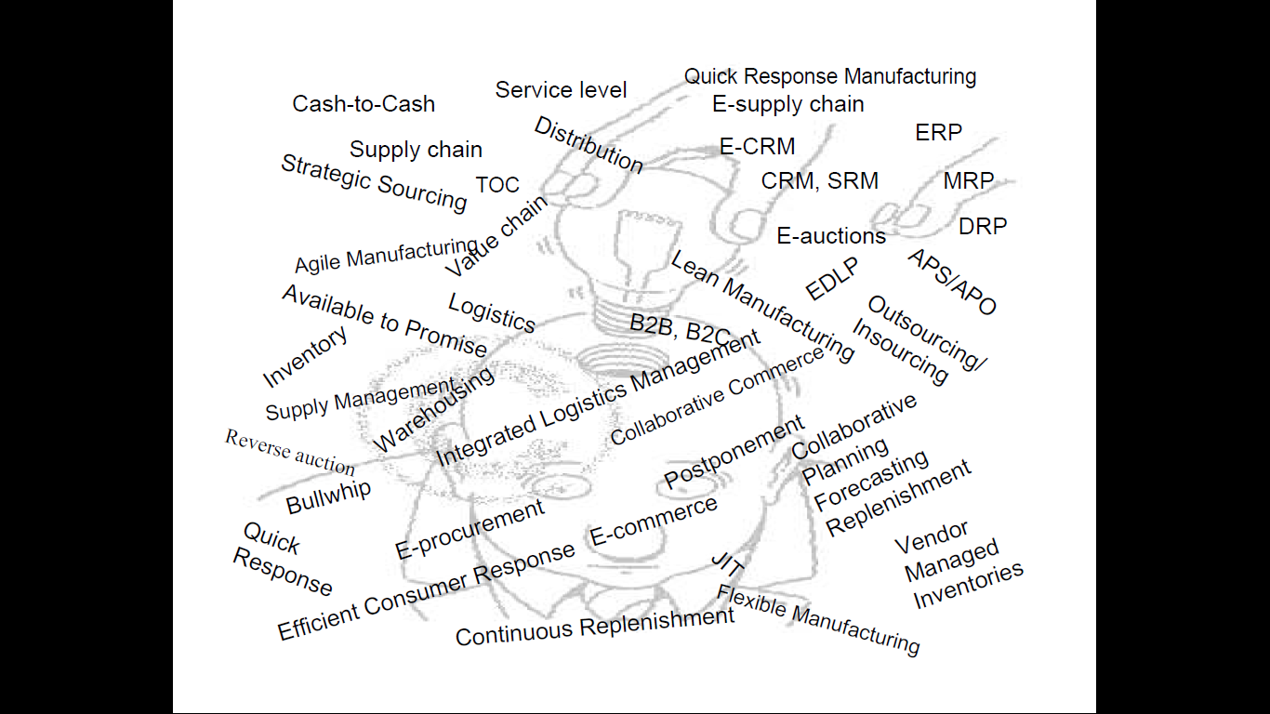
The below SCM activities are being further Digitalised by Artificial Intelligence, Machine Learning,
Data Analytics, Big data, Block Chain etc
But Digitalisation is where the Future is !!!

Slide 6
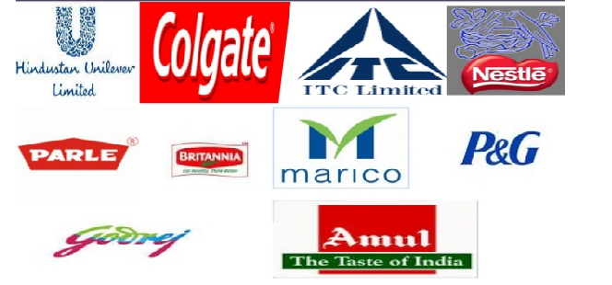
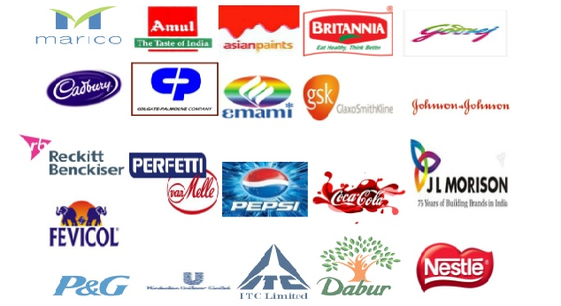



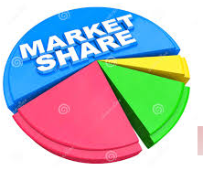
Business Triangle
Top line
( Sales )
Trick to a Business is to FOCUS on Growing both NET PROFIT & MARKET SHARE
Bottom Line or Net Profit
Market Share

Slide 7


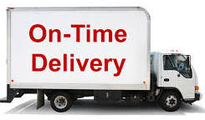
Supply Chain Triangle
Cost
CEP/ Efficiency Next ( Across the Globe in all Good Companies 2 % of cost has to be taken out Y-o-Y .In Emerged Economy where growth is low this is one of the Levers from where the profit comes.
Quality
Delivery

Slide 8
If both the Business Triangle and Supply Chain Triangle are in place then the result is encouraging…….
Top line
( Sales )
Cost
Trick to a Business is to FOCUS on Growing both NET PROFIT & MARKET SHARE
B Next/ Efficiency Next ( Across the Globe in all Good Companies 2 % of cost has to be taken out Y-o-Y .In Emerged Economy where growth is low this is one of the Levers from where the profit comes.
Bottom Line or Net Profit
Market Share
Quality
Delivery

Slide 9
Supply Chain
&
Channel Design and Distribution

Slide 10
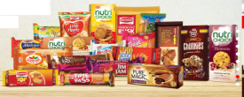

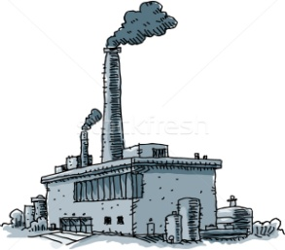
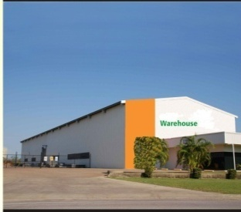
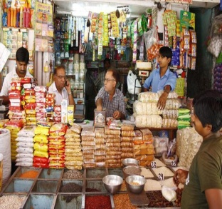
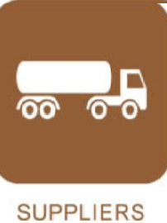
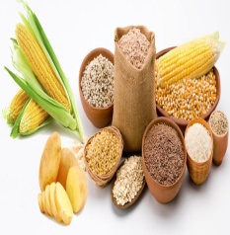
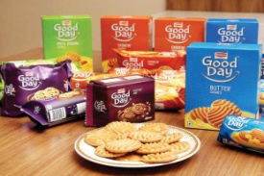

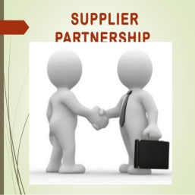


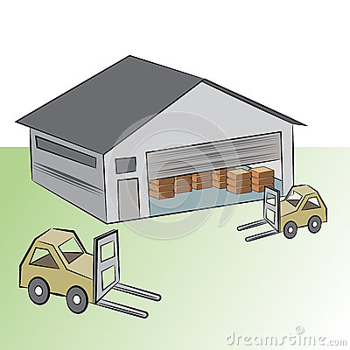
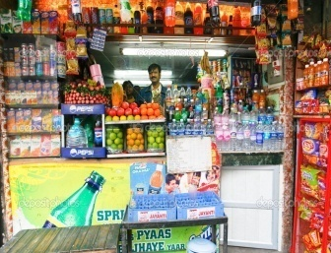

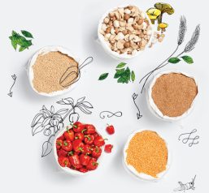
Supply Chain ( For Biscuit Cake and Rusk )
Its is not the companies which competing amongst themselves but the Supply Chain of the Companies
Its not the Organisations which are competing with each other but all functions encompassing
HR, Planning, Manufacturing, Sales, Marketing , Purchase , Quality & RD.
In Supply Chain we look for Increasing Efficiency , Productivity & Reducing Complexity
Retailers
Consumers
RM-PM
AW’s
Depots
SKU’s
Factories
Suppliers

Slide 11
Organisational Supply Chain to Support the Supply Chain
HR
IT
Finance
Administration
Replenishment
Manufacturing
Sales
Marketing
Purchase
Quality
Standards
R & D
Organisational Supply Chain
Business Supply Chain
88 Lacs Retailers ( 68 for BCRD )
1.3 Bn Consumers
600 (RM-PM)
3500 AW’s
50 Depots
250 SKU’s
100 Factories
400 Suppliers
In Supply Chain there is always a scope for Increasing Efficiency , Productivity & Reducing Complexity

Slide 12
SNOP -1
(Sales and Operations Process)

Slide 13
SNOP
( Sales and Operations Planning)
It helps keep Demand and Supply in Balance.
In Operations Management ( OM ) , this process is called Aggregate Planning.
Aggregation on the supply side is done by product families, and on the demand side it is done by groups of customers.
The new terminology is meant to capture the importance of cross-functional work with efforts from Sales, Distribution, Logistics, Operations,Finance, Purchase and Product Development.
The end goal is an agreement between various departmentson best coarse of action to achieve optimum balance between Supply and Demand

Slide 14
Types of Planning
Long-range planning
Planning focusing on a horizon greater than one year
Intermediate-range planning
Planning focusing on a period from 3 to 18 months
Short-range planning
Planning covering a period from 1 day to 6 months
Usually performed annually
Time increments are weekly, monthly, or quarterly
Daily or weekly time increments

Slide 15
Process Planning Deals with specific technology and procedure needed to deliver a product.
Strategic capacity Planning
Deals with determining long term capabilities of production system ( size & scope )
Process Planning
Long Term
Done for 2 things :
Manufacturing Process
Design of Logistic process
that deliver the product.
Supply Network Planning
Strategic capacity Planning
Forecasting and Demand Management
Determination of expected Demand is the focus here.from these data detailed SNOP is worked out
Supply Network Planning
Deals with (1)how product will be distributed to the customer,(2) warehouse location (3)Type of transportation
Forecasting and Demand Management
Sales and Operations Aggregate Planning
Sales Plan
Aggregate Operations Planning
Medium
Term
( Cont ..)
Sales Plan: These are the Plans to sell.
Operations Planning :
These are inputs into Manufacturing, Logistics and Services.
Manuafacturing
Logistics
Services

Slide 16
Long Term
Done for 2 things :
Manufacturing Process
Design of Logistic process
that deliver the product.
Process Planning
Supply Network Planning
Strategic capacity Planning
Sales and Operations Aggregate Planning
Sales Plan
Aggregate Operations Planning
Forecasting and Demand Management
Medium
Term
Manufacturing
Logistics
Services
Master scheduling
Vehicle capacity Planning
Weekly workforce Scheduling
Material Requirement Planning ( MRP )
Vehicle Loading
Short
Term
Order Scheduling
Vehicle Dispatching
Daily workforce scheduling
Manufacturing (Master Scheduling & MRP) : These are detailed scheduling that indicate when material is neded as per production plan.
Warehouse Receipt planning
Logistics :
Proper Transportation Management has to be done for movement of FG.
Services :Manpower laning has to be done to meet the Production plan

Slide 17
To summarise this is how the Short, Medium & Long Term Strategy will look like.

Slide 18
Long Term
Done for 2 things :
Manufacturing Process
Design of Logistic process
that deliver the product.
Process Planning
Supply Network Planning
Strategic capacity Planning
Sales and Operations Aggregate Planning
Sales Plan
Aggregate Operations Planning
Forecasting and Demand Management
Medium
Term
Manuafacturing
Logistics
Services
Master scheduling
Vehicle capacity Planning
Weekly workforce Scheduling
Short
Term
Material Requirement Planning ( MRP )
Vehicle Loading
Daily workforce scheduling
Order Scheduling
Vehicle Despatching
Warehouse Receipt planning

Slide 19
External to Firm
Inputs needed for Production Planning
c
Competitors Behaviour
Raw Material availability
Market Demand
Planning for Production
External capacity ( Subcontracting )
Economic Condition
Internal to Firm
Current Physical capacity
Current Workforce
Inventory levels
Activities required for production

Slide 20
4 Production Planning Strategies

Slide 21
Chase Strategy
Possible Example : Quiet similar to Market CP Model.
Involves hiring and laying off employees.
There are motivational issues as employees fear being laid off , thus have a tendency to reduce output when order is getting completed.
Level Strategy :
Possible Example : HEC ( Heavy Engineering Corporation ), HMT Watch Co etc
Key Principle :Stable workforce who work at Constant Output Rate.
Number of workmen employed by company are fixed.
Workers are emotionally more stable.
This lead to fluctuation in Inventory, Order backlogs and Sales loss.
Inventories can become obsolete.
There can be decrease in customer service levels
Stable Workforce – Variable work Hours :
Possible Example : TATA Steel, BIL company owned factory etc
Key Principle :Stable workforce who vary the output by varing the numbers of hours worked.
Number of workmen employed by company are fixed.
Workers are emotionally more stable.
Sub-contracting Model:
Possible Example : Quiet similar to CP Model.n
Here unless the relationship with the supplier is strong, a manufacturer can lose some control over schedule and quality

Slide 22
Manufacturing

Slide 23
Type of Factories
Company owned Factory
POFG
Company Buyes only the FG.
Company does not supply the RM-PM ( Except for sharing the possible source from where RM-PM can be sourced )
All Employees are on the Pay Roll of Company ( Except Contract employees & workers ).
Typically makes High Volume and has 4 + Lines
It’s a company owned Factory/ Asset
Commitment CP’s
( Contract Packers
Non Committed CP’s
OR Market CP’s
In this model there is NO COMMITMENT by the CP owner on the number of SHIFTs he will allocate .
He may be making his own Private Label Brand or even Competitors product.
This Units becomes a necessity when DEMAND is increasing and sales have to be serviced to avoid any Loss of Market Share or even SALE Loss.
Not all Demand can be met by In House Factory , thus CP’s are needed.
In case of NON UTILISATION of those Shifts company pays for Commitment Charges.
The Company supplies RM-PM.
2 Company employee’s are stationed at the CP ( 1 QUALITY & 1 PRODUCTION Officer).
In this model Company assures UTILISATION OF CERTAIN number of Shifts.
Eg During Covid for Food Industry.
Ratio ( Company : CP ) It keeps on Varying Y-O-Y based on Cost Benefit Analysis ( CBA )
 | Company Owned Factory | CP
FY 18-19 | 40 | 60
F Y 19-20 | 45 | 55
FY 20-21 | 50 | 50
FY 21-22 | 55 | 45

Slide 24
Time Line Depicting When Major OSCM Concepts Became Popular

Slide 25
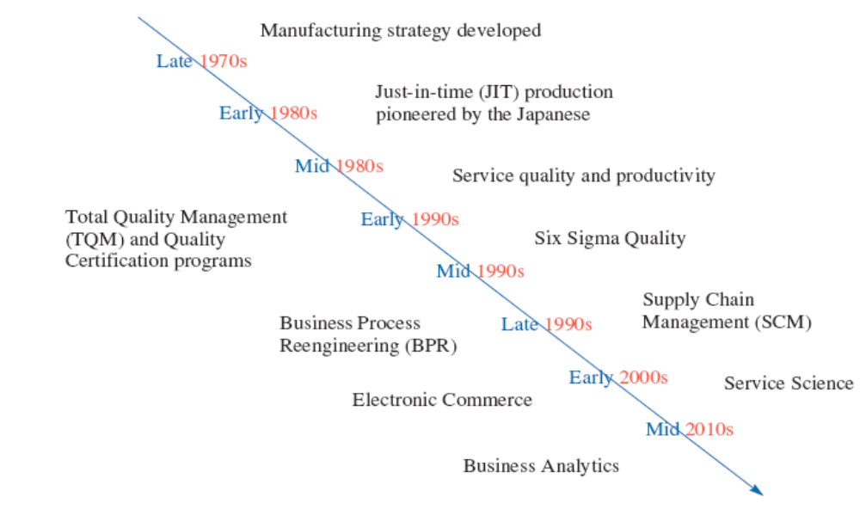
Time Line Depicting When Major OSCM Concepts Became Popular
Exhibit 1.5

Slide 26
8 Business Processes

Slide 27
8 Business Processes of Supply Chain
1)CRM: Customer Relationship Management
2)SRM : Supplier Relationship Management
3) NPD :Product Development and Commecialisation
4)Reverse Logistics : Return Management
5) Replenishment (Order Fulfillment ).
6) Manufacturing (Manufacturing Flow Management)
7) Demand Management
8)Customer Service Management

Slide 28
8 Business Processes runs across all Departments

Slide 29
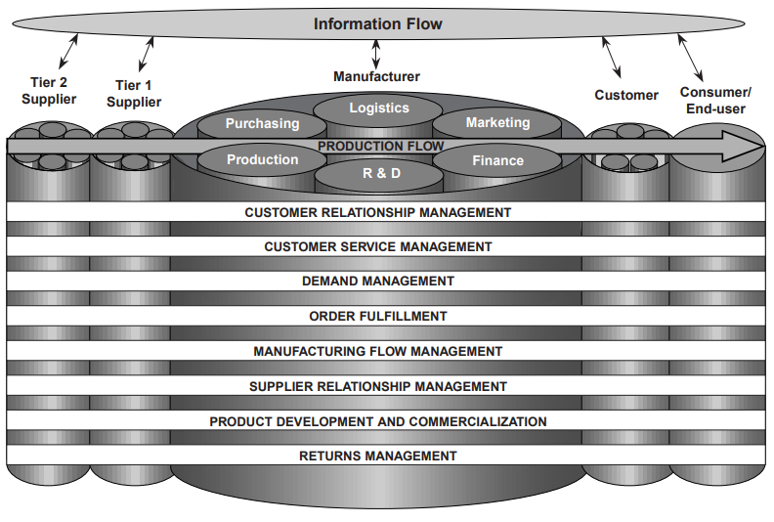
Each of the 8 Business Process runs through the length of the supply Chain and cuts across
Different Departments.
Although activities in these processes will be in specific Department, but the entire Process will
not be contained within one Department.

Slide 30
8 Business Processes and detailing of it in different Departments

Slide 31
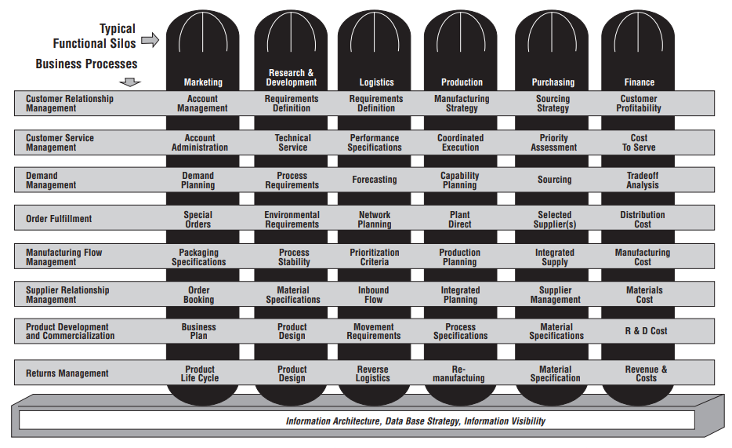
Each Function within the organization is mapped to 8 Business Processes.
Although activities in these processes will be in specific Department, but the entire Process
will not be contained within one Department.
Eg Mundra
Operations
Eg Stage gate
meeting for NPD
Eg Bread Mkt
return

Slide 32
Supply Chain Network Structure
&
Supplier Tiring
&
Customer Tiring

Slide 33
Conventional model of Supplier & Customer tiring
Initial Supplier
End Customer
Company
Tier 2 Supplier
Tier 2 Customer
Tier 3 Customer
Tier 3 Supplier
1
1
1
1
Tier 1 Supplier
Tier 1 Customer
1
1
2
2
2
2
3
3
3
3
n
n
n
n

Slide 34
Digital Economy talks about this Conventional model of Supplier & Customer tiring as B2C or C2C or B2B
Initial Supplier
End Customer
Company
B2C
B2C
B2C
B2C
Tier 2 Supplier
Tier 2 Customer
Tier 3 Customer
Tier 3 Supplier
1
1
1
1
Tier 1 Supplier
Tier 1 Customer
1
1
2
2
2
2
3
3
3
3
n
n
n
n
C2C
C2C
C2C

Slide 35
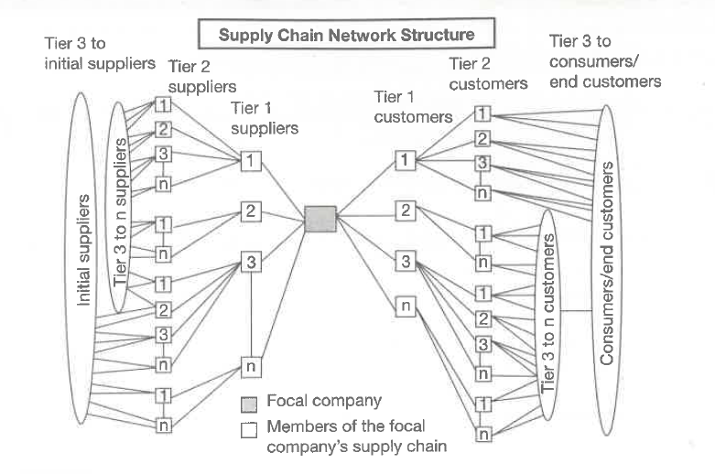

Slide 36
Cycle View of Supply Chain

Slide 37
5 Cycle View of Supply Chain
Customer
Customer Order Cycle
Retailer
Replenishment Cycle
Distributor
Manufacturing Cycle
Manufacturer
Procurement Cycle
Supplier

Slide 38
4 Cycle View of Supply Chain
Customer Order Cycle
Customer places an order
Customers Order is registered.
Replenishment Cycle
AW/ Depot places an order.
Order is Registered
Manufacturing Cycle
PO raised on supplier
NB (2) Supplies must be linked to Manufacturing schedule.
Procurement Cycle
Customer order is fulfilled
Customer receives the order.
Order is serviced.
AW/ Depot received the order
Order comes from AW/ Depot
Production is planned and scheduled.
Production is done.
Goods are Despatched.
Goods are received by AW/ Depot.
Supplier supplies the material.
NB (1) : PO & Production schedule must be factored

Slide 39
Lean Supply Chain

Slide 40
About Lean Supply Chain :
Lean Supply Chain refers to removing as much WASTE as possible in the Supply Chain.
Waste is defined as anything that does not add value from the customer’s perspective.
Lean production: It involves integrated activities designed to achieve High-Volume production using Minimal Inventories.
  (1)Involves the timing of production resources i.e., parts arrive at the next workstation “Just In Time” ( JIT )

Slide 41
7 Wastages

Slide 42
7 Wastages
Taiichi Ohno, the former Chief Engineer of Toyota in Japan, was influential in the development of what is now widely known as ‘Lean thinking’.
He suggested seven common ‘Wastes’ or “Non-Value-Adding Activities.

Slide 43
Toyota Production System
( Benchmark of Lean Manufacturing )
Elimination of Waste
Respect for People
Waste from overproduction
Waste of waiting time
Transportation waste
Inventory waste
Processing waste
Waste of motion
Waste from product defects
Lifetime employment for permanent positions
Maintain level payrolls even when business conditions deteriorate
Company unions
Bonuses
View workers as assets

Slide 44
1)Waste of Over Production :It may happen due to :
--Manaufacturing not abiding by the Production plan issued by the Production planner to meets its LPF optimization target.
--Manufacturing expects Casual labour unavailability , this produces more when possible ( Labour Management )
2)Waste of Unnecessary Inventory : May be due to :
-Wrong PR being issued by Planning Department
-Vendors supplies excess more than required and factory unloads & Purchase gets the PR amended and edits PO.
--Discontinuation of SKU due to Re- Grammage ( DHANUSH )
--Drop in Demand
3)Waste of Defects & Poor Quality amy be due to :
--Product Stabalisation Phase. Machine & Product calibration is being arrived at.
--Labour and supervisor are unskilled for the job.
--PCT ( Pre- Commercial Trials ).
-- Due to RM issue.
4) Waste of Waiting :
--Due to Space shortage “ Inventory of Wheel” has to be maintained.
--Commodity Space Utilisation Matrix
--Lumpy Flow : Due to Poor RM the machine stops regularly leading to recalibration of machine and drop in Efficiency of LPF
:7)The waste of inappropriate processing.
6)The waste Motion
(i) Departments should be close by.
(2) Human movement must be minimal
5)The waste of unnecessary transportation. May be due to :
--Bringing RM-PM from external warehouse & Cold room several times in a day.
7 Wastages

Slide 45
(1)
Waste of Waiting.

Slide 46
Scenario 1 :
Space Constrain_ High Every Day Consumption_ Full Truck Load needed everyday
( UTC Factory )

Slide 47
Scenario 1 : ( UTC Factory)
When Full Truck Load can be serviced
Impact on Commodity Space Utilization Matrix
Given this kind of space constrain how do we resolve it ?
Also :
1)Delivery Lead Time varies from 1- 2 days.
2) What if Consigment gets rejected on arrival due to “ Quality” Issue
State | CP Name | Plant | Category Description | Storage Space | Per Day Consumption | Coverage in terms of NOD ( Number of days ) | Number of Trucls needed per day
Uttranchal | UTC Factory Limited | UTC | Flour | 60 | 110 | 0.5 | 5.5
Waste of Waiting :
1)At any given point of time INVENTORY ON WHEEL is needed.Apart from Stock in Transit( SIT) & Stock in hand ( SIH )

Slide 48
Scenario 2 :
Space Constrain_ Very Low Every Day Consumption_ Part Load needed every alternate day.
( Delta Factory )

Slide 49
Scenario 2 ( eg Delta Cake Plant )
When Part Load is needed to Service due to Space Constrain
Impact on Commodity Space Utilization Matrix
Given this kind of space constrain how do we resolve it ?
Also :
1)Suppliers are not keen to Supply to this plant due to small MOQ, Unloading issues ,Rejection and Harassment
2)Delivery Lead Time varies from 1- 2 days.
3) What if Consignment gets rejected on arrival due to “ Quality” Issue
State | CP Name | Plant | Category Description | Storage Space | Per Day Consumption | Coverage in terms of NOD ( Number of days ) | Number of Trucls needed per day
UP | Delta | Delta | Flour | 10 | 5 | 2 | 1/3 of a Truck i.e 10 MT
Waste of Waiting :
1)At any given point of time INVENTORY ON WHEEL is needed.Apart from Stock in Transit( SIT) & Stock in hand ( SIH )

Slide 50
(2)
Waste of Unnecessary Inventory.
Slow and Non Moving Stock

Slide 51
Example 1
TATA International

Slide 52

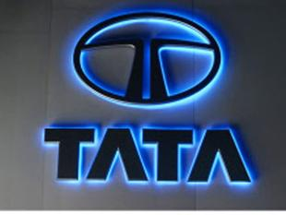
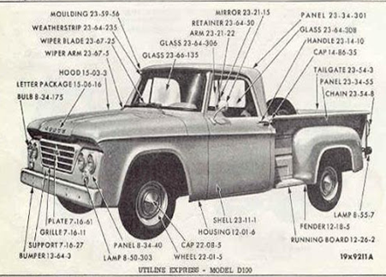

Alternate Part Numbers
On an average there are more than 5000 Parts needed to make a Truck Or a Car.
And Companies introduce alternate Part Numbers for the Existing running Part Number at periodic intervals. Thus for every Single Part Number there can be 4 to 10 alternate Part. Thus SAP will have a total of 50,000 Part Number ( Minimum ).And the SAP Hygiene is a necessity by way of PERMANENTLY BLOCKING the OLD PART NUMBER.
In correct SAP Hyehine can Lead to ordering of same part multiple times under different Part numbers.
Differential Part Number ( Original Part number ) | 9948 2301 1149
Differential Part Number ( Alternate Part Number 1 ) | 9948 2302 1152
Differential Part Number ( Alternate Part Number 2 ) | 9948 2304 1189

Slide 53
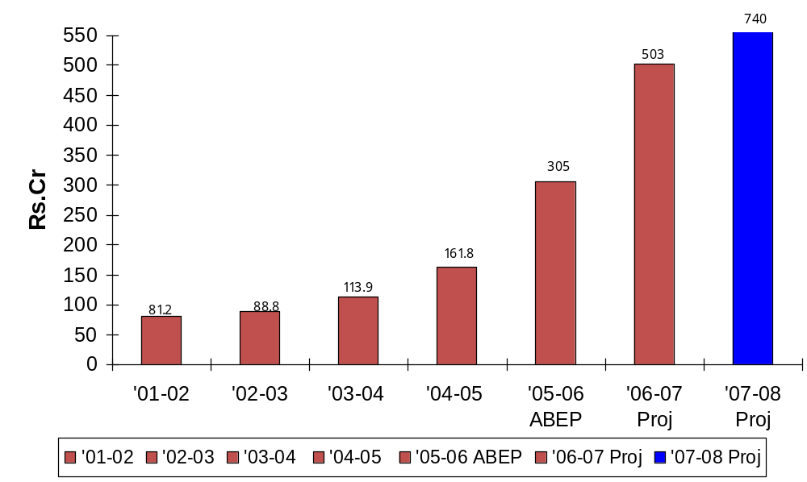
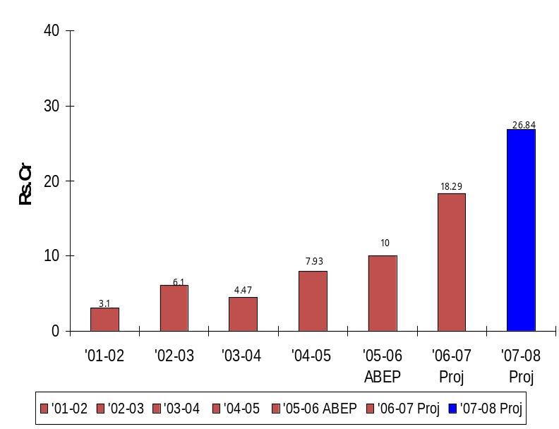
Non Moving Stock
In the initial days in absence of Historical data and Incorrect Forecasting accuracy
Spare Parts worth 3.5 Crore were lying in the Bonded Warehouse of TATA International
For a Business which does a Billing of 1.2 Crore/ month the Non Moving Stock of
3.5 Crore was a case of write off .
A small Business cannot afford wastage.

Slide 54
Lean SCM is based on the Logic of PULL System.

Slide 55
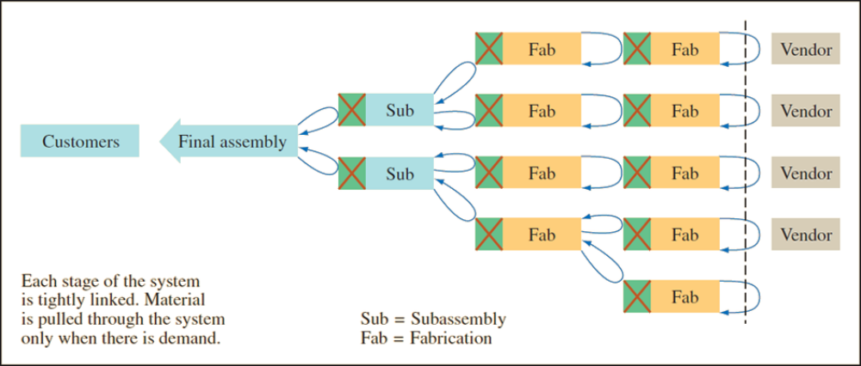
Lean Production – Pull System

Slide 56
Lean Logic
Lean is based on the logic that nothing will be produced until it is needed
A sale pulls a replacement from the last position in the system
This triggers an order to the factory production line
Each upstream station then pulls from the next station further upstream

Slide 57
Lean Supply Chain
( RM to Customer )

Slide 58
Lean-Focused Supply Chain Components
Lean suppliers :
  Able to respond to changes
  Lower prices
  Higher quality
Lean procurement:
  Key is automation (e-procurement)
  Suppliers must see into the customers’ operations and customers must see into their suppliers’ operation
Lean warehousing:
  Eliminate non-value-added steps and waste in storage process

Slide 59
Lean-Focused Supply Chain Components Continued
Lean logistics
  Optimized mode selection and pooling orders
  Combined multi-stop truckloads
  Optimized routing
  Cross docking
  Import/export transportation processes
  Backhaul minimization
Lean customers
  Understand their business needs
  Value speed and flexibility
  Establish effective partnerships with suppliers

Slide 60
5 Principles of Lean Supply Chain :

Slide 61
5 Principles of Lean Supply Chain :
  Identify customer values.
  Focus on processes that create value.
  Eliminate waste to create “flow”.
  Produce only according to customer demand.
  Strive for perfection.

Slide 62
4 Building Blocks of Lean SCM

Slide 63
Building Blocks of Lean SCM
Product Design
Process Design
Personnel/organizational elements
Manufacturing Planning and Control( MPC )

Slide 64
Building Blocks No 1 :
Product Design
Four elements of product design important for lean systems:
  Standard parts.
  Modular design.
  Highly capable systems with quality built in.
  Concurrent engineering

Slide 65
Building Blocks No 2 :
Process Design
Eight aspects of process design that are important for lean systems:
  Small lot sizes
  Setup time reduction
  Manufacturing cells
  Quality improvement
  Production flexibility
  A balanced system
  Little inventory storage
  Fail-safe methods

Slide 66
Building Blocks No 3 : Personnel/Organizational
Five personnel/organizational elements that are important for Lean Systems:
  Workers as assets
  Cross-trained workers
  Continuous improvement
  Cost accounting
  Leadership/project management

Slide 67
Building Blocks No 4 :
MPC ( Manufacturing, Planning & Controlling )
Seven elements of manufacturing planning and control (MPC) are particularly important for lean system:
  Level loading
  Pull systems
  Visual systems
  Limited work-in-process (WIP)
  Close vendor relationships
  Reduced transaction processing
  Preventive maintenance and housekeeping

Slide 68
Transition
&
Obstacles

Slide 69
Transitioning to Lean Systems
Make sure top management is committed and that they know what will be required
Decide which parts will need the most effort to convert
Obtain support and cooperation of workers
Begin by trying to reduce setup times while maintaining the current system
Gradually convert operations, begin at the end and work backwards
Convert suppliers to JIT
Prepare for obstacles

Slide 70
Obstacles to Conversion
Management may not be fully committed or willing to devote the necessary resources to conversion
Workers/management may not be cooperative
It can be difficult to change the organizational culture to one consistent with the lean philosophy
Suppliers may resist

Slide 71
Lean Tools
5W2H & Six Sigma

Slide 72
Lean Tools: 5W2H & Six Sigma
5W2H
  A method of asking questions about a process that includes what, why, where, when, who, how, and how much
Lean and Six Sigma
  Lean and Six Sigma can be viewed as two complementary approaches to process improvement
    Lean focuses on eliminating non-value-added activity to maximize process velocity
    Six Sigma seeks to eliminate process variation
    Together the two approaches can achieve process flow and quality

Slide 73
Kaizen
The kaizen philosophy for attacking waste is based upon these ideas:
  Waste is the enemy, and to eliminate waste it is necessary to get the hands dirty
  Improvement should be done gradually and continuously; the goal is not big improvements done intermittently.
  Everyone should be involved.
  Kaizen is built on a cheap strategy, and it does not require spending great sums on technology or consultants
  It can be applied everywhere
  It is supported by a visual system
  It focuses attention where value is created
  It is process oriented
  It stresses that the main effort for improvement should come from new thinking and a new work style
  The essence of organizational learning is to learn while doing

Slide 74
Value Stream Mapping Before and After Kaizan

Slide 75
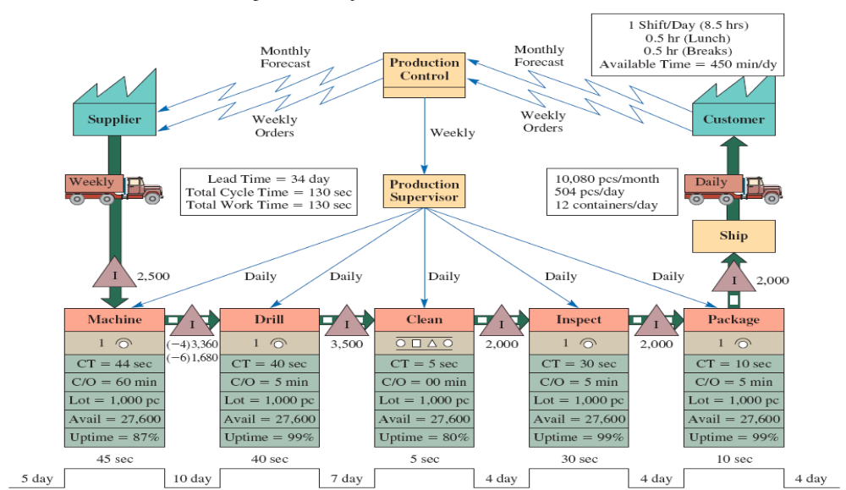
Manufacturing Process Map ( Original )
Lead Time = 34 days.
Total Cycle time =130 seconds

Slide 76
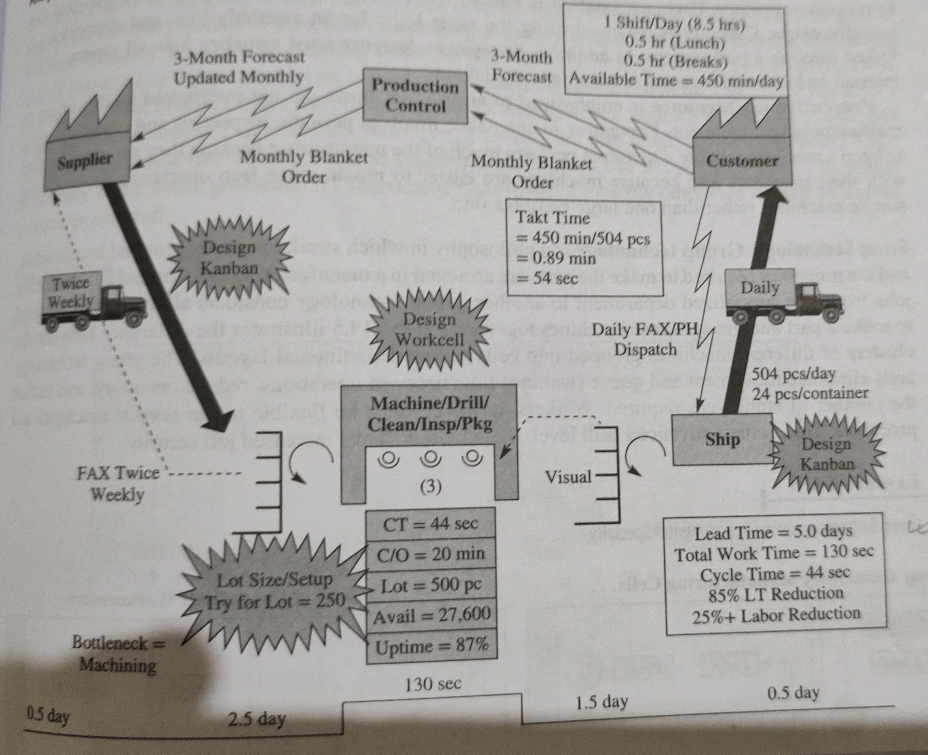
Manufacturing Process Map ( after Kaizan )
All 5 Depts merged
Lead Time = 5 days.
Total Cycle time =44 seconds

Slide 77
Manufacturing Process

Slide 78
Types of Firms
Make-to-Stock
Assemble-to-Order
Make-to-Order
Engineer-to-Order
Serve customers from finished goods inventory eg FMCG Packaged Foods industry, TV, Clothing's etc.
Combine a number of preassembled modules to meet a customer’s specifications eg BSK Festival Gift Hampers, DELL Computers etc
Make the customer’s product from raw materials, parts, and components.eg Mundra Export Orders , CBB, PVC Treys,Bread Polybags, Coffee Cans ,Boeing Aircrafts Defence Equipment's etc
Work with the customer to design and then make the product. They buy RM-PM after design has been finalised with customer.eg GreenField Projects, Boeing Aircrafts, Defence Equipments etc

Slide 79
Customer Order Decoupling Point

Slide 80
Customer Order Decoupling Point
Decoupling point mentions about the position of the Inventory in the Supply Chain.
Inventory can be in the form of :
Finished Goods
Work in Progress.
Raw Material.
With Supplier.
Positioning of the Decoupling point is important for determining the Manufacturing Models weather (i) Make-to-Stock (ii) Assemble-to-Order (iii)Make-to-Order (iv) Engineer-to-Order.
Closer the Decoupling Point is to the Customer the Quicker the Customer can be served.
There is a trade-off between Quick service to the customer and the Investment in keeping the FG Inventory ready.Because Inventory Cost of FG is more expensive than Inventory Cost of RM. ( As FG includes cost of RM + Cost of Convertion )
Selection of Decoupling Point is a Strategic Decision.

Slide 81
Customer Order Decoupling Point
Customer Lead Time
Long
Short
Source
Make
Deliver
Inventory as FG
When Customer Order comes FG is dispatched
Make to Stock
When Customer Order comes then Parts gets Assembled.
Inventory in Pre- Assembled form or as KITs
Assemble – To- Order
Inventory in RM form
When Customer Order comes then RM gets converted to FG
Make to Order
Inventory as RM to be procured.
When Customer Order is finalized then RM is accordingly procured
Engineer to Order
Inventory Investment
Short
Long
Inverted Triangle is the place where Inventory of FG is kept OR is also known as the DECOUPLING Point

Slide 82
5 Formats of Manufacturing Facility or Production Processes

Slide 83
5 Formats of Manufacturing Facility or Production Processes.
Assembly Line
Continuous process
Workcenter (Job shop)
Project
The product remains in a fixed location ( eg Green Field Project , Aircraft making, Builing etc )
Manufacturing cell
A dedicated area where products that are similar in processing requirements are produced ( eg Computer Chips , Metal Fabrication )
Work processes are arranged according to the progressive steps by which the product is made eg FMCG Products ( Packaged Food Industry, Automobiles etc )
Is similar to Assembly line only difference is the flow is continuous such as with liquids eg ( Liquid Industry )
Similar equipment or functions are grouped together. And Similar functions are also known as DEPARTMENTS ( eg In PVC Trey making workcentre’s are Air Blowing workcentre, Tapping workcentre,Stacking Workcentre,Packing Workcentre,Shipping & Despatch workcentre )
Manufacturing equipment is moved to the product.
Notes:
11

Slide 84
Product Process Matrix

Slide 85
Product Standarisation
Product Process Matrix
Inefficient Process
High
Continuous Process
Eg Liquids like Petrol, Gasoline, Milk, Flavours High Volume --High Product Standarisation
Assembly Line Process
Eg FMCG Products
High Volume --High Product Standarisation
Manufacturing Cell
Eg Computer Chips Projects
Medium Volume --Medium Product Standarisation
Work Centre Eg PVC Trey Making Low Volume-- Low Product Standarisation
Projects
Eg Green field Projects
Low Volume --Low Product Standarisation
Mass Customisation
Volume
Low
Low
High

Slide 86
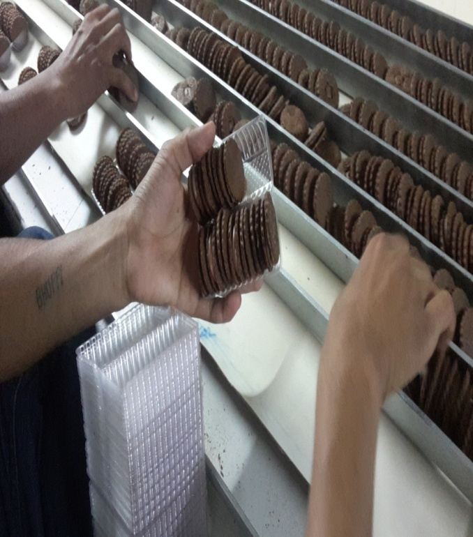
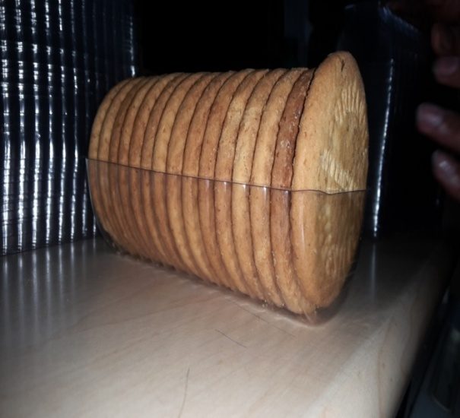
Example :
Work Centre
( Trey Making )

Slide 87
Stages in PVC Trey Making
( In Totality a Assembly Line Process but also has Work Centers )
Stage 2 : Forming ( Work Centre)
Conversion from a Plain Sheet to a Sheet with Multiple PVC Treys in it.
Stage 3 : Cutting ( Work Centre)
Cutting of the Sheet which has Multiple PVC Treys in it . This is done by using Dye Press Machine.
Stage 4 : Cleaning , Stacking & Packing ( Work Centre ) Removal of the unusable plastics from the Edges
Stage 5 :Inspection ( Work Centre)
Satge 6 : Despatch ( Work Centre)
Satge 1 : Raw Material ( Sheet or Roll )
Raw Material arrangement
Vacuum forming
Cutting
Cleaning and QC
Packing
Dispatch
Scrap removal

Slide 88
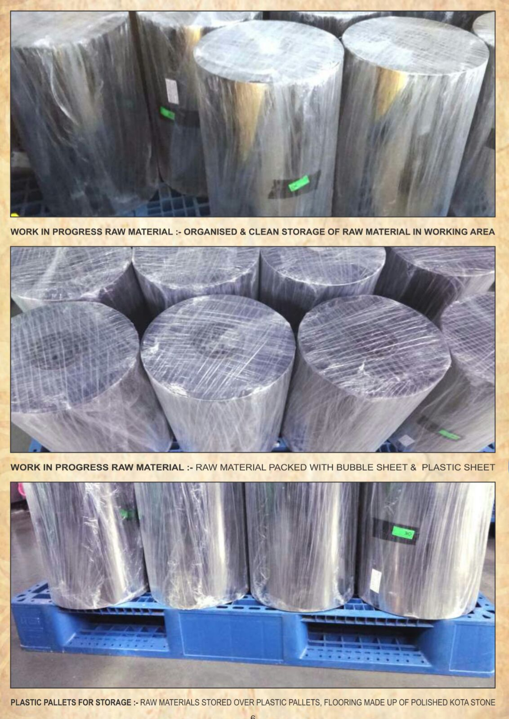
Stage 1 : Raw Material : Sheets & Rolls

Slide 89
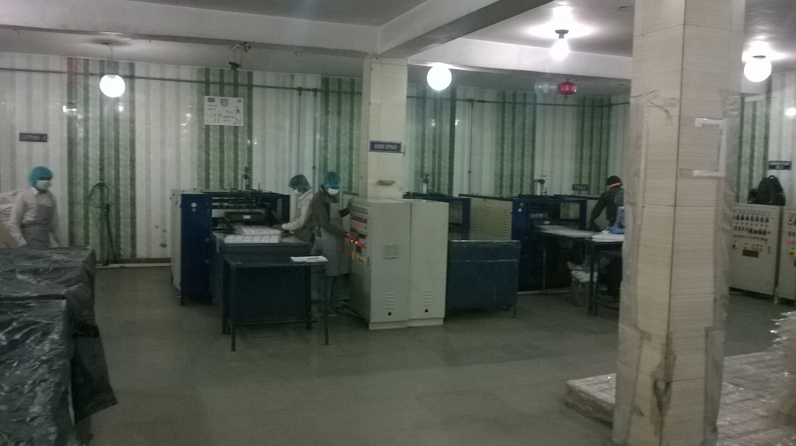
Stage 2(a) : Forming & Cutting

Slide 90
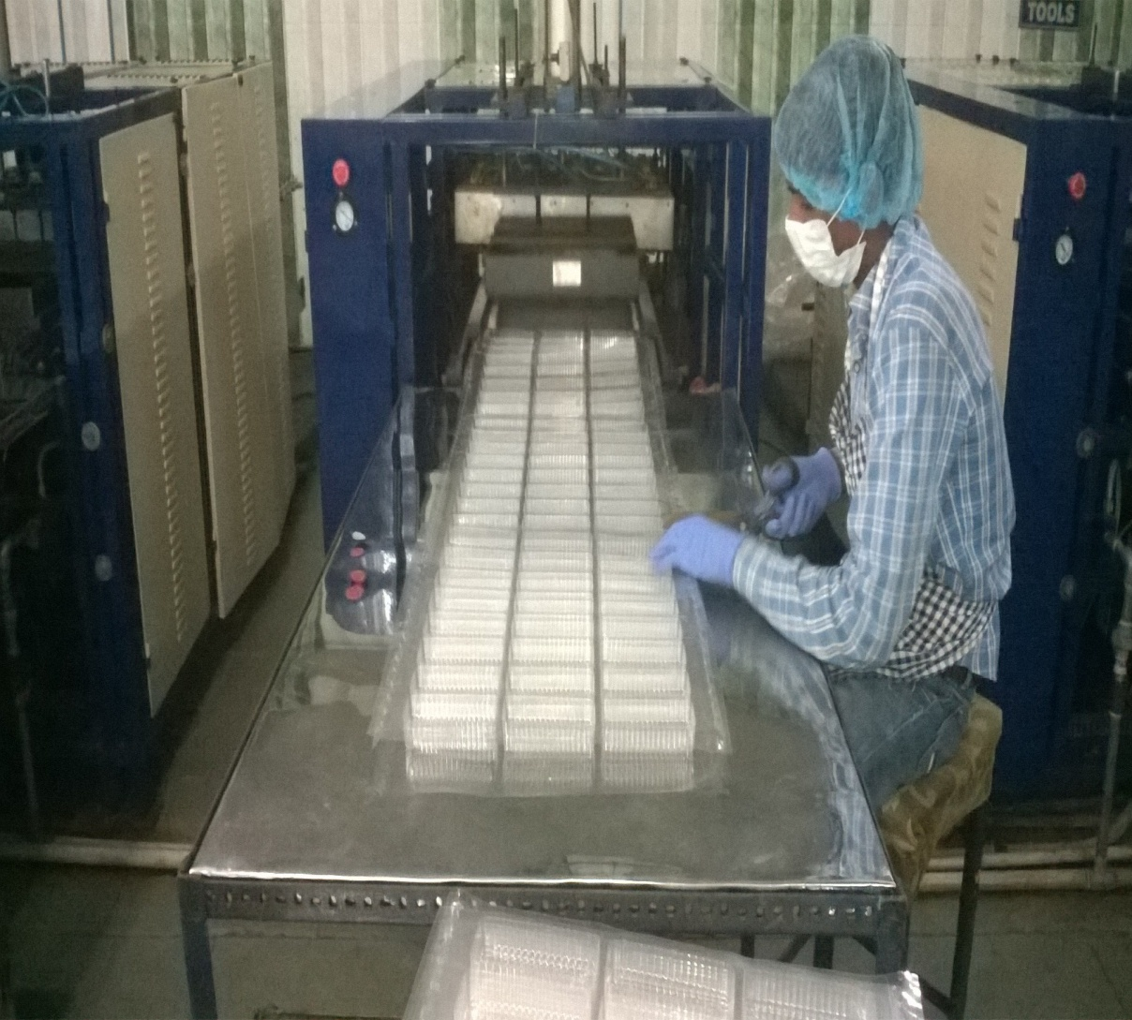
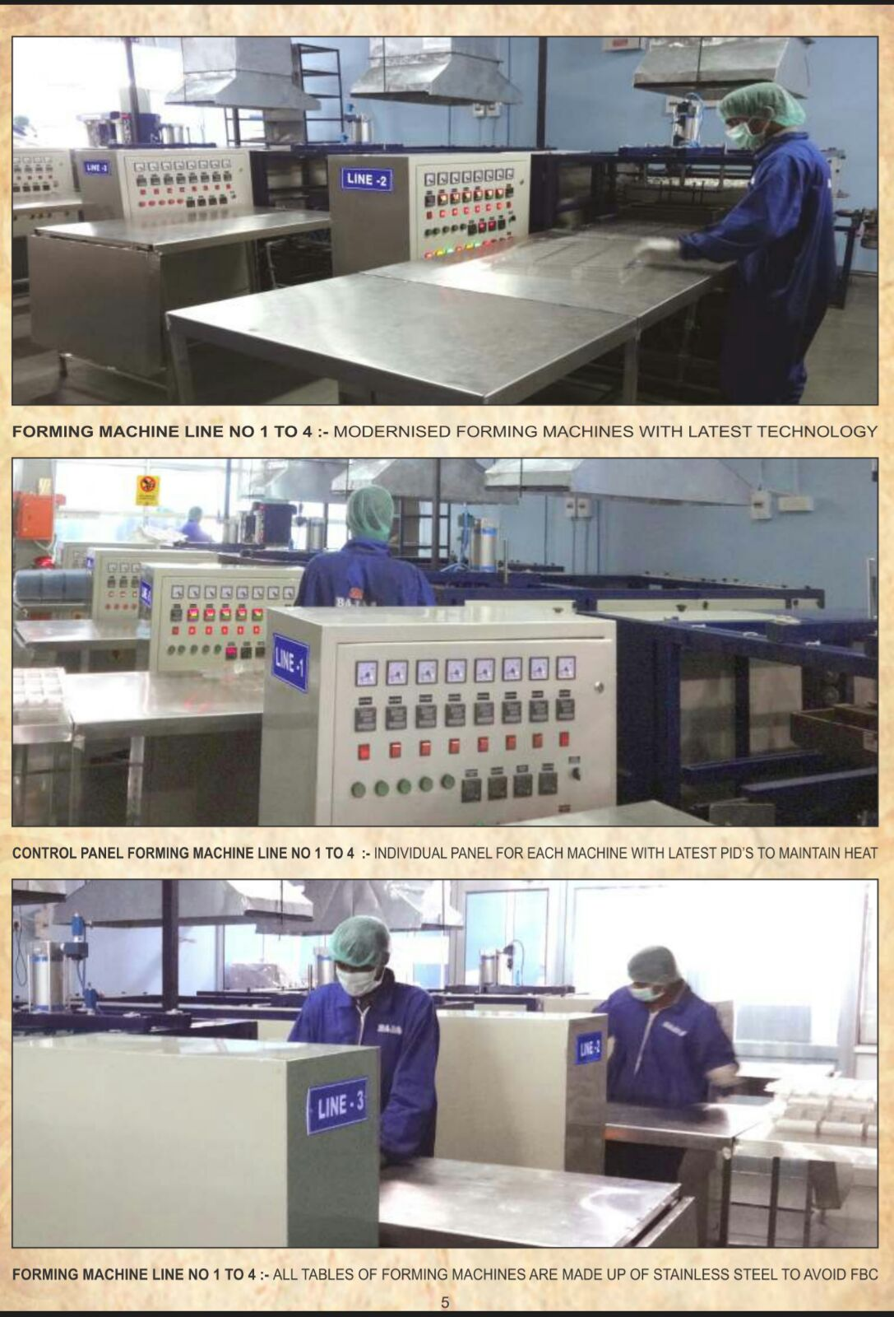
Stage 2(b) : Forming Stage ( Work Centre) : Plain Sheet to a Sheet with Multiple Treys (

Slide 91
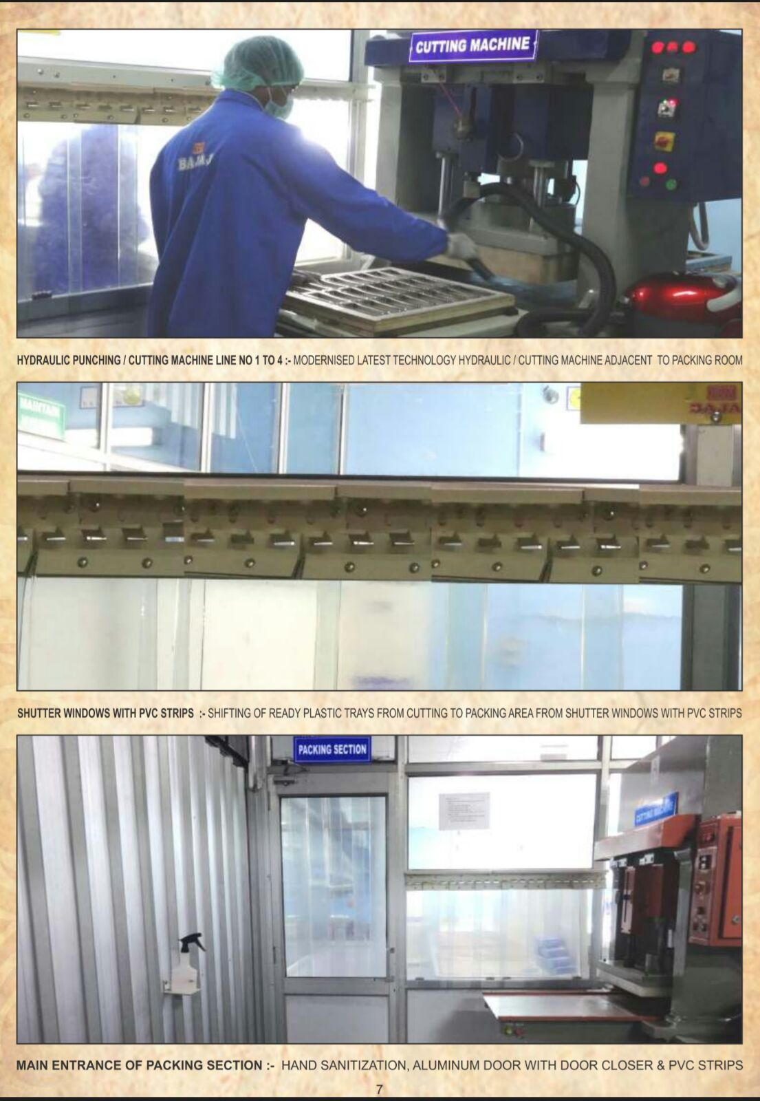
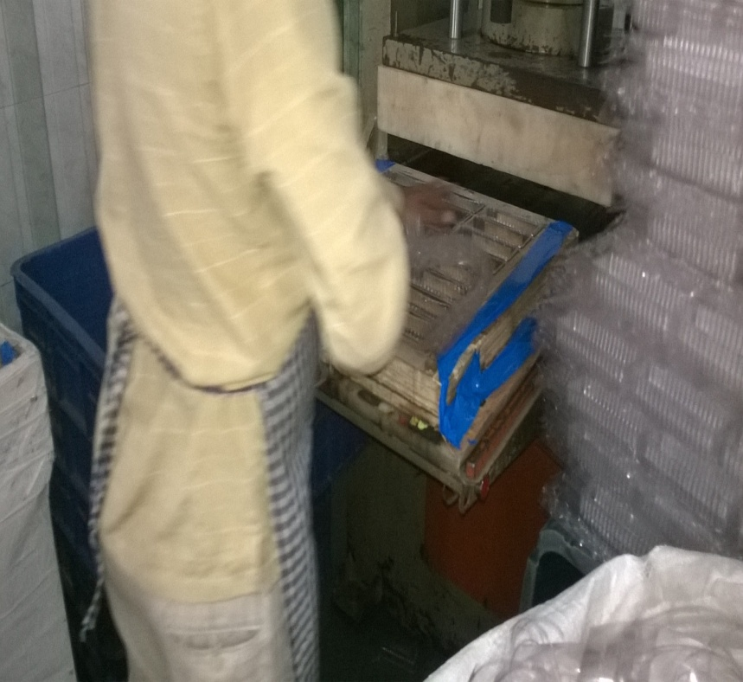
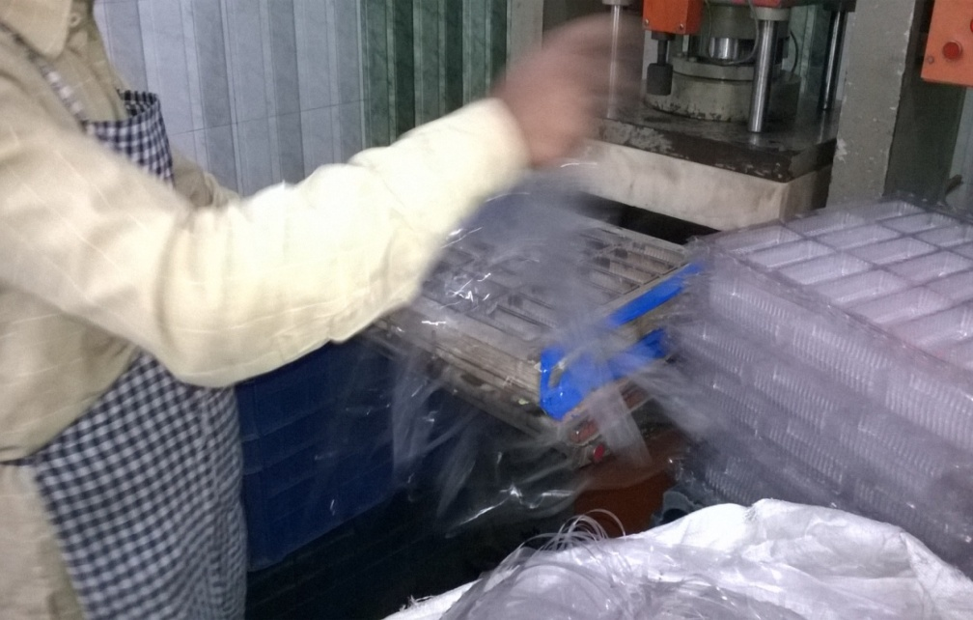
Stage 3 : Cutting Stage ( Work Centre) ( Taking Out the Edges )

Slide 92
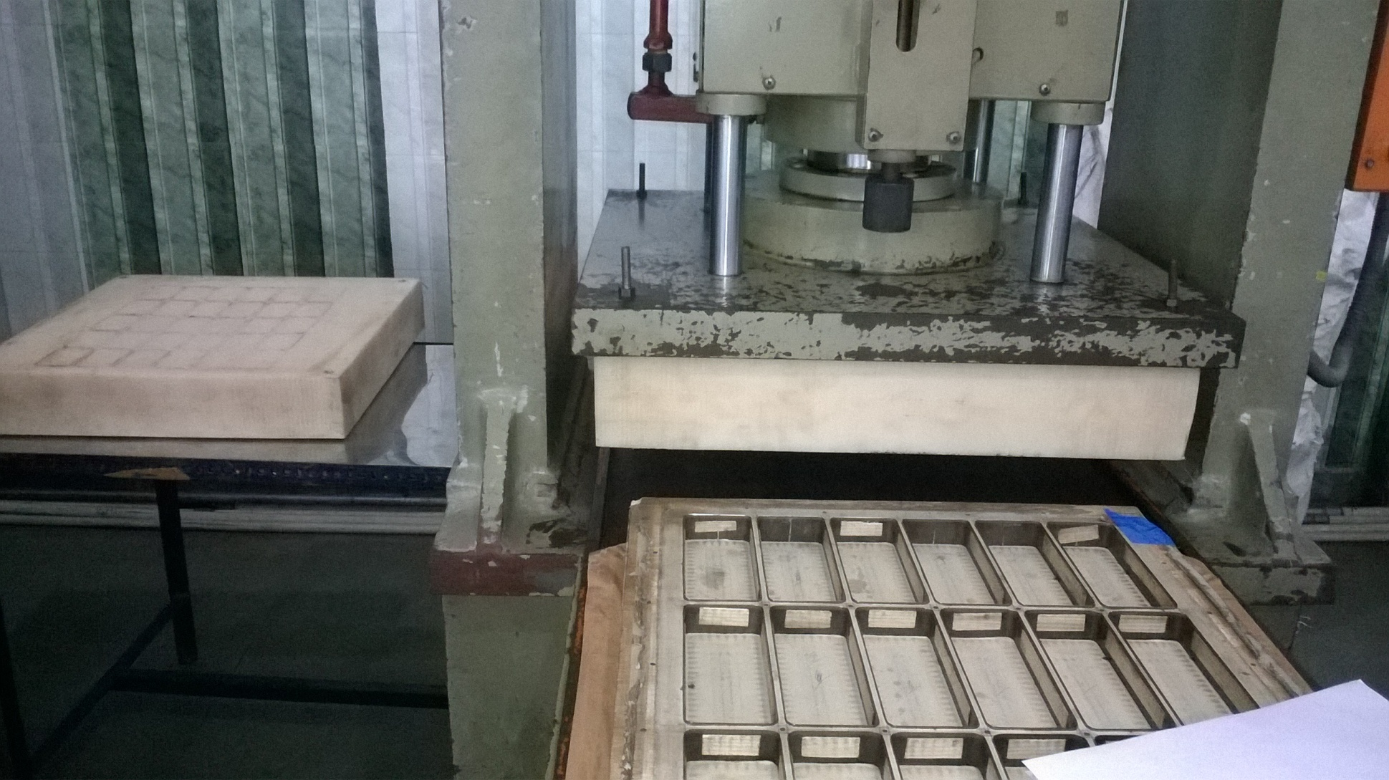
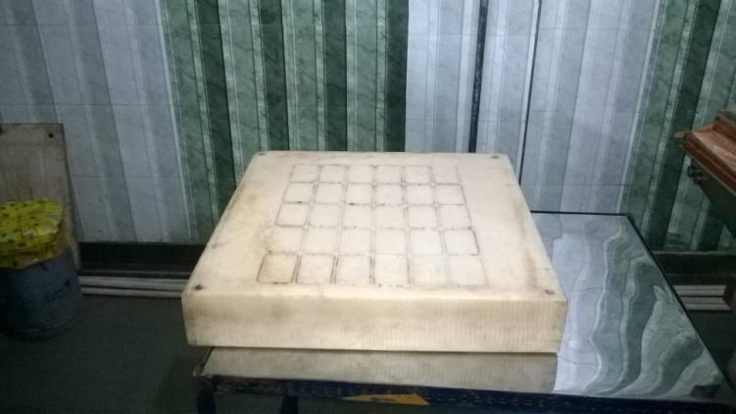
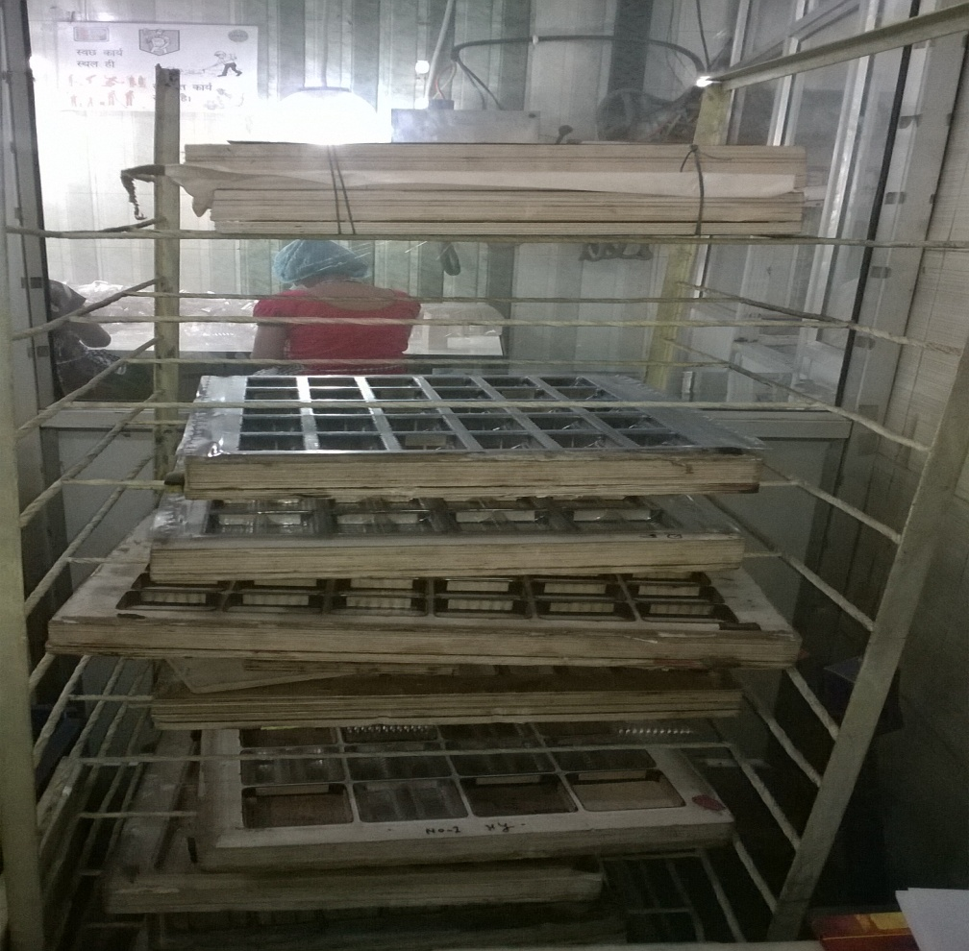
Cont : Cutting Stage ( Work Centre)

Slide 93
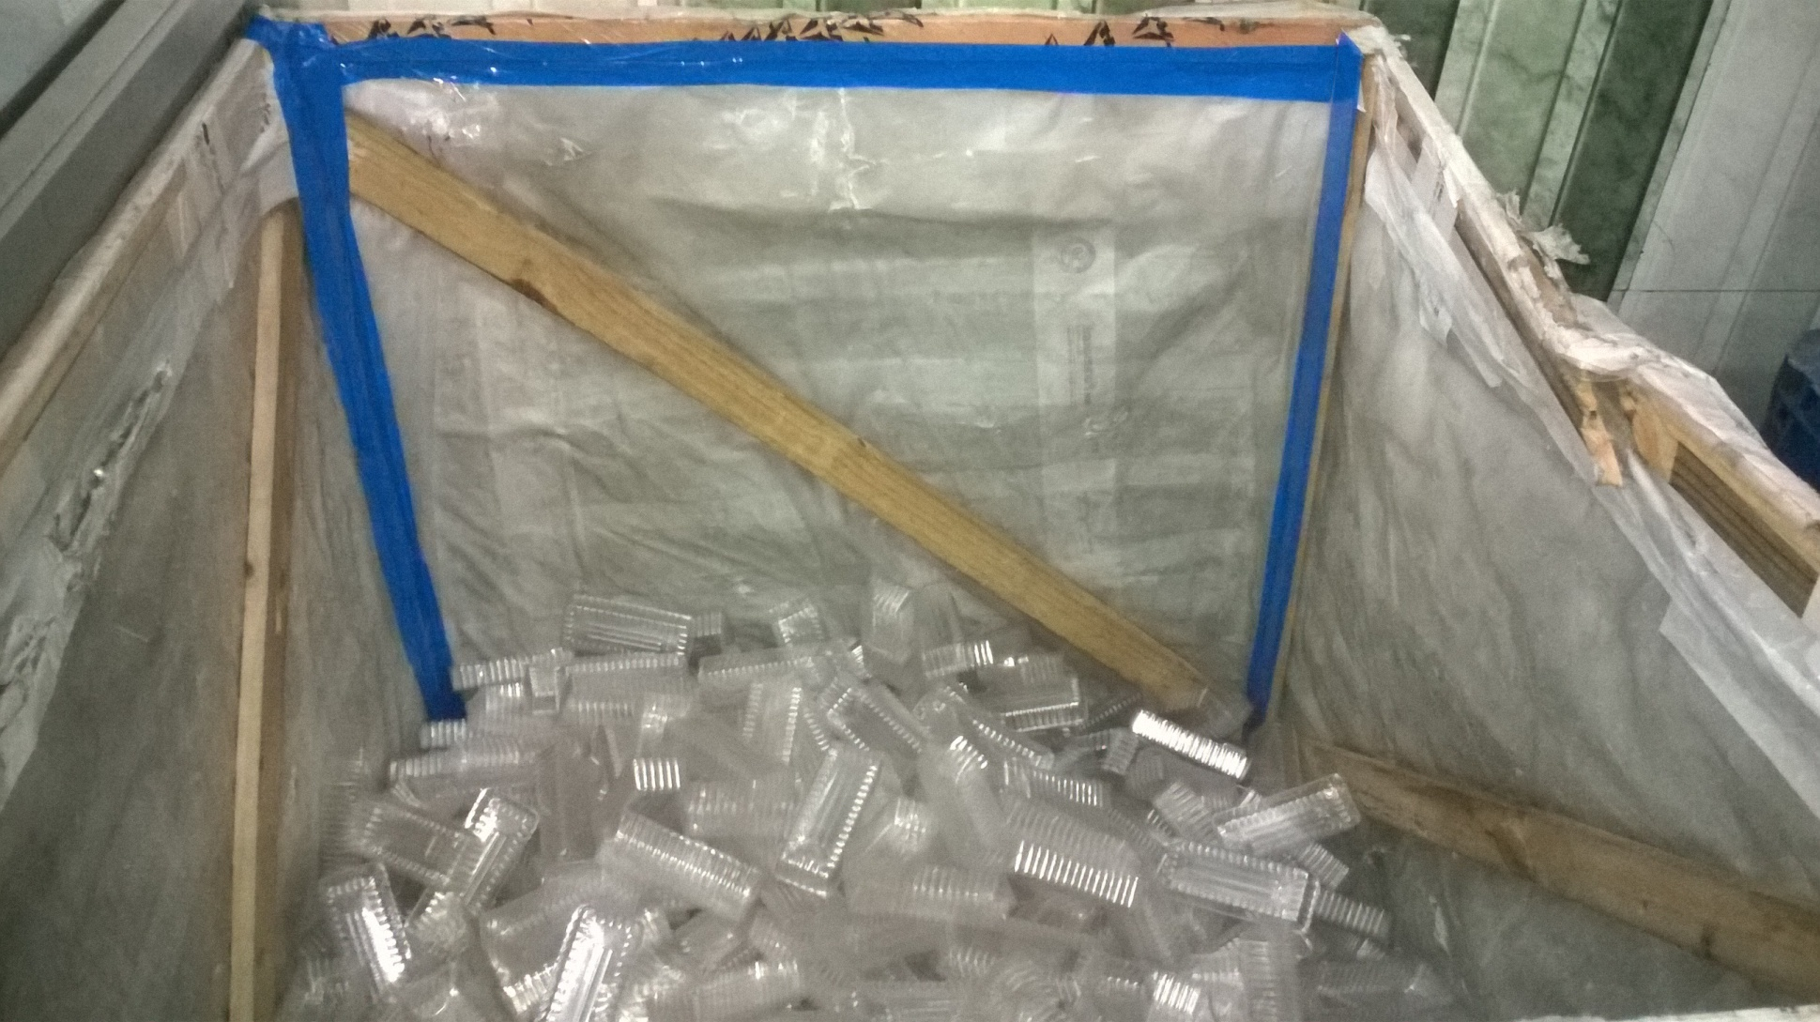
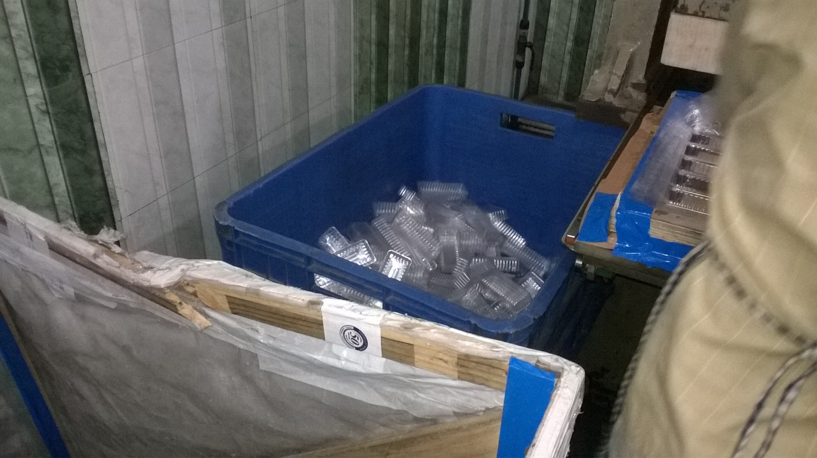
Stage 4 :Post Cutting Stage ( Work Centre) : Collection of individual PVC Treys

Slide 94
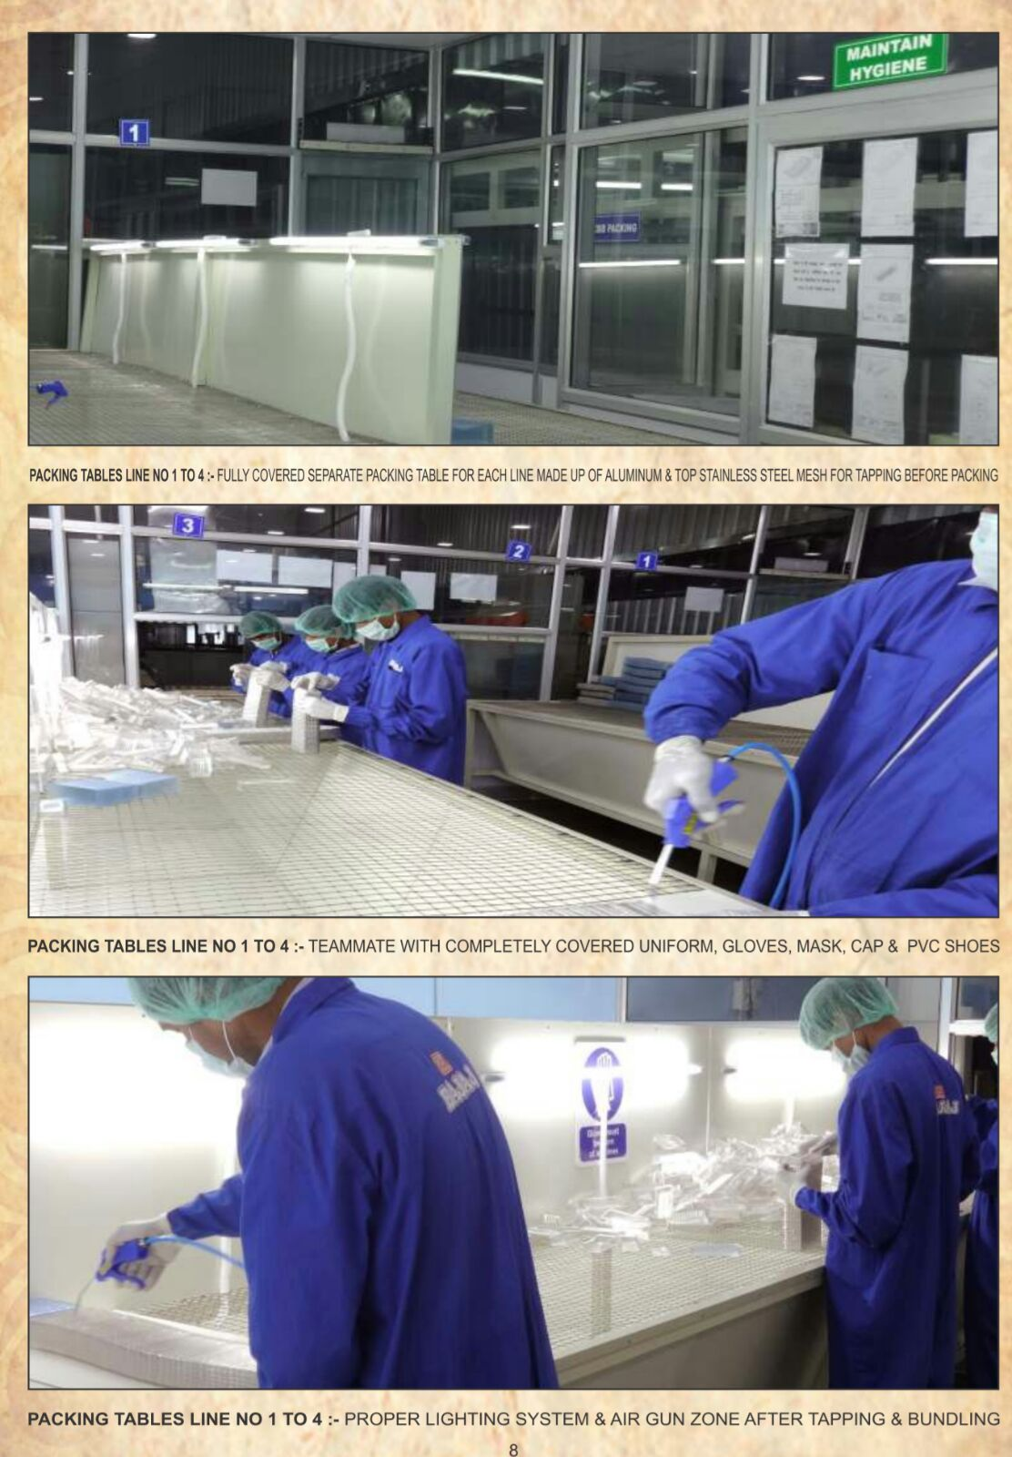
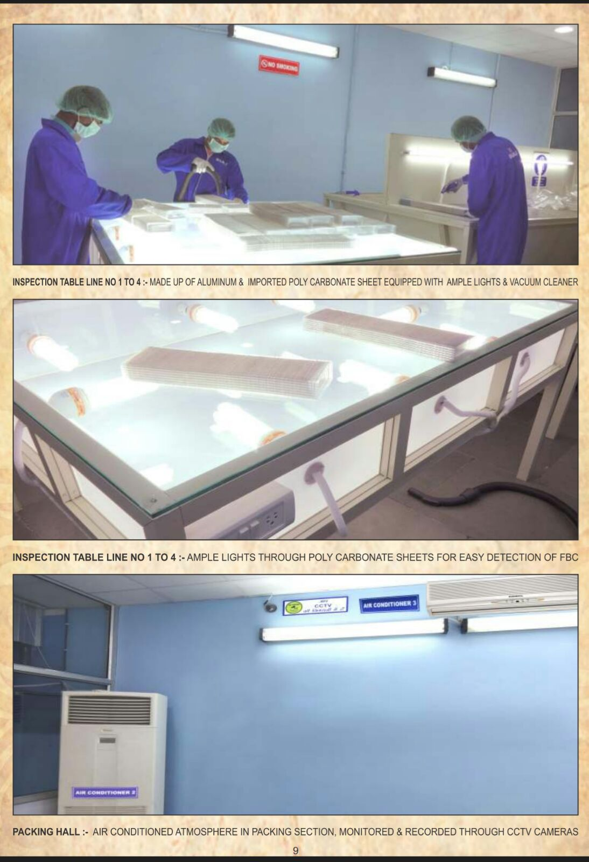
Stage 5 : Stacking,Packing & Inspection ( Work Centre)

Slide 95
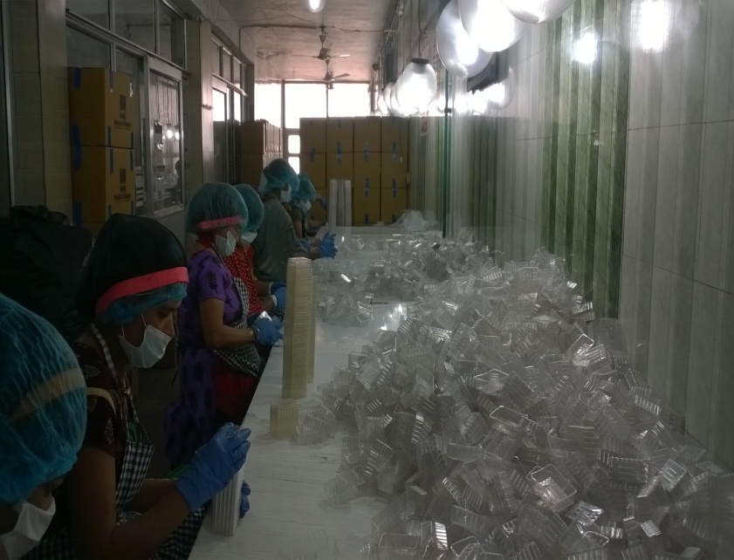
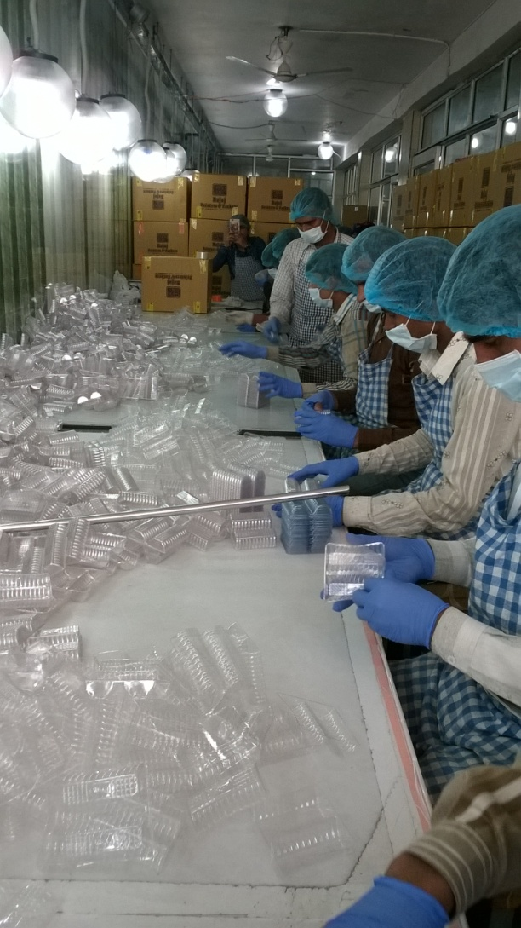
Cont :Stacking , Inspection & Packing ( Work Centre)

Slide 96
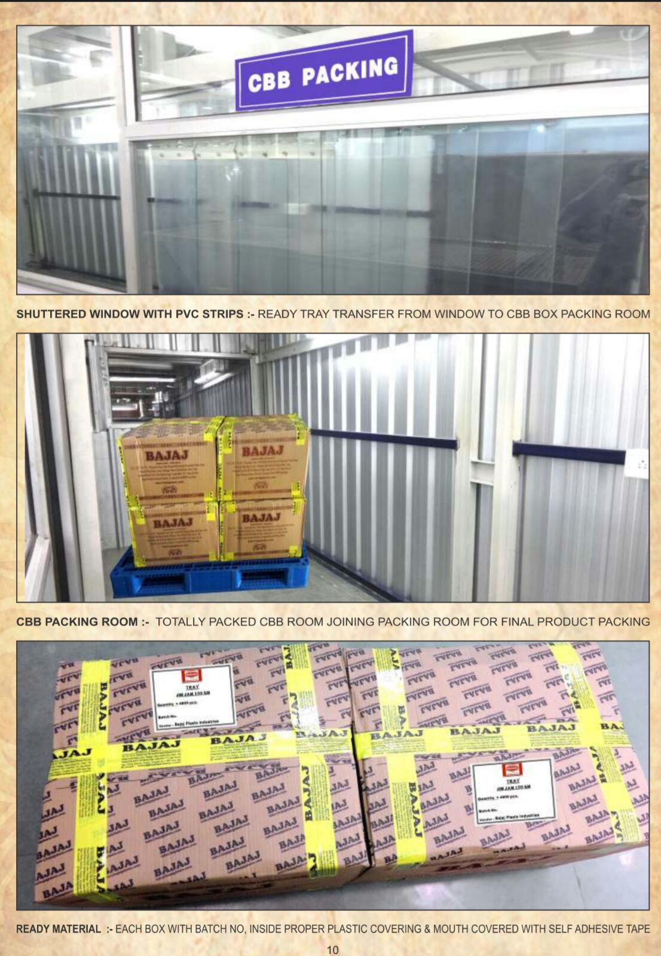
Stage 6 :Packing in CBB & Despatch ( Work Centre)

Slide 97
Automated Version
“Single Stage Process” using ELI Machine.

Slide 98
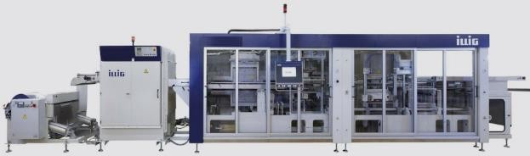
Automatic “Roll Fed >>>>>Forming >>>>>Punching

