Slide 1
Advanced Leadership and Change Management
Session-6
Leading in multi-party negotiations
14/4/2024
Prof. Anupama Sharma

Slide 2
Defining Negotiation
Negotiation is a process whereby two or more parties reach a mutually agreeable arrangement. It is one of the most used and beneficial skills managers can develop.
All negotiations share four common elements:
The parties involved are in some way interdependent
The parties are in conflict over goals and processes
The parties involved are motivated and capable of influencing one another.
The parties believe they can reach an agreement

Slide 3
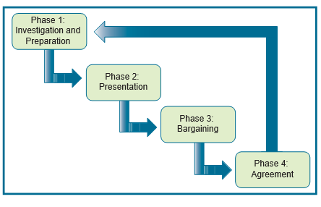
Phases of Negotiation

Slide 4
Negotiators Often……
Attack each other personally
Withhold information from each other
Are suspicious of each other
Go directly to bargaining without understanding exactly why they are taking a particular position
Proceed with a win-lose mindset

Slide 5
Interest-based Negotiations
Where parties...
Separate the person from the problem
Focus on interests, not positions
Generate options
Use objective criteria to decide
Recognize alternatives to negotiated agreement (BATNA)

Slide 6
Separate the person from the problem
First, focus on the factors that led to conflict
Deal with the person separately from the problem
Dealing with perception (Cognitive)
* Put Yourself in the other’s position
* Discuss each other’s perceptions
Dealing with emotion (Feeling)
* Allow the other to express their emotions
* Acknowledge emotions
Focusing on the communication (behavioral)
* Listen Actively
* Speak to be understood and speak about yourself, not the other

Slide 7
Focus on interests, not positions
Understanding the other party’s viewpoint
Understanding oneself better
Parties’ “needs, desires, concerns, and fears”; the “silent movers” behind the positions.
By looking at interests instead of positions, the possibility of developing solutions improves.
Be hard on the problem, soft on the people

Slide 8
Generate Options
DON’T:
Search for a single answer
Think that “solving your problem is your problem”
Diagnose the problem and invent options, jointly
Search for mutual gains
Find ways to make decisions easy
Remember: Solving the other party’s problem is also your problem

Slide 9
Use objective CRITERIA to decide
Agreement may be based on fair standards such as professional standards or tradition
Never yield to pressure but always be willing to yield to principles
Parties should agree in advance about which objective criteria to consult and agree to abide by the outcome
Fair standards, Fair procedure

Slide 10
BATNA
Best Alternative To a Negotiated Agreement
The reason we negotiate is to produce something better than the results we can obtain without negotiating. These ‘results’ are our alternatives. And the best one among those alternatives is our BATNA
Know the strength of your BATNA
Consider the other person’s BATNA
The better your BATNA, the greater your power

Slide 11
Thank you!

