Slide 1

Learning & Development Metrics
Ankur Jain (ankur.jain@iimrohtak.ac.in)

Slide 2

The teacher of the class is not the only teacher in the class.

Slide 3
LEARNING OBJECTIVE
Critically evaluate L&D activities in our organizations using data

Slide 4
How do you approach L&D activities in your organizations?

Slide 5
Statistics about Millennials
Why should organizations invest in L&D of employees?
21%
Changed jobs within the last year
(3 times non-millennials)
60%
Open to new job opportunities
(15 percent pts higher than non-millennials)
55%
Not Engaged at work
(Leading all other generations)
Millennials don’t want to switch jobs, companies unable to give compelling reasons to stay.
They want a job that feels worthwhile, and they will keep looking until they find it.
Source: Gallup Report (2016). How Millennials Want to Work and Live

Slide 6

Why should organizations invest in employee training and development?
Leadership Development
Innovation & Future Readiness
Adaptation to Change
Employee Retention
Employee Commitment
Competitive advantage
Efficiency & Productivity

Slide 7


Reflection Questions
What do people do in organizations?
Where is the time for training?

Slide 8

L&D perceived as HR’s checklist item !!!

Slide 9

75% - Dissatisfied with company’s L&D function
70% - Do not have mastery over skills required for the job
Only 12% - Apply new skills learned in L&D programs on jobs
Only 25% - Believe training improves performance
Survey of 1500 managers across 50 organizations by McKinsey (Glaveski, 2019 - HBR)
Notes:
On a different note… this is the state of L&D in organizations today.
After the slide – let us see what we or organizations can do to make L&D more effective.

Slide 10
How can you make L&D opportunities more acceptable in organizations ?

Slide 11
L&D – The Internal Marketing perspective
Employee
Undergo Training
Long term performance support
Immediate manager
Provides employee bandwidth
Immediate performance
Top management
Provides commitment & resources
Long term firm sustenance
Customers
Ultimate evaluator of training
Best product or service
Four Key Stakeholders

Slide 12

At the beginning of the year, your sales director asked for 100 new sales representatives to be hired. As multiple products were being launched by the organization in the last 6 months, the sales director hurried through the interview process and from a pool of 250 applicants, 100 were hired.
In June, he complains that the representatives are not achieving their monthly quotas. He is convinced they need more sales training to address this issue and asks you to design something by the end of the week.

Slide 13

Training is not the ultimate solution to all performance problems !

Slide 14

Training, may not be the best intervention
Recruiting, selection, compensation problems
Policies and procedures issues
A lack of feedback from managers
Insufficient tools, equipment or resources
Physical setting problems
A lack of motivation – a won’t do problem
Misfit - (job-person fit; person-org fit)

Slide 15
How do you decide the focus area for Learning and Development?

Slide 16
NEEDS ANALYSIS FRAMEWORK
Organizational Analysis
Task
Analysis
Person
Analysis

Slide 17

Organizational Analysis
Company’s strategic direction
Resources available for training
(Budget, Time & Expertise
e.g., decision on buy vs. build)
Support by managers and employees

Slide 18

Person Characteristics
Basic Skills
Cognitive Ability
  Verbal comprehension
  Quantitative ability
  Reasoning ability
Self Efficacy
Awareness of Training Needs & Career goals
Learning Style Inventory
Age and Generation
Not everybody may need the same training !

Slide 19
Task Analysis
Break down of job into tasks to be performed. Take example of a salesman
Task | Description | Importance | Frequency | Difficulty
 |  | How critical is the task for effective performance | How often do you perform the task | Does it require extensive experience or training
1 | Understand product attributes | 1-2-3-4-5 | 1-2-3-4-5 | 1-2-3-4-5
2 | Communication with customer | 1-2-3-4-5 | 1-2-3-4-5 | 1-2-3-4-5
3 | Punch daily sales in the system | 1-2-3-4-5 | 1-2-3-4-5 | 1-2-3-4-5
4 | Credit collection from the market | 1-2-3-4-5 | 1-2-3-4-5 | 1-2-3-4-5
 |  | 1- Negligible 5 – Extremely high | 1- Rarely 5 - Often | 1- Easy 5 – Very Difficult

Slide 20
Competency model
Competencies are a set of skills, knowledge and abilities that enable employees to perform their job
Job analysis is work oriented (what), whereas competencies are worker oriented (how)
Systems Engineer – Technical cluster | Proficiency Ratings
Systems Architecture: Ability to design complex software applications, establish protocols and create prototypes. Data Migration: Ability to establish necessary platform requirements to efficiently and completely coordinate data transfer. | 0 – Not able to perform basic tasks
Systems Architecture: Ability to design complex software applications, establish protocols and create prototypes. Data Migration: Ability to establish necessary platform requirements to efficiently and completely coordinate data transfer. | 1 – Understand basics, Can perform with assistance
 | 2 – Performs routine tasks with minimal supervision
 | 3 – Perform complex tasks, can coach others
 | 4 - Considered an expert, can lead others

Slide 21

Excel Case: Who needs the training?
There are a hundred employees in a department of a Business Process Outsourcing company. Employees are divided into 2 bands – L1 & L2. Some of the employees are located inhouse while some are located at the client location. Recently a 360-degree performance appraisal has been conducted. As the L&D head, you have been allocated a budget of 10 lacs. How shall you identify where to focus your efforts? You also have employees’ demographic data such as their gender and educational qualification.
Notes:
Go to the excel sheet.

Slide 22
Why do you think it is important to evaluate and report on the effectiveness of training?

Slide 23



Slide 24

You become Accepted, Trusted, Respected, and Needed
Your budget requests are granted.
You keep your job. (even promotion)
Your staff keep their jobs.
The quality of your work improves.
Senior management listens to your advice.
You’re given more control.

Slide 25

More specifically
To justify the existence and budget of the training department
To decide whether to continue or discontinue training programs
To gain information on how to improve future training programs

Slide 26
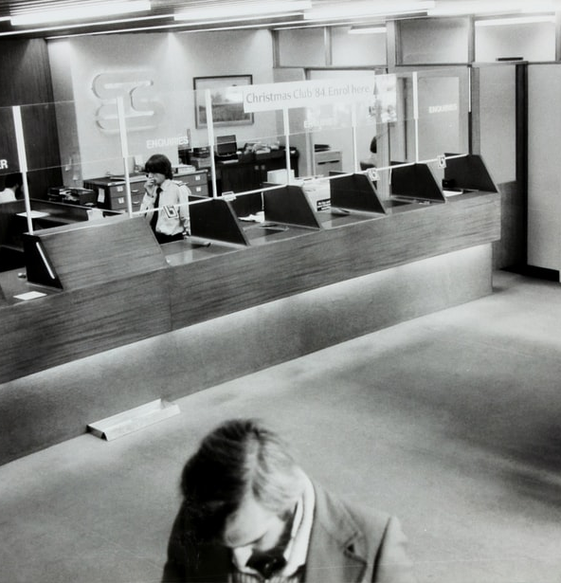
Case: Training Bank Clerks
In a public bank, there are forty data entry clerks. Earlier they used to work on the Tally software. Now the bank has merged with another bank and the combined entity has decided to work on an advanced software for data entry. However, the clerks have not been able to come to speed with respect to error-free entry of data on the software.
You are the L&D head of the combined entity. You believe that you do not have an expert trainer inhouse, so you decide to outsource the training to the software firm. As the external instructor arrives and is walking into the training room where all the data entry clerks have already assembled, you are thinking about how you will evaluate whether the training was a success or a failure.

Slide 27
Kirkpatrick's Four Level Evaluation Model
Level 1
Reaction
Level 2
Learning
Level 3
Behavior
Level 4
Results

Slide 28

Level 1: Reaction
To what degree participants react favorably to the learning event
Immediately after the training
Through a questionnaire
Identifying trainee’s satisfaction with
  Instructor
  Training material
  Training administration

Slide 29
Sample Reaction Measure
The facilities and equipment made it easy to learn
The training met all the stated objectives
The material I received during the training was useful
The instructor was knowledgeable about the training content
The instructor was well prepared
I learnt a lot from this training
What I learnt from this training is useful to my job
Overall, I am satisfied with the training
Strongly Disagree Disagree Neither Agree Strongly Agree
1 2 3 4 5

Slide 30

Level 2: Learning
To what degree participants acquire the intended knowledge, skills and attitudes based on their participation in the learning event
Degree to which participants are familiar with the facts, techniques
Before and After
Tests and Quizzes
Demonstration
Role play

Slide 31
Sample Questions for Data entry clerks
What are the different kinds of errors?
Why do different errors occur?
How do you resolve an error in minimum time?
How do you prevent a particular kind of error from occurring?

Slide 32

Level 3: Behavior
To what degree participants apply what they learned during training when they are back on the job
Doing things differently at work

Slide 33
Whom will you ask?

Slide 34
Stakeholders
Participants: Measure their skills, knowledge, attitudes and application of these.
Participants’ managers: Obtain data or perceptions on what has changed and what gaps still exist.
  Have the participants gotten better at their jobs? How?
  Do they show a better or different attitude?
  Do they work more efficiently?
Participants’ co-workers: Obtain data or perceptions on employee performance, teamwork, attitude, etc.

Slide 35
Stakeholders (contd.)
Participants’ supervisees:
  Does the participant show a better attitude?
  Does the participant work more efficiently?
  Is he or she a better manager or communicator?
Clients/Customers:
  Are they satisfied with service, products or the availability of projects?
Other:
  How many items are produced and how long it takes to produce them?
  Were they produced on time?
  Were they produced correctly?

Slide 36

Level 4: Results
To what degree targeted outcomes occur, as a result of learning event(s) and subsequent reinforcement
Determining the training’s payoff to the organization

Slide 37
Calculating ROI on a training
There are 40 data entry clerks in the combined bank. Their monthly pay is Rs. 30,000. They work on an average 25 days a month, 6 hours in a day. A clerk spends 12 mins daily correcting errors. The bank organizes the training for the data entry clerks. The external instructor charges Rs. 20,000 for the training. The classroom space and audio-visual equipment is rented out which costs the organization additional Rs. 10,000. The trainees will have to attend the training for one complete day.
After the training, the clerks spent 50% less time correcting errors. Calculate the ROI on training.

Slide 38
Calculations
Cost of Training |  |  | Savings from Training
External Trainer Fees | 20,000 |  | Data entry time saved | 6 min Or 0.1 hr | (12*50/100)
Audio Visual Equipment Rent | 10,000 |  | Hourly pay (60 mins) | 200 | (30000/25/6)
Downtime (Opportunity Cost) | 48,000 | (30000/25*40) | Savings per employee per day (6 mins or 0.1 hr) | 20 | (200*0.1)
Total Cost | 78,000 |  | Total Savings per day | 800 | (20*40)
 |  |  | Monthly Savings | 20,000 | (800*25)
 |  |  | Total Annual Savings | 2,40,000 | (20000*12)
ROI | 208% 2.08 : 1 | (240000-78000)/78000 | (For every one rupee spent, we earn slightly more than two rupees)
Payback Period or Turnaround time | 3.90 | (78000/20000) | (In less than 4 months I shall repay you back)
 | < 4 months

Slide 39

Not everything is hard data in HR!
Hard Data: Increased production, reduced costs, reduced accidents, reduced downtime, improved product quality, improved customer satisfaction
Benefits & Soft Skills: Leadership, teamwork, positive attitude and a happier work atmosphere
What to do?

Slide 40
ROE – Return of Engagement
More involved
  Employee engagement
  Reduced turnover
  Greater productivity
  Giving more suggestions/innovations
  Low absenteeism
More stress free
  Less accidents
Better team player
  More team-work
  Less conflicts

Slide 41


Evaluating training effectiveness
Customer service
Employee engagement
Employee retention
Productivity
Quality
No. of defects
No. of patents
Business Impact, Employee Satisfaction, Stakeholder satisfaction, Solution effectiveness

Slide 42
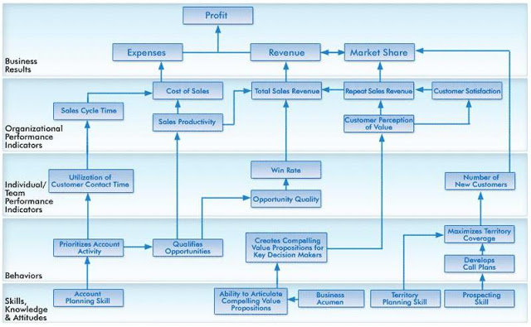
Mapping Learning to Business Results
Notes:
http://homocompetens.blogspot.com/2011/04/reflection-corporate-learning-impact_22.html

Slide 43
How learning translates to business results
Skills, Knowledge, Attitude:
Data Entry Skills, Error Recognition
Behavior:
Error free data entry, Creates classification of data
Business Results:
Profits, Market Share, Revenue
Individual/ Team Performance Indicator:
Productivity, Reduced downtime, Employee engagement
Organizational Performance Indicator:
Cost of Sales, Repeat Customers, Customer Satisfaction

Slide 44

Excel Case: Is the training effective?
You realize that the employees located at the client location are indeed performing lower than those located inhouse. After having discussions with them, you realize that they are disconnected with the workplace. You organize an outdoor experiential training for some of the employees located on the client location. The initial perception of the training seems to be good. Employees appreciate you for taking care of them. However, your boss tells you that it is nothing more than ‘a feel good’ and that you have wasted the budget.
Notes:
Go to the excel sheet. T test

Slide 45
What precautions one should take while measuring L&D outcomes?
Notes:
Break !!!

Slide 46

Threats to Validity
Internal Validity – That the results are indeed because of training
External Validity – Results are applicable to other groups & situations
Pretest – Posttest
Use comparison group

Slide 47
Is the measurement commensurate with the training?
Measured
Trained
Contamination
Relevance
Deficiency

Slide 48
Criteria Relevance
Measured
Trained
Relevance

Slide 49
Time Series Reversal

Slide 50
Case: L&D department in need of performance metrics
You have been recently hired as the head of L&D department of a mid-sized IT company. You meet the CEO on the first day and she mentions that the L&D department is into too many things. For each training that the department undertakes, some metrics are presented, and budgets are granted. But she wants to know whether the L&D department as a whole is effective or not. You are tasked with creating a performance metrics for the L&D department.

Slide 51

Top KPIs for L&D Officers
Budget vs. Spent
Learner Satisfaction Score
No. of training hours per employee
No. of programs delivered
Employee engagement
No show (%) for formal training
No. of new programs launched
New hire percentage after 12 months
% of employees with right skill level
Time to competence

Slide 52
Training Effectiveness Parameters for L&D department
Measurement Parameter | Description | Formula
Time | No of training hours per employee per year | Total Training hours/Total Employees
Quantity | Percentage of employees trained | Total Trained/Total Employees
Need Type | Percentage of employees needing particular training | Total employees needing particular training/Total Employees
Diversity | No of different training programs offered | -
Cost | Return on Investment | (Total Benefit – Total Cost)/Total Cost
Trainer Type | Internal vs External Trainer | Internal/Total Trainers

Slide 53
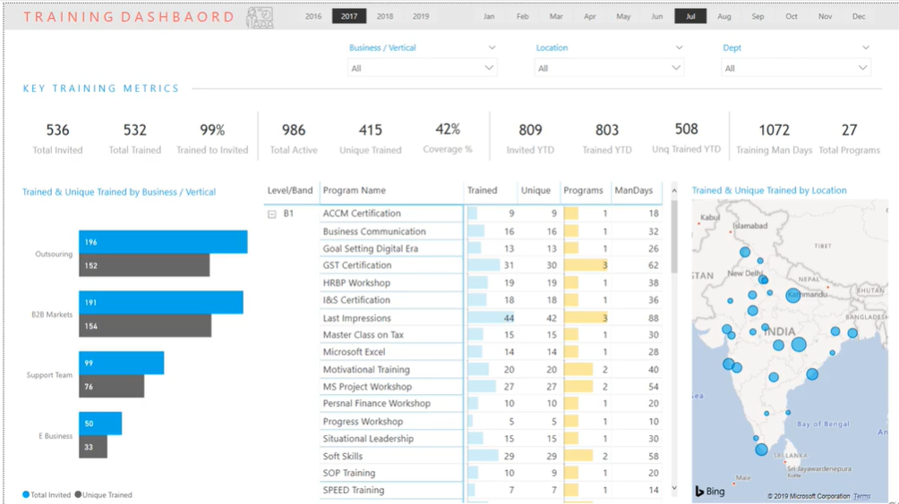
Training Dashboards

Slide 54
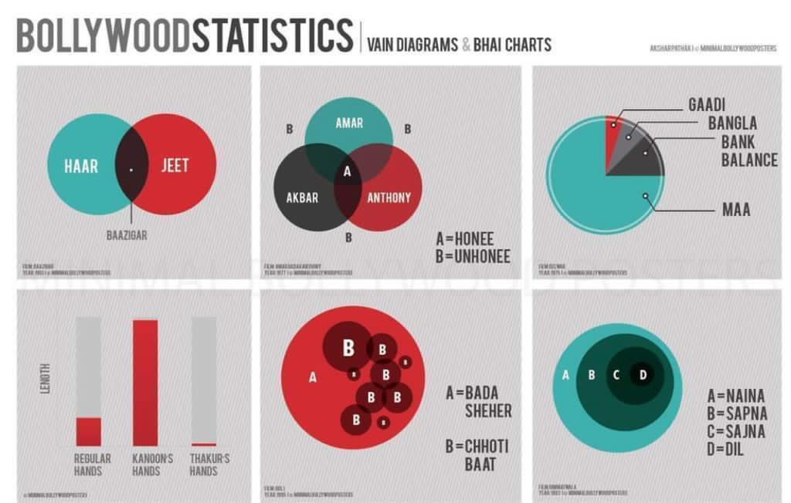
Use Charts, Tell a Story!
Notes:
नैनो मैं सपना
सपनों मैं सजना
सजना पे दिल आ गया
क्यों सजना पे दिल आ गया

Slide 55

What is your Life’s analytics strategy ?
Create a strategy for your life
  Find your Purpose, Do your duties well
  Be conscious, Be responsible
Allocate your resources
  Prioritize what Matters
Choose the right yardstick
  Money or Lives you have touched
Notes:
See what you measure is what you get!

Slide 56

Thank you. May your path be auspicious!
All the best for your journey!
ankur.jain@iimrohtak.ac.in 9916075677

