Slide 1

Learning & Development Metrics
Dr Ankur Jain (ankur.jain@iimrohtak.ac.in)

Slide 2

The teacher of the class is not the only teacher in the class.

Slide 3
LEARNING OBJECTIVE
Critically evaluate L&D activities in our organizations using data

Slide 4
How do you approach L&D activities in your organizations?

Slide 5
Statistics about Millennials
Why should organizations invest in L&D of employees?
21%
Changed jobs within the last year
(3 times non-millennials)
60%
Open to new job opportunities
(15 percent pts higher than non-millennials)
55%
Not Engaged at work
(Leading all other generations)
Millennials don’t want to switch jobs, companies unable to give compelling reasons to stay.
They want a job that feels worthwhile, and they will keep looking until they find it.
Source: Gallup Report (2016). How Millennials Want to Work and Live

Slide 6

Why should organizations invest in employee training and development?
Leadership Development
Innovation & Future Readiness
Adaptation to Change
Employee Retention
Employee Commitment
Competitive advantage
Efficiency & Productivity

Slide 7


Reflection Questions
What do people do in organizations?
Where is the time for training?

Slide 8

L&D perceived as HR’s checklist item !!!

Slide 9
How can you make L&D opportunities more acceptable in organizations ?

Slide 10
L&D – The Internal Marketing perspective
Employee
Undergo Training
Long term performance support
Immediate manager
Provides employee bandwidth
Immediate performance
Top management
Provides commitment & resources
Long term firm sustenance
Customers
Ultimate evaluator of training
Best product or service
Four Key Stakeholders

Slide 11

At the beginning of the year, your sales director asked for 100 new sales representatives to be hired. As multiple products were being launched by the organization in the last 6 months, the sales director hurried through the interview process and from a pool of 250 applicants, 100 were hired.
In June, he complains that the representatives are not achieving their monthly quotas. He is convinced they need more sales training to address this issue and asks you to design something by the end of the week.

Slide 12

Training is not the ultimate solution to all performance problems !

Slide 13

Training, may not be the best intervention
Recruiting, selection, compensation problems
Policies and procedures issues
A lack of feedback from managers
Insufficient tools, equipment or resources
Physical setting problems
A lack of motivation – a won’t do problem
Misfit - (job-person fit; person-org fit)

Slide 14
How do you decide the focus area for Learning and Development?

Slide 15
NEEDS ANALYSIS FRAMEWORK
Organizational Analysis
Task
Analysis
Person
Analysis

Slide 16

Organizational Analysis
Company’s strategic direction
Resources available for training
(Budget, Time & Expertise
e.g., decision on buy vs. build)
Support by managers and employees

Slide 17

Person Characteristics
Basic Skills
Cognitive Ability
  Verbal comprehension
  Quantitative ability
  Reasoning ability
Self Efficacy
Awareness of Training Needs & Career goals
Learning Style Inventory
Age and Generation
Not everybody may need the same training !

Slide 18
Task Analysis
Break down of job into tasks to be performed. Take example of a salesman
Task | Description | Importance | Frequency | Difficulty
 |  | How critical is the task for effective performance | How often do you perform the task | Does it require extensive experience or training
1 | Understand product attributes | 1-2-3-4-5 | 1-2-3-4-5 | 1-2-3-4-5
2 | Communication with customer | 1-2-3-4-5 | 1-2-3-4-5 | 1-2-3-4-5
3 | Punch daily sales in the system | 1-2-3-4-5 | 1-2-3-4-5 | 1-2-3-4-5
4 | Credit collection from the market | 1-2-3-4-5 | 1-2-3-4-5 | 1-2-3-4-5
 |  | 1- Negligible 5 – Extremely high | 1- Rarely 5 - Often | 1- Easy 5 – Very Difficult

Slide 19
Competency Model – e.g., Systems Engineer
Technical Cluster | Proficiency Rating
Systems Architecture: Ability to design software applications, establish protocols and create prototypes Documentation: Ability to prepare comprehensive and complete documents – including specifications, flow diagrams, processes, & budgets | 1 – Have problems in performing basic tasks
 | 2 – Understands basic principles; can perform tasks with assistance
 | 3 – Performs routine tasks with reliable results; works with minimal supervision
 | 4 – Perform complex and multiple tasks; can teach others
 | 5 – Considered as an expert in the task; can coach and lead others

Slide 20
Why do you think it is important to evaluate and report on the effectiveness of training?

Slide 21



Slide 22

You become Accepted, Trusted, Respected, and Needed
Your budget requests are granted.
You keep your job. (even promotion)
Your staff keep their jobs.
The quality of your work improves.
Senior management listens to your advice.
You’re given more control.

Slide 23

More specifically
To justify the existence and budget of the training department
To decide whether to continue or discontinue training programs
To gain information on how to improve future training programs

Slide 24

Excel Case: Who needs the training?
There are a hundred employees in a department of a Business Process Outsourcing company. Employees are divided into 2 bands – L1 & L2. Some of the employees are located inhouse while some are located at the client location. Recently a 360-degree performance appraisal has been conducted. As the L&D head, you have been allocated a budget of 10 lacs. How shall you identify where to focus your efforts? You also have employees’ demographic data such as their gender and educational qualification.
Notes:
Go to the excel sheet.

Slide 25
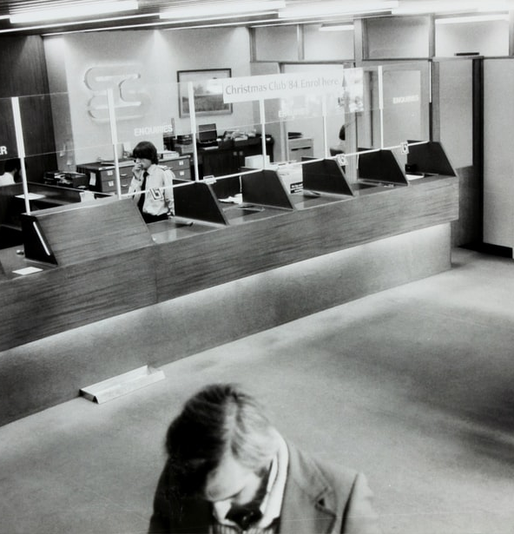
Case: Training Bank Clerks
In a public bank, there are forty data entry clerks. Earlier they used to work on the Tally software. Now the bank has merged with another bank and the combined entity has decided to work on an advanced software for data entry. However, the clerks have not been able to come to speed with respect to error-free entry of data on the software.
You are the L&D head of the combined entity. You believe that you do not have an expert trainer inhouse, so you decide to outsource the training to the software firm. As the external instructor arrives and is walking into the training room where all the data entry clerks have already assembled, you are thinking about how you will evaluate whether the training was a success or a failure.

Slide 26
Kirkpatrick's Four Level Evaluation Model
Level 1
Reaction
Level 2
Learning
Level 3
Behavior
Level 4
Results

Slide 27

Level 1: Reaction
To what degree participants react favorably to the learning event
Immediately after the training
Through a questionnaire
Identifying trainee’s satisfaction with
  Instructor
  Training material
  Training administration

Slide 28
Sample Reaction Measure
The facilities and equipment made it easy to learn
The training met all the stated objectives
The material I received during the training was useful
The instructor was knowledgeable about the training content
The instructor was well prepared
I learnt a lot from this training
What I learnt from this training is useful to my job
Overall, I am satisfied with the training
Strongly Disagree Disagree Neither Agree Strongly Agree
1 2 3 4 5

Slide 29

Level 2: Learning
To what degree participants acquire the intended knowledge, skills and attitudes based on their participation in the learning event
Degree to which participants are familiar with the facts, techniques
Before and After
Tests and Quizzes
Demonstration
Role play

Slide 30
Sample Questions for Data entry clerks
What are the different kinds of errors?
Why do different errors occur?
How do you resolve an error in minimum time?
How do you prevent a particular kind of error from occurring?

Slide 31

Level 3: Behavior
To what degree participants apply what they learned during training when they are back on the job
Doing things differently at work

Slide 32
Whom will you ask?

Slide 33
Stakeholders
Participants: Measure their skills, knowledge, attitudes and application of these.
Participants’ managers: Obtain data or perceptions on what has changed and what gaps still exist.
  Have the participants gotten better at their jobs? How?
  Do they show a better or different attitude?
  Do they work more efficiently?
Participants’ co-workers: Obtain data or perceptions on employee performance, teamwork, attitude, etc.

Slide 34
Stakeholders (contd.)
Participants’ supervisees:
  Does the participant show a better attitude?
  Does the participant work more efficiently?
  Is he or she a better manager or communicator?
Clients/Customers:
  Are they satisfied with service, products or the availability of projects?
Other:
  How many items are produced and how long it takes to produce them?
  Were they produced on time?
  Were they produced correctly?

Slide 35

Level 4: Results
To what degree targeted outcomes occur, as a result of learning event(s) and subsequent reinforcement
Determining the training’s payoff to the organization

Slide 36
Calculating ROI on a training
There are 40 data entry clerks in the combined bank. Their monthly pay is Rs. 30,000. They work on an average 25 days a month, 6 hours in a day. A clerk spends 12 mins daily correcting errors. The bank organizes the training for the data entry clerks. The external instructor charges Rs. 20,000 for the training. The classroom space and audio-visual equipment is rented out which costs the organization additional Rs. 10,000. The trainees will have to attend the training for one complete day.
After the training, the clerks spent 50% less time correcting errors. Calculate the ROI on training.

Slide 37
Calculations
Cost of Training |  |  | Savings from Training
External Trainer Fees | 20,000 |  | Data entry time saved | 6 min Or 0.1 hr | (12*50/100)
Audio Visual Equipment Rent | 10,000 |  | Hourly pay | 200 | (30000/25/6)
Downtime (Opportunity Cost) | 48,000 | (30000/25*40) | Savings per employee per day | 20 | (200*0.1)
Total Cost | 78,000 |  | Total Savings per day | 800 | (20*40)
 |  |  | Monthly Savings | 20,000 | (800*25)
 |  |  | Total Annual Savings | 2,40,000 | (20000*12)
ROI | 208% 2.08 : 1 | (240000-78000)/78000 | (For every one rupee spent, we earn slightly more than two rupees)
Payback Period or Turnaround time | 3.90 | (78000/20000) | (In less than 4 months I shall repay you back)
 | < 4 months
Notes:
Training is not an Investment – It is a Loan and we will repay it with interest. And then you can fetch the returns and we will not even talk about it.

Slide 38

Not everything is hard data in HR!
Hard Data: Increased production, reduced costs, reduced accidents, reduced downtime, improved product quality, improved customer satisfaction
Benefits & Soft Skills: Leadership, teamwork, positive attitude and a happier work atmosphere
What to do?
Notes:
are often the precursor to achieving –

Slide 39
ROE – Return of Engagement
More involved
  Employee engagement
  Reduced turnover
  Greater productivity
  Giving more suggestions/innovations
  Low absenteeism
More stress free
  Less accidents
Better team player
  More team-work
  Less conflicts

Slide 40


Evaluating training effectiveness
Customer service
Employee engagement
Employee retention
Productivity
Quality
No. of defects
No. of patents
Business Impact, Employee Satisfaction, Stakeholder satisfaction, Solution effectiveness

Slide 41
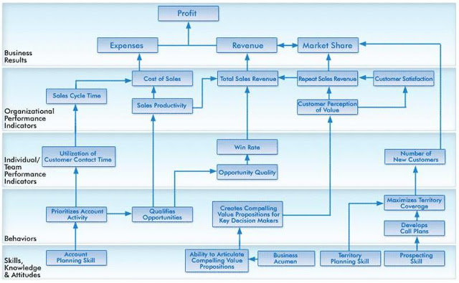
Mapping Learning to Business Results
Notes:
http://homocompetens.blogspot.com/2011/04/reflection-corporate-learning-impact_22.html

Slide 42
How learning translates to business results
Skills, Knowledge, Attitude:
Data Entry Skills, Error Recognition
Behavior:
Error free data entry, Creates classification of data
Business Results:
Profits, Market Share, Revenue
Individual/ Team Performance Indicator:
Productivity, Reduced downtime, Employee engagement
Organizational Performance Indicator:
Cost of Sales, Repeat Customers, Customer Satisfaction

Slide 43
Excel Case: Is the training effective?
You realize that the employees located at the client location are indeed performing lower than those located inhouse. After having discussions with them, you realize that they are disconnected with the workplace. You organize an outdoor experiential training for some of the employees located on the client location. The initial perception of the training seems to be good. Employees appreciate you for taking care of them. However, your boss tells you that it is nothing more than ‘a feel good’ and that you have wasted the budget.
Notes:
Go to the excel sheet. T test

Slide 44

Threats to Validity
Internal Validity – That the results are indeed because of training
External Validity – Results are applicable to other groups & situations
Pretest – Posttest
Use comparison group

Slide 45
What precautions one should take while measuring L&D outcomes?

Slide 46
Is the measurement commensurate with the training?
Measured
Trained
Contamination
Relevance
Deficiency

Slide 47
Criteria Relevance
Measured
Trained
Relevance
Notes:
The aim is to reach at what was measured is what was trained!

Slide 48
Time Series Reversal

Slide 49
Upcoming trends
How can Big Data be used for tracking learning in organizations?

Slide 50

Usage of Big Data for Training Effectiveness @ TELUS
Collects data from Different tracking systems
  Individual, Department, Business
Accessing – Clicking, Opening, Attending
Usage – Viewing, Staying, Reading, Participating
Knowledge acquisition – Grade
Evaluation – Learner assessment
Return – Performance Impact
Dashboard displays Learning Investments, Assessment Results and Analytics by team, region, division
Know your ethical boundaries
Notes:
Telus Communications is a Canadian national telecommunications company that provides a wide range of telecommunications products and services including internet access, voice, entertainment, healthcare, video, and IPTV television.

Slide 51
Case: L&D department in need of performance metrics
You have been recently hired as the head of L&D department of a mid-sized IT company. You meet the CEO on the first day and she mentions that the L&D department is into too many things. For each training that the department undertakes, some metrics are presented, and budgets are granted. But she wants to know whether the L&D department as a whole is effective or not. You are tasked with creating a performance metrics for the L&D department.

Slide 52

Top KPIs for L&D Officers
Budget vs. Spent
Learner Satisfaction Score
No. of training hours per employee
No. of programs delivered
Employee engagement
No show (%) for formal training
No. of new programs launched
New hire percentage after 12 months
% of employees with right skill level
Time to competence

Slide 53
Training Effectiveness Parameters for L&D department
Measurement Parameter | Description | Formula
Time | No of training hours per employee per year | Total Training hours/Total Employees
Quantity | Percentage of employees trained | Total Trained/Total Employees
Need Type | Percentage of employees needing particular training | Total employees needing particular training/Total Employees
Diversity | No of different training programs offered | -
Cost | Return on Investment | (Total Benefit – Total Cost)/Total Cost
Trainer Type | Internal vs External Trainer | Internal/Total Trainers

Slide 54
Are the employees impressed?
What is the metrics they are looking at?

Slide 55

What matters to the Learner?
New Opportunities Score
  Promotion, Rotation
Career Progression Score
New Skills Acquisition Score
Incentives linked to Training
Employability Score

Slide 56
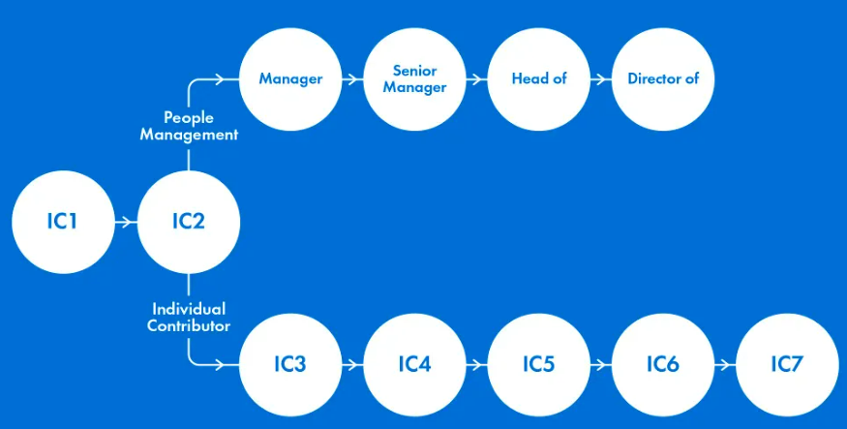
Career Progression
Employability Score
Rating 1: I would find it very hard to get another job. I have not developed the types of skills that are relevant to the job market.
Rating 2: I likely could find another job, but it might take time. As a result, I might have to take a role below what I am used to.
Rating 3: – I have skills and capabilities that would appeal to other employers, but I would have to work hard at finding a new role.
Rating 4: I would find it relatively easy to get a new role, but I might have to take what was on offer rather than selecting something that I really wanted.
Rating 5: I could find a new role in just a few days. I have the option of choosing roles that are of interest to me rather than being forced to take what is on offer.
Defines the possible roles and titles across your business
Shows which roles each team member can progress to
Explains what someone has to do to progress to each role
Notes:
https://www.charliehr.com/blog/building-a-career-progression-system/

Slide 57

Case for Practice
You are the L&D head of an IT products company. The sales team of your company is very efficient. They meet their targets, and the cut-throat competition among themselves keep them charged up. In one of your meetings with the sales team, you realize that the level of knowledge sharing between the team members is low and as a result they miss out on different perspectives and innovative ways of selling.
You take them out for a team-building outdoor training. You are very happy with the training. Over a month, you observe that the level of social interaction between the team members have increased.
At the end of performance appraisal cycle, you measure the productivity of the sales team again. To your surprise, the productivity hasn’t increased significantly. In fact, one of your star salesman hasn’t been able achieve her targets. When you asked her for a reason, she said she was helping a new joinee come to speed with his job. You are wondering, what went wrong.
You had done an employee engagement survey before. The average score of which was 4.34 on a 5-point scale. You do the same survey again thinking that the score must have improved. The score is 4.43, however statistically it is not significantly different from previous score.
Notes:
https://www.forbes.com/sites/larryalton/2016/11/18/can-you-quantify-your-human-resources-department/#4aa0db5d40ba

Slide 58

Everything that can be counted does not necessarily count; Everything that counts cannot necessarily be counted !
Albert Einstein

Slide 59
HR is ahead of the curve
(1510 respondents, 23 countries – 5 continents)
94% agreed that “We are able to predict the likelihood of turnover in critical roles with a high degree of confidence currently.”
94% also agreed that “We have accurate, real-time insight into our employees’ career development goals currently.”
89% agreed or agreed strongly that “My HR function is highly skilled at using data to determine future workforce plans currently (e.g., talent needed),” and only 1% disagreed.
51% of HR respondents said that they could perform predictive or prescriptive analytics, whereas only 37% of Finance respondents could undertake these more advanced forms of analytics
Source: Davenport (2019). HBR. Is HR the most analytics driven function?

Slide 60

Way Forward
Acting on data and analytics to solve issues
Cultivating quantitative analysis and reasoning skills
Advising business leaders by telling a story with data
Notes:
Source: Davenport (2019). HBR. Is HR the most analytics driven function?

Slide 61


Call center
In a call center, things were going well. There were 50 customer service providers. The representatives were very responsive to the callers and would go an extra mile to provide appropriate service.
New CEO took over the call center. As the call center was set to grow by 20% in the next three months, the CEO decided to put a metrics in place. He fixed the bonus of the employees on no. of calls attended.
No. of calls attended increased by 20% by the end of the month. The quality of customer service, however, went down
Measurement is Powerful
What you measure is what you get!

Slide 62

What is your Life’s analytics strategy ?
Create a strategy for your life
  Find your Purpose, Do your duties well
  Be conscious, Be responsible
Allocate your resources
  Prioritize what Matters
Choose the right yardstick
  Money or Lives you have touched
Notes:
See what you measure is what you get!

Slide 63

Thank you. May your path be auspicious!
All the best for your journey!
ankur.jain@iimrohtak.ac.in 9916075677

