Slide 1

Strategic Human Resources Applied Analytics I – Learning & Development Metrics
Dr Ankur Jain (ankur.jain@iimrohtak.ac.in)

Slide 2

The teacher of the class is not the only teacher in the class.

Slide 3
LEARNING OBJECTIVE
Critically evaluate L&D activities in our organizations using data

Slide 4
Statistics about Millennials
Why should organizations invest in L&D of employees?
21%
Changed jobs within the last year
(3 times non-millennials)
60%
Open to new job opportunities
(15 percent pts higher than non-millennials)
55%
Not Engaged at work
(Leading all other generations)
Millennials don’t want to switch jobs, companies unable to give compelling reasons to stay.
They want a job that feels worthwhile, and they will keep looking until they find it.
Source: Gallup Report (2016). How Millennials Want to Work and Live

Slide 5

Why should organizations invest in employee training and development?
Leadership Development
Innovation & Future Readiness
Adaptation to Change
Employee Retention
Employee Commitment
Competitive advantage
Efficiency & Productivity

Slide 6

L&D perceived as HR’s checklist item !!!

Slide 7
L&D – The Internal Marketing perspective
Employee
Undergo Training
Long term performance support
Immediate manager
Provides employee bandwidth
Immediate performance
Top management
Provides commitment & resources
Long term firm sustenance
Customers
Ultimate evaluator of training
Best product or service
Four Key Stakeholders
Notes:
The idea is to get a buy in

Slide 8

At the beginning of the year, your sales director asked for 100 new sales representatives to be hired. As multiple products were being launched by the organization in the last 6 months, the sales director hurried through the interview process and from a pool of 250 applicants, 100 were hired.
In June, he complains that the representatives are not achieving their monthly quotas. He is convinced they need more sales training to address this issue and asks you to design something by the end of the week.

Slide 9

Training is not the ultimate solution to all performance problems !

Slide 10

Training, may not be the best intervention
Recruiting, selection, compensation problems
Policies and procedures issues
A lack of feedback from reporting authorities
Insufficient tools, equipment or resources
Physical setting problems
A lack of motivation – a won’t do problem
Misfit - (job-person fit; person-org fit)

Slide 11
How do you decide the focus area for Learning and Development?
Notes:
Need Assessment !!! What do you do? How do you do?

Slide 12
NEEDS ANALYSIS FRAMEWORK
Organizational Analysis
Task
Analysis
Person
Analysis

Slide 13

Organizational Analysis
Company’s strategic direction
Resources available for training
(Budget, Time & Expertise
e.g., decision on buy vs. build)
Support by managers and employees

Slide 14

Person Characteristics
Basic Skills
Cognitive Ability
  Verbal comprehension
  Quantitative ability
  Reasoning ability
Self Efficacy
Awareness of Training Needs & Career goals
Learning Style Inventory
Age and Generation
Not everybody may need the same training !

Slide 15
Task Analysis
Break down of job into tasks to be performed. Take example of a salesman
Task | Description | Importance | Frequency | Difficulty
 |  | How critical is the task for effective performance | How often do you perform the task | Does it require extensive experience or training
1 | Understand product attributes | 1-2-3-4-5 | 1-2-3-4-5 | 1-2-3-4-5
2 | Communication with customer
3 | Punch daily sales in the system
4 | Credit collection from the market
 |  | 1- Negligible 5 – Extremely high | 1- Rarely 5 - Often | 1- Easy 5 – Very Difficult

Slide 16
Competency Model – e.g., Systems Engineer
Technical Cluster | Proficiency Rating
Systems Architecture: Ability to design software applications, establish protocols and create prototypes Documentation: Ability to prepare comprehensive and complete documents – including specifications, flow diagrams, processes, & budgets | 1 – Have problems in performing basic tasks
 | 2 – Understands basic principles; can perform tasks with assistance
 | 3 – Performs routine tasks with reliable results; works with minimal supervision
 | 4 – Perform complex and multiple tasks; can teach others
 | 5 – Considered as an expert in the task; can coach and lead others

Slide 17
Why do you think it is important to evaluate and report on the effectiveness of training?

Slide 18

You become Accepted, Trusted, Respected, and Needed
Your budget requests are granted.
You keep your job. (even promotion)
Your staff keep their jobs.
The quality of your work improves.
Senior management listens to your advice.
You’re given more control.

Slide 19

More specifically
To justify the existence and budget of the training department
To decide whether to continue or discontinue training programs
To gain information on how to improve future training programs

Slide 20
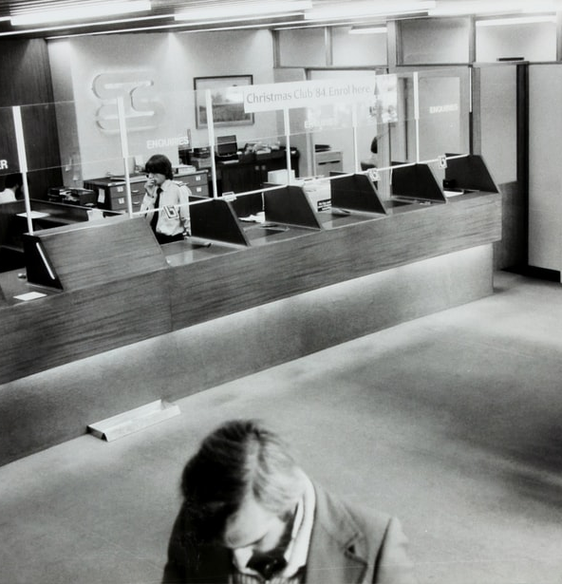
In a public bank, there are forty data entry clerks. Earlier they used to work on the Tally software. Now the bank has merged with another bank and the combined entity has decided to work on an advanced software for data entry. However, the clerks have not been able to come to speed with respect to error-free entry of data on the software.
You are the L&D head of the combined entity. You believe that you do not have an expert trainer inhouse, so you decide to outsource the training to the software firm. As the external instructor arrives and is walking into the training room where all the data entry clerks have already assembled, you are thinking about how you will evaluate whether the training was a success or a failure.

Slide 21
Kirkpatrick's Four Level Evaluation Model
Level 1
Reaction
Level 2
Learning
Level 3
Behavior
Level 4
Results

Slide 22

Level 1: Reaction
To what degree participants react favorably to the learning event
Immediately after the training
Through a questionnaire
Identifying trainee’s satisfaction with
  Instructor
  Training material
  Training administration

Slide 23
Sample Reaction Measure
The facilities and equipment made it easy to learn
The training met all the stated objectives
The material I received during the training was useful
The instructor was knowledgeable about the training content
The instructor was well prepared
I learnt a lot from this training
What I learnt from this training is useful to my job
Overall, I am satisfied with the training
Strongly Disagree Disagree Neither Agree Strongly Agree
1 2 3 4 5

Slide 24

Level 2: Learning
To what degree participants acquire the intended knowledge, skills and attitudes based on their participation in the learning event
Degree to which participants are familiar with the facts, techniques
Before and After
Tests and Quizzes
Demonstration
Role play

Slide 25
Sample Questions for Data entry clerks
What are the different kinds of errors?
Why do different errors occur?
How do you resolve an error in minimum time?
How do you prevent a particular kind of error from occurring?

Slide 26

Level 3: Behavior
To what degree participants apply what they learned during training when they are back on the job
Doing things differently at work

Slide 27
Whom will you ask?

Slide 28
Stakeholders
Participants: Measure their skills, knowledge, attitudes and application of these.
Participants’ managers: Obtain data or perceptions on what has changed and what gaps still exist.
  Have the participants gotten better at their jobs? How?
  Do they show a better or different attitude?
  Do they work more efficiently?
Participants’ co-workers: Obtain data or perceptions on employee performance, teamwork, attitude, etc.

Slide 29
Stakeholders (contd.)
Participants’ supervisees:
  Does the participant show a better attitude?
  Does the participant work more efficiently?
  Is he or she a better manager or communicator?
Clients/Customers:
  Are they satisfied with service, products or the availability of projects?
Other:
  How many items are produced and how long it takes to produce them?
  Were they produced on time?
  Were they produced correctly?

Slide 30

Level 4: Results
To what degree targeted outcomes occur, as a result of learning event(s) and subsequent reinforcement
Determining the training’s payoff to the organization

Slide 31
Calculating ROI on a training
There are 40 data entry clerks in the combined bank. Their monthly pay is Rs. 30,000. They work on an average 25 days a month, 6 hours in a day. A clerk spends 12 mins daily correcting errors. The bank organizes the training for the data entry clerks. The external instructor charges Rs. 20,000 for the training. The classroom space and audio-visual equipment is rented out which costs the organization additional Rs. 10,000. The trainees will have to attend the training for one complete day.
After the training, the clerks spent 50% less time correcting errors. Calculate the ROI on training.

Slide 32
Calculations
Cost of Training |  |  | Savings from Training
External Trainer Fees | 20,000 |  | Data entry time saved | 6 min Or 0.1 hr | (12*50/100)
Audio Visual Equipment Rent | 10,000 |  | Hourly pay | 200 | (30000/25/6)
Downtime (Opportunity Cost) | 48,000 | (30000/25*40) | Savings per employee per day | 20 | (200*0.1)
Total Cost | 78,000 |  | Total Savings per day | 800 | (20*40)
 |  |  | Monthly Savings | 20,000 | (800*25)
 |  |  | Total Annual Savings | 2,40,000 | (20000*12)
ROI | 208% 2.08 : 1 | (240000-78000)/78000
Payback Period or Turnaround time | 3.90 | (78000/20000)
 | < 4 months

Slide 33

Not everything is hard data in HR!
Hard Data: Increased production, reduced costs, reduced accidents, reduced downtime, improved product quality, improved customer satisfaction
Benefits & Soft Skills: Leadership, teamwork, positive attitude and a happier work atmosphere
What to do?

Slide 34
ROE – Return of Engagement
More involved
  Employee engagement
  Reduced turnover
  Greater productivity
  Giving more suggestions/innovations
  Low absenteeism
More stress free
  Less accidents
Better team player
  More team-work
  Less conflicts

Slide 35
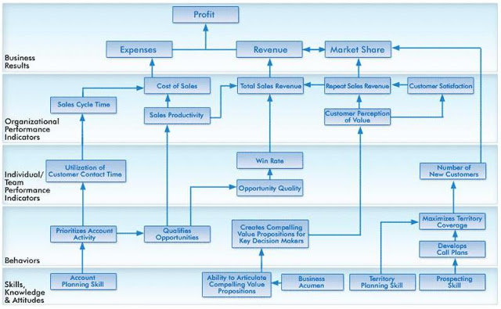
Notes:
http://homocompetens.blogspot.com/2011/04/reflection-corporate-learning-impact_22.html

Slide 36
How learning translates to business results
Skills, Knowledge, Attitude:
Data Entry Skills, Error Recognition
Behavior:
Error free data entry, Creates classification of data
Business Results:
Profits, Market Share, Revenue
Individual/ Team Performance Indicator:
Productivity, Reduced downtime, Employee engagement
Organizational Performance Indicator:
Cost of Sales, Repeat Customers, Customer Satisfaction

Slide 37

Top KPIs for L&D Officers
Budget vs. Spent
Learner Satisfaction Score
No. of training hours per employee
No. of programs delivered
Employee engagement
No show (%) for formal training
No. of new programs launched
New hire percentage after 12 months
% of employees with right skill level
Time to competence

Slide 38
Training Effectiveness Parameters for L&D department
Measurement Parameter | Description | Formula
Time | No of training hours per employee per year | Total Training hours/Total Employees
Quantity | Percentage of employees trained | Total Trained/Total Employees
Need Type | Percentage of employees needing particular training | Total employees needing particular training/Total Employees
Diversity | No of different training programs offered | -
Cost | Return on Investment | (Total Benefit – Total Cost)/Total Cost
Trainer Type | Internal vs External Trainer | Internal/Total Trainers

Slide 39
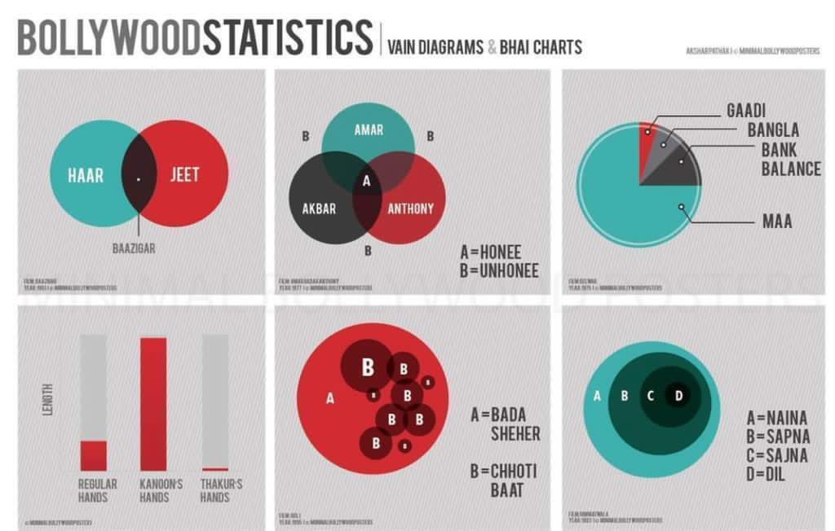
Use Charts, Tell a Story!

Slide 40
What precautions one should take while measuring L&D outcomes?

Slide 41
Is the measurement commensurate with the training?
Measured
Trained
Contamination
Relevance
Deficiency

Slide 42
Criteria Relevance
Measured
Trained
Relevance
Notes:
The aim is to reach at what was measured is what was trained!

Slide 43

Threats to Validity
Internal Validity – That the results are indeed because of training
External Validity – Results are applicable to other groups & situations
Pretest – Posttest
Use comparison group
Time series data analysis

Slide 44
Time Series Reversal

Slide 45
Upcoming trends
How can Big Data be used for tracking learning in organizations?

Slide 46

Usage of Big Data for Training Effectiveness @ TELUS
Collects data from Different tracking systems
  Individual, Department, Business
Accessing – Clicking, Opening, Attending
Usage – Viewing, Staying, Reading, Participating
Knowledge acquisition – Grade
Evaluation – Learner assessment
Return – Performance Impact
Dashboard displays Learning Investments, Assessment Results and Analytics by team, region, division
Know your ethical boundaries
Notes:
Telus Communications is a Canadian national telecommunications company that provides a wide range of telecommunications products and services including internet access, voice, entertainment, healthcare, video, and IPTV television.

Slide 47

What matters to the Learner?
New Opportunities Score
  Promotion, Rotation
Career Progression Score
New Skills Acquisition Score
Incentives linked to Training
Employability Score

Slide 48
Strategic Focus and Kind of Training
Exclusive programs, Mentorship, Lateral Hiring
Learning Organization
Highly differentiated
Strategic Focus
Hiring with requisite skills, Outsourcing
Corporate University
Mass service transactions
Few
Many
Volume (No. of Trainees)

Slide 49
How to Create a learning organization
Supportive Learning Environment
  Employees feel safe in asking questions and disagreeing with managers
  Different perspectives are appreciated
  Employees are encouraged to take risks and innovate
Learning Processes and Practices
  Systems are developed to create, capture and share knowledge
  E-learning, On the go learning, Learning communities, Job enrichment/rotation
Managers Reinforce Learning
  Encourage dialogue and debate
  Actively question and willing to listen
  Reward, promote and support learning
  Devote time to problem solving, learning process and post-performance audit
Notes:
How many of you think that your summer internship companies were learning organizations?

Slide 50

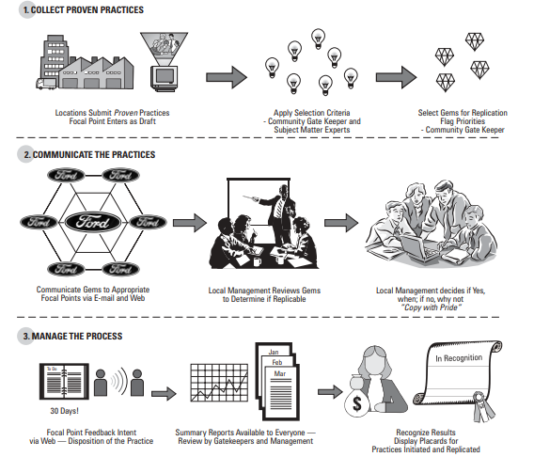
COMMUNITIES OF PRACTICE

Slide 51

LEARNING ORGANIZATION - PIXAR
Freedom to communicate
Inhouse courses for training
Business related – drawing, sculpting
Safe to offer ideas
Training in unique areas to generate insights e.g., Yoga and Pilates
Awareness of innovation
Opportunities to meet & learn together
Courses attended by all – Fun to learn together

Slide 52
Environment
Competition
High Growth
Strategy
Talent Pool
Macro-economic policies
Captive
Third Party
Similar Process Orientation
Repeat Client, Value addition
Recruitment & Selection
Compensation & Benefits
Learning & Development
Simple, Standardized
Complex, Specialized
Opportunities
Notes:
Putting it all together

Slide 53

Case for Practice
You are the L&D head of an IT products company. The sales team of your company is very efficient. They meet their targets, and the cut-throat competition among themselves keep them charged up. In one of your meetings with the sales team, you realize that the level of knowledge sharing between the team members is low and as a result they miss out on different perspectives and innovative ways of selling which the other team members may be employing.
You take them out for a team-building outdoor training. You are very happy with the training. Over a month, you observe that the level of social interaction between the team members have increased. You believe that teamwork and collaboration are major elements in a company’s overall productivity.
At the end of performance appraisal cycle, you measure the productivity of the sales team again. To your surprise, the productivity hasn’t increased significantly. In fact, one of your star salesman hasn’t been able achieve her targets. When you asked her for a reason, she said she was helping a new joinee come to speed with his job. You are wondering, what went wrong.
You had done an employee engagement survey before. The average score of which was 4.34 on a 5-point scale. You do the same survey again thinking that the score must have improved. The score is 4.43, however statistically it is not significantly different from previous score.
Notes:
https://www.forbes.com/sites/larryalton/2016/11/18/can-you-quantify-your-human-resources-department/#4aa0db5d40ba

Slide 54

Everything that can be counted does not necessarily count; Everything that counts cannot necessarily be counted !
Albert Einstein
Thank you.

