Slide 1
Lean Supply Chains
Dr. Mahamaya Mohanty
Assistant Professor
Operations & Supply Chain Management
IIM Rohtak

Slide 2
Lean Supply Chains
LO14–1: Explain what lean production is.
LO14–2: Illustrate how lean concepts can be applied to supply chain processes.
LO14–3: Analyze supply chain processes using value stream mapping.
LO14–4: Apply lean concepts to service processes.
McGraw-Hill/Irwin

Slide 3
Lean Production
Lean production: integrated activities designed to achieve high-volume production using minimal inventories
  Involves the elimination of waste in production effort
  Involves the timing of production resources (i.e., parts arrive at the next workstation “just in time”)
Value chain: each step in the supply chain should create value
  If it does not create value, it should be removed
Customer value: something for which the customer is willing to pay
Waste: anything that does not add value from the customer’s perspective

Slide 4
Uncertainties and Variabilities that are
Hard to Control in Services
Uncertainty in task times
  Each service delivery has some uniqueness and therefore variability in task times
Uncertainty in demand
  Forecasts are uncertain
  Manufacturing can buffer with finished goods inventory but services cannot
  Capacity must be available when the demand arises
Customers’ production roles
  Customers typically are involved in the production of a service
  This introduces uncertainty

Slide 5
Lean Production and Six Sigma
Lean production and Six Sigma work best in repeatable, standardized operations
Many services are repeatable
It is harder to standardize services

Slide 6
Lean Logic
Lean is based on the logic that nothing will be produced until it is needed
A sale pulls a replacement from the last position in the system
This triggers an order to the factory production line
Each upstream station then pulls from the next station further upstream

Slide 7
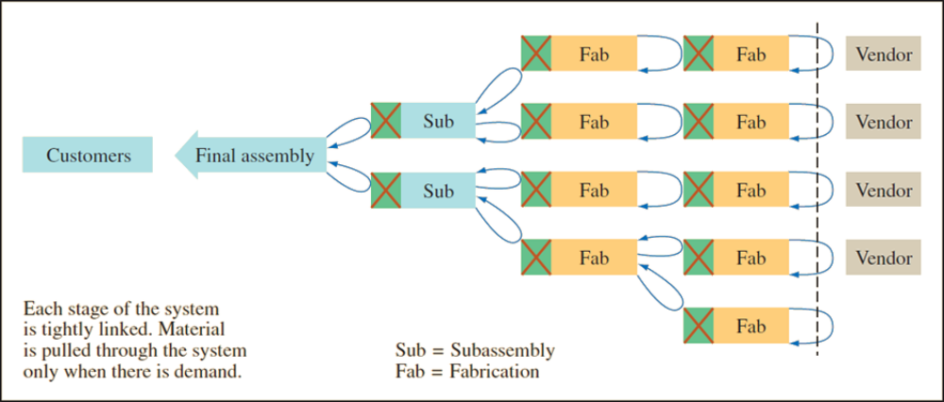
Lean Production – Pull System
Exhibit 14.1

Slide 8
Toyota Production System
Elimination of Waste
Respect for People
Waste from overproduction
Waste of waiting time
Transportation waste
Inventory waste
Processing waste
Waste of motion
Waste from product defects
Lifetime employment for permanent positions
Maintain level payrolls even when business conditions deteriorate
Company unions
Bonuses
View workers as assets

Slide 9
Lean Supply Chains
As the concepts of lean and Six Sigma have evolved and been applied to the supply chain, the goal of maximizing customer value has been added
Value stream: the value-adding and non-value-adding activities required to design, order, and provide a product or service from concept to launch, order to delivery, and raw materials to customers
When applied to supply chains, waste reduction relates to the optimization of the value-adding activities and the elimination of non-value-adding activities

Slide 10
Lean-Focused Supply Chain Components
Lean suppliers
  Able to respond to changes
  Lower prices
  Higher quality
Lean procurement
  Key is automation (e-procurement)
  Suppliers must see into the customers’ operations and customers must see into their suppliers’ operation
Lean warehousing
  Eliminate non-value-added steps and waste in storage process

Slide 11
Lean-Focused Supply Chain Components Continued
Lean logistics
  Optimized mode selection and pooling orders
  Combined multi-stop truckloads
  Optimized routing
  Cross docking
  Import/export transportation processes
  Backhaul minimization
Lean customers
  Understand their business needs
  Value speed and flexibility
  Establish effective partnerships with suppliers

Slide 12
Value Stream Mapping
Value stream mapping: a special type of flowcharting tool for development of lean processes
  Used to visualize product flows through various processing steps
  Illustrates information flows that result from the process
  Also illustrates information used to control flow through the process
Need a full understanding of the business including production processes
Technique is used to identify all of the value-adding, as well as non–value-adding, processes that materials are subjected to within a plant

Slide 13
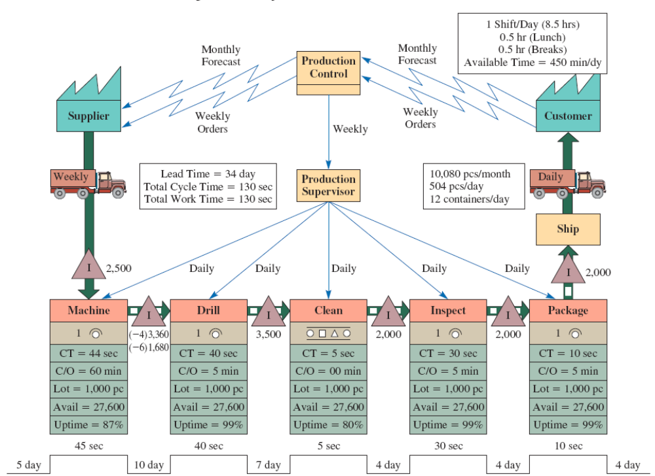
Manufacturing Process Map
Exhibit 14.2

Slide 14
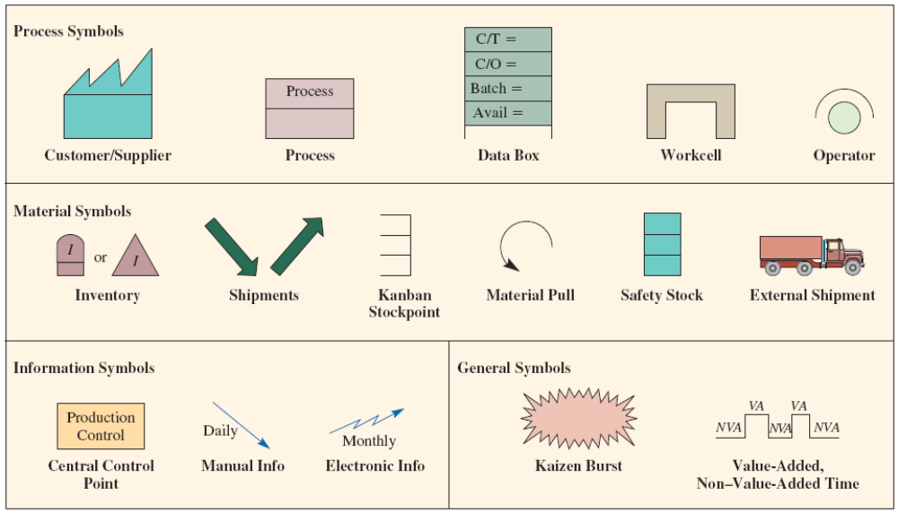
Value Stream Mapping Symbols
Exhibit 14.3

Slide 15
Lean Supply Chain Design Principles
Lean Layouts
  Group technology
  Quality at the source
  JIT production
Lean Production Schedules
  Uniform plant loading
  Kanban production control system
  Determination of number of Kanbans needed
  Minimize setup times
Lean Supply Chains
  Specialized plants
  Collaboration with suppliers
  Building a lean supply chain

Slide 16
Lean Concepts
Plant layout is designed to ensure balanced work flow with a minimum of WIP inventory
Preventive maintenance is emphasized to avoid downtime
  Operators perform much of the maintenance to keep equipment reliable
Group technology: a philosophy in which similar parts are grouped into families
  The processes required to make the parts are arranged in a manufacturing cell
  Eliminates movement and queue time between operations, reduces inventory, and reduces employees

Slide 17
Quality at the Source
Quality at the source: do it right the first time and if something goes wrong, stop the process immediately
  Workers are personally responsible for the quality of their output
  Workers become their own inspectors
  Workers are empowered to do their own maintenance
JIT production: producing what is needed when needed and nothing more
  Anything over the minimum is waste
  Typically applied to repetitive manufacturing
  Ideal lot size is one
  Vendors ship several times a day
  JIT exposes problems otherwise hidden by inventory

Slide 18
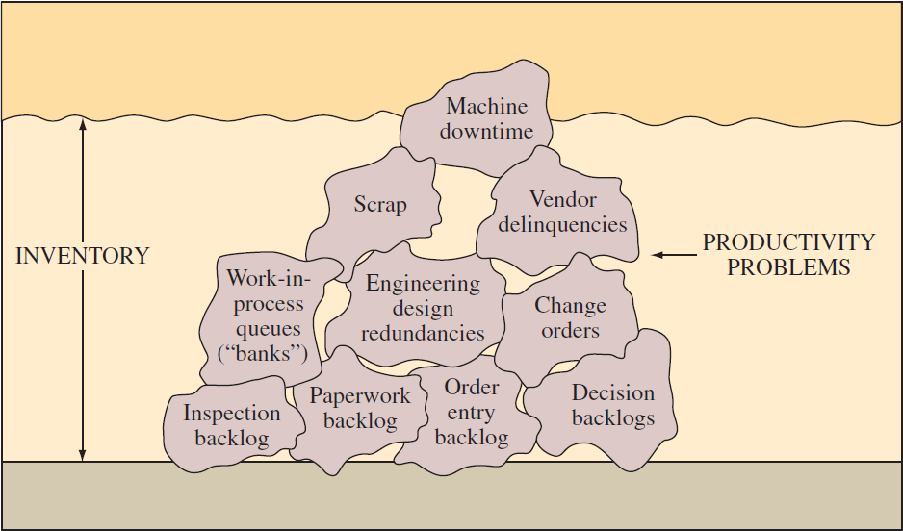
Inventory Hides Problems
Exhibit 14.6

Slide 19
Lean Production Schedules
Level schedule: pulls material into final assembly at a constant rate
Freeze windows: the period of time during which the schedule is fixed and no further changes are possible
Backflush: calculation of how many of each part were required to produce the actual quantity of finished products built
Uniform plant loading: smoothing the production flow to dampen schedule variation

Slide 20
Kanban Production Control Systems
Kanban means “sign” or “instruction card” in Japanese
Cards or containers are used
Make up the kanban pull system

Slide 21
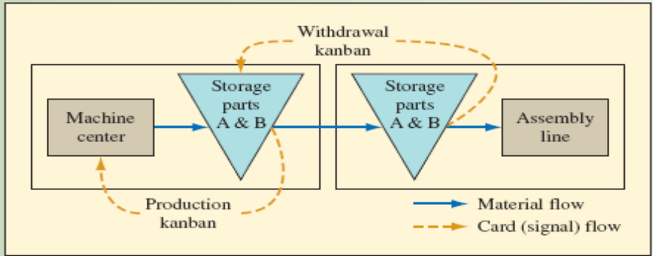
Kanban Pull System
Worker takes the first part A from a full container
Worker takes the withdrawal kanban from the container, and takes the card to the machine center storage area
In machine center, worker finds a container of part A
Worker removes the production kanban, and replaces it with the withdrawal kanban
  This authorizes the movement of the container to the assembly line
The freed production kanban is placed on a rack by the machine center, which authorizes the production of another lot of material
  A similar process is followed for part B
The cards on the rack become the dispatch list for the machine center
Exhibit 14.8

Slide 22
Other Approaches
Kanban squares: marked spaces on the floor to identify where material should be stored
Container system: the container is used as a signal device
Colored golf balls: appropriate golf ball signals production

Slide 23
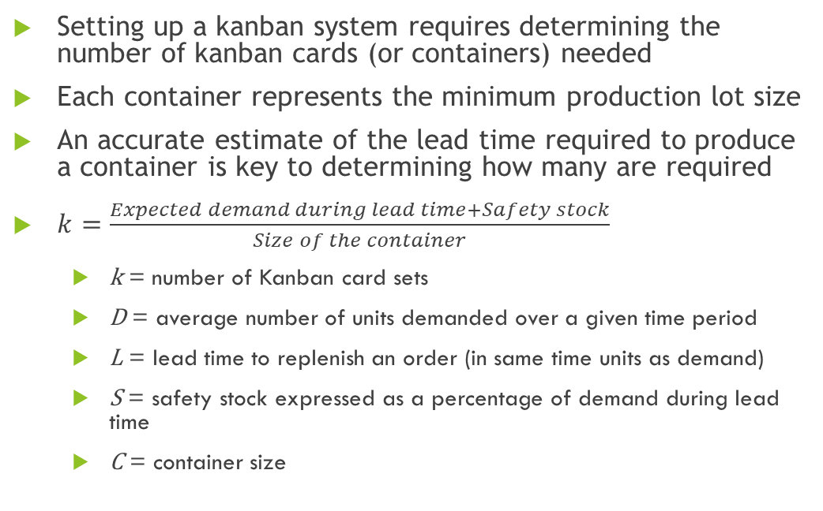
Determining the Number of Kanbans Needed
Setting up a kanban system requires determining the number of kanban cards (or containers) needed
Each container represents the minimum production lot size
An accurate estimate of the lead time required to produce a container is key to determining how many are required
$k=\frac{Expected demand during lead time+Safety stock}{Size of the container}$
  k = number of Kanban card sets
  D = average number of units demanded over a given time period
  L = lead time to replenish an order (in same time units as demand)
  S = safety stock expressed as a percentage of demand during lead time
  C = container size

Slide 24
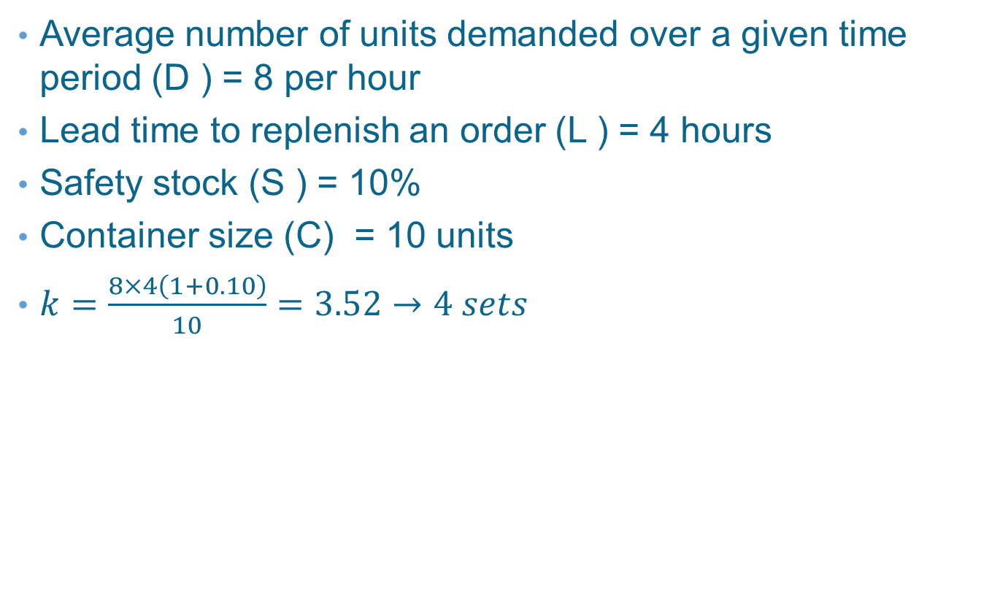
Example 14.1
Average number of units demanded over a given time period (D ) = 8 per hour
Lead time to replenish an order (L ) = 4 hours
Safety stock (S ) = 10%
Container size (C) = 10 units
$k=\frac{8×4\left(1+0.10\right)}{10}=3.52→4 sets$

Slide 25
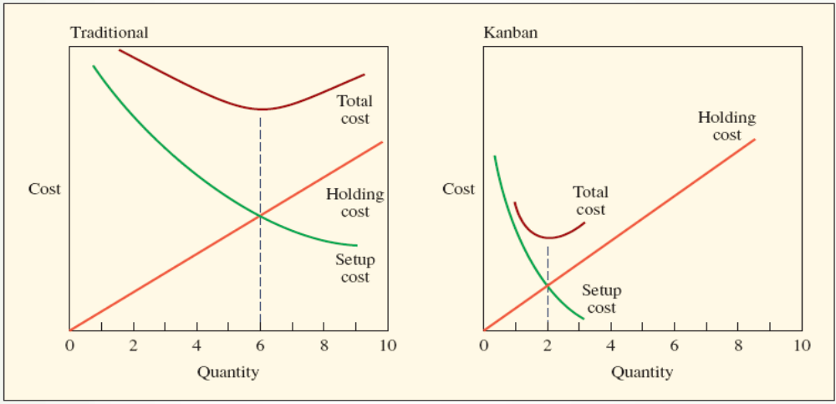
Minimized Setup Times
Reductions in setup and changeover times are necessary to achieve a smooth flow
Kanban significantly reduces the setup cost
The organization will strive for a lot size of one
Exhibit 14.10

Slide 26
Lean Supply Chains
Specialized plants
  Small specialized plants rather than large vertically integrated manufacturing facilities
  Can be constructed and operated cheaper
Collaborate with suppliers
  Important part of process
  Share projections with suppliers
  Link with suppliers online

Slide 27
Building a Lean Supply Chain
Value must be defined jointly for each product family based on the customer’s perception
All firms along the value stream must make an adequate return on their investments
Firms must work together to eliminate waste so overall target cost and ROI targets are met
When cost targets are met, the firms will conduct new analyses to identify remaining waste and set new targets
Every participating firm has the right to examine every activity relevant to the value stream as part of the joint search for waste

Slide 28
Lean Services
Organize problem-solving groups
Upgrade housekeeping
Upgrade quality
Clarify process flows
Revise equipment and process technologies
Level the facility load
Eliminate unnecessary activities
Reorganize physical configuration
Introduce demand-pull scheduling
Develop supplier networks

Slide 29
Summary
Lean production involves improving processes by eliminating waste and excess inventory
  The just-in-time philosophy is the basis for the concept
  Includes the entire supply chain with the goal of creating value for the customer by eliminating all non–value-adding activities
Lean concepts can be applied to virtually all the processes in the supply chain
  Key areas include production layout, the scheduling of production, and the design of the supply chain
Value stream mapping is a flowcharting tool used to visualize flows through a process
  The goal is to identify ways to “lean” a process by eliminating waste and creating value for the customer
Lean concepts can be successfully applied by service firms

Slide 30
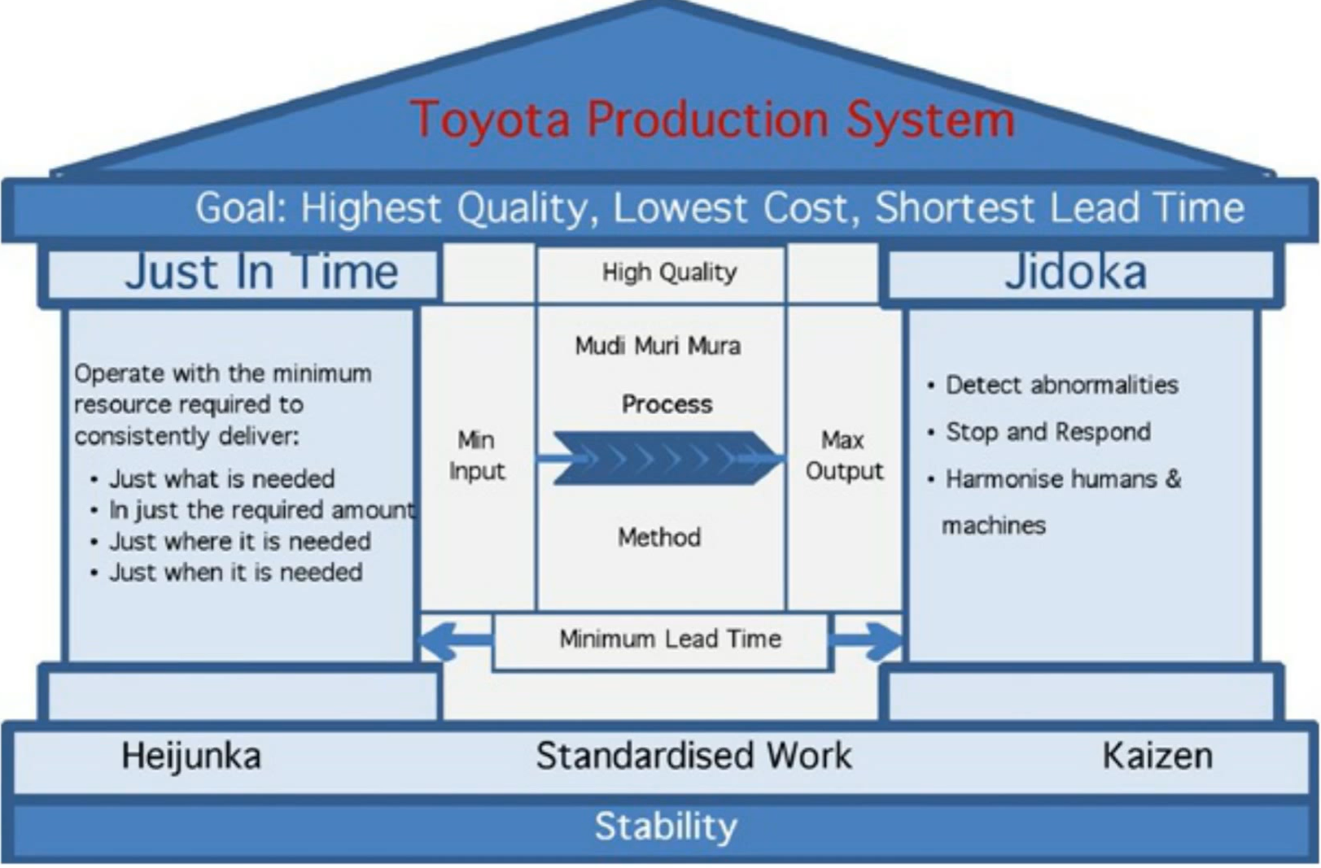

Slide 31
Muda, mura and muri are three types of wasteful actions that negatively impact workflow, productivity and ultimately, customer satisfaction.
The terms are Japanese and play an important role in the Toyota Way, a management philosophy developed by Taiichi Ohno for creating automobiles on demand after World War II.
What is the difference between Muda Mura and Muri?
Muda is the non-value adding actions within your processes;
Muri is to overburden or be unreasonable
Mura is unevenness.

Slide 32
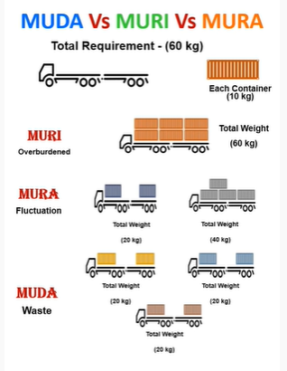

Slide 33
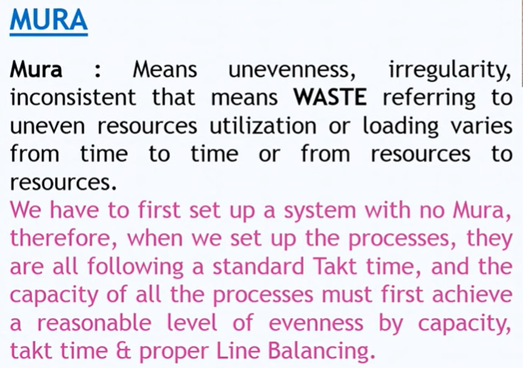

Slide 34
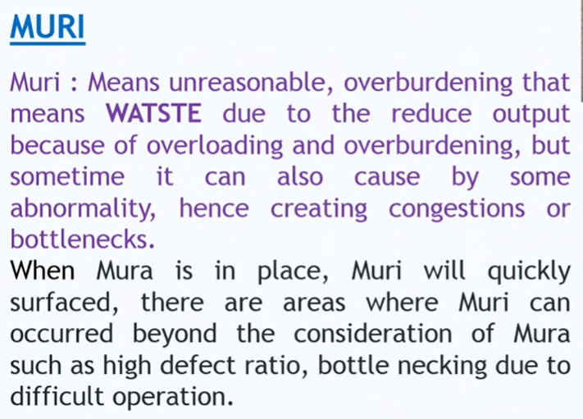

Slide 35
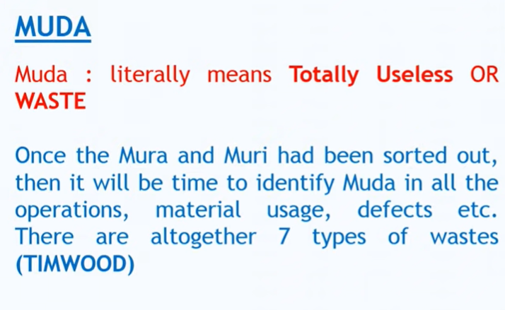

Slide 36
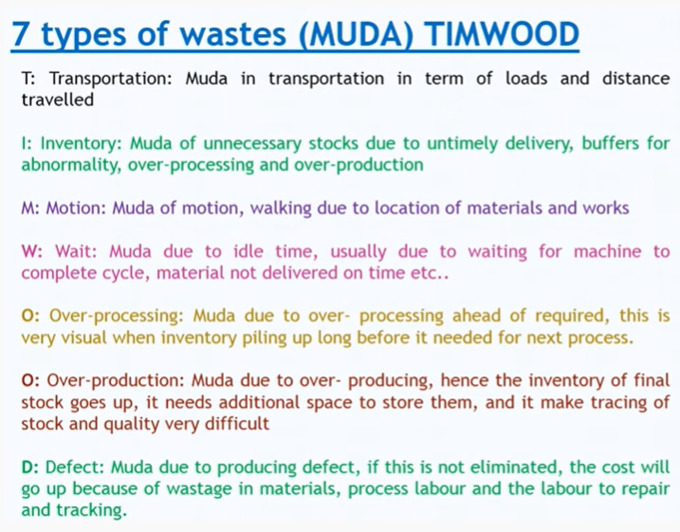

Slide 37
Practice Exam
Anything that does not add value from the customer’s perspective
An integrated set of activities designed to achieve production using minimal inventories of raw materials, work-in-process, and finished goods
The Toyota Production System is founded on these two philosophies
The set of value- and non–value-adding activities required to design, order, and provide a product from concept to launch, order to delivery, and raw materials to customers
The Japanese philosophy that focuses on continuous improvement
A philosophy in which similar parts are brought together in families for production purposes
Means producing only what is needed when needed and no more

Slide 38
Practice Exam Continued
A period of time during which the production schedule cannot be changed
Producing a mix of products that matches demand as closely as possible
A production control system that uses a signaling device to regulate the flow of material
If the lead time for an item is exactly five days, the demand is a constant four units per day, and the shipment container contains two units, how many kanban card sets would be needed? (Assume 0 percent safety stock.)
A firm wants to justify smaller lot sizes economically
  Management knows that it cannot change the cost to carry one unit in inventory because this is largely based on the value of the item
  To justify a smaller lot size, what must it do

