Slide 1

Six Sigma and its implementation steps
Peeyush Pandey
Assistant Professor
IIM Rohtak

Slide 2
Six Sigma
Six Sigma originated at Motorola in the early 1980s
The word Sigma is a statistical term that measures how far a given process deviates from perfection.
Six Sigma is a data driven methodology, and requires accurate data collection for the processes being analyzed.
It is a multi-dimensional approach for:
  Improving Processes
  Lowering Defects
  Reducing process variability
  Reducing costs
  Increasing customer satisfaction
  Increased profits

Slide 3
Key Success Factors for Six Sigma
Commitment from top management
Integration of business process, strategy, and performance measurement
Information of customer and market
Bottom-line orientation and continuous reinforcement and rewards

Slide 4
Process Capability
The natural variation of a process should be small enough to produce products that meet the standards required
A process in statistical control does not necessarily meet the design specifications
Process capability is a measure of the relationship between the natural variation of the process and the design specifications

Slide 5
Process Capability Ratio
Upper Specification - Lower Specification
6σ
C_{p} =
A capable process must have a C_{p} of at least 1.0
Does not look at how well the process is centered in the specification range

Slide 6
Example
The Munchies Snack Food Company packages potato chips in bags. The net weight of the chips in each bag is designed to be 9.0 oz, with a tolerance of 0.5 oz. The packaging process results in bags with an average net weight of 8.80 oz and a standard deviation of 0.12 oz. The company wants to determine if the process is capable of meeting design specifications.

Slide 7
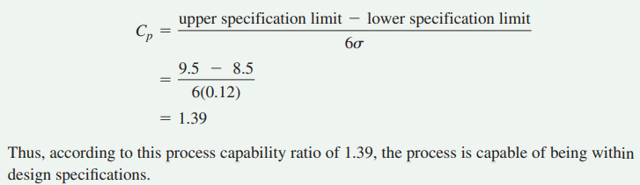
Solution

Slide 8
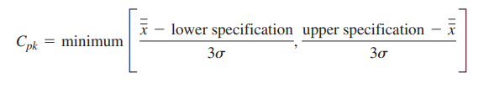
Process Capability Index
A capable process must have a C_{pk} of at least 1.0

Slide 9
Estimating Process Capability Index from A Sample - Cpk Index
Example :
XBAR = 8.80 oz,
S = 0.12 oz
USL = 9.5 oz
LSL = 8.5 oz
Cpk = min { (9.5-8.80) / (3*0.12), (8.80-8.5) / (3*0.12) }
= min {1.94, 0.83} = 0.83

Slide 10
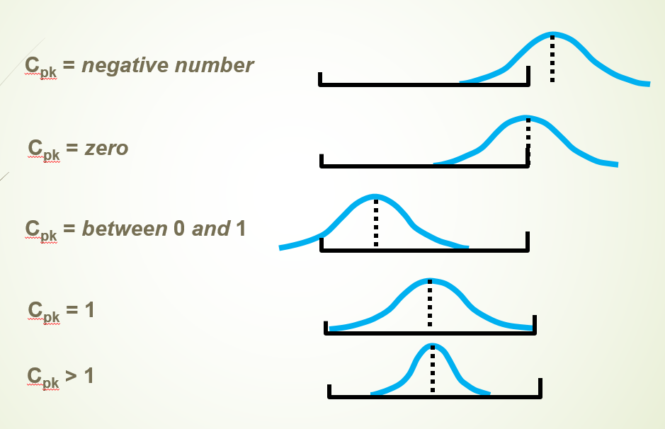
Interpreting C_{pk}

Slide 11
Six-Sigma Metrics
Defects per unit (DPU) = number of defects discovered ÷ number of units produced
Defects per million opportunities (DPMO)
= (number of defects discovered ÷ opportunities for error) × 1,000,000

Slide 12
DMAIC approach for SIX sigma Implementation
Define
Measure
Analyze
Improve
Control

Slide 13
Define

Slide 14
Define
Identify business objectives
Identify customers and their priorities
Define the Critical-to-Quality (CTQ’s) characteristics that the customers consider to have the most impact on quality
Select a six sigma project team

Slide 15
Define
Prepare a Charter
  Business case
  Project Scope
  List the stakeholders
  Team Member roles
  Milestones
  Critical to quality measures
  Financial drivers

Slide 16
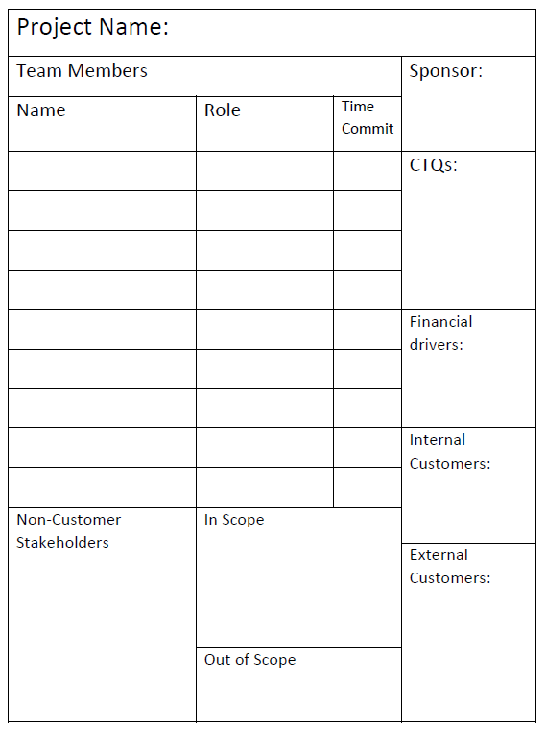
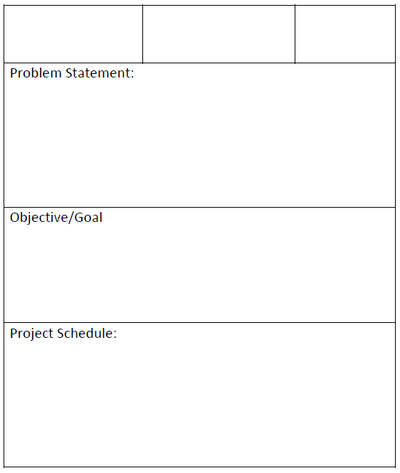

Slide 17
Define
Tools
  5 Whys
  Process Map
  Value stream Mapping
  Run Chart

Slide 18
Define
Analysis
  Stakeholder Analysis
  In and Out of the Box method
  Is/Is Not Matrix

Slide 19
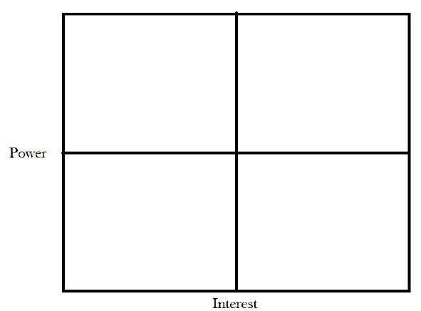
Stakeholder Analysis
Define

Slide 20
In scope and Out of the scope method
Define
In Scope | Out of Scope

Slide 21
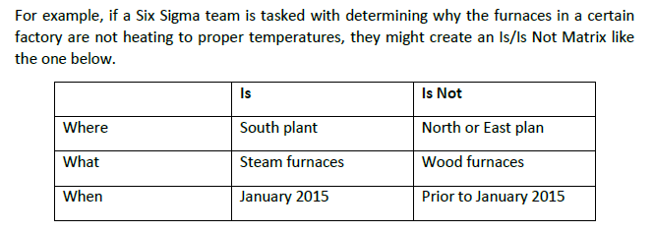
Is/IS Not Matrix
Define

Slide 22
Define Tollgate Checklist
A successful define phase ends with all of the following deliverables.
A comprehensive project statement
A team charter
List of stakeholders
Project scope

Slide 23
Measure

Slide 24
Measure
  Identify key internal processes that influence CTQ’s
  Determine how to measure the processes
  Measure the defect rates currently generated

Slide 25
Failure Modes and Effect Analysis
FMEA used for the detailed information about inputs and associated failed points
FMEA includes following columns in spreadsheet
Process Step
Potential Failure
Potential failure effect
Severity
Potential cause of failure
Occurrence
Current Monitor/Control
Detect failure
Risk priority number

Slide 26
Example1: FMEA
Process step: Refund request is entered in system
Potential failure: Incorrect amount is entered
Potential failure effect: The customer receives more or less refund than anticipated
Severity: 8
Potential cause of failure: data entry employee transposes numbers or makes a similar typing mistake
Occurrence: 10
Current Monitor/Control: A supervisor randomly reviews a sample of refund requests to ensure accuracy
Detect failure: 7
Risk priority number: 8*10*7 = 560

Slide 27
Example2: FMEA
Process step: Refund check is printed
Potential failure: The printed check has defects that make it difficult to cash
Potential failure effect: The customer can’t cash the check and has to call for a new one
Severity: 9
Potential cause of failure: printer is misaligned or out of link
Occurrence: 1
Current Monitor/Control: The person who signs the checks reviews the checks as they sign them
Detect failure: 2
Risk priority number: 9*1*2 = 18

Slide 28
Collecting data
Continuous
Discrete data
Levels of data
  Nominal data: mode is the measure of central tendency
  Ordinal data: mode, median are the measures of central tendency
  Interval data: continuous and quantitative data
  Ratio data

Slide 29
Choosing Best Measurement System
Creating Accuracy
Addressing Resolution
Adjusting for the errors of linearity
Stability

Slide 30
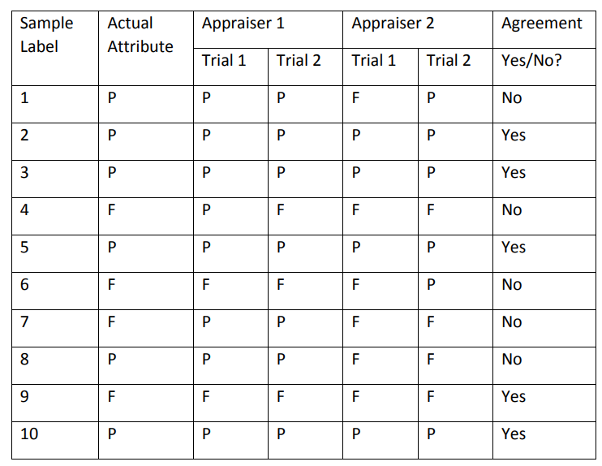
Gage R&R test:
used to test repeatability and reproducibility
  Attribute gage R&R
  Variable gage R&R
Reproducible only 50% of the time
Repeatable 90% of the time for appraiser 1
Repeatable 80% of the time for appraiser 2
Appraisers are accurate 80% and 70% of the time respectively

Slide 31
Collecting Data Samples
Simple random sampling
Stratified sampling
Sequential sampling
Samples that are not Random

Slide 32
Measure Tollgate checklist
Analyzed measurement systems and identify any issues
Correct measurement system to remove error risks
Conducted appropriate sampling to allow for statistically valid conclusions
Come up with the baseline measurement: Run charts
Calculated the process variation and sigma level

Slide 33
Analyze

Slide 34
Analyze
Determine the most likely causes of defects.
Identify key factors that are most likely to create process variation.

Slide 35
Root cause Analysis
The Cause and effect, or Fishbone Diagram
The cause and effect diagram is also called the Ishikawa diagram or the fishbone diagram.
It is a tool for discovering all the possible causes for a particular effect.
The major purpose of this diagram is to act as a first step in problem solving by creating a list of possible causes.

Slide 36
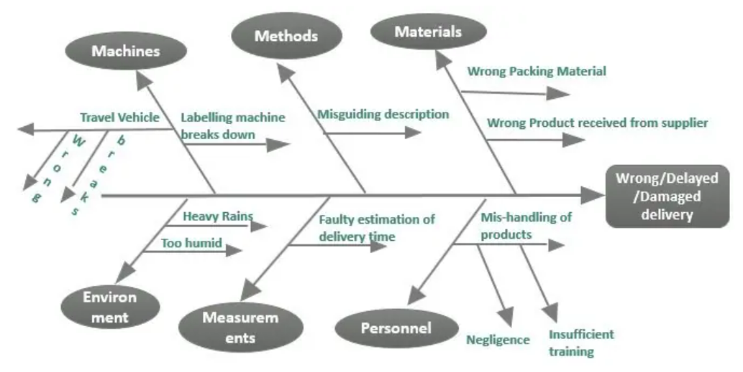
Cause and Effect Diagrams

Slide 37
Graphical Analysis
Pareto chart
Box Plots

Slide 38
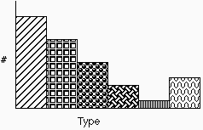
Pareto Charts
Pareto charts are used to identify and prioritize problems to be solved.
They are actually histograms aided by the 80/20 rule adapted by Joseph Juran.
Notes:
This is the economic concept that Juran applied to quality problems. The meaning behind that 80/20 rule is that there are vital few causes that create the problems.

Slide 39
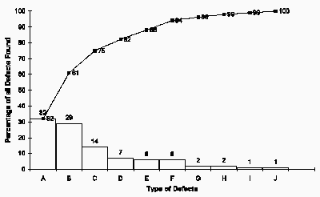
Pareto Charts
Notes:
Concentrating on reducing defects A, B and C since they make up 75% of all defects. Or focus on eliminating defect E, if defect E causes 40% of monetary loss.

Slide 40
Example 1
Stage 1: List the problems
Problem Code | Problem Frequency
101 | 2400
102 | 220
103 | 45
104 | 64
105 | 336
106 | 192
107 | 3600
108 | 12
109 | 450
110 | 60
Total | 7379

Slide 41
Example 1
Stage 2: Calculate the proportion
Problem Code | Problem Frequency | Proportion
101 | 2400 | 32.5%
102 | 220 | 3%
103 | 45 | 0.6%
104 | 64 | 0.9%
105 | 336 | 4.6%
106 | 192 | 2.6%
107 | 3600 | 48.8%
108 | 12 | 0.2%
109 | 450 | 6.1%
110 | 60 | 0.8%
Total usage | 7379

Slide 42
Example 1
Stage 3: Sort the items by proportion
Problem Code | Frequency | Proportion | Cumulative % of total
107 | 3600 | 48.8% | 48.8%
101 | 2400 | 32.5% | 81.3%
109 | 450 | 6.1% | 87.4%
105 | 336 | 4.6% | 92%
102 | 220 | 3.0% | 94.9%
106 | 192 | 2.6% | 97.5%
104 | 64 | 0.9% | 98.4%
110 | 60 | 0.8% | 99.2%
103 | 45 | 0.6% | 99.8%
108 | 12 | 0.2% | 100%
Total frequency | 7379

Slide 43
Example 1

Slide 44
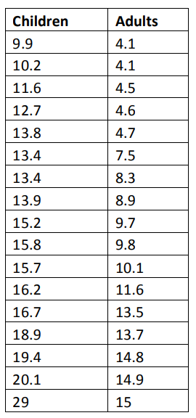
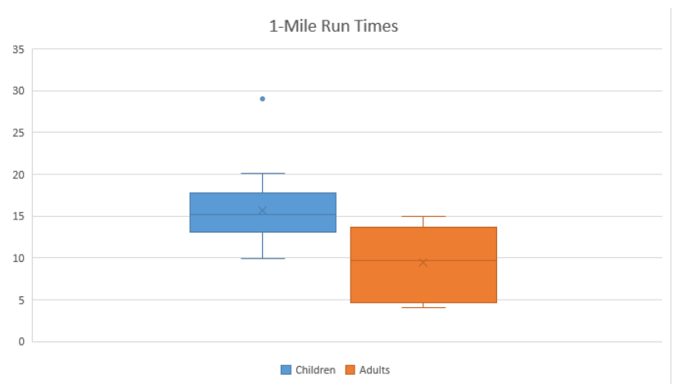
BOX Plots

Slide 45
Statistical Analysis
Correlation
Measures the relative strength of the linear relationship between two variables
Ranges between –1 and 1
The closer to –1, the stronger the negative linear relationship
The closer to 1, the stronger the positive linear relationship
The closer to 0, the weaker any positive linear relationship

Slide 46
Scatter Plots of Various Correlation Coefficients
Y
Y
Y
X
X
X
r = -1
r = -0.6
r = 0
Y
Y
Y
X
X
X
r = +1
r = +0.3
r = 0

Slide 47
Linear relationships
Curvilinear relationships
Y
Y
X
X
Y
Y
X
X

Slide 48
Regression
Regression model estimates the nature of the relationship between the independent and dependent variables.
Explanatory variables are termed the independent variables and the variables to be explained are termed the dependent variables.
Changes in some variables may cause changes in other variables.

Slide 49
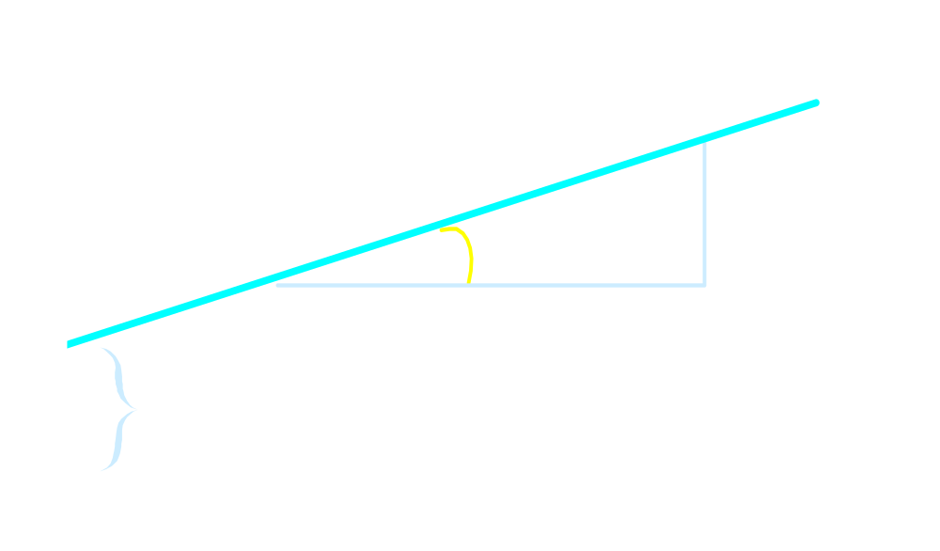

Linear Equations
Notes:
28

Slide 50
Example
Value of Office | Floor space
142000 | 2310
144000 | 2333
151000 | 2356
150000 | 2379
139000 | 2402
169000 | 2425
126000 | 2448
142900 | 2471
163000 | 2494
169000 | 2517
149000 | 2540
Commercial developer is considering purchasing a group of small office buildings in an established business district. He want to assess the value of an office building by floor space in square feet

Slide 51
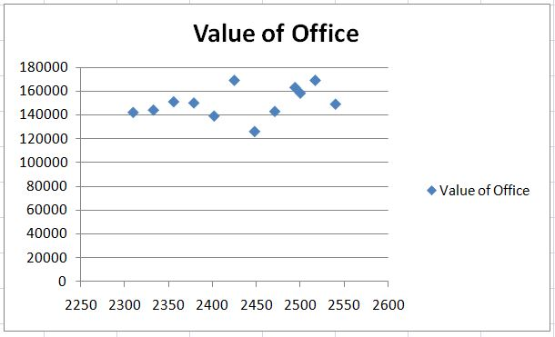
Example

Slide 52
Analyze Tollgate Checklist
Identified primary root causes
Prioritized root causes
Root cause assumptions should be backed by statistical data
Understand relationships between variables within a process
Confirm variable relationships with statistic analysis.

Slide 53
DMAIC - Improve
Identify means to remove causes of the defects.
Confirm the key variables and quantify the effects on CTQ’s
Identify maximum acceptable ranges for the key variables and a system to measure deviations of the variable
Modify the process to stay within the acceptable ranges

Slide 54
DMAIC - Control
Determine how to maintain the improvement
Put tools in place to ensure that the key variables remain within the maximum acceptable ranges under the modified process

Slide 55
Thank You

