Slide 1
LLM - Foundations and applications
23 February 2025
Rishi Raj
IIM Visakhapatnam

Slide 2
Word Embeddings
  Background:
  Does AI work on text/images or numbers?
  Numbers
  So, we need to convert text/images to numerical representation

Slide 3
Word Embeddings
  Map all words in a language into a vector space
  They capture semantic meaning and contextual relationships between words.
  Words with similar meanings have embeddings that are closer in vector space.
💡 Example:
"King" and "Queen" will have similar embeddings.
"Apple" and "Orange" will be closer in the vector space than "Apple" and "Laptop.“
There are different techniques for learning word embeddings, and Word2Vec is one of them.

Slide 4
Word2Vec
Word2Vec is a specific algorithm for learning word embeddings.
Developed by Google (Mikolov et al., 2013).
Uses neural networks to generate word embeddings.
E.g. : Vector (King – Man + Women) = Vector (Queen)
Similar words are placed together in a vector space.
The kid said he would grow up to be a superman.
The child said he would grow up to be a superman.

Slide 5
Word2Vec
Comes in two main variants:
CBOW (Continuous Bag of Words) – Predicts the target word from its context.
Skip-gram – Predicts context words from a given word
The | Quick | Brown | Fox |  | Over | The | Lazy | Dog
Jumps
Jumps
The | Quick | Brown | Fox |  | Over | The | Lazy | Dog

Slide 6
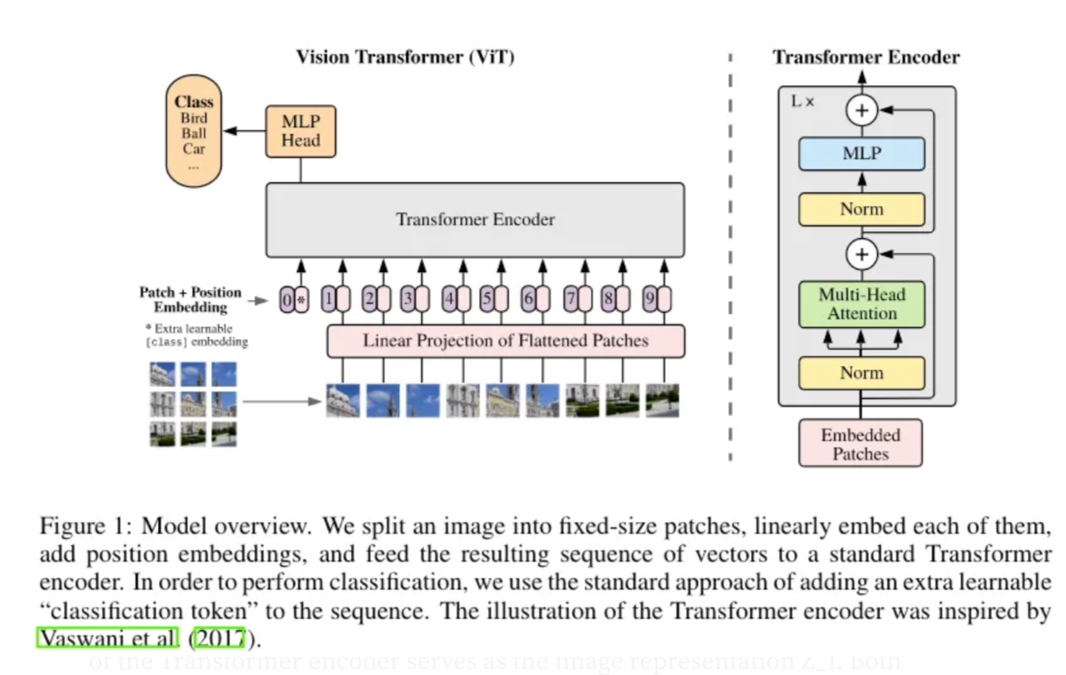
Vision Transformer

Slide 7
Visuals of Foundational Concepts
Visual Basics of Neural Network
Visual Basics of a Transformer
Visual Basics of LLM

Slide 8
Code along Sessions
Building a GPT
Building a simple RAG
Building a RAG

