Slide 2
Supervised
Regression 101
car_consumption_1.csv ,
Price is the outcome variable
Also predict for data in -car_consumption_2.csv

Slide 3
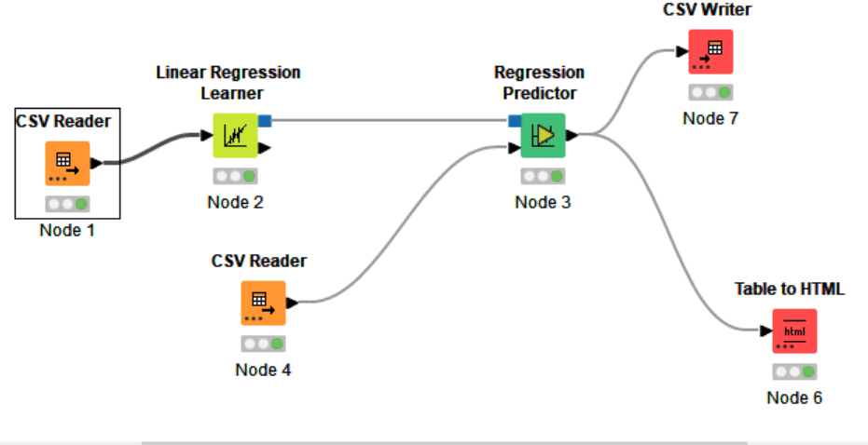

Slide 4
Linear Regression Diagnostics
https://kni.me/c/j01xAUlvxPQE_XEk

Slide 5
Take home exercise Boston Housing data set
housing.csv

Slide 6
Unsupervised
Clustering_101
Absenteesim At Work.csv

Slide 7
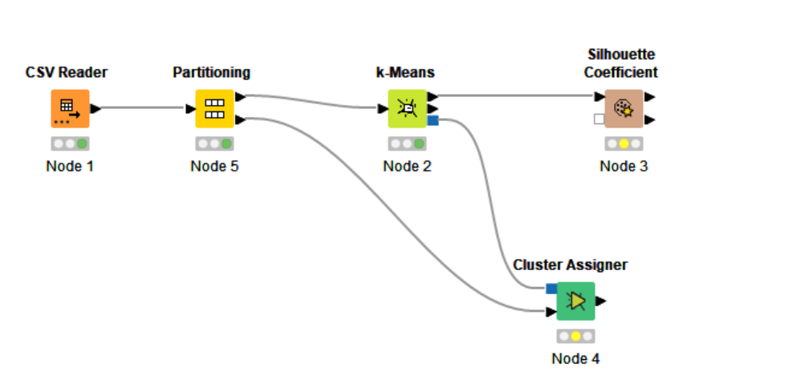

Slide 8
Clustering with k-Means
Iris data set
https://kni.me/w/t8UVEQH1sTTkus_w

Slide 9
Customer Segmentation
Along with interactive visualization
https://kni.me/w/37cHxqru6dblIUeP

Slide 10
Take home task
https://docs.knime.com/2018-12/analytics_platform_quickstart_guide/index.html#introduction
See report- https://info.knime.com/state-of-data-science-and-machine-learning?
https://www.ibm.com/products/spss-modeler

Slide 11
Classification models for NLP

Slide 12
Hands On for data preprocessing
Concept of Document in Knime &
Restaurant_Reviews.tsv
Strings To Document -
Converts the specified strings to documents. For each row a documentwill be created and attached to that row. The strings of thespecified columns will be used as title, authors, andfull text. Furthermore the defined category, source, type, anddate will be set.
https://kni.me/w/ZHAExldZ5M7q6hdG

Slide 13
Classification models

Slide 14
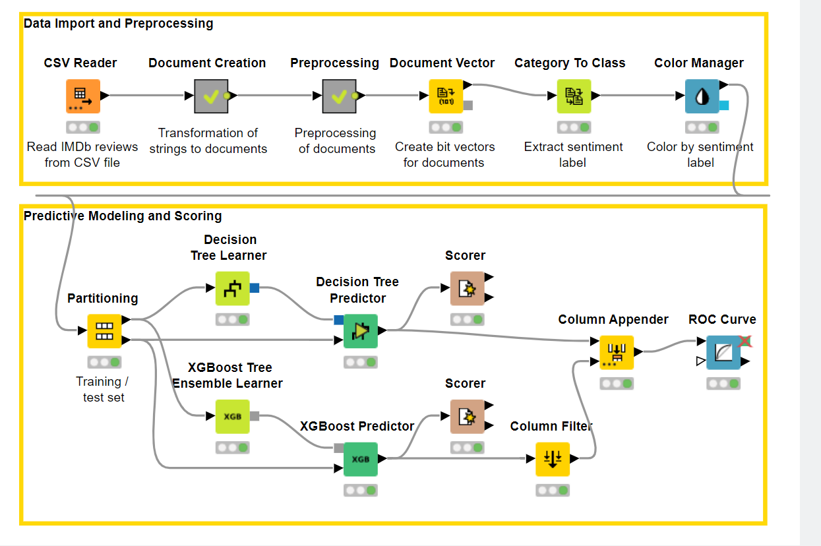

Slide 15
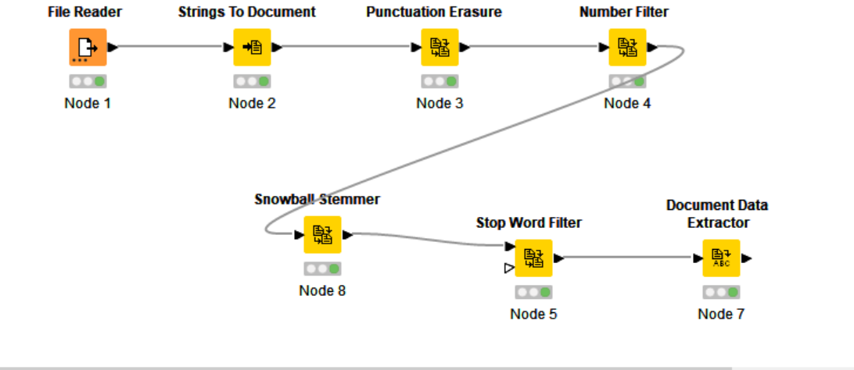

Slide 16
https://kni.me/w/ZHAExldZ5M7q6hdG
NLP_102

