Slide 3
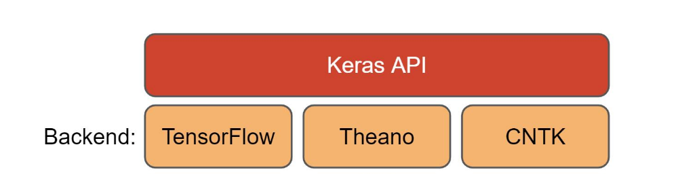

Slide 4
Define
This is the step where you define the architecture of your neural network.
In Keras, this is usually done using the Sequential API or the functional API.Layers:
You add layers to the model one by one.
Each layer can be a dense (fully connected) layer, convolutional layer, recurrent layer, etc.
Input Shape: You specify the input shape in the first layer, which tells the model what kind of data it will be receiving.

Slide 5
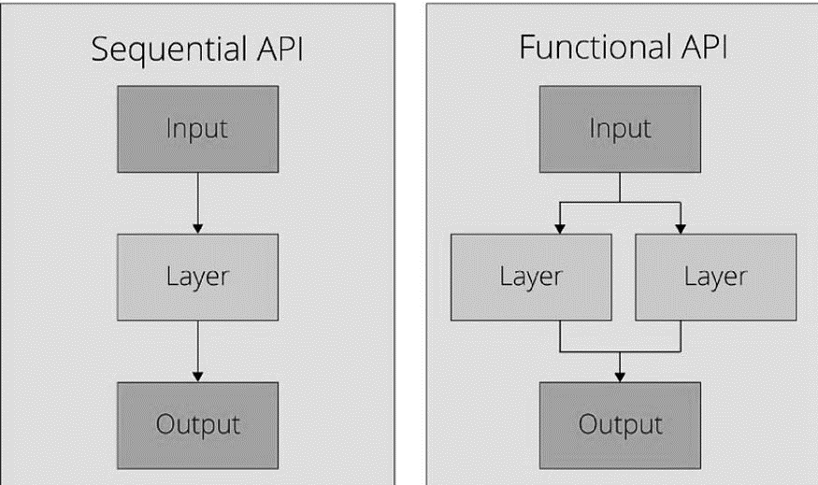

Slide 6
Compile
Configure the model for training by specifying the loss function, optimizer, and metrics.
Optimizer: Algorithms like Adam, SGD, RMSprop used to minimize the loss function.
Loss Function: Function to compute the difference between the predicted and true values. Common ones include mean_squared_error for regression and categorical_crossentropy for classification.
Metrics: Functions to monitor the performance of the model, such as accuracy or precision.

Slide 7
Fit
Actual Training

