Slide 1
KPI

Slide 2
Key Performance Indicator (KPI)
  Is a numeric value that indicates whether your team/company is reaching its targets.
  To evaluate the performance of
    Business processes and
    Individuals
    Ultimately Organization
  Help in making data-driven decisions to grow faster.
  KPIs are also known as
    Performance metrics,
    Performance ratios or
    Business indicators.

Slide 3
Types of KPI’s or Metrics
Financial Metrics
  Profit
  Cost
  Actual Revenue vs target
  Sales by region
Customer Metrics
  Customer life time value
  Customer acquisition cost
    Most important for ecommerce business
  Customer satisfaction & retention
  Number of customers

Slide 4
Types of KPI’s or Metrics
3. Process Metrics
  Customer Support Tickets
    Analysis of the number of new tickets, the number of resolved tickets, and resolution time will help you create the best customer service department in your industry.
  Percentage Of Product Defects
4. People Metrics
  Employee Turnover Rate (ETR)
  Employee Satisfaction

Slide 5
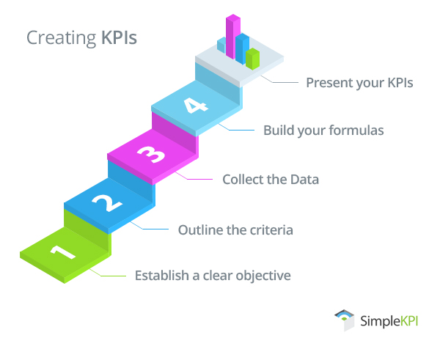

Slide 6
Creating KPI’s
Establish a clear objective.
Become market leader
  KPI objective will be to
    Increase Sales by 10% in the present financial year
    Expand our product lines from 15 to 20
      Enhance customer base
Outline the criteria for success.
  What will the target be?
    Should be realistic
  When should it be accomplished?
    Time bound
  How will progress be monitored?
    Initial stages of KPI monitoring it's best to focus on
      Long-term targets with midterm monitoring.

Slide 7
Creating KPI’s
Collect the data.
Investigate the availability and accuracy of the data.
  Must be available from the existing systems or databases.
Build the KPI formula.
For example, a KPI that measures productivity in revenue by manpower = Total Revenue/total number of manpower.
Hence, build formulas and test to see if the results are what you would expect.
Present your KPIs.
To efficiently communicate present the data into
  Understandable visuals such as graphs and charts
    Dashboard

Slide 8
How to define a KPI
The operative word in KPI is “key” because it every KPI should related to a specific business outcome.
KPIs need to be defined according to critical business objectives.
Follow these steps when defining a KPI:
  What is your desired outcome?
  Why does this outcome matter?
  How are you going to measure progress?

Slide 9
How to define a KPI
How can you influence the outcome?
Who is responsible for the business outcome?
How will you know you’ve achieved your outcome?
How often will you review progress towards the outcome?

Slide 10
Write probable KPI’s of a Chief Sales Officer
Objective is to increase sales revenue in this financial year. How to define this KPI?
  Keeping the earlier discussed steps in mind

Slide 11
KPI’s of a Chief Sales Officer
To increase sales revenue by X % say 20% this year
  Achieving this target will allow the business to become profitable
Progress will be measured as an increase in revenue measured in dollars spent
By hiring additional sales staff, by promoting existing customers to buy more product
The Chief Sales Officer is responsible for this metric
Revenue will have increased by 20% this year
The KPI will be reviewed on a monthly basis

Slide 12
Quizzing??
A startup company monitored the real-time pageviews of the company as major KPI.
Every weekend management congratulated the team for the new records of daily pageviews.
In an analytics study it was found that majority of the pageviews were being served for free customers,
  And that higher pageviews meant higher server costs.

Slide 13
Quizzing??
Is tracking the pageviews a good KPI indicator for business?
  Yes
    Why
  No
    What should be the beneficial KPI’s for start up business?

Slide 14
Answer
KPI’s for early stage startups (Christoph Janz)
Metrics for customer Growth
  Users in each plan
    Paid
    Non Paid
  New customers today
    New email registered
    New username created
Financial Matrices
  Total Monthly Recurring Revenue
  Lost Monthly Recurring Revenue
  New Monthly Recurring Revenue

Slide 15
Important HR Metrics

Slide 16
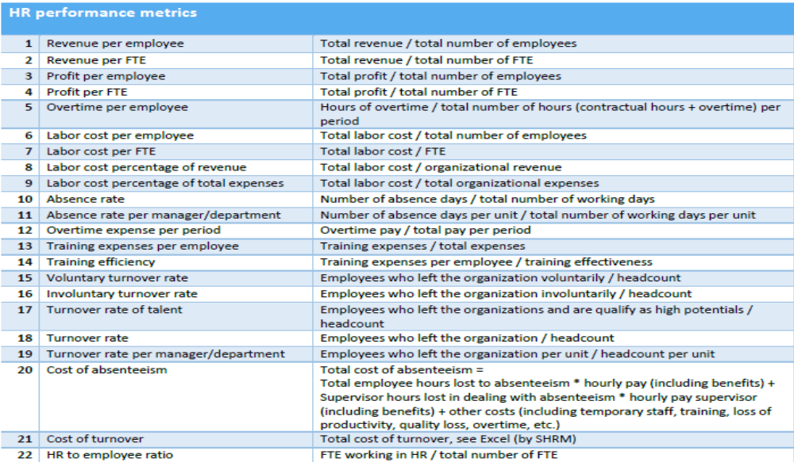

Slide 17


Slide 18


Slide 19
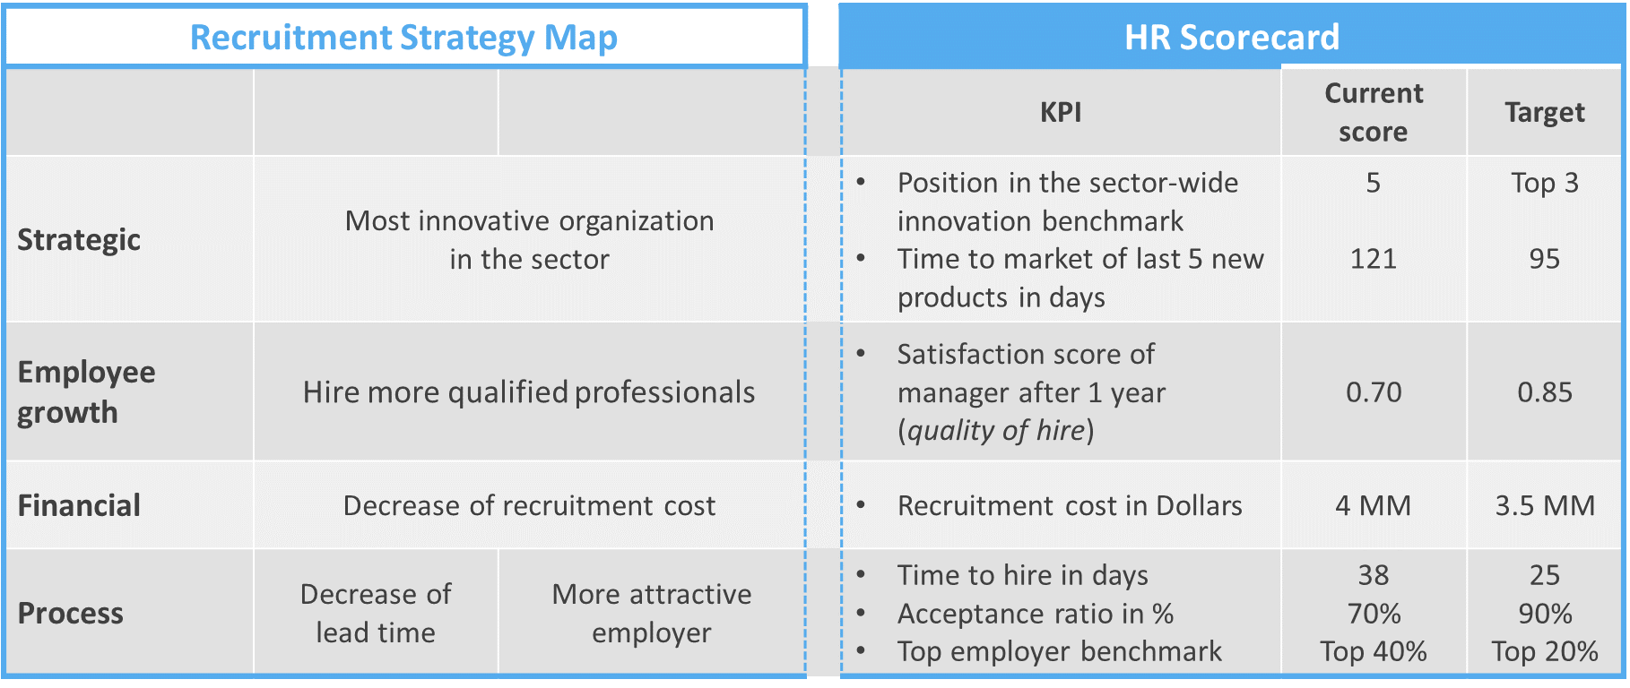

Slide 20
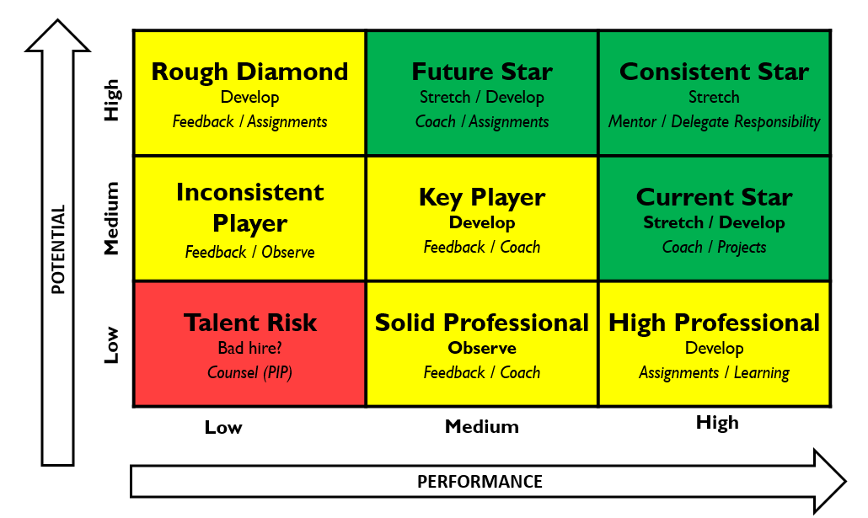
9 Box Grid

Slide 21
Thank You

