Slide 1


Slide 2
Multipersona Data Science and Machine Learning Platforms
"Building Blocks of Analytics" concept
Java

Slide 3
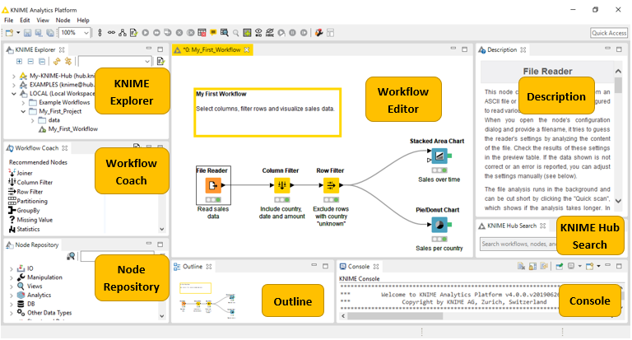
KNIME Workbench

Slide 4
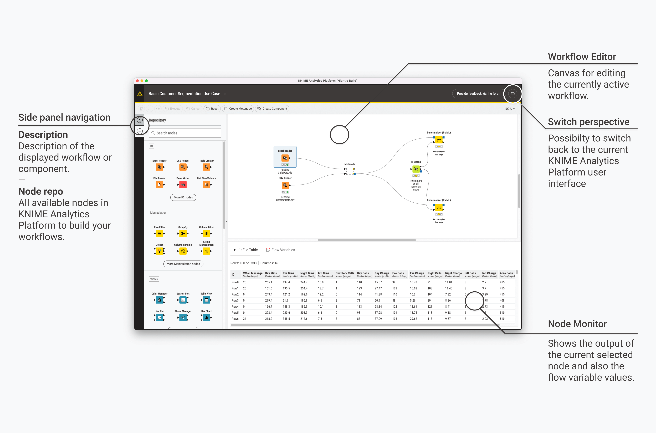

Slide 5
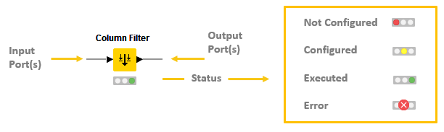
Nodes
In KNIME Analytics Platform, individual tasks are represented by nodes. Each node is displayed as a colored box with input and output ports, as well as a status

Slide 6
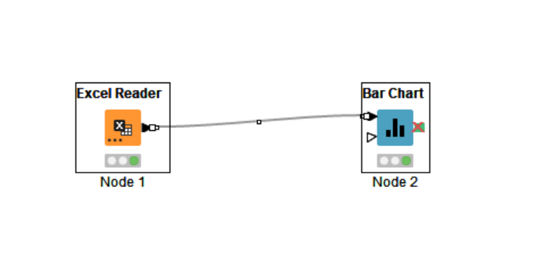
1’st workflow K101
Read Data - revenue.xlsx
Visualize

Slide 7
Knime Hub - True power of Knime
Visual Analysis of Sales Data
From desktop / url
https://hub.knime.com/knime/spaces/Examples/latest/02_ETL_Data_Manipulation/00_Basic_Examples/00_Visual_Analysis_of_Sales_Data~8B_0uf-mtF0acBt-

Slide 8
Take home task
Explore Indian_state_population.csv

Slide 9
Take home task
https://docs.knime.com/2018-12/analytics_platform_quickstart_guide/index.html#introduction
See report- https://info.knime.com/state-of-data-science-and-machine-learning?
https://www.ibm.com/products/spss-modeler

Slide 10
Supervised
Regression 101
car_consumption_1.csv ,
Price is the outcome variable
Also predict for data in -car_consumption_2.csv

Slide 11
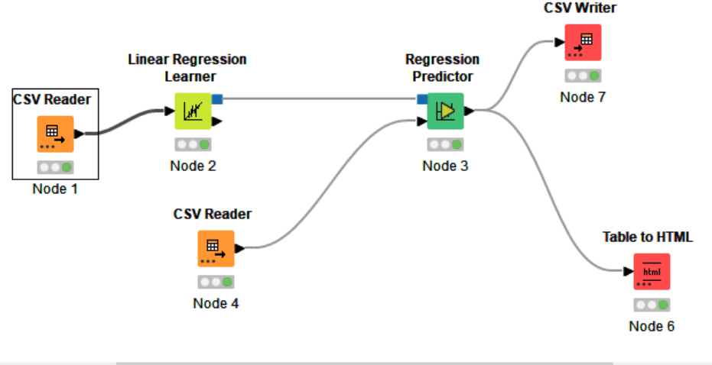

Slide 12
Linear Regression Diagnostics
https://kni.me/c/j01xAUlvxPQE_XEk

Slide 13
Take home exercise Boston Housing data set
housing.csv

Slide 14
Linear Regression Diagnostics
https://kni.me/c/j01xAUlvxPQE_XEk

Slide 15
Take home exercise Boston Housing data set
housing.csv

Slide 16
Unsupervised
Clustering_101
Absenteesim At Work.csv

Slide 17
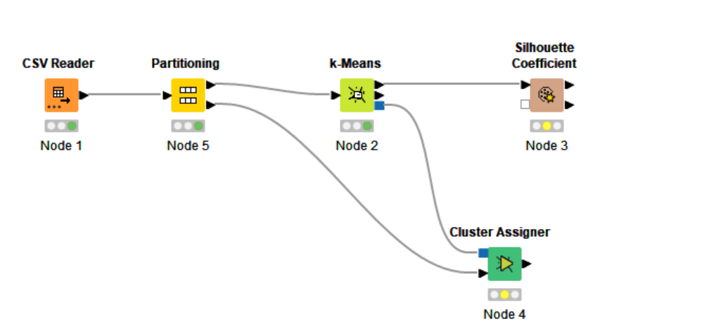

Slide 18
Clustering with k-Means
Iris data set
https://kni.me/w/t8UVEQH1sTTkus_w

Slide 19
Customer Segmentation
Along with interactive visualization
https://kni.me/w/37cHxqru6dblIUeP

