Slide 1
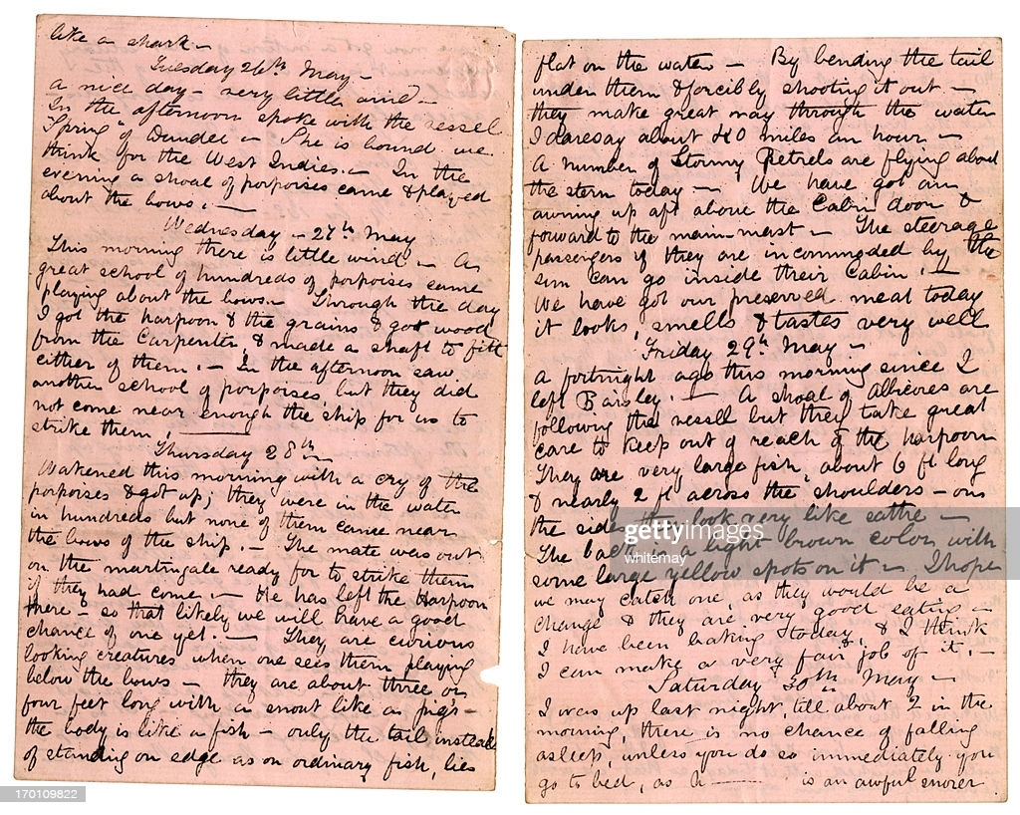
Diary Page of Atharva & KDC business – First Month

Slide 2



Papa contributed $100,000 as capital

Slide 3




Bank loan received $ 50000.

Slide 4



Purchased an equipment costing $ 72000 for cash.
Equipment

Slide 5



Inventory purchased on credit $8,000

Slide 6



During month, an additional $57500 of ingredients and boxes was purchased on credit

Slide 7





Sales made and cash received $120,000

Slide 8


Sales consumed $ 60,000 of inventory

Slide 9



Salary wages paid $30,000.

Slide 10



Catered a party for a fee of Rs. 2000 for my friend who will pay later

Slide 11



My Friend gave cheque of Rs. 2,000 for party catered by KDC
Friend

Slide 12

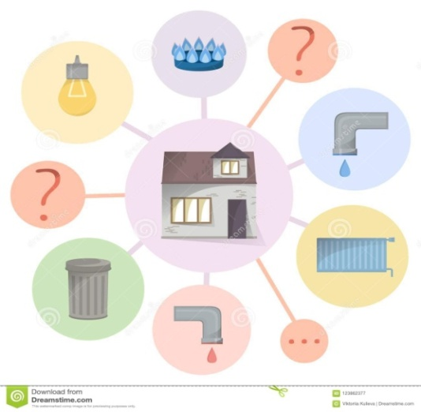


Bills received of various utilities used were received , Total Rs. 4,500.

Slide 13



Account payable Rs. 48,000 was paid in cash (KDC to Supplier)

Slide 14



Rent Paid In Rs. 7500 by KDC to Landlord
Landlord
Rent
Cash
Accommodation
Expenses towards sales

