Slide 1
Inventory management
Dr. Sachin KAMBLE
Professor of Strategy (Operations and Supply Chain Management)

Slide 2
Agenda
Types of inventory
Inventory costs
Inventory models
  Economic Order Quantity (EOQ)
  Continuous Review System

Slide 3
What is inventory management
Inventory
  The number of flow units within the process.
Inventory management
  The practice of regulating the quantity, location, and type of inventory in a process.

Slide 4
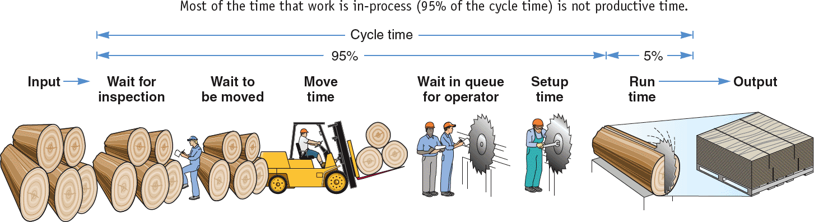
Types of inventory
Raw material
  Purchased but not processed
Work-in-process (WIP)
  Undergone some change but not completed
  A function of cycle time for a product
Maintenance/repair/operating (MRO)
  Necessary to keep machinery and processes productive
Finished goods
  Completed product awaiting shipment

Slide 5
Inventory costs
Holding cost
  Is the sum of the cost of capital and the variable costs of keeping items on hand, such as storage and handling, taxes, insurance, and shrinkage.
  Shrinkage comes from theft, obsolescence, and deterioration.
Ordering costs
  The costs of placing an order and receiving goods.

Slide 6
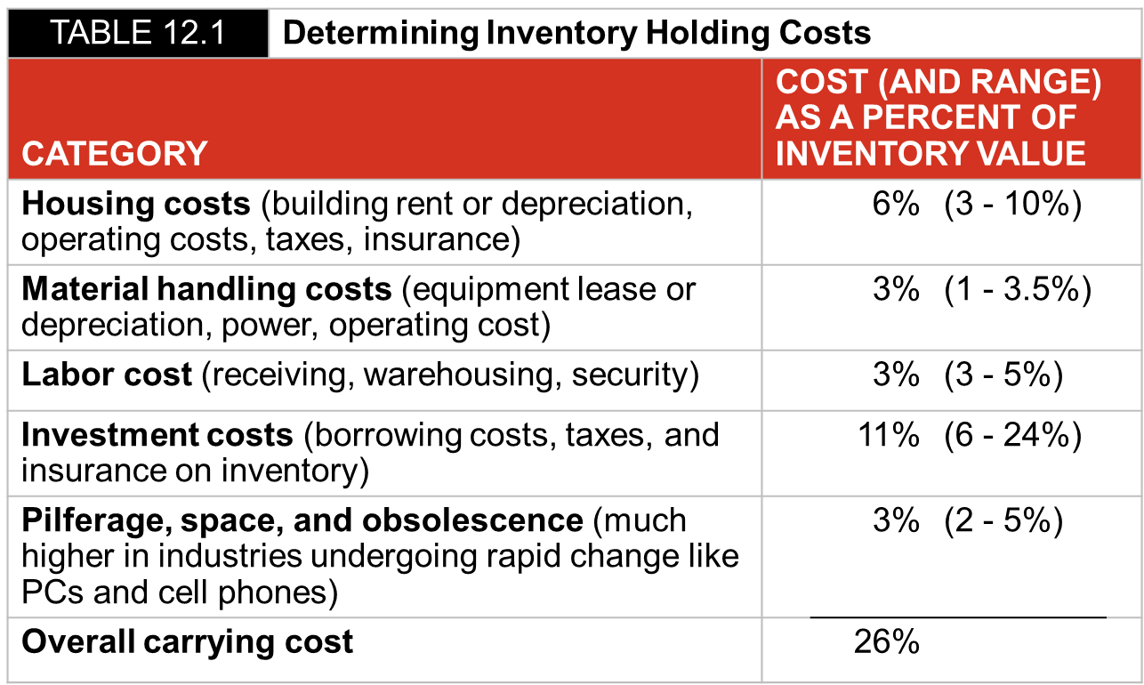
Holding costs

Slide 7
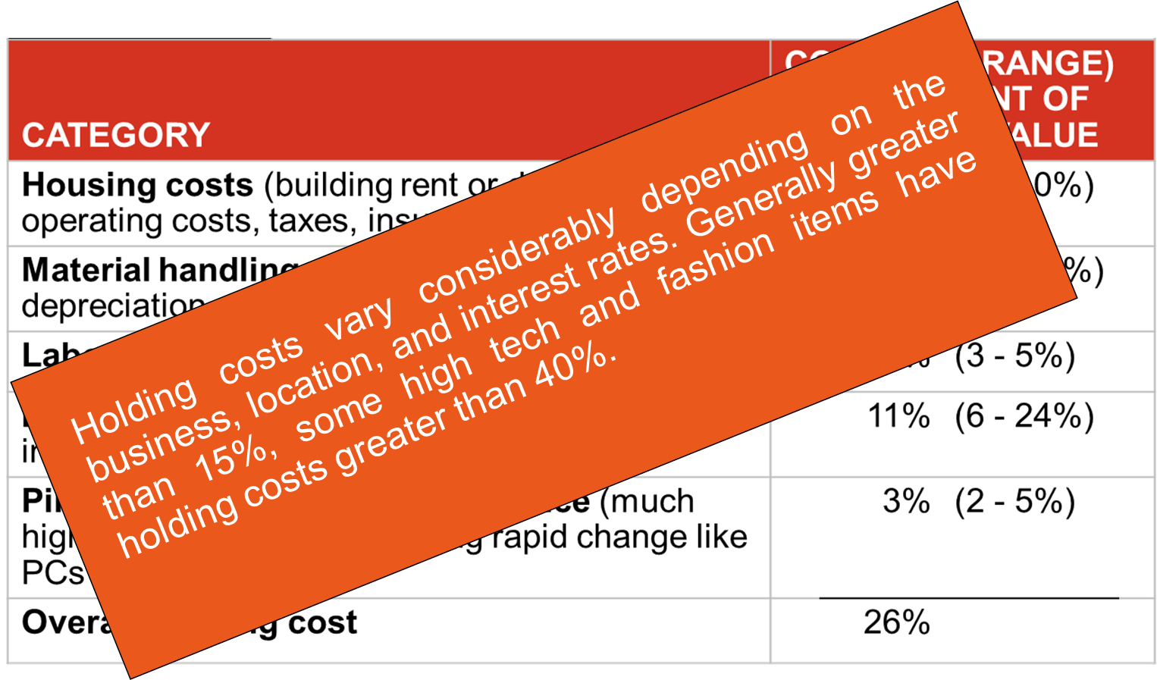

Slide 8
Decisions to be taken
Decisions to be taken for inventory management
  How much to order?
  When to order?

Slide 9
example
Example 1
A company has an annual demand of 12000 units of welding rods. The demand rate and lead time are constant. The ordering cost is $200 per order and the annual holding cost of the inventory is $5 per unit.
Let's discuss the above problem in three different circumstances.
Case 1: The company decides to place two orders in a year to minimize the ordering cost.
Case 2: The company decides to place 24 orders to take advantage of the low transportation costs and minimize the inventory holding costs.
Case 3: The company decides to place 15 orders to take advantage of the low transportation costs and minimize the inventory holding costs.

Slide 10
Case 1: To place two orders in a year to minimize the ordering cost.
  In such a case the order size will be Q= 6000 units.
  The ordering cost will be = orders/year x cost/order = 2 x 200 = $400.
  The inventory holding cost will be = Average number of units in the inventory x carrying cost per unit = 6000/2 x 5 = $15000.
  Total inventory cost = ordering cost + holding cost = $200 + $15000 = $15400.

Slide 11
Case 2: To place 24 orders to take advantage of the low transportation costs and minimize the inventory holding costs.
  In such a case the order size will be Q= 500 units.
  The ordering cost will be = orders/year x cost/order = 24 x 200 = $4800.
  The inventory holding cost will be = Average number of units in the inventory x carrying cost per unit = 500/2 x 5 = $1250.
  Total inventory cost = ordering cost + holding cost = $4800 + $1250 = $6050.

Slide 12
Case 3: To place 15 orders to take advantage of the low transportation costs and minimize the inventory holding costs.
  In such a case the order size will be Q= 800 units.
  The ordering cost will be = orders/year x cost/order = 15 x 200 = $3000.
  The inventory holding cost will be = Average number of units in the inventory x carrying cost per unit = 800/2 x 5 = $2000.
  Total inventory cost = ordering cost + holding cost = $3000 + $2000 = $5000.

Slide 13
So, which is the best option?
CASE A: $15400
CASE B: $6050
CASE C: $5000
Can it be further reduced?
Let us learn how to optimize the order size.
The situation is like the inventory management simulation we played in the class. Different order size placed with the supplier results in different inventory costs.

Slide 14
Economic Order Quantity (EOQ) Model
  Assumptions
    Demand is known, constant, and independent.
    Lead time is known and constant.
    Receipt of inventory is instantaneous and complete.
    Quantity discounts are not possible.
    Only variable costs are ordering and holding.
    Stockouts can be completely avoided.

Slide 15
Inventory usage over time
Total order received
Average inventory on hand
Q
2
Order quantity = Q (maximum inventory level)
Usage rate
Inventory level
Minimum inventory
0
Time

Slide 16
Minimizing costs
Total cost of holding and setup (order)
Minimum total cost
Holding cost
Annual cost
order cost
Optimal order quantity (Q*)
Order quantity

Slide 17
Minimizing Costs
By minimizing the sum of ordering and holding costs, total costs are minimized.
Optimal order size Q* will minimize the total cost
A reduction in either cost reduces the total cost
Optimal order quantity occurs when holding cost and setup cost are equal

Slide 18
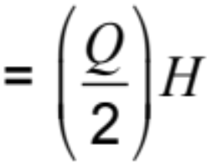
Minimizing costs
Q = Number of pieces per order
Q* = Optimal number of pieces per order (EOQ)
D = Annual demand in units for the inventory item
S = Setup or ordering cost for each order
H = Holding or carrying cost per unit per year
Annual holding cost = (Average inventory level) x (Holding cost per unit per year)
Order quantity
2
=
(Holding cost per unit per year)

Slide 19
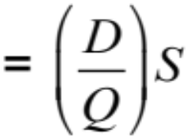
Minimizing costs
Annual ordering cost = (Number of orders placed per year)
x (Order cost per order)
Annual demand
Number of units in each order
order cost per order
=

Slide 20
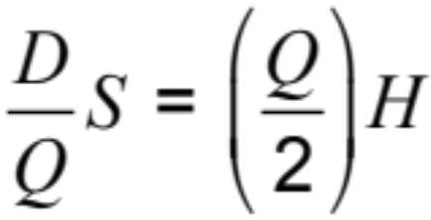
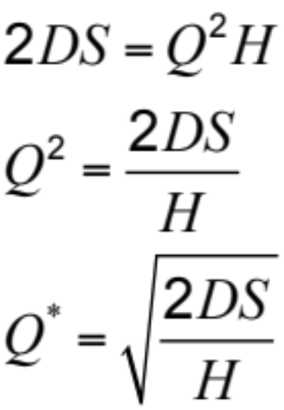
Minimizing costs
Optimal order quantity is found when annual holding cost equals annual holding cost
Solving for Q*

Slide 21
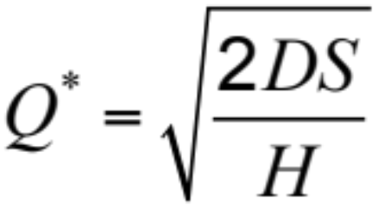
EOQ Formula
D = Annual demand in units for the inventory item
S = Setup or ordering cost for each order
H = Holding or carrying cost per unit per year

Slide 22
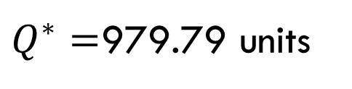
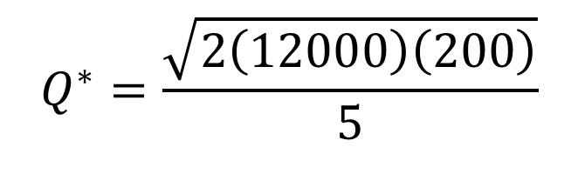
Let us apply the EOQ formula to Example 1
A company has an annual demand of 12000 units of welding rods. The demand rate and lead time are constant. The ordering cost is $200 per order and the annual holding cost of the inventory is $5 per unit.
  D = 12000 units, S = $200 per order, H = $5 per unit per year
$$Q^{∗}=\frac{\sqrt{2\left(12000\right)\left(200\right)}}{5}$$
$Q^{∗}=$979.79 units

Slide 23
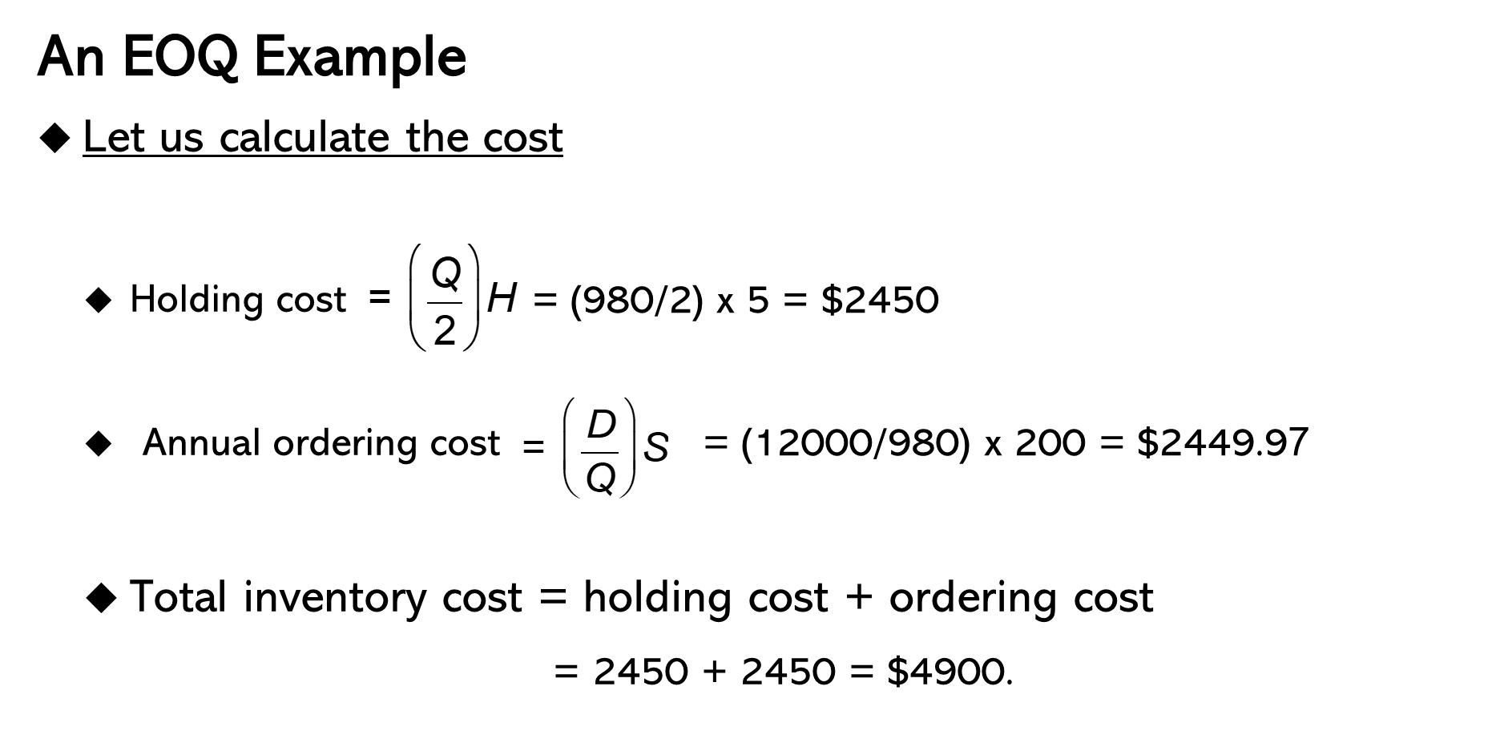
The Inventory cost

Slide 24
So, which is the best option?
Cost comparisons
  CASE 1: $15400
  CASE 2: $6050
  CASE 3: $5000
  EOQ = $4900(Lowest Cost)

Slide 25
EOQ Model
Optimal time between orders (When to order)
D = 12000 units Q* = 980 units
S = $200 per order N = 12.24 orders/year
H = $5 per unit per year
Expected time between orders
Number of working days per year
Expected number of orders
= T =
250
12.24
T = = 20.42 days between orders

Slide 26
Practice Problem
The ABC Computer Corporation purchases 8,000 motherboards each year as components in computers. The unit cost of each motherboard is $150, and the cost of carrying one motherboard in inventory for a year is $30. The ordering cost is $130 per order.
Calculate
  The optimal order quantity
  the expected number of orders placed each year, and
  the expected time between orders?
  Assume that Fisher operates on a 200-day working year.

Slide 27
Continuous Review System
Continuous review (Q) system
  Reorder point system (ROP) and fixed order quantity system
  Tracks the remaining inventory of a SKU each time a withdrawal is made to determine if it is time to reorder.
  Inventory position = On-hand inventory + Scheduled receipts − Backorders
  IP = OH + SR − BO

Slide 28
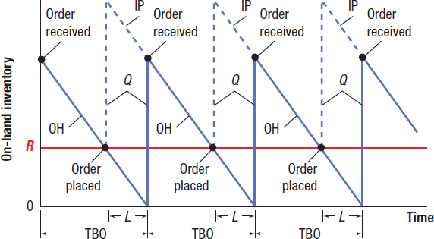
Continuous Review System
Selecting the Reorder Point When Demand and Lead Time are Constant

Slide 29
Example 1
  Demand for chicken soup at a supermarket is always 25 cases a day and the lead time is always 4 days. The shelves were just restocked with chicken soup, leaving an on-hand inventory of only 10 cases. No backorders currently exist, but there is one open order in the pipeline for 200 cases. What is the inventory position? Should a new order be placed?
  R = Total demand during lead time = (25)(4) = 100 cases
  IP = OH + SR − B O
  = 10 + 200 − 0 = 210 cases

Slide 30
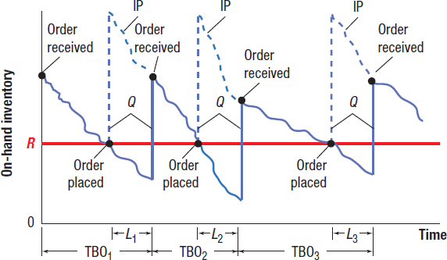
Continuous Review System
Selecting the Reorder Point When Demand is Variable, and Lead Time is Constant

Slide 31
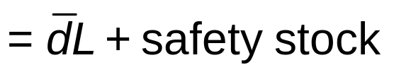
Continuous Review System
Selecting the reorder point when demand is variable and lead time is constant
Reorder point = Average demand during lead time + Safety stock
where
L = constant lead time in weeks (or days or months)

Slide 32
Continuous Review System
Choosing a Reorder Point
  Choose an appropriate service-level policy
  Determine the distribution of demand during lead time
  Determine the safety stock and reorder point levels

Slide 33
Continuous Review System
Step 1: Service Level Policy
  Service Level (Cycle Service Level) – The desired probability of not running out of stock in anyone ordering cycle, which begins at the time an order is placed and ends when it arrives in stock.
  Protection Interval – The period over which safety stock must protect the user from running out of stock.

Slide 34
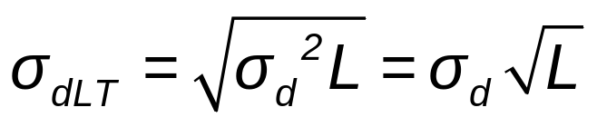
Continuous Review System
Step 2: Distribution of Demand during Lead Time
  Specify mean and standard deviation
    Standard deviation of demand during lead time

Slide 35
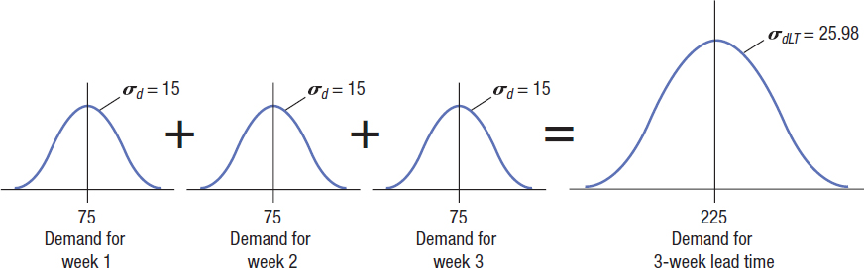
Continuous Review System

Slide 36
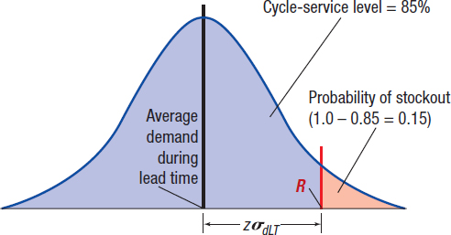
Continuous Review System (9 of 13)
Finding Safety Stock with Normal Probability Distribution for an 85 Percent Cycle-Service Level

Slide 37


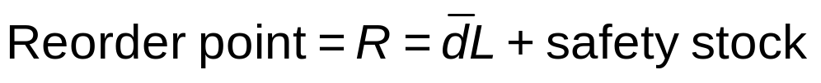
Continuous Review System
Step 3: Safety Stock and Reorder Point
where
z = number of standard deviations needed to achieve the cycle service level
= standard deviation of demand during lead time

Slide 38
Example of Continuous review system
The EOQ is 75 units.
Suppose that the average demand is 18 units per week with a standard deviation of 5 units.
The lead time is constant at two weeks.
Determine the safety stock and reorder point if management wants a 90 percent cycle-service level.

Slide 39

Want to know more?
sachinnitie06@gmail.com

