Slide 1


Cyber Security Risk Management
Online Executive Development Program,
offered by Indian Institute of Management Raipur in partnership with UPTOP
Introductory Session
Sourya Joyee De
(Program Director)

Slide 2
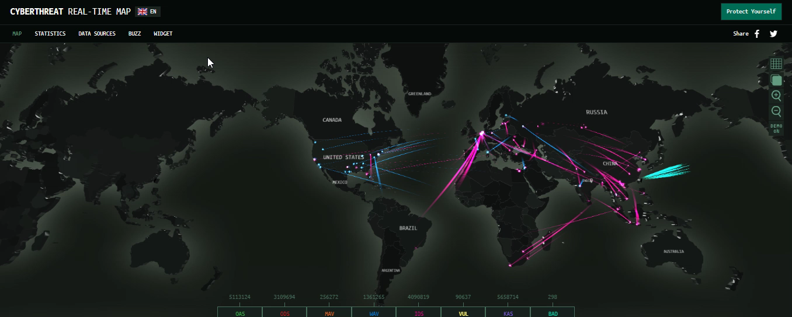
Cyber Attacks Worldwide
Source: https://cybermap.kaspersky.com/

Slide 3













Slide 4
Meanwhile in India…
CERT-In discovers malware attack in Kudankulam Nuclear Power Plant
17 million user records stolen from Zomato database
Union Bank on the verge of losing $171 million as a result of a phishing attack
Loss of Aadhaar numbers and personal information of 135mn Indians
Malware attack on Indian Whatsapp users

Slide 5

The Cost of Cyber Attacks
Part of Microsoft President Brad Smith’s RSA keynote address on April 17, 2018.

Slide 6
Digital Transformation and Cyber Security
Growth of automation, IoT, AI and ML, cloud processing and storage
High reliance on digital technologies in critical areas such as banking, aviation, healthcare, power grids and other industrial control systems
Gathering of customer data is at the center of business operations and strategy
Advancements in AI and quantum computing could render current cybersecurity efforts obsolete

Slide 7
Challenges
Companies do not understand the critical cyber risks they are facing
Cybersecurity is a “necessary evil”
Too much dependency on IT specialists, too little involvement of top management

Slide 8
Changing Regulatory Environment
Response to increasing breaches and public awareness
EU General Data Protection Regulation (May 25, 2018)
Personal Data Protection Bill, 2018 in India
Stringent requirements on disclosure of security breaches, seeking user consent, processing of sensitive personal data etc.
Severe penalties

Slide 9
The Need for Talent
More than 1.5 mn unfilled positions by 2020 in global cybersecurity workforce
Pressing crisis of cybersecurity professionals in India
25-30% increment in salaries offered
Need to hire from both traditional IT and non-traditional talent pools

Slide 10
Questions we address in this course
How should organizations assess their security and privacy risks?
How should these risks be handled?
How should organizations respond to crisis situations?
What is the role of the CISO/CPO/DPO in an organization?
What is the role of top management?
How does an evolving regulatory environment affect business?
What opportunities exist in the risky world?
Where do privacy and security stand w.r.t ethics?
What role do new technologies play in making and breaking security and privacy?

Slide 11

Course take-aways
You will
become conversant with current and future cyber-security issues, relevant to your role, organization and industry
understand how you are both a part of your organization’s cybersecurity problem as well as a key player in identifying and managing solutions

Slide 12
In details, you will be able to
Understand
basic concepts in security, privacy and data protection
Appreciate
the need for managers to pay attention to security and privacy
Assess
security and privacy risks relevant to your organization
Select
appropriate countermeasures to mitigate risks
Manage
crisis situations in your organization
Form
views on various social, ethical and human aspects of privacy and security

Slide 13




About me
Work Experience
Researcher, Team PESTO, LORIA-CNRS-INRIA Nancy Grand-Est, France
Post doc, Team Privatics, INRIA Grenoble Rhone-Alpes, France
Visiting Scientist, R. C. Bose Centre for Cryptology & Security, Indian Statistical Institute, Kolkata
Current Position
Assistant Professor, IT & Systems
Member, Center for Digital Economy
I am a Fellow of Indian Institute of Management Calcutta

Slide 14

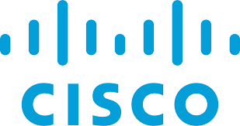


Research
Data privacy and security
In social media, quantified self, smart grids, biometric systems, cloud computing, e-governance schemes

