Slide 1



Module 1: Introduction to Product Management

Slide 2

Term Context
Introduction to Product Management
Foundations of Strategic Thinking
Understanding Product Vision & Mission
Competitive Analysis & Market Research

Slide 3

“Great companies are built on great products.”
~ Elon Musk

Slide 4
Agenda
What is Product Management?
Scope and Activity of Product Management
Importance of Product Management
Case Study
Mindset of a Product Manager
Core Skills of Product Manager
Responsibilities of Product manager
Best Practices to become a Great Product Manager
What is a Product?
Case Study
Introduction to Product Life Cycles Stages
User Centricity Approach
Benefits of User Centricity Approach

Slide 5
Class Discussion
What is Product Management?
Who is Product Manager?
What does a Product Manager do?

Slide 6
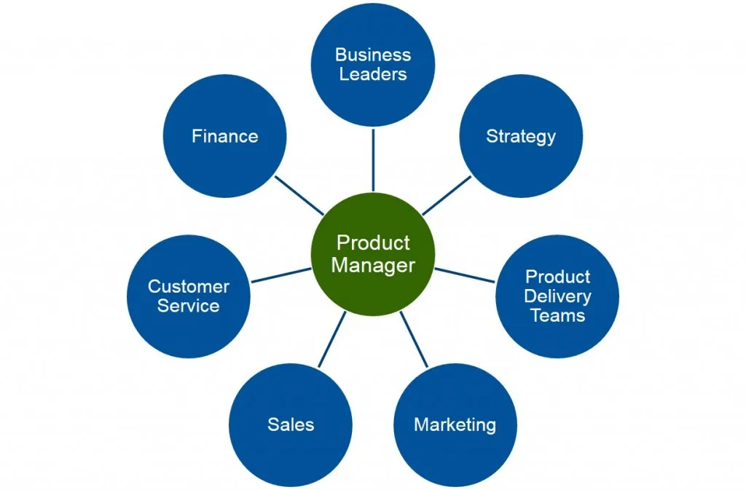
What is Product Management
Process of bringing new product to market or developing an existing one.

Slide 7
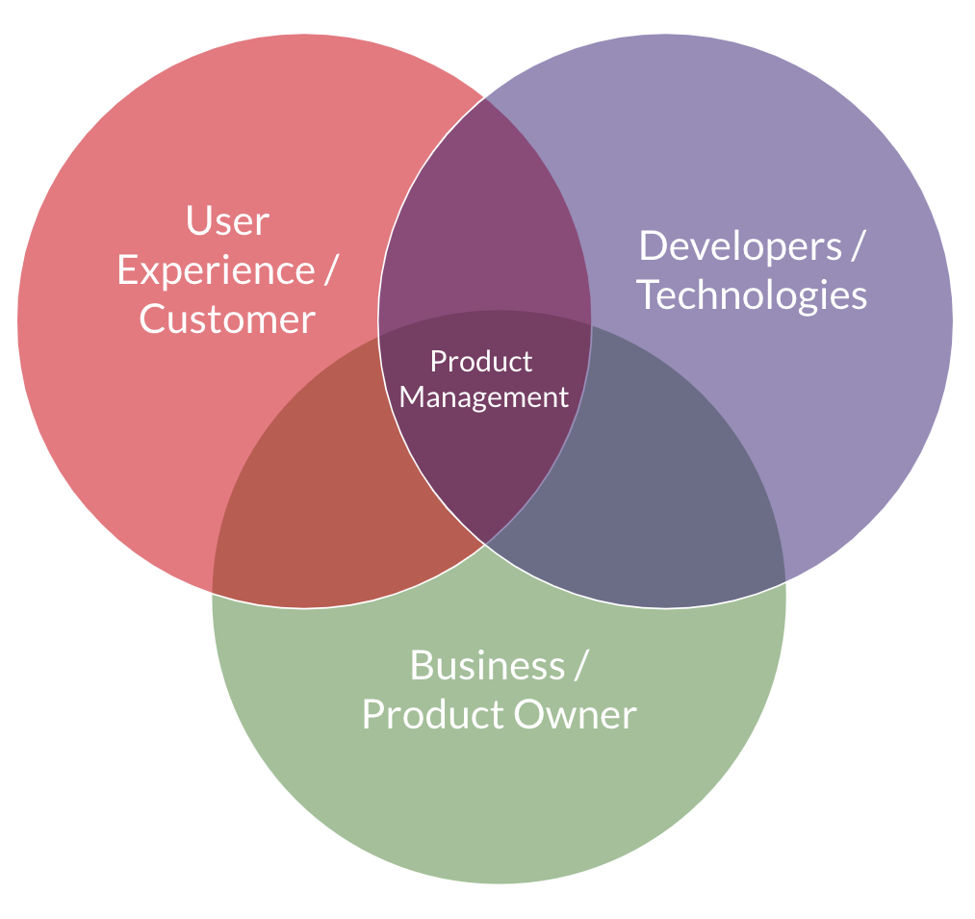
Who is a Product Manager?
Person who creates internal & external product vision and leads product development from scratch.
This individual defines:
Customer needs.
Works with stakeholders & teams on creating the required product.
Responsible for overall product success.

Slide 8
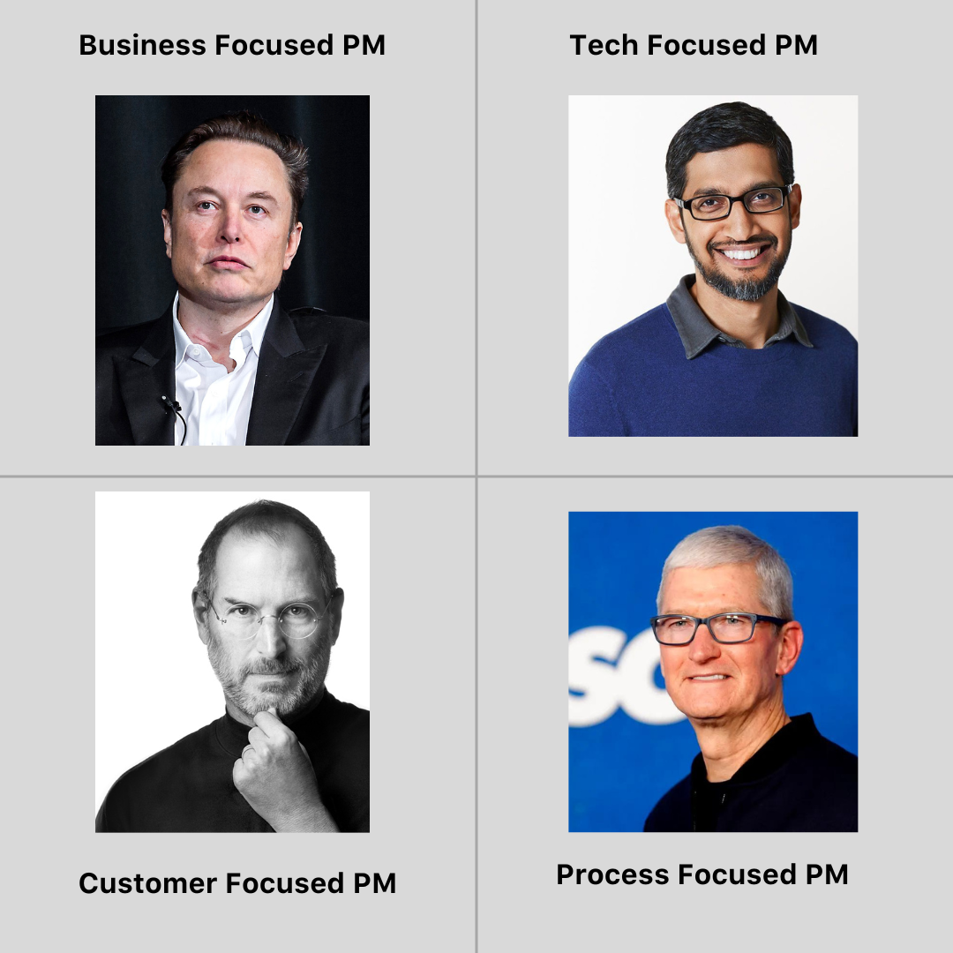
Types of a Product Manager

Slide 9
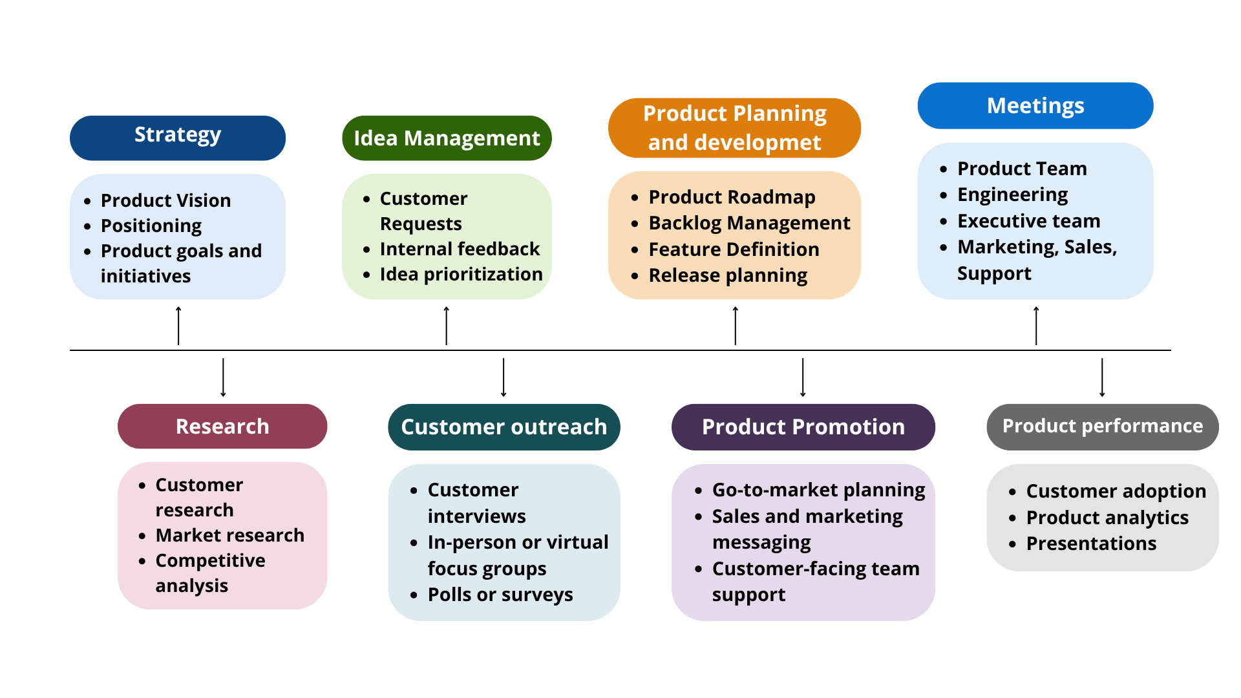
A Day in the Life of a Product Manager

Slide 10
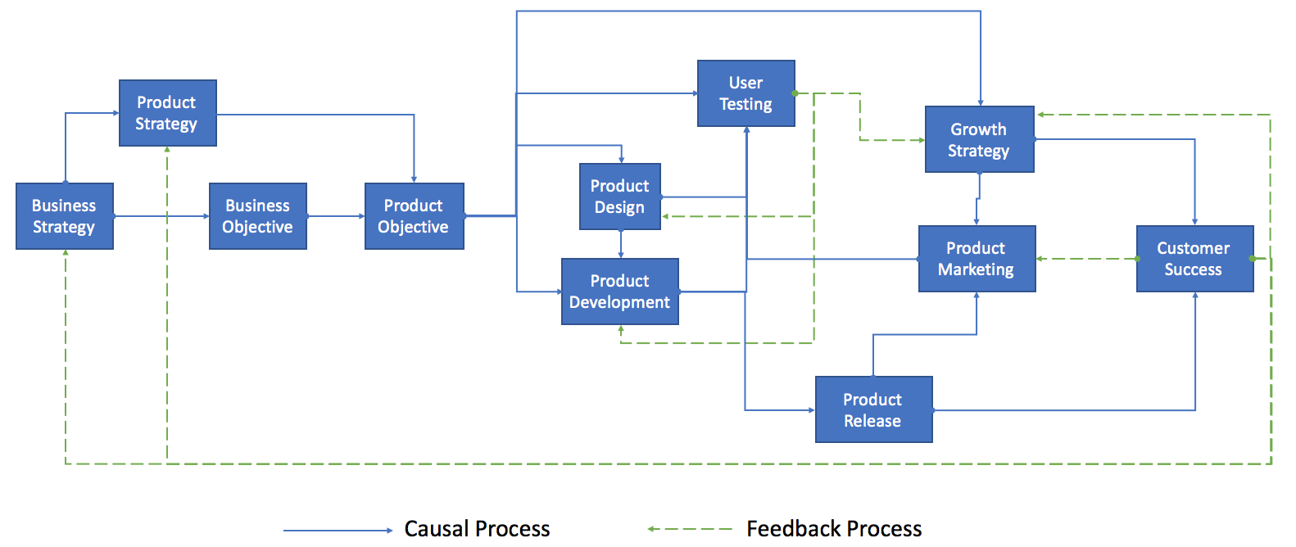
Scope of Product Management

Slide 11
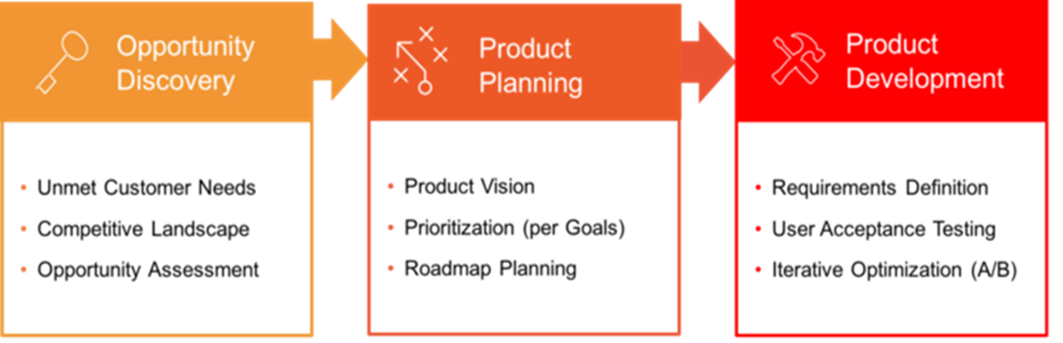
Activity of Product Management

Slide 12
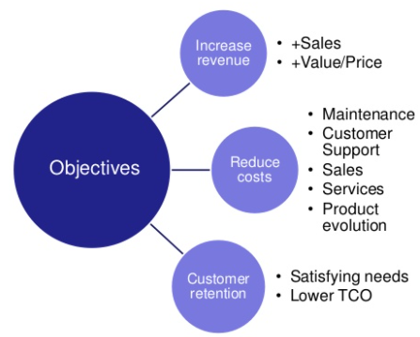
Great Product Management Makes Great Companies
Deliver products: Better Meet Customer Needs
Increase Revenue and Profitability
Delight Customers: Generate +ve word-of-mouth referrals
Capture Markets: Focus on Reducing Cost
Solid product strategy: Drives overall Company Efforts

Slide 13

Importance of Product Management
Fulfilling business objectives
Helps business achieve its objectives
Produces products to satisfy need of user
Increases sales for company

Slide 14

Importance of Product Management
Goodwill, reputation, & image
Helps in satisfaction of customers
Improves the image of organization for users
Earns goodwill & reputation to help organization grow

Slide 15

Importance of Product Management
Introduction of new products
New products in market
Conducts R&D for new products
Helps in creating new & better products

Slide 16
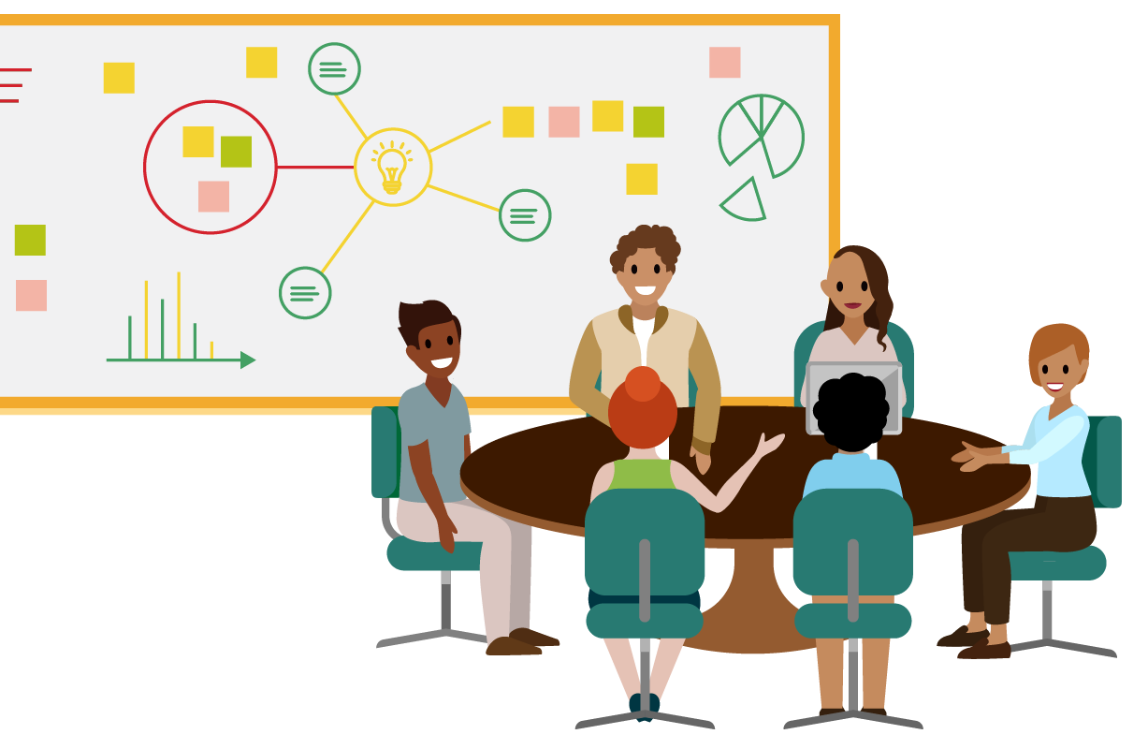
Importance of Product Management
Supporting functional areas
Supports marketing , sales, & personnel
Makes it easier for marketing & sales to sell product
Helps in collaboration between teams

Slide 17

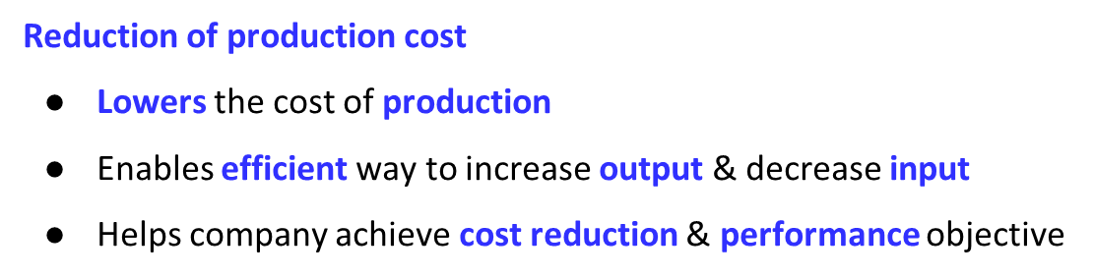
Importance of Product Management

Slide 18

Case study activity
Paper Boat, a renowned beverage brand, has carved a niche for itself in the market with its unique offerings of traditional Indian drinks. As a product manager at Paper Boat, introduce new flavors and variants inspired by regional culture to cater to diverse consumer preferences.

Slide 19
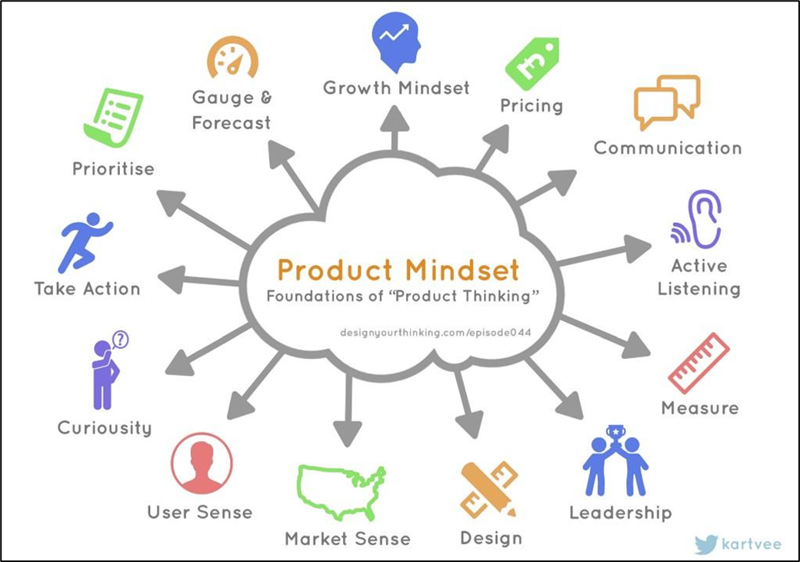
Mindset of a PM

Slide 20
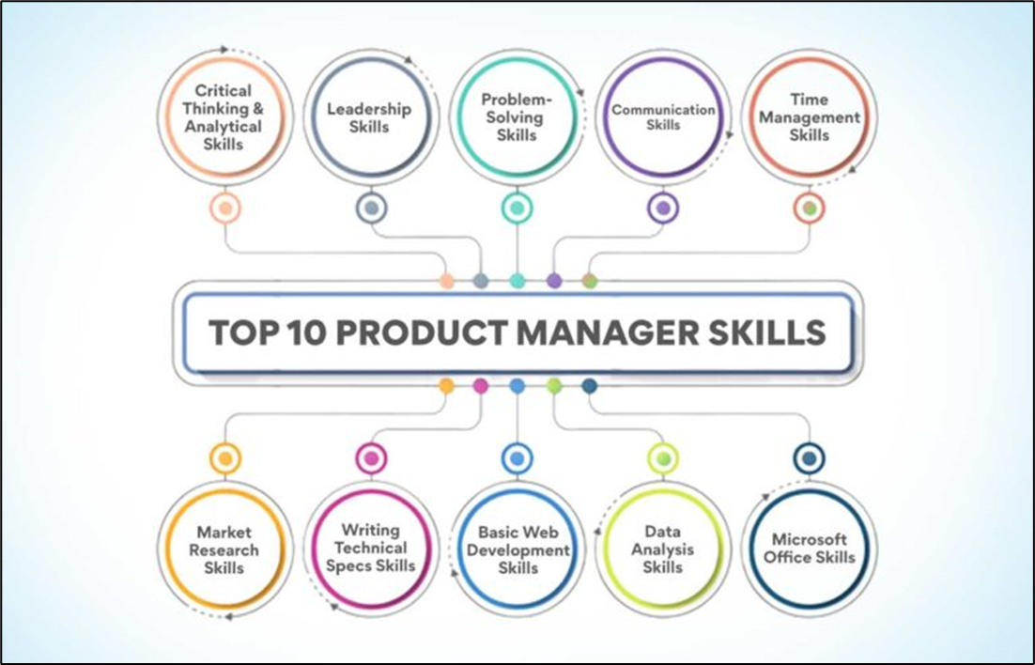
Core Skills of a Product Manager

Slide 21
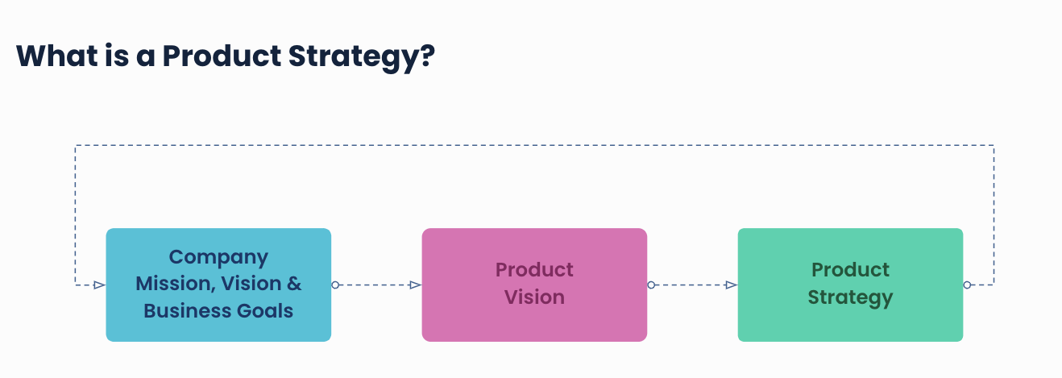
Responsibilities of Product Manager
Defining the product vision and strategy.
Aligning the vision and strategy with the overall business objectives.

Slide 22

Responsibilities of Product Manager
Knowing what customers want is a crucial responsibility.
Conduct market research, gather feedback, and analyze user data to identify customer needs and pain points.

Slide 23
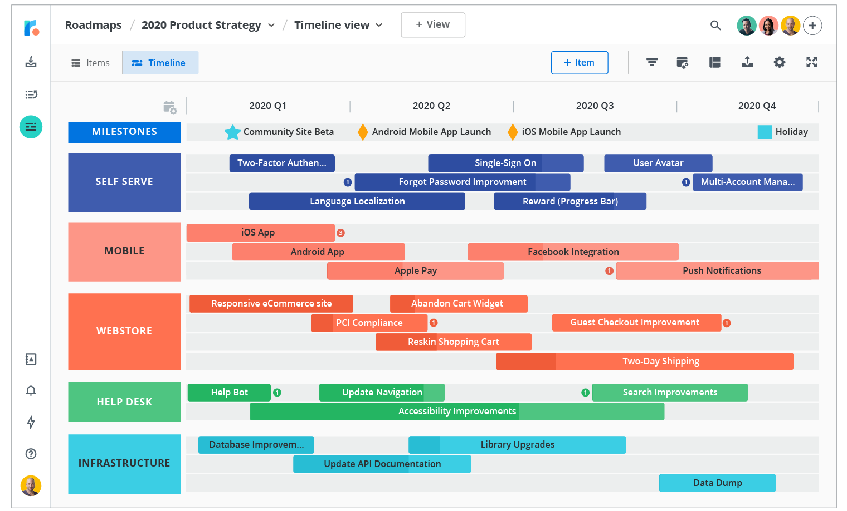
Responsibilities of Product Manager
Develop product roadmaps that outline the planned features and enhancements of products,
Prioritizing them based on customer and business needs

Slide 24

Responsibilities of Product Manager
Effective collaboration with other members of the organization.
Work closely with UX/UI designers, developers, and other stakeholders to ensure successful product development and delivery.

Slide 25
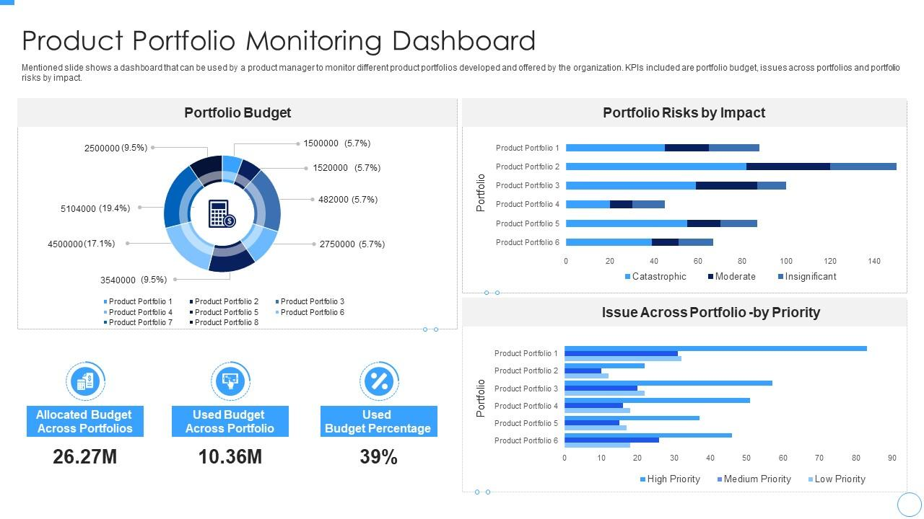
Responsibilities of Product Manager
Monitoring and analyzing product performance.
Track Key Performance Indicators (KPIs) to assess the product’s success and make data-driven decisions for its improvement.

Slide 26

Best Practices to Become a Great Product Manager
Prioritize relentlessly
Understanding cost & benefits of each choice
Manage resources in such way that they achieve a larger goal

Slide 27

Best Practices to Become a Great Product Manager
Get lay of the land
Before executing understand environment
Stop & ask question till you get all answers

Slide 28

Best Practices to Become a Great Product Manager
Empower team to make decisions
Do not try to make all decisions by yourself
Delegate responsibility effectively & build context of tasks

Slide 29
What is a Product?
A product is any item or service you sell to serve a customer’s need or want. They can be physical or virtual.

Slide 30

Case Study Swiggy
Define the key Products that are present in swiggy when you order food.

Slide 31
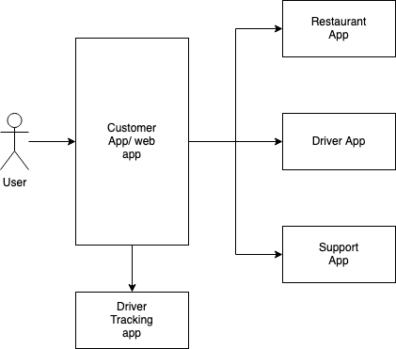
Products in Swiggy
Customer App
Restaurant App
Driver App
Driver tracking App
Customer Support App

Slide 32
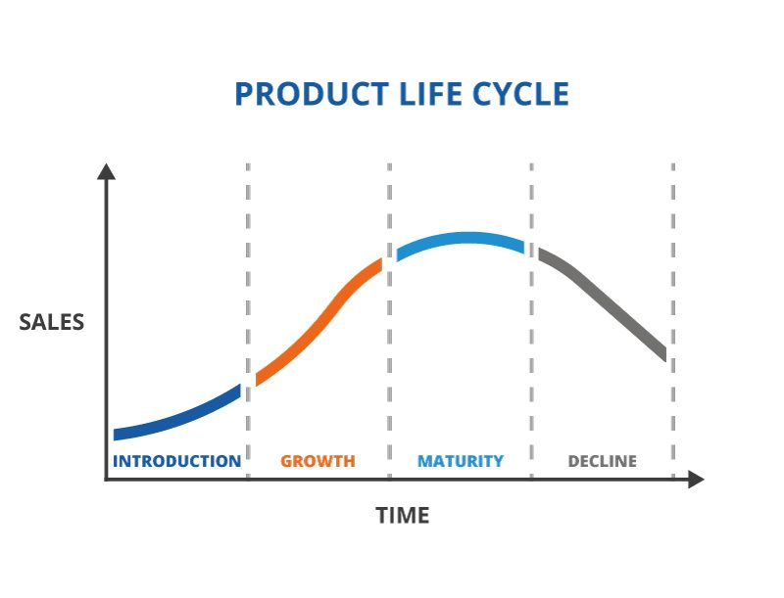
Introduction Product Life Cycle Stages
Introduction Stage
Growth Stage
Maturity Stage
Decline Stage

Slide 33
Product Lifecycle Stages
Introduction
Growth
Maturity
Decline
Goals:
Build Awareness
Capture Market Share
Invest in Promotion
Challenges:
High Costs
Uncertain Demand
Educating Consumers
Strategic Focus:
Product Features
Distribution
Pricing
Goals:
Expand Market Share
Maximize Profits
Enhance Product Features
Challenges:
Growing Competition
Maintaining Quality
Managing Increased Demand
Strategic Focus:
Brand Building
Differentiation
Scalability
Goals:
Maintain Market Share
Optimize Profitability
Innovate or Diversify
Challenges:
Intense Competition
Saturation
Price Erosion
Strategic Focus:
Cost Efficiency
Product Diversification
Customer Loyalty
Goals:
Harvesting Remaining Profits
Managing Exit Strategies
Challenges:
Obsolescence
Customer Shifts
Resource Allocation
Strategic Focus:
Cost Cutting
Inventory Management
Product Retirement

Slide 34
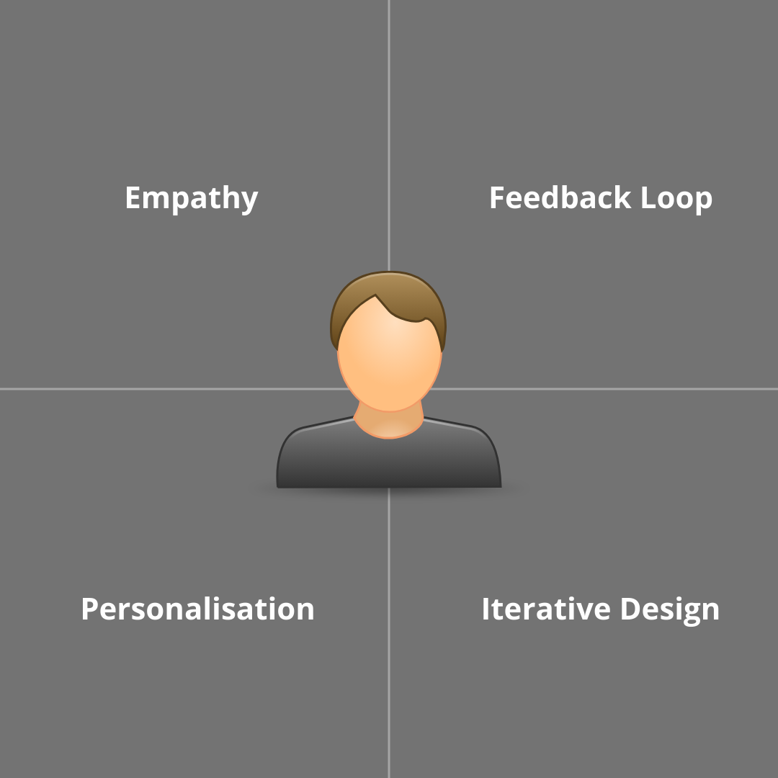
User Centricity Approach
User-Centricity Approach is a philosophy in product management that prioritizes understanding, empathizing with, and meeting the needs of end-users.
Key Principles:
Empathy
Feedback Loop
Iterative Design
Personalization

Slide 35
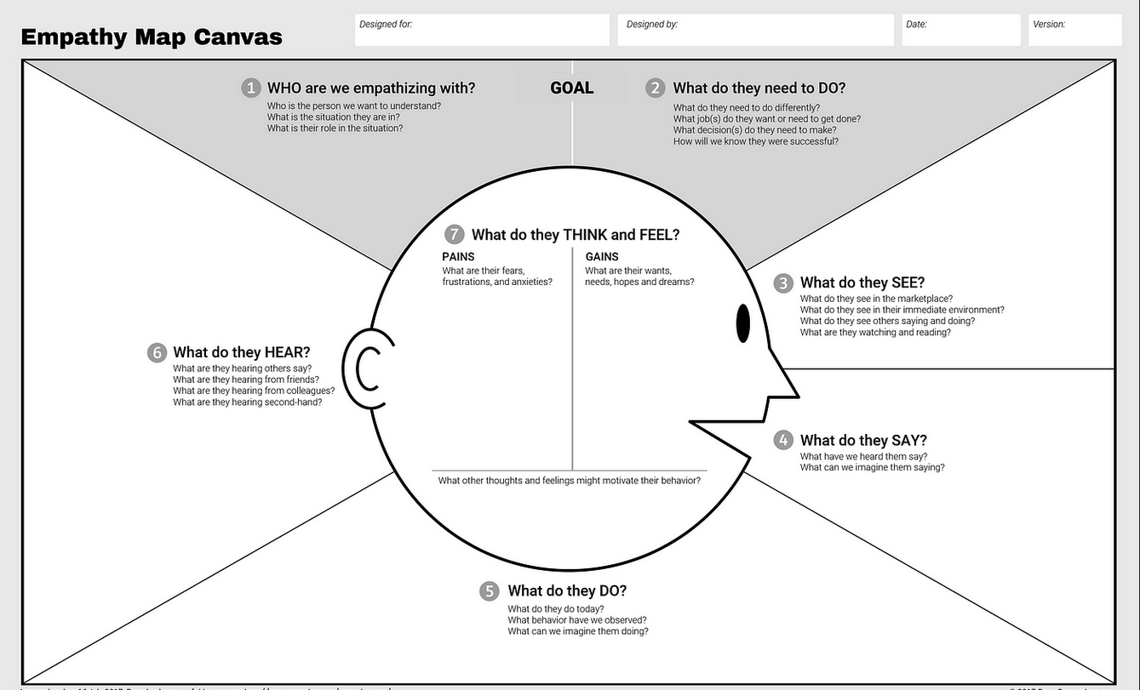
Empathy
understand user's needs, motivations, and frustrations

Slide 36

Feedback Loop
An ongoing process of gathering, analyzing, and incorporating user feedback into the product development lifecycle.
Channels for User Feedback
Surveys
Interviews
Usability Testing
Online Platforms

Slide 37
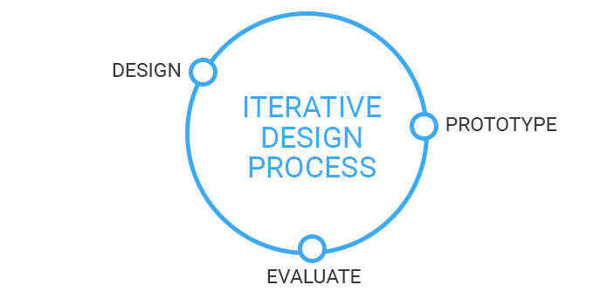
Iterative Design
A dynamic and iterative approach to product development, featuring continuous cycles of prototyping, testing, learning, and refining.
The Iterative Cycle
Prototype
Test
Learn
Refine

Slide 38

Personalisation
Dynamically tailoring products or experiences to meet the unique needs and preferences of individual users.
Key Elements of Personalization
Content
User Interfaces
Recommendations

Slide 39

Benefits of User Centricity
Enhanced User Satisfaction
2. Increased User Engagement
3. Improved Product Adoption
4. Competitive Advantage
5. Real-Time Adaptation to User Needs
6. Efficient Resource Allocation
7. Increased Revenue and ROI
8. Data-Driven Decision Making

Slide 40
Key Takeaways
Product is bundle of utilities consisting of various feature & services
Product management is process of bringing new product in market
Product management fulfills overall business objectives
Product managers are responsible for product management

Slide 41
THANK YOU

