Slide 1

Introduction to Operations & Supply Chain
Milan Kumar
IIM Visakhapatnam

Slide 2
Careers in OSCM
OSCM careers specialize in managing the planning, production, and distribution of goods and services
Operations and supply chain manager works with people to figure out the best way to deliver the goods and services of the firm
OSCM jobs are hands-on, working with people and figuring out the best way to do things

Slide 3
OSCM Specialist Areas
Product design
Purchasing
Manufacturing
Service operations
Logistics
Distribution

Slide 4
Possible Careers in OSCM
Plant manager
Hospital administrator
Branch manager
Department store manager
Call center manager
Supply chain manager
Purchasing manager
Business process improvement analyst
Quality control manager
Lean improvement manager
Project manager
Production control analyst
Facilities manager
Chief operating officer

Slide 5
Chief Operating Officer (COO)
Works with CEO and president to determine the company’s competitive strategy
COO determines…
  Location
  Facilities
  Vendors to use
  Implementation of the hiring policy
Once key decisions are made, lower-level operations personnel carry them out

Slide 6
What Is Operations and Supply Chain Management?
The design, operation, and improvement of the systems that create and delivery the firm’s primary products and services
Operations and supply chain management (OSCM) is
  A functional field of business
  Clear line management responsibilities
  Concerned with the management of the entire production/delivery system

Slide 7
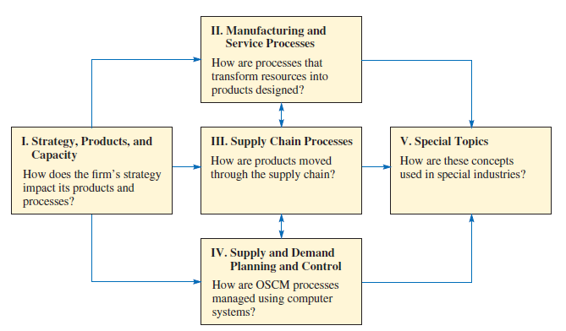
Considerations in different part of decision-making

Slide 8
Operations and Supply Chain Terms
Operations
Supply Chain
Manufacturing and service processes used to transform resources into products
Processes that move information and material to and from the firm

Slide 9
Process Activities
Planning – processes needed to operate an existing supply chain
Sourcing – selection of suppliers that will deliver the goods and services needed to create the firm’s product
Making – producing the major product or service
Delivering – logistics processes such as selecting carriers, coordinating the movement of goods and information, and collecting payments from customers
Returning – receiving worn-out, excess, and/or defective products back from customers

Slide 10
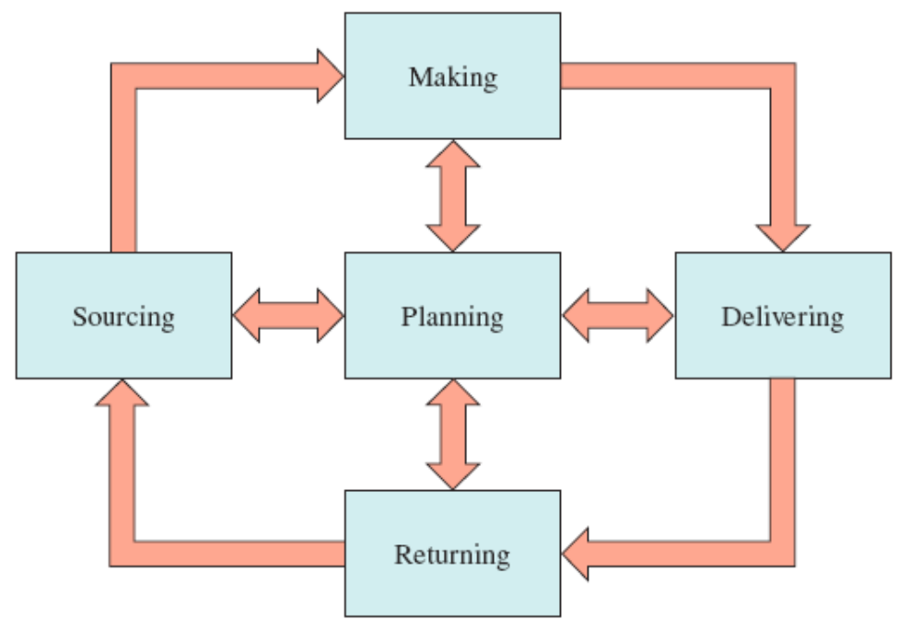
Supply Chain Processes

Slide 11
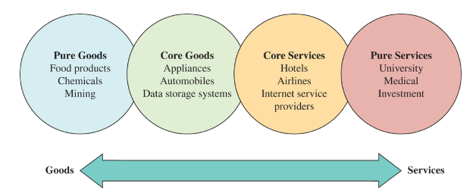
The Goods-Services Continuum
Goods are physical items produced by business organization
Services are activities that provide some combinations of time, location, form and psychological value

Slide 12
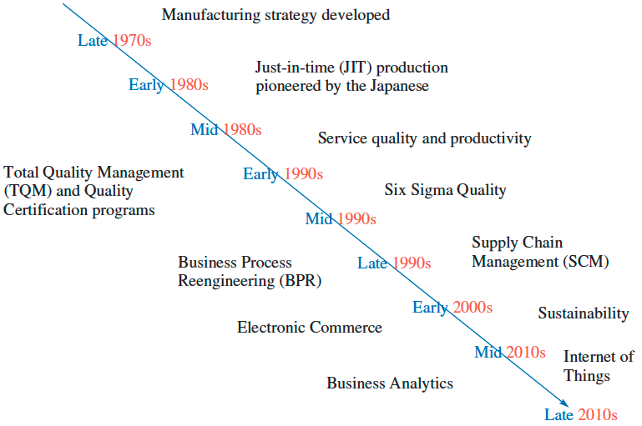
Timeline Depicting When Major OSCM Concepts Became Popular
Exhibit 1.5

Slide 13
The Major Concepts that Define the OSCM Field
Manufacturing strategy paradigm
Lean manufacturing, JIT, and TQC
Service quality and productivity
Total quality management and quality certification
Business process reengineering
Six sigma quality
Supply chain management
Electronic commerce
Sustainability and the triple bottom line
  Business strategy that includes social, economic and environmental criteria
Business analytics

Slide 14
Current Issues in Operations and Supply Chain Management
Uncertainty in global tariffs and regulations
Difficulty in hiring and keeping employees
Adapting to change in business technology and infrastructure

Slide 15
Efficiency, Effectiveness, and Value
Efficiency – doing something at the lowest possible cost
Effectiveness – doing the right things to create the most value for the company
Value – quality divided by price
  Quality – the attractiveness of the product, considering its features and durability

Slide 16
How Does Wall Street Evaluate Efficiency?
Earnings growth is largely a function of profitability
Profits can be increased through higher sales or lower cost
Highly efficient firms usually do well during recessions
Benchmarking – a process in which one company studies the processes of another company (or industry) to identify best practices

Slide 17


Supply chain demand and variability
Over the long run the average inflow to a firm must equal the average outflow
However, the volatility of the inflow can differ substantially from the volatility of the outflow
Firm
Outflow (sales)
Inflow
Firm
Outflow (sales)
Inflow

Slide 18
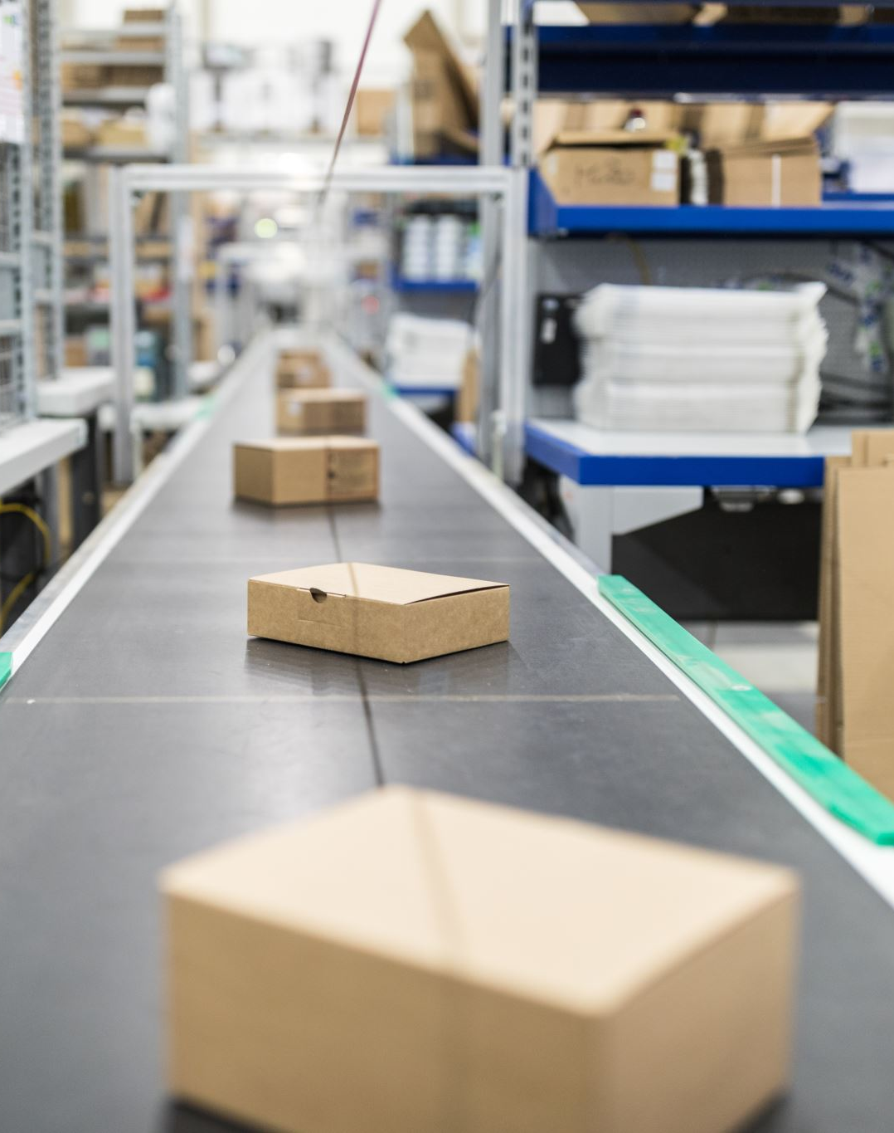
What is a Supply Chain?
Flow of products and services from:
  Raw materials manufacturers
  Intermediate products manufacturers
  End product manufacturers
  Wholesalers and distributors and
  Retailers
Connected by transportation and storage activities
Integrated through information, planning, and integration activities
Cost and service levels

Slide 19
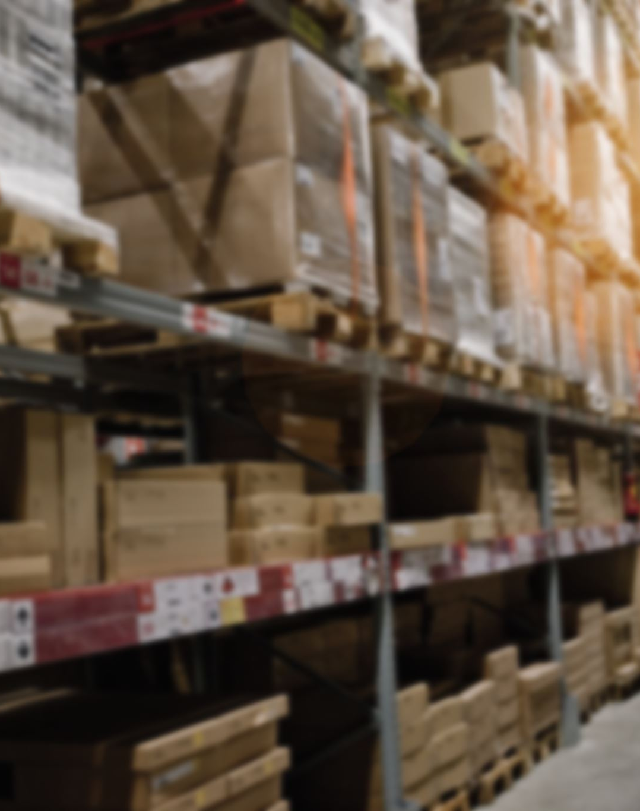
What Is Supply Chain Management?
Supply chain management is a set of approaches utilized to efficiently integrate suppliers, manufacturers, warehouses, and stores, so that merchandise is produced and distributed at the right quantities, to the right locations, and at the right time, in order to minimize system wide costs while satisfying service level requirements.

Slide 20

Two Other Formal Definitions
The design and management of seamless, value-added process across organizational boundaries to meet the real needs of the end customer
Institute for Supply Management
Managing supply and demand, sourcing raw materials and parts, manufacturing and assembly, warehousing and inventory tracking, order entry and order management, distribution across all channels, and delivery to the customer
The Supply Chain Council

Slide 21





SCM Definition
Material Flow
Converter
Retailer
Supplier
Distributor
Source
Converter
Consumers
Supplier
Distributor
End-User
Value-Added Services
Funds/Demand Flow
Information Flow
Reuse/Maintenance/After Sales Service Flow

Slide 22

The Objective of a Supply Chain
Maximize net value generated
Supply Chain Surplus = Price − Supply Chain Cost
Price = Function of Customer Value and Reservation Price

Slide 23

The Objective of a Supply Chain
(2 of 3)
Example: a customer purchases a wireless router from Best Buy for $60 (revenue)
Supply chain incurs costs (convey information, produce components, storage, transportation, transfer funds, etc.)
Difference between $60 and the sum of all of these costs is the supply chain profitability
Supply chain profitability is total profit to be shared across all stages of the supply chain
Success should be measured by total supply chain surplus, not profits at an individual stage

Slide 24
The Objective of a Supply Chain
(3 of 3)
Customer is the only source of revenue
Sources of cost include flows of information, products, or funds between stages of the supply chain
Effective supply chain management involves the management of supply chain assets and product, information, and fund flows to grow the total supply chain surplus

Slide 25
Customer Needs and Implied Demand Uncertainty
Customer Need | Causes Implied Demand Uncertainty to …
Range of quantity required increases | Increase because a wider range of the quantity required implies greater variance in demand
Lead time decreases | Increase because there is less time in which to react to orders
Variety of products required increases | Increase because demand per product becomes less predictable
Required service level increases | Increase because the firm now has to handle unusual surges in demand
Rate of innovation increases | Increase because new products tend to have more uncertain demand
Number of channels through which product may be acquired increases | Increase because the total customer demand per channel becomes less predictable

Slide 26
Key Issues in Supply Chain Management
Distribution network configuration
    How should management select a set of warehouse locations and capacities, determine production levels for each product at each plant, and set transportation flows between facilities
    Want to minimize total production, inventory, and transportation costs and satisfy service level requirements
Inventory control
    What is the optimum inventory level
    Can demand uncertainty be reduced
    What inventory turnover ratio should be used
Supply chain flexibility
      Flexibility can be a powerful tool to gain competitive advantage
      How can the firm achieve flexibility?

Slide 27
Key Issues in Supply Chain Management contd..
Production sourcing
    Must balance transportation and manufacturing costs
Supply contracts
    In traditional supply chain strategies, each party in the chain focuses on its own profit
    Causes them to make decisions without regard to other supply chain partners
    Can supply chain contracts be used to optimizes the entire supply chain performance
Distribution strategies
    How much should a firm centralize (or decentralize) their distribution system
    What transportation methods should be used

Slide 28
Key Issues in Supply Chain Management contd..
Supply chain integration and strategic partnering
    Designing and implementing a globally optimal supply chain is quite difficult
    However, in today’s competitive markets, most companies have no choice
    How can integration be achieved successfully
Outsourcing and offshoring strategies
    What should be done internally and what should be purchased from outside suppliers
    How to deal with the risks of outsourcing/offshoring
    If the firm decides not to outsource, does it make sense to move facilities to the Far East
Product design
    Effective design plays several critical roles in the supply chain
    May effect inventory holding and transportation costs
    When is it work redesigning a product

Slide 29
Key Issues in Supply Chain Management contd..
Information technology and decision-support systems
    The primary issue in supply chain management is not whether data can be received, but what data should be transferred
Customer value
    In recent years, this measure has superseded measures such as quality and customer satisfaction
    How is it measured
Smart pricing
    In recent years, a number of manufacturers, retailers, and carriers have applied a variation of revenue management to improve supply chain performance
    How can this be done
Sustainability
    Corporate social responsibility offers an opportunity for new revenue streams, additional efficiencies, and unique branding

Slide 30
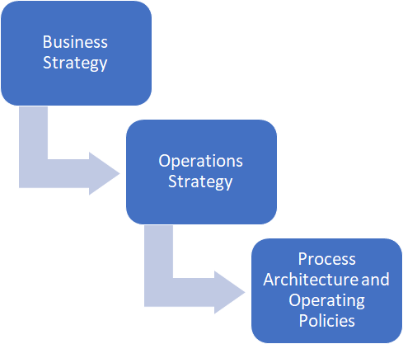
Where do we place Operations Strategy?

Slide 31
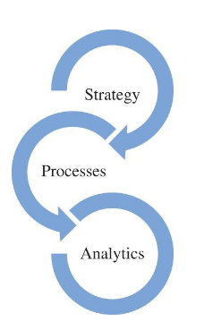
Success Depends On
Clever integration of a great operations-related strategy
Processes to deliver products and services
Analytics to support the decisions needed to manage the firm

Slide 32
Competitive Dimensions
Price
  Make the product or deliver the service cheap. Eg. Walmart, Southwest Airlines, Indigo Airlines, Xiaomi
Quality
  Make a great product or delivery a great service. Eg. Apple, Samsung, BMW
Delivery Speed
  Make the product or deliver the service quickly. Eg. Amazon
Delivery Reliability
  Deliver it when promised. E.g. Dominoes
Coping with Changes
  Change its volume. Eg. Zara
Flexibility and new product introduction
  Change it. Eg. Honda, Toyota

Slide 33
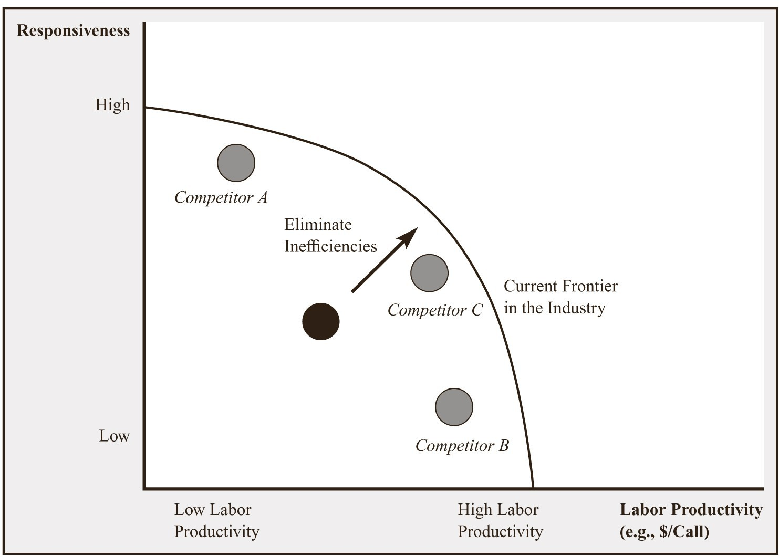
Trade-Offs: Example of a Call Centre

Slide 34
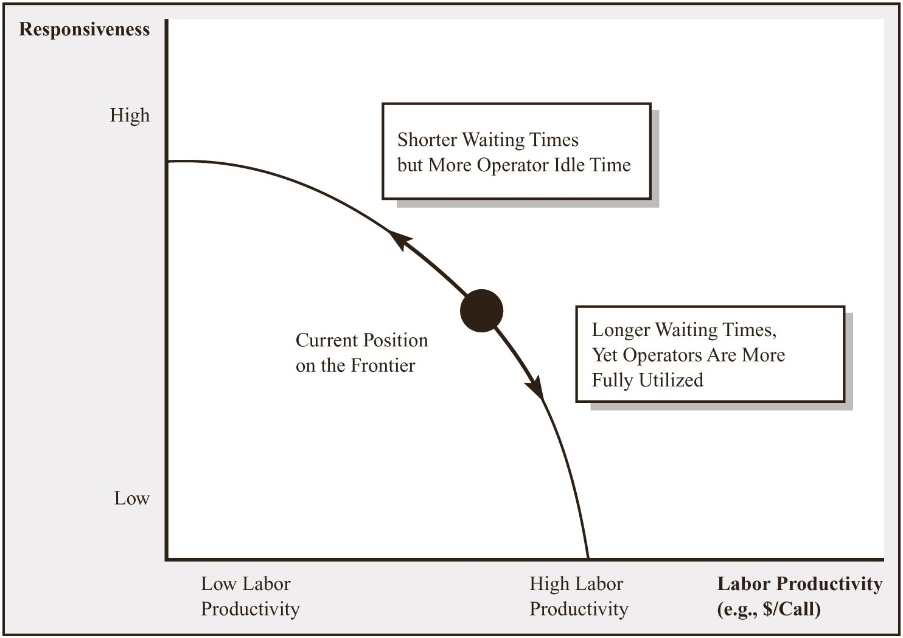
Trade-Offs: Example of a Call Centre contd..
Trade-off between Labour Productivity and Responsiveness

Slide 35
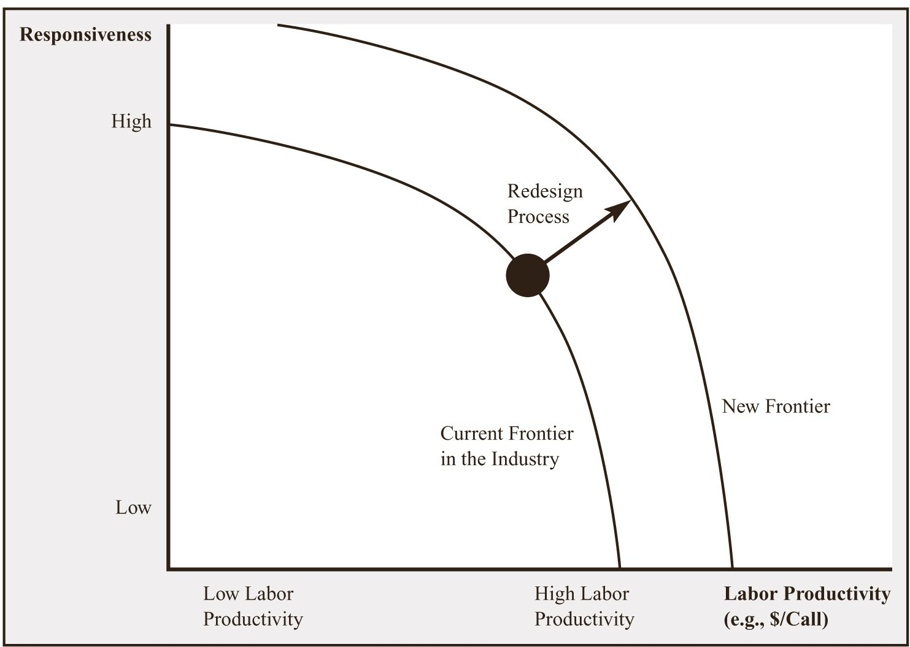
Trade-Offs: Example of a Call Centre contd..
Redesigning the Process to Operate at an Improved Frontier

Slide 36
Trade-offs
Management must decide which parameters of performance are critical and concentrate resources on those characteristics.
Efﬁciency, Effectiveness and Value:
  Efﬁciency - Doing something at the lowest possible cost.
  Effectiveness - Doing the right things to create the most value for the company.
  Value - Quality divided by price.
        Quality - The attractiveness of the product, considering its features and durability.
Benchmarking is a process in which one company studies the processes of another company or industry to identify best practices.
16

Slide 37
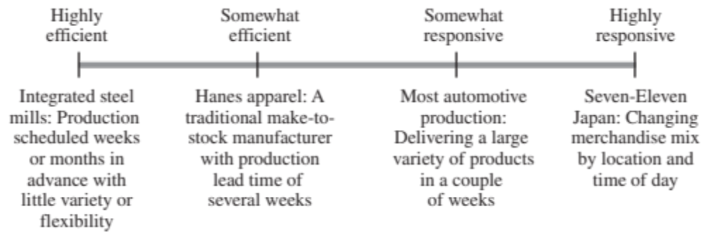
Responsiveness Spectrum

Slide 38
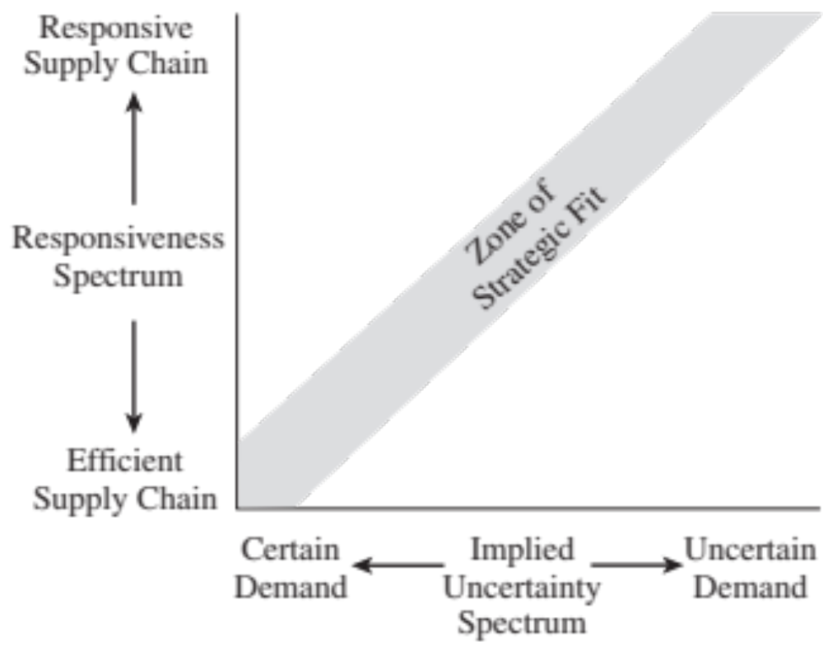
Zone of Strategic Fit

Slide 39
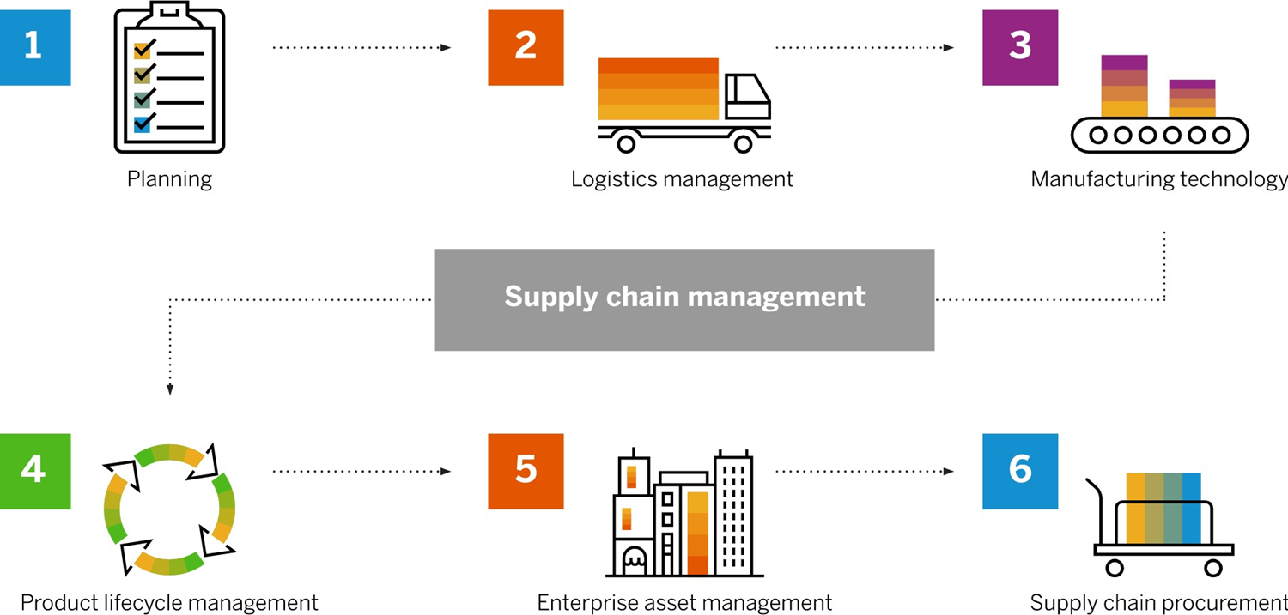
Components of a supply chain

Slide 40
What is Artificial Intelligence?
Artificial intelligence is a broad field, which refers to the use of technologies to build machines and computers that have the ability to mimic cognitive functions associated with human intelligence, such as being able to see, understand, and respond to spoken or written language, analyze data, make recommendations, and more. - Google

Slide 41
What is machine learning?
Machine learning is a subset of artificial intelligence that automatically enables a machine or system to learn and improve from experience. Instead of explicit programming, machine learning uses algorithms to analyze large amounts of data, learn from the insights, and then make informed decisions. - Google

Slide 42
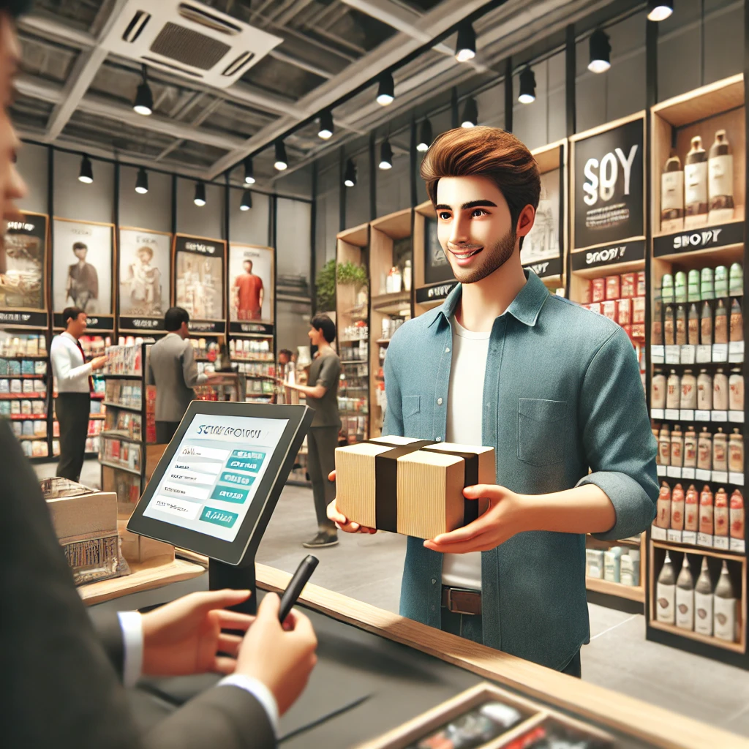
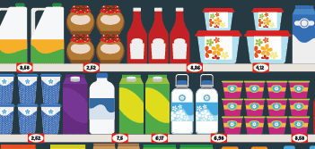


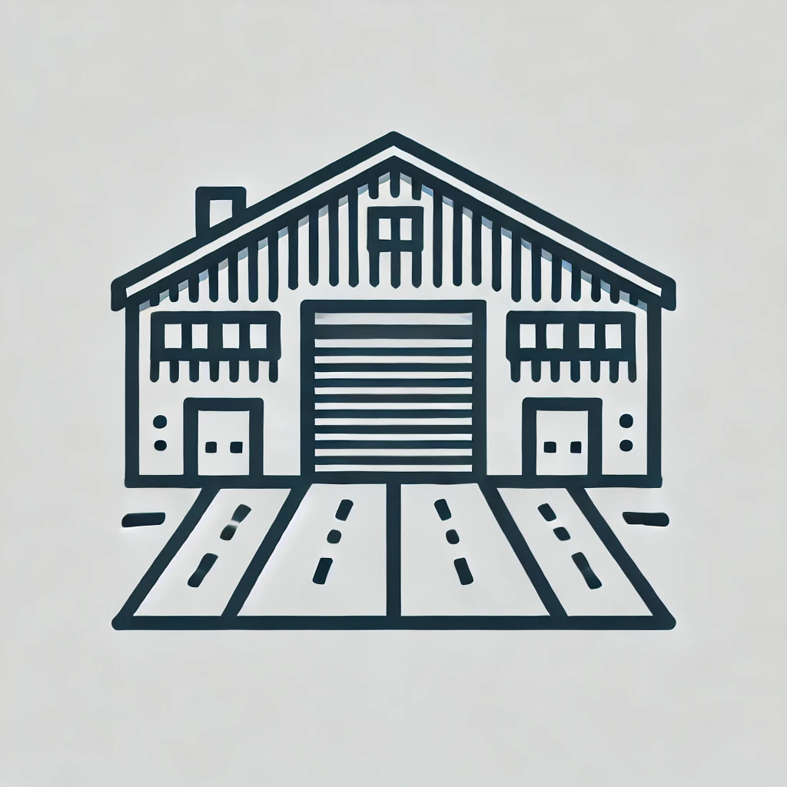
Order Flow - Example

Slide 43
What is demand forecasting?
Demand forecasting refers to the process of planning and predicting goods and materials demand to help businesses stay as profitable as possible.
Why is demand forecasting important for modern supply chains?
Demand forecasting is important to the supply chain because it helps to inform core operational processes such as demand-driven material resource planning (DDMRP), inbound logistics, manufacturing, financial planning, and risk assessment.

Slide 44
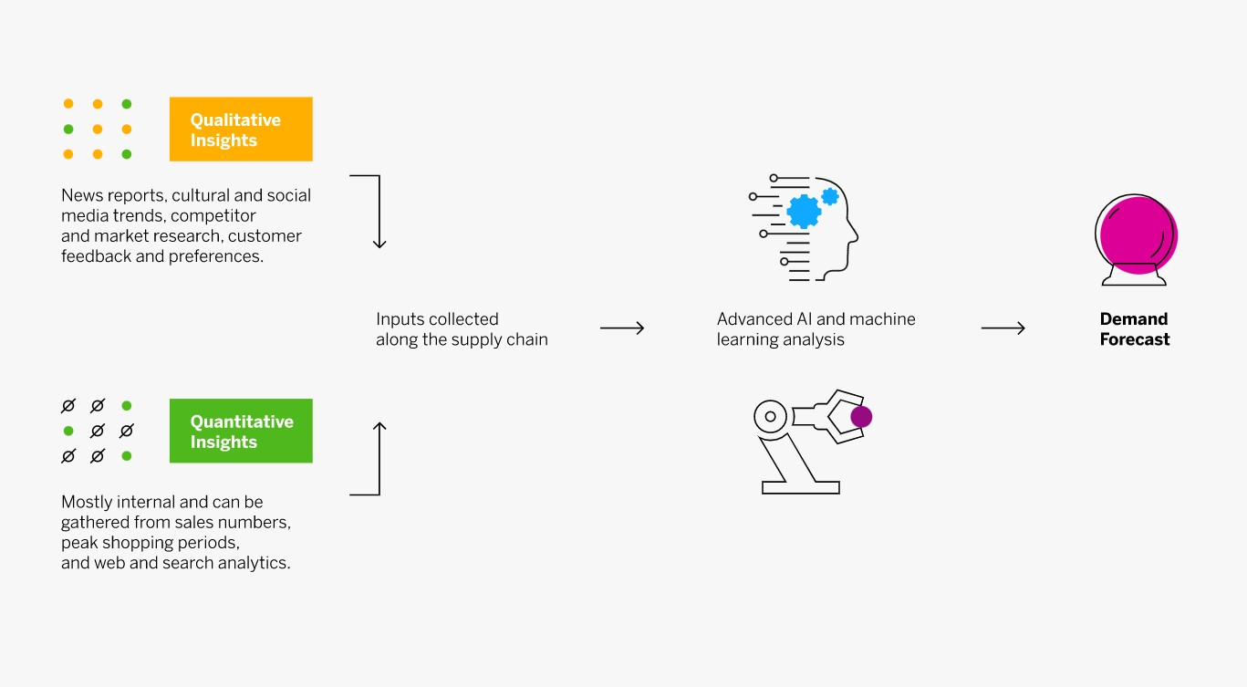
How does demand forecasting work?

Slide 45

Questions

Slide 46
References
Jacobs, F. R., Shankar, R., & Chase, R. B. (2024). Operations and supply chain management (17th ed., Chapter 1). McGraw Hill.
Chopra, S., & Kalra, D. (2019). Supply chain management (7th ed., Chapters 1-2). Pearson.
Simchi-Levi, D., Kaminsky, P., Simchi-Levi, E., & Shankar, R. (2022). Designing and managing the supply chain: Concepts, strategies, and case studies (4th ed., Chapter 1). McGraw Hill.
Cachon, G., & Terwiesch, C. (2023). Chapter 1: Matching supply with demand: An introduction to operations management. In Matching supply with demand (4th ed.). McGraw Hill.

