Slide 1
Business Intelligence (BI)?
Business intelligence (BI) is a broad category of applications, technologies, and processes for gathering, storing, accessing, and analyzing data to help business users make better decisions.

Slide 2
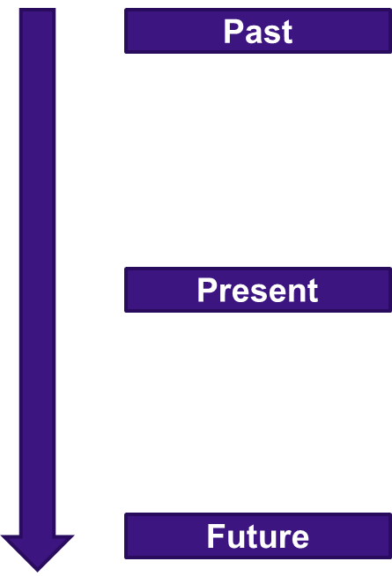
Why Business Intelligence?
What happened?
  What were our total sales this month?
What is happening?
  Are our sales going up or down, trend analysis
Why did it happen?
  Why have sales gone down?
What will happen?
  Forecasting & What If Analysis
What do I want to happen?
  Planning & Targets

Slide 3
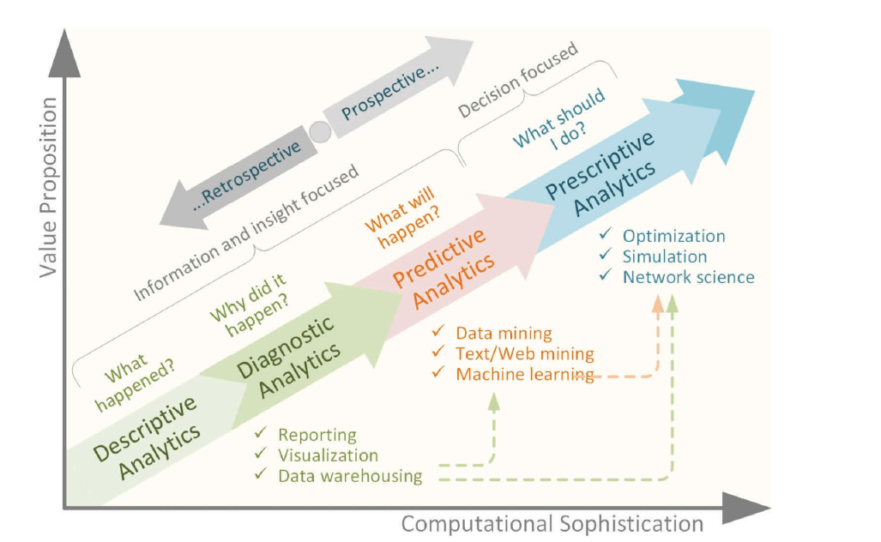

Slide 4
Significance of BI
Companies need to have accurate, up-to-date information on customer preferences , So that company can quickly adapt to their changing demands
BI applications can also help managers to be better informed about actions that a company’s competitors are taking
It help analysts and managers to determine which adjustments are mostly likely to respond to changing trends
IT can help companies develop a more consistent, data-based decision, which can produce better results than making business decisions by “guesswork”

Slide 5
Business Intelligence Infrastructure (1 of 3)
Array of tools for obtaining information from separate systems and from big data
Data warehouse
  Stores current and historical data from many core operational transaction systems
  Consolidates and standardizes information for use across enterprise, but data cannot be altered
  Provides analysis and reporting tools

Slide 6
Business Intelligence Infrastructure (2 of 3)
Data marts
  Subset of data warehouse
  Typically focus on single subject or line of business
Hadoop
  Enables distributed parallel processing of big data across inexpensive computers
  Key services
    Hadoop Distributed File System (H D F S): data storage
    MapReduce: breaks data into clusters for work
    Hbase: No S Q L database
  Used Yahoo, NextBio

Slide 7
Business Intelligence Infrastructure (3 of 3)
In-memory computing
  Used in big data analysis
  Uses computers main memory (R A M) for data storage to avoid delays in retrieving data from disk storage
  Can reduce hours/days of processing to seconds
  Requires optimized hardware
Analytic platforms
  High-speed platforms using both relational and non-relational tools optimized for large datasets

Slide 8
Database Management Systems
Database
  Serves many applications by centralizing data and controlling redundant data
Database management system (D B M S)
  Interfaces between applications and physical data files
  Separates logical and physical views of data
  Solves problems of traditional file environment
    Controls redundancy
    Eliminates inconsistency
    Uncouples programs and data
    Enables organization to centrally manage data and data security

Slide 9
Relational D B M S
Represent data as two-dimensional tables
Each table contains data on entity and attributes
Table: grid of columns and rows
  Rows (tuples): Records for different entities
  Fields (columns): Represents attribute for entity
  Key field: Field used to uniquely identify each record
  Primary key: Field in table used for key fields
  Foreign key: Primary key used in second table as look-up field to identify records from original table

Slide 10
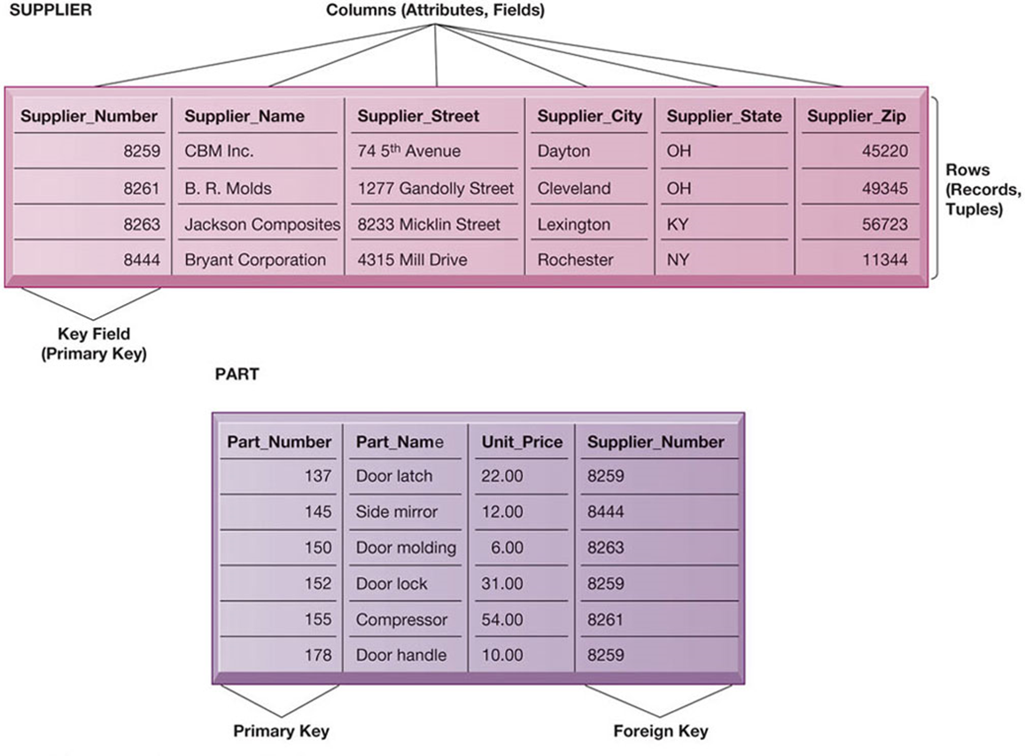
Relational Database Tables

Slide 11
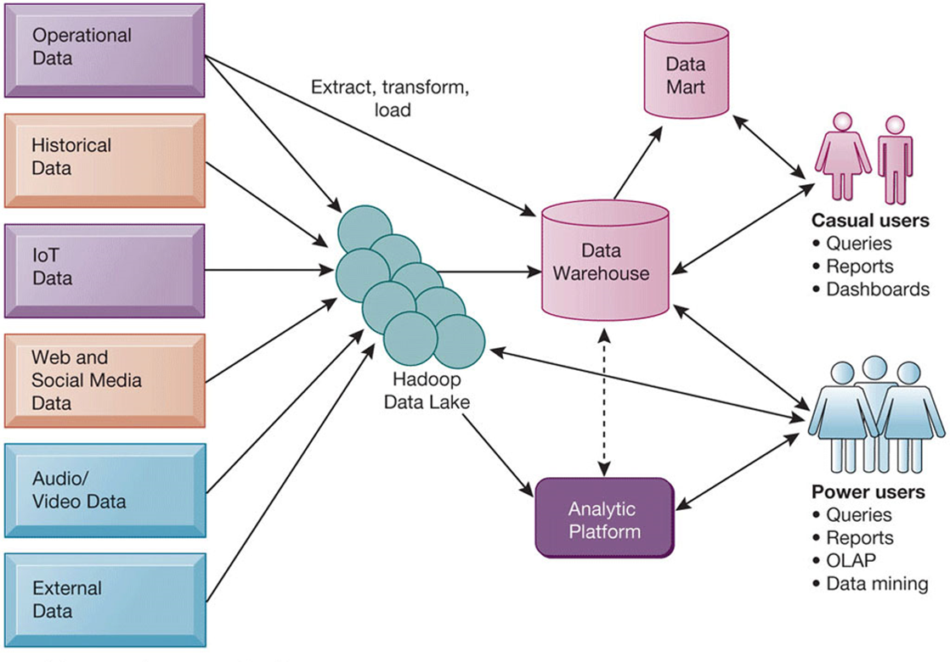
Contemporary Business Intelligence Infrastructure

Slide 12
Data Mining
Data mining is the process of sorting through large data sets to identify patterns and relationships that can help solve problems through data analysis.
Non-trivial
Implicit
Novel
Potentially Useful

Slide 13
Data Mining
Database
Statistics
Visualization
Algorithm
Machine Learning
Patter Recognition

Slide 14
Why Data Mining
Volume, Variety, Velocity
Structured, Semi-Structured, Unstructured
Web usage, structure, content mining, Sentiment Analysis, Social Network Analysis, IoT

Slide 15
Data Mining
Frequent patterns, association, corelation vs causality
  Bread → Milk (Corelation or causality)
Classification and prediction
  Construct models (functions) that describe and distinguish classes or concepts for future prediction
  * E.g. classify countries based on (climate), or classify cars based on (gas mileage)
  Predict some unknown or missing numerical values

Slide 16
Data Mining
Cluster analysis
  Class label is unknown: Group data to form new classes
  Maximizing intra-class similarity & minimizing interclass similarity
Outlier analysis
  Outlier: Data object that does not comply with the general behavior of the data
  Noise or exception? Useful in fraud detection, rare events analysis
Trend and evolution analysis
  Trend and deviation: e.g., regression analysis
  Sequential pattern mining: e.g., digital camera → large SD memory
  Periodicity analysis
  Similarity-based analysis
Other pattern-directed or statistical analyses

Slide 17
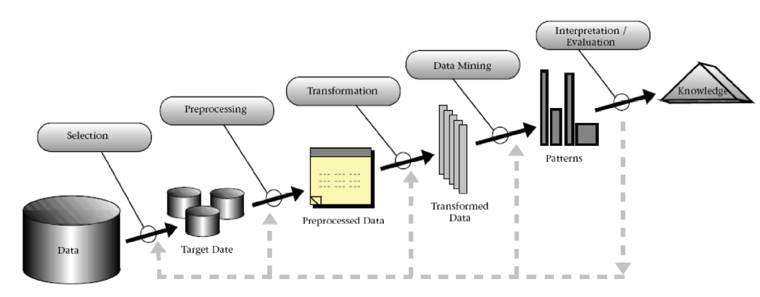
KDD

Slide 18
Major Issues in Data Mining
Culture
Expertise
Return on investment
Mining methodology

Slide 19
Data
Data
  Collection of objects and their attributes
Attribute
  Property or characteristic of an object
  Variable, field, characteristic, feature, column
Object
  Collection of field
  Record, Point, case, sample, entity, instance, row

Slide 20
Types of Attributes
Nominal
  Examples: ID numbers, eye color, zip codes
Ordinal
  Examples: rankings (e.g., taste of potato chips on a scale from 1- 10), grades, height in {tall, medium, short}
Interval
  Examples: calendar dates, income, temperatures in Celsius or Fahrenheit.
Ratio
  Examples: Length, time, counts
Discrete Attribute vs Continuous Attribute

Slide 21
Types of Data Sets
Records – Tables, Transactions
Text Data
Graph
Ordered Data – spatial, temporal, sequence

Slide 22
Data Quality
What kind of quality problems can happen?
How do we know that there are problems?
And how to solve them?

Slide 23
Data Quality Issues
Noise
Outlier
Mission Values
Duplicate Values

Slide 24
Normalization
scaling to a range
clipping
log scaling
z-score

Slide 25
Similarity and Dissimilarity
Euclidian Distance

Slide 26
Projects

