Slide 1

Introduction to Agile

Slide 2
Team Collaboration Exercise
Present a short skit/roleplay for not more than 3 minutes as a group.
All members to participate
You will get 5 minutes to organize and prepare and I will keep a check on the timer.
Help us organize as a team and collaborate.
The time starts now.
I will be on mute for the next 5 mins.

Slide 3
Demo Time

Slide 4
What I as a Customer/ PO Wanted?
Short Skit on how different Indian Actors/Actresses will be in a Party (Keeping it sober).

Slide 5
Lessons Learnt:
Did we present the play on the topic the PO desired?
What prevented us from doing so?
Learnings – Open Discussion.
What went well?
What went bad?
What can be done to improve the situation?

Slide 6
What is Agile
An Agile methodology is a collaborative and flexible approach that teams typically adopt to accomplish tasks more efficiently.
The project management methodology is often a more natural way to keep cross-functional team members organized and on track.
Using Agile, they work on various iterations of a project, which is then organized into a prioritized backlog based on end-user feedback.

Slide 7
4 Values:
Individuals and interactions over processes and tools
Working software over comprehensive documentation
Customer collaboration over contract negotiation
Responding to change over following a plan

Slide 8
1. We value individuals and interactions over processes and tools.
People and how they interact, and work together are more valuable than any defined process or tools they use.
Individuals come first.
This value reflects that agile frameworks, including Scrum, are used in complex environments where more is unknown than known.
When the work is complex, Scrum Teams must determine the best way to work together, creating the processes and procedures that work for them, and discarding the processes that aren’t serving them well.
A Scrum Team’s focus is on working together to meet goals, not complying with processes or tools for the sake of doing so.
Is communication between people clear?
Are the teams working well together?

Slide 9
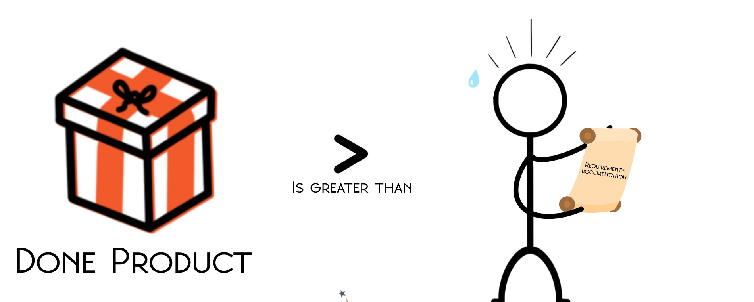
2. We value working software over comprehensive documentation
Teams using traditional software development methods sometimes emphasize creating beautiful requirements documents or technical specifications.
While these documents can be helpful in certain situations, agile teams place more focus on delivering a working product.
Anything that helps the team to achieve that goal is beneficial. Anything that does not help the team to deliver that goal is not.
This value does not suggest agile teams disregard documentation—simply that it is less important than delivering a working product.

Slide 10
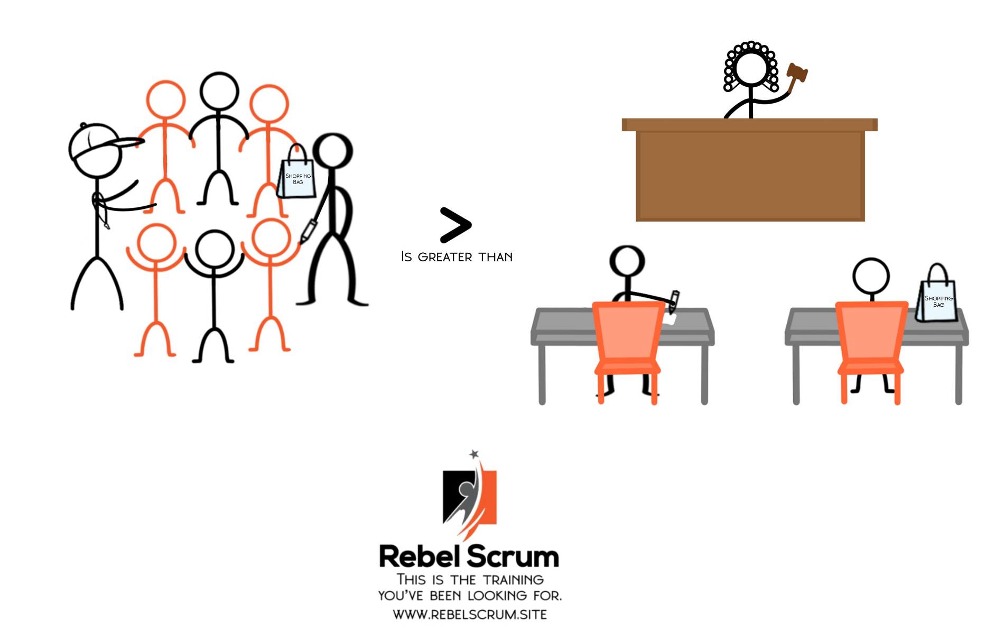
3. We value customer collaboration over contract negotiation
Contracts are necessary in most business environments.
The Agile Manifesto is not against binding agreements.
Instead, reflecting on this value might encourage us to structure contracts that support collaboration between the customer and the team to provide value together.

Slide 11
4. We value responding to change over following a plan
This value can lead some to falsely believe that agile teams don’t plan at all when the opposite is true.
Agile teams plan more than teams using traditional project management approaches such as waterfall. They just do so frequently in the face of new information rather than all at once up front.
It makes more sense to plan frequently than to make one grand plan at the beginning when so much can (and does) change along the way.

Slide 12
15 Mins Break

Slide 13
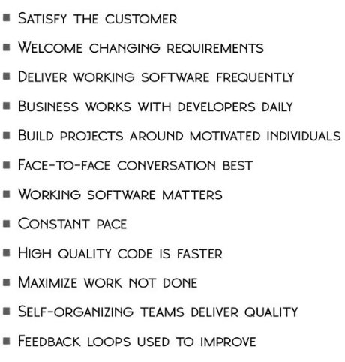
12 principles:

Slide 14
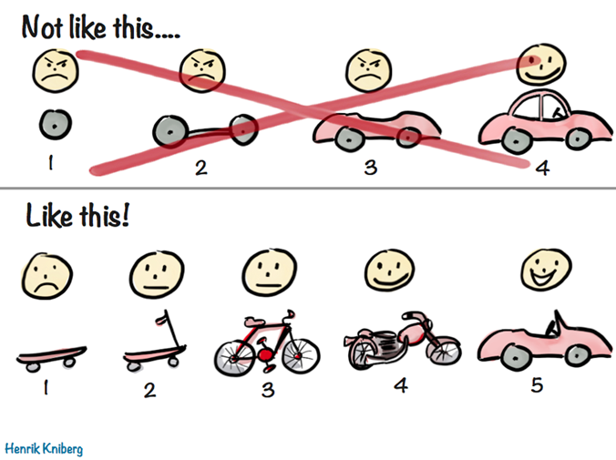
1. Satisfy the customer through early and continuous delivery of valuable software.
The image below is a famous example from Henrik Knilberg demonstrating an agile approach to product delivery and comparing It with more traditional methods.
Unlike waterfall or other traditional project management approaches, agilists deliver early and continuously. We are not producing software once in one large delivery. Instead, we're delivering it frequently—or iteratively. Further, our customers must find what we deliver usable and valuable. It's an incremental approach.

Slide 15
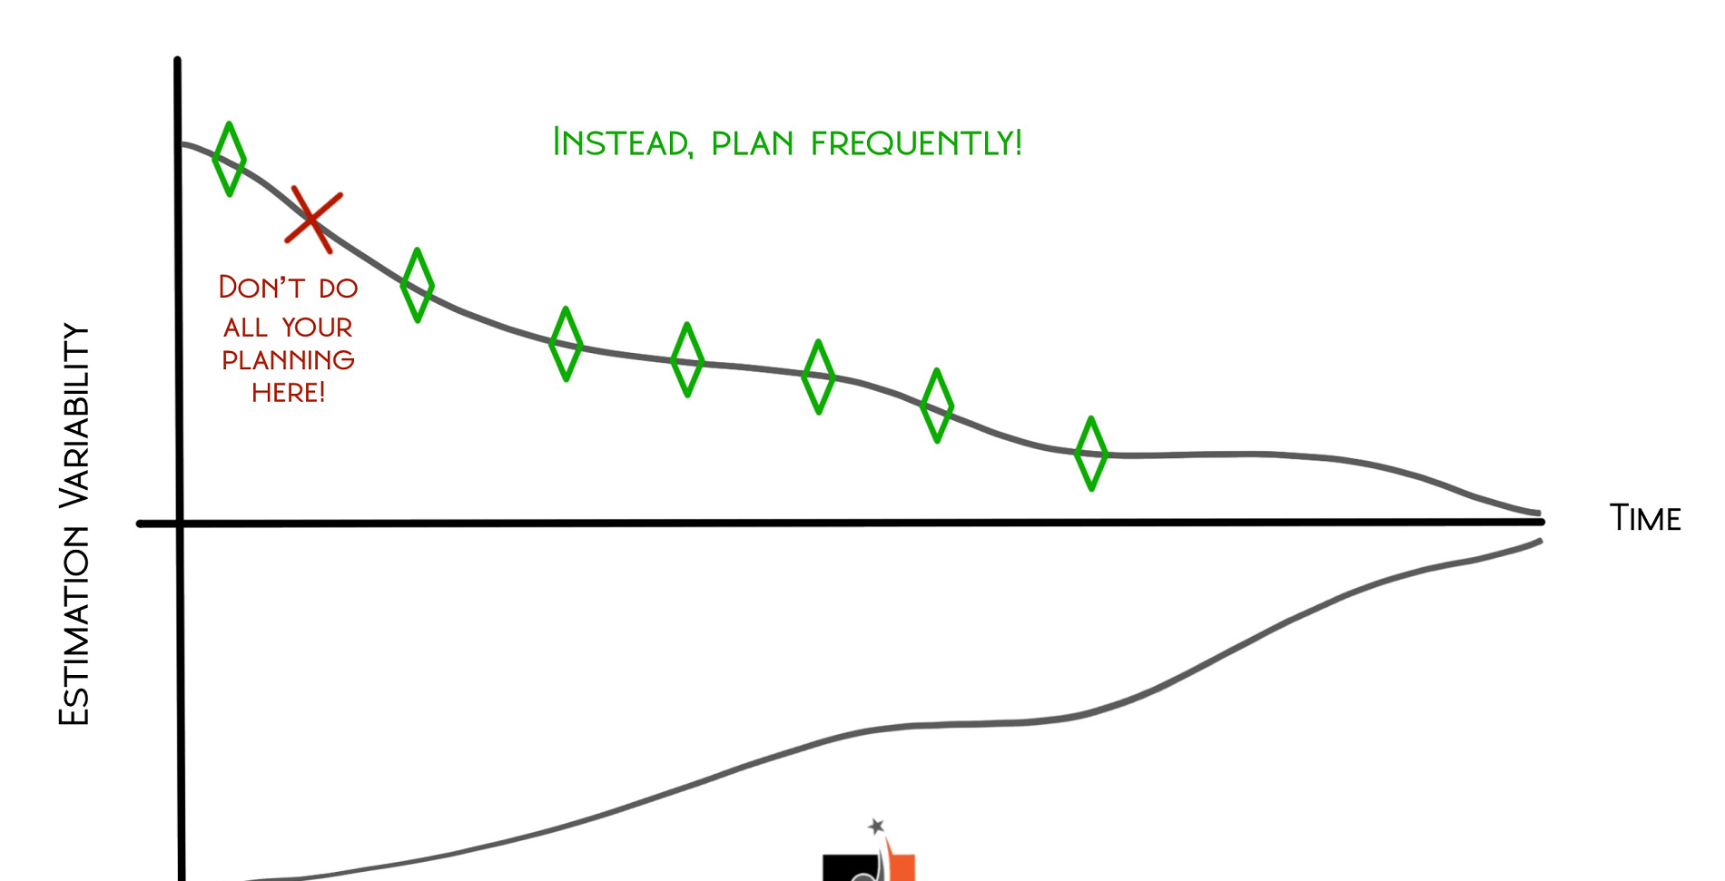
2. Welcome changing requirements, even late in development.
Traditional methods aim to reduce the amount of change while product development is in flight. Agile does just the opposite. Instead of focusing on reducing variation and changes to the original requirements, Agile frameworks welcome change.
Teams use an agile framework in complex environments, where more is unknown than known. In that context, does it make sense for the team to plan everything at the start, when they know less, or does it make sense to replan regularly as they learn more?

Slide 16
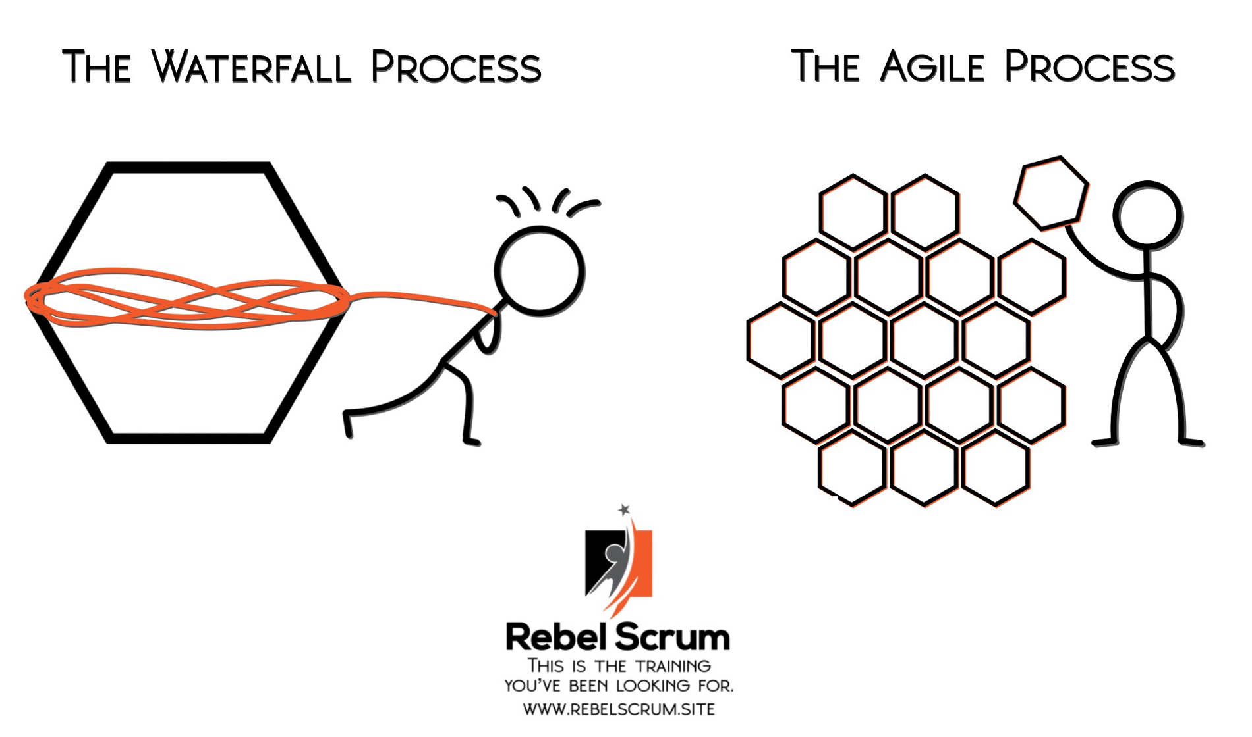
3. Deliver working software frequently
All agile frameworks rely upon the principle of delivering working software frequently, but this principle takes it a step further. Teams must deliver working software; not just a cog in the machine, so to speak.
Consider the image.
    The left-hand side of the image represents the traditional way of delivering value to the customer, which is a large deliverable provided after everything envisioned in the final product is complete.
    Contrast this with the right-hand side of the image, which shows an iterative (frequent), incremental (Done) approach for delivering value. Each piece of what is delivered is usable, but it’s a smaller piece of the bigger puzzle.

Slide 17
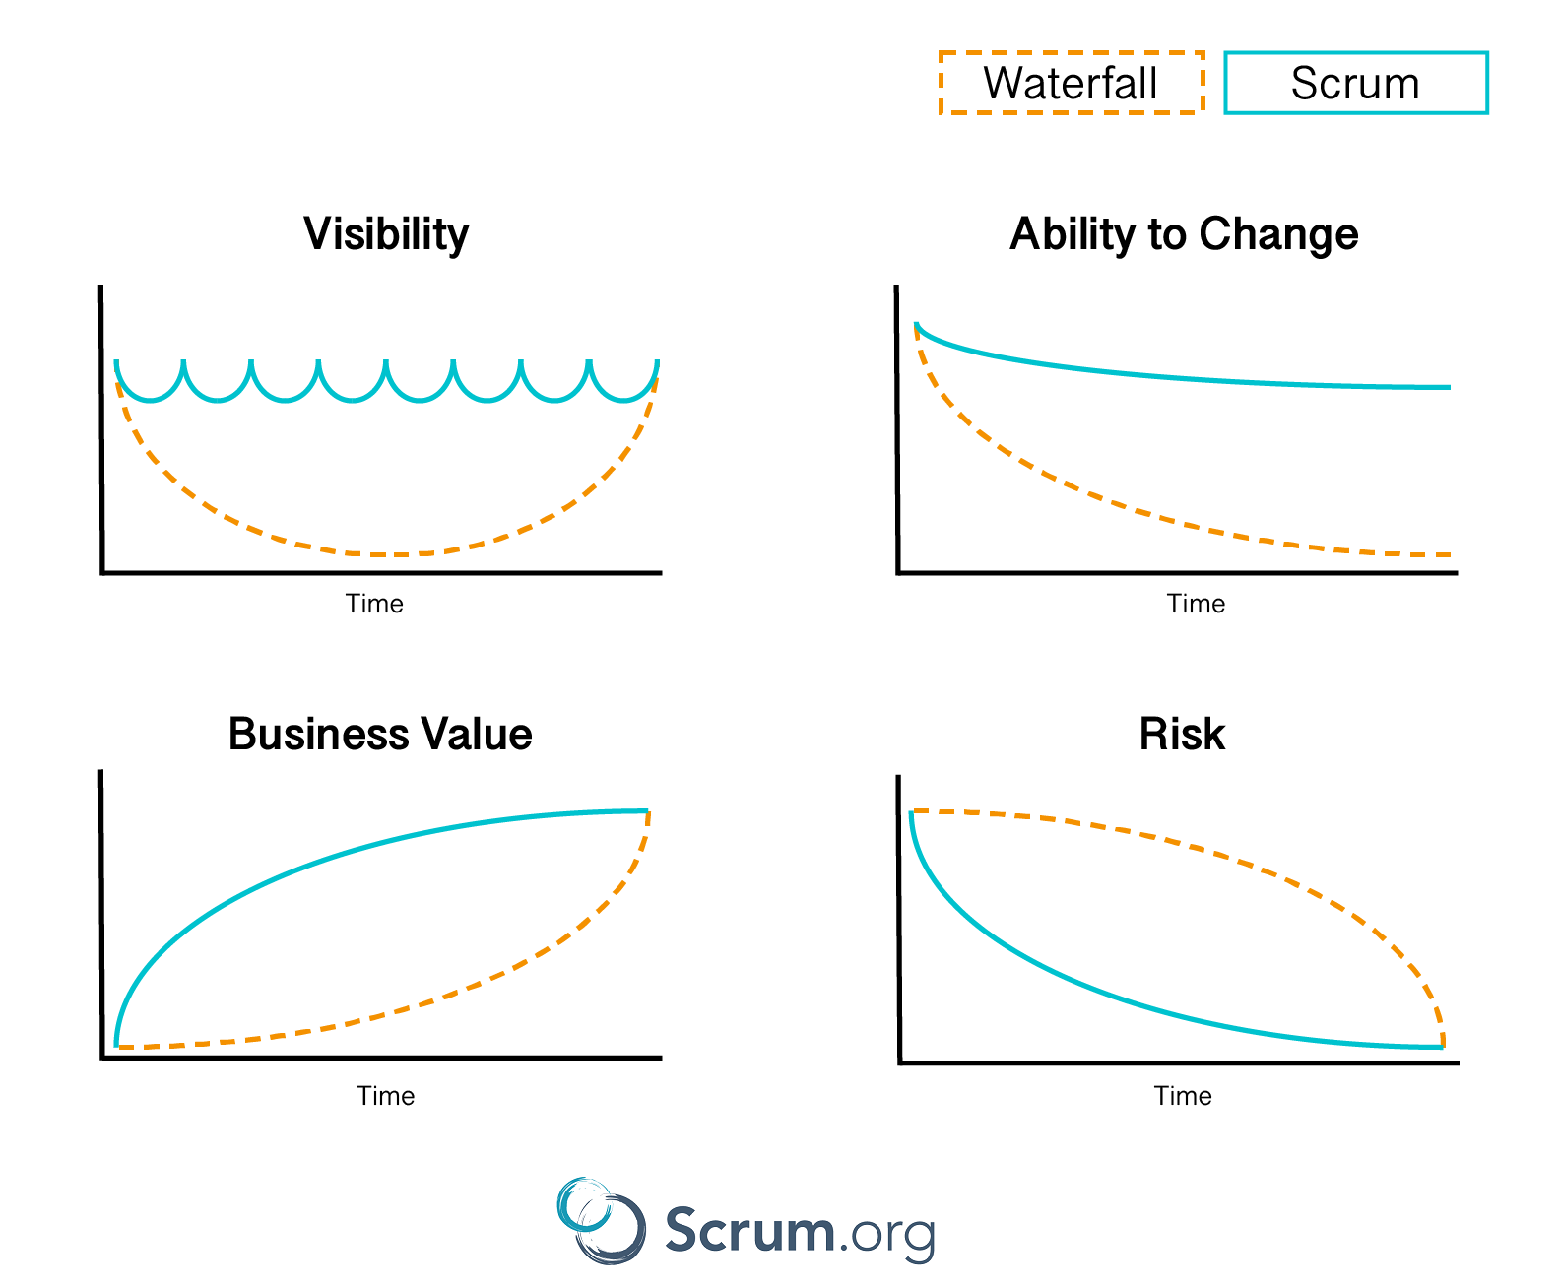
4. Business people and developers must work together daily throughout the project.
Using a traditional approach, the delivery team often goes through a long, intense requirements phase where they frequently meet with the business stakeholders. After they complete the requirements phase, the delivery team disappears to build whatever they understand the stakeholders specified.
Agile is different. Business stakeholders meet regularly with the agile team at a lower level of engagement. In Scrum, this engagement may take place in refinement meetings or at the Sprint Review.
By engaging with stakeholders more frequently, agile teams provide greater visibility into product delivery.

Slide 18
Activity
I want you all to re-create a short scene of Indian team Dressing Room after winning 2011 WC (Sober part only).
  A short 3mins play
  You have 5mins to prepare
  You have 2mins for queries.

Slide 19
What the events mean?
2 mins for queries and refining the requirement is Grooming of backlog story
5 mins is the Sprint time
3 mins is Sprint Review

Slide 20
Let us have a Review/ Demo

Slide 21

Was it a success?
Did we provide something that added value to the PO?
Did we face any challenges?
Were priorities changed in between of the activity?
Did this change impact your performance?
What could have been done differently?

Slide 22
5. Build projects around motivated individuals.
Leaders who work with agile teams focus on ensuring that the teams have the support (tools, access, resources) and environment (culture, people, external processes) they need, and then trust them to get the job done.
Successful agile leaders enable teams to deliver value by providing them with the tools that they need to be successful, providing guidance when needed, embracing servant leadership and focusing on outcomes.

Slide 23
6. face-to-face conversation
With the greater adoption of Zoom and other meeting platforms, the words face-to-face have taken on a slightly different meaning lately, but the idea behind this principle remains.
The best way to convey information is to have a real-time conversation rather than a back-and-forth via email or messaging app.
For agile teams, this may mean that those who deliver the work speak directly to those using the work. Or it could mean that those who deliver the work collaborate amongst themselves to solve their problems.

Slide 24
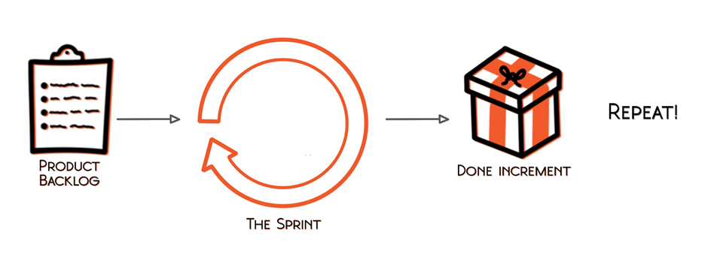
7. Working software is the primary measure of progress.
Success isn’t about the percentage of the work we have completed or how well we are sticking to a plan.
In agile, we measure success by the product that we have delivered, and whether it is in a usable state.

Slide 25
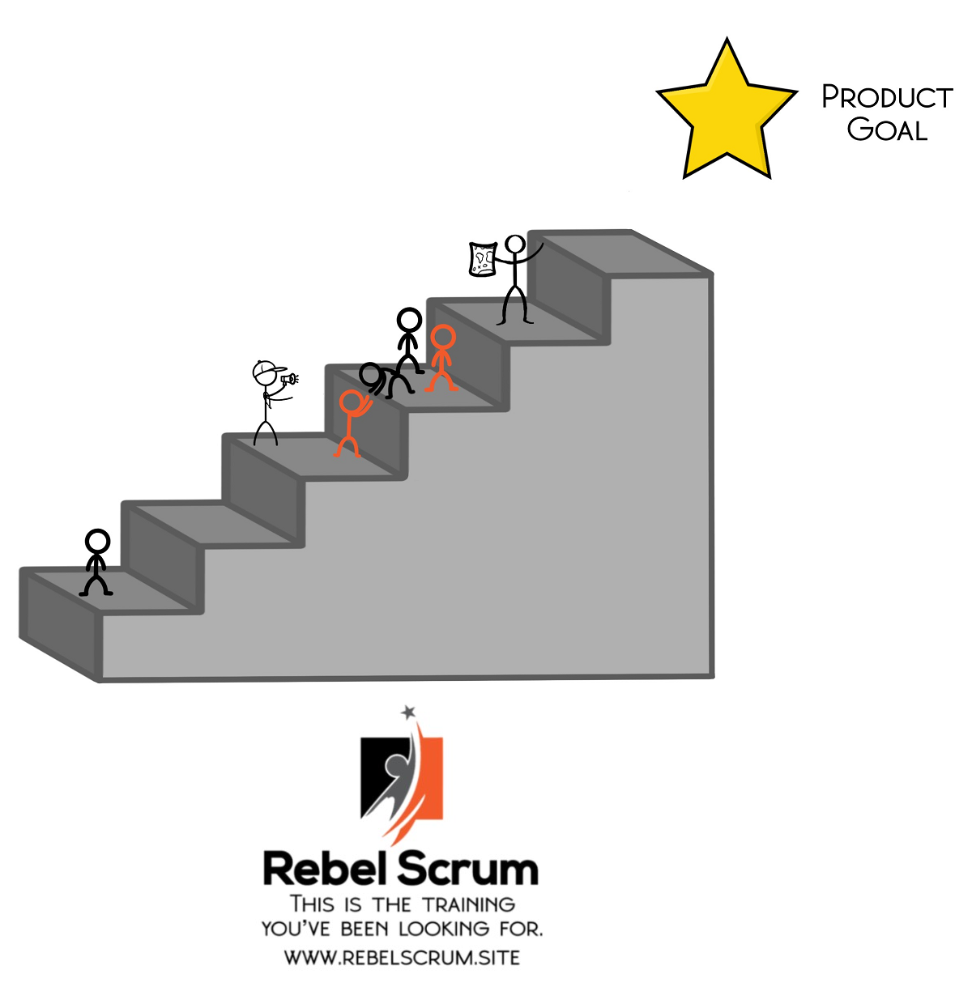
8. Agile processes promote sustainable development
The team tests the work as it goes and has a series of concrete steps to take.
They have an unwavering focus on the end goal. Because they are delivering value incrementally, each piece is usable and is a step in the direction of the goal because they get constant stakeholder feedback about its value.
This way of approaching work means that the team establishes a steady pace. It’s a much more even paced, satisfying experience.

Slide 26
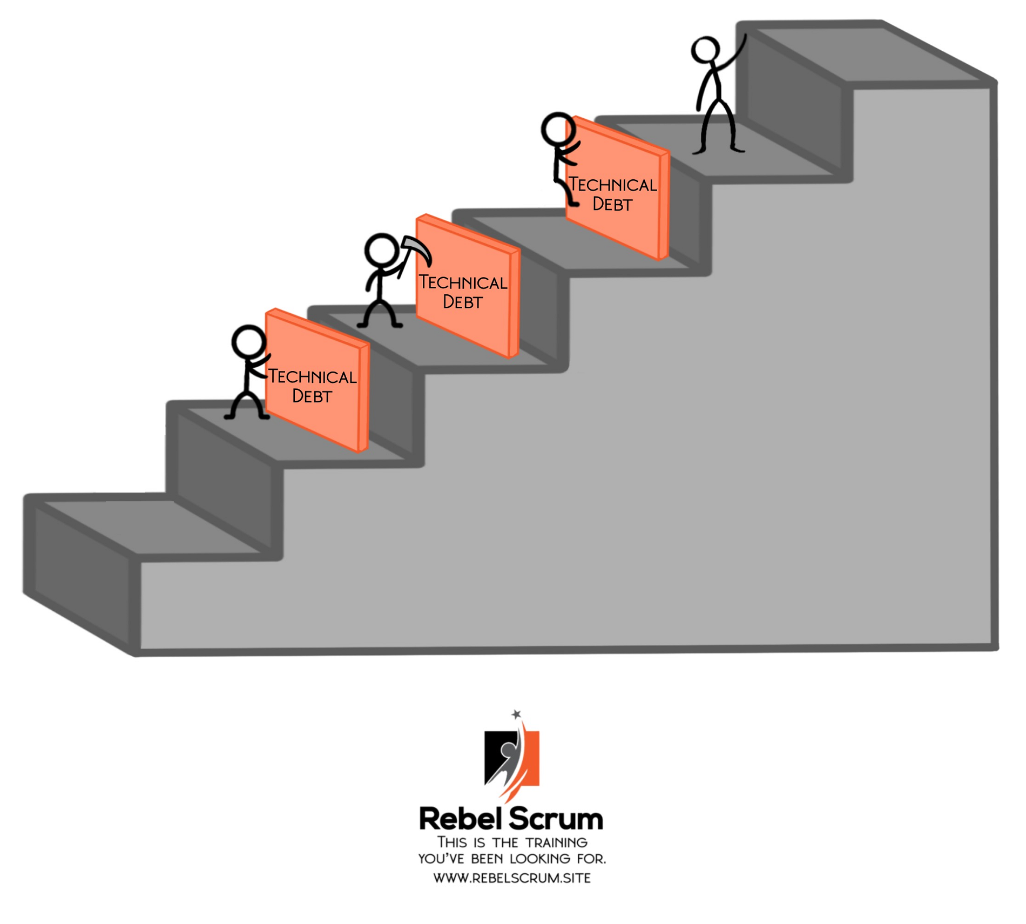
9. Continuous attention to technical excellence and good design enhances agility.
Agile teams should focus not only on feature development but also on ensuring that they deliver high-quality products.
This might include addressing any existing technical debt and preventing its accumulation.
Agile teams using the Scrum framework might work with the Product Owner to include items that increase product quality in the Product Backlog.
Teams can also create a Definition of Done that prevents the accidental accumulation of technical debt by implementing best practices such as regular code reviews and security standards.

Slide 27
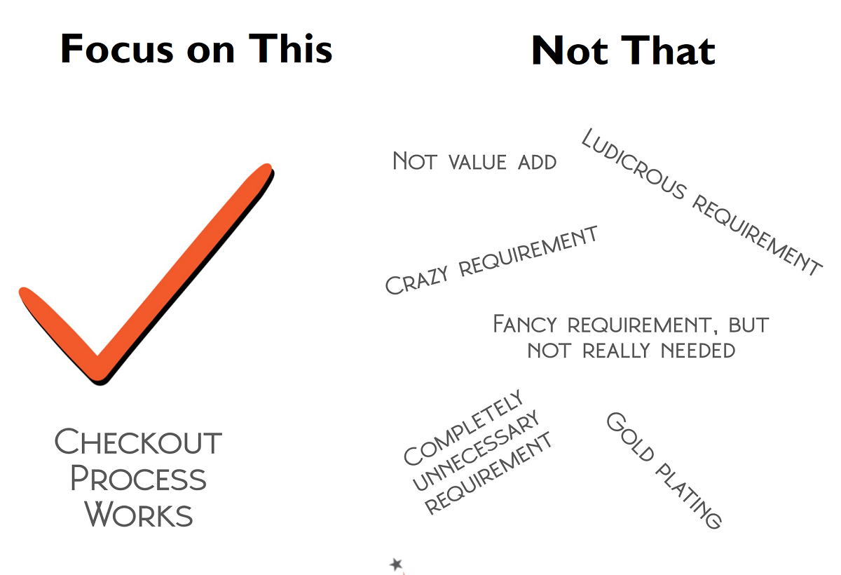
10. Simplicity—the art of maximizing the amount of work not done—is essential.
Because Agile teams focus on smaller, more frequent deliveries, the attitude of the business stakeholders towards the work often changes.
Instead of asking for every requirement they may need in the future, the agile team can instead focus on the most valuable thing to do next.
This kind of focus can significantly reduce waste, as the agile teams build trust with their customers and stakeholders through frequent delivery of working software.

Slide 28
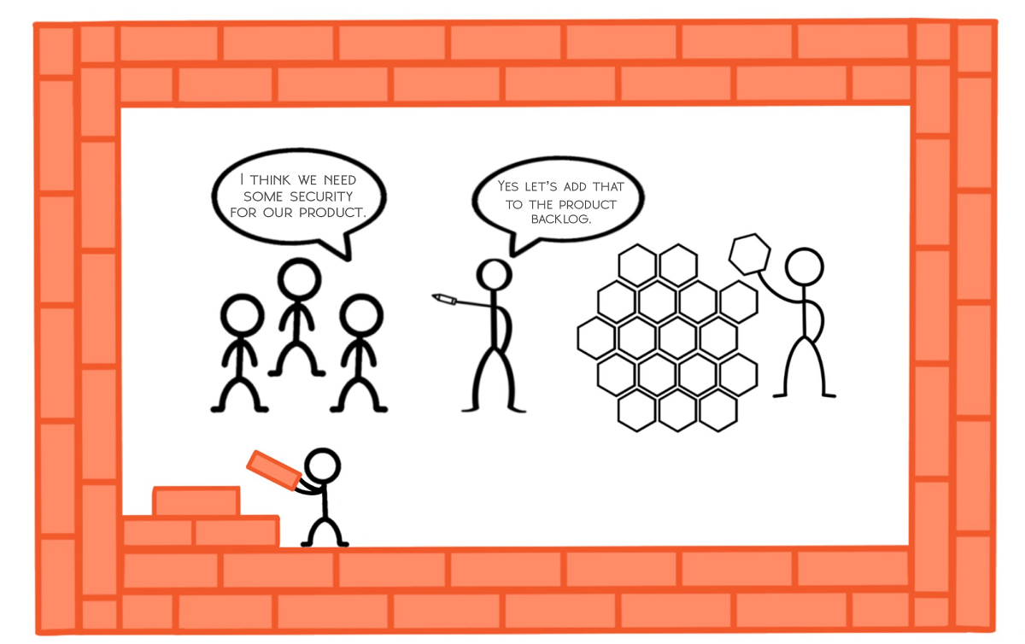
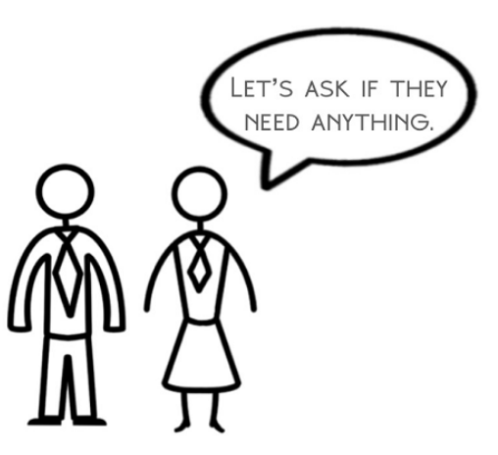
11. The best architectures, requirements, and designs emerge from self-organizing teams.
The architecture for the product emerges along with feature delivery.
Adhering to this principle means that the team doesn’t disappear for months while they figure out the best long-term architecture.
Instead, team members decide how best to build the product while they build the product.
The idea of self-organization is that the people closest to the work are best and figuring out how to do it.

Slide 29
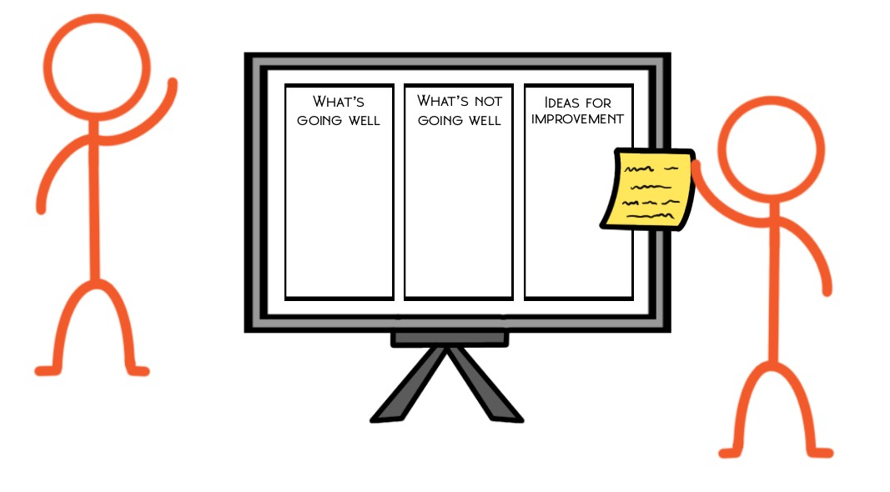
12. At regular intervals, the team reflects on how to become more effective, then tunes and adjusts its behavior accordingly.
On a regular basis, the team ask themselves, how it’s going and what changes should they should make
Then they make those changes and repeat the process regularly
A series of small improvements made over time is better than any single reorganization

Slide 30
Let’s Rewind
How do you feel does Agile benefit organizations?
Which Value do you think matters most to your current team and can add max value to your team?
Which Principle of Agile would help your team in current state?

Slide 31
Q & A

Slide 32
Knowledge Check
Name any 1 Value of Agile

Slide 33
Knowledge Check
Name any 3 Principles of Agile we discussed.

Slide 34
LookBack
I had asked to come up with below points:-
How do you feel does Agile benefit organizations?
Which Value do you think matters most to your current team and can add max value to your team?
Which Principle of Agile would help your team in current state?

Slide 35
The Three Pillars of Empiricism (Scrum)
Empiricism means working in a fact-based, experience-based, and evidence-based manner.
Scrum implements an empirical process where progress is based on observations of reality, not fictitious plans.
Scrum also places great emphasis on mind-set and cultural shift to achieve business and organizational Agility.

Slide 36
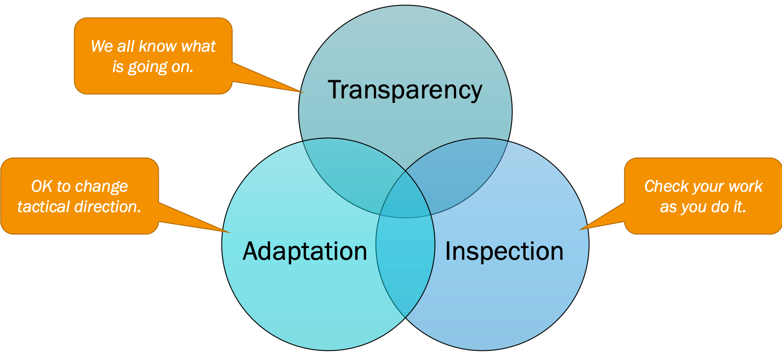
The three pillars of empiricism are as follows:

Slide 37
Transparency: This means presenting the facts as is. All people involved—the customer, the CEO, individual contributors—are transparent in their day-to-day dealings with others. They all trust each other, and they have the courage to keep each other abreast of good news as well as bad news. Everyone strives and collectively collaborates for the common organizational objective, and no one has any hidden agenda.
Inspection: Inspection in this context is not an inspection by an inspector or an auditor but an inspection by every- one on the Scrum Team. The inspection can be done for the product, processes, people aspects, practices, and continuous improvements. For example, the team openly and transparently shows the product at the end of each Sprint to the customer in order to gather valuable feedback. If the customer changes the requirements during inspection, the team does not complain but rather adapts by using this as an opportunity to collaborate with the customer to clarify the requirements and test out the new hypothesis.
Adaptation: Adaptation in this context is about continuous improvement, the ability to adapt based on the results of the inspection. Everyone in the organization must ask this question regularly: Are we better off than yesterday? For profit-based organizations, the value is represented in terms of profit. The adaptation should eventually relay back to one of the reasons for adapting Agile—for example, faster time to market, increased return on investment through value- based delivery, reduced total cost of ownership through enhanced software quality, and improved customer and employee satisfaction.

Slide 38
Scrum Framework
Scrum is a framework within which people can address complex adaptive problems, while productively and creatively delivering products of the highest possible value.
Scrum is a lightweight framework that helps people, teams and organizations generate value through adaptive solutions for complex problems.
Scrum co-creators Ken Schwaber and Jeff Sutherland have written The Scrum Guide to explain Scrum clearly and succinctly.
This Guide contains the definition of Scrum. This definition consists of Scrum’s accountabilities, events, artifacts, and the rules that bind them together.

Slide 39
In a nutshell, Scrum requires a Scrum Master to foster an environment where:
  A Product Owner orders the work for a complex problem into a Product Backlog.
  The Scrum Team turns a selection of the work into an Increment of value during a Sprint.
  The Scrum Team and its stakeholders inspect the results and adjust for the next Sprint.
  Repeat

Slide 40
How does scrum fit into the agile methodology?
Scrum is merely a framework that’s part of the overall agile methodology, an innovative way of approaching project management and product development.
The guiding principles of the agile manifesto focus on core values including the following.
    Customer satisfaction
    Collaboration
    Conversation
    Early, continuous delivery
    Functional product development
    Self-organized teams
    Simplicity of process

Slide 41
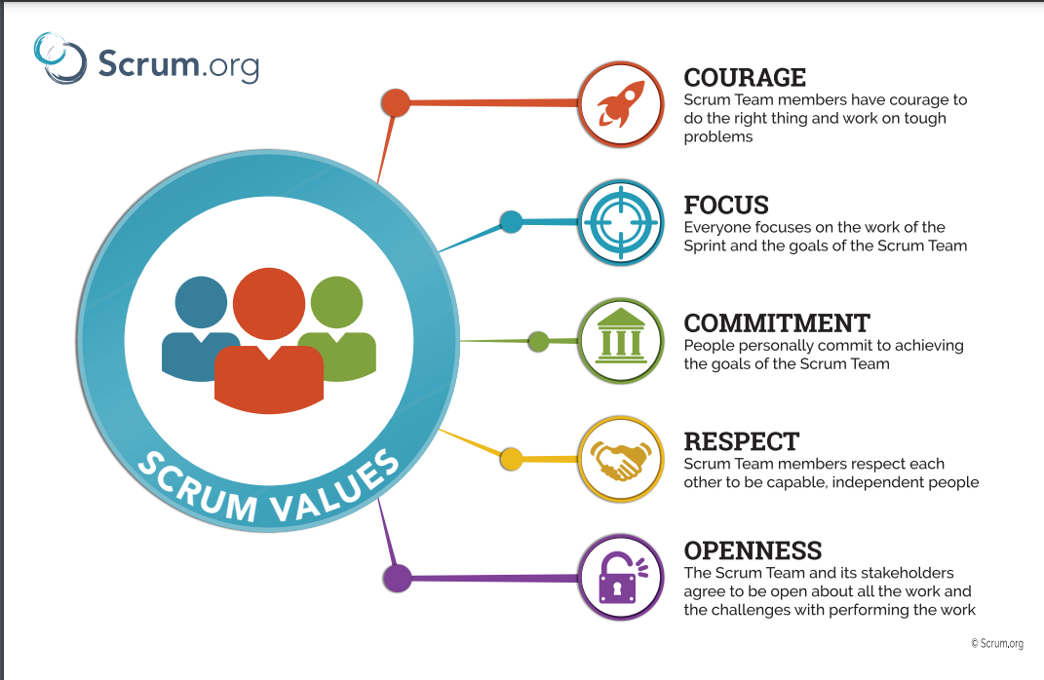
The Scrum Values

Slide 42
The Scrum Team
The fundamental unit of Scrum is a small team of people, a Scrum Team.
The Scrum Team consists of one Scrum Master, one Product Owner, and Developers.
Within a Scrum Team, there are no sub-teams or hierarchies. It is a cohesive unit of professionals focused on one objective at a time, the Product Goal.

Slide 43
Scrum master: The scrum master leads the development process, holding daily check-in meetings to communicate with the core team. The scrum master also enforces the scrum rules if needed, while keeping the team motivated along the way. They are more akin to a coach than a boss.
Product owner: The product owner helps set the goals by presenting the customers or other stakeholders. This role helps outline expectations, administer the backlog, and prioritize the most important goals during each sprint based on stakeholder value. This helps ensure that the scrum process focuses on the most high-value features during each product iteration.
Scrum team members: Each core team is composed of three to nine individuals, who form a self-organized group. The scrum team members work together to plan, solve problems, and produce a finished product. There’s no hierarchy within the scrum team; all work together to achieve the sprint goals.

Slide 44
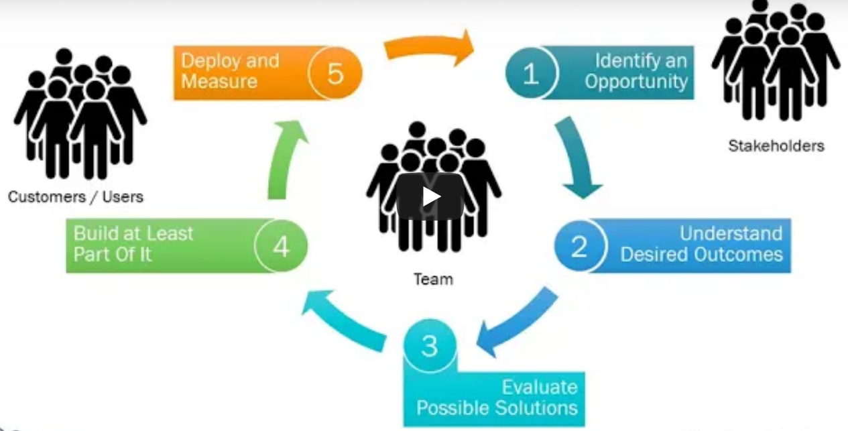

Slide 45
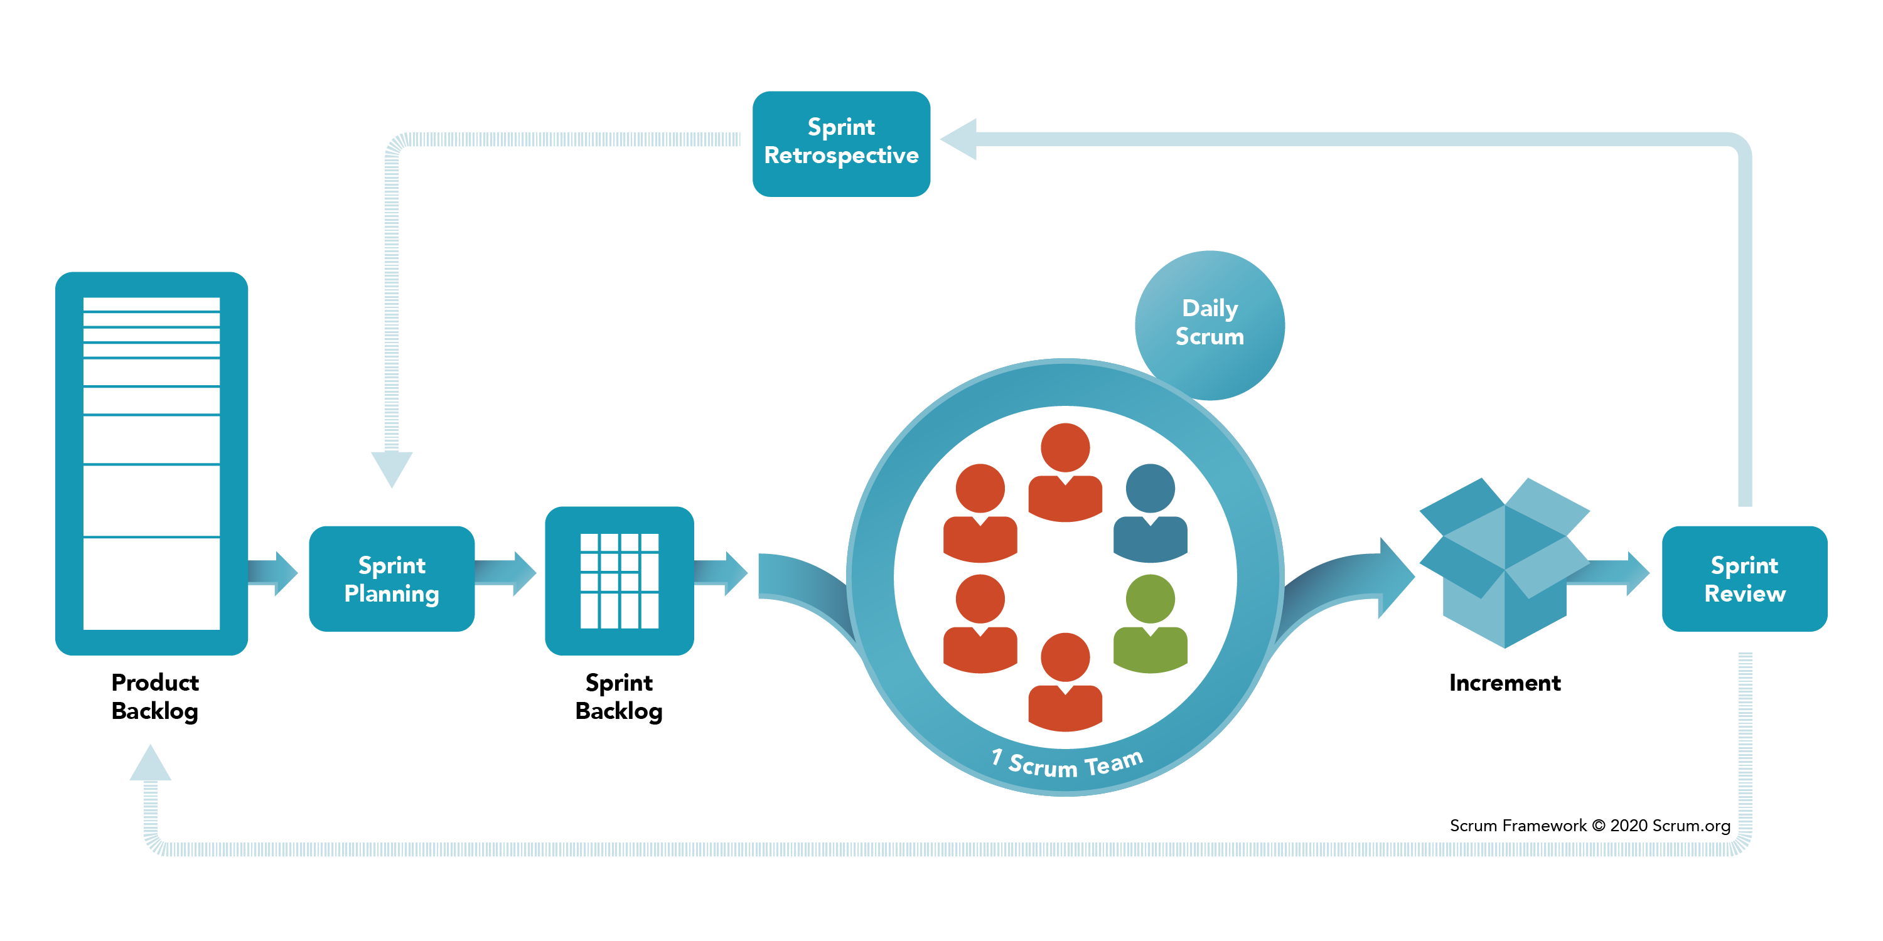
The Scrum Events
Sprint
Sprint Planning
Daily Scrum
Sprint Review
Sprint Retrospective

Slide 46
Scrum Artifacts
Scrum’s artifacts represent work or value to provide transparency and opportunities for inspection and adaptation. Artifacts defined by Scrum are specifically designed to maximize transparency of key information so that everybody has the same understanding of the artifact. The Scrum Artifacts are:
  Product Backlog
  Sprint Backlog
  Increment

Slide 47
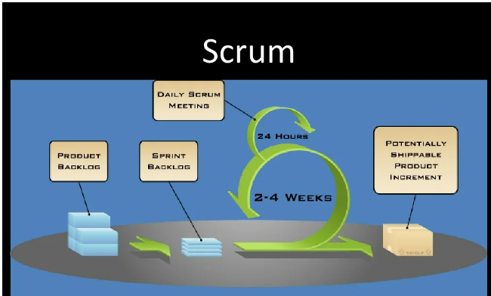

Slide 48
Remember:
Scrum works not because it has three roles, five events, and three artifacts but because it adheres to the underlying Agile principles of iterative, value-based incremental delivery by frequently gathering customer feedback and embracing change.
This results in faster time to market, better delivery predictability, increased customer responsiveness, ability to change direction by managing changing priorities, enhanced software quality, and improved risk management.

Slide 49
Scrum Glossary & Retro Themes
https://www.scrum.org/resources/scrum-glossary
https://miro.com/guides/retrospectives/ideas-games
https://easyretro.io/retrospective-ideas/

Slide 50
Case Studies Links
https://www.growthaccelerationpartners.com/blog/real-life-examples-of-agile-methodology
https://www.agilebusiness.org/page/case-study-air-france-lean-agile-procurement
https://www.agilebusiness.org/page/case-study-northumbria-university-agile-culture
https://www.agilebusiness.org/page/case-study-APMG-Coronavirus-meets-agility

Slide 51
Toyota
https://www.agilearena.net/toyota-agile-case-study-with-agile-arena/
https://docs.microsoft.com/en-us/archive/blogs/ericgu/lean-toyota-and-how-it-relates-to-agile
https://www.infoq.com/articles/scrum-the-toyota-way/
https://www.scruminc.com/what-i-learned-at-toyota/

Slide 52
Intro to Agile Tools
2 of the most widely used tools in the industry are :
  VSTS Azure Board
  Jira
We will be having an overview of how these tools help the teams work and monitor the progress seamlessly.

Slide 53
What is Azure Boards?
Azure Boards provides software development teams with the interactive and customizable tools they need to manage their software projects. It provides a rich set of capabilities including native support for Agile, Scrum, and Kanban processes, calendar views, configurable dashboards, and integrated reporting. These tools scale as your business grows.
Quickly and easily track work, issues, and code defects associated with your project. The Kanban board, shown in the following image, is just one of several tools that allows you to add, update, and filter user stories, bugs, features, and epics.

Slide 54
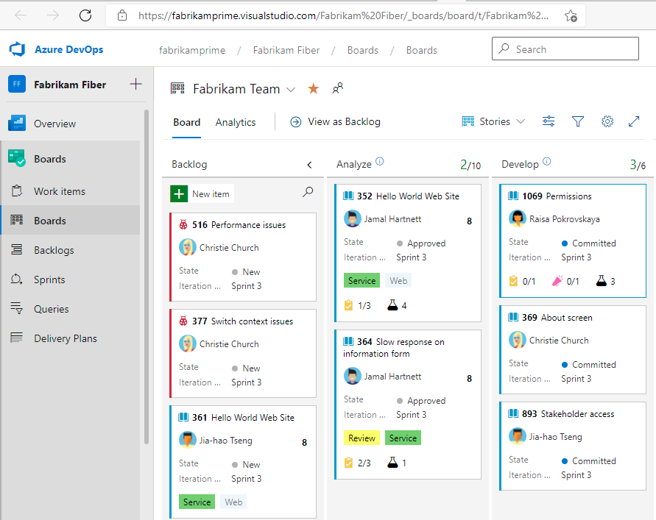

Slide 55
Track user stories, bugs, features, and epics
Track various types of work using the default work item types—such as user stories, bugs, features, and epics. Or, customize these types or create your own. Each work item form provides a standard set of system fields and controls, including Discussion for adding and tracking comments, History, Links, and Attachments. The Deployment, Development, and Related Work controls support tracking when code is released or changed, and relationships between work items.

Slide 56
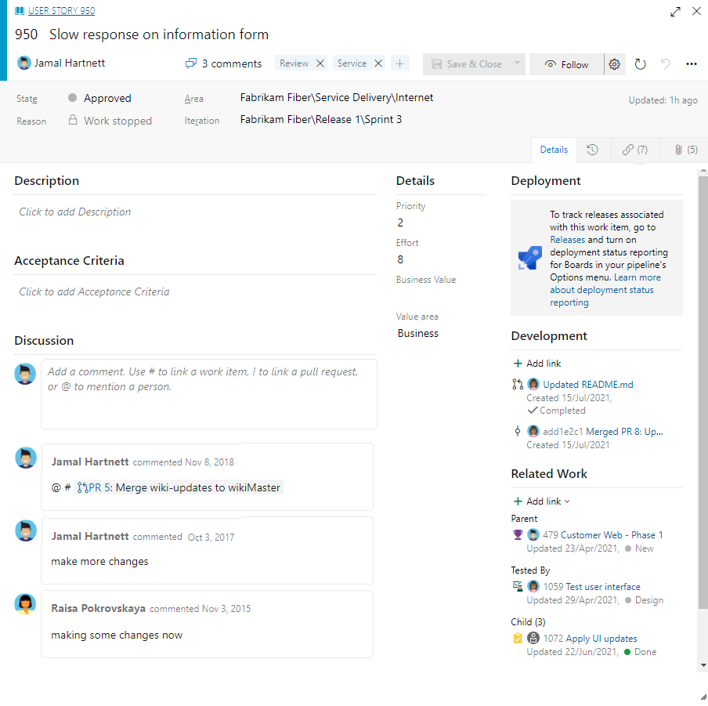
Sample user Story/PBI

Slide 57
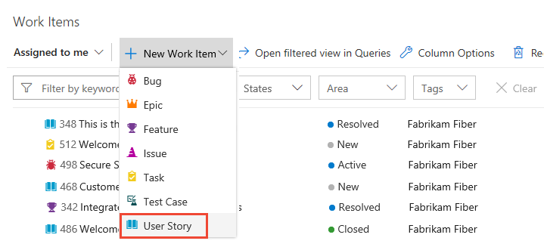
Open Work Items for personalized filtered lists

Slide 58
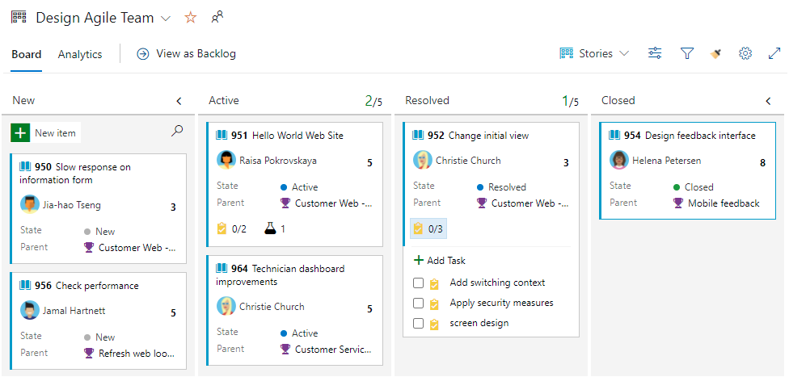
Use Boards to add, update, and track status

Slide 59
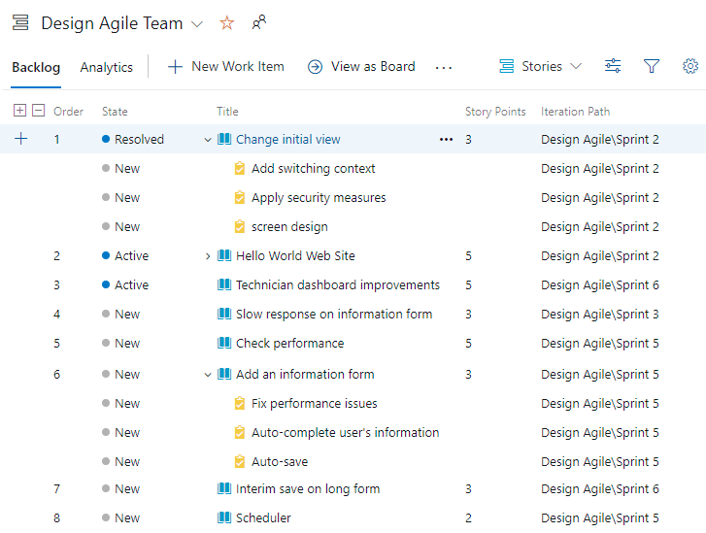
Use Backlogs to add, prioritize, organize, and assign work

Slide 60
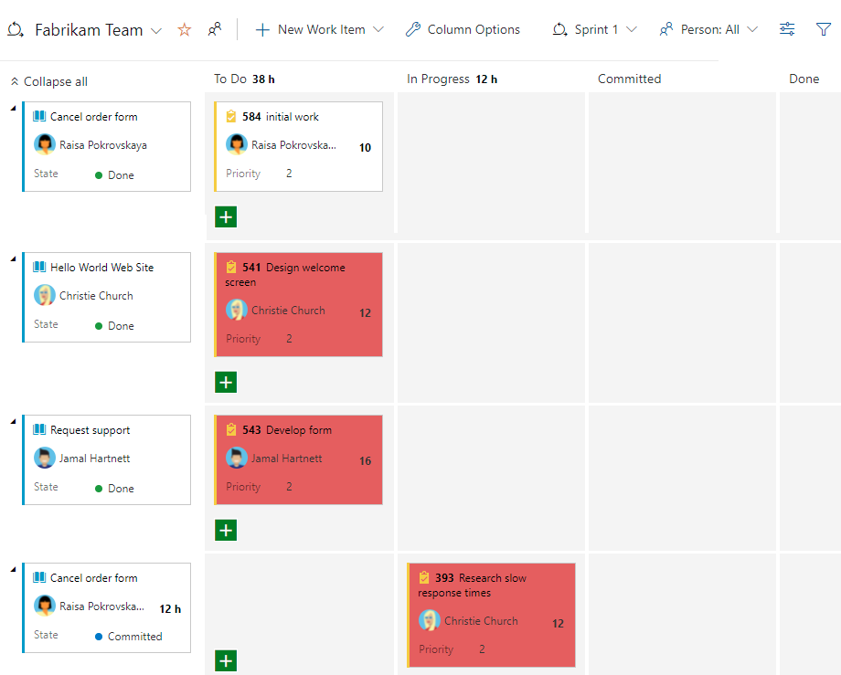
Use Sprints for Scrum processes

Slide 61
Request for Stopping Screen Sharing
This is needed so that I can demo what has been shown in above slides

Slide 62
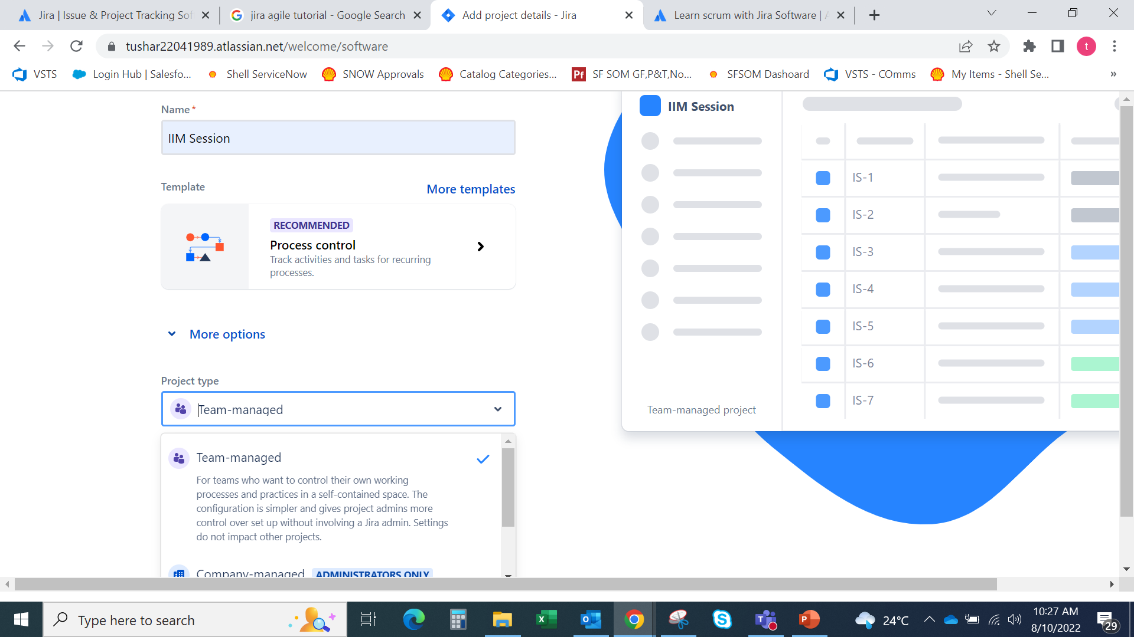
Jira Snapshots

Slide 63
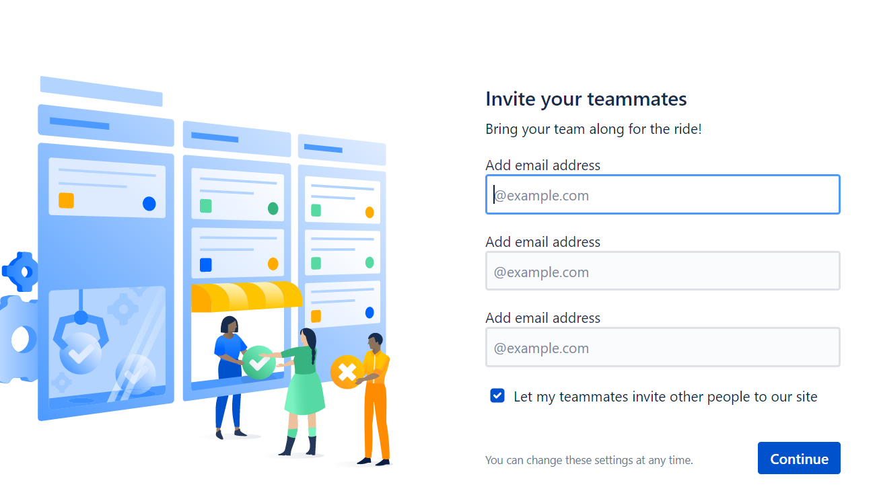
Collaborate

Slide 64
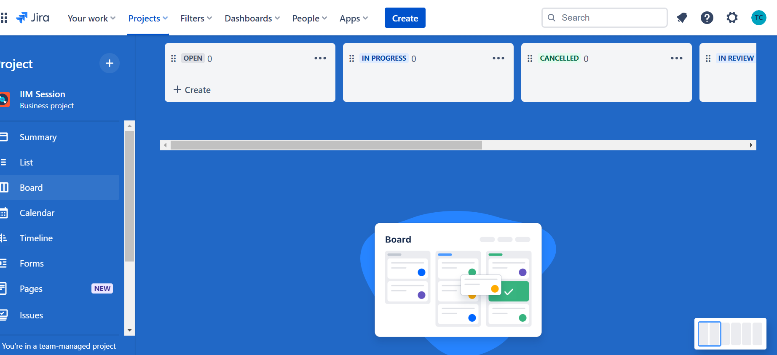
Backlog Area (This is where we create our Backlog Items)

Slide 65
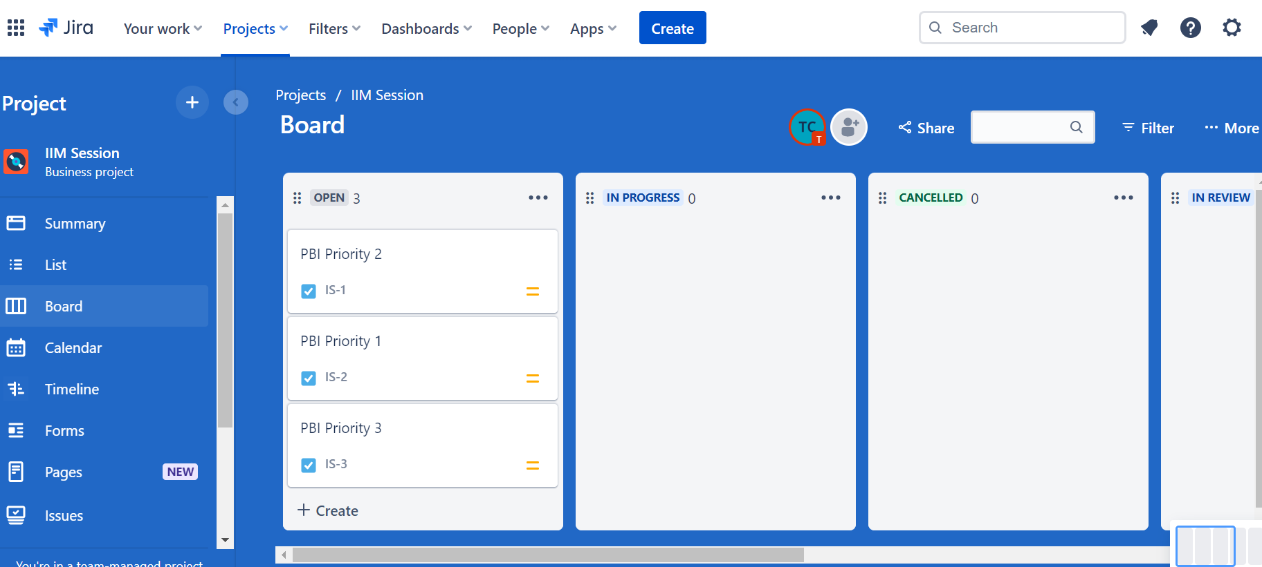
Create user stories or tasks in the backlog
In Jira Software, we call work items like user stories, tasks, and bugs "issues". I have created 3 PBIs here for reference.

Slide 66
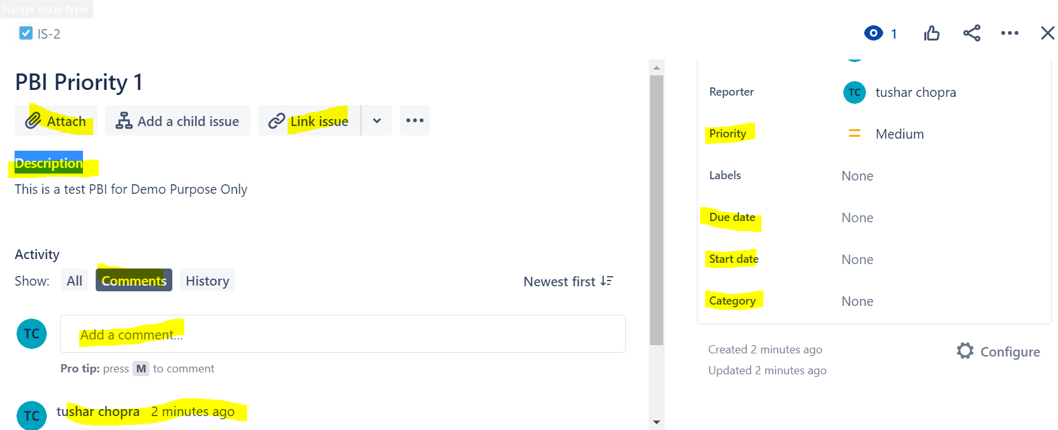
Details captured in PBIs

Slide 67
Details of Highlighted Items
Description:
  This is used to mention the details of the PBI/Work Item
Comments:
  This is used to collaborate on the task. All members can post comments and have discussions.
History:-
  Details out all actions performed in the past.
Due Date & Start Date
Category

Slide 68
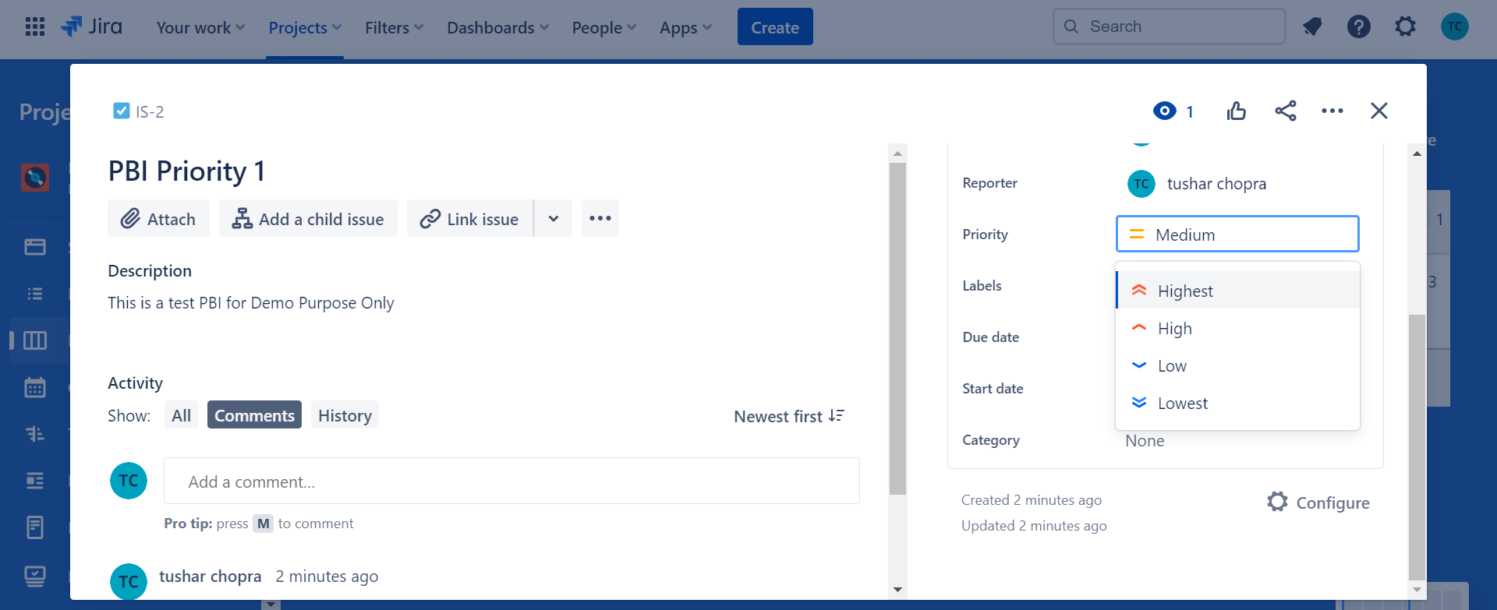
Priority

Slide 69
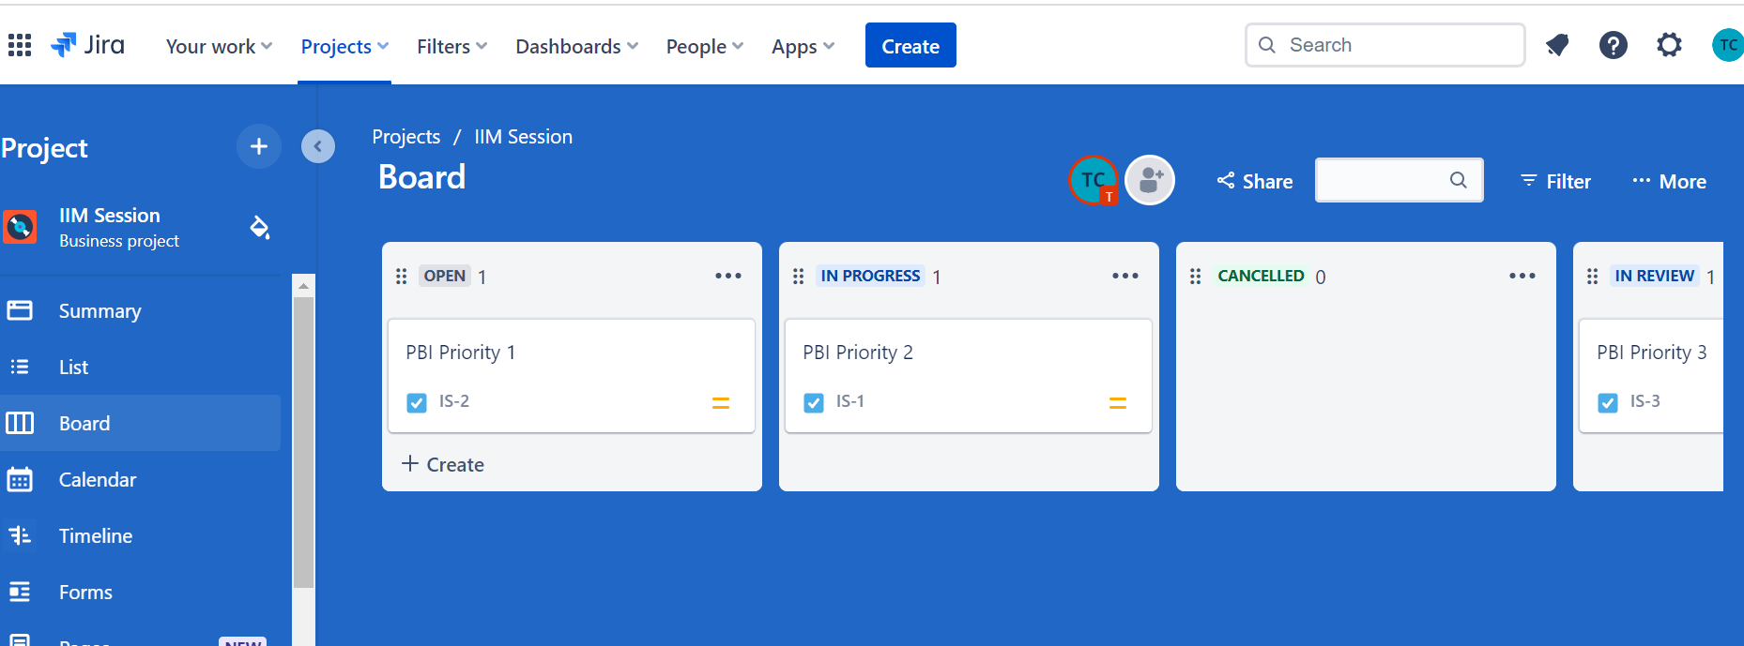
Drag and Drop
We can easily drag and drop these into different columns to show the progress or state:

Slide 70
Overview of Top Panel

Slide 71
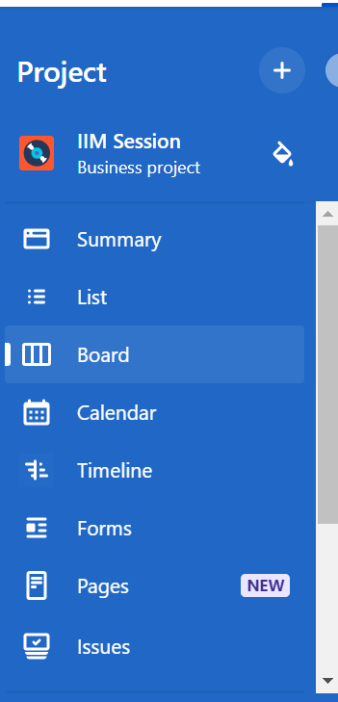
Overview of Side Panel

Slide 72
Links for Downloading Agile Tools
Jira Link:
  https://www.atlassian.com/agile/tutorials/how-to-do-scrum-with-jira-software
  Jira Templates:- https://www.atlassian.com/software/jira/templates
Mocrosoft Azure Link:
  https://azure.microsoft.com/en-in/services/devops/

Slide 73
Q&A

