Slide 2
Jargons & Battle of Venn Diagrams
AI
ML
Neural Network
Deep Learning
Generative AI

Slide 3
Introduction to Modelling

Slide 4
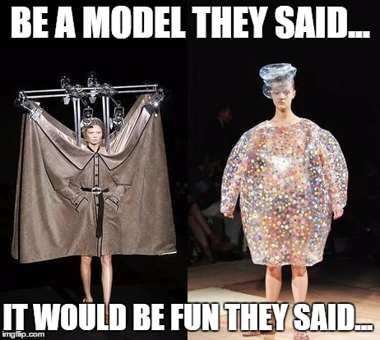
What is a Model !

Slide 5
A mathematical model is a description of a system using mathematical concepts and language

Slide 6
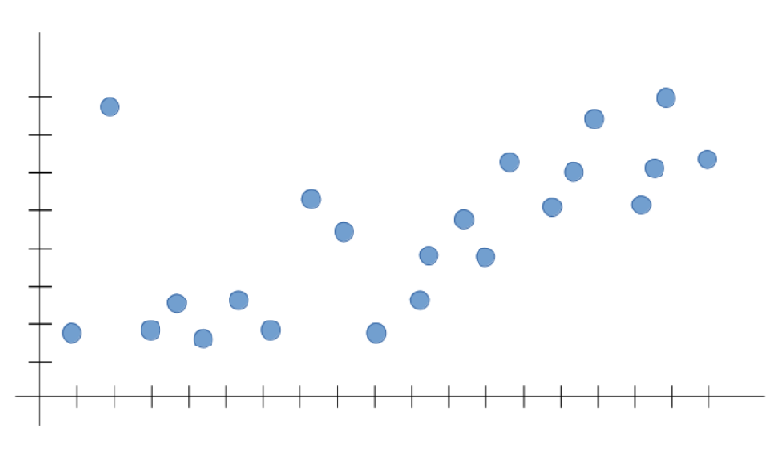
Notes:
A Model to capture the dominant trend

Slide 7
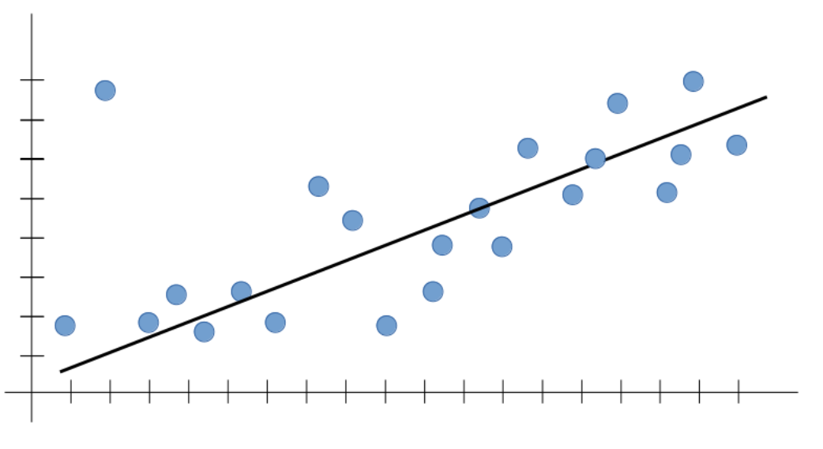
Notes:
Seems to be idea . Simple linear regression

Slide 8
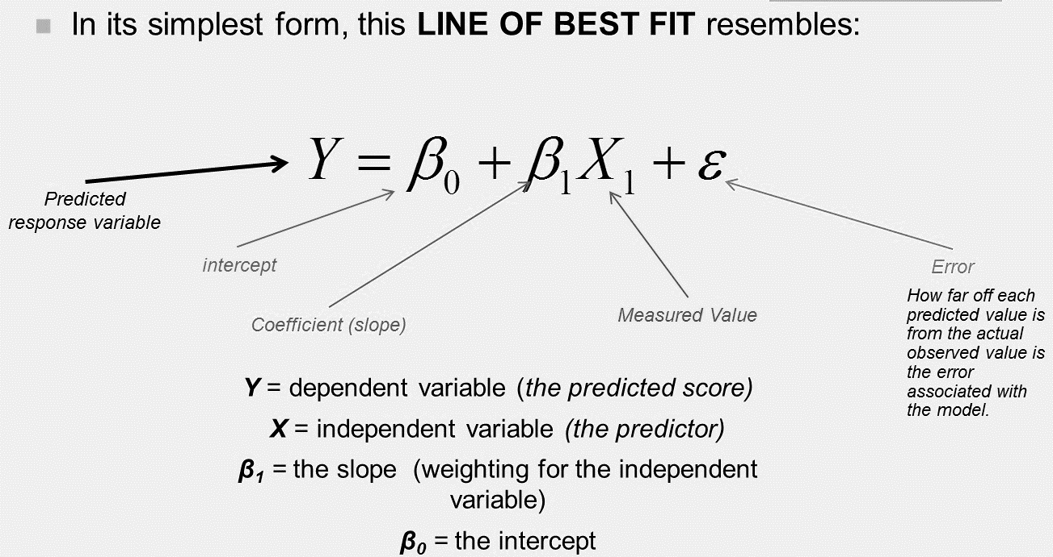

Slide 9
Outcome_{i} = (model) + error_{i}

Slide 10
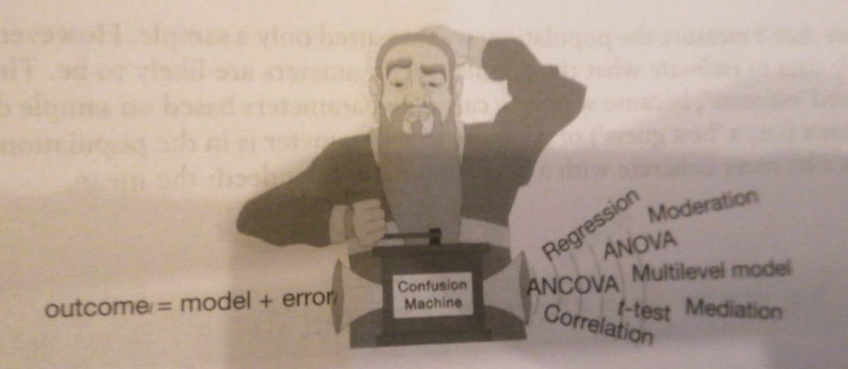

Slide 11
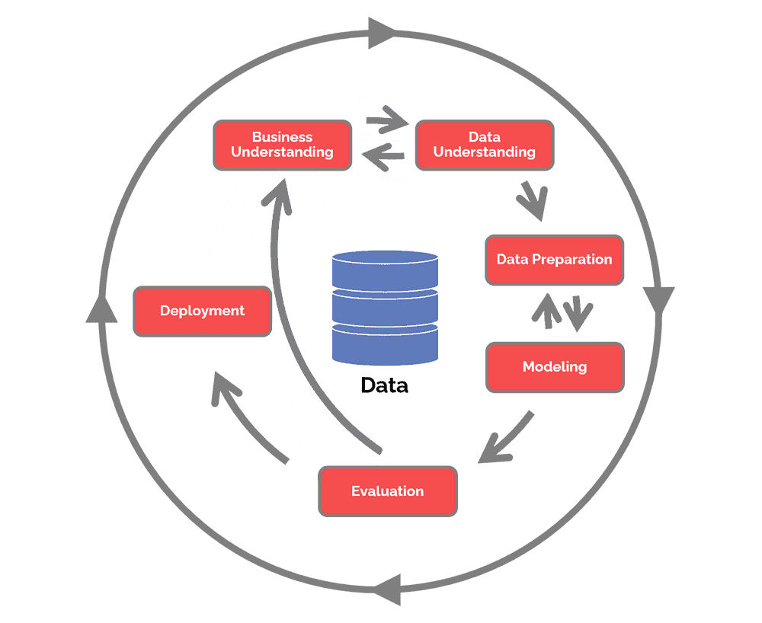
CRISP-DM - Cross-Industry Standard Process for Data Mining

Slide 12
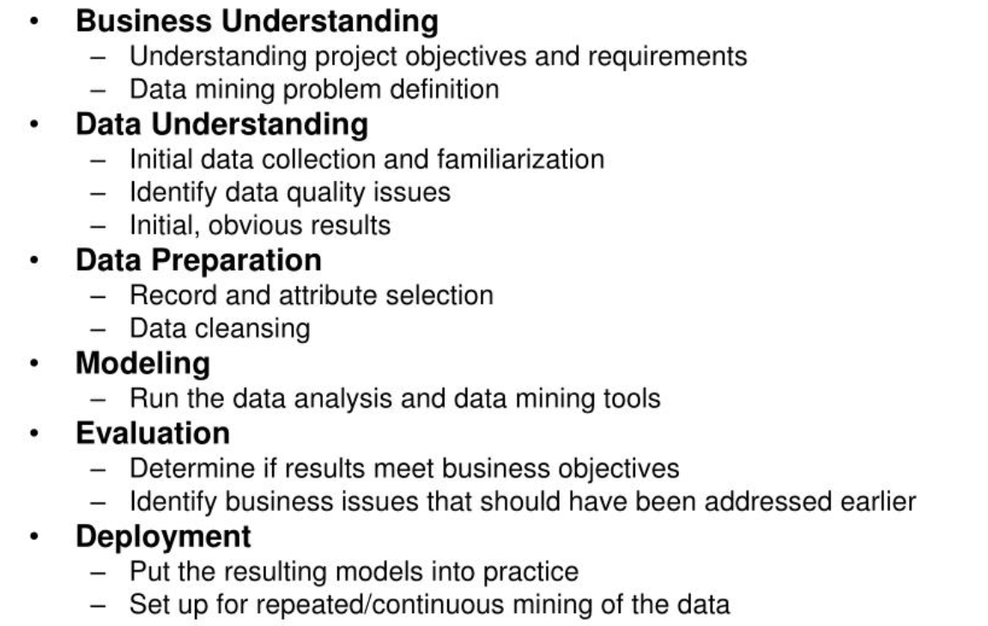

Slide 14
Data Preparation

Slide 15
Missing Values In a Dataset
Data Imputation

Slide 16
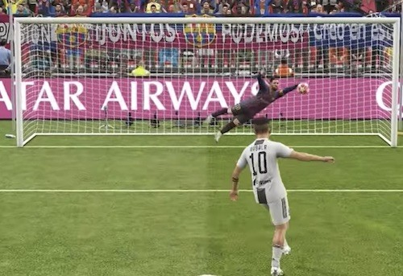
Do Nothing !
Notes:
Let Algorithms take care of it !
Ignore those data records !

Slide 17
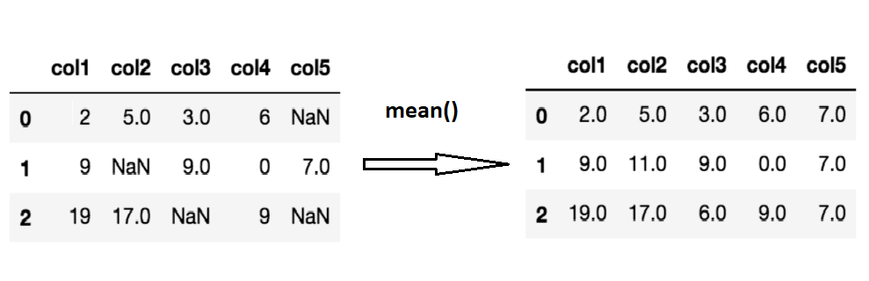
Imputation Using Mean/Median
Notes:
Pros:
•Easy and fast.
•Works well with small numerical datasets.
Cons:
•Doesn’t factor the correlations between features. It only works on the column level.
•Will give poor results on encoded categorical features (do NOT use it on categorical features).
•Not very accurate.

Slide 18
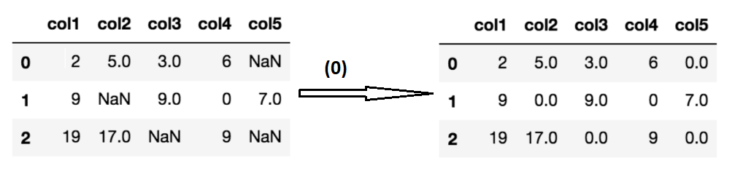
Imputation Using Most Frequent /Zero/ Constant
Notes:
Pros:
•Works well with categorical features.
Cons:
•It also doesn’t factor the correlations between features.
•It can introduce bias in the data.

Slide 19
Imputation Using k-NN or other algorithms including deep learning
Notes:
•Can be much more accurate than the mean, median or most frequent imputation methods (It depends on the dataset).
Cons:
•Computationally expensive. KNN works by storing the whole training dataset in memory.
•K-NN is quite sensitive to outliers in the data (unlike SVM

Slide 20
Notes:
Sample data set , we want to use for . The essence of an algorithm like Linear Regression is to capture the dominant trend and fit our line within that trend.regression

Slide 21
Notes:
Seems to be idea . Simple linear regression

Slide 22
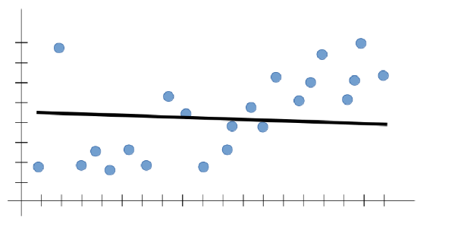
Notes:
Underfitting
It usually happens when we have less data to build an accurate model and also when we try to build a linear model with a non-linear data. In such cases the rules of the machine learning model are too easy and flexible to be applied on such a minimal data and therefore the model will probably make a lot of wrong predictions. Underfitting can be avoided by using more data and also reducing the features by feature selection.

Slide 23
Underfitting:
A statistical model is said to have underfitting when it cannot capture the underlying trend of the data.
This is usually indicated by poor performance in training data itself
Notes:
It usually happens when we have less data to build an accurate model and also when we try to build a linear model with a non-linear data. In such cases the rules of the machine learning model are too easy and flexible to be applied on such a minimal data and therefore the model will probably make a lot of wrong predictions. Underfitting can be avoided by using more data and also reducing the features by feature selection.
A solution to avoid overfitting is using a linear algorithm if we have linear data or using the parameters like the maximal depth if we are using decision trees.

Slide 24
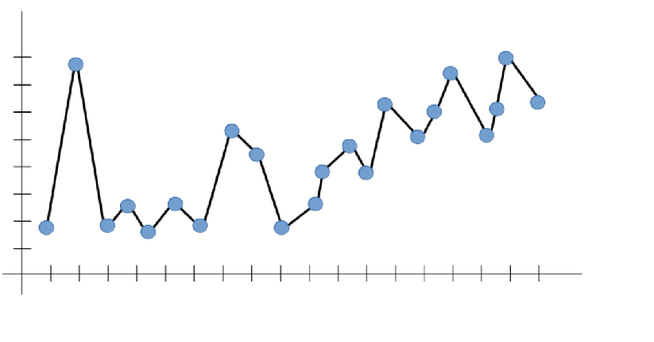
Notes:
The essence of an algorithm like Linear Regression is to capture the dominant trend and fit our line within that trend. In the figure above, the algorithm captured all trends — but not the dominant one. If we want to test the model on inputs that are beyond the line limits we have (i.e. generalize), what would that line look like? There is really no way to tell. Therefore, the outputs aren’t reliable. If the model does not capture the dominant trend that we can all see (positively increasing, in our case), it can’t predict a likely output for an input that it has never seen before — defying the purpose of Machine Learning to begin with!
A solution to avoid overfitting is using a linear algorithm if we have linear data or using the parameters like the maximal depth if we are using decision trees.

Slide 25
Overfitting:
A statistical model is said to be overfitted, it learns the detail and noise in the training data to the extent that it negatively impacts the performance of the model on new data
This is usually indicated by very high performance in training data but poor performance in test data / during real world application .

Slide 26
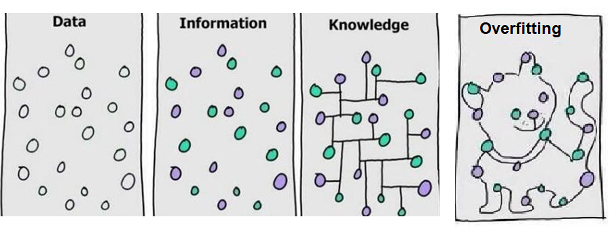

Slide 27
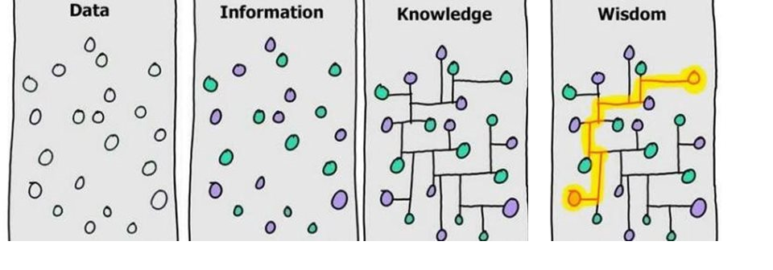

Slide 28
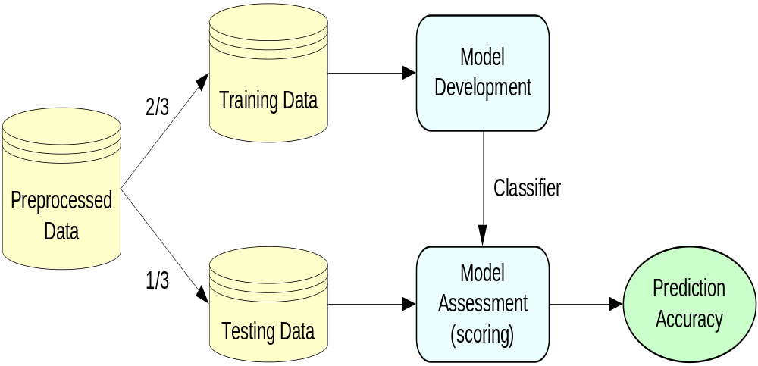
Training and Testing Data Sets
Notes:
Disadvantage – Test data information is missed out while building model

Slide 29
Cross Validation
Is a technique which involves reserving a particular sample of a dataset on which you do not train the model. Later, you test your model on this sample before finalizing it.
You reserve a sample data set
Train the model using the remaining part of the dataset
Use the reserve sample of the test (validation) set

Slide 30
k-fold cross validation
Randomly split your entire dataset into k”folds”
For each k-fold in your dataset, build your model on k – 1 folds of the dataset. Then, test the model to check the effectiveness for kth fold
Record the error you see on each of the predictions
Repeat this until each of the k-folds has served as the test set
The average of your k recorded errors is called the cross-validation error and will serve as your performance metric for the model

Slide 31
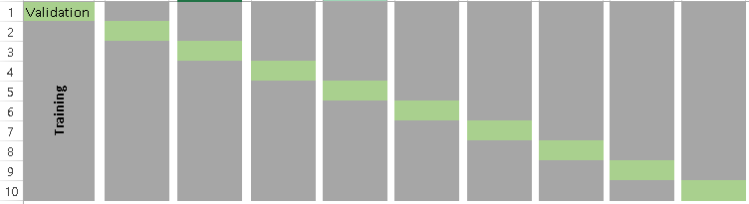
K= 10, fold validation

Slide 32
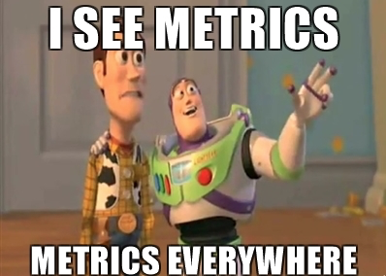
Evaluation Metrics

Slide 33
MAE

Slide 34



Mean Absolute Error (MAE): MAE measures the average magnitude of the errors in a set of predictions, without considering their direction. It’s the average over the test sample of the absolute differences between prediction and actual observation where all individual differences have equal weight.

Slide 35
When can MAE come in negative ?

Slide 36


Root mean squared error (RMSE): RMSE is the square root of the average of squared differences between prediction and actual observation.

Slide 37

Why use RMSE

Slide 38



RMSE penalizes larger errors

Slide 39
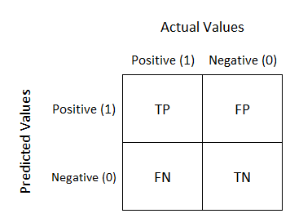



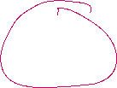

















Confusion Matrix

Slide 40
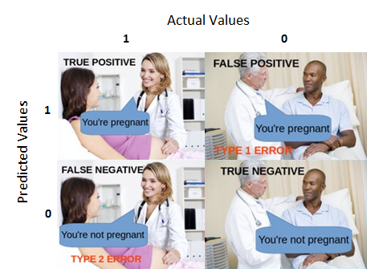
@Jane Alam

Slide 41

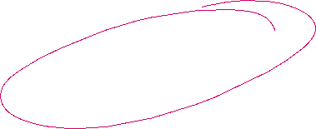
Accuracy = (TP + TN) / (TP + TN + FP + FN)
Accuracy is the ratio of true results among the total number of cases examined.
Ideal scenario !
Extra territorial life

Slide 42
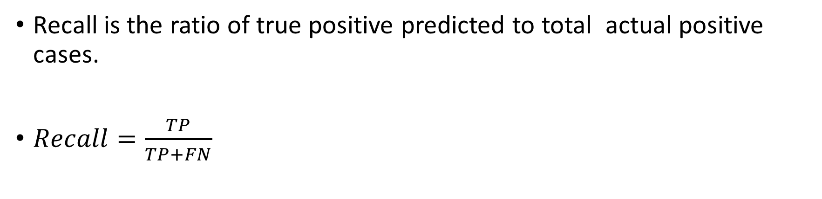

Recall is the ratio of true positive predicted to total actual positive cases.
$Recall=\frac{TP}{TP+FN}$

Slide 43


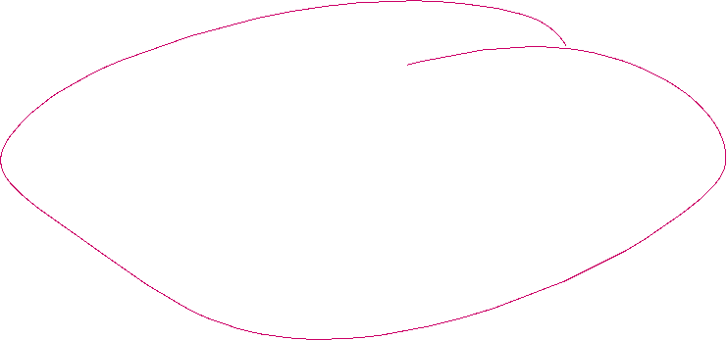


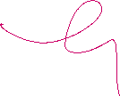



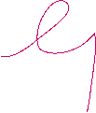

Recall shall be the model metric we use to select our best model when there is a high cost associated with False Negative.
For instance, in fraud detection or sick patient detection. If a fraudulent transaction (Actual Positive) is predicted as non-fraudulent (Predicted Negative), the consequence can be very bad for the bank.

Slide 44

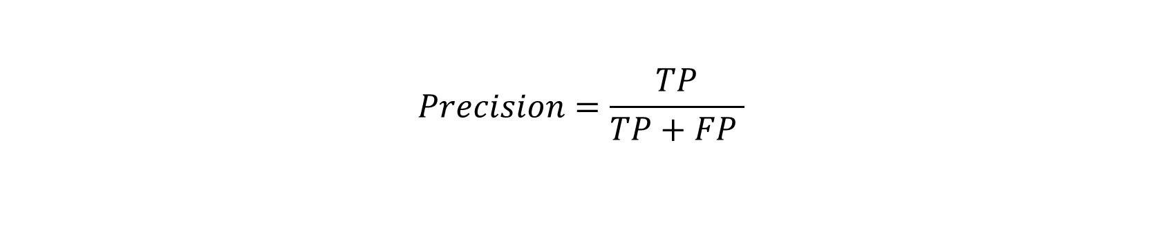


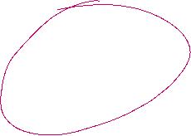
Precision is the ratio of true positive to total number of items predicted as positive
$$Precision=\frac{TP}{TP+FP }$$

Slide 45
Precision is a good measure to consider, when the costs of False Positive is high.
For instance, email spam detection. In email spam detection, a false positive means that an email that is non-spam (actual negative) has been identified as spam (predicted spam). The email user might lose important emails if the precision is not high for the spam detection model.

Slide 46
Class Task

Slide 47
AIIMS Mangalagiri has created a new rapid testing kit using the latest AI algorithms to screen for covid for all the pilgrims visiting the Shri Tirupati Balaji Shrine.
As an AI Consultant , you are hired to advise the local district administration on how efficient the kit is.
You got the kit evaluated and found that out of 165 test samples, 100 times the kit was able to detect a person as covid positive when the person was covid positive in reality. However, for 5 covid positive patients, the kit diagnosed them as covid negative. For 50 covid negative patients, the kit also diagnosed them as covid negative, but for 10 people who were covid negative, the kit falsely diagnosed them as covid positive.
Which evaluation metric will you use and why. What is it’s value ?

Slide 48
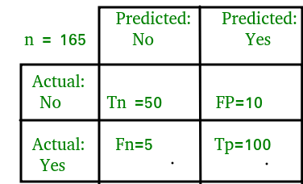
Notes:
Classification Rate/Accuracy:
Accuracy = (TP + TN) / (TP + TN + FP + FN)= (100+50) /(100+5+10+50)= 0.90
Recall: Recall gives us an idea about when it’s actually yes, how often does it predict yes.
Recall=TP / (TP + FN)=100/(100+5)=0.95
Precision: Precsion tells us about when it predicts yes, how often is it correct.
Precision = TP / (TP + FP)=100/ (100+10)=0.91
F-measure:
Fmeasure=(2*Recall*Precision)/(Recall+Presision)=(2*0.95*0.91)/(0.91+0.95)=0.92

Slide 49

F1-Score.

Slide 50
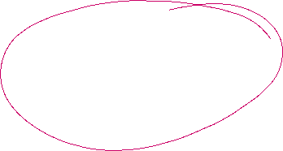
Biasness
Researchers at MIT found that three of the latest gender-recognition programmes, developed by IBM, Microsoft, and Megvii, could correctly identify a person’s gender from a photograph 99% of the time – but only for white men. For Black, Asian and Minority Ethnic (BAME) communities , women, accuracy dropped to just 35%.

Slide 51
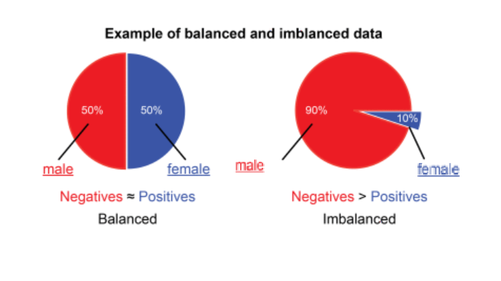


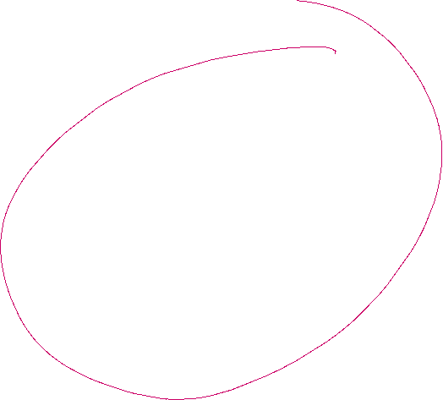
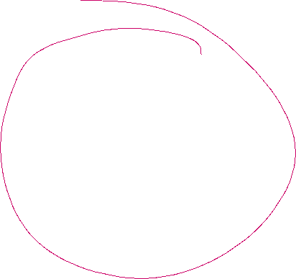


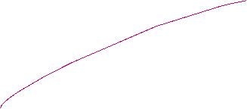

Slide 52









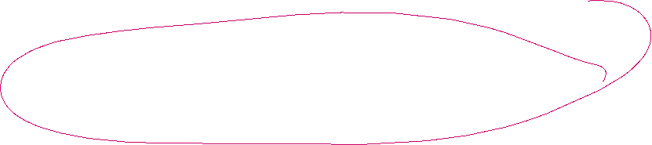
Best Practices…
Under-sampling - Under-sampling balances the dataset by reducing the size of the abundant class.
Oversampling – It tries to balance dataset by increasing the size of rare samples. Rather than getting rid of abundant samples, new rare samples are generated ( including repetition !)
Using Right evaluation metrices
Ensembling – Combining several model
Notes:
Oversampling could lead to overfitting

