Slide 1
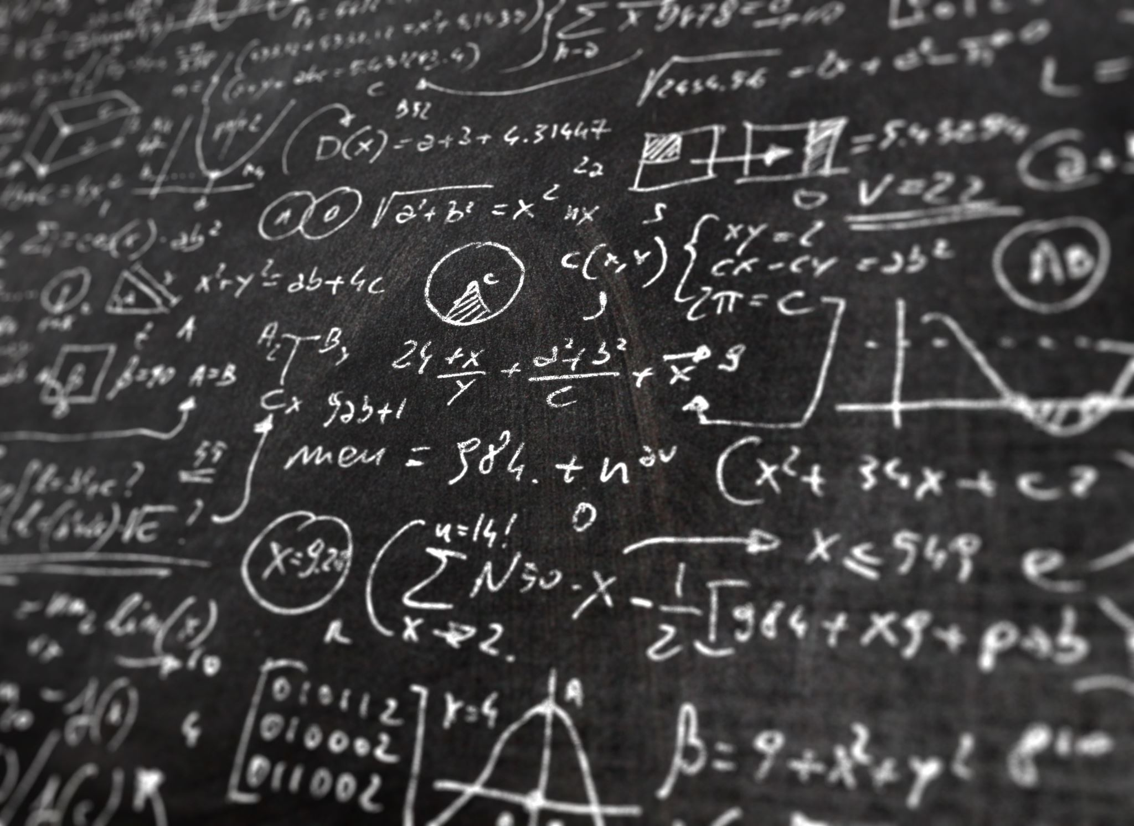
Introduction to Machine Learning & Modelling

Slide 2

@Graeme Stuart

Slide 3
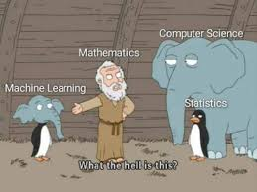
What is Machine Learning ?

Slide 4
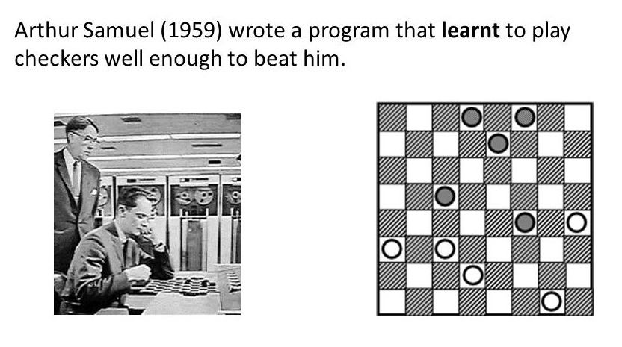

Slide 5
Machine learning - computers discovering how they can perform tasks without being explicitly programmed to do so (Arthur Samuel coined the term)

Slide 6
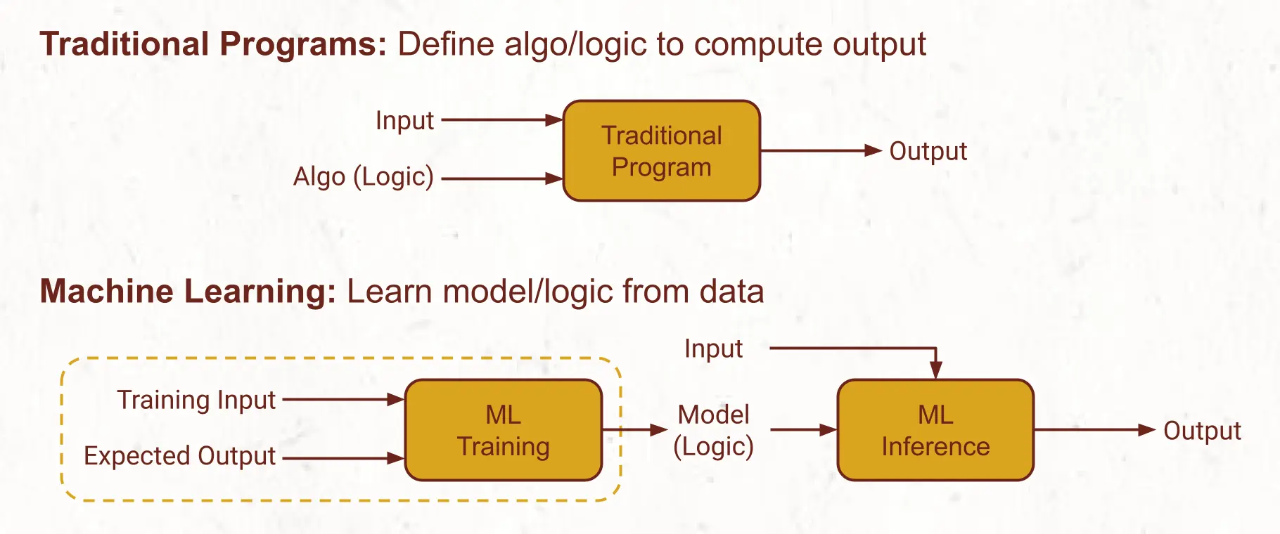
@ml4dev

Slide 7
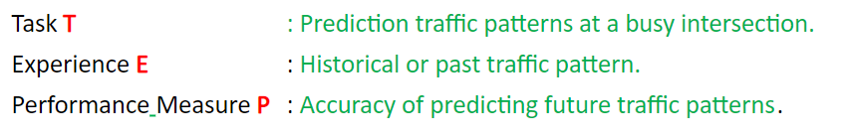
"A computer program is said to learn from experience E with respect to some class of tasks T and performance measure P if its performance at tasks in T, as measured by P, improves with experience E."
Tom M Mitchell et al. “Machine learning. 1997”. In: Burr Ridge, IL: McGraw Hill 45.37 (1997), pp. 870–877.

Slide 8
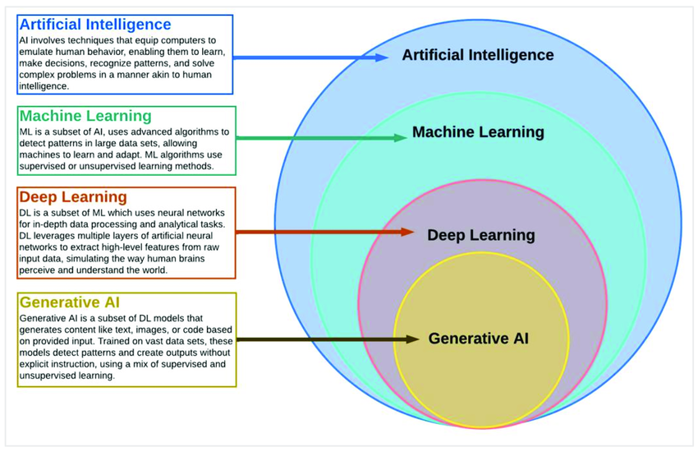
Zhuhadar, Lily & Lytras, Miltiadis. (2023). The Application of AutoML Techniques in Diabetes Diagnosis: Current Approaches, Performance, and Future Directions. Sustainability. 15. 13484. 10.3390/su151813484.

Slide 9
Types of Machine Learning - Supervised , Unsupervised , Semi-Supervised

Slide 10
Supervised
Human interaction/interference
Labelled data
Y = f(x)

Slide 11
Example of Supervised Learning
Linear Regression
Logistic regression based Classification
Naive Bayesian based Classification
Decision trees
SVM
kNN

Slide 12
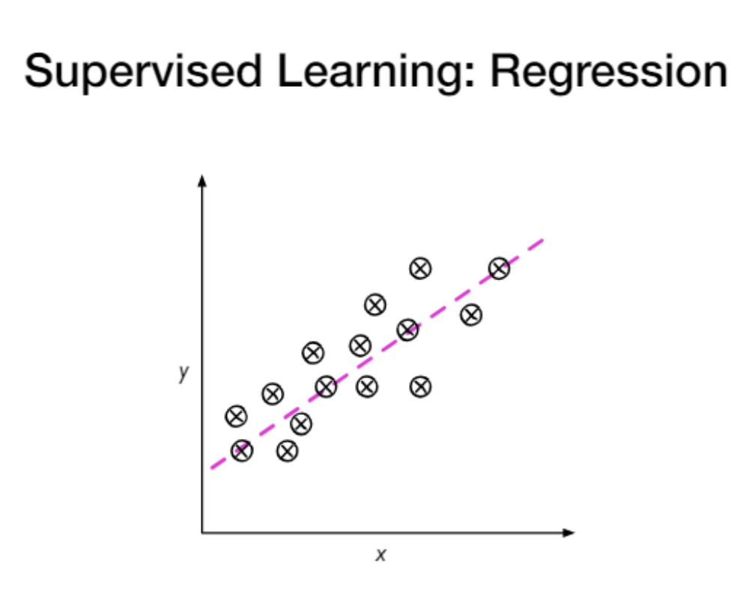

Slide 13
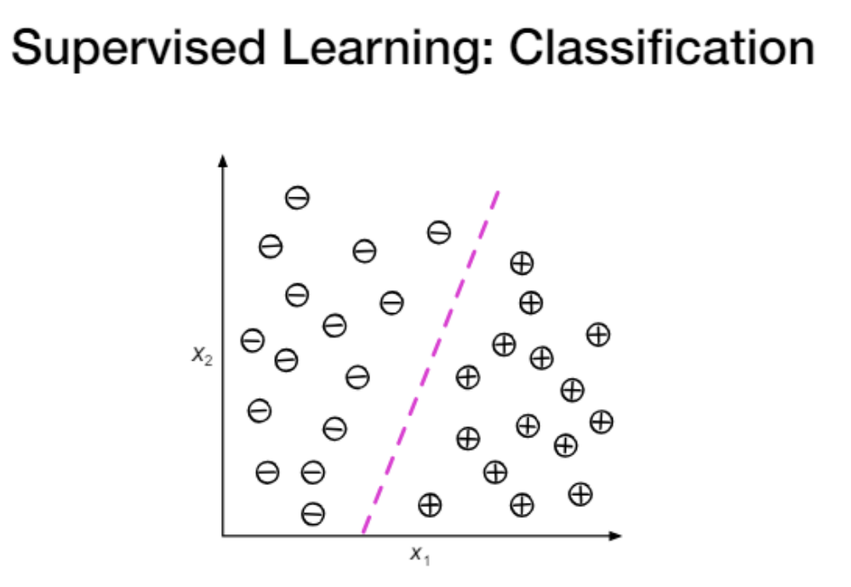

Slide 14
Unsupervised
algorithm is not provided with any pre-assigned labels or scores for the training data.
No Y

Slide 15
Examples of UnSupervised Learning
K means Clustering
hierarchical clustering
Association Rules

Slide 16


Slide 17
Semi supervised
100 records
90 records – unlabelled
10 records – labelled
100 unlabelled records – unsupervised ML problem

Slide 18
Uses the unlabeled data to gain more understanding
When only small training set is available.
To take advantage of the test set which also contains a lot of valuable information .
Quite frequently used in text and image data.

Slide 19
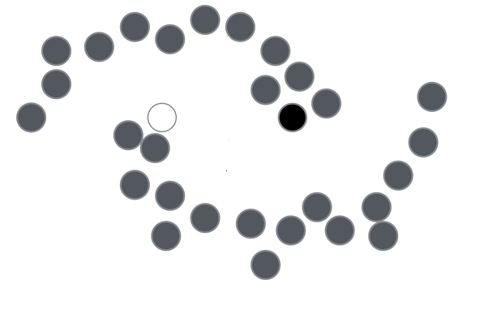
Only 1 black and 1 white is labelled , grey are unlabelled data and needs to be predicted.

Slide 20
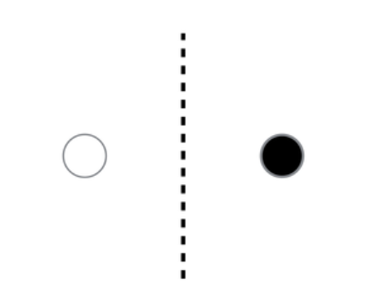

Slide 21
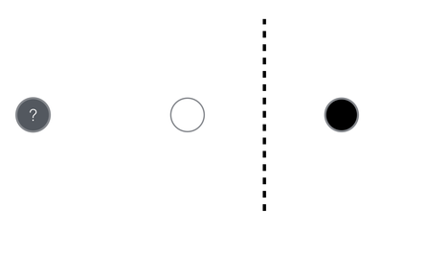

Slide 22
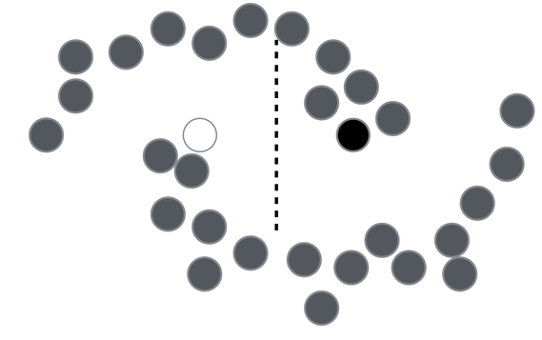

Slide 23
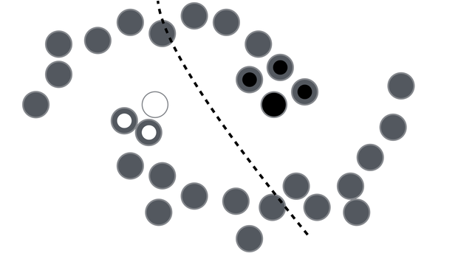
Some homogeneity , smoothness assumption - points close to each other belong to the same class

Slide 24
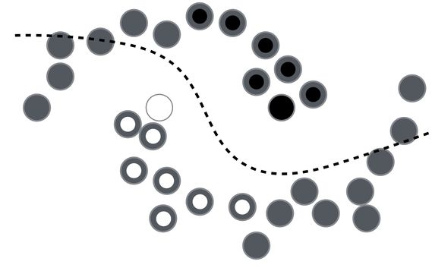

Slide 25
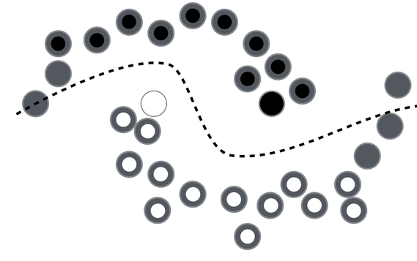

Slide 26
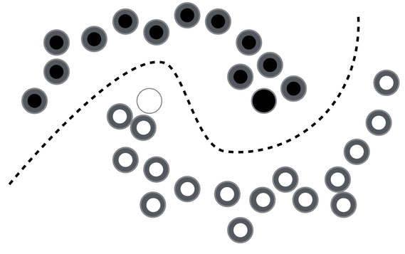

Slide 27
Vapnik Principle

Slide 28
Vapnik Principle
In order to solve a problem don’t pick an intermediate problem of a higher order of complexity.

