Slide 1
Traditional Business Analytics vs AI/ML Projects
Output of a BA project is usually a report with a summary of current situation and actionable insights, while usually output of a ML/AI project is a module / piece of computer code than gets incorporated into a larger software application / deployed in production environment.

Slide 2
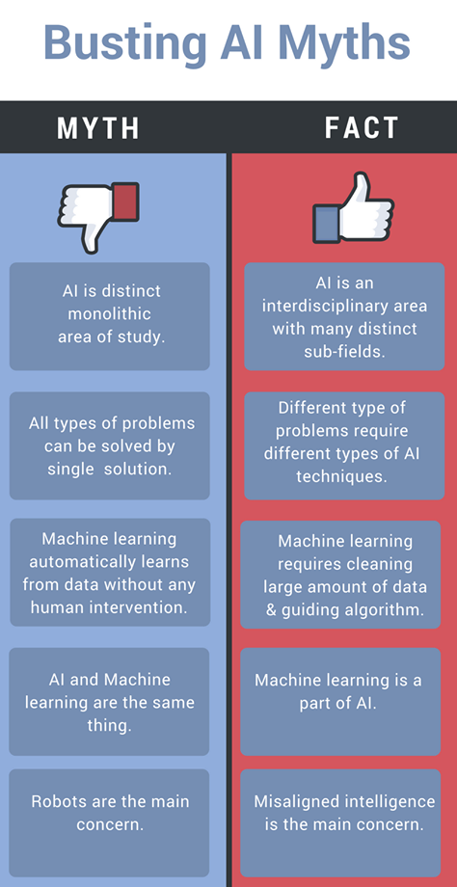
@hacker.io

Slide 3
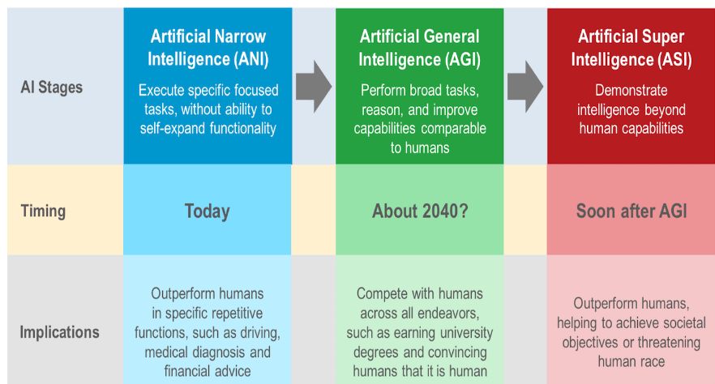

Slide 4

#AIForGood
https://aiforgood.itu.int/gateway/

Slide 5
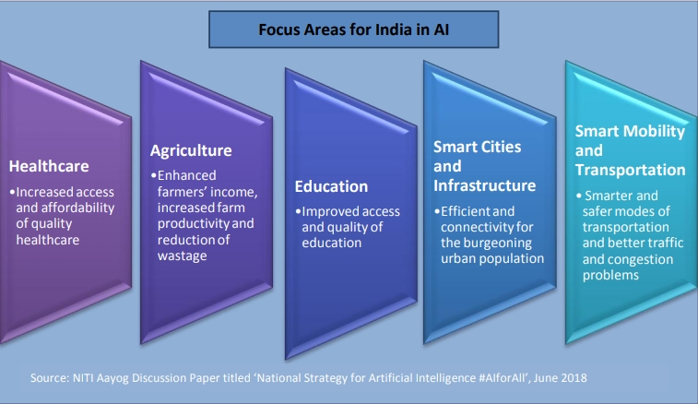
#AIforALL
#NitiAyog

Slide 6
Where to start with AI in your Organisation ?

Slide 7
Take an organization selfie
What is the current state of AI in your Organization / BU / Team
Clear and well-defined use cases ?
Right Data capturing processes ?
Tech capabilities to build AI models ?
Tech capabilities to deploy & scale AI models ?
Promised value getting realized or not ?

