Slide 1
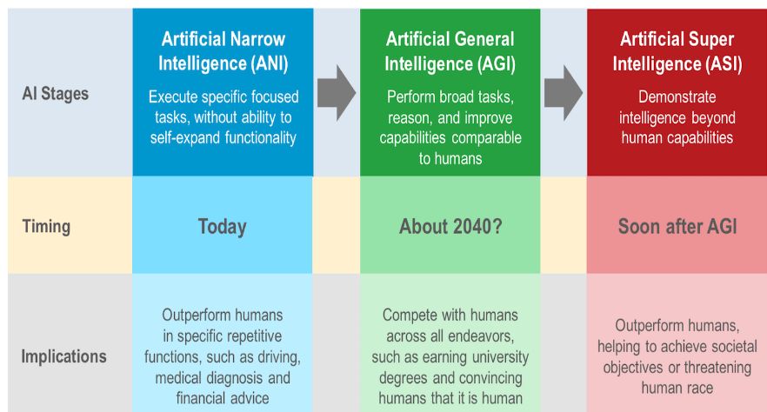

Slide 2

#AIForGood
https://aiforgood.itu.int/gateway/

Slide 3
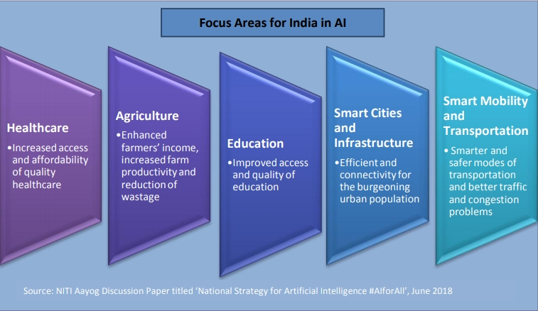
#AIforALL
#NitiAyog

Slide 4
Where to start with AI in your Organisation ?

Slide 5
Take an organization selfie
What is the current state of AI in your Organization / BU / Team
Clear and well-defined use cases ?
Right Data capturing processes ?
Tech capabilities to build AI models ?
Tech capabilities to deploy & scale AI models ?
Promised value getting realized or not ?

Slide 7

Moat !

Slide 8

Competitive moat / or as Warren Buffett Calls it “economic moat” is business' ability to maintain competitive advantages in order to protect its long-term profits and market share from competing firms . (Defensibility)

Slide 9
Can Technology be a moat ?

Slide 10


Slide 11
In the long-term, all technology becomes commoditized.
All tech moats are temporary,

Slide 12
How is long term Defensibility created in a Business

Slide 13
Economies of scale
Brand
Embedding
Network effects

Slide 14
Network Effect !
70% of the value created by tech companies since the Internet became a thing in 1994
Product or Service becomes more valuable as usage increases.
Value increase - > N , N² , 2^{N} (Reed’s Law)
Saturation levels
Not to be confused with viral effects. Viral is about getting new users (for free), while network effect is about creating defensibility

Slide 16
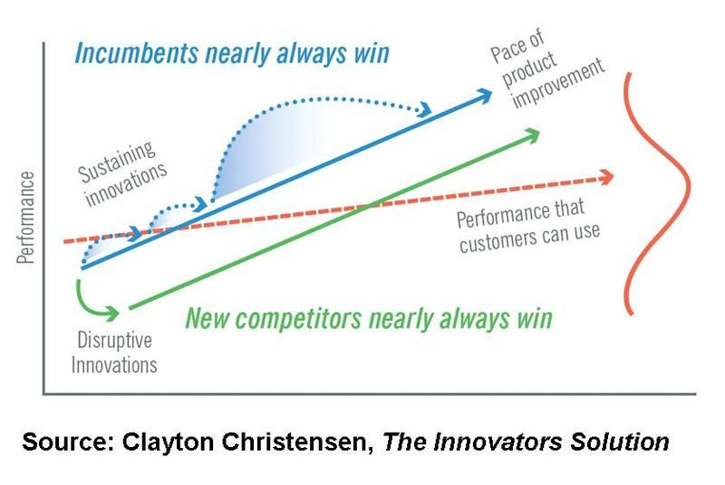

Slide 17
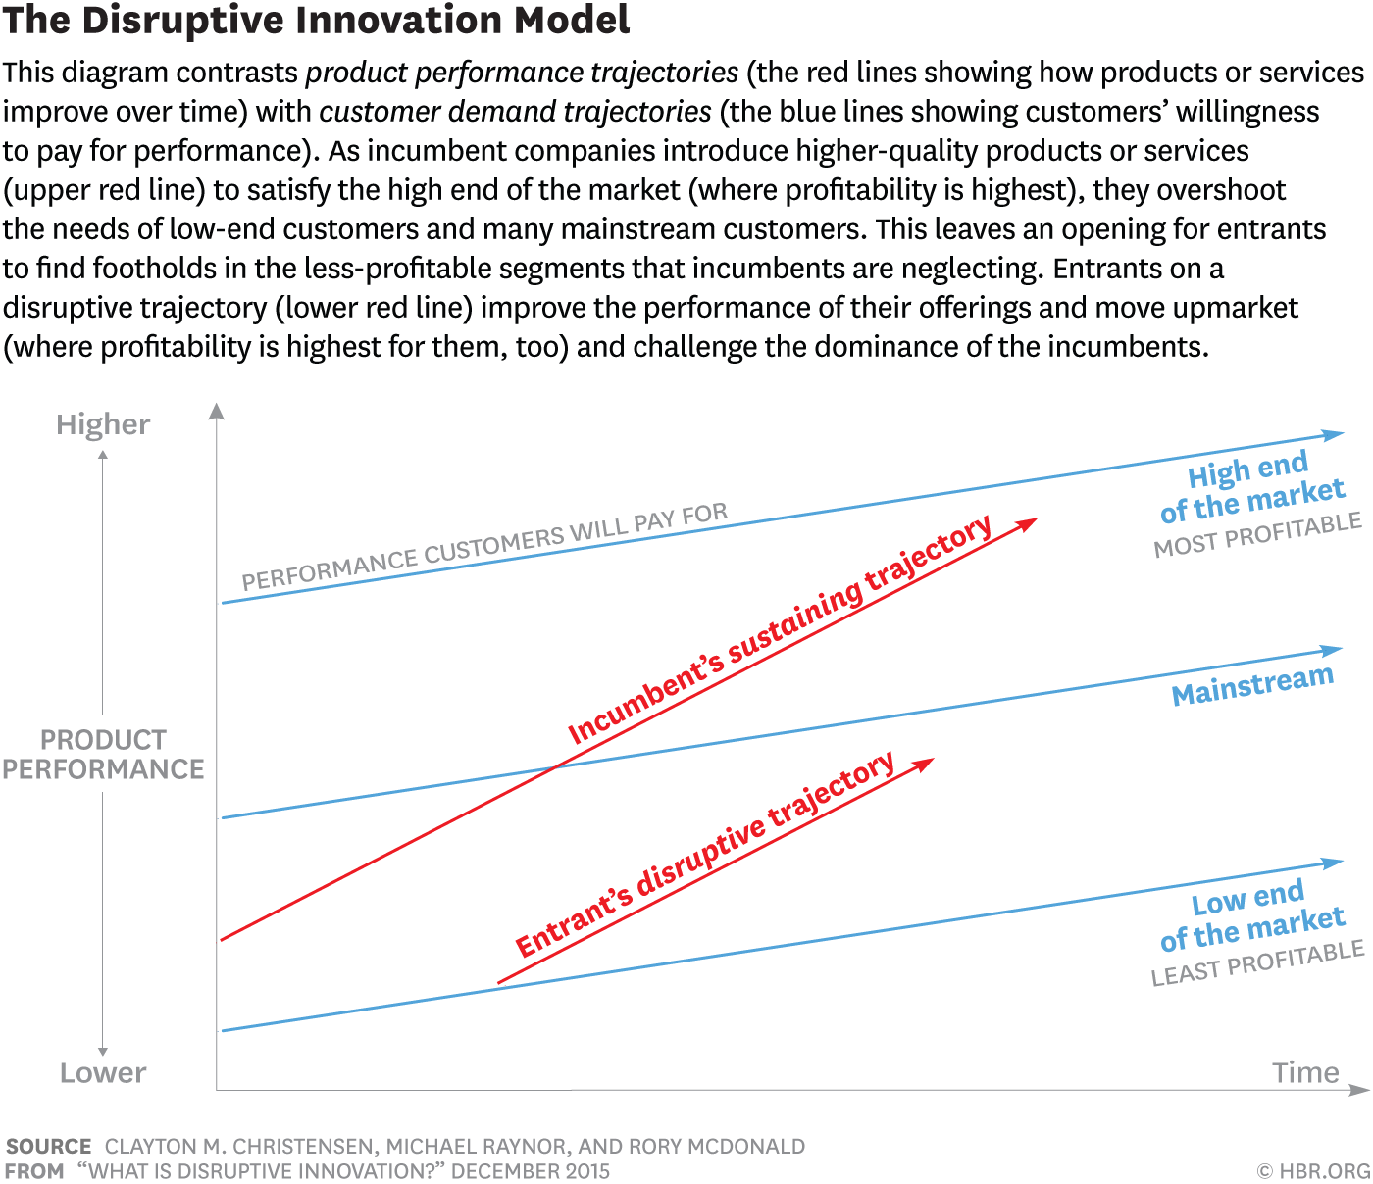

Slide 18
Key points
Trajectory of technological progress often slopes up much faster than ability of customer to utilize it !
Basis of competition changes usually from Functionality -> Reliability -> Speed /Convenience/Customization

