Slide 1
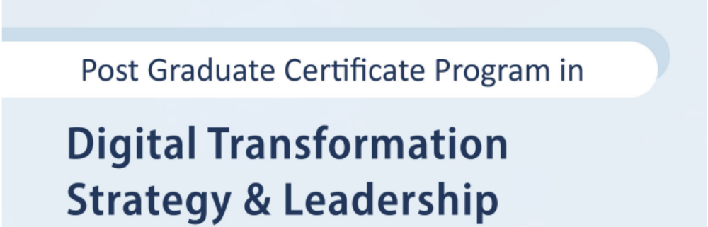
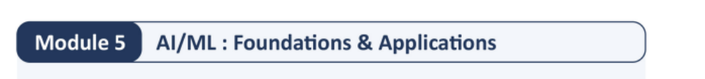

Slide 2
Session 1

Slide 3
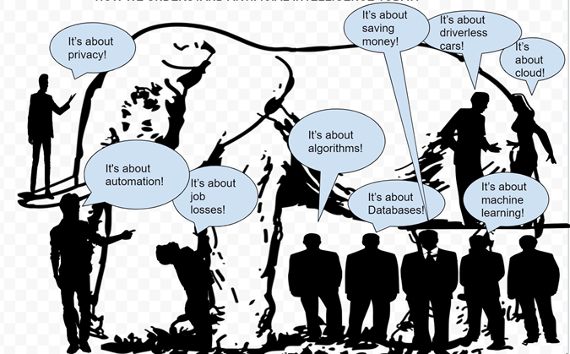
What is AI for you ?

Slide 4
What we want for you

Slide 5


Slide 6


Hands on sessions using various tools and frameworks.

Slide 7
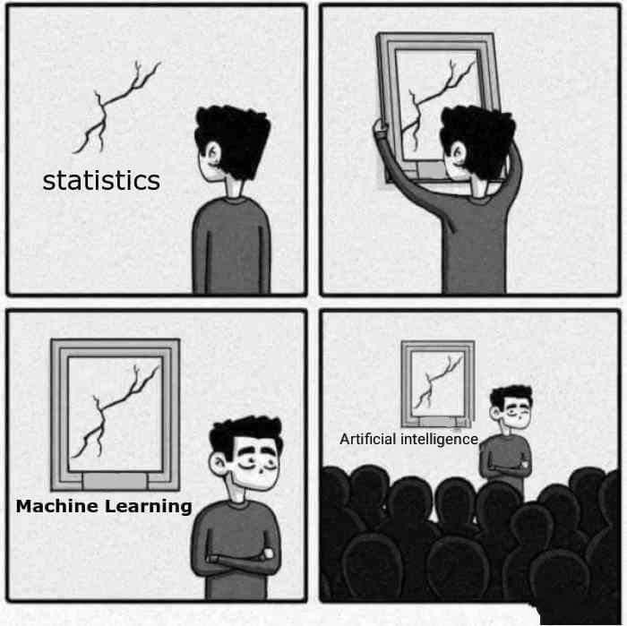
AI

Slide 8
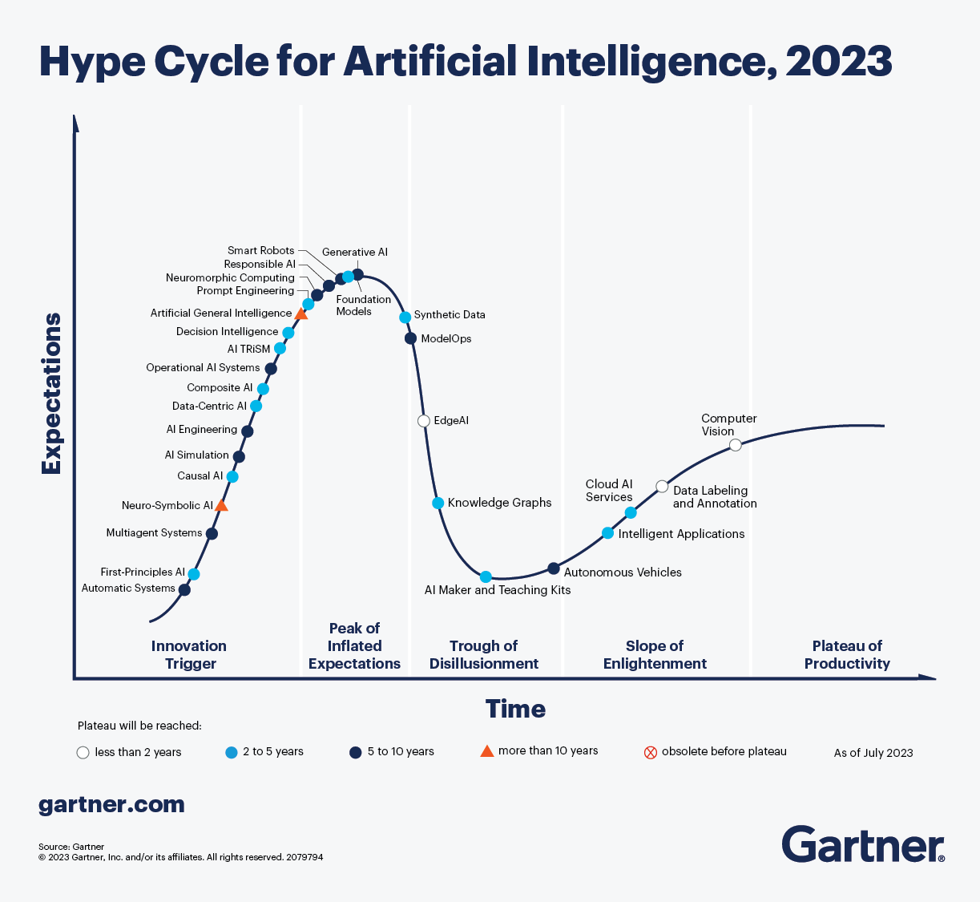

Slide 9
What is Intelligence ?

Slide 10
Intelligence is a property of an entity, which we will call the agent,
It interacts with an external problem or situation, which we will call the environment.
An agent’s intelligence is typically related to its ability to succeed with respect to one or more objectives, which we will call the goal.
Intelligence measures an agent’s general ability to achieve goals in a wide range of environments

Slide 11
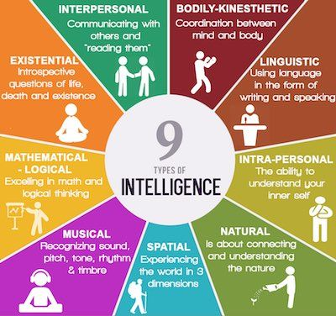
https://communicatorz.com/2016/07/27/9-types-of-intelligence/

Slide 12
What is Artificial Intelligence
“It is the science and engineering of making intelligent machines, especially intelligent computer programs. It is related to the similar task of using computers to understand human intelligence, but AI does not have to confine itself to methods that are biologically observable.” – Stanford

Slide 13
John McCarthy in 1956 was amongst the first use the term AI
the science and engineering of making intelligent machines

Slide 14
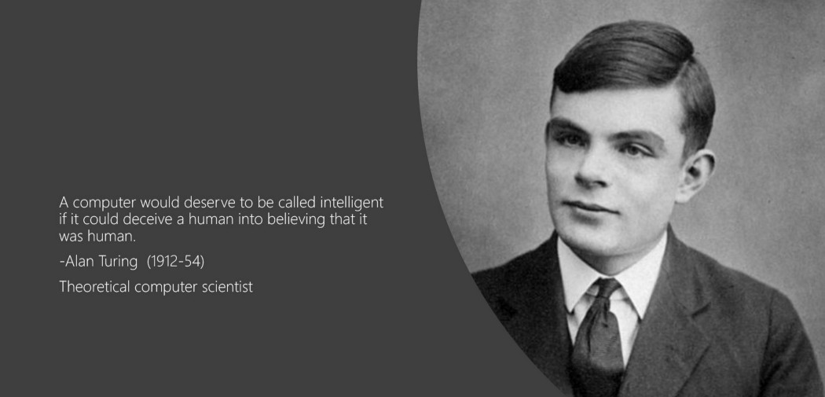

Slide 15
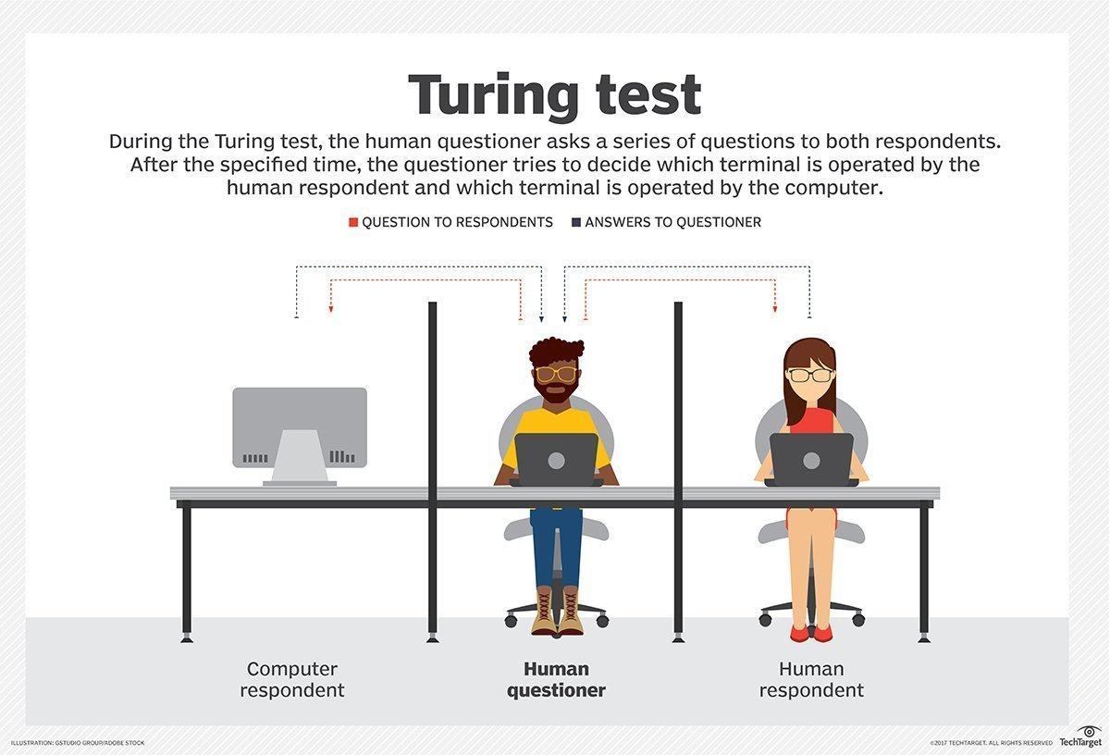

Slide 16
Reverse Turing test

Slide 17
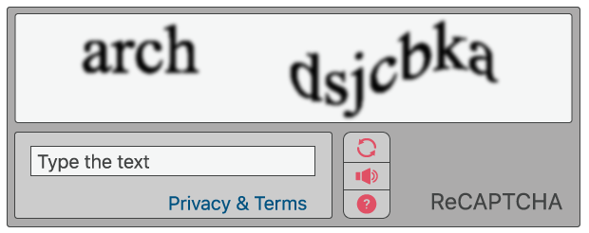
CAPTCHA - Completely Automated Public Turing test to tell Computers and Humans Apart

Slide 18
Jargons & Battle of Venn Diagrams
AI
ML
Neural Network
Deep Learning
Generative AI

Slide 19
AI for a typical Manager

Slide 20
How does a typical manager spends their time .
In what activities

Slide 21
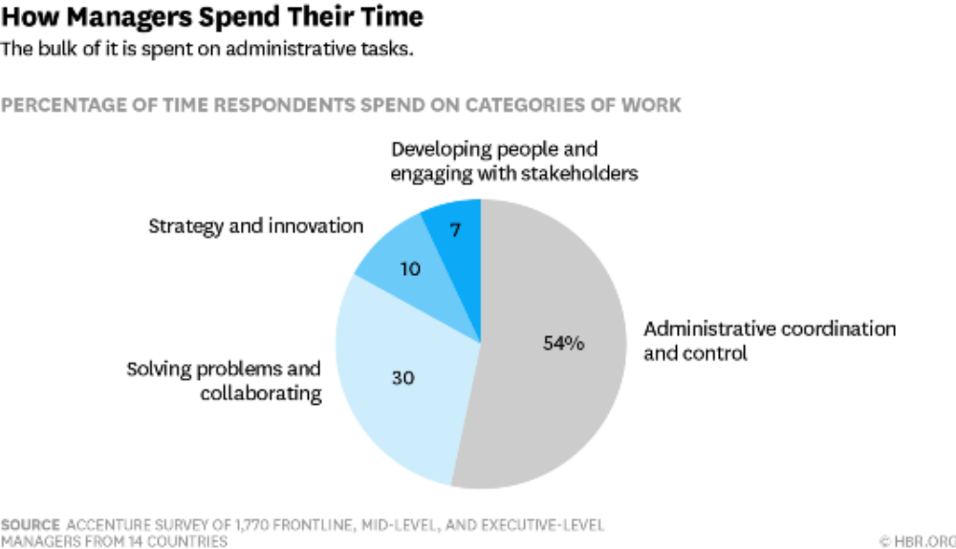

Slide 22
AI can support three important business needs:
Automating business processes
Gaining insight through data analysis (Analytics on Steroids)
Engaging with customers and employees.

Slide 23
Traditional Business Analytics vs AI/ML Projects
Output of a BA project is usually a report with a summary of current situation and actionable insights, while usually output of a ML/AI project is a module / piece of computer code than gets incorporated into a larger software application / deployed in production environment.

Slide 24
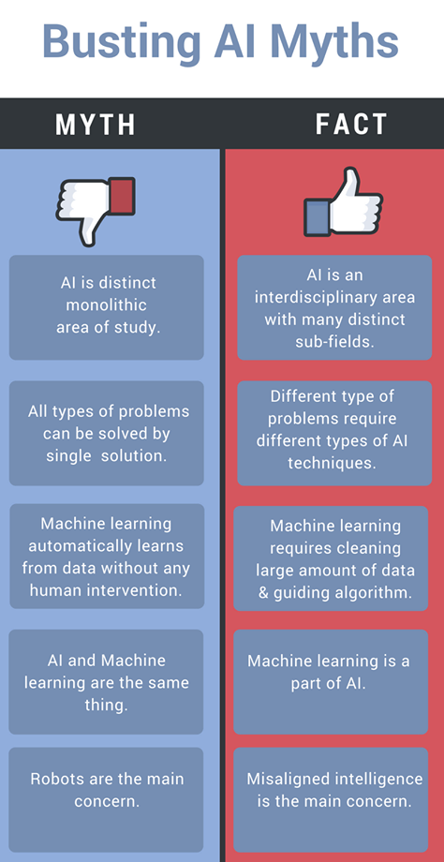
@hacker.io

Slide 25
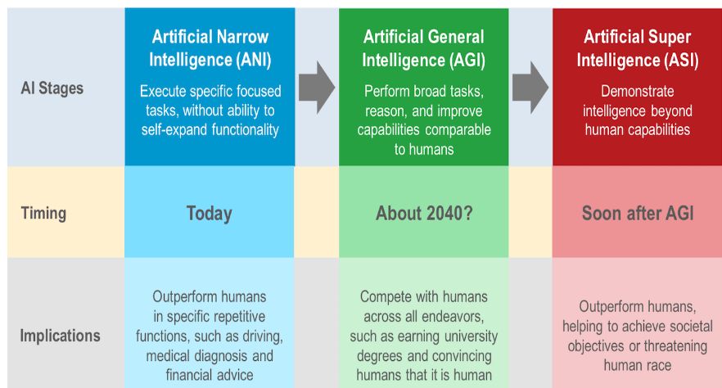

Slide 26

#AIForGood
https://aiforgood.itu.int/gateway/

Slide 27
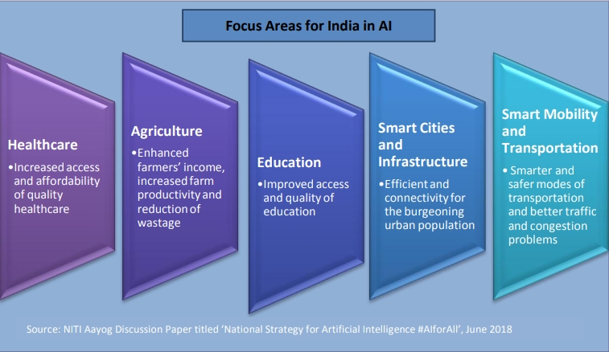
#AIforALL
#NitiAyog

Slide 28
Where to start with AI in your Organisation ?

Slide 29
Take an organization selfie
What is the current state of AI in your Organization / BU / Team
Clear and well-defined use cases ?
Right Data capturing processes ?
Tech capabilities to build AI models ?
Tech capabilities to deploy & scale AI models ?
Promised value getting realized or not ?

