Slide 1

Introduction
Demystifying Jargon, AI & Business
Introductory Session

Slide 2
In today’s era of “influencers”

Slide 3
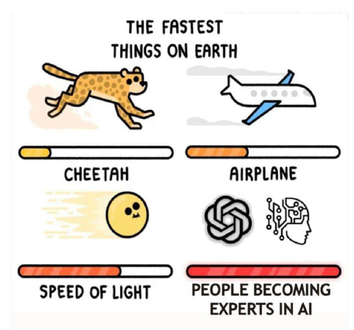

Slide 4
Role | Who They Are | What They Do
Makers | Builders & Innovators | Develop AI models, algorithms, and systems; Drive R&D in AI.
Shapers | Policymakers & Strategists | Set AI policies, regulations, and ethical guidelines; Shape the future of AI adoption.
Takers | Adopters & Users | Apply ready-made AI tools and solutions for practical business needs; Focus on implementation.
Fakers | Hype Creators & Buzzword Users | Use AI buzzwords without real knowledge; Overpromise capabilities; Fuel hype cycles for short term gains.

Slide 5

https://www.technologyreview.com/2019/03/05/65990/about-40-of-europes-ai-companies-dont-actually-use-any-ai-at-all/

Slide 6
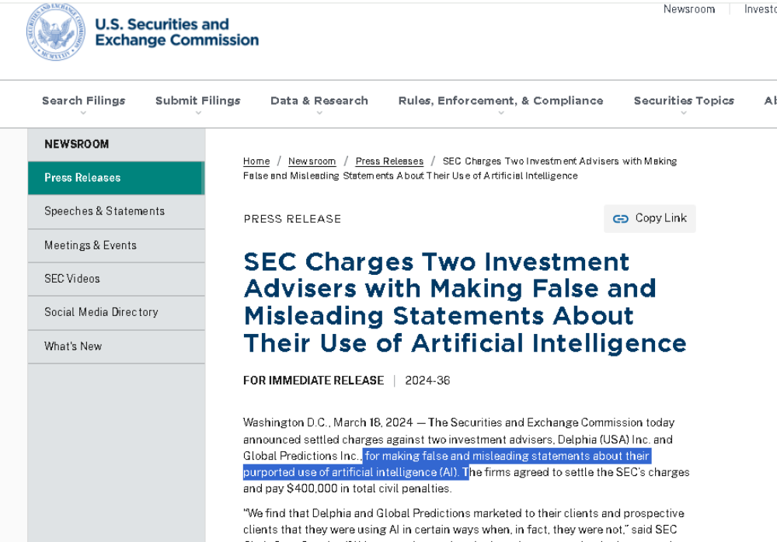
https://www.sec.gov/newsroom/press-releases/2024-36

Slide 7
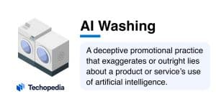
https://www.techopedia.com/definition/ai-washing
@Graeme Stuart

Slide 8
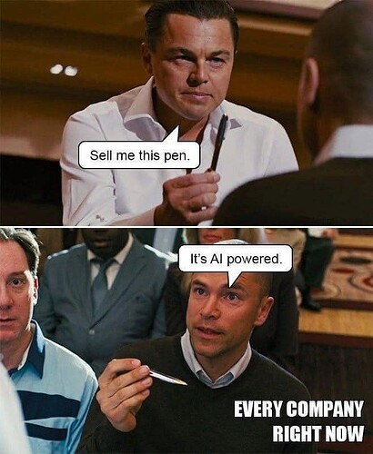

Slide 9

@Graeme Stuart

Slide 10
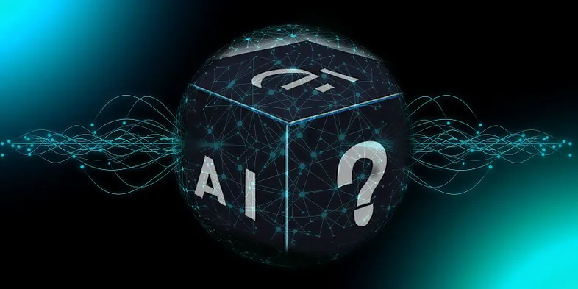
AI/ML shouldn’t be a black box for you.
Develop a foundational understanding of these algorithms and come up with innovative applications relevant to your context.
https://medium.com/@w.staceyy/demystifying-the-black-box-how-explainable-ai-is-building-trust-in-ai-systems-1f1c764aa66e

Slide 11
What we want for you

Slide 12


Slide 13
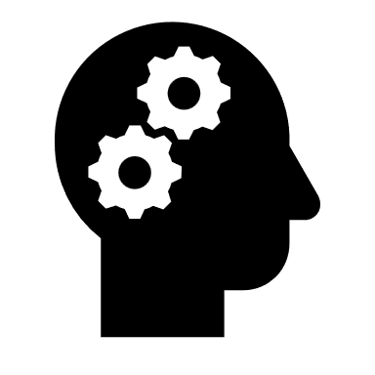

Hands on sessions using various tools and frameworks.

Slide 14
Quiz and Project

Slide 15
Thinking about data

Slide 16
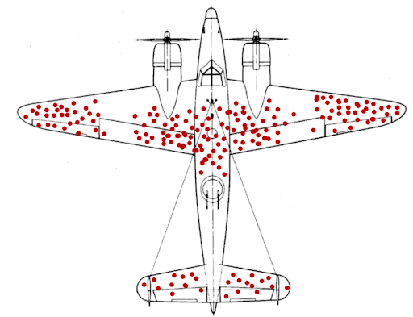

Slide 17
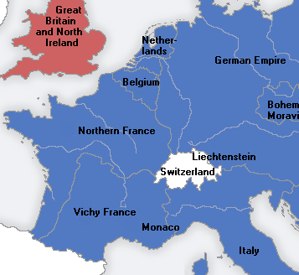



Slide 18
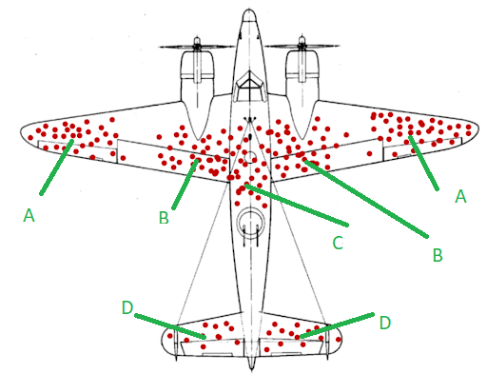

Slide 19
Understanding the Hype

Slide 22
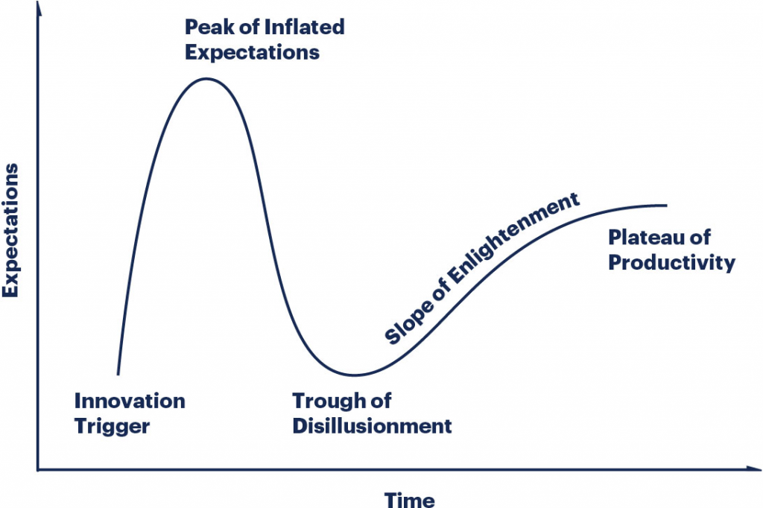

Slide 23
Hype Cycle
The Hype Cycle is a graphical depiction of a common pattern that arises with each new technology or other innovation. Although many of Gartner’s Hype Cycles focus on specific technologies or innovations, the same pattern of hype and disillusionment applies to higher level concepts such as IT methodologies and management disciplines.
@Gartner

Slide 24
Establish the expectation that most innovations, services and disciplines will progress through a pattern of overenthusiasm and disillusionment, followed by eventual productivity.
Provide a snapshot of the relative market promotion, maturity and value of innovations within a certain segment, such as a technology area, horizontal or vertical business market, or a demographic audience.
Show the speed at which each innovation is progressing through the Hype Cycle by indicating how long it will take to reach the Plateau of Productivity and the start of mainstream adoption.
Help strategists and planners by evaluating the market promotion and perception of value, business benefit, adoption rate and future direction of innovations
@Gartner

Slide 25
A technology (or related service and discipline innovation) passes through several stages on its path to productivity:
Innovation Trigger (formerly called Technology Trigger): The Hype Cycle starts when a breakthrough, public demonstration, product launch or other event generates press and industry interest in a technology innovation.
Peak of Inflated Expectations: A wave of “buzz” builds and the expectations for this innovation rise above the current reality of its capabilities. In some cases, an investment bubble forms, as happened with the web and social media.
Trough of Disillusionment: Inevitably, impatience for results begins to replace the original excitement about potential value. Problems with performance, slower-than-expected adoption or a failure to deliver financial returns in the time anticipated all lead to missed expectations, and disillusionment sets in.
Slope of Enlightenment: Some early adopters overcome the initial hurdles, begin to experience benefits and recommit efforts to move forward. Organizations draw on the experience of the early adopters. Their understanding grows about where and how the innovation can be used to good effect and, just as importantly, where it brings little or no value.
Plateau of Productivity: With the real-world benefits of the innovation demonstrated and accepted, growing numbers of organizations feel comfortable with the now greatly reduced levels of risk. A sharp rise in adoption begins (resembling a hockey stick when shown graphically), and penetration accelerates rapidly as a result of productive and useful value.
@Gartner

Slide 27
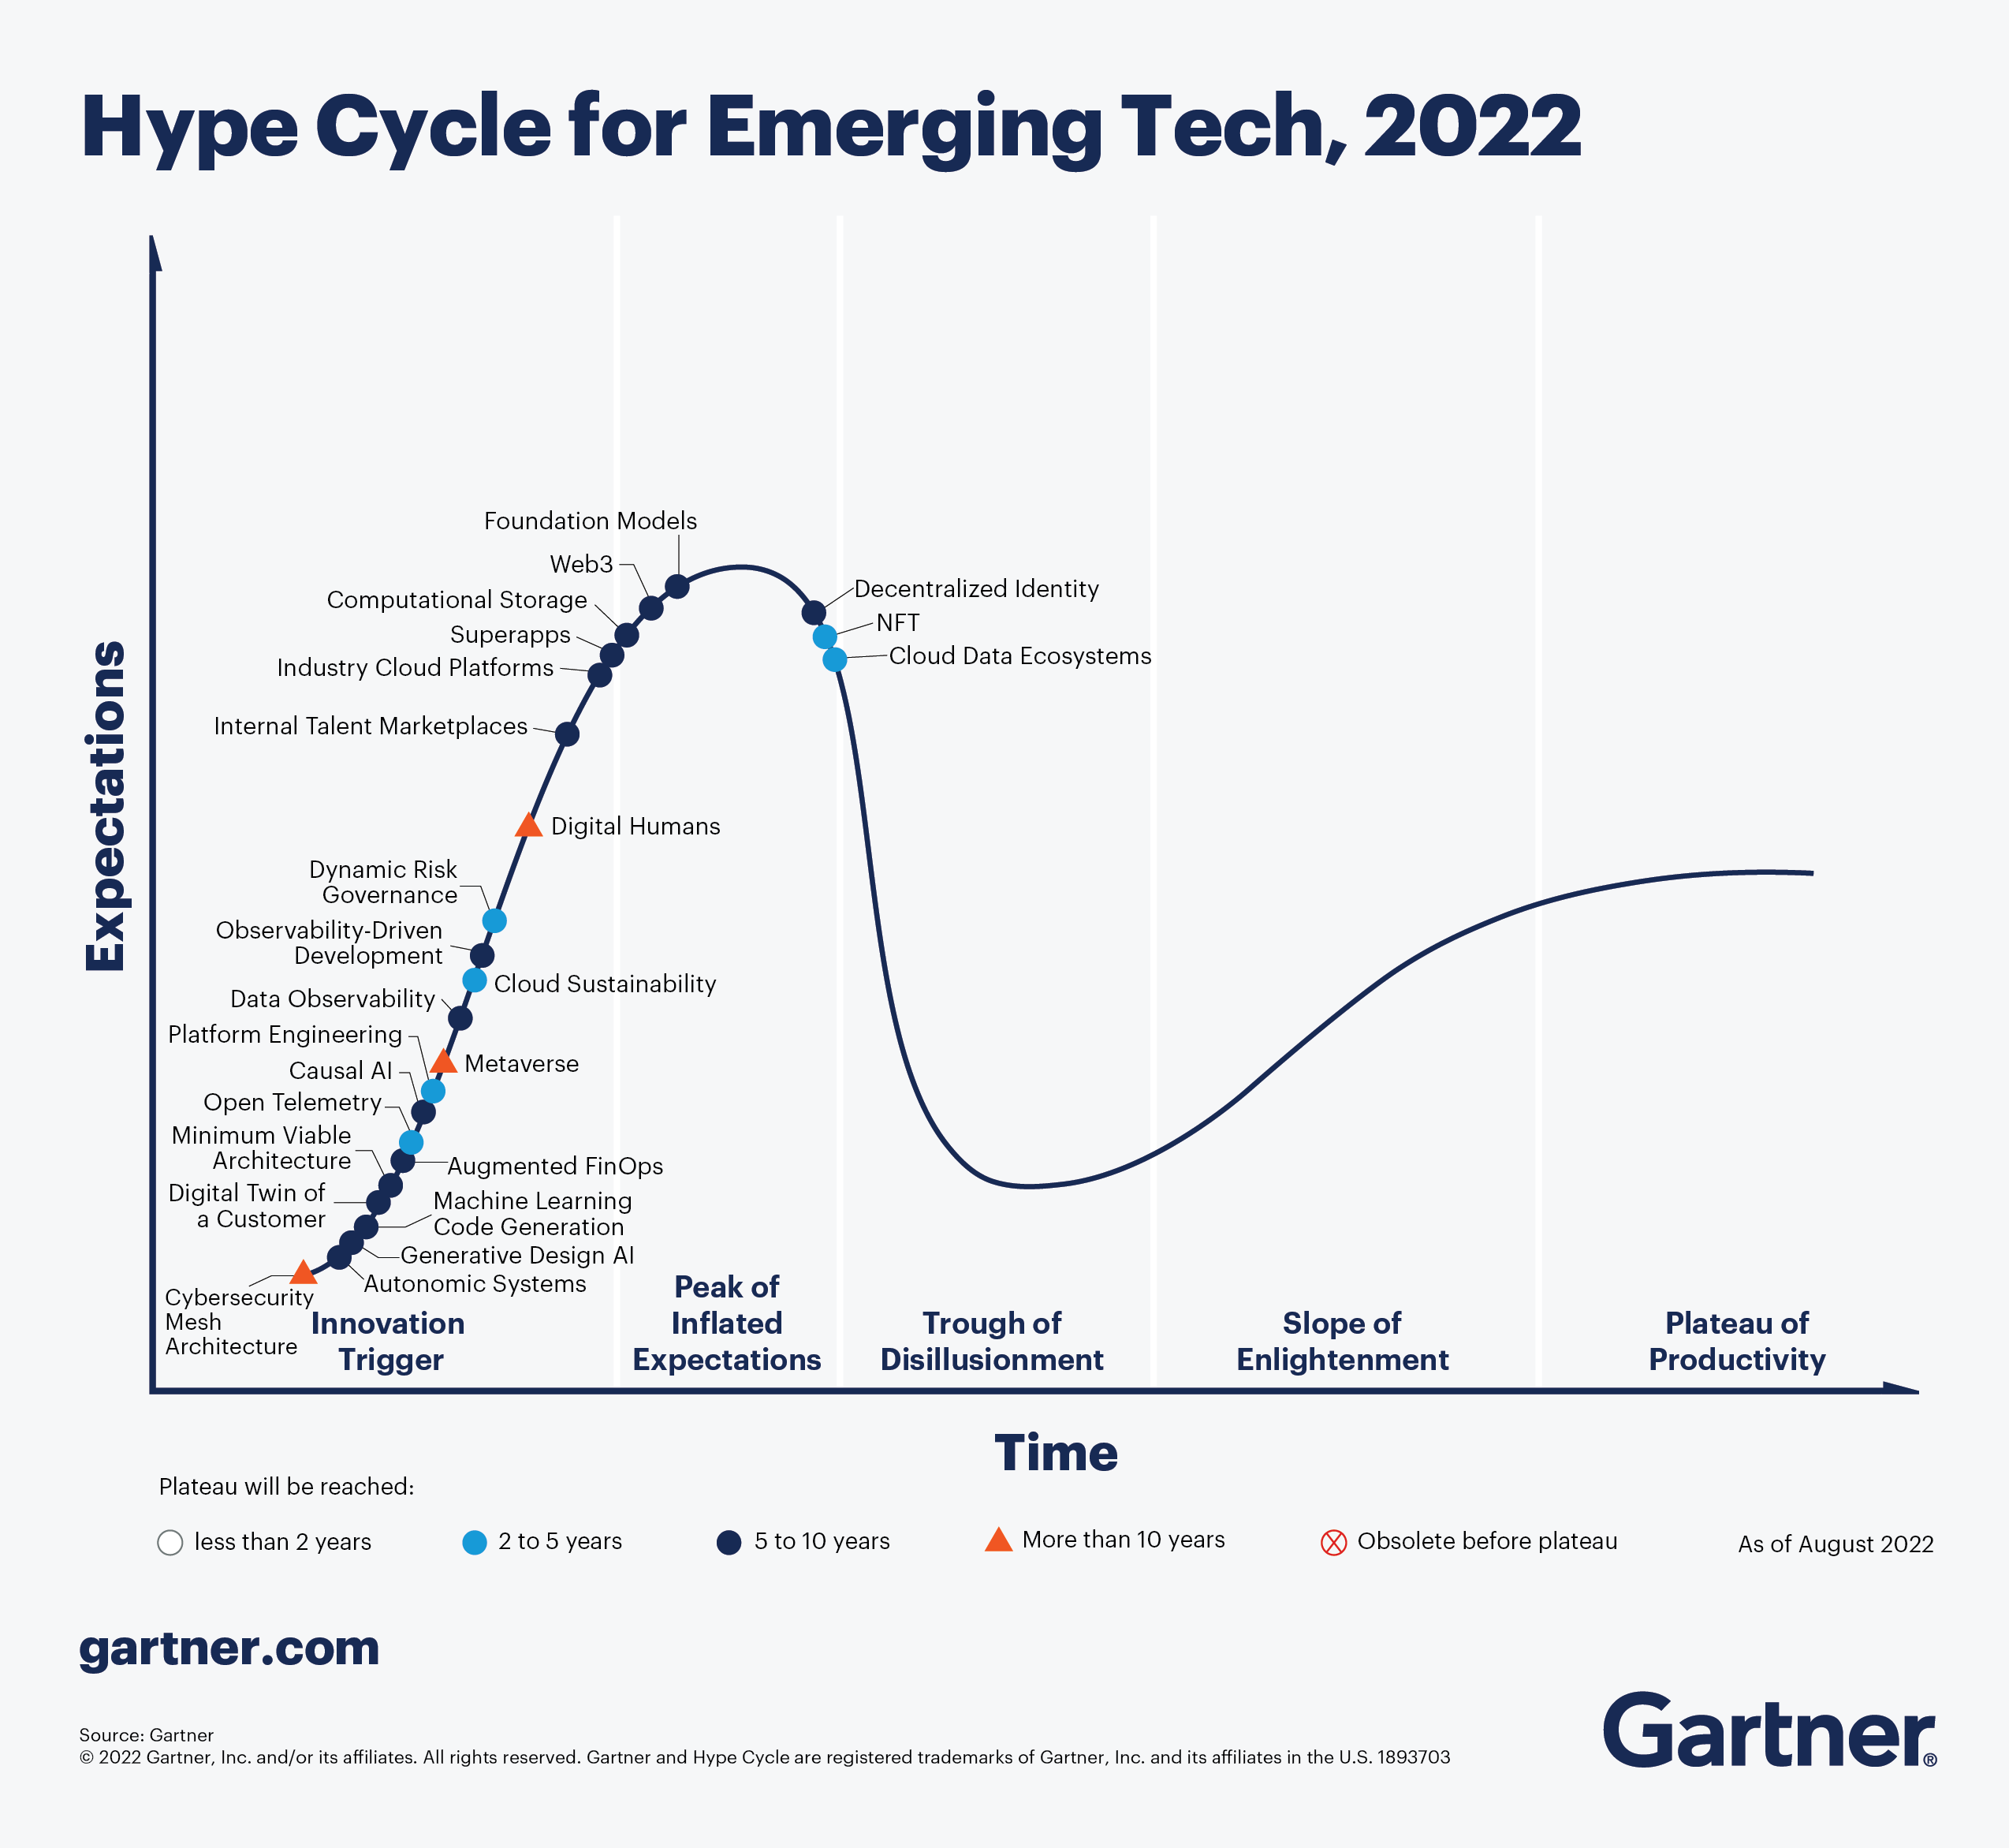
Hype Cycle for Emerging Technologies

Slide 28
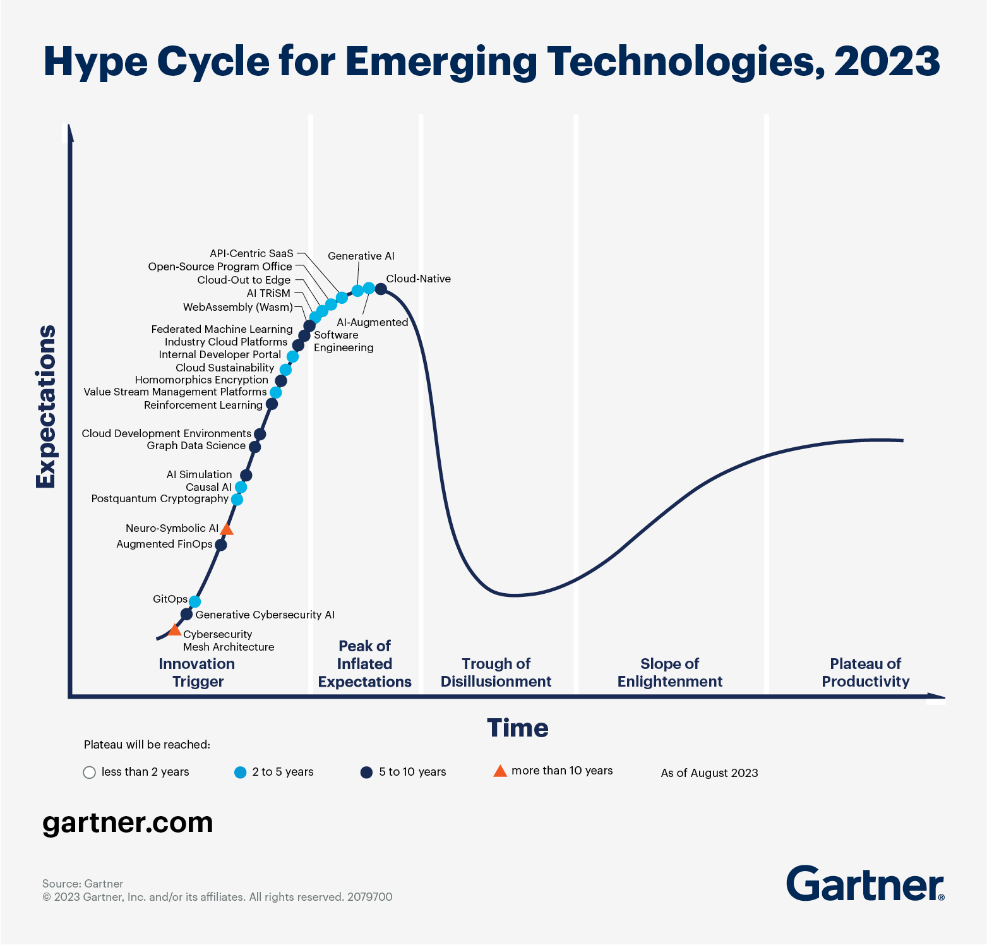

Slide 29
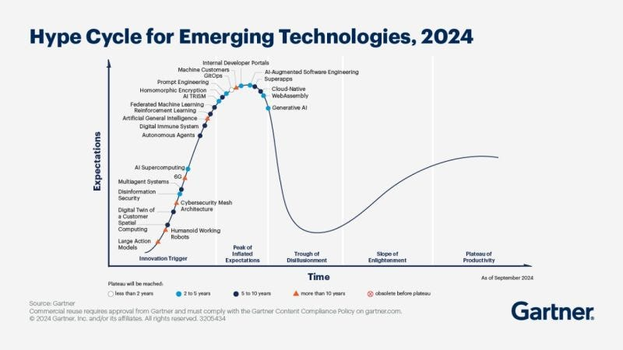
https://substackcdn.com/image/fetch/f_auto,q_auto:good,fl_progressive:steep/https%3A%2F%2Fsubstack-post-media.s3.amazonaws.com%2Fpublic%2Fimages%2F8cd609fa-8215-4dc3-9d75-e0ea34fb5d1f_800x450.jpeg

Slide 30
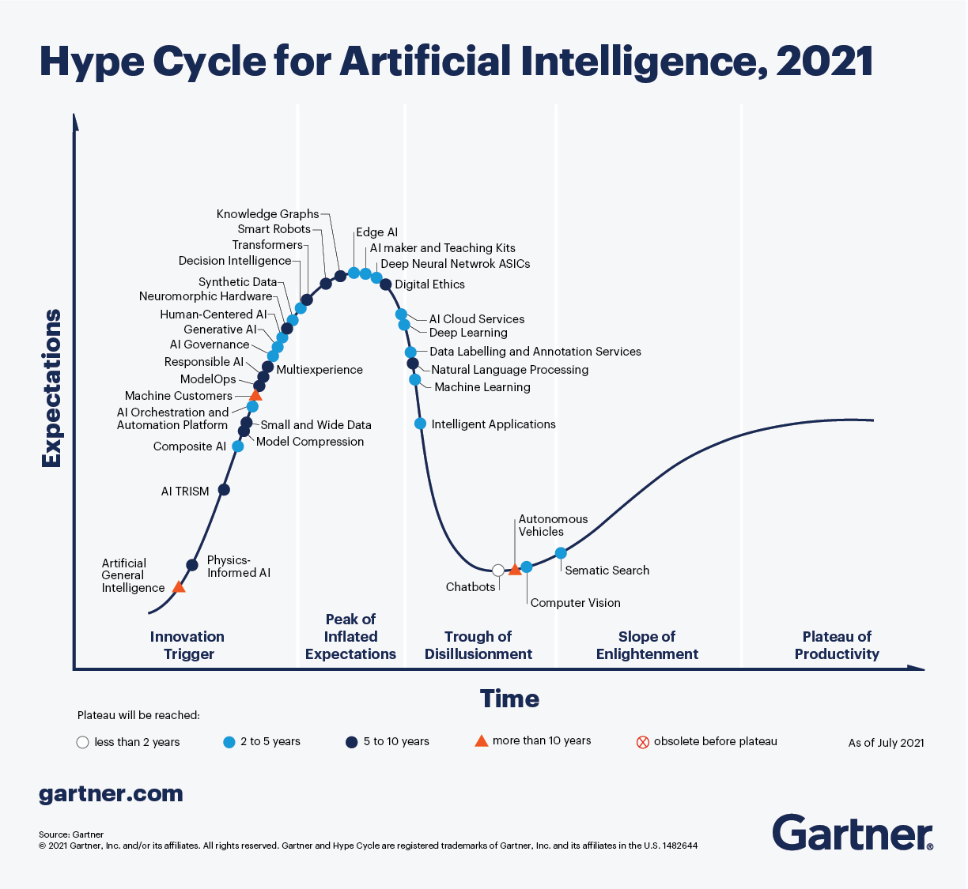

Slide 31
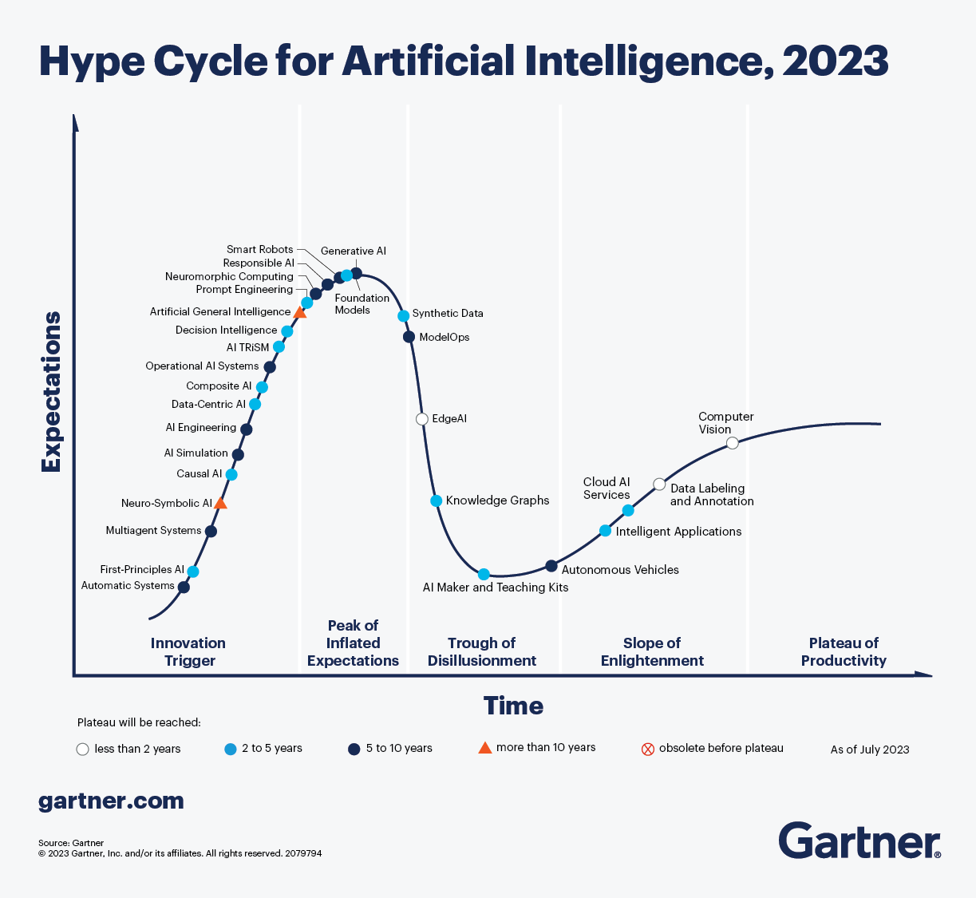

Slide 33
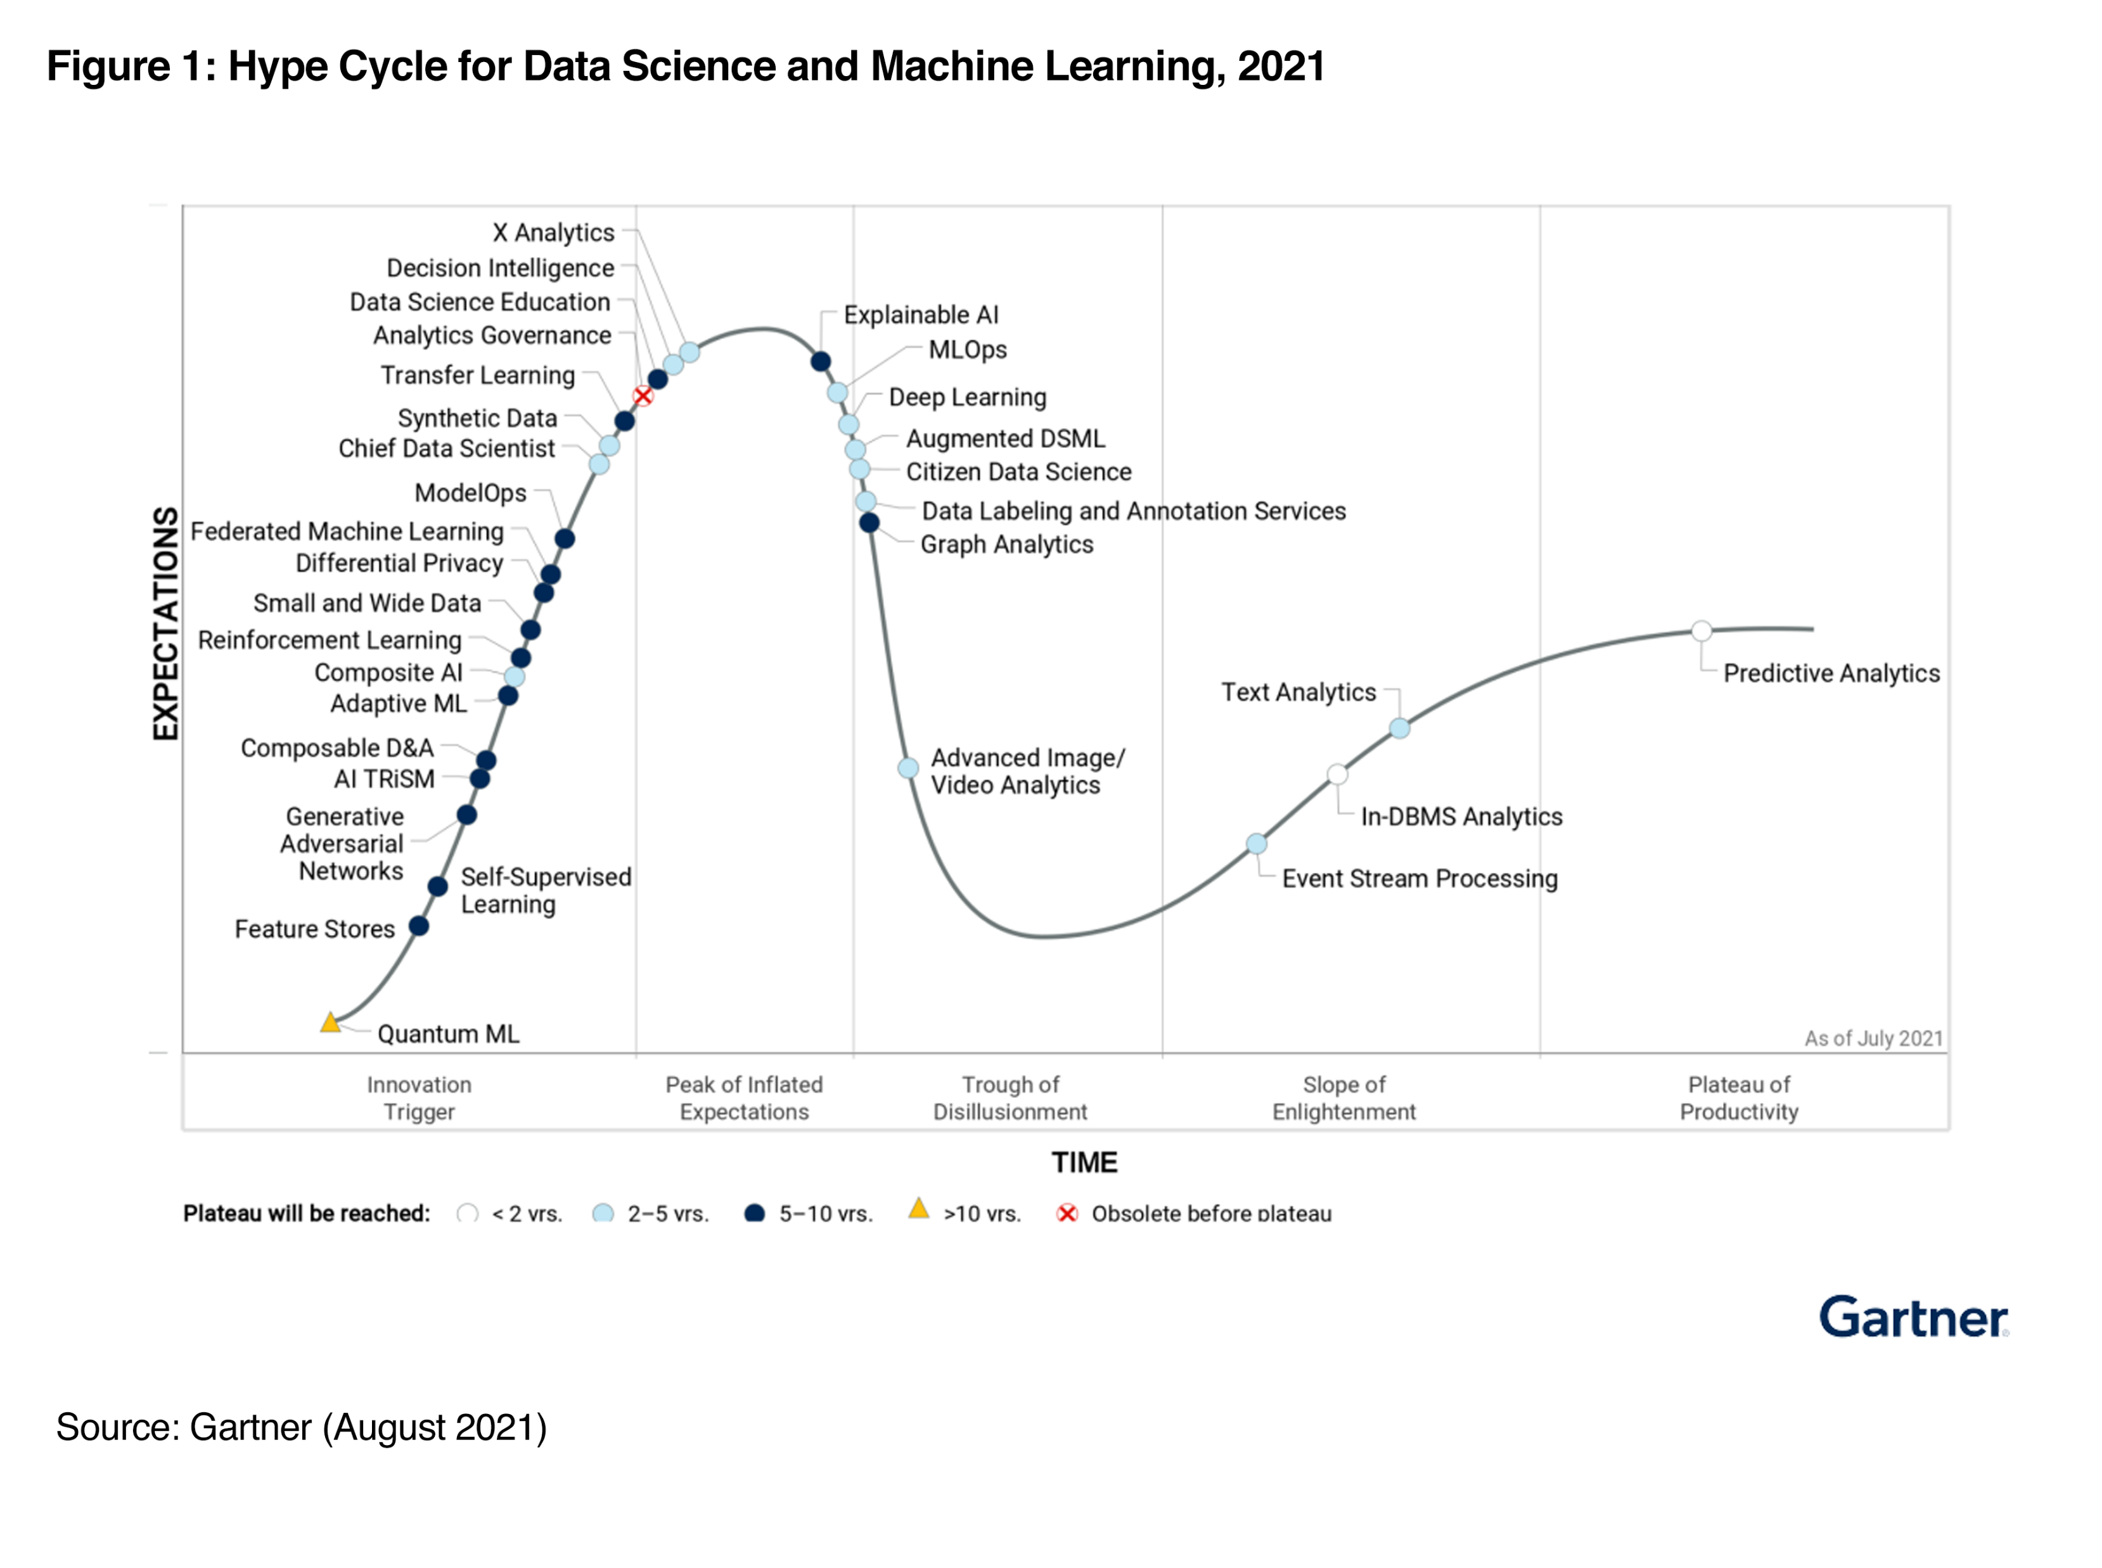

Slide 34
Take home exercise
Check the latest Hype cycle in an area of your interest

Slide 35
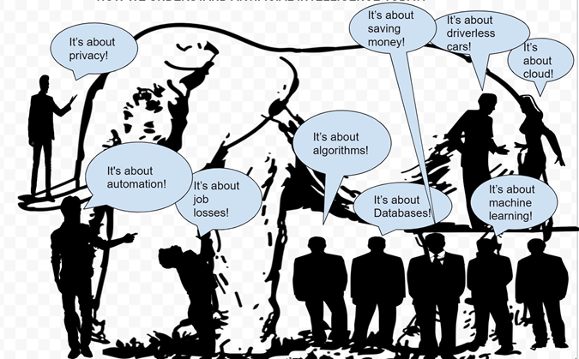
What is AI for you ?

Slide 36
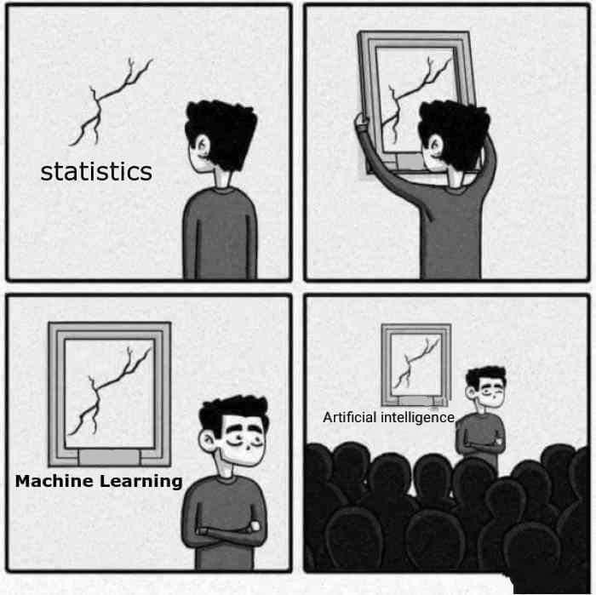
AI

Slide 37
What is Intelligence ?

Slide 38
Intelligence is a property of an entity, which we will call the agent,
It interacts with an external problem or situation, which we will call the environment.
An agent’s intelligence is typically related to its ability to succeed with respect to one or more objectives, which we will call the goal.
Intelligence measures an agent’s general ability to achieve goals in a wide range of environments

Slide 39
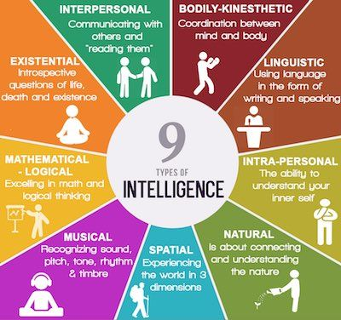
https://communicatorz.com/2016/07/27/9-types-of-intelligence/

Slide 40
What is Artificial Intelligence
“It is the science and engineering of making intelligent machines, especially intelligent computer programs. It is related to the similar task of using computers to understand human intelligence, but AI does not have to confine itself to methods that are biologically observable.” – Stanford

Slide 41
John McCarthy in 1956 was amongst the first use the term AI
the science and engineering of making intelligent machines

Slide 42
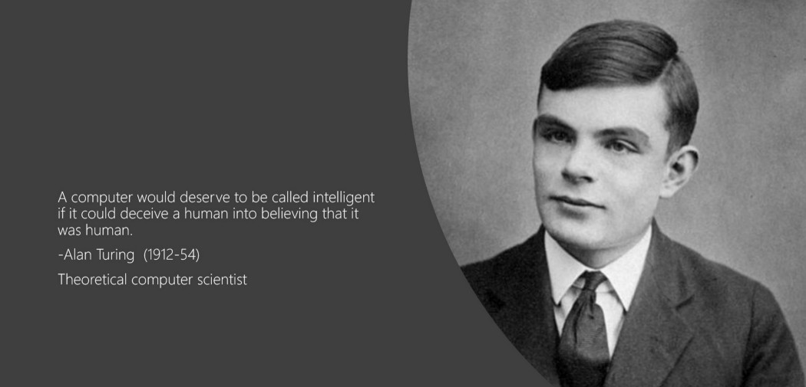

Slide 43
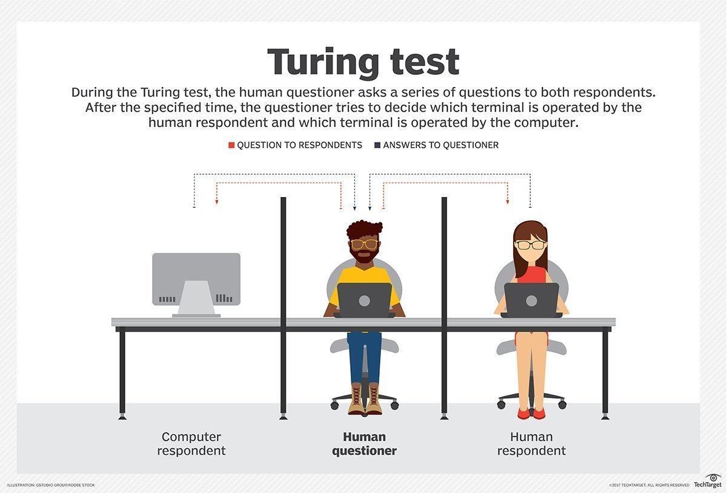

Slide 44
Reverse Turing test

Slide 45
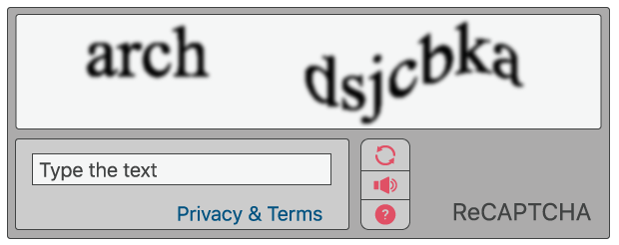
CAPTCHA - Completely Automated Public Turing test to tell Computers and Humans Apart

Slide 46
Jargons & Battle of Venn Diagrams
AI
ML
Neural Network
Deep Learning
Generative AI

Slide 47
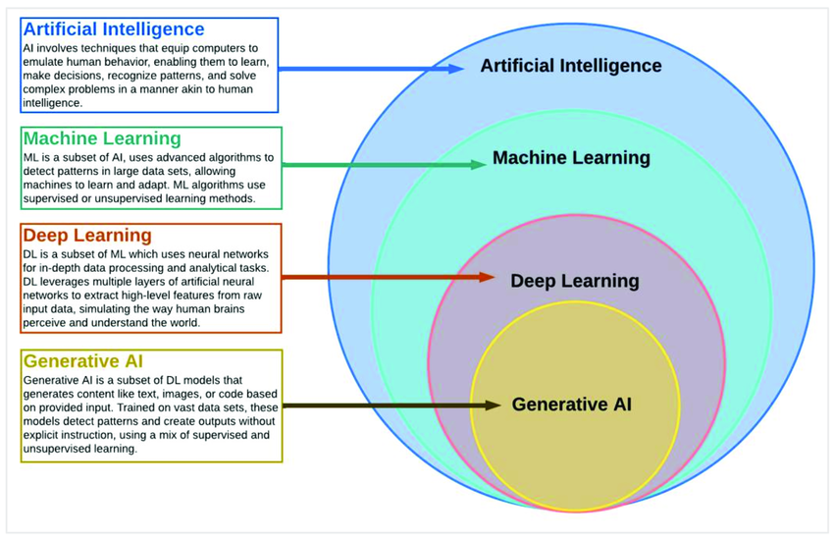
Zhuhadar, Lily & Lytras, Miltiadis. (2023). The Application of AutoML Techniques in Diabetes Diagnosis: Current Approaches, Performance, and Future Directions. Sustainability. 15. 13484. 10.3390/su151813484.

Slide 48
AI for a typical Manager

Slide 49
How does a typical manager spends their time .
In what activities

Slide 50
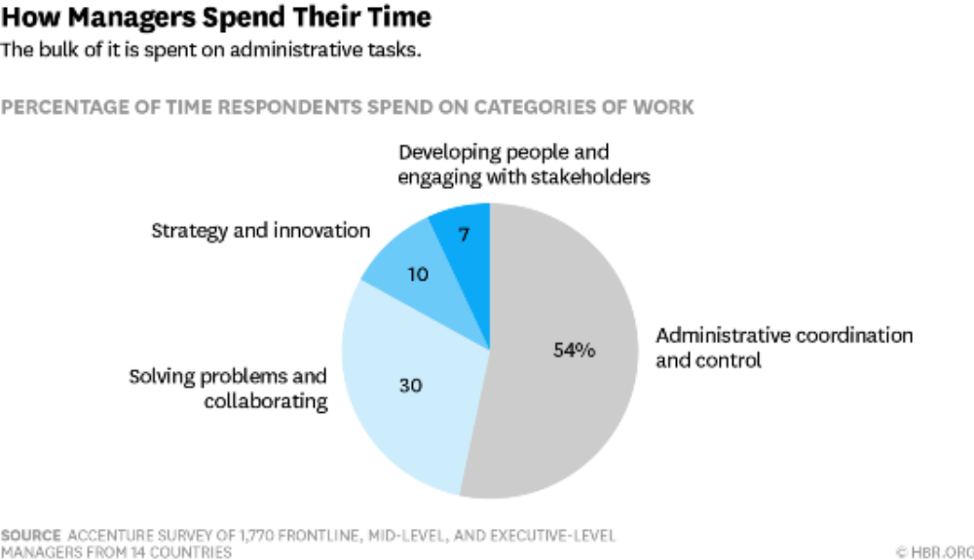

Slide 51
AI can support three important business needs:
Gaining insight through data analysis (Analytics on Steroids)
Engaging with customers and employees.
Automating business processes

