Slide 1
Session 1

Slide 2
Intro
Name / Company / Location / Designation & area of work and interest
AI for you

Slide 3
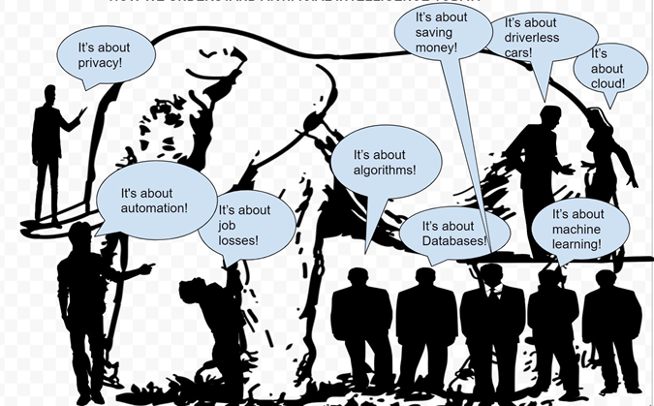
What is AI for you ?

Slide 4
What we want for you

Slide 5


Slide 6


Hands on sessions using various tools and frameworks.

Slide 7
Thinking about data

Slide 8
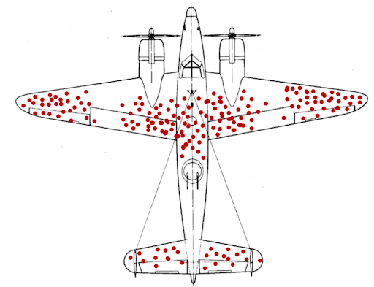

Slide 9
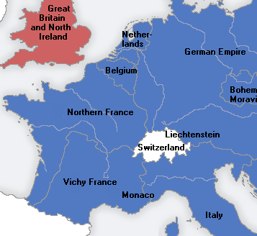



Slide 10
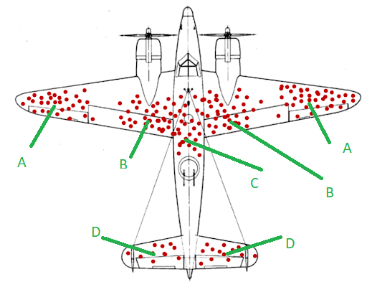

Slide 11
Understanding the Hype

Slide 12
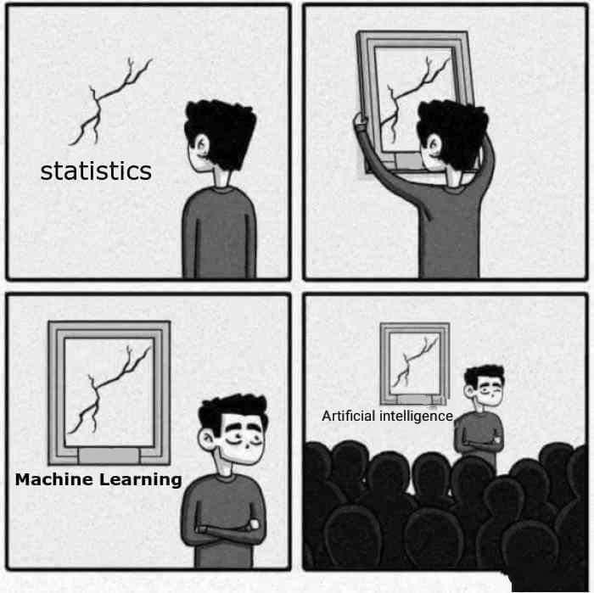
AI

Slide 14
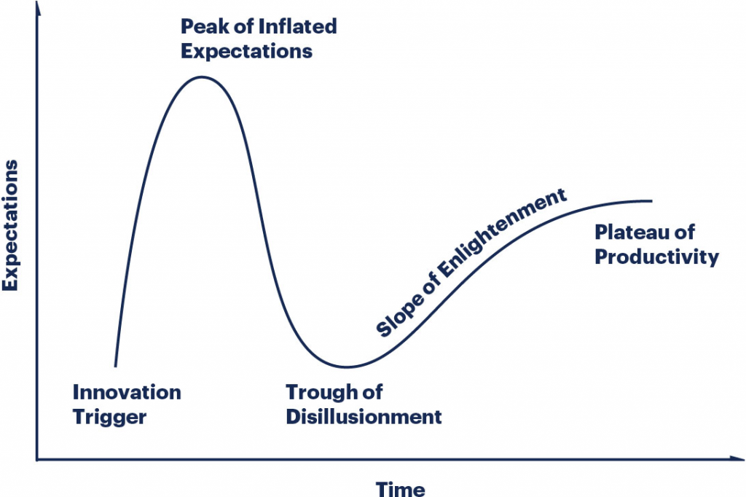

Slide 15
Hype Cycle
The Hype Cycle is a graphical depiction of a common pattern that arises with each new technology or other innovation. Although many of Gartner’s Hype Cycles focus on specific technologies or innovations, the same pattern of hype and disillusionment applies to higher level concepts such as IT methodologies and management disciplines.
@Gartner

Slide 16
Establish the expectation that most innovations, services and disciplines will progress through a pattern of overenthusiasm and disillusionment, followed by eventual productivity.
Provide a snapshot of the relative market promotion, maturity and value of innovations within a certain segment, such as a technology area, horizontal or vertical business market, or a demographic audience.
Show the speed at which each innovation is progressing through the Hype Cycle by indicating how long it will take to reach the Plateau of Productivity and the start of mainstream adoption.
Help strategists and planners by evaluating the market promotion and perception of value, business benefit, adoption rate and future direction of innovations
@Gartner

Slide 17
A technology (or related service and discipline innovation) passes through several stages on its path to productivity:
Innovation Trigger (formerly called Technology Trigger): The Hype Cycle starts when a breakthrough, public demonstration, product launch or other event generates press and industry interest in a technology innovation.
Peak of Inflated Expectations: A wave of “buzz” builds and the expectations for this innovation rise above the current reality of its capabilities. In some cases, an investment bubble forms, as happened with the web and social media.
Trough of Disillusionment: Inevitably, impatience for results begins to replace the original excitement about potential value. Problems with performance, slower-than-expected adoption or a failure to deliver financial returns in the time anticipated all lead to missed expectations, and disillusionment sets in.
Slope of Enlightenment: Some early adopters overcome the initial hurdles, begin to experience benefits and recommit efforts to move forward. Organizations draw on the experience of the early adopters. Their understanding grows about where and how the innovation can be used to good effect and, just as importantly, where it brings little or no value.
Plateau of Productivity: With the real-world benefits of the innovation demonstrated and accepted, growing numbers of organizations feel comfortable with the now greatly reduced levels of risk. A sharp rise in adoption begins (resembling a hockey stick when shown graphically), and penetration accelerates rapidly as a result of productive and useful value.
@Gartner

Slide 18
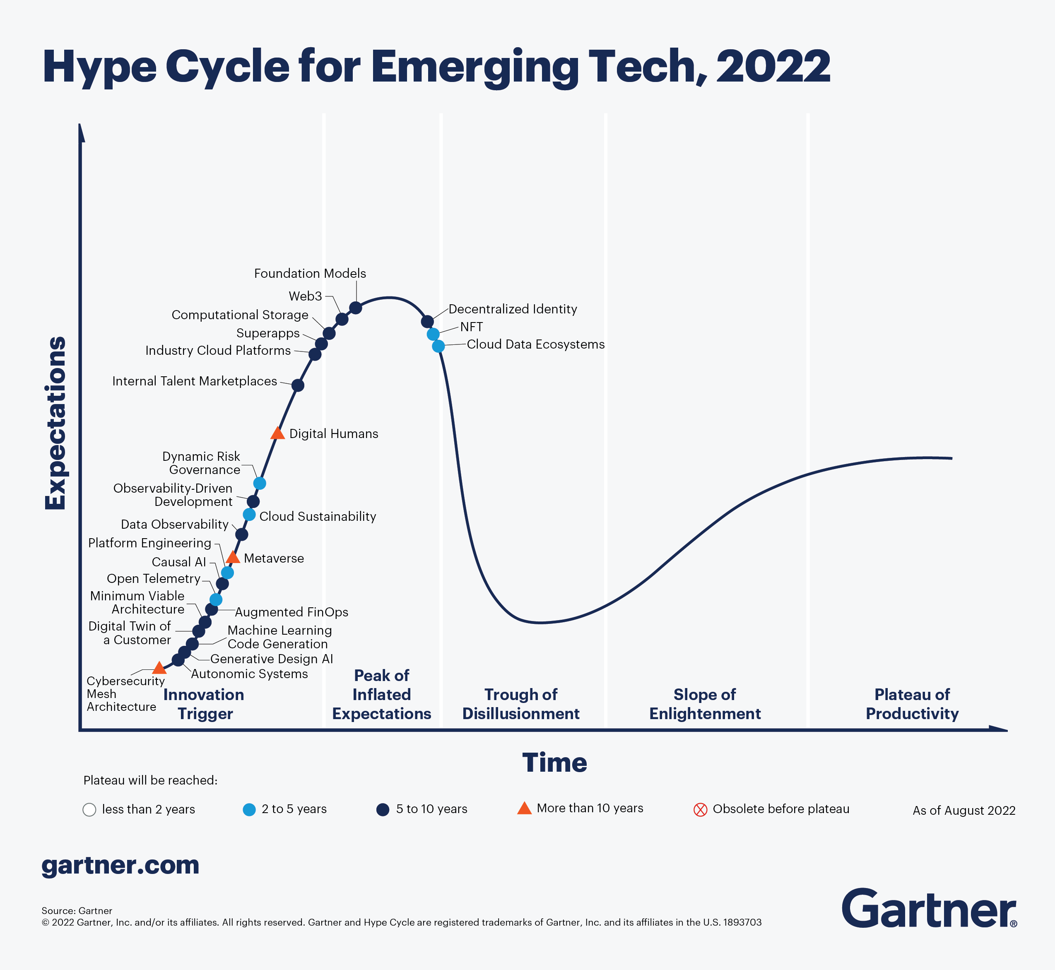
Hype Cycle for Emerging Technologies

Slide 19
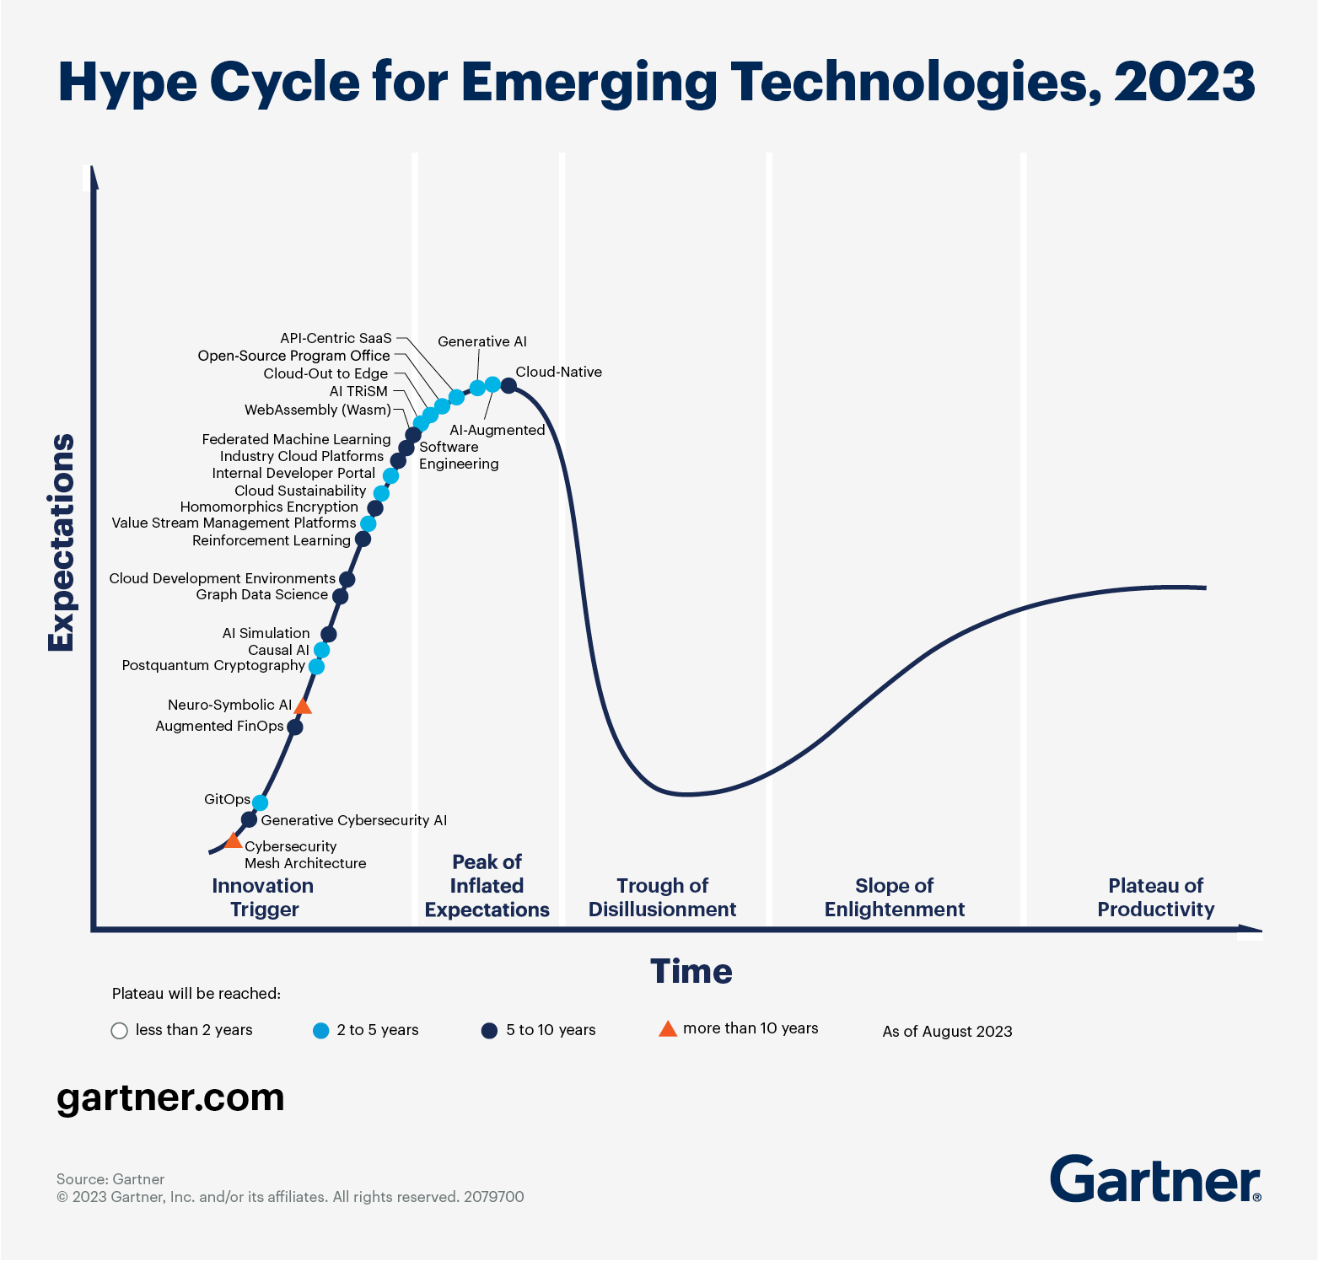

Slide 20
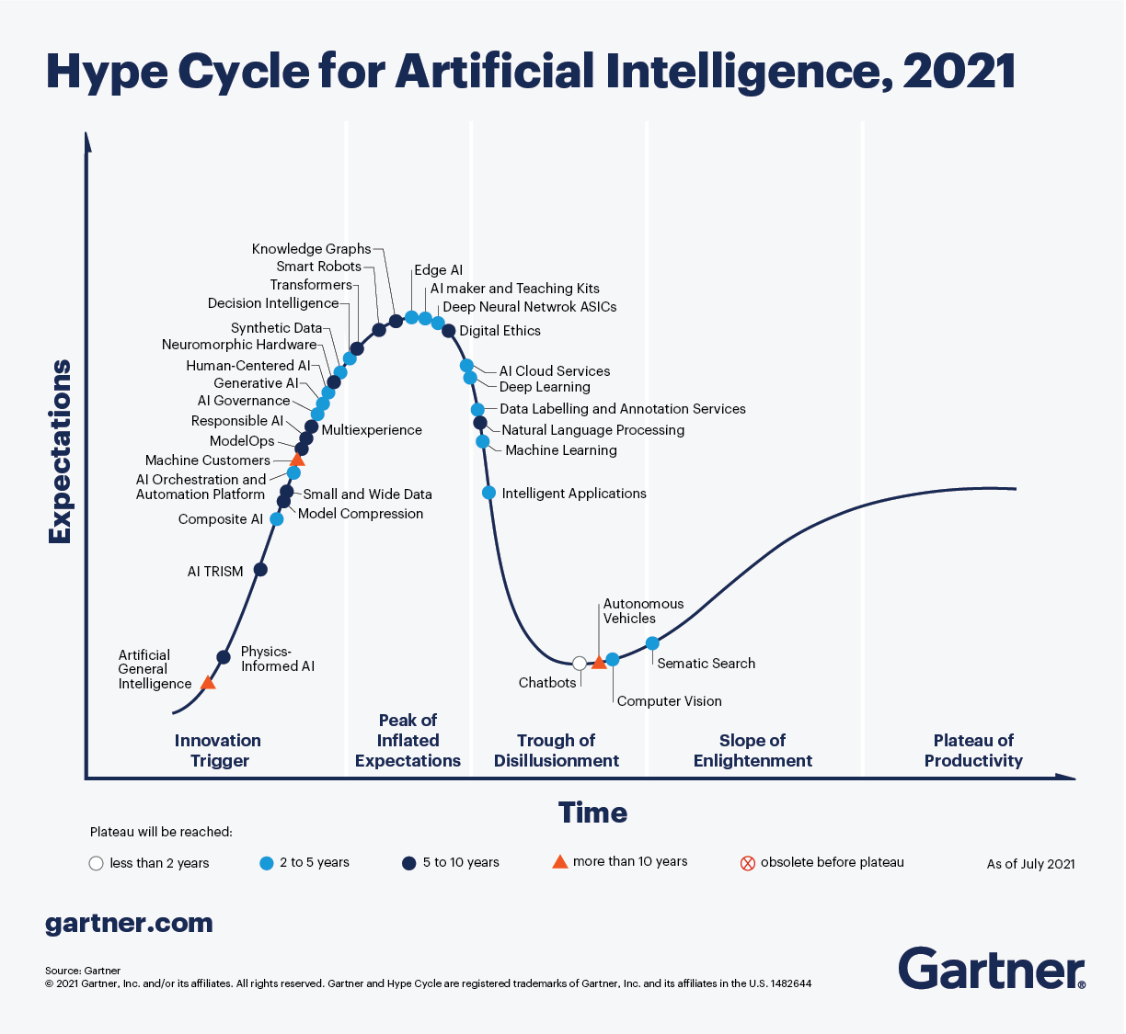

Slide 21
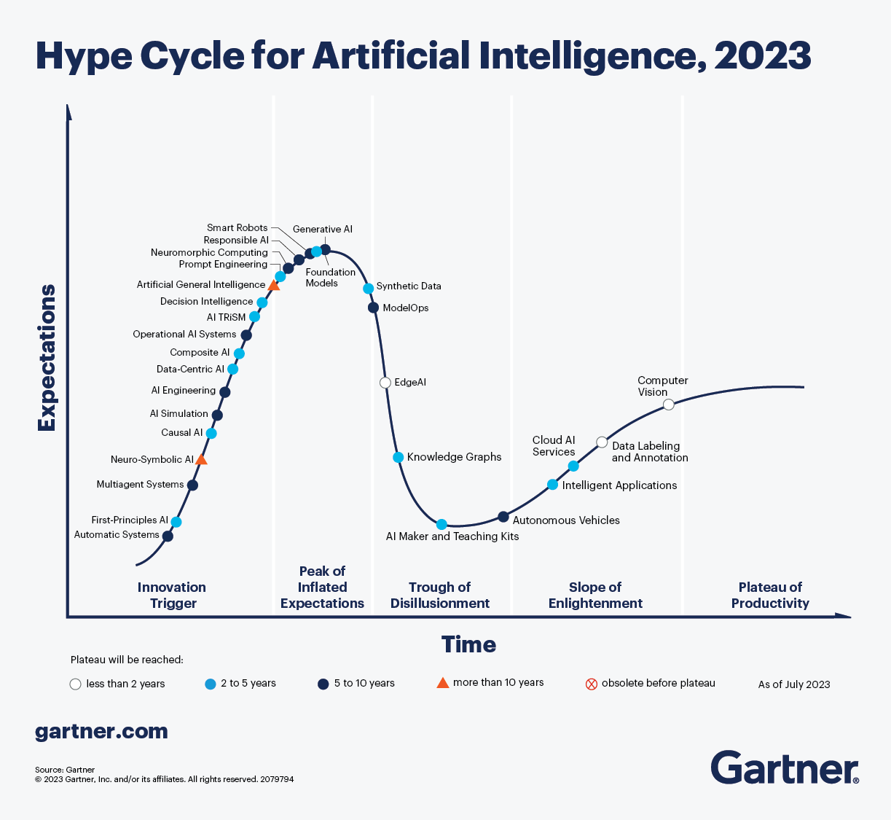

Slide 22
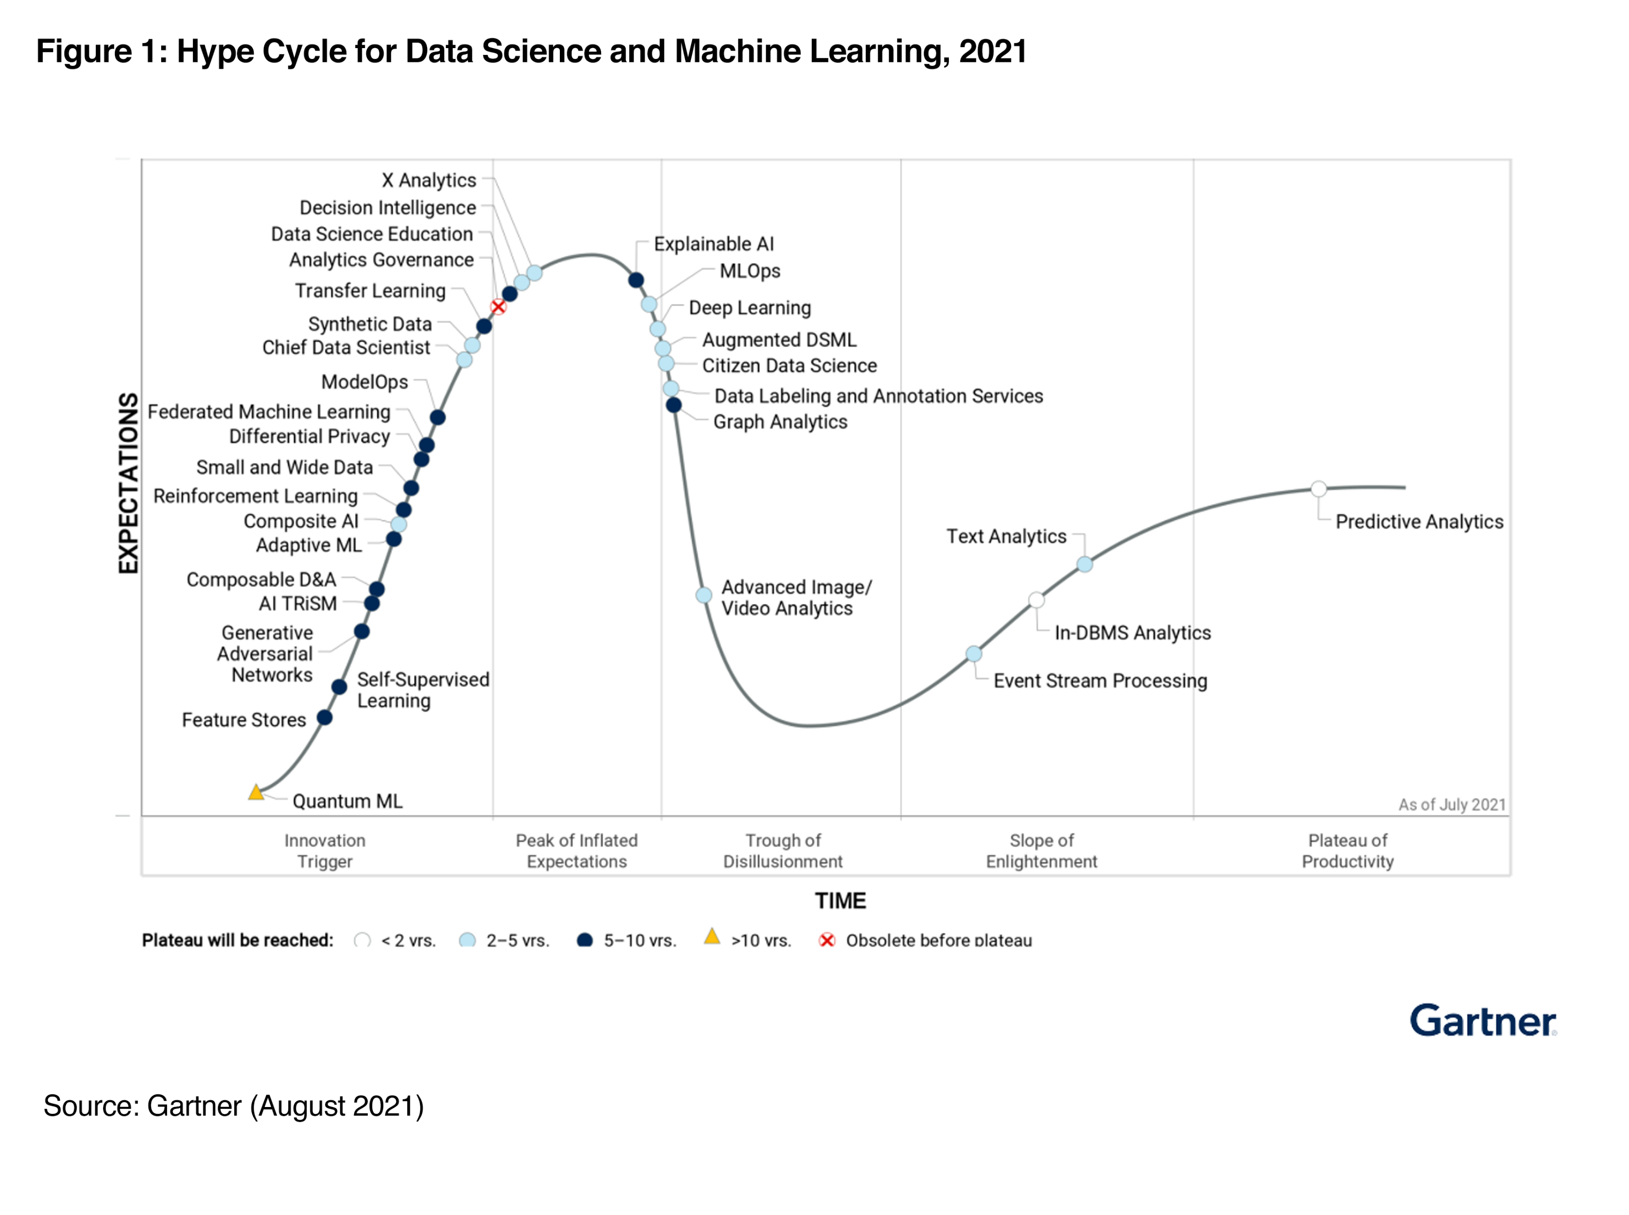

Slide 23
Take home exercise
Check the latest Hype cycle in an area of your interest

Slide 24
What is Intelligence ?

Slide 25
Intelligence is a property of an entity, which we will call the agent,
It interacts with an external problem or situation, which we will call the environment.
An agent’s intelligence is typically related to its ability to succeed with respect to one or more objectives, which we will call the goal.
Intelligence measures an agent’s general ability to achieve goals in a wide range of environments

Slide 26
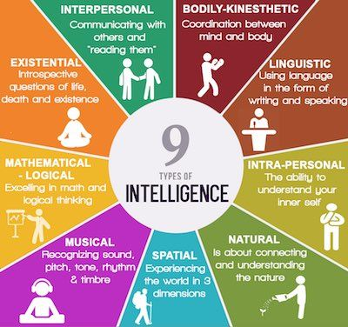
https://communicatorz.com/2016/07/27/9-types-of-intelligence/

Slide 27
What is Artificial Intelligence
“It is the science and engineering of making intelligent machines, especially intelligent computer programs. It is related to the similar task of using computers to understand human intelligence, but AI does not have to confine itself to methods that are biologically observable.” – Stanford

Slide 28
John McCarthy in 1956 was amongst the first use the term AI
the science and engineering of making intelligent machines

Slide 29
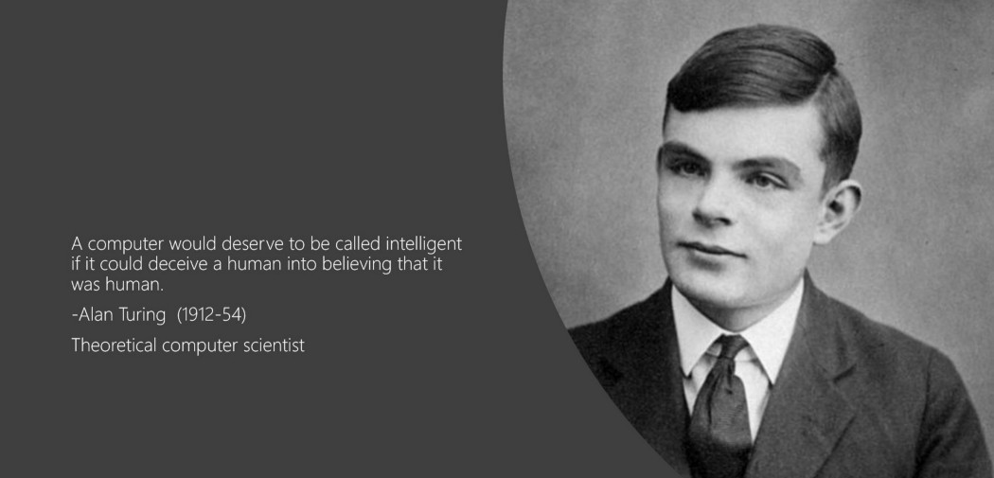

Slide 30
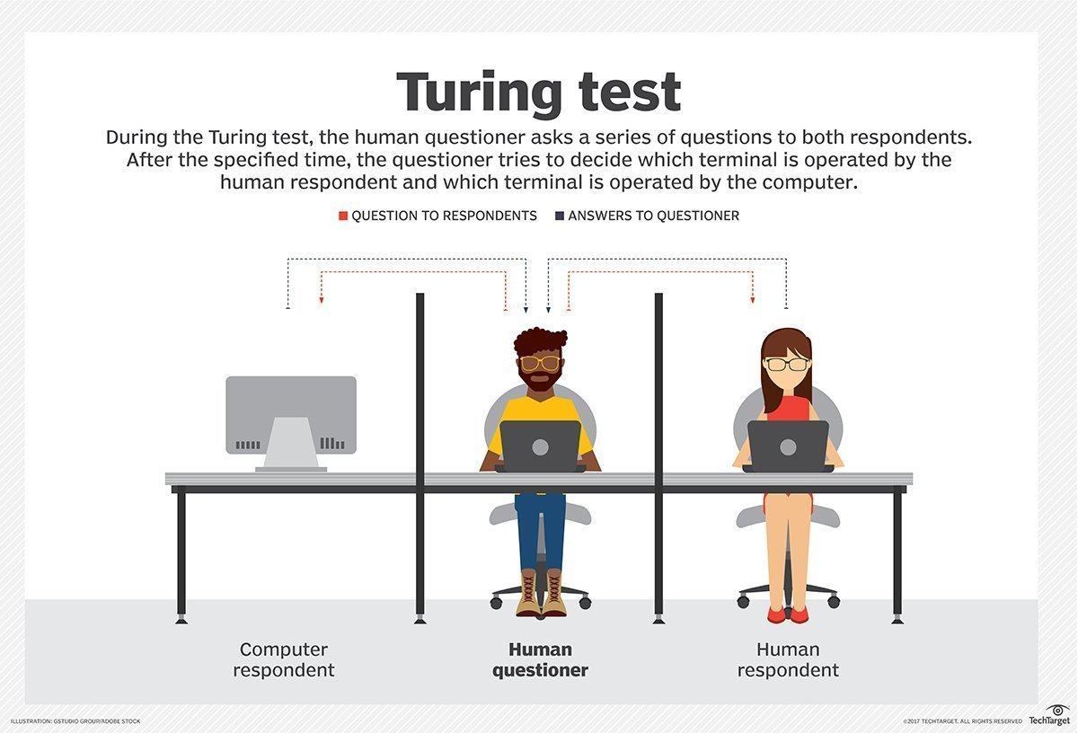

Slide 31
Reverse Turing test

Slide 32
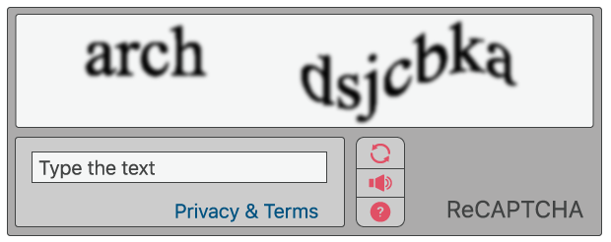
CAPTCHA - Completely Automated Public Turing test to tell Computers and Humans Apart

Slide 33
Jargons & Battle of Venn Diagrams
AI
ML
Neural Network
Deep Learning
Generative AI

Slide 34
AI for a typical Manager

Slide 35
How does a typical manager spends their time .
In what activities

Slide 36
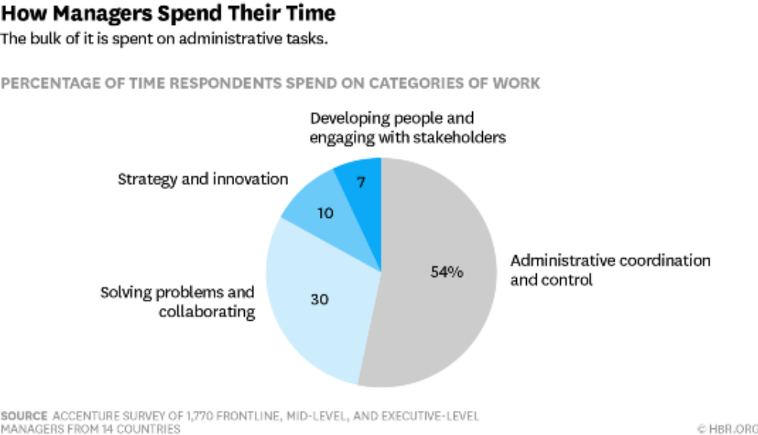

Slide 37
AI can support three important business needs:
Automating business processes
Gaining insight through data analysis (Analytics on Steroids)
Engaging with customers and employees.

Slide 38
Traditional Business Analytics vs AI/ML Projects
Output of a BA project is usually a report with a summary of current situation and actionable insights, while usually output of a ML/AI project is a module / piece of computer code than gets incorporated into a larger software application / deployed in production environment.

Slide 39
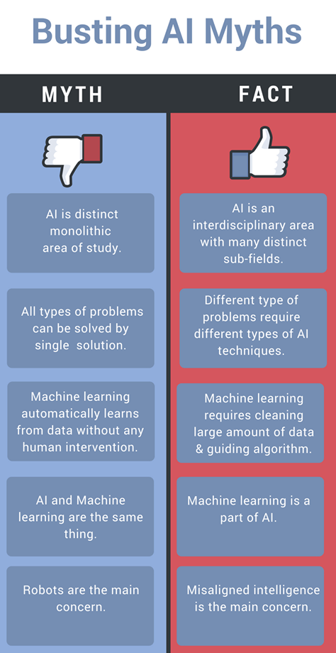
@hacker.io

