Slide 1
AI & ML: Foundations and Applications

Slide 2


Slide 3
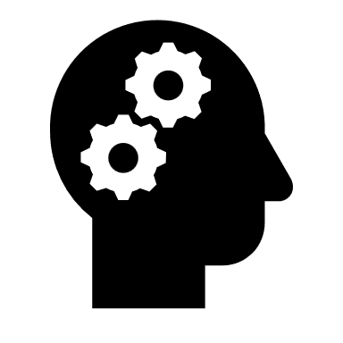

Hands on sessions using various tools and frameworks.

Slide 4
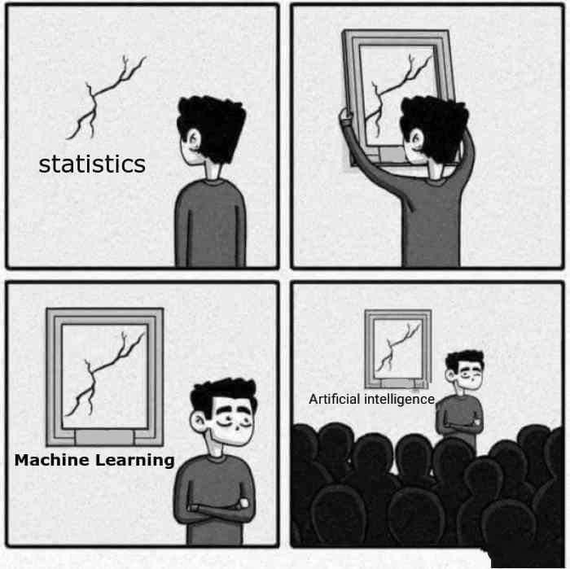
AI

Slide 5
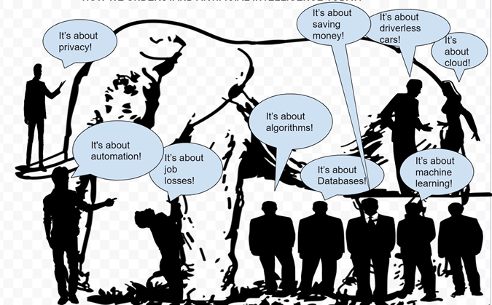
What is AI as per you ?

Slide 6
Understanding the Hype

Slide 8
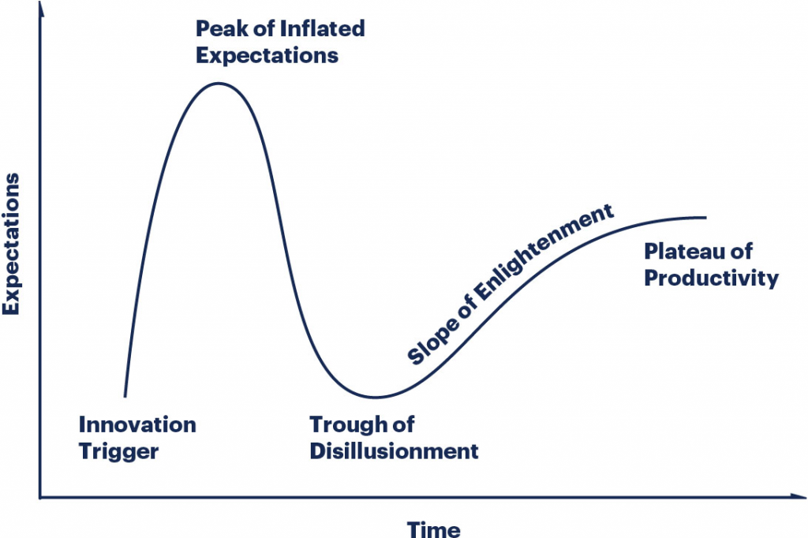

Slide 10
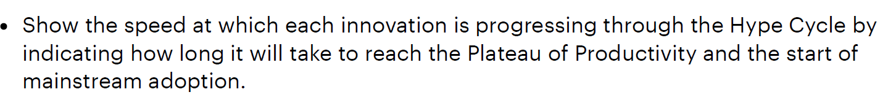
The Hype Cycle is a graphical depiction of a common pattern that arises with each new technology or other innovation. Although many of Gartner’s Hype Cycles focus on specific technologies or innovations, the same pattern of hype and disillusionment applies to higher level concepts such as IT methodologies and management disciplines.

Slide 11
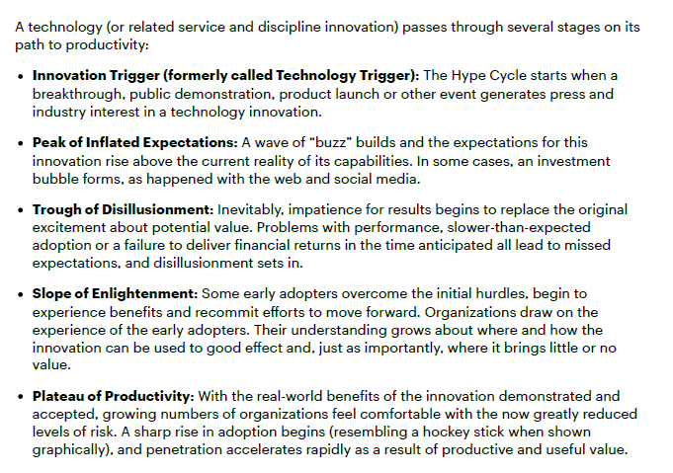

Slide 12
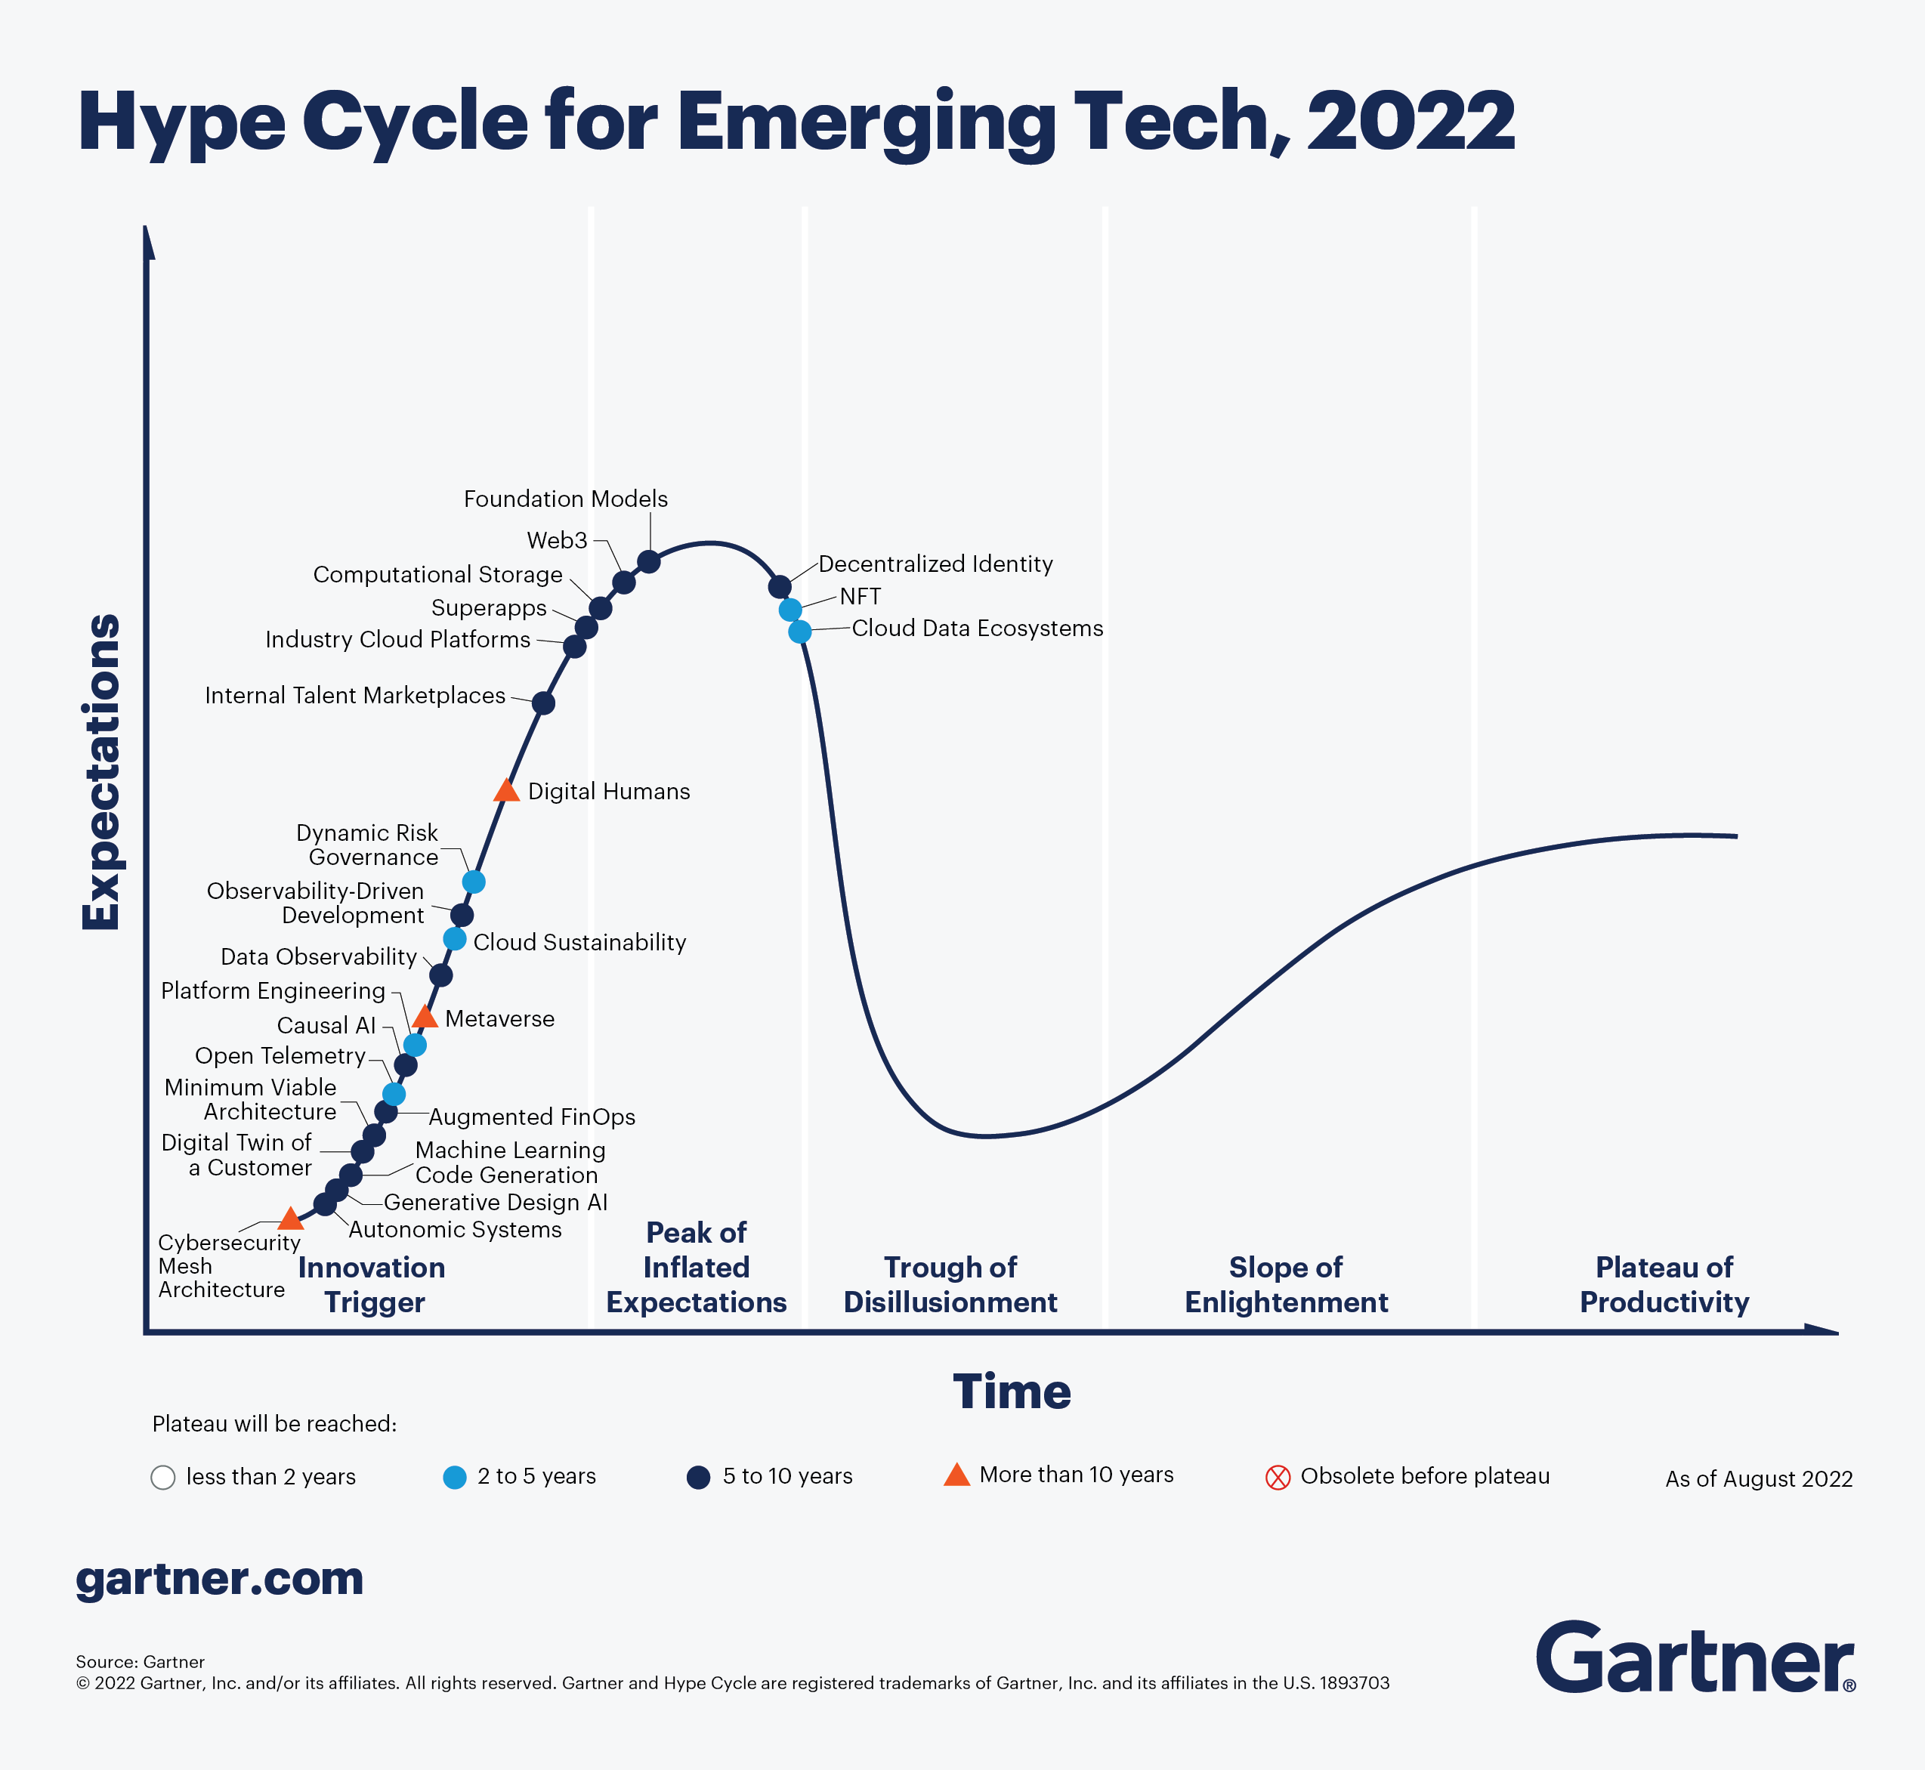
Hype Cycle for Emerging Technologies

Slide 13
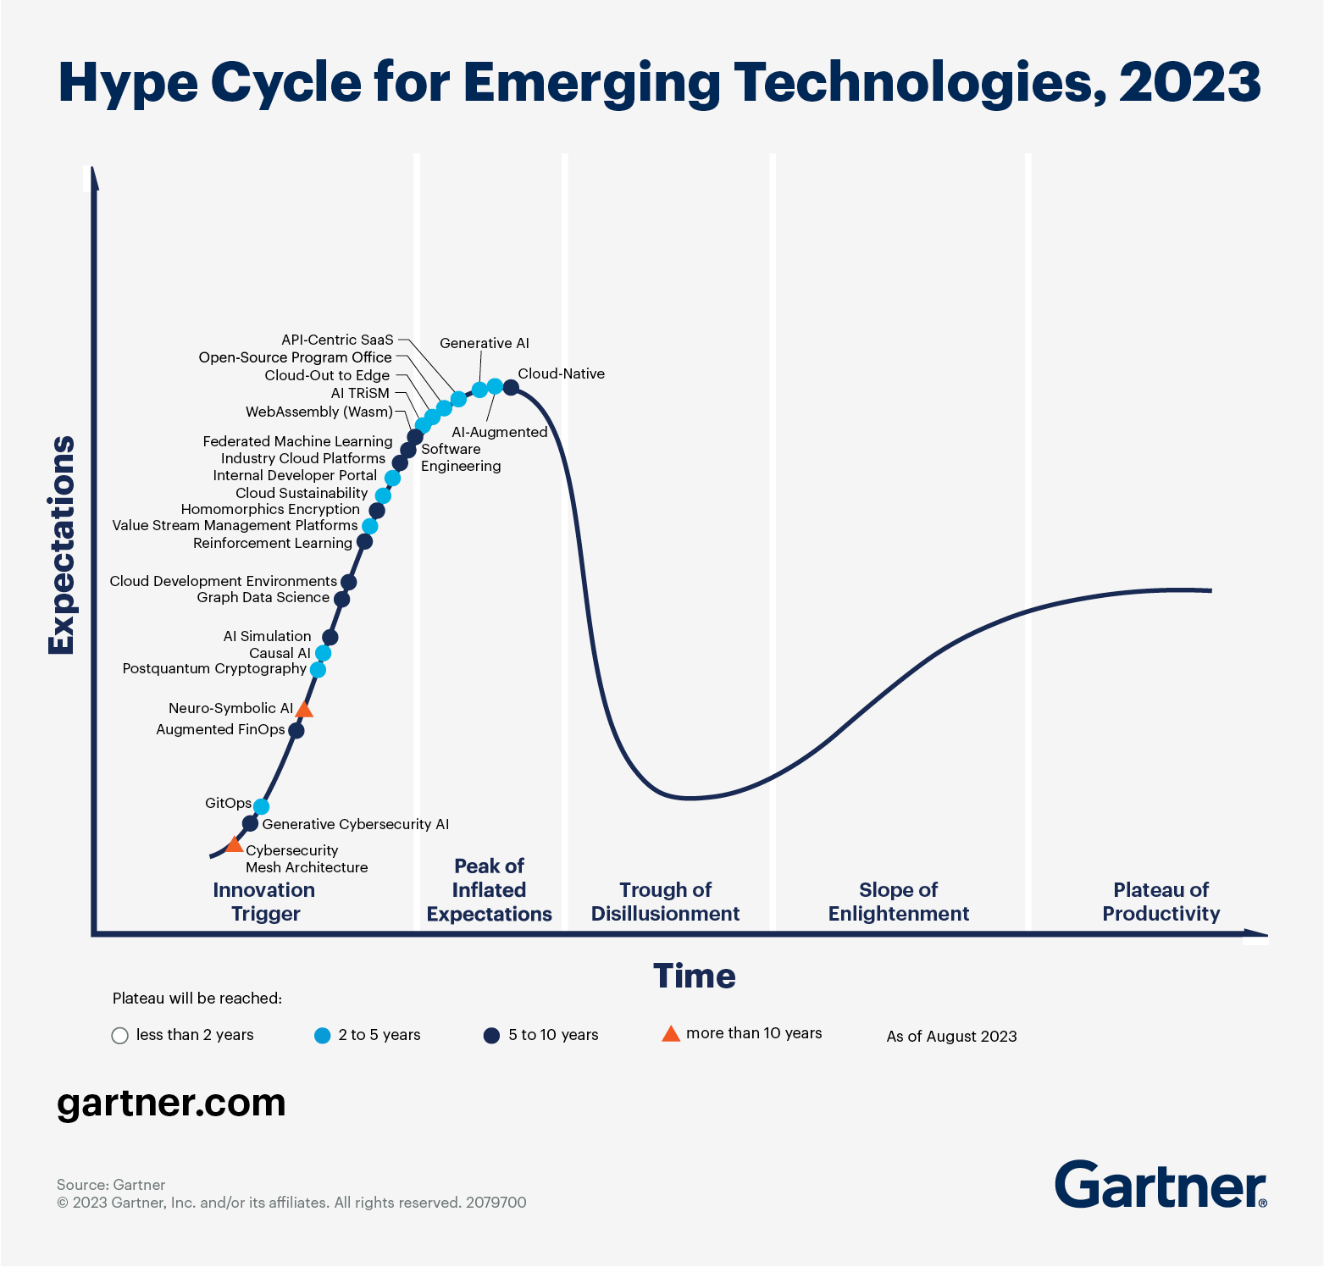

Slide 14
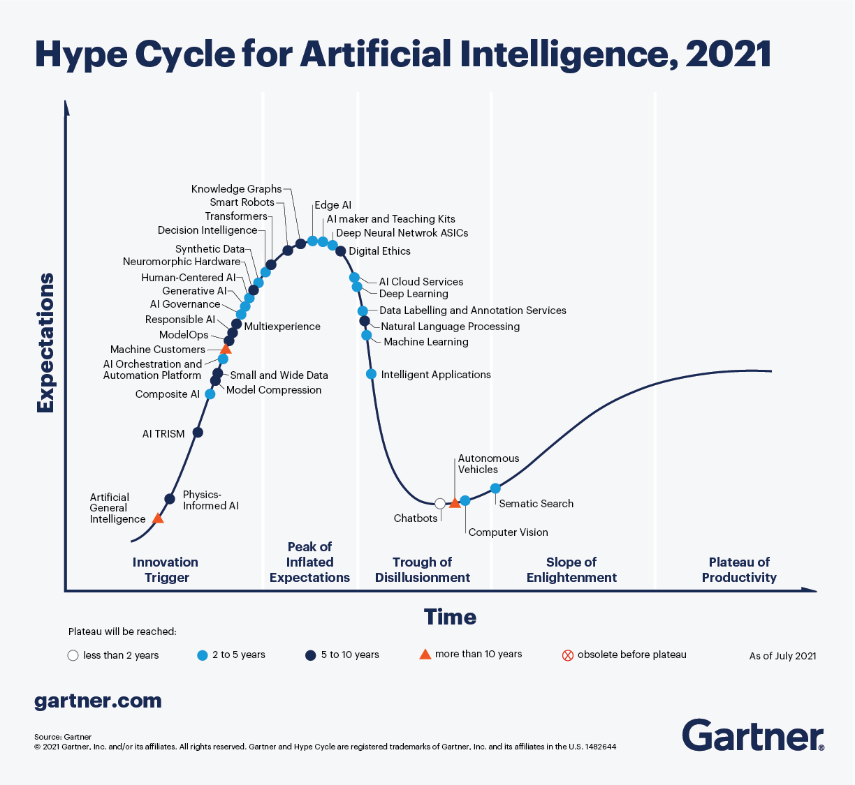

Slide 15
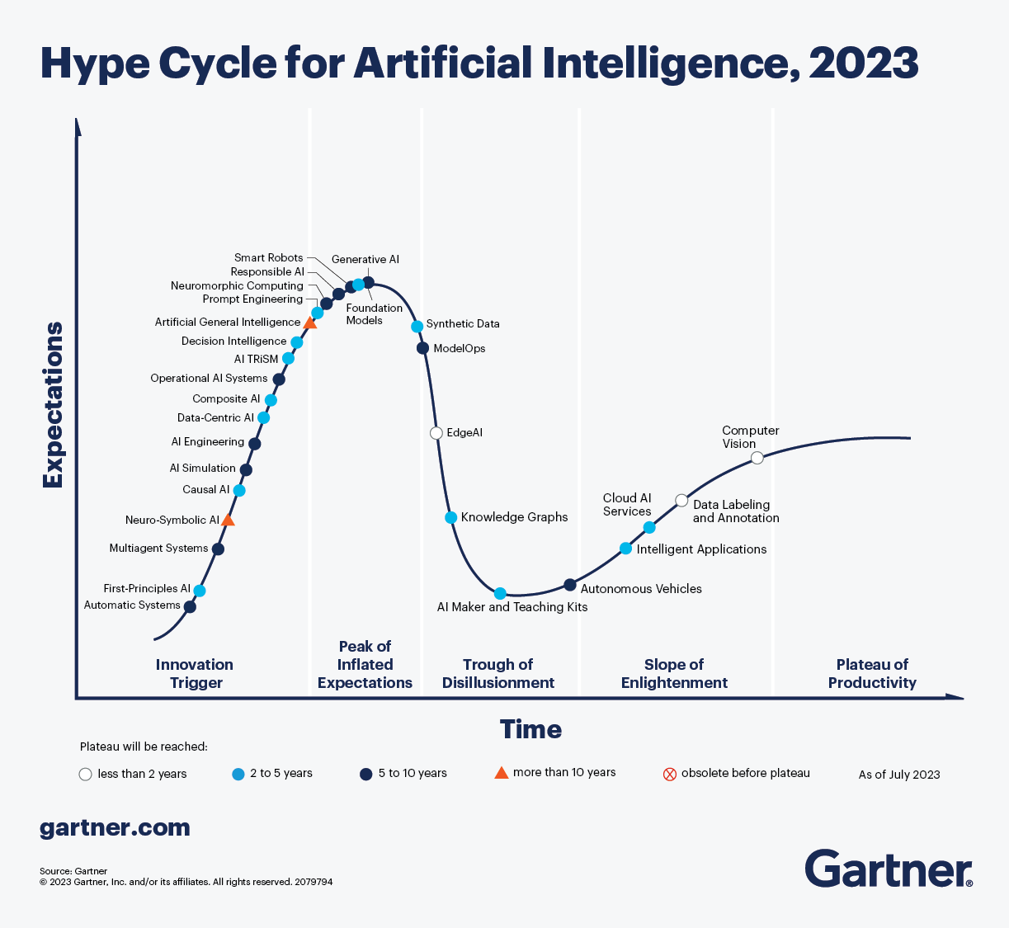

Slide 16
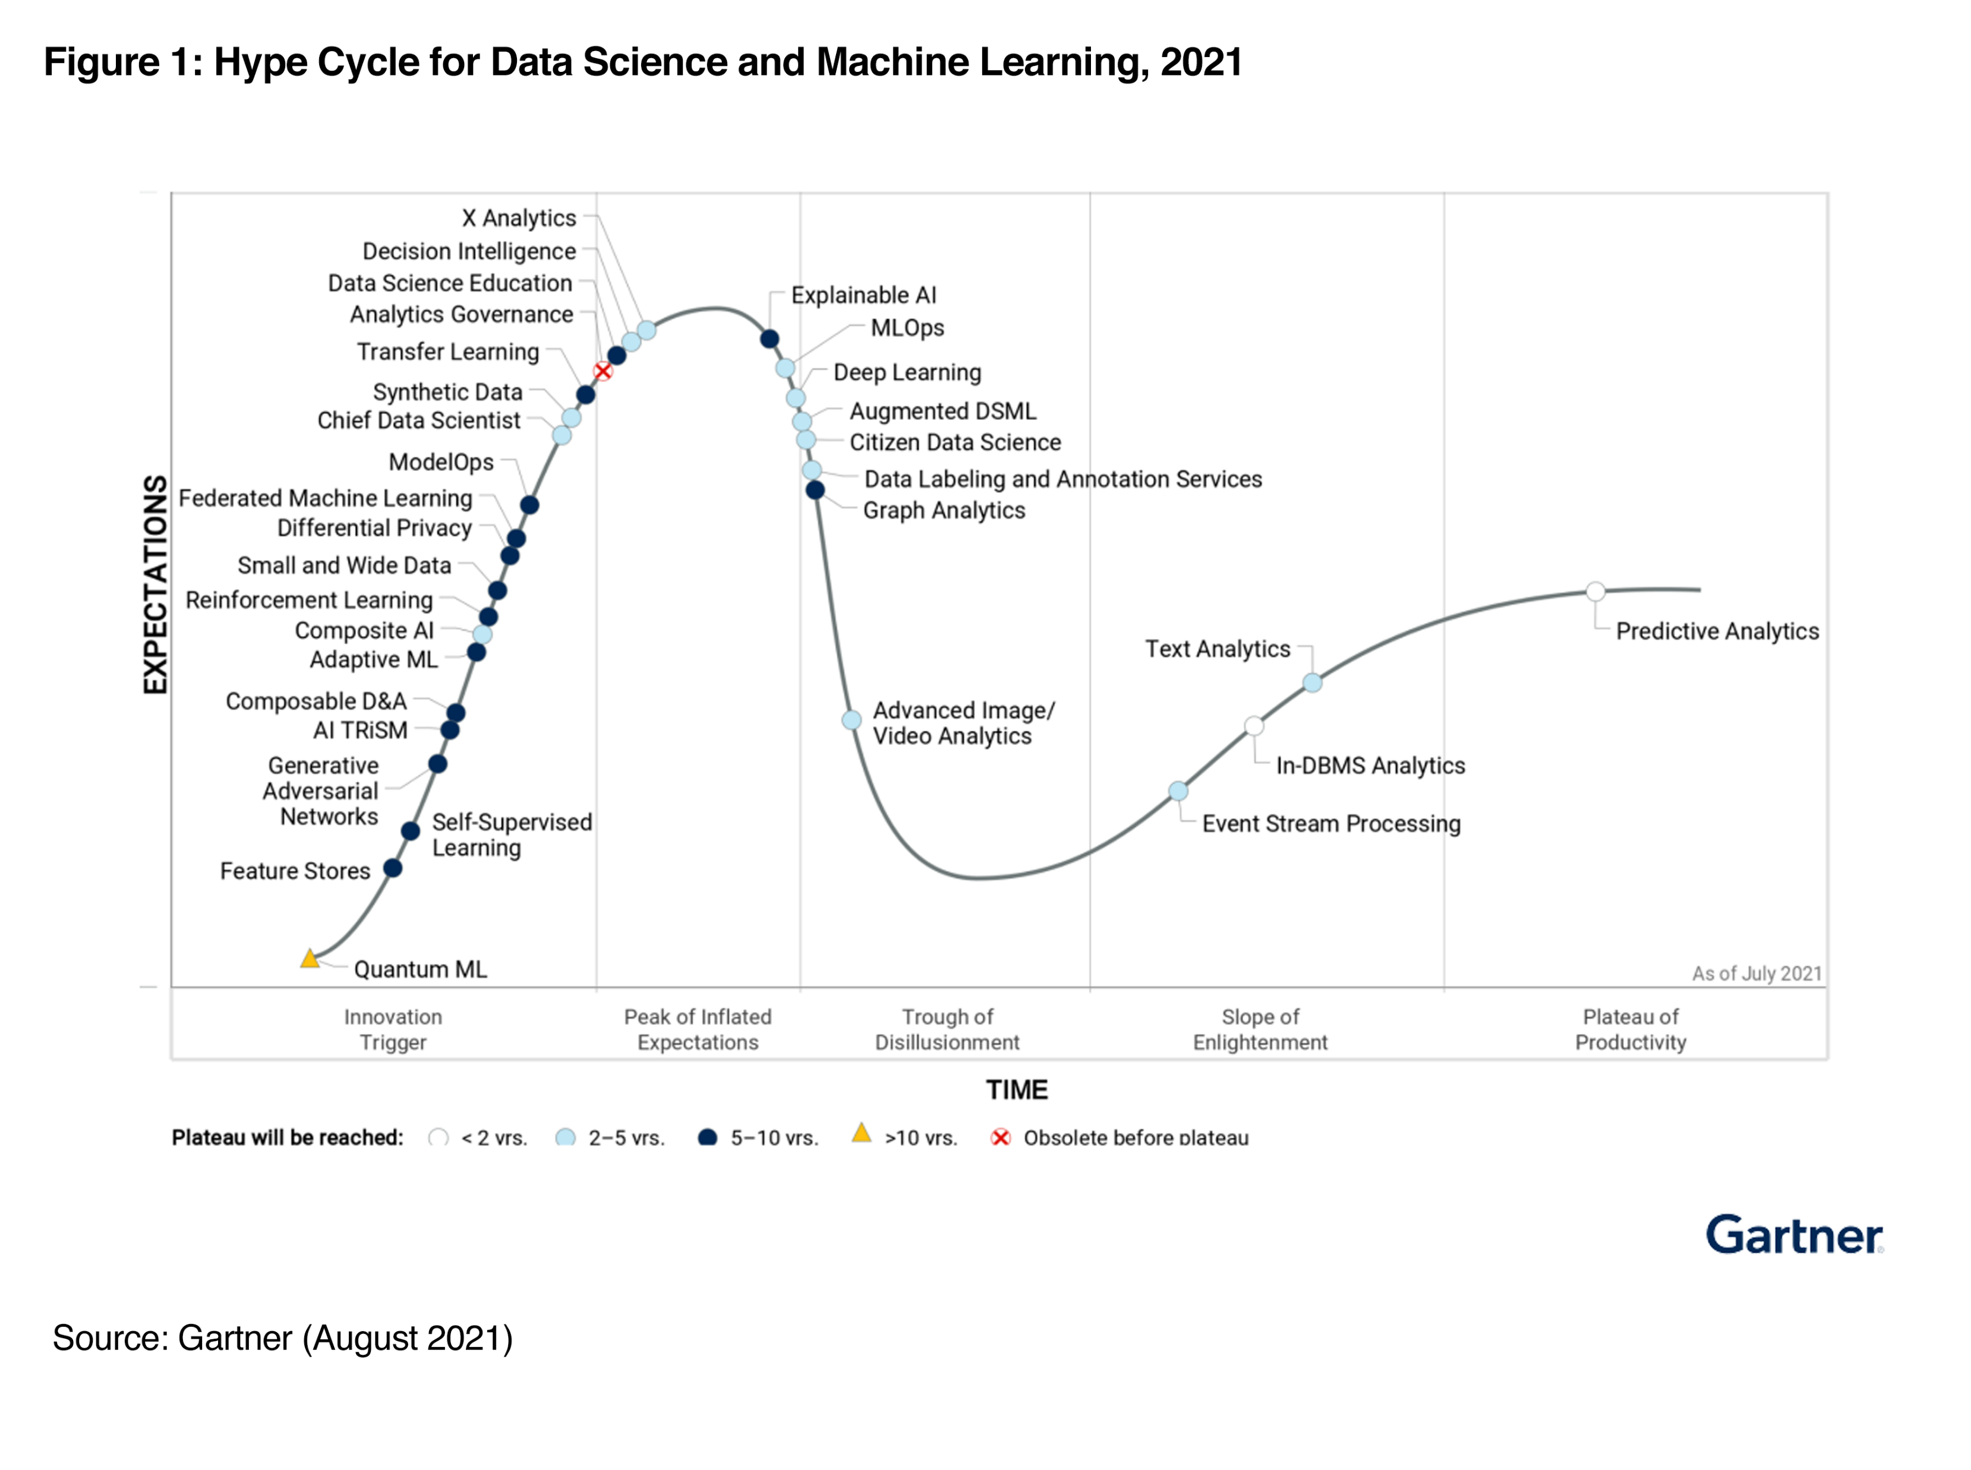

Slide 17
Take home exercise
Check the latest Hype cycle in an area of your interest

Slide 18
What is Intelligence ?

Slide 19
Intelligence is a property of an entity, which we will call the agent,
It interacts with an external problem or situation, which we will call the environment.
An agent’s intelligence is typically related to its ability to succeed with respect to one or more objectives, which we will call the goal.
Intelligence measures an agent’s general ability to achieve goals in a wide range of environments

Slide 20
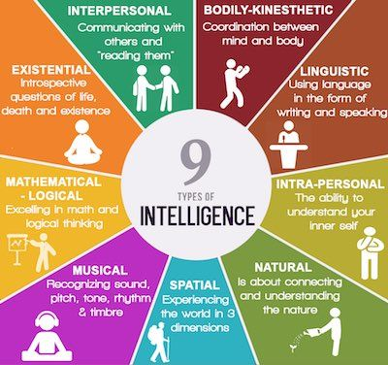
https://communicatorz.com/2016/07/27/9-types-of-intelligence/

Slide 21
What is Artificial Intelligence
“It is the science and engineering of making intelligent machines, especially intelligent computer programs. It is related to the similar task of using computers to understand human intelligence, but AI does not have to confine itself to methods that are biologically observable.” – Stanford

Slide 22
John McCarthy in 1956 was amongst the first use the term AI
the science and engineering of making intelligent machines

Slide 23
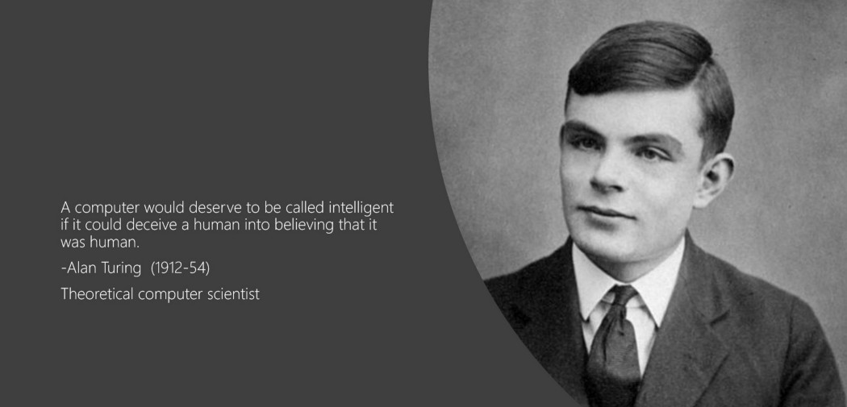

Slide 24
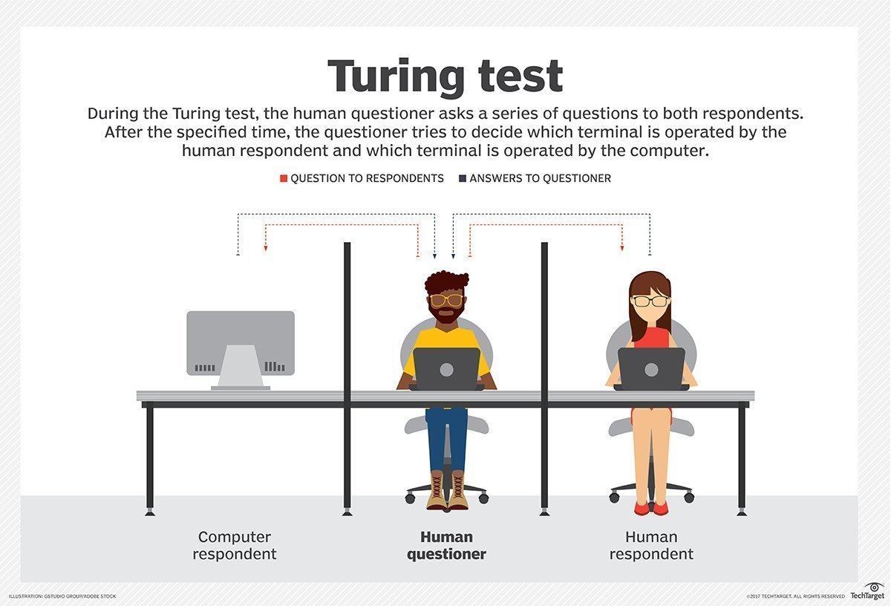

Slide 25
Reverse Turing test

Slide 26
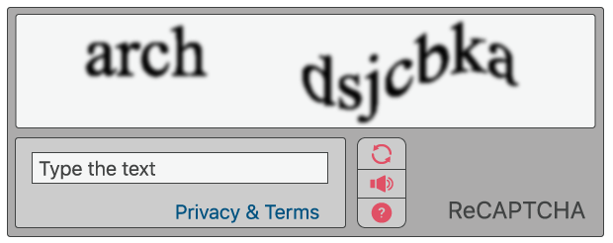
CAPTCHA - Completely Automated Public Turing test to tell Computers and Humans Apart

Slide 27
AI for you as a Manager

Slide 28
How does a typical manager spends their time .
In what activities

Slide 29
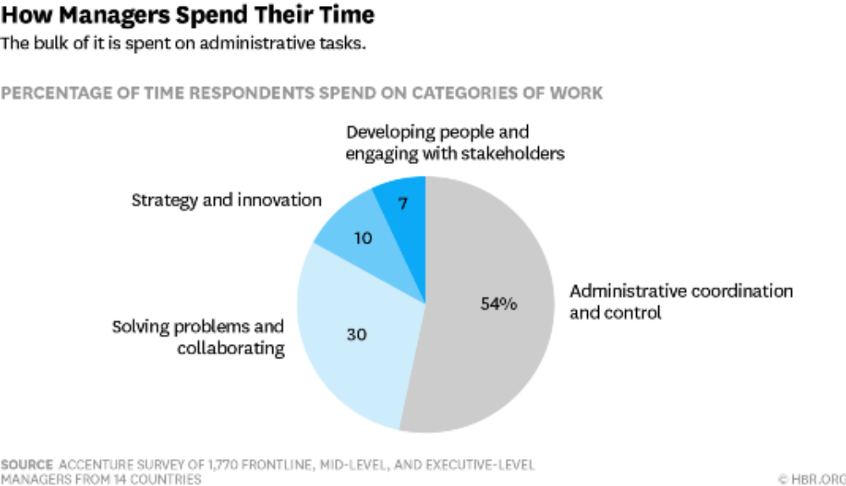

Slide 30
AI can support three important business needs:
Automating business processes
Gaining insight through data analysis (Analytics on Steroids)
Engaging with customers and employees.

Slide 31
Traditional Business Analytics vs AI/ML Projects
Output of a BA project is usually a report with a summary of current situation and actionable insights, while usually output of a ML/AI project is a module / piece of computer code than gets incorporated into a larger software application / deployed in production environment.

Slide 32
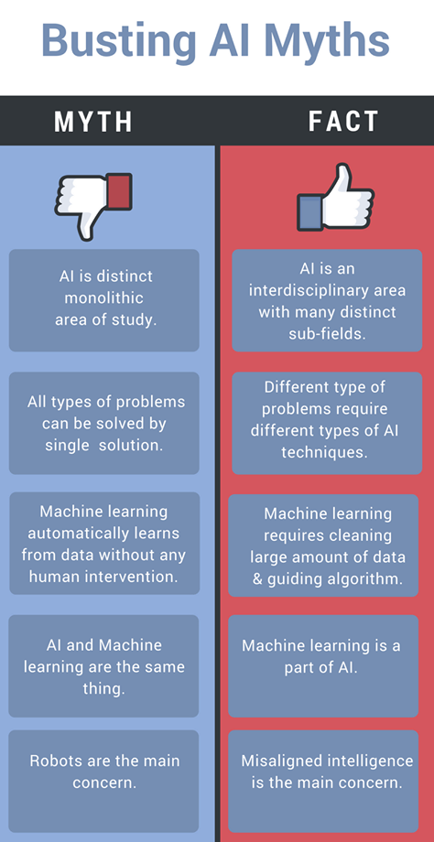
@hacker.io

Slide 33
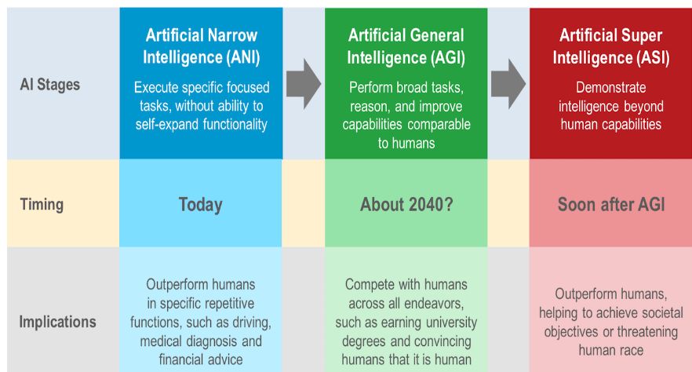

Slide 34
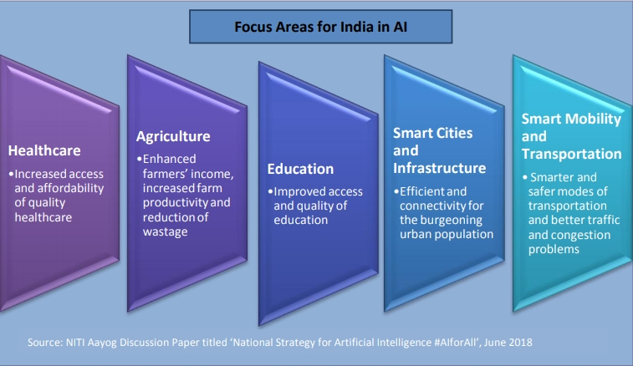
#AIforALL
#NitiAyog

Slide 35

#AIForGood

Slide 36
Where to start with AI in your Organisation ?

Slide 37
Take an organization selfie
What is the current state of AI in your Organization / BU / Team
Clear and well defined use cases ,
Right data capturing processes
Tech capabilities to build AI models
Tech capabilities to deploy & scale AI models
Promised value getting realized or not ?

