Slide 1
Integrated Media Planning: Business Analytics and Model building
Sangeeta Shah Bharadwaj
ssbharadwaj@mdi.ac.in
Notes:
Marketing Mix Modelling – How to build a market mix model using Python; what portion of Sales can be attributed to which Promotion Channel

Slide 2
Case Study: Toyota Camry
Today’s consumers are exposed to an expanding, fragmented array of marketing touch points across media and sales channels.
Imagine that while viewing a TV spot for a Toyota Camry, a consumer say Rita uses her mobile device to Google “sedans. ” Up pops a paid search link for Camry, as well as car reviews
She clicks through to Car and Driver’s website to read some reviews, and while perusing, she notices a display ad from a local dealership but doesn’t click on it
One review contains a link to YouTube videos people have made about their Camrys. On YouTube she also watches Toyota’s clever “Camry Reinvented” Super Bowl ad from eight months earlier
During her commute to work that week she sees a Toyota billboard she hadn’t noticed before and then RELATED VIDEO receives a direct-mail piece from the company offering a time limited deal
She visits local dealerships’ websites, including those promoted on Car and Driver and in the direct-mail piece, and at last heads to a dealer, where she test-drives the car and buys it.

Slide 3
How many off line and online channels has she touched?
Off line
Online
TV
Youtube, website, google ads
Billboards
Direct mails
Radio
Print media ad
To which channel will attribute the sales?

Slide 4
It becomes impertinent to talk about Various Media Platforms
TV
Radio
Mobile Apps or Alerts
Paid Search
Organic Social Media Content
Website Features
Influencer Campaigns
External Press Coverage
Paid Social Media
Media: YouTube videos, podcasts
etc
etc

Slide 5
What questions should Toyota’s chief marketing officer ask ?
??
Which advertising media? Garners maximum attention, how do you know?
How do you arrive at right media mix plan? Cost and benefit??
What is my target segment?
Customer persona
Preferred platforms for information consumptions?
Areas visiting
Design Campaigns and place advertisement

Slide 6
What questions should Toyota’s chief marketing officer (digital Marketing) should ask ?
??
How did this combination of ad exposures interact to influence this consumer?
Is Toyota investing the right amounts at the right points in the customer-decision journey to spark her to action?

Slide 7
Another case
How do ads work across media and sales channels, following is an example
TV ate up 85% of the budget in one new-product campaign, whereas YouTube ads—a 6% slice of the budget
However You Tube ads were nearly twice as effective at prompting online searches that led to purchases
And search ads, at 4% of the company’s total advertising budget, generated 25% of sales.
Armed with those rich findings and the latest predictive analytics, the company reallocated its ad dollars, realizing a 9% lift in sales without spending a penny more on advertising

Slide 8
What is different here?
??

Slide 9
So what is different in this case?
??
Capture the data
Use predictive analytics
In this case improved sales by just reallocation without spending extra money.

Slide 10
Hence it is important to study analytics arounds advertising spend , media mix and timings of ads, impact on sales
How Data Analytics is helping ?

Slide 11
Media Mix Analytics
What are the different ways of setting advertising budget?
  Media decisions (what mix?)
What are the methods that involve measuring advertising effectiveness?
  Advertising effectiveness ( can normally be done by conducting experiments in controlled advertisement or otherwise)

Slide 12
Media Mix Analytics
What are the different ways of setting advertising budget?
  Media decisions (what mix?)
What are the methods that involve measuring advertising effectiveness?
  Advertising effectiveness ( can normally be done by conducting experiments in controlled advertisement or otherwise)

Slide 13
Media Mix Budget Decisions
Advertising expenditure is percentage of sales, how do you decide?
  Delphi techniques
  Benchmarking: Advertising investment varies by industry(B2B: Product and Services, B2C: Product and Services)
  Competitors analysis (what is competition doing, what is the spending etc)

Slide 14
What else is important?
Sensitivity of sales or other variables to different input variables
What does that mean?
One example is…

Slide 15
How sensitive is demand to advertising?
Advertising elasticity of Demand= Proportionate change in demand for the product/ proportionate change in advertising expenditure
If Advertising elasticity of demand (AED) is more than 1 , the product is advertising elastic
If Advertising elasticity(AED) is less than 1, the product is advertising inelastic

Slide 16
So what next?
If you know reach of media let us say impact of media in garnering interest/ sales, what next??
You may want to collect this information for all media points
You will have to analyze how to allocate the budget to each media channel

Slide 17
Marketing Analytics in Media mix involves three broad activities
???
attribution, the process of quantifying the contribution of each element of advertising;
optimization, or “war gaming” by using predictive analytics tools to run scenarios for business planning; and
allocation, the real-time redistribution of resources across marketing activities according to optimization scenarios.

Slide 18
Attribution
To determine how your advertising activities interact to drive purchases
start by gathering data, What type of data and Where do you find that data?
market conditions
marketing actions
competitive activities

Slide 19
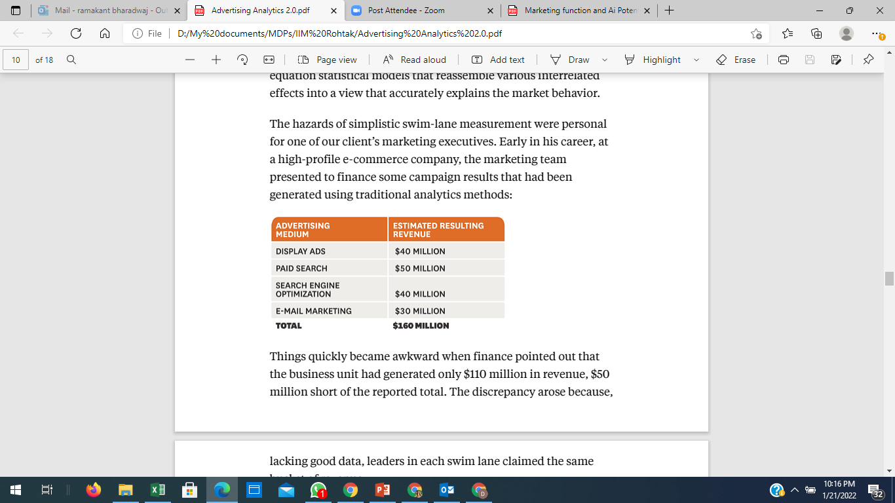
Individual swimlane without attribution
the marketing team presented to finance some campaign results that had been generated using traditional analytics methods
Things quickly became awkward when finance pointed out that the business unit had generated only $110 million in revenue, $50 million short of the reported total.
The discrepancy arose because, leaders in each swim lane claimed the same bucket of revenue

Slide 20
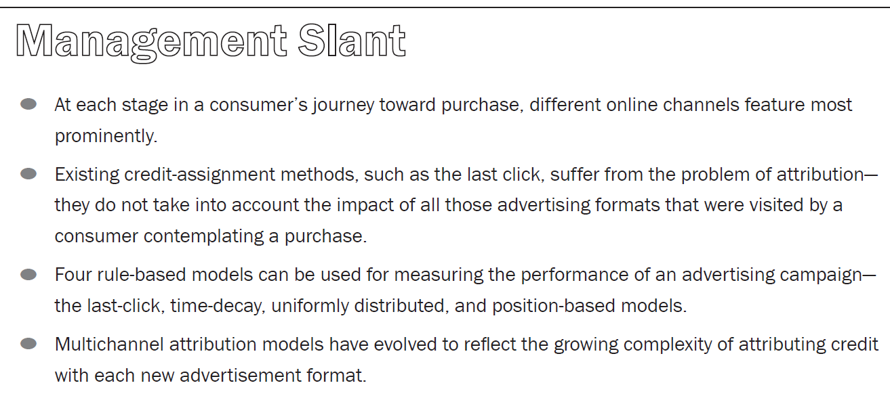
Attribution Models

Slide 21
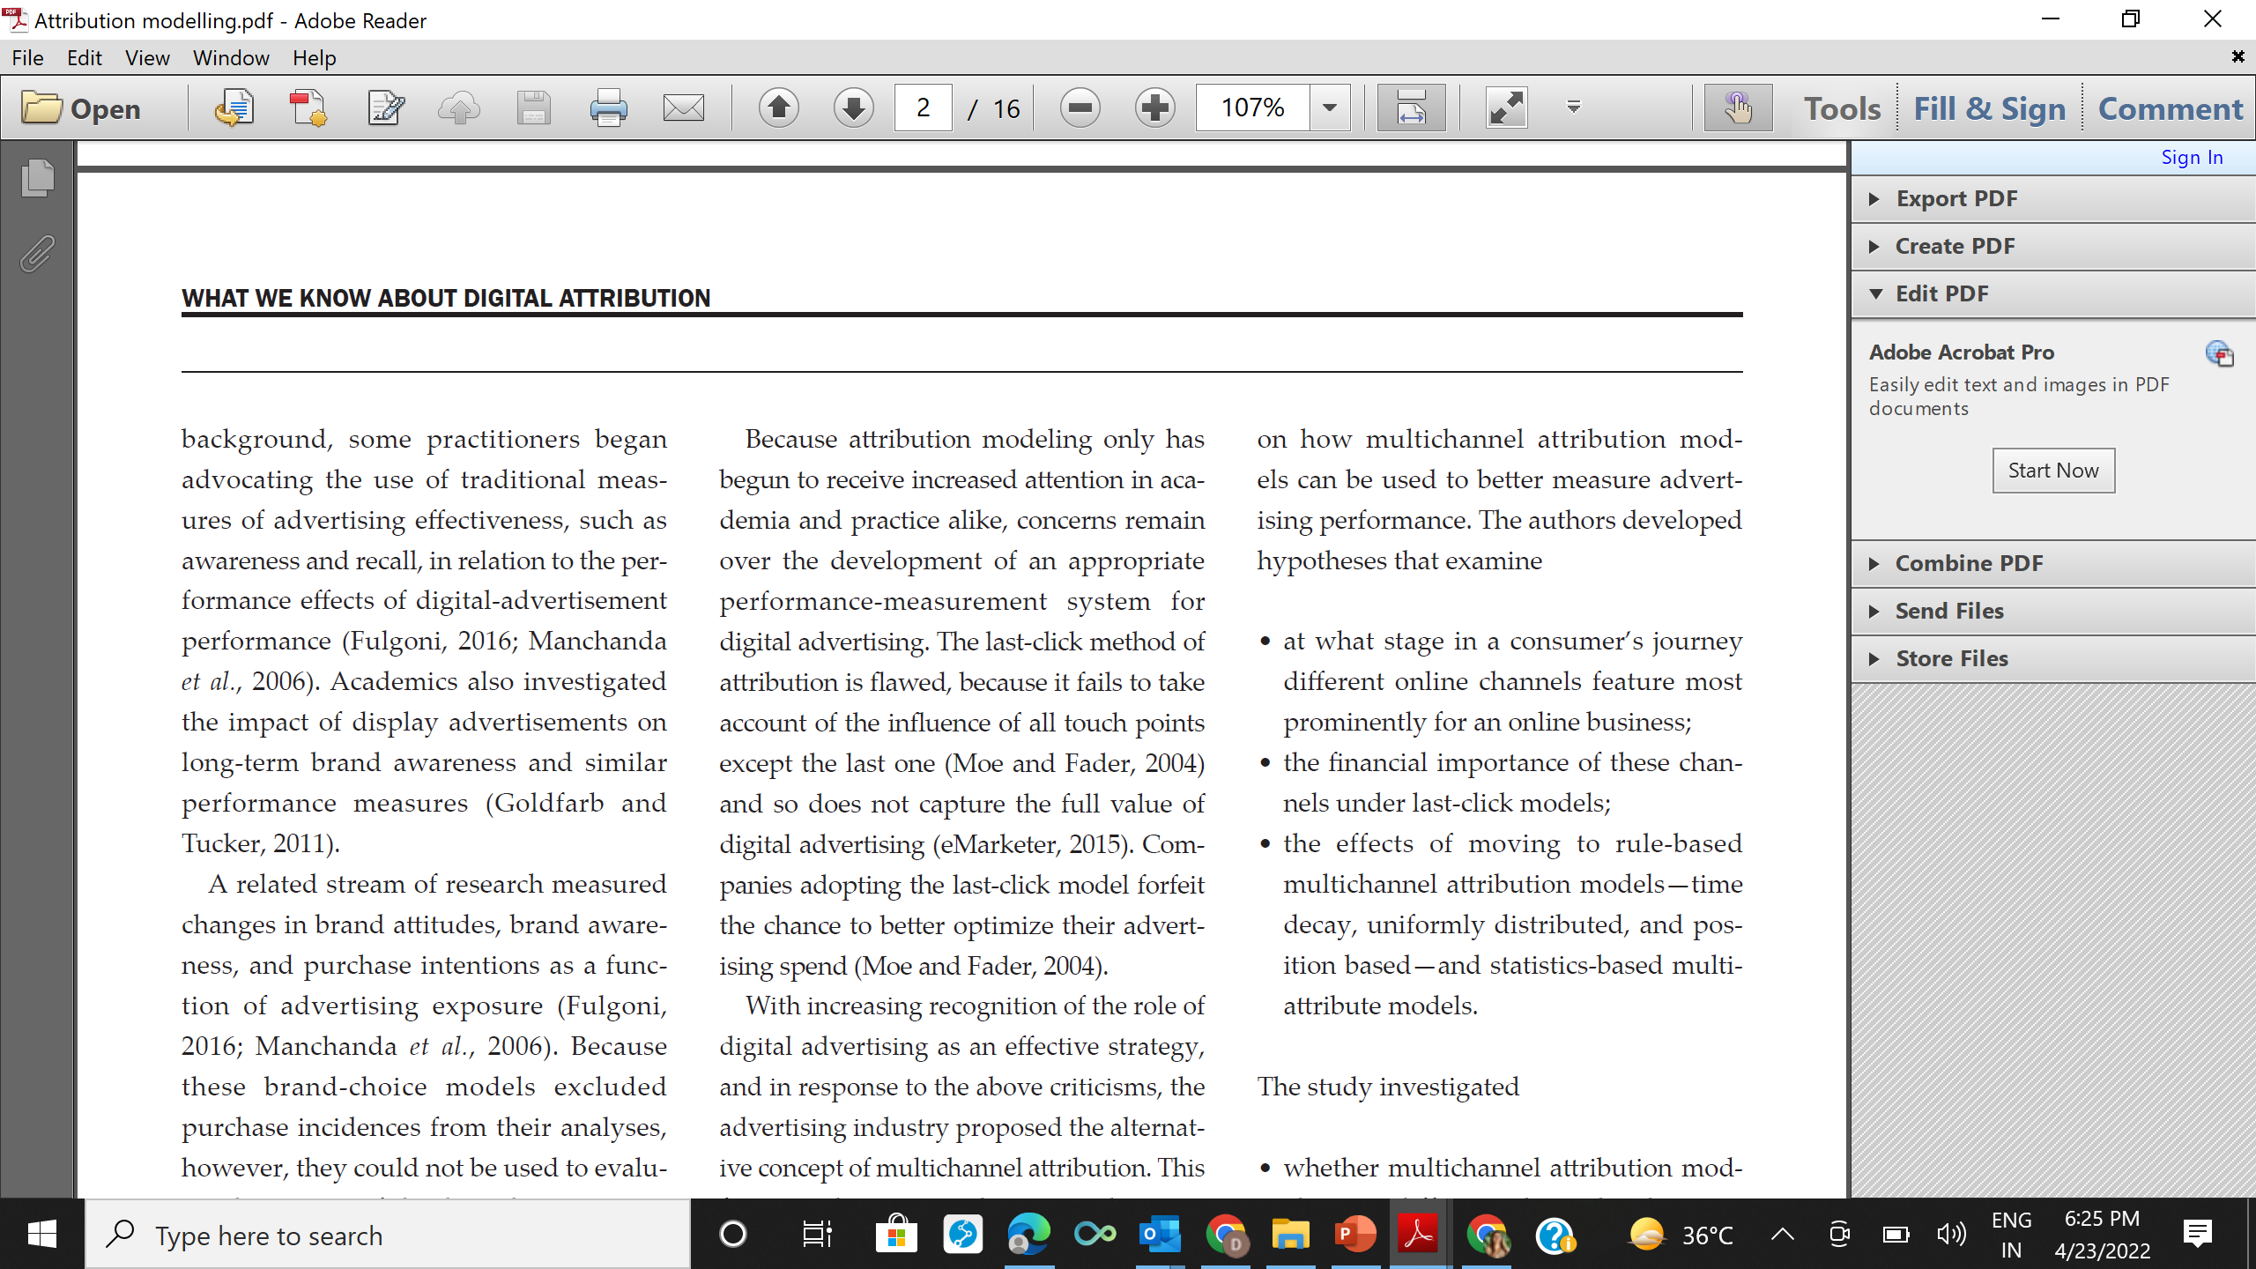
Need to study the following

Slide 22
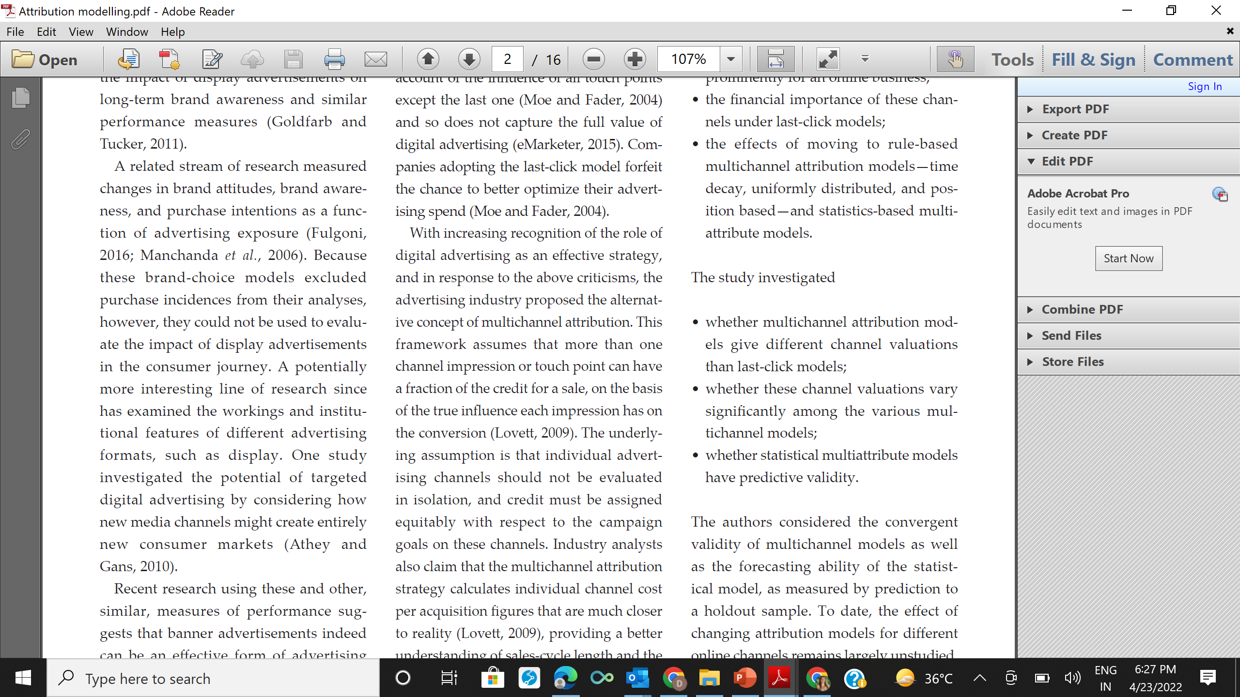

Slide 23
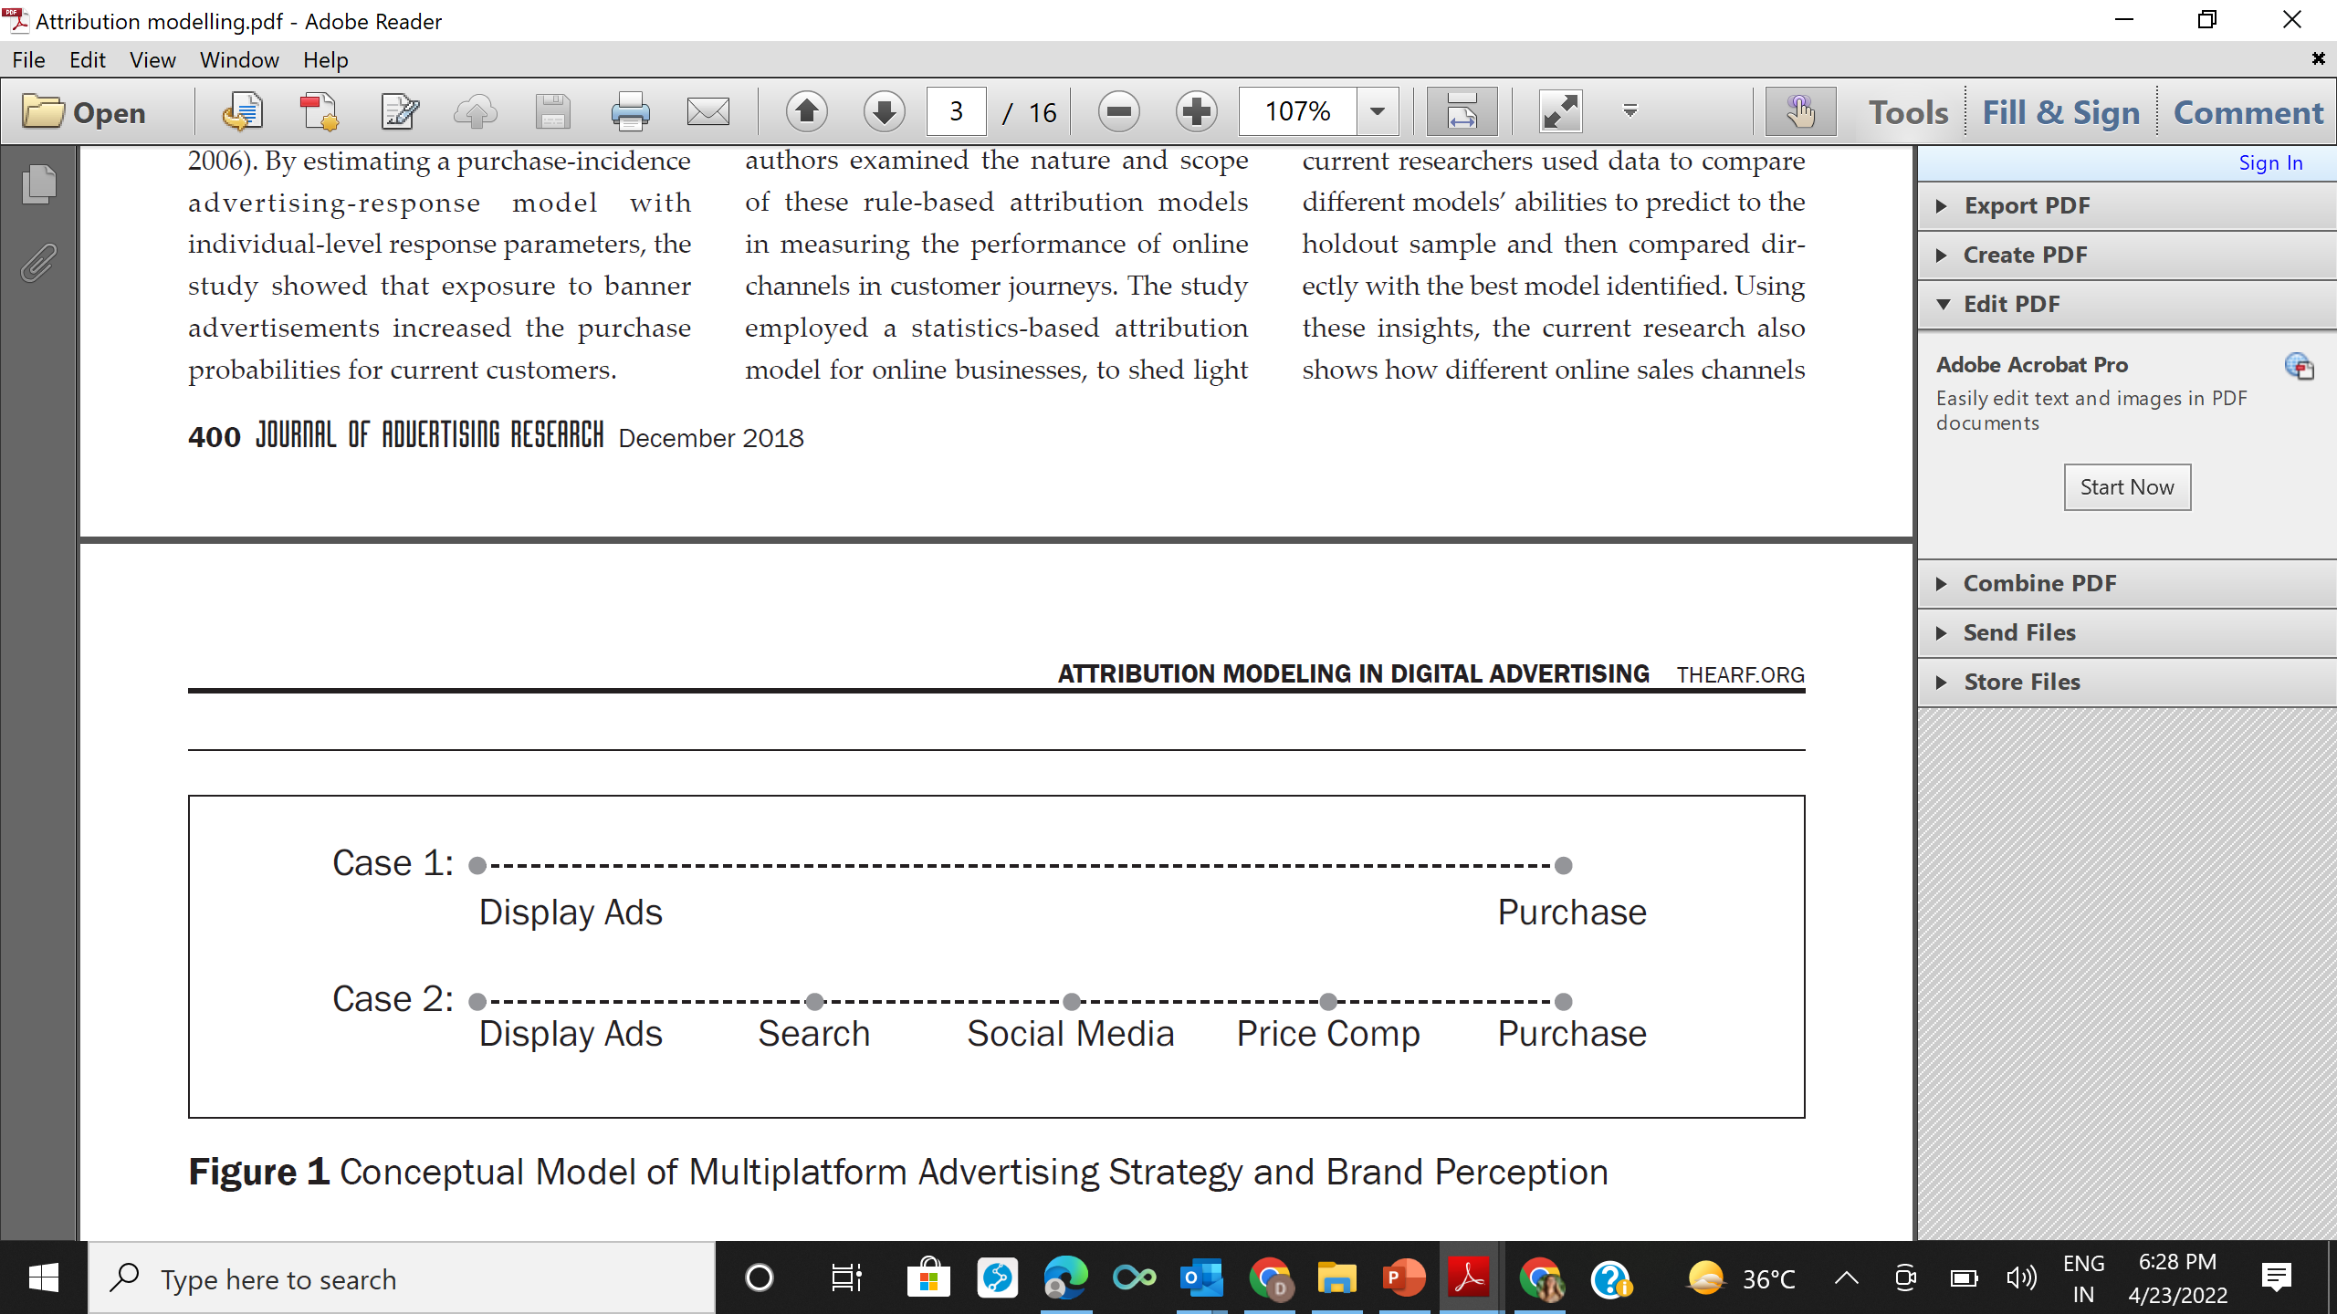
Following scenarios are discussed

Slide 24
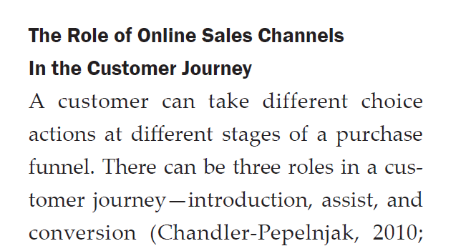

Slide 25
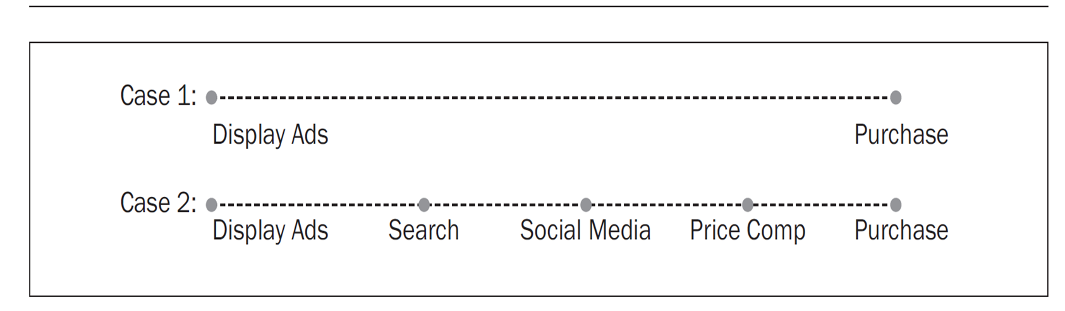
The last click model
The last click model ascribes 100% credit to the last advertisement clicked o before a purchase conversion so in case 2 model would attribute the entire conversion to price comparison

Slide 26
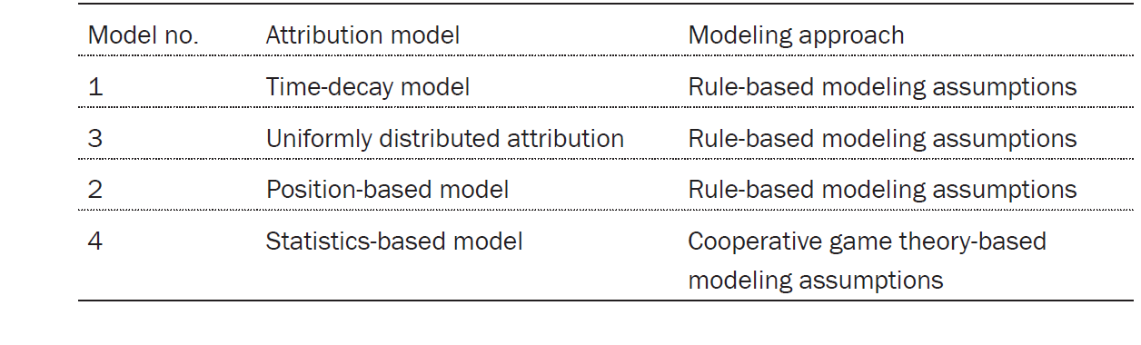
Multichannel attribution Model

Slide 27
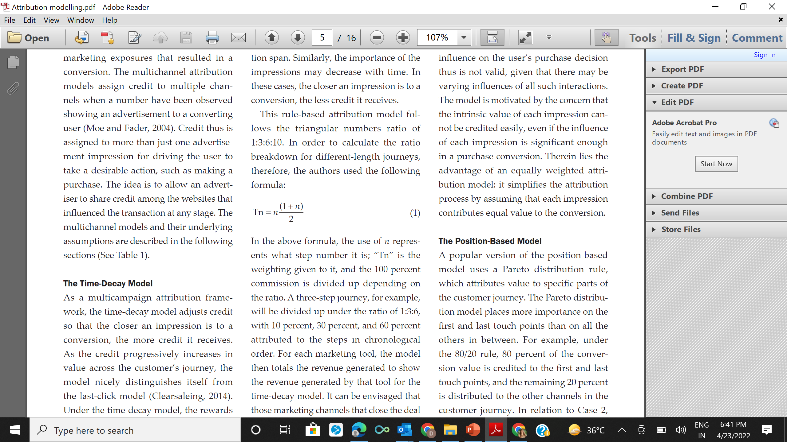
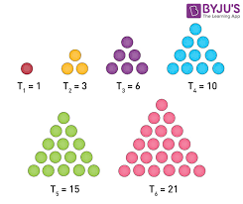
The time decay model

Slide 28
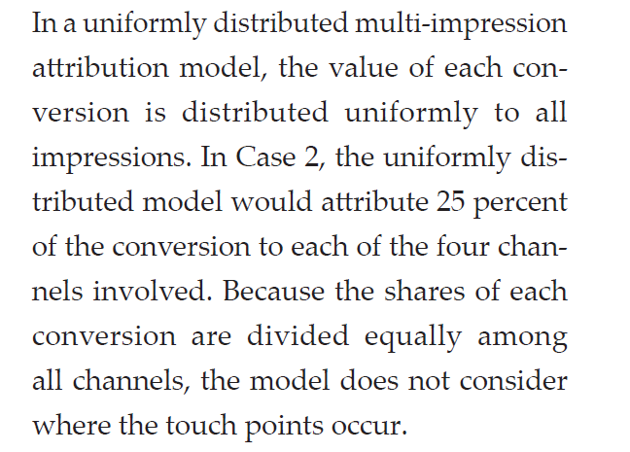
Uniform Distribution Model
The Position Based Model
A popular position based model uses pareto distribution and hence places gigh values to first and last purchase (80% attribution and equally distribute rest 20% on all other channels

Slide 29
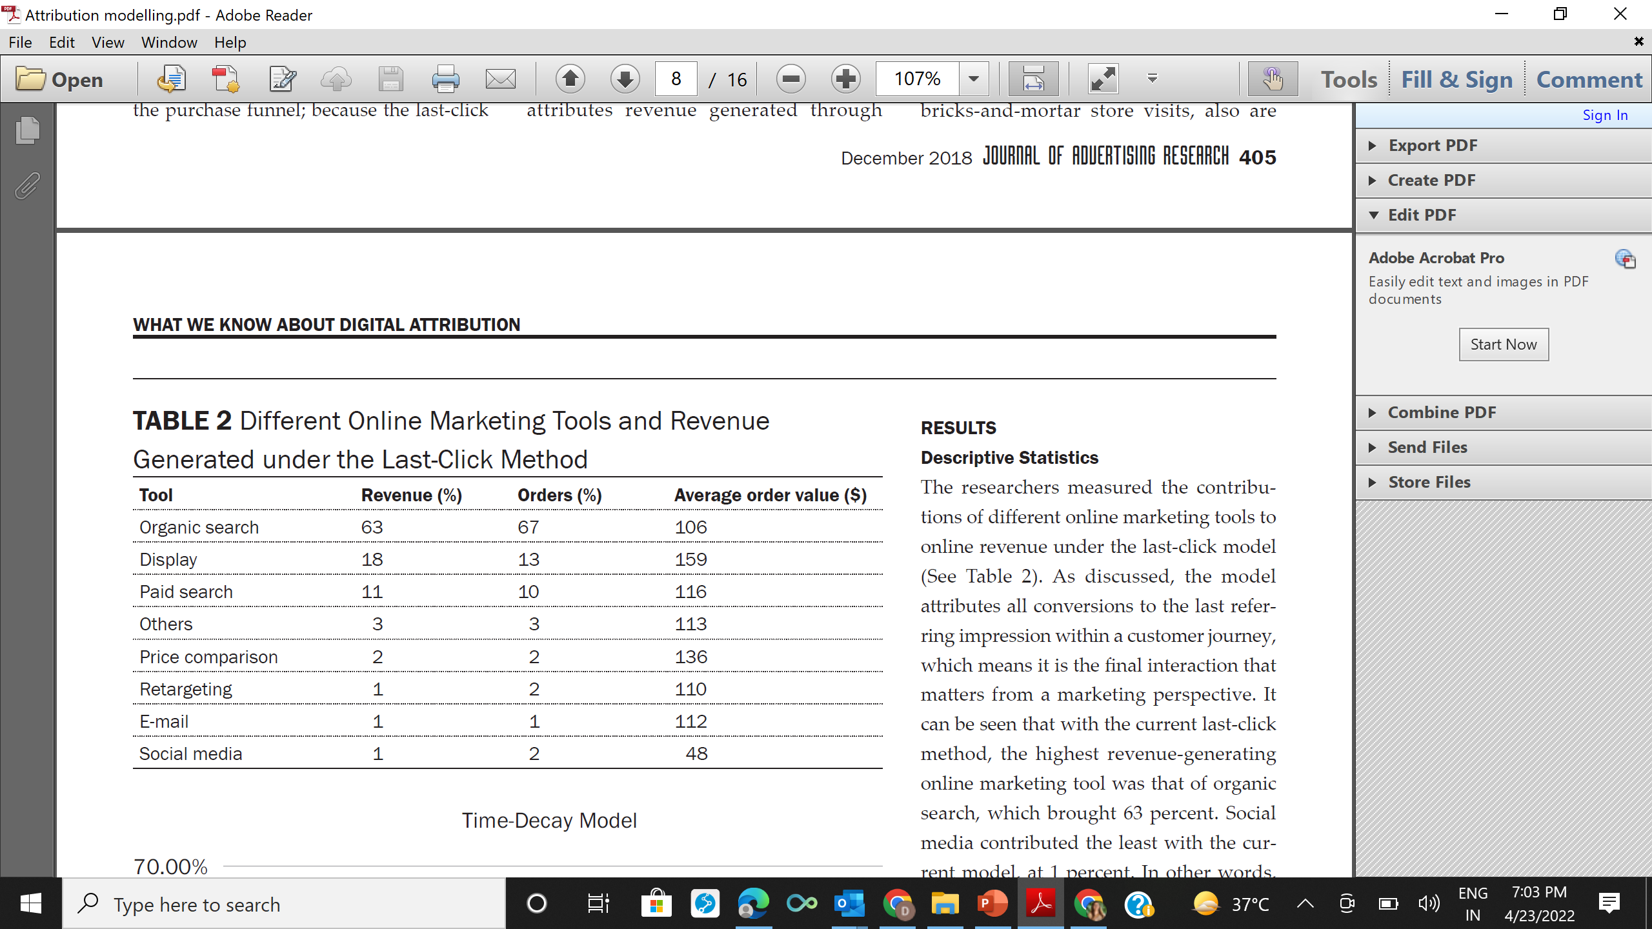
Results of descriptive statistics

Slide 30
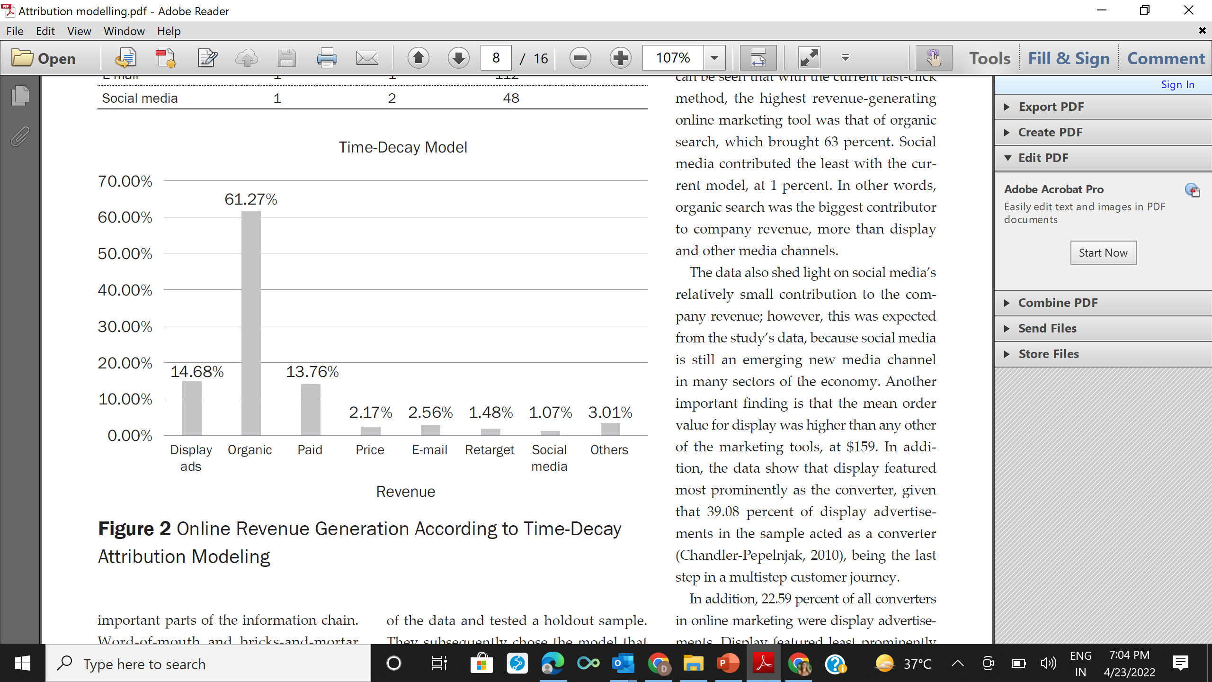
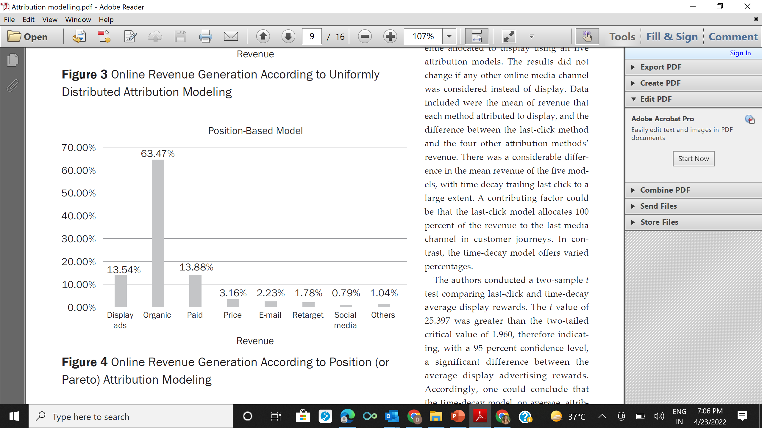
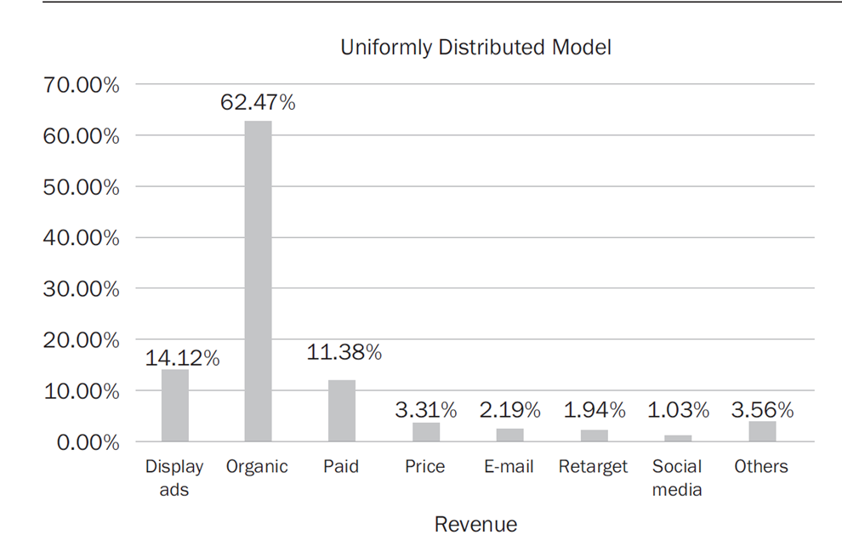

Slide 31
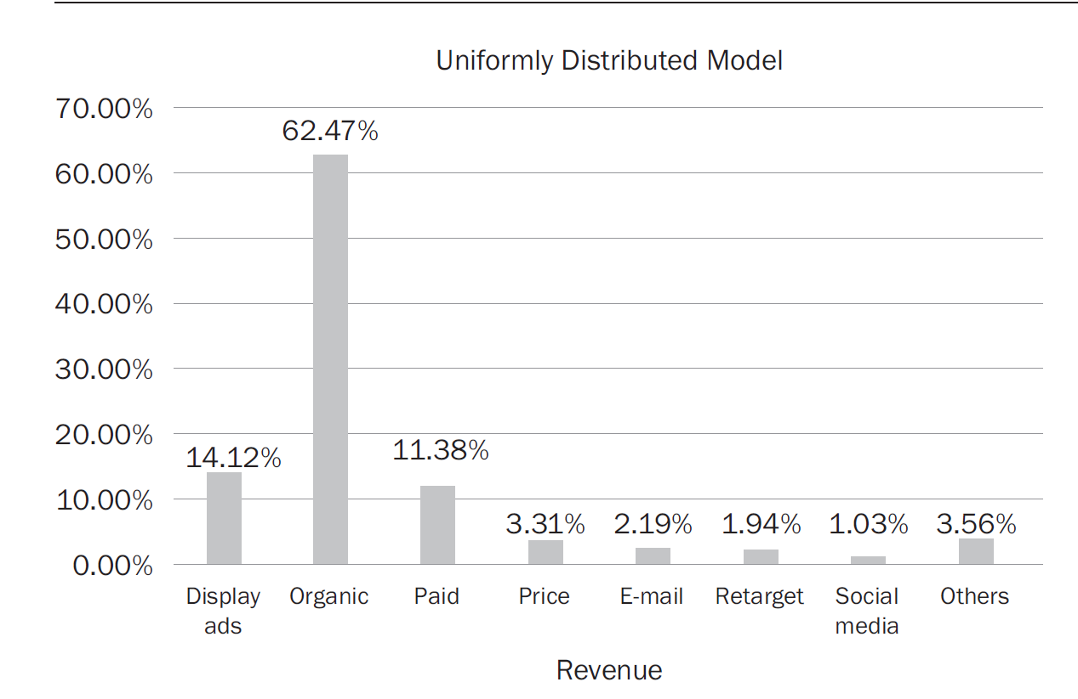

Slide 32
So what we are saying here is that there is synergy because of multimedia channels i.e. 1+1+1+1+1=5

Slide 33
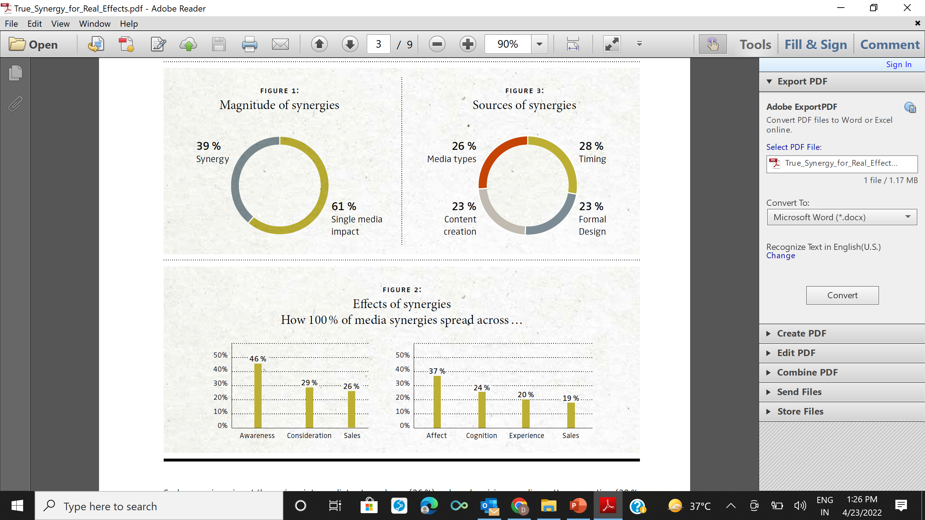

Slide 34
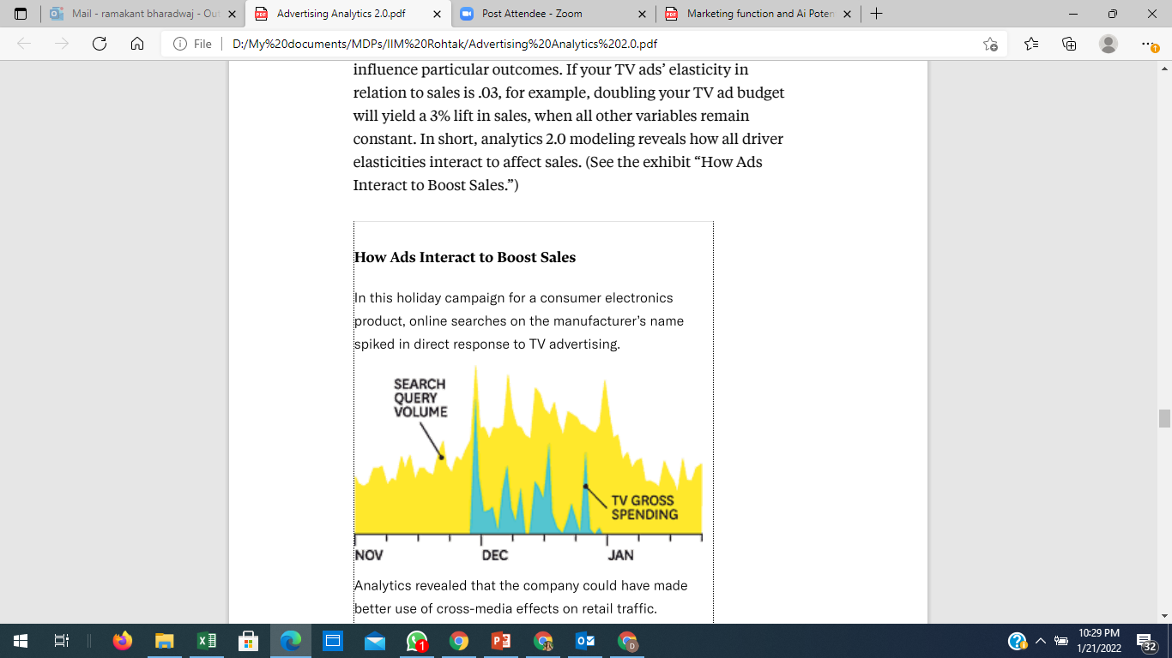
Advertising Analytics
In actual analyses statistical models may account for hundreds or thousands of permutations of advertising and sales tactics, as well as exogenous variables such as geography, employment rates, pricing, season of the year, competitive offerings, and so on
such analyses allows to instantly see how a new TV ad affects consumers’ online search patterns—and then to change your keyword-search bidding strategy to buy up relevant words as the ad is running.

Slide 35
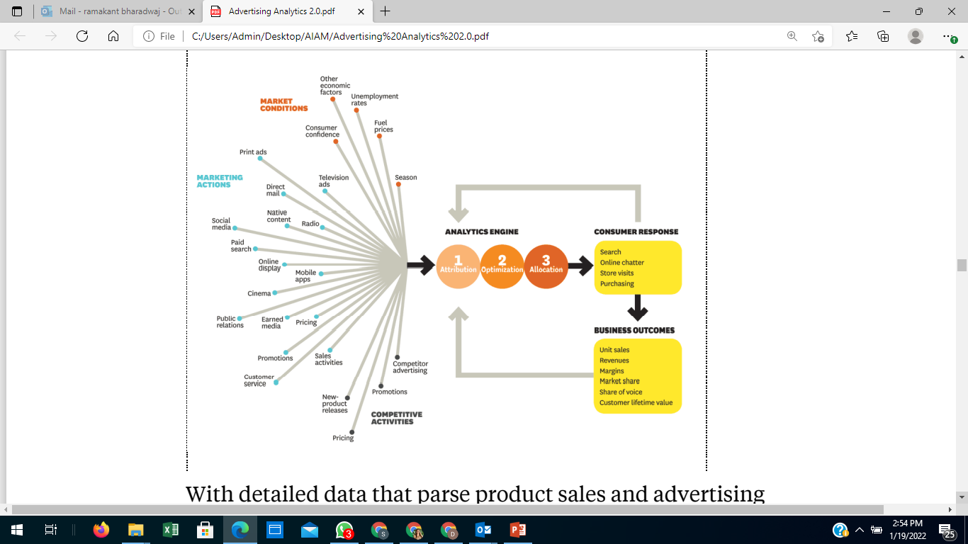

Slide 36
Optimization
Once a marketer has quantified the relative contribution of each component of its marketing activities and the influence of important exogenous factors, war gaming is the next step
It involves using predictive-analytics tools to run scenarios for business planning
Maybe you want to know what will happen to your revenue if you cut outdoor display advertising for a certain product line by 10% in city A—or if you shift 15% of your product-related TV ad spending to online search and display

Slide 37
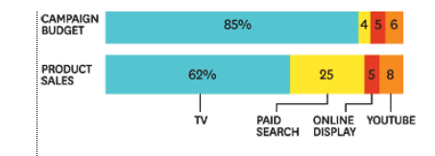
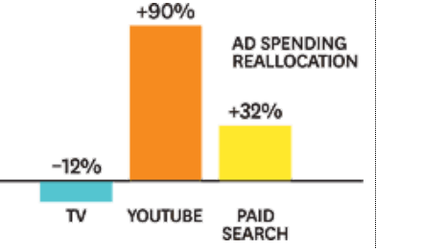
Remember Elasticity
Working with data analyzed through the attribution process, you can assign an “elasticity” to every business driver, from TV advertising to search ads to fuel prices and local temperatures
(Elasticity is the ratio of the percentage change in one variable to the percentage change in another.) Knowing the elasticities of your business drivers helps you predict how specific changes you make will influence particular outcomes
If your TV ads’ elasticity in relation to sales is .03, for example, doubling your TV ad budget will yield a 3% lift in sales, when all other variables remain constant
In short, analytics modeling reveals how all driver elasticities interact to affect sales

Slide 38
War Gaming
War gaming uses the actual elasticities of your business drivers to run hundreds or thousands of scenarios within minutes
In a typical war-gaming process, team members define marketing goals (such as a certain revenue target, share goal, or margin goal), often across multiple products and markets
Crunching the vast database of driver elasticities, optimization software generates a set of most-likely scenarios along with marketing recommendations to achieve them
The software also can test specific what-if scenarios: For instance, how will sales of our midsize pickup truck in Denver be affected if gas prices climb 5% and we launch a combined TV and online campaign promoting a $300 rebate?

Slide 39
Allocation
Allocation involves putting the results of your attribution and war-gaming efforts into the market, measuring outcomes, validating models (that is, running in-market experiments to confirm the findings of an analysis), and making course correction
Gone are the days of setting a marketing plan and letting it run its course—the so-called run-and-done approach.
Advertising has become easier to transact, place, measure, and expand or kill.
Marketers can now readily adjust or allocate advertising in different markets on a monthly, weekly, or daily basis—and, online, even from one fraction of a second to the next.

Slide 40
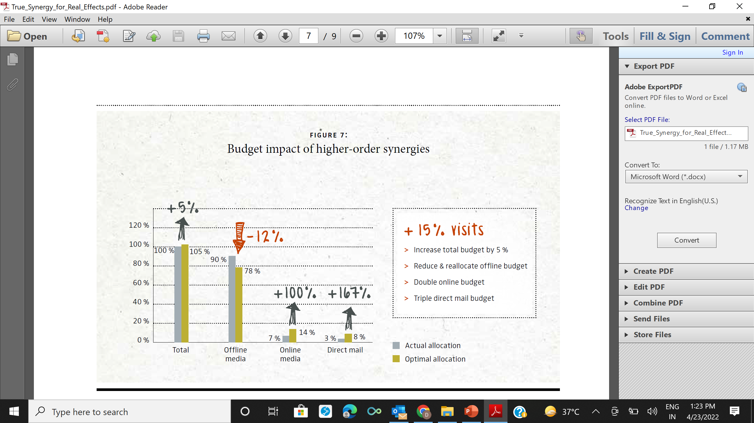
Notes:
By reallocating budget across media and marginally incaresing it in this case by 5%, greater synergies can be achieved as shown in the next slide

Slide 41
Can we summarize our learning here
No one media is the best
We need to swift through large set of data
Analyze them in real time and take fast decisions

