Slide 1
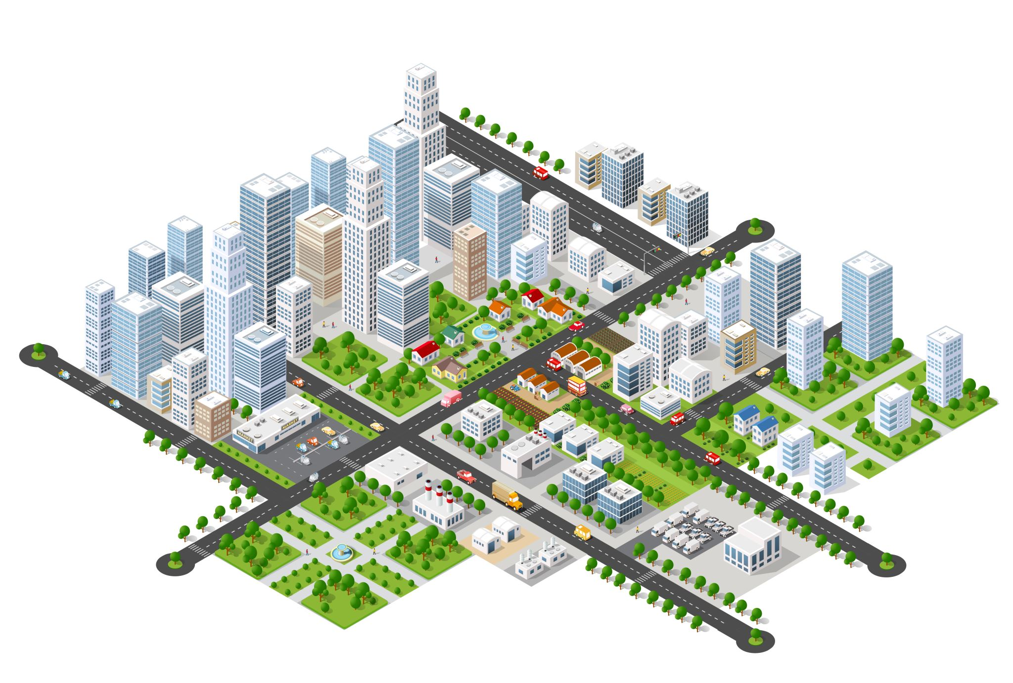
Infrastructure Project Management
Dr. Rohit Titiyal
IIM Visakhapatnam

Slide 2
INTRODUCTION
A group of physical systems or facilities that provide essential public services across the areas of transportation, water, waste, utilities, government and society and to include the workforce associated with their development and maintenance.
Infrastructure projects include large-scale, multidimensional, long-term investments in transportation systems, buildings, water resources, communications, power generation, and public services.

Slide 3
INTRODUCTION
“Infrastructure’’ refers to the physical systems that provide transportation, water, buildings, and other public facilities that are needed to meet basic human social and economic needs. These facilities are needed by people regardless of their level of economic development. When infrastructure is not present or does not work properly, it is impossible to provide basic services such as food distribution, shelter, medical care, and safe drinking water.

Slide 4
INTRODUCTION
Infrastructure projects, which typically provide essential services, have one or more of the characteristics mentioned below:
They are highly capital-intensive.
They involve huge sunk costs.
They have a long operating life.
Infrastructure benefits are frequently qualitative or difficult to measure
Infrastructure projects and programs will be of great concern to many different groups of people

Slide 5
CHARACTERISTICS OF INFRASTRUCTURE PROJECTS
High Capital Costs
Long Gestation Period
Steady Cash Flows
High Entry Barriers
Need for High Government Support
High Regulation
Highly "Contractual" Project Structures
Multiple Risks

Slide 6

TOWARD MORE SUSTAINABLE INFRASTRUCTURE
The performance Infrastructure systems can be measured in terms of many factors, including cost, energy consumption, resource requirements, capacity, service quality, safety, impacts on society, and impacts on the environment.
Performance can also be measured in terms of sustainability.
Sustainability can be enhanced by reducing costs, improving social and economic benefits, restricting the use of fossil fuels and other nonrenewable resources, or reducing negative social and environmental impacts.
Other infrastructure projects and programs are designed to replace or upgrade systems that, for some reason, have become obsolete or nonsustainable.

Slide 7
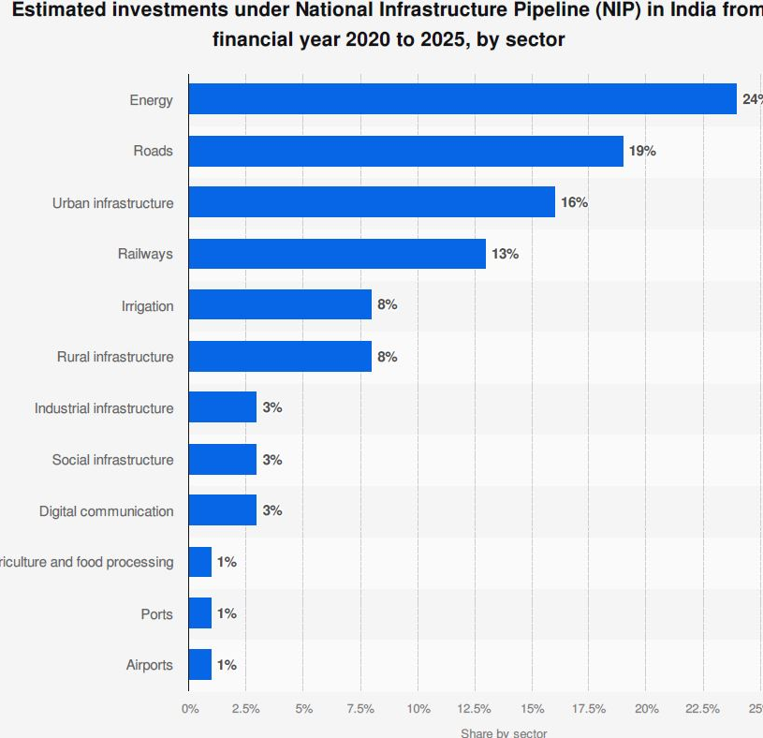
Infrastructure project in India (2020to 2025)

Slide 8
EVALUATING INFRASTRUCTURE PROJECTS
Project evaluation is a qualitative process as much as it is a quantitative one.
Implementing and maintaining a project over a long period of time will require.
Financing
Govt. Approvals
Engineering skills
Resources
Public support

Slide 9
EVALUATING INFRASTRUCTURE PROJECTS
Where Do Projects Come From?
A project begins with an idea with a vision of what is wrong or what is needed or what is possible
At idea generation point, and not before this point, project management skills are needed.

Slide 10
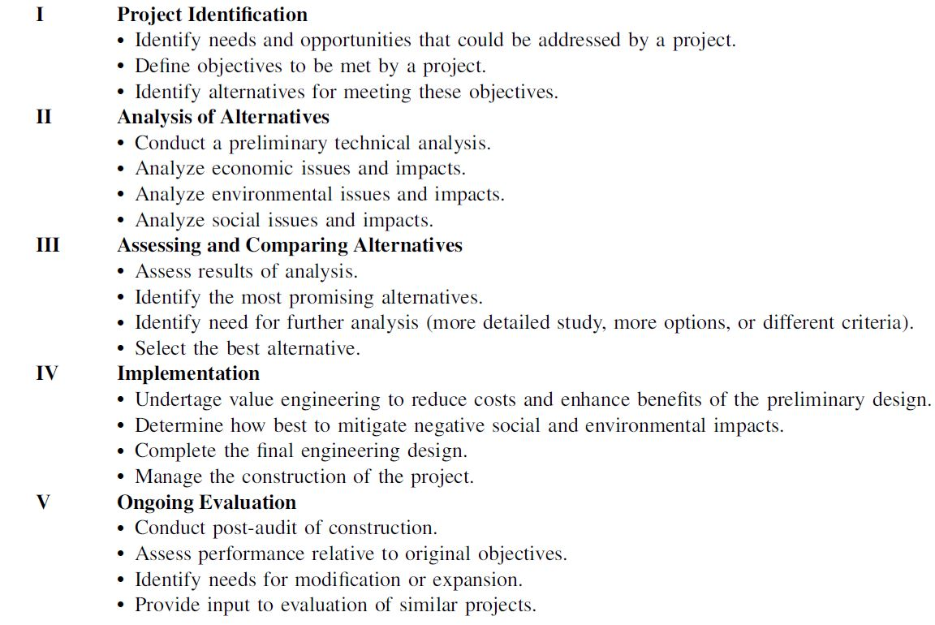
A FRAMEWORK FOR PROJECT EVALUATION

Slide 11
PHASE I—PROJECT IDENTIFICATION
Many ideas for projects arise in response to perceived problems and the needs of society.
Congestion leads to ideas for new roads or new transit systems
Rising populations require new schools, housing, and drinking water
If problems and needs are understood, and if there is a process
for examining possible ways to deal with them, then it should be possible to develop effective projects and programs that result in a better society.

Slide 12
PHASE I—PROJECT IDENTIFICATION
it is useful to have a framework in which the first step examines problems or needs. For an infrastructure-based system, problems are likely to relate to cost, capacity, service quality, or safety.
A problem may exist if some aspect of performance is believed to restrict the efficiency or effectiveness of the system.

Slide 13
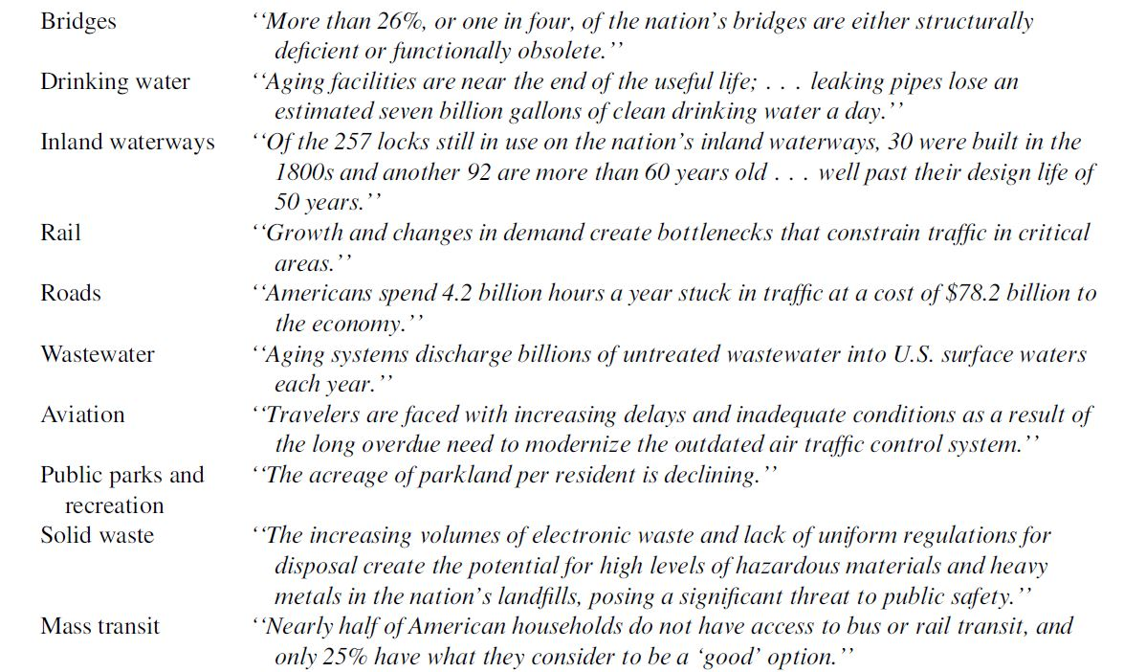
SELECTED PROBLEMS AND NEEDS RELATED TO AMERICA’S INFRASTRUCTURE

Slide 14
The objectives of the project need to be clear and well-defined, but they can be modified based on feedback and assessments concerning completed projects.
The next step is to generate alternatives for addressing the problems and needs that have been identified.
For example, many systems must deal with potential capacity problems related to growth in population. If so, then alternatives could consider not only expanding capacity to keep pace with population growth but also increasing prices in order to limit demand, or increasing efficiency of operations in order to allow more effective use of existing capacity

Slide 15
PHASE II—ANALYSIS OF ALTERNATIVES
Studies provide information that will help in assessing and comparing the various alternatives being evaluated.
Assess the viability of each alternative with respect to technical, financial, operational, social, economic, environmental, or other objectives.
Analysis may include market demand studies, cost-benefit analysis, environmental impact assessment, and social assessment.

Slide 16
PHASE III—ASSESSING AND COMPARING ALTERNATIVES
During this phase, it will be necessary to compare alternatives with respect to how well they satisfy the objectives that were previously established.
Assessment will involve consideration of financial, economic, environmental, and social factors.
To what extent does each alternative meet the needs that are being addressed?
What are the costs and benefits of each alternative?
Are costs and benefits measured properly?
what extent does each alternative lead to positive or negative externalities?

Slide 17
PHASE III—ASSESSING AND COMPARING ALTERNATIVES
For public projects and for large private projects that require public approval, there will have to be opportunities for input from potential users, abutters, and the general public.
NIMBY (not in my backyard)
The outcome from this stage could be one of three broad conclusions.
One alternative clearly is the best.
Further study is necessary to determine which alternative is best.
None of the alternatives is worth pursuing

Slide 18
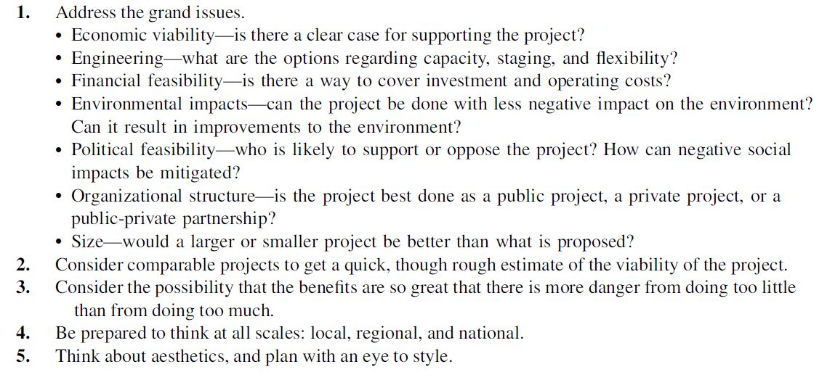
GUIDELINES FOR ASSESSING THE PROJECTS

Slide 19
PHASE IV—IMPLEMENTATION
At some point, detailed engineering design can be completed, and a construction management program can be initiated.
How soon should construction begin? How quickly should construction proceed? What are the possibilities for implementing the project in stages?

Slide 20
PHASE V—ONGOING EVALUATION
Monitoring performance, revising the project as needed, and identifying better approaches for evaluating similar projects and programs.

Slide 21
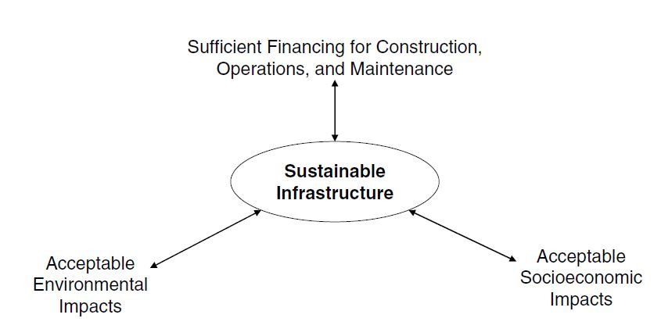
Requirements for Sustainable Infrastructure
Large-scale infrastructure, even if it appears to be adequately financed, can be sustained over long periods of time only if it is supported by society and the resources it requires are available at a reasonable cost.

Slide 22
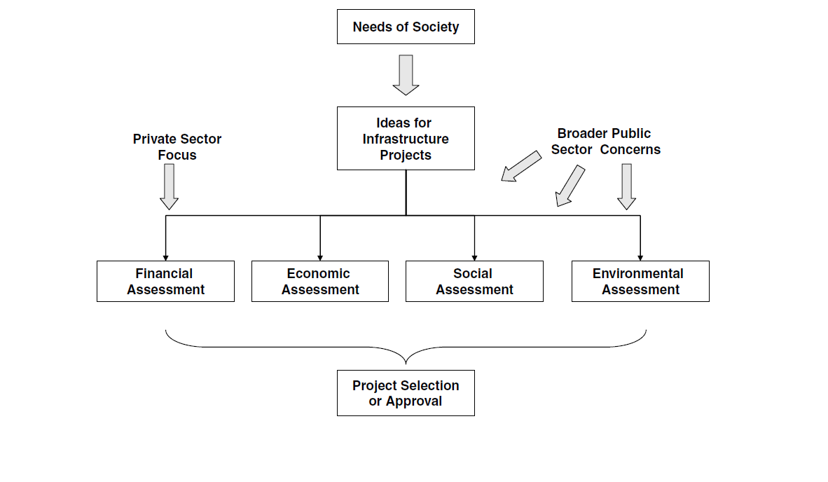

Slide 23
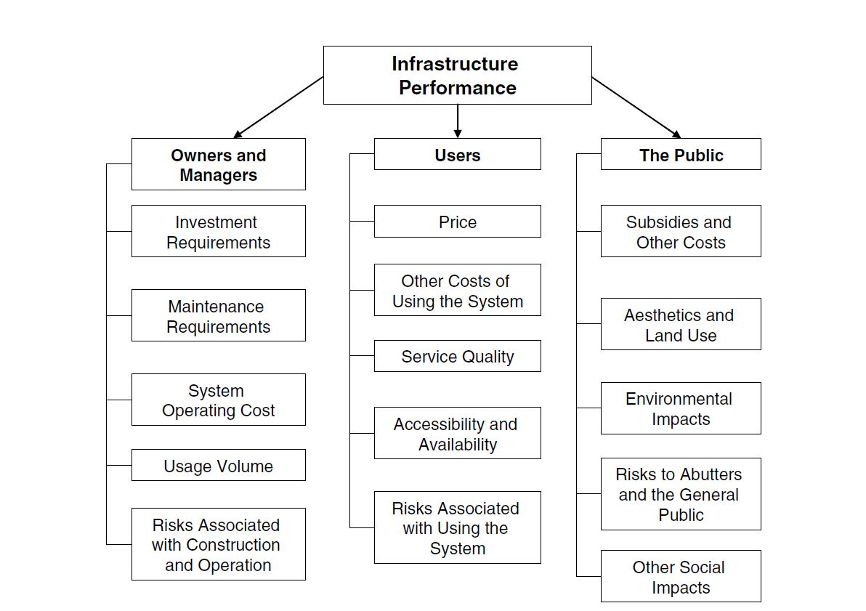
PERFORMANCE OF INFRASTRUCTURE-BASED SYSTEMS

Slide 24
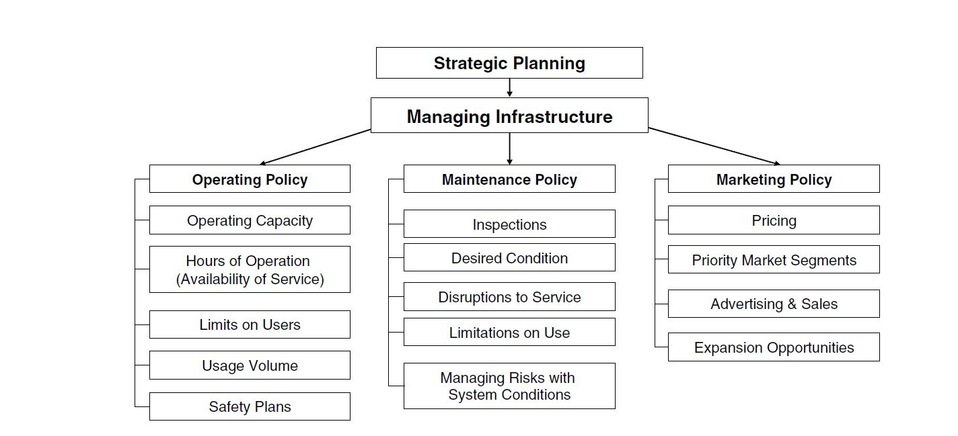
MANAGING INFRASTRUCTURE

Slide 25
PUBLIC-PRIVATE PARTNERSHIP
PPP refers to a contractual partnership between the public and private sector agencies in which the private sector is entrusted with the task of providing infrastructure facilities and services that were traditionally provided by the public sector.
E.g., Toll expressway project financed, constructed, and operated by a private developer
Ultimately the government remains accountable for the quality of service and reasonableness of price.
The role of the government is to facilitate, enable, and monitor the service

Slide 26
CHARACTERISTICS OF A PPP PROJECT
The project stems from a government-led planning and prioritization process. (
There is a genuine sharing of risks between the government and the private sector

Slide 27
RELEVANCE OF PPPS FOR INDIA
There are huge gaps between the demand and supply of essential social and economic infrastructure and services.
There is a shortage of power, roads, ports (airports and seaports), irrigation facilities, water and sanitation services, and so on.
The Government of India ( GOI) has stepped up its spending on infrastructure through a series of national programmes such as the National Highway Development Programme (NHDP), Bharat Nirman, Providing Urban Services in Rural Areas (PURA), Jawaharlal Nehru National Urban Renewal Mission ONNURM), the Prime Minister's Rural Road Programme, National Rail Vikas Yojana, National Maritime Development Programme (NMDP), airport expansion programme, and so on.

Slide 28
STATUS OF PPP’S AND KEY GOVERNMENT INITIATIVES
The Delhi-Noida Bridge Project,
The Tirupur Water Supply Project
NHAI, ports at Mundra and Pipavav, and airport projects at Mumbai and Delhi
The GOI has established a Cabinet Committee on Infrastructure (COI)
PPP Appraisal Committee (PPPAC)
India Infrastructure Finance Company Limited (IIFCL)

Slide 29
STATUS OF PPP’S AND KEY GOVERNMENT INITIATIVES
India today offers the world's largest market for PPPs.
India's success in deploying PPPs as an important instrument for creating infrastructure here will depend on a change in attitude and in the mindset of all authorities dealing with PPPs, including public agencies partnering with the private sector, government departments supervising PPPs, and auditing and legislative institutions providing oversight of PPPs.
The Government may take early action to amend the Prevention of Corruption Act 1988 which does not distinguish between genuine errors in decision making and acts of corruption.
•

Slide 30
STATUS OF PPP’S AND KEY GOVERNMENT INITIATIVES
Inefficient and inequitable allocation of risk in PPPs can be a major factor in PPP failures.
Typically, infrastructure PPP projects span over 20-30 years and a developer often loses bargaining power related to tariffs and other matters in case there are abrupt changes in the economic or policy environment which are beyond his control. The committee feels strongly that the private sector must be protected against what has been called an 'Obsolescing Bargain'.

Slide 31
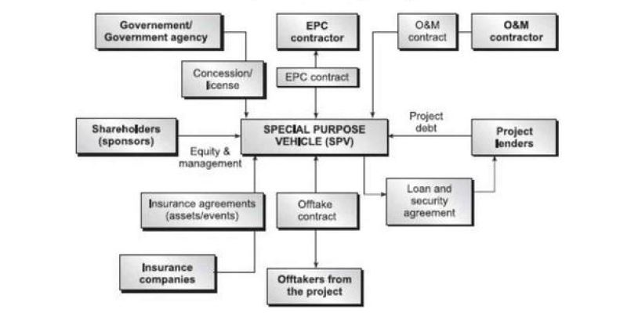
TYPICAL STRUCTURES

Slide 32

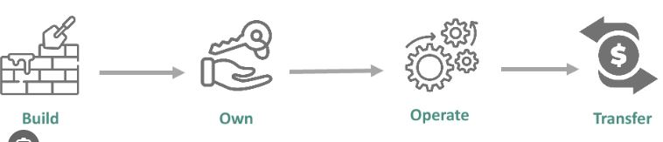
STRUCTURES OF PPP
Build-operate-transfer (BOT)
Build-own-operate-transfer (BOOT)

Slide 33
STRUCTURES OF PPP
Build-own-operate (BOO)
Build-lease-transfer (BLT)
Lease-develop-operate (LOO)
Rehabilitate-operate-transfer (ROT)
Design-build-finance-operate-transfer (DBFOT)

Slide 34
Benefits and Obstacles of PPPs
a PPP can increase the "value for money" spent for infrastructure services by providing more-efficient, lower-cost, and reliable services; ■
a PPP helps keep public sector budgets, and especially budget deficiencies, down; ■
a PPP allow the public sector to avoid up-front capital costs and reduce public sector administration costs; ■
the project life-cycle costs and project delivery time can be reduced by using a PPP;

Slide 35
a PPP can improve the quality and efficiency of infrastructure services; ■
a PPP facilitates innovation in infrastructure development; ■
the public sector can transfer risks related to construction, finance, and operation of projects to the private sector; and

Slide 36
Obstacles
PPPs are relatively new concepts that are not well understood in some countries;
both public and private sectors still lack the appropriate knowledge and skills to implement such long-term projects
competition in PPP projects is limited due to the high tendering costs;
PPP projects are highly likely to be delayed by political debates, public opposition, and complex negotiation processes;
PPP projects may cost more since the private sector cannot borrow capital to finance projects as cheaply as the public sector;

Slide 37
Project accountability may be reduced in PPPs because a great deal of information can now be treated as "commercial-in-confidence.
PPPs can result in a monopoly situation and higher costs to public users for using the infrastructure services.

Slide 38
Lessons Learned and Recommendations
Adopting a PPP scheme is not easy
The credibility and competence of the government plays a critical role in PPP infrastructure development.
A financially strong, technically competent and managerially outstanding concessionaire is required for the success of a PPP project.
All potential risks of the project should be identified and an appropriate risk allocation should be secured
Reasonable financial incentives and a stable revenue stream are critical to attract private investments.

Slide 39
Identify and prioritize pilot PPP projects.
Develop a database for historical PPP project.
Standardize PPP procurement process and contract documentation.
Provide training at all levels for government staff.
Establish two-way communication channels with the private sectors

