Slide 1

Industrial Design
Instructor:
Dr. Sushil Kumar
Assistant Professor
Entrepreneurship , IIM Visakhapatnam

Slide 2

WHAT IS INDUSTRIAL DESIGN?
The Industrial Designers Society of America (IDSA) defines industrial design as “the professional service of creating and developing concepts and specifications that optimize the function, value, and appearance of products and systems for the mutual benefit of both user and manufacturer.”

Slide 3
Five Critical Goals of Industrial Design (Dreyfuss)​
Utility​
Appearance​
Ease of maintenance​
Low costs​
Communication​

Slide 4
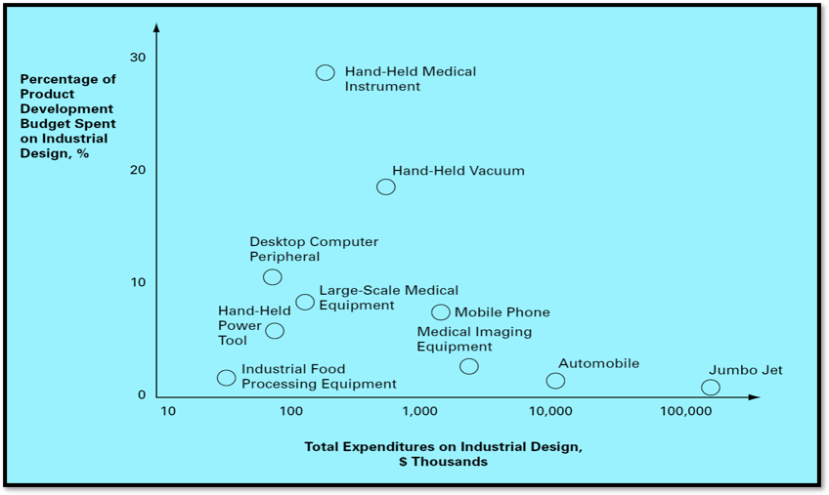
Industrial design expenditures for some consumer and industrial products​

Slide 5
How Important Is Industrial Design to a Product?​
Aesthetic Needs
Ergonomic Needs
How important is ease of use?
How important is ease of maintenance?
How many user interactions are required for the product’s functions?
How novel are the user interaction needs?
What are the safety issues?
Is visual product differentiation required?
How important are pride of ownership, image, and fashion?
Will an aesthetic product motivate the team?

Slide 6
THE IMPACT OF INDUSTRIAL DESIGN​
Is Industrial Design Worth the Investment?
The costs of ID include direct cost, manufacturing cost, and time cost.
The benefits of using ID include increased product appeal and greater customer satisfaction through additional or better features, strong brand identity, and product differentiation.

Slide 7
How Does Industrial Design Establish a Corporate Identity?​
In product-based companies, ID plays an important role in determining the company’s identity.
When a company’s products maintain a consistent and recognizable appearance, visual equity is established.

Slide 8
THE INDUSTRIAL DESIGN PROCESS​
Investigation of customer needs.
Conceptualization.
Preliminary refinement.
Further refinement and final concept selection.
Control drawings or models.
Coordination with engineering, manufacturing, and external vendors.

Slide 9
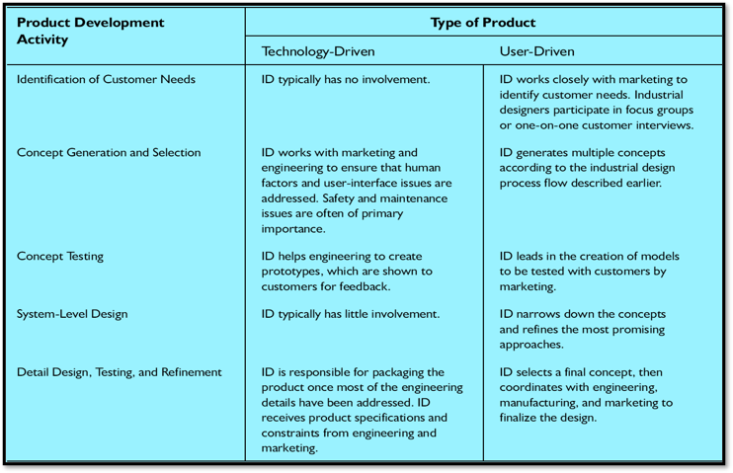
The role of industrial design according to product type​

Slide 10
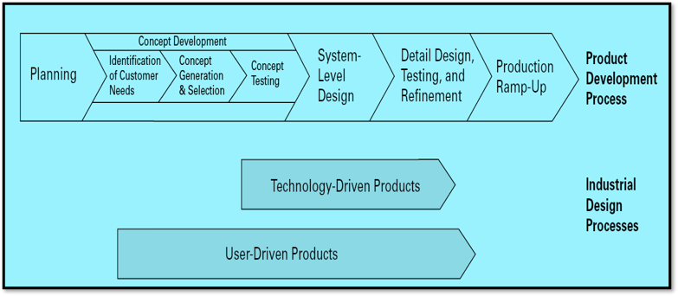
Relative timing of the industrial design process for two types of products​

Slide 11
ASSESSING THE QUALITY OF INDUSTRIAL DESIGN​
Quality of the User Interface
Emotional Appeal
Ability to Maintain and Repair the Product
Appropriate Use of Resources
Product Differentiation

